Slide 1

Development of a Coronavirus Vaccine Library
Dory Kovacs, PhD
7 May 2025

Slide 2
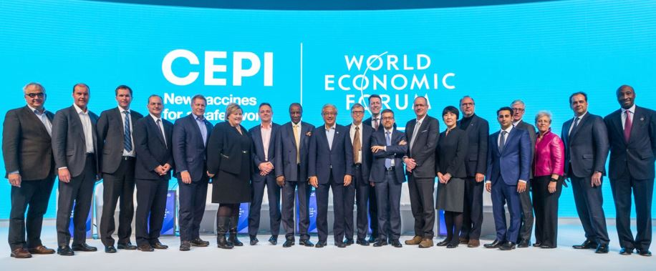
A Global partnership
CEPI was created in 2017, in response to the West Africa Ebola epidemic and in recognition that international coordination is needed to develop and deploy new vaccines to prevent future epidemics.
CEPI was launched in Davos by the governments of Norway, India, the Bill & Melinda Gates Foundation, Wellcome, at the World Economic Forum.

Slide 3







CEPI’s Mission
To accelerate development of vaccines and biologics against epidemic and pandemic threats for all people.
Governments
Pharmaceutical industry
30+ Donors/Investors
130+ Partnerships
2bn+ pledged
Regulators
Academia
Civil society and
health organizations
Philanthropies
Notes:
CEPI's unique connecting role and extensive networks allow it to pool and deploy resources in ways that nation states
often cannot.

Slide 4
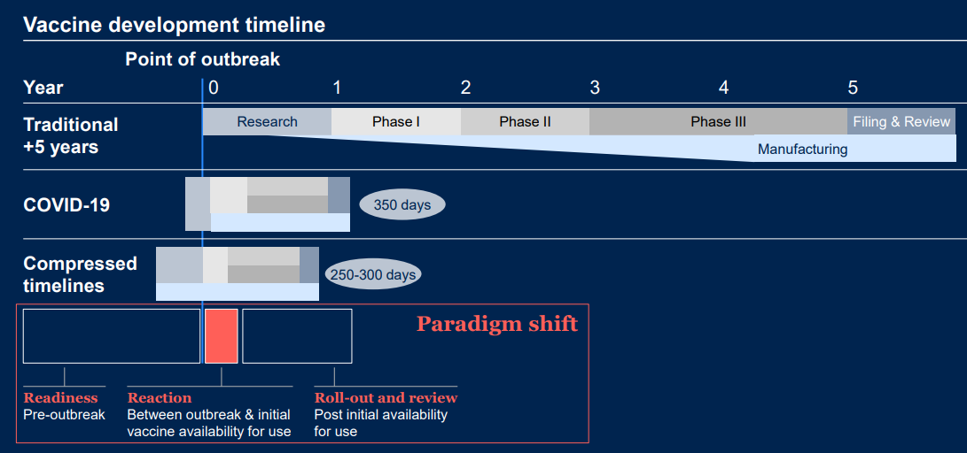

Paradigm shift towards preparedness​
5+ years
100
days
The
100 Days Mission
4

Slide 5







Priority Pathogens
Rift Valley Fever
Nipah
Ebola
Disease X
Chikungunya
Lassa
Coronaviruses
Since 2017
Over 35 R&D funding calls for proposals
52 investments in vaccine candidates or platform technologies
Including 14 COVID-19 vaccine candidates with hundreds of millions of doses for global use, and one of the world’s leading portfolio of broadly protective coronavirus vaccines.
Notes:
Focus on Disease X and CoVs only

Slide 6
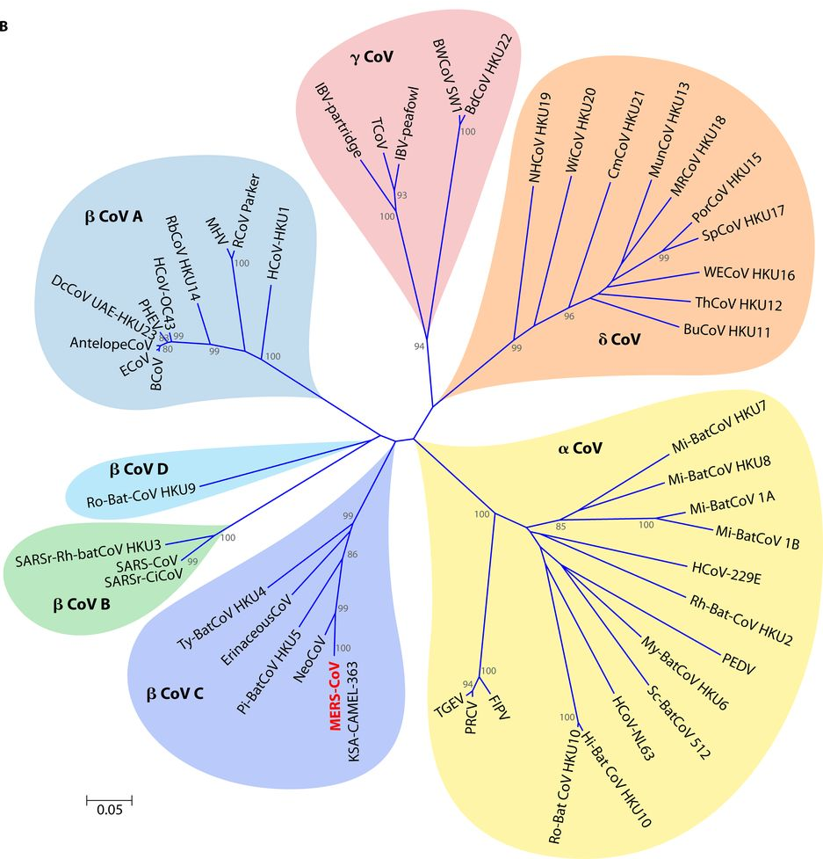
CEPI is investing in vaccine development to accelerate & equalise responses against future coronavirus outbreaks
For centuries, CoVs have spilled over from animals into humans, some are now endemic
Since 2003, spillovers have caused multiple severe outbreaks (SARS-CoV-1, MERS-CoV) and the only pandemic in our lifetime (SARS-CoV-2)
Vaccines were a gamechanger during the pandemic
With shifts in climate and host range, spillovers of new CoVs to humans will likely become more frequent.
HKU1
OC43
SARS-CoV-1 and 2
229E
MERS-CoV
NL63
Figure adapted from Chan et al. 2015 ASM

Slide 7
What vaccines exist and are being developed against CoVs?
Pre-clinical
Clinical
Registered
SARS-CoV-2, VOC boosters
MERS-CoV (phase I)
“Pan-” or more broadly protective vaccines
Vaccines against seasonal/common CoVs
Veterinary coronavirus vaccines (e.g. porcine epidemic diarrhoea virus)

Slide 8
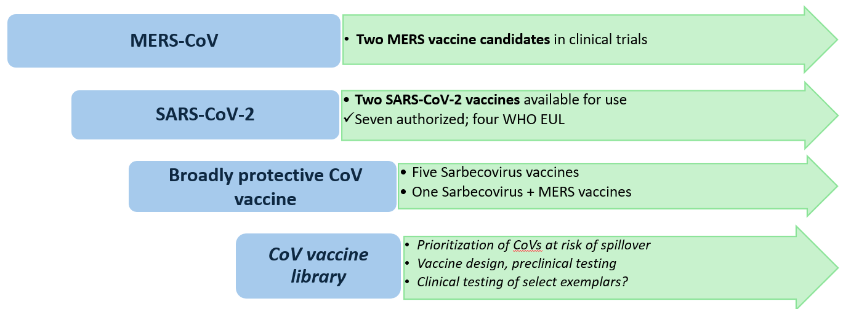
Overview of CoV work and trajectory at CEPI
Enabling activities*
Vaccine development
\
Assays, tools and models
\\\\\\
Supportive knowledge generation
Prep/ response planning
Use case definition
Regulatory engagement
Coordination and collaboration with external stakeholders
*Not part of vaccine development plan

Slide 9

The CoV Vaccine Library
CoV vaccine library
Knowledge and tools for vaccine development against pre-emergent CoVs are lacking.
To fill this gap, the CoV vaccine library, inscribed in the CEPI Disease X framework, was initiated in 2024.
An ideal library would cover all subgenera, but logistically not feasible.
Antigen design against a list of CoVs prioritized by expert committee has initiated, with development of tools and pre-clinical testing planned.
Exemplars vaccines will be selected for phase I testing.
BPCVs
MERS-CoV vaccines
Notes:
Making prototype vaccines against future emerging coronaviruses – assays/tools for all clades/nodes. Unlikely that next pandemic caused by one of selected viruses, but prototype vaccines across phylogeny provide good starting point.

Slide 10
Prioritisation of Coronaviruses
Panel of experts considered the following factors:
Host spillover
Antigenic distance between viruses
Existing immunity in humans
Virulence
Environment/ecosystem
Geography (limited knowledge in some regions)
26 coronaviruses selected:
16 Alphacoronaviruses
8 Betacoronaviruses
1 Gammacoronavirus
1 Deltacoronavirus
Panel of Experts
Edward HOLMES | Inst Infectious Diseases, Sydney (Australia)
Leo POON | HKU Pasteur Research Pole (Hong Kong)
Lin-Fa WANG | Duke-NUS, (Singapore)
Christian DROSTEN | DZIF German Center for Infection Research, Charité – Universitätsmedizin, Berlin (Germany)
Joris van de PUTTE | Consultant, (Brussels)
Linda SAIF | Ohio State, Center for Food Animal Health, Columbus (US)
Stanley PERLMAN | Univ. Iowa, Iowa City (US)
Volker GERDTS | VIDO, Univ Saskatchewan (Canada)
Simon ANTHONY | UC Davis, San Francisco (US)
Series of consultations led by Georges Thiry (CEPI)
Notes:
1. Risk factors for spillover and emergence: Candidate viruses were initially assessed based on factors such as their host range, geographic distribution, and presence at the human-animal interface, as well as any documented evidence of spillover or zoonotic potential (even if rare or sporadic).
2. Capturing gaps in phylogenetic diversity: To ensure broad coverage, viruses were selected across a wide phylogenetic gradient to fill gaps in our understanding of coronavirus diversity, particularly across underrepresented subgenera and antigenically diverse clades. This step aimed to maximize the coverage of vaccine prototypes across the wider CoV sub family—especially as the specific virus most likely to emerge next remains unpredictable—and to strengthen our knowledge base for less well-studied viruses, in turn improving our ability to anticipate and respond to emerging threats.
3. Refinement based on vaccine feasibility considerations: Among the viruses identified as high-priority, final selections were made based on practical considerations, including the characteristics of the antigen target (e.g., antigenic stability and immunogenicity) and the availability of critical resources such as reagents, genome sequences, immunoassays, and animal models.

Slide 11
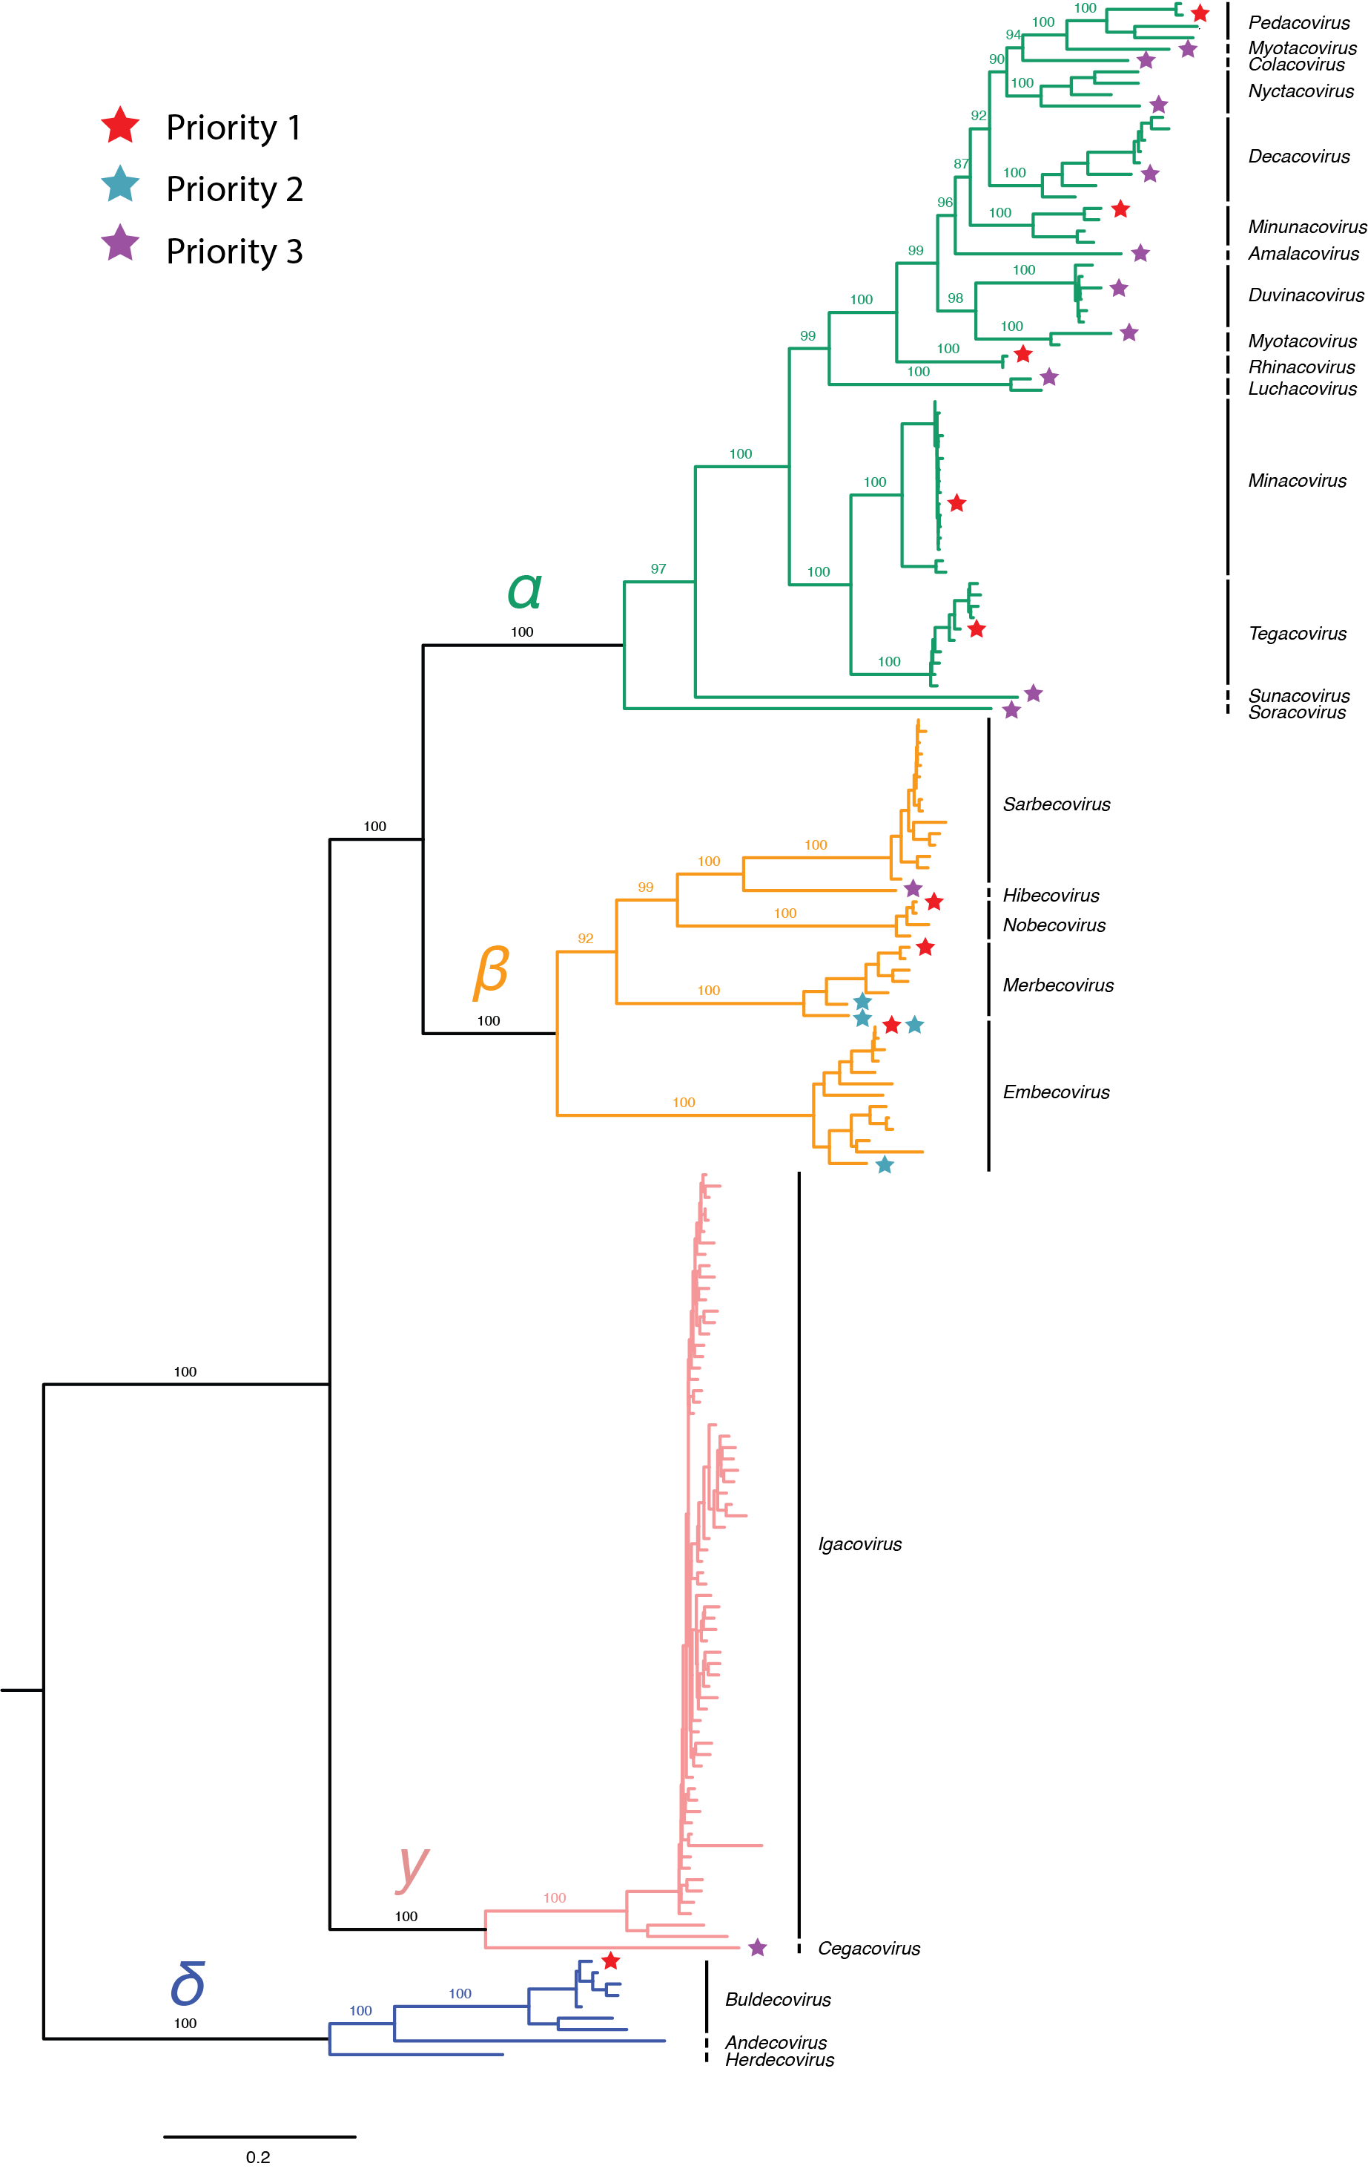
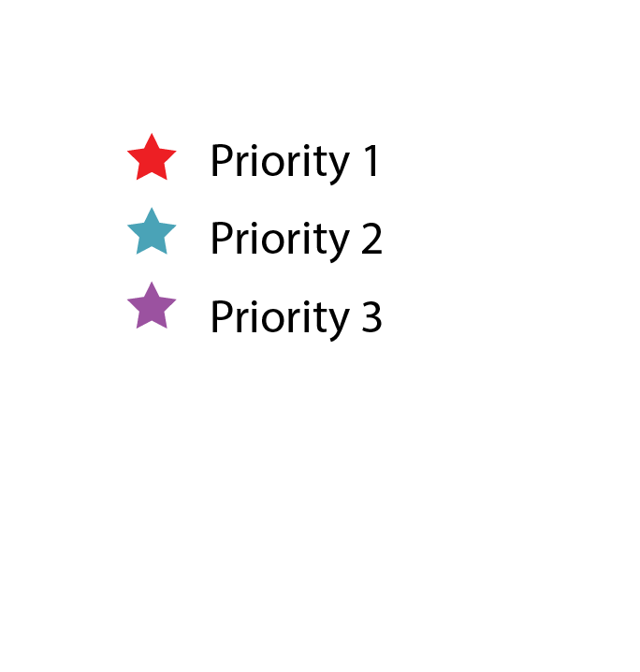
With thanks to UC Davis
Notes:
16 Alphacoronaviruses
8 Betacoronaviruses
1 Gammacoronavirus
1 Deltacoronavirus

Slide 12
Priority 1 Coronaviruses (n=9)
CoV Genus | CoV Subgenus | Representative virus | Main host
α | Minunacovirus | Miniopterus bat coronavirus HKU8 | Bat
α | Minacovirus | Mink coronavirus 1 (MCoV-1) | Mink
α | Pedacovirus | Porcine epidemic diarrhoea virus (PEDV) | Pig
α | Rhinacovirus | Swine acute diarrhoea syndrome (SADS) | Pig
α | Tegacovirus | Canine coronavirus-human pneumonia-2018 (CCoV-HuPn-2018) | Dog
β | Embecovirus | Bovine coronavirus 1 (BCoV) | Cow
β | Merbecovirus | Middle East respiratory syndrome (MERS-CoV) | Camel
β | Nobecovirus | Rousettus bat coronavirus HKU9 | Bat
δ | Buldecovirus | Porcine delta coronavirus (PDCoV) | Pig
Notes:
Prioritised – starting work first = in silico vaccine design currently + immunogenicity studies to follow by end of 2025. One virus per subgenera.

Slide 13
Priority 2 Coronaviruses (n=5)
Genus | Subgenus | Representative virus | Main host
α | Minunacovirus | Miniopterus bat coronavirus 1 | Bat
β | Embecovirus | Canine respiratory coronavirus 1 (CRCoV) | Dog
β | Embecovirus | PDF-2560/PREDICT-CoV-55 | Rat
β | Merbecovirus | Pipistrellus bat coronavirus HKU5 | Bat
β | Merbecovirus | Tylonycteris bat coronavirus HKU4 | Bat
Notes:
Following P1, 2026-27, once preclinical work is done with P1. Antigenic diversity means limited cross-protection within subgenera based on existing knowledge, second representative virus for selected subgenuses for coverage.

Slide 14
Priority 3 Coronaviruses (n=12)
Genus | Subgenus | Representative virus | Main host
α | Amalacovirs | Alphacoronavirus AMALF | Bat
α | Colacovirus | Bat coronavirus CDPHE15 | Bat
α | Decavirus | Hipposideros pomona bat coronavirus CHB25 | Bat
α | Myotacovirus | Myotis ricketti alphacoronavirus Sax-2011 | Bat
α | Nyctacovirus | Tylonycteris bat coronavirus HKU33 | Bat
α | Duvinacovirus | Human coronavirus 229E | Human
α | Setracovirus | Human coronavirus NL63 | Human
α | Sunacovirus | Suncus murinus coronavirus X74 | Mouse
α | Luchacovirus | Lucheng Rn rat coronavirus | Rat
α | Soracovirus | Sorex Araneus coronavirus T14 | Shrew
β | Hibecovirus | Bat Hp-betacoronavirus/Zhejiang2013 | Bat
γ | Cegaco | Beluga whale CoV | Whale
Notes:
Keeping diversity in mind, we will also work on additional subgenera to continue with goal of one prototype vacc per genera. List is ambitious, limited research data availability, may not have models, but also include endemic covs (lower risk based on existing immunity)

Slide 15

Prototype vaccine design characteristics
  Platform:
  mRNA, protein, or viral vector (fast & safe deployment)
  Design:
  spike protein for optimal immune response
  Evaluation of efficacy:
  Primary: neutralising antibodies against spike protein
  Secondary: T cell responses
Notes:
AIMs not set in stone

Slide 16
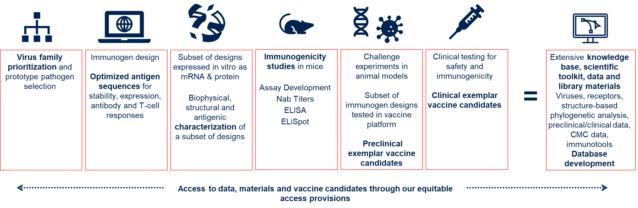

Summary of CEPI’s CoV vaccine library and CEPI’s Disease X framework
Virus Families
Paramyxoviridae
Arenaviridae
Coronaviridae
Filoviridae
Hantaviridae
Phenuiviridae
Nairoviridae
Poxviridae
Flaviviridae
Hepeviridae
Retroviridae
Picornaviridae
Orthomyxoviridae
Togaviridae
Caliciviridae
Herpesviridae
Rhabdoviridae
Expert Consultation
P1 CoVs
HKU8
HKU9
MCoV-1
MERS
SADS
PDCoV
PEDV
CCoV
BCoV
Currently here
Immunogenicity and Challenge Studies
Q4 2025
Q1 2026
Q2 2026
Q3 2026
Q4 2026
Q1 2027
Notes:
Closing line: While this is an ambitious project, we hope it gets us closer to our 100 DM when disease X comes.

Slide 17
Coronavirus Vaccine Library
Gurpreet Brar (project lead) – gurpreet.brar@cepi.net
Dory Kovacs (epidemiologist) – dory.kovacs@cepi.net

Slide 18
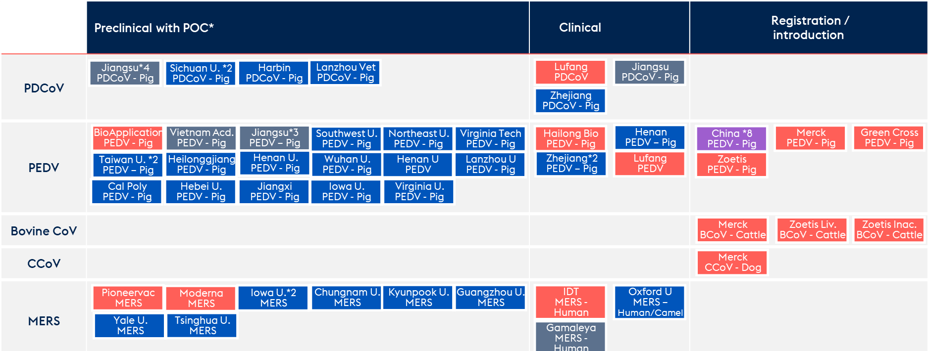

Ongoing vaccine development (active candidates since 2020)
*Defined as success in animal challenge study
Notes:
Figure 3. Overview of priority 1 coronaviruses with ongoing vaccine development. Preclinical proof of concept was interpreted as a minimum of one challenge study in relevant animal model, or targeted animal. Clinical development was based on vaccine candidates registered in clinical trial registered or referenced in papers (102). Licensed vaccines were based on manufacturer web page information. BCoV: bovine coronavirus, CCoV: canine coronavirus, MERS: Middle East Respiratory Syndrome, PDCoV: porcine deltacoronavirus, PEDV: porcine epidemic diarrhoea virus, POC: proof of concept. Asterisks with numbers denote multiple candidates in the same stage of development.
https://pmc.ncbi.nlm.nih.gov/articles/PMC10820180/pdf/vaccines-12-00011.pdf

