Slide 1
Global
Pregnancy
Collaboration
Summary of Membership Expertise
May 2025

Slide 2
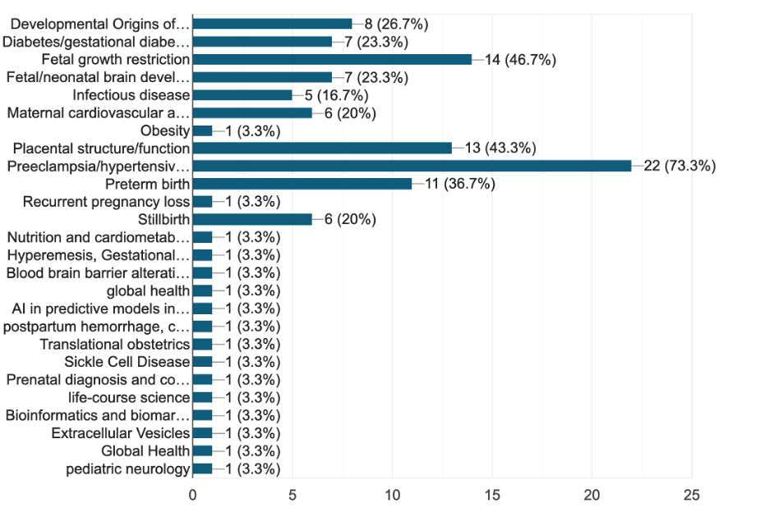
CoLab Membership Areas of Expertise

Slide 3

Assistant Professor
University of Pennsylvania
Children's Hospital of Philadelphia
United States of America
Sonika Agarwal, MBBS, MD
Summary
Dr. Sonika Agarwal’s experience of several years in clinical and academic medicine in the field of maternal-fetal medicine, combined with pediatric neurology as well as fetal and neonatal neurology are a unique blend. Her areas of expertise include fetal and neonatal consultations with a focus on prenatal counseling, acute N/IICU management, neurocritical care and neurodevelopmental follow up across the lifespan in neonates with perinatal brain injury, HIE, stroke, seizures, structural brain abnormalities and other high-risk perinatal events. As a culminating project in the AAN leadership program, she successfully launched an innovative Fetal Neurology Consortium and Registry Workgroup with collaborations across the United States with leaders of well-established fetal-neonatal neurology programs. The aim of this consortium will be to develop applicable educational curricula to apply to multicenter research projects, educational partnerships and family resources for both professional and non-professional stakeholders. Her dual experiences with maternal -fetal medicine and pediatric neurology has been a great asset given the importance of the first-thousand days for diagnosis, therapeutic interventions and prognosis. These experiences have guided her to serve on the Board of Directors for the Child Neurology Foundation, a non-profit organization committed to advocating for children and families who are challenged by a neurologic condition. As an Adjunct Member of the CoLab, Dr. Agarwal hopes to expand the educational and research footprint to maternal disorders and adverse conditions confronted by the maternal/placental/fetal triad that may impact long term neurodevelopmental outcomes. Her on-going focused efforts with fetal-neonatal neurology within pediatric neurology will strive to enhance her institution’s national and global commitments to improved maternal, pediatric and family health through service, education and research collaborations. Her commitment to interdisciplinary collaboration of healthcare teams and collaborative initiatives will leverage maternal and early-life pediatric health care to mitigate later life health consequences and serve to advocate for life-course brain health worldwide.
Expertise
Fetal/neonatal brain development | Prenatal diagnosis and counseling for brain disorders | Fetal neonatal neurology | Long term follow up of infants with prenatally and neonatally diagnosed brain disorders
Publications
▸Agarwal S, Scher MS. Fetal-neonatal neurology program development: Continuum of care during the first 1000 days. J Perinatol. 2021 Nov 30. doi: 10.1038/s41372-021-01282-5. Epub ahead of print. PMID: 34848849.
▸Agarwal S, Scher MS, Tilton A. Cerebral Palsy and Rehabilitative Care: The Role of Home-Based Care and Family-Centered Approach. Indian Pediatr. 2021 Sep 15;58(9):813-814. doi: 10.1007/s13312-021-2298-z. PMID: 34508333; PMCID: PMC8464190.
▸Agarwal S, Keller JR, Nunneley CE, Muscal E, Braun MC, Srivaths P, Lotze TE. Therapeutic Plasma Exchange Use in Pediatric Neurologic Disorders at a Tertiary Care Center: A 10-Year Review. J Child Neurol. 2018 Feb;33(2):140-145. doi: 10.1177/0883073817749368. PMID: 29334853.
▸Agarwal S, Agarwal A, Bansal AK, Agarwal DK, Agarwal KN. Birth weight patterns in rural undernourished pregnant women. Indian Pediatr. 2002 Mar;39(3):244-53. PMID: 11910133.

Slide 4

Research & Registry Manager
Preeclampsia Foundation
United States of America
VeeAnn Argyle
Summary
VeeAnn Argyle is the Preeclampsia Foundation Research & Registry Manager, managing a variety of patient-centric research initiatives. Her work brings together preeclampsia survivors and researchers to engage in the common purpose of advancing knowledge and treatment of preeclampsia. VeeAnn executes new and ongoing research projects utilizing data from the Preeclampsia Registry, conducts data analysis and visualization, and manages Registry data for quality assurance.
VeeAnn brings over 20 years' experience in the genetic research industry working in various capacities on women’s reproductive disorders, birth defects, and spinal disorders. She is an author and contributor to numerous scientific publications, journals, poster presentations, and abstracts. Several have received several peer-recognition awards at scientific meetings. She has a passion for giving individuals and families hope for a better future through research.
Expertise
VeeAnn brings over 20 years' experience in the genetic research industry working in various capacities on women’s reproductive disorders, birth defects, and spinal disorders.
Publications
Ward K, Chettier RN, Argyle V. Whole exome sequencing of 137 endometriosis
patients with a common ancestor in Shakespeare’s England. Fertility and Sterility.
2018;110(4), e395.
Ward K, Argyle V, Cederholm P, Chettier RN. Can genetic markers of endometriosis
predict a patient’s responsiveness to leuprolide acetate. American Society for
Reproductive Medicine, 2018.
Ward K, Argyle V, Cederholm P, Chettier RN. Can genetic markers of endometriosis
predict a patient’s responsiveness to leuprolide acetate. Fertility and Sterility.
2018;110(4), e14.
Ward K, Argyle V. Segregation analyses of 123 families: dominant genes commonly
contribute to pathogenesis of endometriosis. American Society for Reproductive
Medicine, 2018.
Ward K, Argyle V. Segregation analyses of 123 families: dominant genes commonly
contribute to pathogenesis of endometriosis. Fertility and Sterility. 2018;110(4),
E396.

Slide 5

Gabriela Laura Barrientos, PhD
Laboratorio de Medicina Experimental
Hospital Alemán
Summary
Dr. Gabriela Laura Barrientos is a biologist from Buenos Aires, Argentina. She holds a PhD in Biochemistry from the Universidad de Buenos Aires, specializing in reproductive immunology and placental molecular physiology. She is a member of the National Scientific and Technical Research Council (CONICET) working at Hospital Alemán, where she leads the Physiopathology of Pregnancy research group. Dr Barrientos’ research focuses on the immunological and molecular mechanisms underlying preeclampsia and fetal growth restriction. Her lab pioneered the characterization of pregnancy in the Stroke-prone Spontaneously Hypertensive Rat as a preclinical model of preeclampsia. Additionally, she has made significant contributions to the study of the physiological role of galectins in maternal-fetal immune tolerance and placental function. She has authored more than 50 journal articles, and her work has been recognized among others by the Alexander von Humboldt Foundation and the American Heart Association. Her contributions continue to provide valuable insights into improving maternal and infant health.
Expertise
Preeclampsia/Hypertensive Disorders of Pregnancy, Maternal Cardiovascular Health, Placental development/function, Fetal Growth Restriction, Developmental Origins of Health and Disease (DOHaD)
Alhasan MM, Landa MS, García SI, Gerlach RG, Harb H, Fahlbusch FB, Conrad ML, Barrientos G. Distinct gut microbial signature and altered short chain fatty acid metabolism at disease onset in a rat preclinical model of superimposed preeclampsia. Sci Rep. 2024 Dec 30;14(1):32137. doi: 10.1038/s41598-024-83981-5.
Barrientos G, Schuman ML, Landa MS, Robello E, Incardona C, Conrad ML, Galleano M, García SI.Therapeutic Effect of Alpha Lipoic Acid in a Rat Preclinical Model of Preeclampsia: Focus on Maternal Signs, Fetal Growth and Placental Function. Antioxidants (Basel). 2024 Jun 16;13(6):730. doi: 10.3390/anƟox13060730.
Barrientos G, Ronchi F, Conrad ML. Nutrition during pregnancy: Influence on the gut microbiome and fetal development. Am J Reprod Immunol. 2024 Jan;91(1):e13802. doi: 10.1111/aji.13802.
Blois SM, Prince PD, Borowski S, Galleano M, Barrientos G. Placental Glycoredox Dysregulation Associated with Disease Progression in an Animal Model of Superimposed Preeclampsia. Cells. 2021 Apr 3;10(4):800. doi: 10.3390/cells10040800.
Barrientos G, Pussetto M, Rose M, Staff AC, Blois SM, Toblli JE. Defective trophoblast invasion underlies fetal growth restriction and preeclampsia-like symptoms in the stroke-prone spontaneously hypertensive rat. Mol Hum Reprod. 2017 Jul 1;23(7):509-519. doi: 10.1093/molehr/gax024.
Additional Publications:
https://orcid.org/0000-0002-5613-023X
Publications

Slide 6

Massachusetts General Hospital
Infectious Disease Division, GRJ-504
United States of America
Lisa Bebell, MD, MSC
Summary
Lisa Bebell is a cross-disciplinary clinical and translational researcher trained in infectious diseases and critical care medicine. My current research focuses on pregnancy-related infections and their effects on child health outcomes. Currently, she is studying differences in placental structure, function, and transplacental antibody transfer by maternal HIV serostatus; microbiology of maternal and neonatal sepsis; and associations between antibiotic use and antimicrobial resistance in resource-limited settings. In her research work, she partners with obstetricians, pediatricians, immunologists, computational biologists, and biostatisticians to carry out multidisciplinary research on these topics in Uganda and South Africa. Broadly, she is interested in understanding how maternal infections affect health outcomes in their offspring in resource-limited settings. She also practices clinical infectious diseases and critical care medicine in the inpatient setting.
Expertise
infectious diseases and critical care medicine
Publications
▸ Bebell LM, Ngonzi J, Bazira J, Fajardo Y, Boatin AA, Siedner MJ, Bassett IV, Nyehangane D, Nanjebe D, Jacquemyn Y, van Geertruyden JP, Mwanga-Amumpaire J, Bangsberg DR, Riley LE, Boum Y 2nd. Antimicrobial-resistant infections among postpartum women at a Ugandan referral hospital. PLoS One. 20170413th ed. 2017;12(4):e0175456.
▸ Ngonzi J, Tibaijuka L, Kintu TM, Kihumuro RB, Onesmus A, Onesmus B, Adong J, Salongo W, Boatin AA, Bebell LM. Prevalence and risk factors for newborn anemia in southwestern Uganda: a prospective cohort study. Res Sq. 2023 Jun 26;rs.3.rs-3054549. PMCID: PMC10350226
▸ Ngonzi J*, Bebell LM*, Fajardo Y, Boatin AA, Siedner MJ, Bassett IV, Jacquemyn Y, Van Geertruyden JP, Kabakyenga J, Wylie BJ, Bangsberg DR, Riley LE. Incidence of postpartum infection, outcomes and associated risk factors at Mbarara regional referral hospital in Uganda. BMC pregnancy and childbirth. 2018/06/30 ed. 2018 Jun 28;18(1):270.
▸ McDiehl RP, Boatin AA, Mugyenyi GR, Siedner MJ, Riley LE, Ngonzi J, Bebell LM. Antenatal Care Visit Attendance Frequency and Birth Outcomes in Rural Uganda: A Prospective Cohort Study. Matern Child Health J. 2020/11/18 ed. 2020 Nov 17;
▸ Dolatshahi S, Butler AL, Siedner MJ, Ngonzi J, Edlow AG, Adong J, Jennewein MF, Atyeo C, Bassett IV, Roberts DJ, Lauffenburger DA, Alter G, Bebell LM. Altered maternal antibody profiles in women with HIV drive changes in transplacental antibody transfer. Clin Infect Dis. United States; 2022 Mar 4;ciac156. PMID: 35245365

Slide 7

Associate Professor
Gothenburg University
Sweden
Lina Bergman, MD, PhD
Summary
Dr. Lina Bergman is an obstetrician working 50% in the clinic and 50% in research. She is Associate Professor at Gothenburg University and also affiliated senior researcher at Stellenbosch University, South Africa and Uppsala University, Sweden. She leads a research group in Gothenburg, Sweden and in Cape Town, South Africa where they investigate maternal complications to preeclampsia through biobanks connected to special investigations with focus on the maternal brain. The biobank comprises of blood samples, cerebrospinal fluid samples, urine samples and placental samples. Special investigations include MRI brain, MRI heart, cerebral auto regulation, cognitive function tests, echocardiography and coagulation tests (ROTEM and Multiple). Dr. Bergman also leads a pre-clinical model of preeclampsia together with researchers at Gothenburg University and also collaborates with Dr. Carlos Escudero in Chile around a human in vitro blood-brain barrier model in preeclampsia. In addition, she collaborates around epidemiological studies of women with adverse events in pregnancy and long-term complications. More information about ongoing studies, collaborators and publications can be found at www.preeclampsiaresearch.com.
Expertise
Preeclampsia/hypertensive disorders of pregnancy | Preterm birth
Additional publications: https://orcid.org/0000-0001-5202-9428
Publications
▸Lina Bergman, Roxanne Hastie, Henrik Zetterberg, Kaj Blennow, Sonja Schell, Eduard Langenegger, Ashley Moodley, Susan Walker, Stephen Tong, Catherine Cluver, Evidence of neuroinflammation and blood-brain barrier disruption in women with preeclampsia and eclampsia, Cells November 2021, DOI:https://doi.org/10.3390/cells10113045
▸Jose Leon, Jesenia Acurio, Lina Bergman, Juan Lopez, Anna Karin Wikström, Pablo Torres-Vergara, Felipe Troncoso, Fidel Ovidio Castro, Manu Vatish, Carlos Escudero, Disruption of the blood-brain barrier by extracellular vesicles from preeclampsia plasma and hypoxic placentae- attenuation by magnesium sulphate, Hypertension October 2021;78:00-00. DOI: 10.1161/HYPERTENSIONAHA.121.17744
▸Bergman L, Bergman K, Langenegger E, Moodley, A, Griffiths-Richards, S, Wikström, J, Hall, D, Joubert, L, Herbst, P, Schell, S, van Veen, T, Belfort, M, Tong, S, Walker, S, Hastie, R, Cluver, C, PROVE – Preeclampsia Obstetric Adverse Events: Etablishment of a Biobank and Database for Preeclampsia, Cells, 2021, Apr 20;10(4):959.doi:10:3390/cells10010959
▸Bergman, L, Cluver, C, Carlberg, N, Belfort, M, Tolcher, M, Panerai, R, Van Veen, T, Cerebral perfusion pressure and autoregulation in eclampsia – a case control study. Am J Obstet Gynecol. 2021 Mar 17;S0002-9378(21)00169-1 DOI https://doi.org/10.1016/j.ajog.2021.03.017

Slide 8

Founder & CEO
Organization: EndPreeclampsia.org
Kara Boeldt, BA, TIP
Summary
Kara Boeldt is an internationally recognized patient advocate and peer educator, a certified trauma-informed professional, and the founder of EndPreeclampsia.org, a 60,000+ patient member charitable maternal health organization focused on hypertensive disorders of pregnancy. Fueled by her own severe preeclampsia experience, Kara embarked on a mission to provide patients and their families with support, advocacy, and evidence-based health education to empower them and improve outcomes. Kara is a patient advisor and patient engagement consultant for organizations, institutions, and industry. EndPreeclampsia is a national sponsor of several maternal health legislation initiatives.
Expertise
Patient advocate and peer educator, certified trauma-informed professional, and the founder of EndPreeclampsia.org
Publications
https://www.pcori.org/research-results/2023/aspire-build-pcor-cer-capacity-hypertensive-disorders-pregnancy
https://pubmed.ncbi.nlm.nih.gov/39669112/
https://www.ahajournals.org/doi/abs/10.1161/hyp.81.suppl_1.P402
https://faseb

Slide 9

Assistant Professor
University Medical Center Utrecht
Utrecht University
The Netherlands
Joyce Browne, MD, PhD
Summary
Dr. Joyce Browne has an academic background and trained as a medical doctor, social and clinical epidemiologist. Her clinical research expertise focuses on global health, health equity, health care improvement in low- and middle-income countries, community engagement, patient engagement, global health ethics and interdisciplinary collaboration.
Publications
▸Persistent Hypertension Up to One Year Postpartum among Women with Hypertensive Disorders in Pregnancy in a Low-Resource Setting: A Prospective Cohort Study.
Ishaku SM, Jamilu T, Innocent AP, Gbenga KA, Lamaran D, Lawal O, Warren CE, Olorunfemi OO, Abubakar HD, Karima T, Patience OO, Musa A, Azubuike OK, Baffah AM, Franx A, Grobbee DE, ▸ ▸ Browne JL. Glob Heart. 2021 Sep 9;16(1):62.
▸Childbirth outcomes and ethnic disparities in Suriname: a nationwide registry-based study in a middle-income country.
Verschueren KJC, Prüst ZD, Paidin RR, Kodan LR, Bloemenkamp KWM, Rijken MJ, Browne JL. Reprod Health. 2020 May 7;17(1):62.
▸Prognostic models for adverse pregnancy outcomes in low-income and middle-income countries: a systematic review. Heestermans T, Payne B, Kayode GA, Amoakoh-Coleman M, Schuit E, Rijken MJ, Klipstein-Grobusch K, Bloemenkamp K, Grobbee DE, Browne JL.
▸Equity in maternal health outcomes in a middle-income urban setting: a cohort study.
De Groot A, Van de Munt L, Boateng D, Savitri AI, Antwi E, Bolten N, Klipstein-Grobusch K, Uiterwaal CSPM, Browne JL. Reprod Health. 2019 Jun 18;16(1):84.
Expertise
Maternal cardiovascular and metabolic disease | Preeclampsia/hypertensive disorders of pregnancy | Preterm birth | Stillbirth | Global health
Additional publications: https://www.researchgate.net/profile/Joyce-Browne

Slide 10

Anna Bunin, PhD
Senior Director of In Vivo Pharmacology & Translational Science
Biohaven Pharmaceuticals
Summary
Anna Bunin, Ph.D. is a senior biopharmaceutical executive and scientist with extensive experience in drug discovery, translational science, and early clinical development. She has led teams and programs across immunology, autoimmunity, immuno-oncology, and rare diseases, driving multiple therapeutic candidates from discovery into the clinic. Over her career, Dr. Bunin pioneered approaches in extracellular protein degradation.
Dr. Bunin received her Ph.D. in Immunology from Emory University, where she conducted foundational research in cellular and molecular immunology. She then completed postdoctoral training at Columbia University, focusing on dendritic cell biology and autoimmune disease, where her discoveries led to high-impact publications and novel therapeutic insights.
She is currently Senior Director of In Vivo Pharmacology and Translational Science at Biohaven Pharmaceuticals, where she leads cross-functional teams to design and execute translational strategies across multiple therapeutic areas. Dr. Bunin is presently heading a program developing a novel therapeutic to treat preeclampsia, addressing a major unmet medical need in maternal health.
Expertise
She has led teams and programs across immunology, autoimmunity, immuno-oncology, and rare diseases, driving multiple therapeutic candidates from discovery into the clinic.

Slide 11

Department of Neonatology; Department of Obstetrics
School of Medicine
Pontificia Universidad Católica de Chile
Chile
Paola Casanello, CM, MSc, PhD
Summary
Dr. Casanello is an Associate Professor in the Department of Obstetrics and the Department of Neonatology at the Pontificia Universidad Católica de Chile, in Santiago, Chile. A graduate Midwife (1996), trained in Perinatology (2000), MSc in Biological Sciences/Physiology (2003) at the Universidad de Concepción, Chile and PhD in Physiological Sciences (2007) at the Pontificia Universidad Católica de Chile (PUC). She directs the Developmental Programming Lab at the School of Medicine, at PUC since 2010. Her team is centered in studying maternal nutrition, placental function, fetal growth and adiposity, neonatal immunity and epigenetic mechanisms leading to chronic disease in the offspring of women with obesity. To date she has supervised 14 postgraduate students (4 MSc and 10 PhD) from diverse Chilean PhD programs at PUC, University of Chile, and University of Valparaiso. She has developed interdisciplinary research on early metabolic, vascular, endocrine, and epigenetic programming of chronic disease. She actively collaborates with groups in Canada, The Netherlands, India, and the UK. She has published 74 full papers, has led 3 associative national grants (FONDEF & Anillo), PI in 5 national FONDECYT (4-year individual grants) and co-researcher in 10 FONDECYT grants. She is the current delegate for Chile in the LatinAmerican Chapter of DOHaD International Society and in the Council (treasurer)iIn the Chilean Society for Physiological Sciences.
Expertise
Developmental Origins of Health and Disease (DOHaD) | Diabetes/ gestational diabetes | Fetal growth restriction | Obesity | Placental structure/function
Additional publications: https://pubmed.ncbi.nlm.nih.gov/?term=casanello%20p&sort=date
Publications
▸Jaramillo-Ospina A, Casanello P, Garmendia ML, Andersen R, Levitan R, Meaney M, Pelufo Silveira PP. Interactions between a polygenic risk score for plasma docosahexaenoic fatty acid concentration, eating behaviour, and body composition in children. International Journal of Obesity 2022 (in press). doi: 10.1038/s41366-022-01067-6. PMID: 35058573
▸Jaramillo-Ospina A, Castaño-Moreno E, Muñoz-Muñoz E, Krause BJ, Uauy R, Casanello P*, Castro-Rodriguez JA*. Maternal obesity is associated with higher cord blood adipokines in offspring most notably in females. J Pediatr Gastroenterol Nutr. 2021;73(2):264-270. doi: 10.1097/MPG.0000000000003172. PMID: 34016877
▸Arroyo-Jousse V., Jaramillo A., Castaño-Moreno E., Lépez M., Casanello P. Adipokines underlie the early origins of metabolic risk in the offspring of women with pregestational obesity. BBA - Molecular Basis of Disease 2020,1866:165558. doi: 10.1016/j.bbadis.2019.165558. PMID: 31654701
Carrasco-Wong I. Hernández C, Jara-Gutiérrez C, Porras O, Casanello P. Human umbilical artery endothelial cells from Large-for-Gestational-Age newborn have increased antioxidant efficiency and gene expression. J Cell Physiol. 2019,234:18571-18586. doi: 10.1002/jcp.28494. PMID: 30937903

Slide 12

Internal Medicine/Pediatrics
Brigham and Women's Hospital
Harvard Medical School, Boston, Massachusetts
Ann Celi MD, MPH
Summary
Dr. Ann Celi MD, MPH is an Internal Medicine/Pediatrics trained physician. She has a degree in Chemistry from Wellesley College, an MD from Harvard Medical School/Massachusetts Institute of Technology Health, Sciences and Technology program and a MPH in Quantitative Methods from the Harvard School of Public Health. She completed her residency and fellowship training at the Harvard Medical School combined Medicine and Pediatrics residency and and a Harvard Medical School Faculty Development Fellowship. Dr. Celi has worked in the Division of General Medicine and Primary Care at BWH since 2003 and the Department of OBGYN and Division of Maternal Fetal Medicine formally since 2011 when a postpartum transition clinic focusing on hypertensive pregnancies was set up in collaboration with Maternal Fetal Medicine and the Department of Medicine and Primary Care.
Expertise
Internal Medicine/Pediatrics
Publications
1. Celi AC, Seely EW, Wang P, Thomas AM, Wilkins-Haug LE. Caring for Women After Hypertensive Pregnancies and Beyond: Implementation and Integration of a Postpartum Transition Clinic. Maternal Child Health Journal 2019 July 23: 1459-1466.
2. Seely EW, Celi AC, Chausmer J, Graves C, Kilpatrick S, Nicklas J, Rosser ML, Rexrode KM, Stuart JJ, Tsigas E, Voelker J, Zelop C, Rich-Edwards JW. Journal of Women’s Health, 2020 September.
3. McCloskey L, Bernstein J, Celi AC. The Bridging the Chasm Collaborative, et al. Bridging the Chasm between Pregnancy and Health over the Life Course: A National Agenda for Research and Action et al Women’s Health Issues 31(3) 204-218, 2021May-Jun.
4. Phillips, SE**, Celi, AC, Wehbe, A**, Kaduthodil, J, Zera C Mobilizing the fourth trimester to improve population health: interventions for postpartum transitions of care AJOG, 2022 December.
5. Phillips SE**, Celi AC, Margo J, Wehbe A**, Karlage A, Zera CA. Improving Care Beyond Birth: A Qualitative Study ofPostpartum Care After High-Risk Pregnancy, Journal of Women’s Health. June 11, 2024.

Slide 13

Associate Professor
Stellenbosch University
Cape Town
South Africa
Catherine Cluver
Summary
Dr. Cathy Cluver is an Associate Professor in the Department of Obstetrics and Gynaecology, Stellenbosch University. She is Maternal Fetal Medicine Subspecialist and runs the Preeclampsia Research Unit at Tygerberg Hospital.
Publications
▸Cluver CA, Hiscock R, Decloedt EH, Hall DR, Schell S, Mol BW, Brownfoot F, Kaitu'u-Lino TJ, Walker SP, Tong S. Use of metformin to prolong gestation in preterm pre-eclampsia: randomised, double blind, placebo controlled trial. BMJ. 2021 Sep 22;374:n2103. doi: 10.1136/bmj.n2103. PMID: 34551918; PMCID: PMC8457042.
▸Cluver CA, Hannan NJ, van Papendorp E, Hiscock R, Beard S, Mol BW, Theron GB, Hall DR, Decloedt EH, Stander M, Adams KT, Rensburg M, Schubert P, Walker SP, Tong S. Esomeprazole to treat women with preterm preeclampsia: a randomized placebo controlled trial. Am J Obstet Gynecol. 2018 Oct;219(4):388.e1-388.e17. doi: 10.1016/j.ajog.2018.07.019. Epub 2018 Jul 26. PMID: 30055127.
▸Chappell LC, Cluver CA, Kingdom J, Tong S. Pre-eclampsia. Lancet. 2021 Jul 24;398(10297):341-354. doi: 10.1016/S0140-6736(20)32335-7. Epub 2021 May 27. PMID: 34051884.
▸Bergman L, Bergman K, Langenegger E, Moodley A, Griffith-Richards S, Wikström J, Hall D, Joubert L, Herbst P, Schell S, van Veen T, Belfort M, Tong SYC, Walker S, Hastie R, Cluver C. PROVE-Pre-Eclampsia Obstetric Adverse Events: Establishment of a Biobank and Database for Pre-Eclampsia. Cells. 2021 Apr 20;10(4):959. doi: 10.3390/cells10040959. PMID: 33924230; PMCID: PMC8074755.
Expertise
Preeclampsia/hypertensive disorders
Additional publications: https://pubmed.ncbi.nlm.nih.gov/?term=Catherine%20Cluver

Slide 14

Professor
EGA Institute for Women's Health
University College London
England
Anna David, PhD, FRCOG
Summary
Dr. Anna David is a Professor and Consultant in Obstetrics and subspecialty trained in Maternal Fetal Medicine, working 60% research at UCL and 40% clinical at UCLH. As Director of the EGA Institute for Women's Health she leads an 80 strong team of researchers taking a life-course approach to women's health. Clinically she specialises in fetal medicine, severe congenital disease, fetal growth restriction and prevention of preterm birth. Her research team is developing novel prenatal therapies using stem cells and gene therapy including exploring the ethics and legality of such approaches and phase 1 trials. They are studying manipulating VEGF expression to increase maternal uteroplacental blood flow as a treatment for early onset fetal growth restriction. Dr. David secured orphan disease designation for fetal growth restriction in Europe. She also researches MR imaging of the placenta to increase our knowledge of its function. She led development of the first standardized Maternal and Fetal Adverse Event Terminology: MFAET version 1.0, for use in clinical trials of pregnancy interventions.
Expertise
Fetal growth restriction | Placental structure/function | Preterm birth
Additional publications: https://scholar.google.com/citations?hl=en&user=9LWYm0wAAAAJ
Publications
▸Swanson AM, Rossi, CA, Ofir K, Mehta V, Boyd M, Barker H, Ledwozyw A, Vaughan O, Martin J, Zachary I, Sebire N, Peebles DM, David AL. Maternal therapy with Ad.VEGF-A165 increases fetal weight at term in a guinea pig model of fetal growth restriction. Human Gene Therapy 2016 Dec;27(12):997-1007. doi: 10.1089/hum.2016.046.
▸Spencer RN, Hecher K, Norman G, Marsal K, Deprest J, Flake A, Figueras F, Lees C, Thornton S, Beach K, Powell M, Crispi F, Diemert A, Marlow N, Peebles DM, Westgren M, Gardiner H, Gratacos E, Brodszki J, Batista A, Turier H, Patel M, Power B, Power J, Yaz G, David AL. Development of standard definitions and grading for Maternal and Fetal Adverse Event Terminology. Prenatal Diagnosis 2021 Sep 22. doi: 10.1002/pd.6047.
https://www.ucl.ac.uk/womens-health/research/maternal-and-fetal-medicine/prenatal-therapy/current-projects-professor-anna-david-0
▸Sheppard M, Spencer RN, Ashcroft R, EVERREST consortium, David AL. Ethics and social acceptability of a proposed clinical trial using maternal gene therapy to treat severe early onset fetal growth restriction. Ultrasound in Obstetrics and Gynecology 2016;47:484-491 doi: 10.1002/uog.15880.
▸Desforges M, Rogue AR, Pearson N, Rossi C, Olearo E, Forster R, Lees M, Sebire N, Greenwood S, Sibley C, David AL*, Brownbill P*. In vitro human placental studies to support an adenovirus-mediated VEGF-DΔNΔC maternal gene therapy for the treatment of severe early-onset fetal growth restriction. Human Gene Therapy Clinical Development. 2017 Dec 11. doi: 10.1089/humc.2017.090. PMID: 29228803

Slide 15
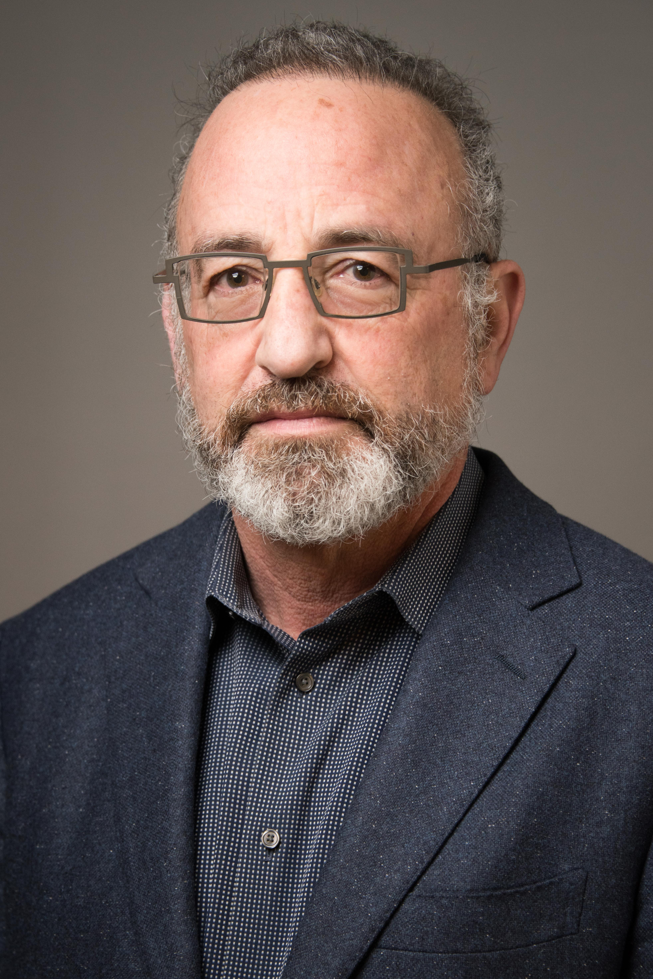
Professor & Governor's Chair
University of Tennessee Health Sciences Center
United States of America
Robert Davis, MD, MPH
Summary
Dr. Robert Davis is trained in epidemiology and pediatrics, and currently is the head of a center of biomedical informatics doing machine learning and prediction of preeclampsia. He is also a co-PI of a study assessing APOL1 and risk for preeclampsia in Ghana.
Publications
▸ Reidy K, Hjorten R, Simpson CL, Rosenberg AZ, Rosenblum SD, Kovesdy CP, Tylavsky FA, Myrie J, Ruiz BL, Mozhui K, Haque S, Suzuki M, Jacob J, Reznik SE, Kaskel FJ, Kopp JB, Winkler CA, Davis RL. Fetal and Maternal APOL1 Genotype in Preeclampsia. Am J Hum Genet, 2018;103(3):367-76.
Expertise
Developmental Origins of Health and Disease (DOHaD) | Preeclampsia/hypertensive disorders of pregnancy | Preterm birth

Slide 16

Associate Professor
Botucatu Medical School
São Paulo State University, UNESP
Brazil
Leandro Gustavo de Oliveira, MD, PhD
Summary
Dr. Leandro Gustavo de Oliveira is an obstetrician by training with a specialization in high-risk pregnancy and fetal medicine. Dr. De Oliveira is based in Brazil and his work is comprised of clinical assistance and basic science, both involving graduate students, residents and post-graduate students. His main interest is preeclampsia and includes the clinical approach, pathophysiology and epidemiological studies. Dr. De Oliveira is an active member of the Global Pregnancy Collaboration (CoLab) and conducted two studies in collaboration with CoLab: PREPARE - Prematurity Reduction by Preeclampsia Care and AWARE - Angiogenic Factors will Add in Risk Evaluation. In terms of clinical practice, Dr. De Oliveira is currently involved in a project to reduce maternal mortality related to preeclampsia in Brazil. This is a national approach to empower women for self-monitoring and to provide a knowledge transfer to healthcare professionals. The project considers a realistic approach for poor areas in Brazil. In terms of science, Dr. De Oliveira is currently interested in the concept of recognition of subtypes of preeclampsia. This idea may amplify the process of recognition of preeclampsia and reduce time between the diagnosis and management, with a focus on low- and middle-income settings.
Expertise
Fetal growth restriction | Maternal cardiovascular and metabolic disease | Placental structure/function | Preeclampsia/hypertensive disorders of pregnancy
Additional publications: https://drive.google.com/open?id=1_lMkZb8lNirudqDgAWSI7O931NEhtqka
Publications
▸Nunes PR, Peracoli MTS, Romao-Veiga M, Matias ML, Ribeiro VR, Da Costa Fernandes CJ, Peracoli JC, Rodrigues JR, De Oliveira L. Hydrogen peroxide-mediated oxidative stress induces inflammasome activation in term human placental explants. Pregnancy Hypertens. 2018 Oct;14:29-36. doi: 10.1016/j.preghy.2018.07.006. Epub 2018 Jul 27. PMID: 30527115.
▸Korkes HA, Sass N, Moron AF, Câmara NO, Bonetti T, Cerdeira AS, Da Silva ID, De Oliveira L. Lipidomic assessment of plasma and placenta of women with early-onset preeclampsia. PLoS One. 2014 Oct 17;9(10):e110747. doi: 10.1371/journal.pone.0110747. PMID: 25329382; PMCID: PMC4201564.
▸De Oliveira L, Peraçoli JC, Peraçoli MT, Korkes H, Zampieri G, Moron AF, Sass N. sFlt-1/PlGF ratio as a prognostic marker of adverse outcomes in women with early-onset preeclampsia. Pregnancy Hypertens. 2013 Jul;3(3):191-5. doi: 10.1016/j.preghy.2013.02.003. Epub 2013 Apr 23. PMID: 26106033.
▸De Oliveira LG, Lash GE, Murray-Dunning C, Bulmer JN, Innes BA, Searle RF, Sass N, Robson SC. Role of interleukin 8 in uterine natural killer cell regulation of extravillous trophoblast cell invasion. Placenta. 2010 Jul;31(7):595-601. doi: 10.1016/j.placenta.2010.04.012. Epub 2010 May 18. PMID: 20483454.

Slide 17

Full Professor
Universidad del Bio Bio
Chile
Carlos Escudero, MD, PhD
Summary
Dr. Carlos Escudero is studying what would be the implications of fetoplacental endothelium dysfunction present in preeclamptic pregnancies (PE) for the future cardiovascular and cerebrovascular health in the mother and the offspring. Of interest to CoLab, and thanks to national and international collaboration, we have been able to demonstrate that circulating molecules present in plasma of women with PE, including VEGF and extracellular vesicles can disrupt the blood-brain barrier. We are interested in understanding the underling mechanisms, as well as the potential long-lasting consequences of this disruption.
Expertise
Fetal/neonatal brain development | Preeclampsia/hypertensive disorders of pregnancy | Blood brain barrier alterations in preeclampsia
Additional publications: https://orcid.org/0000-0001-7688-4621
Publications
▸Leon J; Acurio J; Bergman L; Lopez J; Wikström AK; Torres-Vergara P; Troncoso F; Castro FO; Vatish M; Escudero C*. Disruption of the Blood-Brain-Barrier by extracellular vesicles from preeclampsia plasma and hypoxic placentae: attenuation by magnesium sulfate. Hypertension. 2021 Nov;78(5):1423-1433. doi: 10.1161/HYPERTENSIONAHA.121.17744. Epub 2021 Oct 4.
▸Bergman L; Acurio J; Leon J; Gatu E; Friis T; Nelander M; Wikström J; Larsson A; Lara E; Aguayo C; Torres-Vergara P; Wikström AK; Escudero C*. Preeclampsia and increased permeability over the blood brain barrier –a role of vascular endothelial growth factor receptor 2. Am J Hypertens. 2021 Feb 18;34(1):73-81. doi: 10.1093/ajh/hpaa142.
▸Lara E, Acurio J, Leon J, Torres-Vergara P, Penny J, Escudero C*. Are the cognitive alterations present in children born from preeclamptic pregnancies the result of impaired angiogenesis?: Focus on the potential role of the VEGF family. Front Physiol. 2018 Nov 14;9:1591. doi: 10.3389/fphys.2018.01591. eCollection 2018.
▸Escudero C*, Celis C, Saez T, San Martin S, Valenzuela FJ, Aguayo C, Bertoglia P, Roberts JM, Acurio J. Increased placental angiogenesis in late and early onset pre-eclampsia is associated with differential activation of vascular endothelial growth factor receptor 2. Placenta. 2014 Mar;35(3):207-15. doi: 10.1016/j.placenta.2014.01.007. Epub 2014 Jan 29.

Slide 18

Chief Physician
University Hospital Odense of Southern Demark
Anne Catherine M Godtfredson, MD,PhD
Summary
Anne Cathrine Godtfredsen is a Chief Physician at the University Hospital Odense of Southern Denmark. Alongside the clinical work with high-risk pregnancies, her research focus on the contact system and how it is affected, in pregnant women with and without preeclampsia. This is in adjacent collaboration with the Unit of Thrombosis Research, Department of Regional Health Research, University of Southern Denmark. Additionally, investigation of the late implications of preeclampsia and its impact on the contact system, such as cardio-vascular disease, is a top priority. To investigate this, she has established a regional clinic for women with prior pregnancies complicated by hypertensive disorders with the purpose of preventing and treat cardio-vascular disease later in life.
Expertise
Preeclampsia and the contact system - propagation of pathways and implications for therapy
Publications
· Godtfredsen AC, Sidelmann JJ, Dolleris BB, Jørgensen JS, Johansen EKJ, Pedersen MFB, Palarasah Y, Gram JB. Fibrinolytic Changes in Women with Preeclampsia. Clin Appl Thromb Hemost. 2022 Jan-Dec;28.
· Godtfredsen AC, Gram JB, Pham STD, Dolleris BB, Jørgensen JS, Sidelmann JJ, Palarasah Y. Depressed Kallikrein Generation in Women With Preeclampsia: A Matched Cross-Sectional Study. Front Med (Lausanne). 2022 Jun 6;9:896811.
· Godtfredsen AC, Palarasah Y, Dolleris BB, Jørgensen JS, Sidelmann JJ, Gram JB. Increased contact activated endogenous thrombin potential in pregnant women with preeclampsia. Blood Coagul Fibrinolysis. 2024 Jan 1;35(1):1-7.
· Godtfredsen AC. Preeclampsia and the contact system - Propagation of inflammatory, coagulation and fibrinolytic pathways. The PreCAS Study[PhD-thesis]. University of Southern Denmark Press 2023.
· Johannes J Sidelmann , Jørgen B Gram , Anne C M Godtfredsen , Jens J Thorn , Janne Ingerslev , Else M Pinholt. Orthognathic Surgery-Induced Fibrinolytic Shutdown Is Amplified by Tranexamic Acid. J Oral Maxillofac Surg 2020 Jul;78(7):1183-1189
· Godtfredsen ACM, Sidelmann JJ, Gram JB, Andersen M, Glintborg D. Fibrin lysability is associated with central obesity and inflammation in women with polycystic ovary syndrome. Acta Obstet Gynecol Scand. 2020 Aug;99(8):1078-1084.
· Line Fich, Ann-Marie Hellerung Christiansen, Kathrine Vauvert R. Hviid, Anna J. M. Aabakke, Eva Hoffmann, Andreas Ingham, Joaquim Ollé-López, Judith Bello-Rodríguez, Helle Gybel Juul-Larsen, Louise Kelstrup, Kathrine Perslev, Tine Dalsgaard Clausen, Line Rode, Christina Vinter, Gitte Hedermann, Marianne Jenlev Vestgaard, Richard Farlie, Anne Sørensen, Iben Sundtoft, Anne Cathrine Godtfredsen, Lars Winter Burmester, Johanna Lindman, Elin Rosenbek Severinsen, Caroline Elisabeth Kann, Christine Bo Hansen, Mette Marie Babiel Schmidt Petersen, Pia Egerup, Anne Zedeler, Amalie Dyhrberg Boje, Marie-Louise Mathilde Friis Bertelsen, Lisbeth Prætorius, Aidan Grundtvig Kristensen, Finn Stener Jørgensen, Henrik Westh, Henrik L. Jørgensen, Nina la Cour Freiesleben and Henriette Svarre Nielsen. Maternal-Fetal Outcomes and Antibody Transfer, Depending on the Trimester of SARS-CoV-2 Infection in Non-Vaccinated Women—A Danish Nationwide Prospective Cohort Study. Int. J. Mol. Sci. 2025, 26, 2533
· Mette Hykkelbjerg Christensen, Anne Cathrine Godtfredsen, Fariha Olawi, Lisa Grange Persson, Kasper Pihl, Gitte Skajaa, Jannie Dalby Salvig and Marianne Jenlev Vestgaard. DSOG Guideline Bulletin: Preeclampsia and hypertension. DJOG, 3(1), 42-54

Slide 19

Associate Professor
University of Washington School of Medicine
United States of America
Kathryn Gray, MD PhD
Summary
Dr. Kathryn Gray is a physician-scientist with training in Ob/Gyn, Maternal-Fetal Medicine, and Clinical Genetics. She is an Associate Professor and the Director of Research in Maternal-Fetal Medicine at the University of Washington. She leads a research group at the University of Washington focused on using genetics and other translational research tools to understand the mechanisms underlying adverse pregnancy outcomes and to advance prenatal screening and diagnosis. To further understanding of preeclampsia genetics, she led the creation of the NIH-NHLBI funded TOPMed Boston-Colombia Collaborative for Adverse Outcomes (BCC-PREG) cohort, with whole genome sequencing on 14,615 maternal-offspring samples and other omic profiling on maternal samples in pregnancy prior to the development of preeclampsia. BCC-PREG is the largest pregnancy cohort sequenced to date with detailed phenotyping and molecular characterization, which will enable a precision medicine approach to preeclampsia. She is also part of an international fetal genomics consortium (FGC; fetalgenomics.org) that prospectively recruits trio DNA samples from patients with fetal loss >14 weeks gestation for whole genome sequencing to understand the genetic changes that contribute to pregnancy loss. Her team is also assessing social determinants of health (SDOH) that impact risk of fetal demise. Finally, she is interested in advancing tools for prenatal genetic screening, including information available from cell-free DNA present in the maternal circulation. Overall, her research group aims to use translational approaches to advance pregnancy biology and diagnostic tools.
Expertise
Genetics and other omics of adverse pregnancy outcomes, including preeclampsia, stillbirth, and fetal anomalies; prenatal diagnosis and screening
Additional publications:
https://www.ncbi.nlm.nih.gov/sites/myncbi/1L1o-kbia8jQN/bibliography/public/
Publications
▸Gray KJ, Kovacheva VP, Mirzakhani H, Bjonnes AC, Almoguera B, Wilson ML, Ingles SA, Lockwood CJ, Hakonarson H, McElrath TF, Murray JC, Norwitz ER, Karumanchi SA, Bateman BT, Keating BJ, Saxena R. Risk of preeclampsia in patients with maternal genetic predisposition to common medical conditions: a case-control study. BJOG, 2021 Jan;128(1):55-65. doi: 10.1111/1471-0528.16441.
▸ Adams S, Llorin H, Maher O, Dean M, Dobson LJ, Gbur S, Foster J, McElhinney S, Evans C, Kelly H, Wilkins-Haug L, Guseh S, Gray KJ. Single Gene Non-invasive Prenatal Screening (NIPS-SGD) for Autosomal Dominant Conditions in a High-risk Cohort. Prenat Diagn. 2023 Apr 5. doi: 10.1002/pd.6351.
▸ Brand H, Whelan CW, Duyzend M, Lemanski J, Salani M, Hao SP, Wong I, Valkanas E, Cusick C, Genetti C, Dobson L, Studwell C, Gianforcaro K, Wilkins-Haug L, Guseh S, Currall B, Gray KJ*, Talkowski* ME. High-Resolution and Non-Invasive Fetal Exome Screening. NEJM, 2023, Nov 23;389(21):2014-2016. doi: 10.1056/NEJMc2216144.
Kovacheva VP, Eberhard BW, Cohen RY, Maher M, Saxena R, Gray KJ. Preeclampsia Prediction Using Machine Learning and Polygenic Risk Scores From Clinical and Genetic Risk Factors in Early and Late Pregnancies. Hypertension. 2023 Oct 30. doi: 10.1161/HYPERTENSIONAHA.123.21053.

Slide 20

Professor
University of Washington
United States of America
Michael Gravett, MD
Summary
Dr. Michael Gravett is Director of MFM Research at the Univeristy of Washington with a background in proteomics, point of care testing for preeclampsia for LMIC and global health.
Publications
▸Maternal serum glycosylated fibronectin as a point-of-care biomarker for assessment of preeclampsia. Rasanen J, Quinn MJ, Laurie A, Bean E, Roberts CT Jr, Nagalla SR, Gravett MG.
Am J Obstet Gynecol. 2015 Jan;212(1):82.e1-9. doi: 10.1016/j.ajog.2014.07.052. Epub 2014 Jul 31.
PMID: 25086276
▸Glycosylated fibronectin point-of-care test for diagnosis of pre-eclampsia in a low-resource setting: a prospective Southeast Asian population study. Nagalla SR, Janaki V, Vijayalakshmi AR, Chayadevi K, Pratibha D, Rao PV, Sage KM, Nair-Schaef D, Bean E, Roberts CT Jr, Gravett MG.
BJOG. 2020 Dec;127(13):1687-1694. doi: 10.1111/1471-0528.16323. Epub 2020 Jun 16.
PMID: 32426899
▸The INTERGROWTH-21st fetal growth standards: toward the global integration of pregnancy and pediatric care. Papageorghiou AT, Kennedy SH, Salomon LJ, Altman DG, Ohuma EO, Stones W, Gravett MG, Barros FC, Victora C, Purwar M, Jaffer Y, Noble JA, Bertino E, Pang R, Cheikh Ismail L, Lambert A, Bhutta ZA, Villar J; International Fetal and Newborn Growth Consortium for the 21(st) Century (INTERGROWTH-21(st)). Am J Obstet Gynecol. 2018 Feb;218(2S):S630-S640. doi: 10.1016/j.ajog.2018.01.011. MID: 29422205 Review.
▸Prevention of preterm birth: harnessing science to address the global epidemic.
Rubens CE, Sadovsky Y, Muglia L, Gravett MG, Lackritz E, Gravett C.
Sci Transl Med. 2014 Nov 12;6(262):262sr5. doi: 10.1126/scitranslmed.3009871.
PMID: 25391484 Review.
Expertise
Infectious disease | Preeclampsia/hypertensive disorders of pregnancy | Preterm birth | Global health
Additional publications: https://www.ncbi.nlm.nih.gov/sites/myncbi/14qWclt-8o7ki/bibliography/47937209/public/?sort=date&direction=descending

Slide 21

Professor, Senior Consultant
Obstetrics & Gynecology
Institute Clinical Sciences Lund, Lund University
Sweden
Stefan Hansson MD, PhD
Summary
Dr. Stefan Hansson received his medical degree from the Faculty of Medicine at Lund University in 1994. He became a licensed physician in 1999 and became specialized in Obstetrics and Gynecology 2004. Parallel to his studies, he began his scientific career in the first year at medical school. With his background as a chemist, it was natural to specialize in molecular biology. He did a three-year postdoctoral program at National Institutes of Health, US, and received his PhD in neurobiology 1998. In conjunction with that, he began his residency training in Obstetrics and Gynecology in 1999 and began his current area of research. He became associate professor in this subject in 2004 and an adjunct professor 2010. Since June 2014 he is tenured professor of medical research, specializing in Obstetrics and Gynecology and holds a combined position, which allows him to serve 33% as a senior consultant at Lund/Malmö University Hospitals. Dr. Hansson has served 6 years as vice dean for research education at the medical faculty and is currently the prefect for research at his institute. Dr. Hansson has during the last 24 years been engaged in a focused and innovative clinical translational research on preeclampsia (PE). Based on findings from his and a colleague’s research group he co- founded the drug company Guard Therapeutics (formerly A1M Pharma). In addition, his research has focused on I) new disease mechanism for PE II) new PE biomarkers III) cardiovascular function post PE. IV) genetic predisposition for PE in Ethiopian women and V) the role of air pollution as a risk factor for PE.
Expertise
Fetal growth restriction | Fetal/ neonatal brain development | Maternal cardiovascular and metabolic disease | Placental structure/function | Preeclampsia/ hypertensive disorders of pregnancy
Additional publications: https://portal.research.lu.se/portal/en/persons/stefan-hansson(d1a60df3-5f3f-4a57-9f0f-9108ff7c89c6)/publications.html
Publications
▸Engström, K., Mandakh, Y., Garmire, L., Masoumi, Z., Isaxon, C., Malmqvist, E., Erlandsson, L. & Hansson S. R Early Pregnancy Exposure to Ambient Air Pollution among Late-Onset Preeclamptic Cases Is Associated with Placental DNA Hypomethylation of Specific Genes and Slower Placental Maturation. 2021, Toxics. 9, 12, s. 1-23 338.
▸Erlandsson L, Ducat A, Castille J, Zia I, Kalapotharakos G, Hedström E, Vilotte JL, Vaiman D, Hansson SR. Alpha-1 microglobulin as a potential therapeutic candidate for treatment of hypertension and oxidative stress in the STOX1 preeclampsia mouse model. Sci Rep. 2019 Jun 12;9(1):8561
▸Erlandsson, L., Masoumi, Z., Hansson, L. R. & Hansson S. R. The roles of free iron, heme, haemoglobin, and the scavenger proteins haemopexin and alpha-1-microglobulin in preeclampsia and fetal growth restriction. Journal of Internal Medicine. 2021, 290, 5, s. 952-968
▸Masoumi, Z, Erlandsson L, Hansson E, Magnusson M, Mezey E, Hansson SR. Hypoxia-induced alpha-globin expression in syncythiotrophoblasts mimics the pattern observed in preeclamptic placentas. International Journal of Molecular Sciences. 2021, 22, 7, 3357

Slide 22

Assistant Professor
Ohio State University, College of Nursing, Martha S. Pitzer Center for Women, Children , and Youth
United States of America
McKenzie Jancsura, PhD, RN
Summary
Dr. McKenzie Jancsura is an Assistant Professor at the Ohio State University, College of Nursing, Martha S. Pitzer Center for Women, Children, and Youth Her research investigates immunological pathways associated with preeclampsia and other pregnancy complications and leverages behavioral and social interventions to modulate the immune response in pregnancy. Her research has investigated cytokines and DNA methylation across pregnancy to identify prediction tools for preeclampsia. She also explores how factors like diet, physical activity and stress impact the immune milieu in pregnancy as possible intervention targets to prevent pregnancy complications and to prevent the development of cardiometabolic disease for women who have experienced an adverse pregnancy outcome. Her clinical experiences include labor and delivery, postpartum, well-women care and primary care in community health settings.
Expertise
Investigations of immunological pathways associated with preeclampsia and other pregnancy complications and leverages behavioral and social interventions to modulate the immune response in pregnancy.
Publications
▸ Jancsura, M. K., Schmella, M. J., Helsabeck, N., Gillespie, S. L., Roberts, J. M., Conley, Y. P., & Hubel, C. A. (2023). Inflammatory markers are elevated in early pregnancy, but not late pregnancy, in women with overweight and obesity that later develop preeclampsia. American Journal of Reproductive Immunology, 90(3), e13763. https://doi.org/https://doi.org/10.1111/aji.13763
▸ *Magnus, M.C., *Wallace, M.K., Demirci, J.R., Catov, J., Schmella, M.J., Fraser, A (2023). Breastfeeding and later-life cardiometabolic health in women with and without hypertensive disorders of pregnancy. Journal of the American Heart Association. https://doi.org/10.1161/jaha.122.026696
▸ Wallace, M. K., Shivappa, N., Wirth, M. D., Hebert, J. R., Huston-Gordesky, L., Alvarado, F., Mouzon, S. H., & Catalano, P. M. (2021). Longitudinal Assessment of Relationships Between Health Behaviors and IL-6 in Overweight and Obese Pregnancy. Biological Research for Nursing, 23(3), 481-487. https://doi.org/10.1177/1099800420985615

Slide 23
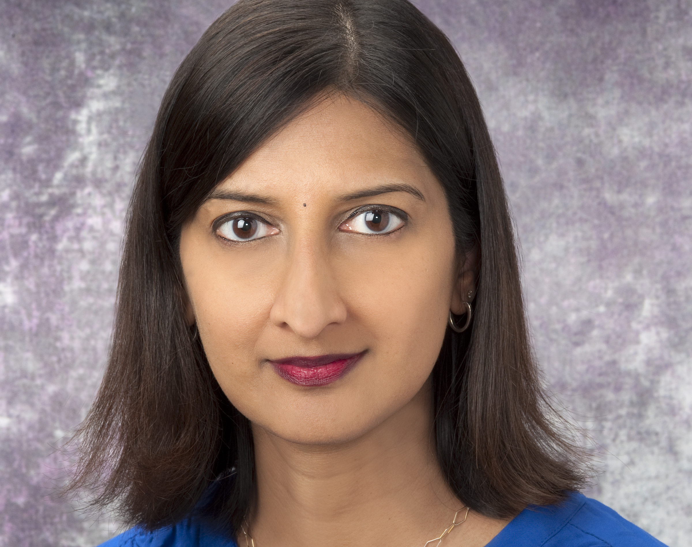
Associate Professor, Department of Obstetrics, Gynecology, and Reproductive Sciences
University of Pittsburgh School of Medicine and University of Pittsburgh Clinical and Translational Sciences Institute, UPMC Magee-Womens Hospital, Magee-Womens Research Institute and Foundation
United States of America
Arun Jeyabalan, MD, MS
Summary
Dr. Arun Jeyabalan is a Maternal-Fetal Medicine specialist with approximately 20 years of research in the field of vascular disorders in pregnancy including preeclampsia, chronic hypertension, renal disease, and other placental disorders. She has been involved in clinical, laboratory, and translational research projects in the area of placental contribution to the risk stratification of hypertensive disorders using biomarkers, postpartum preeclampsia, pathogenesis of preeclampsia, mechanisms of vascular adaptation to pregnancy, and management of hypertensive disorders of pregnancy. She was a selected member of the American College of Obstetricians and Gynecologists’ Task Force on Hypertension in Pregnancy. She is the site PI of the Global Pregnancy Collaboration. In addition, she is an active clinician serving as the Division Director of the Maternal-Fetal Medicine as well as the Medical Director of the Obstetric Specimen Procurement Unit and Clinical and Translational Research Center at Magee-Womens Hospital.
Expertise
Maternal cardiovascular and metabolic disease | Preeclampsia/hypertensive disorders of pregnancy
Additional publications: https://pubmed.ncbi.nlm.nih.gov/?term=jeyabalan+arun
https://pubmed.ncbi.nlm.nih.gov/?term=jeyabalan+arundhathi
Publications
▸Redman EK, Hauspurg A, Hubel CA, Roberts JM, Jeyabalan A. Clinical course, associated factors, and blood pressure profile of delayed-onset postpartum preeclampsia. Obstetrics and Gynecology 2019; 134(5):995-1001. PMID: 31599846.
▸De Oliveira L, Dias MA, Jeyabalan A, Payne B, Redman CW, Magee L, Poston L, Chappell L, Seed P, von Dadelszen P, Roberts JM. Creating biobanks in low and middle-income countries to improve knowledge – The PREPARE initiative. Pregnancy Hypertension 2018; 13:62-64. PMID: 30177073.
▸Samuel A, Lin C, Parviainen K, Jeyabalan A. Expectant management of preeclampsia superimposed on chronic hypertension. Journal of Maternal-Fetal and Neonatal Medicine 2011; 24(7):907-911. PMID: 21142774.

Slide 24

Associate Professor
Wayne State University School of Medicine
United States of America
Steven J. Korzeniewski, PhD, MS, MA
Dr. Steven Korzeniewski is an epidemiologist whose research focuses broadly on the antecedents, correlates and consequences of early-onset hypertension, with major interests in pregnancy and potentially related neurodevelopmental disorders in offspring. His pre-and post-doctoral training focused on perinatal epidemiology132HD046477-01A1;L40HDO/7654KZ),andfrom2011to2017,he conducted research as an Associate Investigator in the NICHD Intramural Program in Perinatal Research and Obstetrics (NIH contract no.HHSNZ75201300006C. Dr. Korzeniewski then shifted focus to translational research and reproductive health at the C.S. Mott Center for Human Growth and Development, where he is currently the Director of Translational Epidemiology and Biostatistics. His ongoing research is supported by the NIMHD P50MD017351(), NIEHS (P30 ES036084), and multiple other sources. He is also the principal investigator who architected and oversees Wayne State University's award-winning PHOENIX Virtual Data Warehouse (IRB-22-UZ-4397 and its interactive visualization platform hosted in Google cloud (phoenix-data.wayne.edu)
Summary
Expertise
Epidemiology&Biostatistics| Virtual DataWarehousingandVisualization| HypertensiveDisorderso fPregnancyI
NeurodevelopmentalDisorders|
Additionalpublications:
PubMedBibliography ORCIDID:0000-0002-8895-6052
• Korzeniewski SJ. Early Blood Pressures Warrant Attention in Modern Clinical Data Infrastructure Hypertension. 2025:82(5):772_3.
• Prasad Van Steenwincke, Gunn A.J, Bennet L, Korzeniewski S, Gressens P, Dean JM. Chronic Inflammation Offers Hints About Viable Therapeutic Targets for Preeclampsia and Potential Related Offspring Sequelea. International journal of molecular sciences. 2024;25(23).
• Korzeniewski SJ, Sutton E, Escudero C, Roberts MJ. The Global Pregnancy Collaboration (CoLab) symposium on short- and long-term outcomes in offspring whose mothers had preeclampsia: A scoping review of clinical evidence. Frontiers in medicine. 20229:984291.
• Korzeniewski SJ. Allred EN. O'Shea TM. Leviton A. Kuban KCK. Elevated protein concentrations in newborn
blood and the risks of autism spectrum disorder, and of social impairment, at age 10 years among infants born
Before the 28th week of gestation. Transschiatry.2018:8(1):115.
• Korzeniewski SJ, Romero R, Chaiworapongsa T, Chaemsaithong P, Kmi CJ, Kim YM, et al. Maternal plasma
angiogenic index-1 (placental growth factor/soluble vascular endothelial growth factor receptor-1) is a biomarker for the burden of placental lesions consistent with uteroplacental underperfusion: a longitudinal case-cohort
study. Am J Obstet Gynecol. 2016;214(5):629 e1- e17
Publications

Slide 25

Faculty Member, Obstetrics and Gynecology Division
Hadassah Hebrew-University Medical Center
Henrietta Szold Hadassah Hebrew University School of Nursing in the Faculty of Medicine
Jerusalem, Israel
Michal Lipschuetz, RN, PhD
Summary
The goal of Dr. Michal Lipschuetz’s research team is to develop and expand artificial intelligence and machine learning methods alongside traditional epidemiological investigations and analyses, to examine the relationships between different exposure factors and outcomes during pregnancy, in order to enable more individualized birth management to reduce complications for the mother and newborn using traditional statistical analysis and machine learning methods for various research topics. Because most complications are rare, large populations are needed to provide reliable analyzes of risk factors for many possible outcomes. Using machine learning methods, they are able to analyze multiple prediction and outcome parameters to identify individual risk factors and high risk groups, in order to personalize patient risk assessment and optimize provision of care. Electronic medical records contain extensive data on births and obstetric complications, which constitute a valuable resource for big data analysis. Dr. Lipschuetz’s research addresses challenges that obstetric caregivers contend with on a daily basis; their results potentially provide real-time solutions for labor management to improve the well-being of mothers and their babies. For example, they developed a machine learning algorithm that assigns a personalized risk score for a successful vaginal birth after cesarean delivery, which may help in clinical decision making and contribute to a reduction in cesarean delivery rates. In other projects, Dr. Lipschuetz’s research team examined the effect of fetal head size on delivery outcomes. These studies have already made an impact. Today, in addition to the estimated fetal weight assessment, many places in Israel and around the world incorporate evaluation of the fetus’s head size. They investigated the timing of epidural analgesia vis à vis cervical dilation, and whether timing is associated with a modulation of its effects on the duration of the labor, ultimately showing that the timing did not impact duration of the labor stages or increase the risk of interventional delivery, and further, that early administration of EA is not associated with increased risk for complications. It is safe to offer EA early in the first stage of labor at parturient request.
Expertise
AI in predictive models in OB/GYN | Epidemiology in OB/GYN
Additional publications: https://pubmed.ncbi.nlm.nih.gov/?term=lipschuetz+M%5Bauthor%5D&sort=date&size=100&show_snippets=off
Publications
▸Guedalia, J., Lipschuetz, M., Cohen, S. M., Sompolinsky, Y., Walfisch, A., Sheiner, E., Sergienko, R., Rosenbloom, J., Unger, R., Yagel, S., & Hochler, H. (2021). Transporting an Artificial Intelligence Model to Predict Emergency Cesarean Delivery: Overcoming Challenges Posed by Interfacility Variation. Journal of medical Internet research, 23(12), e28120. PMID: 34890352
▸Guedalia, J., Sompolinsky, Y., Novoselsky Persky, M., Cohen, S. M., Kabiri, D., Yagel, S., Unger, R., & Lipschuetz, M. (2021). Prediction of severe adverse neonatal outcomes at the second stage of labour using machine learning: a retrospective cohort study. BJOG : an international journal of obstetrics and gynaecology, 128(11), 1824–1832. PMID: 33713380
▸Lipschuetz, M., Guedalia, J., Rottenstreich, A., Novoselsky Persky, M., Cohen, S. M., Kabiri, D., Levin, G., Yagel, S., Unger, R., & Sompolinsky, Y. (2020). Prediction of vaginal birth after cesarean deliveries using machine learning. American journal of obstetrics and gynecology, 222(6), 613.e1–613.e12. PMID: 32007491
▸Lipschuetz, M., Cohen, S. M., Israel, A., Baron, J., Porat, S., Valsky, D. V., Yagel, O., Amsalem, H., Kabiri, D., Gilboa, Y., Sivan, E., Unger, R., Schiff, E., Hershkovitz, R., & Yagel, S. (2018). Sonographic large fetal head circumference and risk of cesarean delivery. American journal of obstetrics and gynecology, 218(3), 339.e1–339.e7. PMID: 29305249

Slide 26
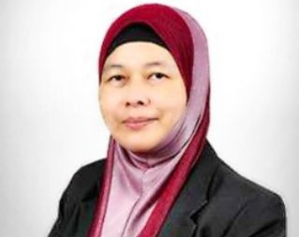
Professor
The National University of Malaysia (UKM)
Malaysia
Zaleha Abdullah Mahdy, MD, FRCOG
Summary
Dr. Zaleha Abdullah Mahdy graduated with a basic medical degree from UKM in 1989. Between 1992 and 1998, she trained and obtained membership of the Royal College of Obstetricians and Gynaecologists (RCOG) in London, Masters in Ob-Gyn (UKM), and a Doctorate in Medicine (Newcastle University, United Kingdom). Her Ob-Gyn special interest area is maternal fetal medicine, specifically in preeclampsia research. She is currently Professor and Senior Consultant Obstetrician and Gynaecologist at UKM Medical Centre in Kuala Lumpur, having finished her three-year term as Dean of the UKM Faculty of Medicine in February 2019. Between February 2016 and November 2017, she was also the Director of UKM’s teaching hospital. Until the end of 2020, she was an appointed council member of the Malaysian Medical Council (MMC) for three terms. In 2018, she was appointed as a co-opted committee member of the Malaysian International Representative Committee (IRC) of the RCOG for one term. Currently she chairs the MMC Education Specialty Sub-Committee for Obstetrics and Gynaecology training. Dr. Mahdy has published 107 articles in journals, several books and chapters in books, and more than 150 abstracts and proceedings. She is an Associate Editor in the Editorial Board of three international journals – Frontiers in Medicine, Frontiers in Surgery, and BMC Pregnancy and Childbirth. Currently she heads the Health Technology Innovation Lab in UKM (HTIL@UKM) and her current research interests include medical virtual reality (m-VR), 3D animation for medical and health education, medical drone development, and mobile app design for antenatal care. She is the Vice Chairperson of the Malaysian Society for Simulation in Healthcare (MaSSH), Immediate Past President of the Perinatal Society of Malaysia, a trainer in iCOE (Intensive Course in Obstetric Emergencies) under the Obstetrical and Gynaecological Society of Malaysia (OGSM), and a member of the Society for Simulation in Healthcare (SSH).
Expertise
Diabetes/gestational diabetes | Fetal growth restriction | Preeclampsia/hypertensive disorders of pregnancy | Preterm birth | Stillbirth
Additional publications: https://pubmed.ncbi.nlm.nih.gov/?term=zaleha%20abdullah%20mahdy
Publications
▸Aminuddin NA, Sutan R, Mahdy ZA. Role of Palm Oil Vitamin E in Preventing Pre-eclampsia: A Secondary Analysis of a Randomized Clinical Trial Following ISSHP Reclassification. Front Med (Lausanne). 2021 Jan 21;7:596405. doi: 10.3389/fmed.2020.596405. PMID: 33553199; PMCID: PMC7859347.
▸Za'im Sahul Hameed M, Sutan R, Mahdy ZA, Tamil AM, Sulong S. Maternal Variables as Determinant of Fetal Growth: Study Protocol on Customized Fetal Growth Charts in Malaysia (GROW-My). Front Med (Lausanne). 2021 May 25;8:592462. doi: 10.3389/fmed.2021.592462. PMID: 34113624; PMCID: PMC8185033.
▸Nordin F, Idris MRM, Mahdy ZA, Wahid SFA. Preeclampsia in pregnancy affecting the stemness and differentiation potency of haematopoietic stem cell of the umbilical cord blood. BMC Pregnancy Childbirth. 2020 Jul 10;20(1):399. doi: 10.1186/s12884-020-03084-7. PMID: 32650736; PMCID: PMC7350629.
▸Mohd Idris MR, Nordin F, Mahdy ZA, Abd Wahid SF. Gestational Diabetes Mellitus in Pregnancy Increased Erythropoietin Level Affecting Differentiation Potency of Haematopoietic Stem Cell of Umbilical Cord Blood. Front Med (Lausanne). 2021 Aug 19;8:727179. doi: 10.3389/fmed.2021.727179. PMID: 34490314; PMCID: PMC8416672.

Slide 27
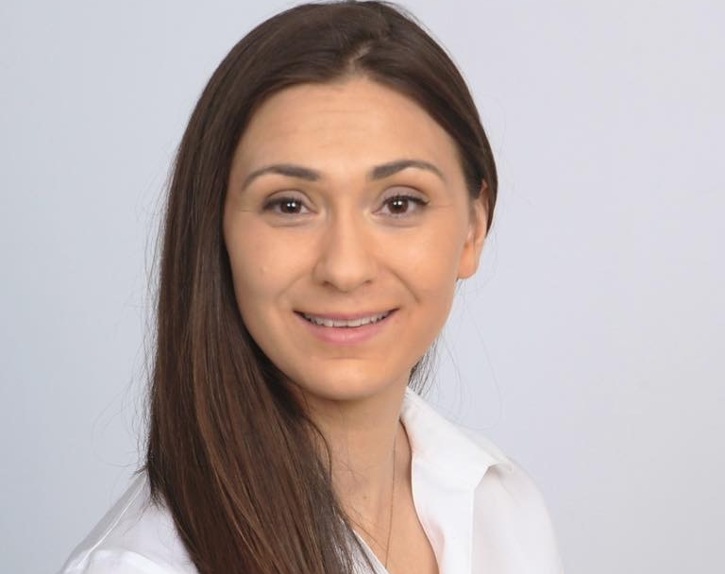
Assistant Professor
Division of Gynecologic Specialties, Department of Obesterics, Gynecology and Reproductive Sciences
UPMC Magee-Womens Hospital
United States of America
Jennifer Carol Makin, MD
Summary
Dr. Jennifer Makin is an Obstetrician and Gynecologist and she completed a Global Health fellowship. She currently manages an international elective for OB/GYN residents in Kisumu, Kenya. She is a co-investigator on an NIH Grant Pathways for Innovation in Blood Transfusion Systems in Kenya currently UG3 phase. Her role is in design, execution and analysis of the qualitative assessment. She has a strong interest in innovations for low-resource settings, and is working to develop a low cost, re-useable instrument for treatment of the pre-invasive changes for cervical cancer.
Publications
▸Makin, Jennifer, Kasey Blount, Leslie Myatt, and James M. Roberts. The Global Pregnancy Collaboration (CoLab) Biobank of rare placentas. Placenta 114 (2021): 50-51.
▸Raykar, Nakul P., Jennifer Makin, Monty Khajanchi, Bernard Olayo, Alejandro Munoz Valencia, Nobhojit Roy, Pablo Ottolino et al. Assessing the global burden of hemorrhage: The global blood supply, deficits, and potential solutions." SAGE Open Medicine 9 (2021): 20503121211054995.
▸Makin, Jennifer, Daniela Suarez-Rebling, Sebastian Suarez, Anna Leone, and Thomas F. Burke. Operations supported by ketamine anesthesia in resource-limited settings: Surgeons’ perceptions and recommendations–Qualitative Study. International Journal of Surgery Open 29 (2021): 1-8.
▸Masaki, Charles O., Jennifer Makin, Sebastian Suarez, Gabriella Wuyke, Ayla N. Senay, Daniela Suarez-Rebling, Javan Imbamba, Jackton Juma, Moytrayee Guha, and Thomas F. Burke. Feasibility of a ketamine anesthesia package in support of obstetric and gynecologic procedures in Kenya when no anesthetist is available." African journal of reproductive health 23, no. 1 (2019): 37-45.
Expertise
Postpartum hemorrhage | Cervical dysplasia

Slide 28

Doctor
UTH Women and Newborn Hospital
Zambia
Chileshe Mabula-Bwalya, MBChB, MSc, DTM&H
Summary
Dr. Chileshe Mabula-Bwalya has undertaken medical training, clinical work and academic research in urban and rural settings in Zambia. She completed a year-long NIH-funded research fellowship on prevention of adverse obstetric outcomes (with a focus on preterm birth and IUGR), attached to the University of North Carolina at Chapel Hill's Zambia field office. She completed the Msc Tropical Medicine and International Health at the London School of Hygiene and Tropical Medicine (dissertation: rates of stillbirth in advanced maternal age pregnancie). She is currently affiliated with the Clinical Research Unit at UTH Women and Newborn Hospital Zambia's. Her interests include adverse obstetric outcomes, pre-eclampsia/hypertensive disorders of pregnancy, infectious disease in pregnancy, placenta and obstetric care in LMICs.
Expertise
Fetal growth restriction | Placental structure/function | Preeclampsia/hypertensive disorders of pregnancy | Preterm birth | Stillbirth
Publications
▸Association of mid-trimester maternal angiogenic biomarkers with small-for-gestational-age infants in an urban Zambian cohort: a nested case-control study. Mabula-Bwalya CM, Smithmyer ME, Mwape H, Chipili G, Conner M, Vwalika B, De Paris K, Stringer JSA, Price JT. Int J Gynaecol Obstet. 2021 Aug 6. doi: 10.1002/ijgo.13860. Online ahead of print. PMID: 34358336
▸Circulating angiogenic factors and HIV among pregnant women in Zambia: a nested case-control study. Smithmyer ME, Mabula-Bwalya CM, Mwape H, Chipili G, Spelke BM, Kasaro MP, De Paris K, Vwalika B, Sebastião YV, Stringer JSA, Price JT. BMC Pregnancy Childbirth. 2021 Jul 28;21(1):534. doi: 10.1186/s12884-021-03965-5. PMID: 34320947
▸Acceptability of a trial of vaginal progesterone for the prevention of preterm birth among HIV-infected women in Lusaka, Zambia: A mixed methods study. Price JT, Mabula-Bwalya CM, Freeman BL, Carda-Auten J, Phiri WM, Chibwe K, Kantumoya P, Vwalika B, Stringer JSA, Golin CE. PLoS One. 2020 Sep 24;15(9):e0238748. doi: 10.1371/journal.pone.0238748. eCollection 2020. PMID: 32970697
▸Vaginal progesterone to prevent preterm delivery among HIV-infected pregnant women in Zambia: A feasibility study. Price JT, Phiri WM, Freeman BL, Vwalika B, Winston J, Mabula-Bwalya CM, Mulenga HB, Stringer JSA. PLoS One. 2020 Jan 29;15(1):e0224874. doi: 10.1371/journal.pone.0224874. eCollection 2020. PMID: 31995557

Slide 29
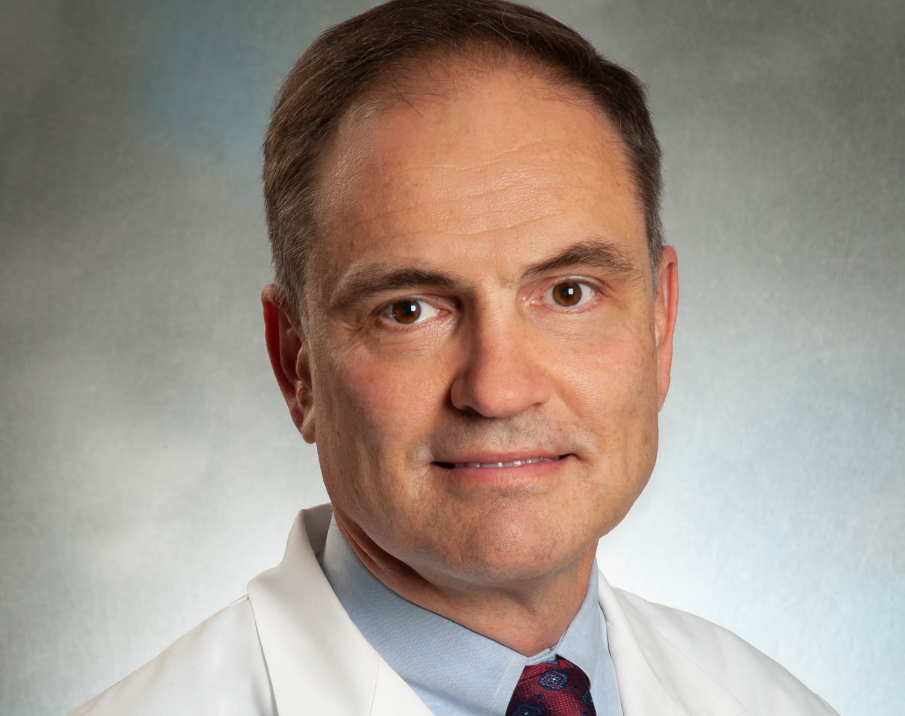
Professor
Harvard Medical School
United States of America
Thomas F. McElrath, MD, PhD
Summary
Dr. Thomas McElrath is a specialist in maternal fetal medicine with a background in epidemiology and biostatistics. He has been PI of the LIFECODES birth cohort for 20 years. His areas of interest are twofold:
1) The effects of environmental exposure to endocrine disruptors on pregnancy outcome
2) The molecular epidemiology of biomarkers for adverse pregnancy outcome including preeclampsia, spontaneous preterm birth and placenta accreta spectrum.
Expertise
Preeclampsia/hypertensive disorders of pregnancy | Preterm birth | Bioinformatics and biomarker epidemiology
Additional publications: https://www.ncbi.nlm.nih.gov/myncbi/thomas.mcelrath.2/bibliography/public/
Publications
▸Rasmussen M, Reddy M, Nolan R, Camunas-Soler J, Khodursky A, Scheller NM, Cantonwine DE, Engelbrechtsen L, Mi J, Dutta A, Brundage T, Siddiqui1 F, Thao1 M, Gee EPS, La J, Baruch-Gravett C, Santillan MK, Deb S, Ame SM, Ali SM, Adkins M, DePristo MA, Lee M, Namsaraev E, Gybel-Brask DJ, Skibsted L, Litch JA, Santillan DA, Sazawal S, Tribe RM, Roberts JM, Jain M, Høgdall E, Holzman C, Quake SR, Elovitz MA, McElrath TF. RNA profiles reveal signatures of pregnancy’s future health and disease. Nature. 2021 (in press).
▸McElrath TF, Cantonwine DE, Gray KJ, Mirzakhani H, Doss RC, Khaja N, Khalid M, Page G, Brohman B, Zhang Z, Sarracino D, Rosenblatt KP. Late first trimester circulating microparticle proteins predict the risk of preeclampsia < 35 weeks and suggest phenotypic differences among affected cases. Sci Rep. 2020;10(1):17353. PMID: 33087742; PMCID: PMC7578826.
▸Ferguson KK, Meeker JD, Cantonwine DE, Mukherjee B, Pace GG, Weller D, McElrath TF. Environmental phenol associations with ultrasound and delivery measures of fetal growth. Environ Int. 2018 Mar;112:243-250. PMID: 29294443; PMCID: PMC5899051.
▸Ferguson KK, McElrath TF, Meeker JD. Environmental phthalate exposure and preterm birth. JAMA Pediatr. 2014 Jan;168(1):61-7. PMID: 24247736; PMCID: PMC4005250.

Slide 30

Associate Professor
College of Medical Sciences, Gombe State University
Federal Teaching Hospital, Gombe - Nigeria
Abdullahi Mohammed, MBBS, MD,FMCPath
Summary
Dr. Abdullahi Mohammed is an Associate Professor of Chemical Pathology and Metabolic Medicine at the Gombe State University and also Honorary Consultant at the Federal Teaching Hospital, Gombe, Nigeria.
My Clinical Research interest focuses on studying maternal and fetal complications that occur due to metabolic dysfunctions in pregnancy.
As the Principal Investigator, our ongoing research grant project, funded by the National Research Fund - Nigeria has focused on characterizing the effect of diet-derived advanced glycation end products (AGEs) accumulation in the placenta on the expression profile of the pro-inflammatory RAGE andTLR4 receptors in the placenta; as well as its impact on the risk of preterm delivery and fetal complications.
As an Adjunct Member of the CoLab, and also, being from a low-resource setting with high prevalence of preterm births, we hope to work and collaborate with international experts in the field and gain additional mentoring especially in the area of intervention researches aimed at testing novel and effective strategies for early prediction and more targeted preventive and therapeutic interventions of preterm births and the associated fetal complications and thereby improving maternal and newborn health in our local population and worldwide.
Expertise
Metabolic Dysfunctions in Pregnancy/Preterm Birth
Publications
▸ Abdullahi M, Aliyu IS, Manu M. Lower Serum level of Adiponectin is associated with increased Insulin Resistance in Nigerian women with Gestational Diabetes Mellitus. Ann. Trop. Pathol. 2016; 7(2): 91 – 95.
▸ Abdullahi M, Aliyu IS, Manu M. Correlation between Circulating Level of Tumor Necrosis Factor-α and Insulin Resistance in Nigerian Women with Gestational Diabetes Mellitus. Ann. Afr. Med. 2018; 17(4):168 – 171. doi: 10.4103/aam.aam_53_16, PMCID: PMC6330778, PMID: 30588928
▸ Abdullahi M, Ibrahim MB. Impact of magnesium deficiency on pancreatic β-cell function in type 2 diabetic Nigerians. Iran. j. diabetes obes. 2019; 11(2): 87 – 92. DOI: https://doi.org/10.18502/ijdo.v11i2.2653
▸ Abdullahi M, Bello IM, Hassan A. Magnesium Deficiency in Hospitalized Patients with Hypokalemia. Niger J Gen Pract. 2019; 17: 8 – 11. DOI: 10.4103/NJGP.NJGP_12_18
▸ Abdullahi M, Aliyu GG, Adamu H. Dietary Acid Intake and the Risk of Microalbuminuria in Apparently Healthy Adult Nigerians. J. Exp. Res. 2021; 9(4):1 – 7.

Slide 31

Professor of Obstetrics and Gynecology
Oregon Health & Science University
United States of America
Leslie Myatt, PhD, FRCOG
Summary
Dr. Leslie Myatt is Professor of Obstetrics and Gynecology, and has been continuously funded by NIH since 1987 with over 300 publications in several areas of perinatology examining the paracrine regulation of human parturition including regulation of prostaglandin synthesis and action in intrauterine tissues, the regulation of placental blood flows and the role of oxidative and nitrative stress, mitochondrial dysfunction, sexual dimorphism in placental function, and biomarkers to predict preeclampsia and other adverse outcomes. He is currently the PI of the Global Pregnancy Collaboration (CoLab). Together with Dr. James Roberts he was co-PI of the NIH-funded CAPPS study that aimed to define predictors of preeclampsia in low-risk nulliparous women. He has broad expertise in molecular biology, proteomic and epigenetic techniques, placental perfusion and trophoblast cell culture, with many local, national and international collaborators. Dr. Myatt has directed several NIH-training grants including a MD/PhD program, has trained many graduate students and basic and clinical postdoctoral fellows in his laboratory and has held leadership positions in several scientific societies. He maintains an active placental research program currently studying mitochondrial respiration and glycolysis in trophoblast and has shown a sexual dimorphism in generation of oxidative stress and responses to inflammatory stimuli in these settings together with changes in substrate utilization for placental energy generation with obesity and GDM, which may relate to differences in pregnancy outcomes with a male vs a female fetus. He also has major interests in prediction of adverse pregnancy outcomes and in assessment of placental function or “health” in adverse intrauterine environments. He plans to continue his studies to elucidate therapeutic approaches in this work and bring this expertise to CoLab.
Expertise
Developmental Origins of Health and Disease (DOHaD) | Diabetes/gestational diabetes | Fetal growth restriction | Infectious disease | Obesity | Placental structure/function | Preeclampsia/hypertensive disorders of pregnancy | Preterm birth
Publications
▸Myatt L. Redman CW,Staff AC, Hansson S, Wilson ML, Laivuori H, Poston L and Roberts JM for the Global Pregnancy CoLaboratory (COLAB). A Strategy for Standardization of Preeclampsia Research Study Design. Hypertension 63(6):1293-1301, 2014: PMID24688121
▸Myatt L, Roberts JM, Redman CWG; Global Pregnancy Collaboration (CoLab) Availability of COLLECT, a database for pregnancy and placental research studies worldwide. Placenta. 2017 57:223-224. PMID: 28864015
▸Wang Y, Bucher M, Myatt L. Use of Glucose, Glutamine and Fatty Acids for Trophoblast Respiration in Lean, Obese and Gestational Diabetic Women. J Clin Endocrinol Metab. 2019; 104(9): 4178-4187 PMID:31116396
▸Myatt L. The prediction of preeclampsia: the way forward. Am J Obstet Gynecol. 2022, 226(2): S1102-S1107. PMID: 33785181

Slide 32

Clinical Professor
University of Manchester
England
Jenny Myers, PhD, MRCOG
Summary
Dr. Jenny Myers has the following academic experience: PI SCOPE study in Manchester - led several biomarker studies; PI PELICAN, PARROT studies - development and implementation of placental growth factor for the diagnosis of pre-eclampsia. She has expertise with delivery of observational cohort studies (MAViS, SCOPE, VELOCITY) and RCTs in pregnancy (e.g. Giant PANDA, MIMICH, Beetroot, PICK-UP); Portfolio of ongoing translational research focused on hypertension and diabetes in pregnancy (e.g. placental phenotyping, vascular biology, preclinical models); Biobanks: SCOPE, MAViS, VELOCITY and PICK-UP. Additionally, Dr. Myers has clinical experience as the Consultant Obstetrician & Maternal Medicine lead in tertiary centre with 18000 births per annum. She is the regional lead for Hypertensive and renal disease in Pregnancy North West England, a specialist committee member for NICE, Hospital Chief Clinical Informatics Officer and Implementation of MyMatCare, an app for BP and blood glucose monitoring during pregnancy.
Expertise
Diabetes/gestational diabetes | Fetal growth restriction | Placental structure/function | Preeclampsia /hypertensive disorders of pregnancy
Additional publications: https://drive.google.com/open?id=1PTnd_5WIl8fZU8U33au2Kd8YYqfS8TyI
Publications
▸10.1161/HYPERTENSIONAHA.120.15875
▸10.1161/CIRCRESAHA.120.317612
▸https://doi.org/10.1016/S0140-6736(18)33212-4
▸https://doi.org/10.1161/HYPERTENSIONAHA.114.03578

Slide 33

Founder & CEO of Maiden Solution LTD
Abidan Nambajimana, Bsc, MScm, Sr CRA
Summary
Abidan Nambajimana is a Clinical Research Associate and Project Manager with over 13 years of experience in clinical trials and public health research across East Africa. He holds a Master of Science in Hospital Administration (Public Health branch) and has extensive expertise in clinical trial monitoring, protocol development, research coordination, and capacity building.He is the Founder & CEO of Maiden Solution LTD, a Rwanda-based research and consultancy company dedicated to advancing maternal and child health research, with a focus on preeclampsia and adverse pregnancy outcomes. Through partnerships, including with Wayne State University, he leads efforts to strengthen predictive research, surveillance systems, and innovative interventions for maternal health in East Africa. He has also led technical and evaluation consultancies for organizations such as SOS Children’s Villages Rwanda, Rwanda Biomedical Centre (RBC), and the Norwegian Refugee Council. As an Adjunct Member of CoLab, Abidan brings expertise in clinical trial operations, maternal health research in LMICs, and collaborative partnerships. His mandate is to leverage innovation and cross-border collaborations to reduce the burden of preeclampsia and improve pregnancy outcomes in Sub-Saharan Africa.
Expertise
Developmental Origins of Health and Disease (DOHaD) | Diabetes/ gestational diabetes | Fetal growth restriction | Obesity | Placental structure/function
Publications
▸ The effectiveness of nutrition supplements to improve sputum conversion, treatment completion and weight gain among TB patients: A systematic review”
Compensating control participants when the intervention is of significant value: experience in
Guatemala, India, Peru and Rwanda
Comparison of next-generation portable pollution monitors to measure exposure to PM2.5 from household air pollution in Puno, Peru.
Design and conduct of facility-based surveillance for severe childhood pneumonia in the
Household Air Pollution Intervention Network (HAPIN) trial
This study, featured in the Journal of Chromatography B, focuses on the cross-validation of biomonitoring methods for polycyclic aromatic hydrocarbon metabolites in human urine. The findings contribute to the development of reliable biomarkers for assessing exposure to household air pollution. HAPIN TrialThe Lancet+8Rollins School of Public Health+8HAPIN
Also published in Ultrasound in Medicine & Biology, this paper describes the establishment of an ultrasound core laboratory for the HAPIN trial.

Slide 34

Research Fellow, Department of Immunology
Noguchi Memorial Institute for Medical Research
University of Ghana
Ghana
Dorotheah Obiri, PhD
Summary
Dr. Dorotheah Obiri is a Research Fellow at the Department of Immunology, Noguchi Memorial Institute for Medical Research, University of Ghana. She obtained her PhD in Molecular and Cell Biology of Infectious Diseases at the West African Centre for Cell Biology of Infectious Pathogens, University of Ghana (2019), with the sponsorship from the World Bank’s African Centres of Excellence grant. She received the VECD Fogarty Global Health Fellowship for her postdoctoral work. Dr. Obiri envisions a world where maternal and fetal mortality is eliminated and a key aspect of her research is channeled into investigating pregnancy complications associated with the placenta. She has strong interest in improving maternal and fetal health in resource-limited settings with focus on infectious and non-infectious disease interactions during pregnancy. Currently her research seeks to understand placental biology and associated immune interactions in pregnancy complications - especially in cases of comorbidity. Conditions of interest which she is actively investigating include preeclampsia, placental malaria, sickle cell disease and COVID-19. The overarching goal is to identify novel targets and interventions through basic and translational research to provide further insights into preventive management, diagnosis and treatment for these conditions during pregnancy. Dr. Obiri is a member of several organisations such as the American Society for Tropical Medicine and Hygiene (ASTMH) and the ASTMH Subcommittee on Global Health, the Immunological Society of Ghana, the Federation of Clinical Immunology Societies, and the Organisation of Women in Science for the Developing World. She has interests in advocacy and serve as the National Campaign Coordinator, Research Committee Member and co-chair of the Newsletter Editorial Board of the Action on Preeclampsia Ghana – the sole preeclampsia working advocacy group in Ghana.
Expertise
Fetal growth restriction | Infectious disease | Placental structure/function | Preeclampsia/hypertensive disorders of pregnancy | Preterm birth | Sickle cell disease
Additional publications: https://www.ncbi.nlm.nih.gov/myncbi/dorotheah.obiri.1/bibliography/public/
Publications
▸Obiri, D., I.J. Erskine, D. Oduro, K.A. Kusi, J. Amponsah, B.A. Gyan, K. Adu-Bonsaffoh, and M.F. Ofori, Histopathological lesions and exposure to Plasmodium falciparum infections in the placenta increases the risk of preeclampsia among pregnant women. Sci Rep. 2020;10(1), 8280. PubMed PMID: 32427864
▸Frimpong, A., J. Amponsah, D. Agyemang, A. Sena Adjokatseh, S. Eyiah-Ampah, N. Aba Ennuson, D.Obiri, L. Eva Amoah, and K. Asamoah Kusi, Elevated levels of endothelial molecules ICAM-1, VEGFA and VEGFR2 in microscopic asymptomatic malaria. Open Forum Infectious Diseases, 2021. Pubmed PMID: 34277886

Slide 35

Professor of OB/GYN and Reproductive Sciences, Epidemiology and Clinical and Translational Research
University of Pittsburgh; Magee-Womens Research Institute
United States of America
James M. Roberts, MD
Summary
Dr. Jim Roberts has had extensive experience in the study of adverse pregnancy outcomes and specifically the study of preeclampsia at several levels: mechanistic, clinical, epidemiological and behavioral. His current research efforts include fundamental, clinical and health services approaches to the understanding and management of this disorder in this country and abroad. He served as Chair of the NICHD Maternal Fetal Medicine Network for clinical trials for 9 years. After stepping down as Chair, he accepted the position of Protocol Subcommittee Chair for the CAPPS antioxidant trial to prevent preeclampsia that randomized 10,000 women to the use of Vitamins C and E or placebo. He has previously chaired the NHLBI Working Group on Research in Hypertension in Pregnancy as well as the NHLBI/ NICHD Workshop on Preeclampsia Research. He also chaired the ACOG Task Force for Hypertension in Pregnancy. Dr. Roberts is currently co-investigator of the Global Pregnancy Collaboration (CoLab), a program to bring together international cohorts with patient data and biological samples to pool resources to study preeclampsia and other adverse pregnancy outcomes. CoLab currently has more than 40 groups from around the world with data and biosamples from over 300,000 pregnancies (about 4,000 preeclamptics). He continues with clinical/translational research on preeclampsia. Other current activities include efforts to facilitate collaboration and data sharing worldwide through CoLab and emphasizing and supporting preeclampsia as more than one disorder. He is member of the National Academy of Medicine, is an ad eundem member of the Royal College of Obstetrics and Gynecology (UK). He has been honored by lifetime achievement awards by the American Journal of Obstetrics and Gynecology, The Society for Reproduction Investigation and the Preeclampsia Foundation. His passion is mentoring and has headed three training grants and personally trained more than 60 pre and postdoctoral trainees.
Expertise
Fetal growth restriction | Maternal cardiovascular and metabolic disease | Obesity | Preeclampsia/ hypertensive disorders of pregnancy | Preterm birth | Identification of preeclampsia subtypes
Additional publications: https://pubmed.ncbi.nlm.nih.gov/collections/48319783/?sort=pubdate
Publications
▸Roberts JM, Rich-Edwards JW, McElrath TF, Garmire L, Leslie M, for the Global Pregnancy C: Subtypes of Preeclampsia: Recognition and Determining Clinical Usefulness. Hypertension. 2021:HYPERTENSIONAHA12014781. PubMed PMID: 33775113
▸Redman CWG, Staff AC, Roberts JM: Syncytiotrophoblast stress in preeclampsia: the convergence point for multiple pathways. Am J Obstet Gynecol. 2020;08:08. PubMed PMID: 33546842.
▸Myatt L, Roberts JM. Preeclampsia: Syndrome or Disease? (Review) Curr Hypertens Rep. 2015 Nov;17(11):83. PMID: 26362531.
▸Roberts JM, Taylor RN, Musci TJ, Rodgers GM, Hubel CA, McLaughlin MK: Preeclampsia: An endothelial cell disorder? Am J Obstet Gynecol. 161(5):1200-1204, 1989. Comments in Am J Obstet Gynecol. Oct. 163(1).

Slide 36

Emeritus Scholar Tenured Professor
Pediatrics and Neurology
Case Western Reserve University
United States of America
Mark S. Scher, MD
Summary
Fetal/neonatal neurology has been integrated into Dr. Mark Scher’s pediatric neurology practice at two academic institutions where he served children and families into adulthood. Clinical service was embedded into interdisciplinary teaching programs including neurology, pediatrics, OBGYN, psychiatry and other healthcare specialties. Fetal neurology followed by neonatal neurocritical care consultations underscored his approach to the neurologic care of children relative to maternal and family health equity and/or disparities. His research applied neonatal EEG/Sleep analyses to assess neonatal encephalopathy, seizures, perinatal stroke, prematurity, and developmental care interventions. He considered trimester-specific factors affecting the maternal/placental/fetal triad when assessing neonatal and childhood EEG/Sleep patterns to treat disorders and predict outcome. These interdisciplinary clinical, educational and research experiences provide Dr. Scher an opportunity to participate in CoLab activities, applying perspectives of developmental origins of brain health and life-course science.
Expertise
Developmental Origins of Health and Disease (DOHaD) | Fetal/neonatal brain development | Life-course science
Publications
▸Scher MS (2021) “The First Thousand Days” Define a Fetal/Neonatal Neurology Program. Front. Pediatr. 9:683138.doi: 10.3389/fped.2021.683138
▸Scher MS. Fetal neurology: Principles and practice with a life-course perspective. Handb Clin Neurol. 2019;162:1-29. doi: 10.1016/B978-0-444-64029-1.00001-1. PMID: 31324306
▸Scher MS. Neurologic Sequelae Associated with Hypertensive Disorders of Pregnancy. Children (Basel). 2021;8(11):945. Published 2021 Oct 20. doi:10.3390/children8110945
▸Scher MS, Loparo KA. Neonatal EEG/sleep state analyses: a complex phenotype of developmental neural plasticity. Dev Neurosci. 2009;31(4):259-75. doi: 10.1159/000216537. Epub 2009 Jan 2. PMID: 19546563

Slide 37

Professor
University of Cambridge
England
Gordon C. S. Smith, MD, PhD
Summary
Dr. Gordon Smith’s research is focused on clinical epidemiology and translational research. He is the PI of cohort studies collecting blood and placental samples on large numbers of women having first pregnancies. Their broad aims are to identify mechanisms and predictors of placentally related complications of human pregnancy.
Publications
▸Coorens THH, Oliver TRW, Sanghvi R, Sovio U, Cook E, Vento-Tormo R, Haniffa M, Young MD, Rahbari R, Sebire N, Campbell PJ, Charnock-Jones DS*, Smith GCS*, Behjati S* [*corresponding]. Somatic mutations reveal universal mosaicism and extensive cancer-like mutagenesis in human placentas. Nature 2021;592:80-85.
▸Sovio U, Goulding N, McBride N, Cook E, Gaccioli F, Charnock-Jones DS, Lawlor DA, Smith GCS. A maternal serum metabolite ratio predicts term fetal growth restriction. Nature Medicine 2020;26:348-353.
▸de Goffau MC, Lager SM, Sovio U, Gaccioli F, Cook E, Peacock SJ, Parkhill J, Charnock-Jones DS, Smith GCS. Article: Human placenta has no microbiome but can contain potential pathogens. Nature 2019;572:329-334.
▸Sovio U, White IR, Dacey A, Pasupathy D, Smith GCS. Screening for fetal growth restriction with universal third trimester ultrasonography in nulliparous women in the Pregnancy Outcome Prediction (POP) study: a prospective cohort study. Lancet 2015;386:2089-97.
Expertise
Diabetes/gestational diabetes | Fetal growth restriction | Infectious disease | Placental structure/function | Preeclampsia/hypertensive disorders of pregnancy | Stillbirth

Slide 38
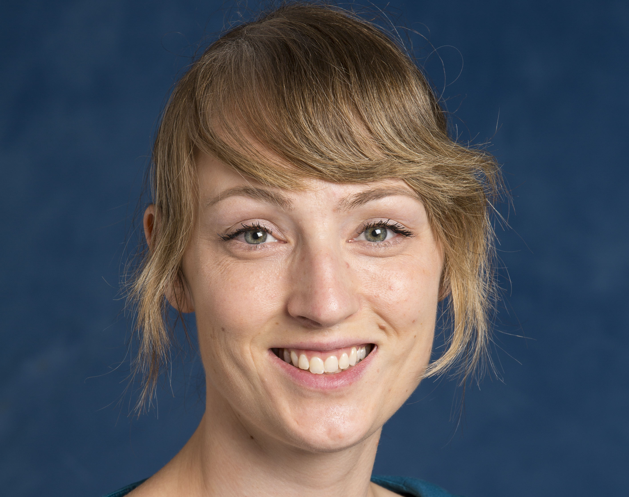
Clinical Lecturer
University of Leeds
England
Rebecca Spencer, MBChB, PhD
Summary
Dr. Rebecca Spencer is an NIHR Clinical Lecturer in Obstetrics and Gynaecology and a subspecialty trainee in Maternal Fetal Medicine in the UK. From a disease perspective her research focuses on early-onset fetal growth restriction and placental insufficiency. This includes the discovery and validation of maternal serum proteins as predictive markers of pregnancy outcome, the validation of maternal circulating mRNAs as diagnostic markers of FGR and the evaluation of placental extracellular vesicles as non-invasive placental biopsies. However, she also has a wider interest in translational obstetrics. Dr. Spencer has experience of designing a phase I/IIa clinical trial of a maternal VEGF gene therapy for early-onset FGR, working with a small-medium enterprise company to submit a successful application for European Medicines Agency orphan designation, developing standard severity grading criteria for maternal and fetal adverse events and liaising with the Medical Dictionary for Regulatory Activities (MedDRA) to expand their fetal adverse event terms. She has a diploma in epidemiology, including training on advanced statistical methods, and has completed the Eureka Institute for Translational Medicine International Certificate Course.
Expertise
Fetal growth restriction | Translational obstetrics
Publications
▸Spencer R, Hecher K, Norman G, Marsal K, Flake A, Figueras F, Lees C, Beach K, Powell M, Crispi F, Diemert A, Marlow N, Peebles D, Westgren M, Gardiner H, Gratacos E, Brodski J, Batista A, Turier H, Patel M, Power B, Power J, Yaz G, David AL. Development of standard definitions and grading for Maternal and Fetal Adverse Event Terminology. Prenatal Diagnosis 2021 doi 10.1002/pd.6047
▸Spencer R, Rossi C, Lees M, Peebles D, Brocklehurst P, Martin J, Hansson S, Hecher K, Marsal K, Figueras F, Gratacos E, David AL. Achieving orphan designation for placental insufficiency: annual incidence estimations in Europe. BJOG 2018, doi 10.111/1471-0528.15590
▸Hannan N, Stock O, Spencer R, Whitehead C, David AL, Groom K, Petersen S, Henry A, Said JM, Seeho S, Kane S, Gordon L, Beard S, Chindera K, Karegodar S, Hiscock R, Pritchard N, Kaitu'u-Lino TJ, Walker SP, Tong S. Circulating mRNAs are differentially expressed in pregnancies with severe placental insufficiency and at high risk of stillbirth. BMC Medicine 2020;18(1): 145.
▸Sheppard M*, Spencer R*, Ashcroft R, David A. Ethics and social acceptability of a proposed clinical trial using maternal gene therapy to treat severe early onset fetal growth restriction. Ultrasound in Obstetrics and Gynaecology 2016;47(4):484-91

Slide 39

Professor of Women's Health, Institute for Clinical Medicine
Faculty of Medicine, University of Oslo
Head of Research, Division of OB/GYN, Oslo University Hospital
Norway
Anne Cathrine (Annetine) Staff, MD, PhD
Summary
Dr. Annetine Staff is a specialist in Gynecology and Obstetrics. She is at present full-time Professor at the Faculty of Medicine, University of Oslo, Norway. She is also Head of Research at the Oslo University Hospital, Division of Obstetrics and Gynaecology. Dr. Staff was the EPG (European Placenta Group) Spokesperson 2011-17, Vice-President of the ISSHP (International Society for the Study of Hypertension in Pregnancy) 2012-16, and currently an ISSHP (International Society for the Study of Hypertension in Pregnancy) Executive Committee member. She is a Steering and Executive Committee member of CoLab (Global Pregnancy CoLaboratory) since 2011. She is Associate Editor of Pregnancy Hypertension, An International Journal of Women's Cardiovascular Health, since 2021. Dr. Staff heads the Research Center for Obstetrics and Gynaecology in Oslo. She established in 1997 a new vacuum suction method for investigating uteroplacental tissue (decidua basalis), that is crucial for placentation and uteroplacental blood flow. Many of her studies relates to this maternal-fetal tissue interface, including an arterial lesion named acute atherosis. Her current main research effort is within translational understanding of pregnancy complications, placental dysfunction, biomarkers and future maternal cardiovascular health. An important clinical task linked to this research area is identifying preventive measures for premature female cardiovascular disease. She has built a comprehensive biobank with multiple biosamples from pregnancy and postpartum, which is correlated to extensive clinical phenotyping and data. The ensuing translational research projects have demonstrated a large range of maternal and offspring dysfunctional biomarkers related to placental dysfunction and hypertensive disorders of pregnancy, in particular preeclampsia. Dr Staff has a long mentoring and supervision track record of PhD students, postdocs and senior researchers. She has contributed to national and international clinical guidelines and research text books (eg. Chesley’s Hypertensive Disorders in Pregnancy) related to preeclampsia.
Expertise
Maternal cardiovascular and metabolic disease | Placental structure/function | Preeclampsia/hypertensive disorders of pregnancy
Additional publications: https://pubmed.ncbi.nlm.nih.gov/?term=staff%20a%20c&sort=date&page=25
Publications
▸Staff AC, Redman CW, Williams D, Leeson P, Moe K, Thilaganathan B, Magnus P, Steegers EA, Tsigas EZ, Ness RB, Myatt L, Poston L, Roberts JM; Global Pregnancy Collaboration (CoLab). Pregnancy and Long-Term Maternal Cardiovascular Health: Progress Through Harmonization of Research Cohorts and Biobanks. Hypertension. 2016 Feb;67(2):251-60. PMID: 26667417
▸Staff AC, Fjeldstad HE, Fosheim IK, Moe K, Turowski G, Johnsen GM, Alnaes-Katjavivi P, Sugulle M. Failure of physiological transformation and spiral artery atherosis: their roles in preeclampsia. Am J Obstet Gynecol. 2022 Feb;226(2S):S895-S906. PMID: 32971013
▸Redman CWG, Staff AC, Roberts JM. Syncytiotrophoblast stress in preeclampsia: the convergence point for multiple pathways. Am J Obstet Gynecol. 2022 Feb;226(2S):S907-S927. PMID: 33546842
▸Staff AC, Burke Ó, Benton S, von Dadelszen P, Szafranski P, Zhang C, Buhimschi C, Cetin I, Figueras F, Holzman C, Hubel C, Laivuori H, McElrath T, Myers, Ness R, Poston L, Ris-Stalpers C, Roberts J, Schistermann E, Steegers E, Timmermans S, van der Post JA, Villa PM, Williams D, Redman C. Maternal circulating PlGF concentrations and placenta-related pregnancy complications: First results from the CoLab AngF Study. Pregnancy Hypertens. 2013 Apr;3(2):59. PMID: 26105843

Slide 40

Professor
Knight Cardiovascular Institute, Department of Medicine
United States of America
Kent L. Thornburg, MS, PhD, FAPS
Summary
Dr. Kent Thornburg is a cardiovascular physiologist who studies the physiology of pregnancy, placental physiology and fetal development. These studies led him to gain expertise in the developmental origins of health and disease using epidemiological methods. Thus, his laboratory uses animal studies, clinical studies and epidemiological investigations to address question regarding stresses during pregnancy and offspring outcomes.
Expertise
Developmental Origins of Health and Disease (DOHaD) | Diabetes/gestational diabetes | Fetal growth restriction | Maternal cardiovascular and metabolic disease | Placental structure/function | Preeclampsia/hypertensive disorders of pregnancy
Additional publications: http://www.ncbi.nlm.nih.gov/sites/myncbi/kent.thornburg.1/bibliography/41487019/public/?sort=date&direction=ascending
Publications
▸Gluckman PD, Hanson MA, Cooper C, Thornburg KL. Effect of in utero and early-life conditions on adult health and disease. N Engl J Med. 2008 Jul 3;359(1):61-73. PMCID: PMC3923653.
▸Burton GJ, Fowden AL, Thornburg KL. Placental Origins of Chronic Disease. Physiol Rev. 2016 Oct;96(4):1509-65. PMC5504455.
▸Lindgren IM, Drake RR, Chattergoon NN, Thornburg KL. Down-regulation of MEIS1 promotes the maturation of oxidative phosphorylation in perinatal cardiomyocytes. FASEB J. 2019 Jun;33(6):7417-7426. PMCID: PMC6529342.
▸Kolahi K. Louey S. Varlamov O. Thornburg K. Real-Time Tracking of BODIPY-C12 Long-Chain Fatty Acid in Human Term Placenta Reveals Unique Lipid Dynamics in Cytotrophoblast Cells. PLoS One 28;11(4):e0153522, 2016. PMCID: PMC4849650.

Slide 41

Chief Executive Officer
Preeclampsia Foundation
United States of America
Eleni Z. Tsigas
Summary
Eleni Z. Tsigas has been the Chief Executive Officer of the Preeclampsia Foundation since 2009, the North American patient advocacy organization for hypertensive disorders of pregnancy. As a preeclampsia survivor, she has served as a relentless champion for patient education and engagement, innovating healthcare practices, catalyzing science, and for accelerating progress by building partnerships to improve pregnancy outcomes. She is frequently engaged to give keynote addresses and training talks on preeclampsia at international, national and regional meetings. She has served as a Technical Advisor for the World Health Organization (WHO), numerous global research consortia including CoLab, the Hypertension in Pregnancy and the Pregnancy and Heart Disease Task Forces for the American College of Obstetricians and Gynecologists (ACOG), as well as several statewide preeclampsia task forces such as the current TexasAIM hypertension bundle deployment. She currently serves as a member of the National Institute of Child Health and Human Development (NICHD) Task Force on Research Specific to Pregnant Women and Lactating Women (PRGLAC) Implementation Working Group, and as a patient ambassador for the Foundation for the National Institutes of Health (NIH). Eleni has collaborated on numerous research studies, authored chapters and papers in peer-reviewed journals, and is the Principal Investigator for the Preeclampsia Registry.
Expertise
Preeclampsia/hypertensive disorders of pregnancy, patient advocacy, speaking engagements, lived experience integration in research and clinical care improvement initiatives, preeclampsia patient education, self-measured blood pressure (SMBP), early interventions for cardiovascular disease prevention, maternal mental health after a severe maternal event, media engagement
Additional publications at:
https://pubmed.ncbi.nlm.nih.gov/?term=Eleni+Z.+Tsigas
Publications
▸ Kinshella M-LW, Pickerill K, Bone JN, Prasad S, Campbell O, Vidler M, Craik R, Volvert M-L, Mistry H, Tsigas EZ, Magee LA, von Dadelszen P, Moore S, Elango R. An evidence review and nutritional conceptual framework for pre-eclampsia prevention. British Journal of Nutrition. 2023;130(6):1065-1076. doi:10.1017/S0007114522003889
▸ Bijl RC, Bangert SE, Shree R, Brewer AN, Abrenica-Keffer N, Tsigas EZ, Koster MPH, Seely EW. Patient journey during and after a pre-eclampsia-complicated pregnancy: a cross-sectional patient registry study. BMJ Open. 2022 Mar 3;12(3):e057795. doi: 10.1136/bmjopen-2021-057795. PMID: 35241475; PMCID: PMC8896051.
▸Tsigas EZ, The Preeclampsia Foundation-the voice and views of the patient and her family. Am J Obstet Gynecol. 2021 Aug 23:S0002-9378(20)31289-8. doi: 10.1016/j.ajog.2020.10.053. Epub ahead of print. PMID: 34479720

Slide 42
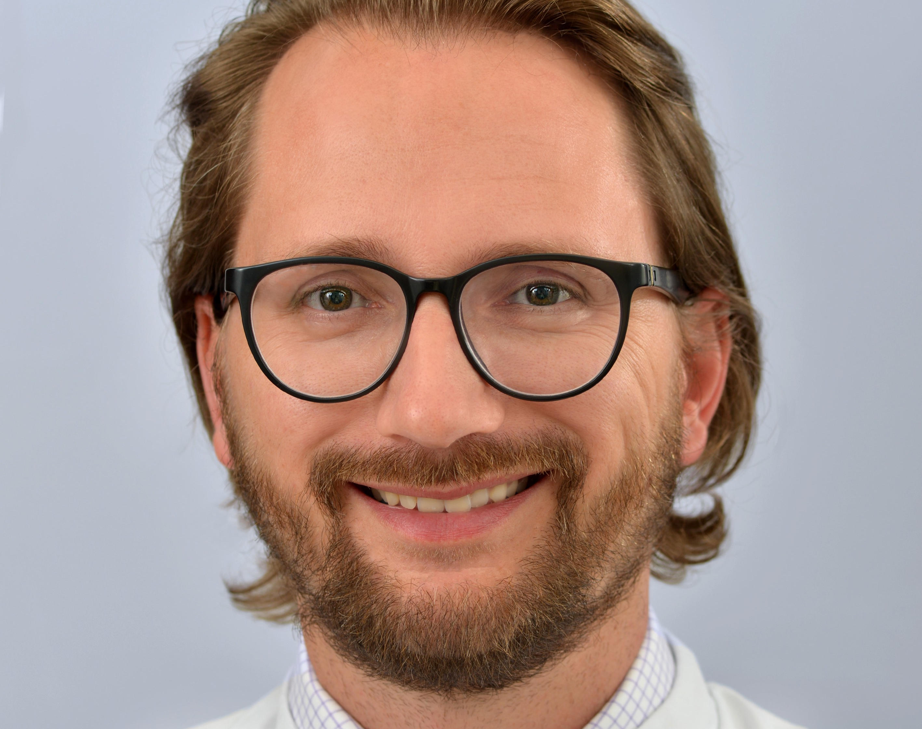
Full Professor
Charité – Universitätsmedizin Berlin
Germany
Stefan Verlohren, MD, PhD
Summary
Dr. Stefan Verlohren’s work involves basic and clinical research in preeclampsia, recently focusing on data driven-solutions employing machine-learning and digital health.
Publications
▸Zeisler H, Llurba E, Chantraine F, Vatish, M, Staff AC, Sennström M, Olovsson M, Brennecke SP, Stepan H, Allegranza D, Dilba P, Schoedl M, Hund M, Verlohren S. Predictive Value of the sFlt-1:PlGF Ratio in Women with Suspected Preeclampsia. N Engl J Med 2016; 374(1):13-22.
▸Dröge LA, Perschel FH, Stütz N, Gafron A, Frank L, Busjahn A, Henrich W, Verlohren S. Prediction of preeclampsia-related adverse outcomes with the sFlt-1/PlGF-ratio in the clinical routine - a real-world study. Hypertension 2020 (in press).
▸Verlohren S*, Niehoff M*, Hering L*, Geusens N, Herse F, Tintu AN, Plagemann A, LeNoble F, Pijnenborg R, Muller DN, Luft FC, Dudenhausen JW, Gollasch M, Dechend R. Uterine vascular function in a transgenic preeclampsia rat model.
▸Verlohren S, Geusens N, Morton J, Verhaegen I, Hering L, Herse F, Dudenhausen JW, Muller DN, Luft FC, Cartwright JE, Davidge ST, Pijnenborg R, Dechend, R. Inhibition of Trophoblast-Induced Spiral Artery Remodeling Reduces Placental Perfusion in Rat Pregnancy. Hypertension 2010; 56(2):304-10.
Expertise
Fetal growth restriction | Preeclampsia/hypertensive disorders of pregnancy
Additional publications: https://pubmed.ncbi.nlm.nih.gov/?term=verlohren-s

Slide 43

Associate Professor
University of Southern California
United States of America
Melissa Lee Wilson, PhD, MPH
Summary
Dr. Melissa Wilson’s background is in molecular epidemiology and biostatistics. Her research focuses on fetal and maternal genetic contributions to severe preeclampsia. She has also done some work on hyperemesis and gestational trophoblastic disease. She is also interested in long term maternal and infant outcomes after PE and HG. In addition to her own research, she is partly funded through her CTSI to analyze investigator data from a range of disciplines and assist in study design and data management. She has experience using and analyzing data collected via social media (Facebook, Twitter, Instagram, etc.) and has recruited using these methods for her research.
Expertise
Developmental Origins of Health and Disease (DOHaD) | Fetal/neonatal brain development | Placental structure/function | Preeclampsia/hypertensive disorders of pregnancy | Hyperemesis | Gestational trophoblastic disease | Research using social media
Additional publications: https://www.ncbi.nlm.nih.gov/myncbi/melissa.wilson.1/bibliography/public/
Publications
▸Szabolcsi Z, Demeter A, Kiraly P, Balogh A, Wilson ML, King JR, Hetey S, Gelencser Z, Matsuo K, Hargitai B, Mhawech-Fauceglia P, Hupuczi P, Szilagyi A, Papp Z, Roman LD, Cortessis VK, Than NG. Epigenetic dysregulation of trophoblastic gene expression in gestational trophoblastic disease. Biomedicines. 2021 Dec 17; 9(12):1935. PMID: 34944751. PMCID:PMC8698431.
▸Reuter K*, Wilson ML*, Moran M, Le N, Angyan P, Majmundar A, Kaiser EM, Unger J. General audience engagement with public health messages across multiple social media sites: Comparative Analysis. JMIR Public Health and Surveillance 2021;7(2):e24429. PMID: 33605890.
▸Gray K, Kovacheva VP, Mirzakhani H, Bjonnes AC, Almoguera B, Wilson M, Ingle SA, Lockwood CJ, Hakonarson H, McElrath TF, Murray JC, Norwitz ER, Karumanchi SA, Bateman BT, Keating BJ, Saxena R. Risk of preeclampsia in patients with maternal genetic predisposition to common medical conditions: a case-control study. BJOG 2020 Aug 2 (online ahead of print). PMID: 32741103
▸Ding L, Blitz M, Wing D, Epstein A, Gjessing H, Wilson ML. PHLDA2 gene polymorphisms and risk of HELLP syndrome and severe preeclampsia. Pregnancy Hypertension. 2020 Jan;19:190-194. PMID: 32062476.

Slide 44

Reader in Paediatrics
University of Jos
Nigeria
Christopher Yilgwan, FWACP, PhD
Summary
Dr. Christopher Yilgwan’s main research interest is in maternal and child health. He is interested in how events in pregnancy affects the unborn child, infant and older child. He is particularly interested in how placental disorders of pregnancy especially preeclampsia impact on the growing fetus as well as the development of the fetus in utero. Dr. Yilgwan is also particularly interested on how the environment and other emerging infectious diseases interact to impact on the mother, fetus and her offspring.
Expertise
Developmental Origins of Health and Disease (DOHaD) | Infectious disease | Preeclampsia/hypertensive disorders of pregnancy | Preterm birth
Additional publications: https://www.ncbi.nlm.nih.gov/myncbi/christopher.yilgwan.1/bibliography/public/
Publications
▸Yilgwan, C. S., Pam, V. C., Ige, O. O., Golit, W. N., Anzaku, S., Imade, G. E., ... & Simon, M. A. (2020). Profile of congenital heart disease in infants born following exposure to preeclampsia. PloS one, 15(3), e0229987.
▸Ige, O. O., Afolanranmi, T. O., Yilgwan, C. S., Ayatse, F., Nkereuwem, E., Sagay, A. S., ... & Bode-Thomas, F. (2021). Study of congenital heart defects among neonates in Jos, Nigeria: prevalence and spectrum. Cardiovascular Journal of Africa, 32(1), 21-27.
▸Yilgwan, C. S., Pam, V. C., Ige, O. O., Golit, W. N., Anzaku, S., Imade, G. E., ... & Bode-Thomas, F. (2020). Neonatal Blood Pressure and Anthropometric Indices in Newborns of Pre-Eclamptic and Normal Mothers in Jos, Nigeria. West African Journal of Medicine, 37(4), 423-427.
▸Yilgwan, C. S., Pam, V. C., Yilgwan, G., Ige, O. O., Golit, W. N., Anzaku, S., ... & Zoakah, A. (2020). Comparing neonatal outcomes in women with preeclampsia and those with normal pregnancy. Nigerian Journal of Paediatrics, 47(3), 258-263.

Slide 45

Professor
National University of Singapore, School of Medicine
Singapore
Cuilin Zhang MD, PhD, MPH
Summary
Dr. Zhang is a physician scientist and clinical epidemiologist. Before joining National University of Singapore as a Professor in Medicine and Women's health at the Yong Loo Lin School of Medicine in 2022, Dr. Zhang had been with the Division of Intramural Population Health Research, NICHD, National Institutes of Health (2007-2021) as a Senior Investigator and the interim Branch Chief. Dr. Zhang's research program is designed within a life course health paradigm so that the etiology and prevention of complex diseases may be investigated during multiple critical time windows over life plan and across generations. These time windows range from intrauterine and pre- and peri-conception period through infancy, childhood, and adulthood. Her recent research focuses on nutrition and lifestyle, metabolic and genetic determinants, and health consequences of obesity, gestational diabetes (GDM) and type 2 diabetes, and developmental origins of cardio-metabolic diseases. Dr. Zhang has initiated and led five large cohort studies supported by the National Institutes of Health, USA (total funding >US $50 Million as Principal Investigator): the Diabetes & Women’s Health Study, the Longitudinal Pathogenesis Study of Impaired Glucose Tolerance in Pregnancy, the NICHD Fetal Growth Studies, the Collaborative Perinatal Project Mortality Linkage Study, and the Intergenerational Health Study.
Expertise
Developmental Origins of Health and Disease (DOHaD) | Diabetes/gestational diabetes | Maternal cardiovascular and metabolic disease | Obesity | Nutrition and cardiometabolic health over lifespan
Additional publications: https://pubmed.ncbi.nlm.nih.gov/?term=Cuilin+Zhang
Publications
▸Li M, Grewal J, Hinkle SN, Yisahak SF, Grobman WA, Newman RB, Skupski DW, Chien EK, Wing DA, Grantz KL, Zhang C. Healthy dietary patterns and common pregnancy complications: a prospective and longitudinal study. Am J Clin Nutr. 2021 Sep 1;114(3):1229-1237. doi: 10.1093/ajcn/nqab145. PMID: 34075392; PMCID: PMC8408886.
▸Zhang C, Catalano P. Screening for Gestational Diabetes. JAMA. 2021 Aug 10;326(6):487-489. doi: 10.1001/jama.2021.12190. PMID: 34374733.
▸Li M, Hinkle SN, Grantz KL, Kim S, Grewal J, Grobman WA, Skupski DW, Newman RB, Chien EK, Sciscione A, Zork N, Wing DA, Nageotte M, Tekola-Ayele F, Louis GMB, Albert PS, Zhang C Glycaemic status during pregnancy and longitudinal measures of fetal growth in a multi-racial US population: a prospective cohort study. Lancet Diabetes Endocrinol. 2020 Apr;8(4):292-300.
▸Rawal S, Olsen SF, Grunnet LG, Ma RC, Hinkle SN, Granström C, Wu J, Yeung E, Mills JL, Zhu Y, Bao W, Ley SH, Hu FB, Damm P, Vaag A, Tsai MY, Zhang C. Gestational Diabetes Mellitus and Renal Function: A Prospective Study With 9- to 16-Year Follow-up After Pregnancy. Diabetes Care. 2018 Jul;41(7):1378-1384. doi: 10.2337/dc17-2629. Epub 2018 May 4. PMID: 29728364; PMCID: PMC6014536.

Slide 46

Senior Research Scientist
New York State Institute for Basic Research in Developmental Disabilities
United States of America
Nanbert Zhong, MD, PhD
Summary
As a medical and developmental geneticist who has spent the last three decades immersed in the study of human developmental disabilities, Dr. Nanbert Zhong is passionate about identifying ways to better understand maternal and children’s health. He has broad research interests on the maternal fetal medicine and perinatal health. He has been focusing on molecular pathophysiology for pregnancies. In the recent decade, Dr. Zhong has been particularly interested in the physiopathogenesis of placental development and placenta-associated Great Obstetrical Syndromes, including miscarriage, still birth, intrauterine fetal growth retardation, preeclampsia, and preterm birth. He has participated in Human Placenta Project that was initiated by NIH/NICHD and played a key role as the leader in initiating China Human Placenta Project and promoted placental research in India. He has been playing a leadership in the Preterm Birth International Collaborative (PREBIC, www.prebicglobal.org). He served as the Secretary General (2014-2017), President (2017-2019), and the Counsel member (2019-) for PREBIC. He was one of the 16 International Expert Review Panelists for WHO global report “Born Too Soon.” Dr. Zhong’s research studies have been founded by NIH, March of Dimes Foundation, Batten Disease Support and Research Association, New York State Research Foundation for Mental Hygiene. He has 170 research articles published in peer reviewed journals including Nature Genetics and Lancet.
Expertise
Developmental Origins of Health and Disease (DOHaD) | Diabetes/gestational diabetes | Fetal growth restriction | Fetal/neonatal brain development | Infectious disease | Placental structure/function | Preeclampsia/hypertensive disorders of pregnancy | Preterm birth | Recurrent pregnancy loss | Stillbirth
Additional publications: https://scholar.google.com/citations?user=3WZHjwMAAAAJ
Publications
▸Fang Y, Wan C, Wen Y, Wu Z, Pan J, Zhong M, Zhong N. Autism-associated synaptic vesicle transcripts are differentially expressed in maternal plasma exosomes of physiopathologic pregnancies. J Transl Med. 2021 Apr 15;19(1):154. doi: 10.1186/s12967-021-02821-6. PMID: 33858444; PMCID: PMC8051067.
▸Wang H, Cao Q, Ge J, Liu C, Ma Y, Meng Y, Wang Y, Zhao X, Liu R, Li C, Wang Y, Zhong J, Ju W, Jenkins EC, Brown WT, Zhong N. LncRNA-regulated infection and inflammation pathways associated with pregnancy loss: genome wide differential expression of lncRNAs in early spontaneous abortion. Am J Reprod Immunol. 2014 Oct;72(4):359-75. doi: 10.1111/aji.12275. Epub 2014 Jun 11. PMID: 24916667.
▸Zhong N, Zhong M. China Human Placenta Project: A global effort to promote placenta medicine. Placenta. 2016 Aug;44:112-3. doi: 10.1016/j.placenta.2016.05.004. Epub 2016 May 12. PMID: 27207829.
▸Wang J, Luo X, Pan J, Dong X, Tian X, Tu Z, Ju W, Zhang M, Zhong M, De Chen C, Flory M, Wang Y, Ted Brown W, Zhong N. (Epi)genetic variants of the sarcomere-desmosome are associated with premature utero-contraction in spontaneous preterm labor. Environ Int. 2021 Mar;148:106382. doi: 10.1016/j.envint.2021.106382. Epub 2021 Jan 17. PMID: 33472089.

