Slide 1
Pathogen Variants Research Network
London, 10-11 October 2024

Slide 2
Welcome Remarks
Dr Titus Divala, Head of Epidemics and Epidemiology, Wellcome

Slide 3
The Pathogen Variants Network,
…a year later
Titus Divala
Head of Epidemics and Epidemiology

Slide 4
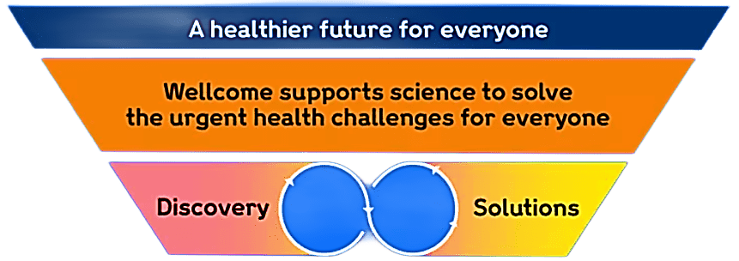
Wellcome Strategic Programmes
Discovery Research
Climate & Health
Infectious Disease
Mental Health
Wellcome Collection
Wellcome Leap
wellcome.org | @wellcometrust
4
Notes:
Wellcome’s vision is a healthier future for everyone, and our mission is to support science to solve urgent health challenges.
We are funding transformative research, from discovery to solutions, across all disciplines.
We have a broad Discovery research programme, which explores open questions about life, health and wellbeing.
And we have the Solutions programme, focusing on the urgent health challenges where our experience, expertise and influence can drive rapid change.

Slide 5
Discovery Research remit
Includes research into:
fundamental processes that underpin biology
complexities of human health and disease, including clinical research and population-based approaches
developing methodologies, conceptual frameworks, technologies, tools or techniques that could benefit health-related research
needs, values and priorities of the people and communities affected by disease and health disparities
social, cultural, political and historical contexts of human health and disease
Excludes activities not grounded in discovery, such as:
purely translational research, including clinical trials to test and develop interventions and treatments
proposals that are primarily implementation science
large-scale population-level interventions and trials
studies on companion and exotic animals, except as models for human disease
Our three challenge-led programmes will fund these and other types of activity when needed to achieve the specific goals we have identified.
Notes:
Recognising the thematic areas to be covered today I wanted to briefly touch upon our Discovery Research programme, as this may be a suitable route for applying for research funding in the future.
Researchers across different career stages can apply for funding through regular schemes described on the Wellcome website. There are exceptions to the funding - which can be generally grouped into purely translation research, implementation science, large scale population level interventions and trials and research into companion and exotic animals.
I would encourage anyone interested and requiring more info to contact the team via the Wellcome website.

Slide 6

The Infectious Disease Strategic Program
Our goals
Our Goals ensure that we focus on tackling the biggest challenges where science can make a difference
Supporting science to
bring innovative solutions to combat infectious disease in the most affected communities
1: Accelerate the discovery and development of impactful products, interventions and strategies to combat infectious diseases
2: Understand how Infectious diseases emerge or escape control to drive the development of evidence-based prevention strategies
Infectious Disease Strategic Programme - IDSP

Slide 7

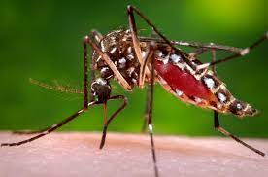
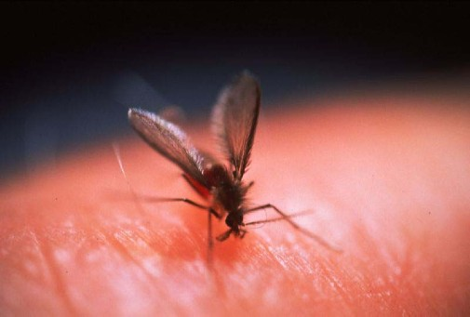
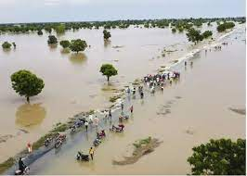
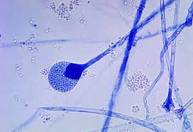
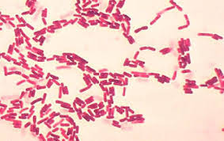
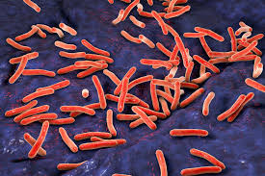
Infectious Disease Strategic Program: Diseases
Environmental Change
Drug Resistant Infections
Vector Borne
Water Borne
Fungi
Bacteria
Snail Mosquito Fly
Schistosomiasis
¹Viruses
Leishmaniasis
Cholera
² Pathogenic
Fungi
²LMIC Pathogen Focus
Tuberculosis
Dengue, Zika, Chikungunya, Yellow Fever, Rift Valley Fever
²We are currently further defining which bacterial and fungal diseases we will focus on
We are focusing on diseases that have a high burden in Africa and South-East Asia,
but take a global approach to these diseases

Slide 8
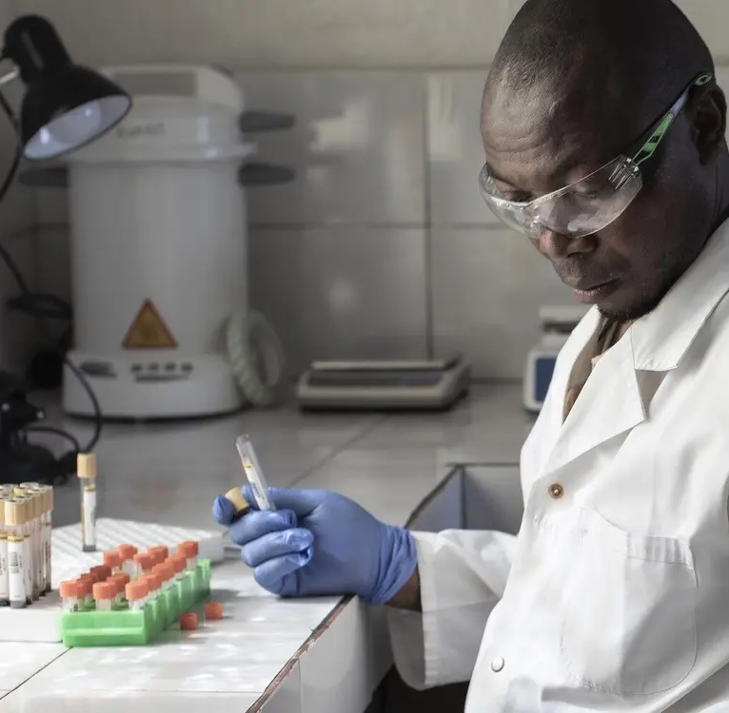
How we will achieve our mission
Investing in research and innovation
Empowering researchers with optimised environments
Maximising the impact of research
  Engaging and involving communities
  in the science
  Building global partnerships
  Using evidence to advocate for change
  Credit: Raissa Karama Rwizibuka / Wellcome

Slide 9
Pathogen Variants Network:
Building a resilient, proactive ID research ecosystem
Our Identity:
Collaborative network of world-class researchers
Experts in pathogen variants and outbreak preparedness
Spanning multiple disciplines, institutions and countries
Our Goals:
Enhance collective understanding of pathogen evolution and impact
Rapidly assess biological implications of novel variants
Facilitate swift translation of research into policy & practice
Our Future:
Expanding focus beyond COVID-19 to other potential pathogens
Develop agile research methodologies for emerging infectious threats
Serve as a model for responsive, collaborative infectious disease research
Build LMIC capacity for outbreak response

Slide 10
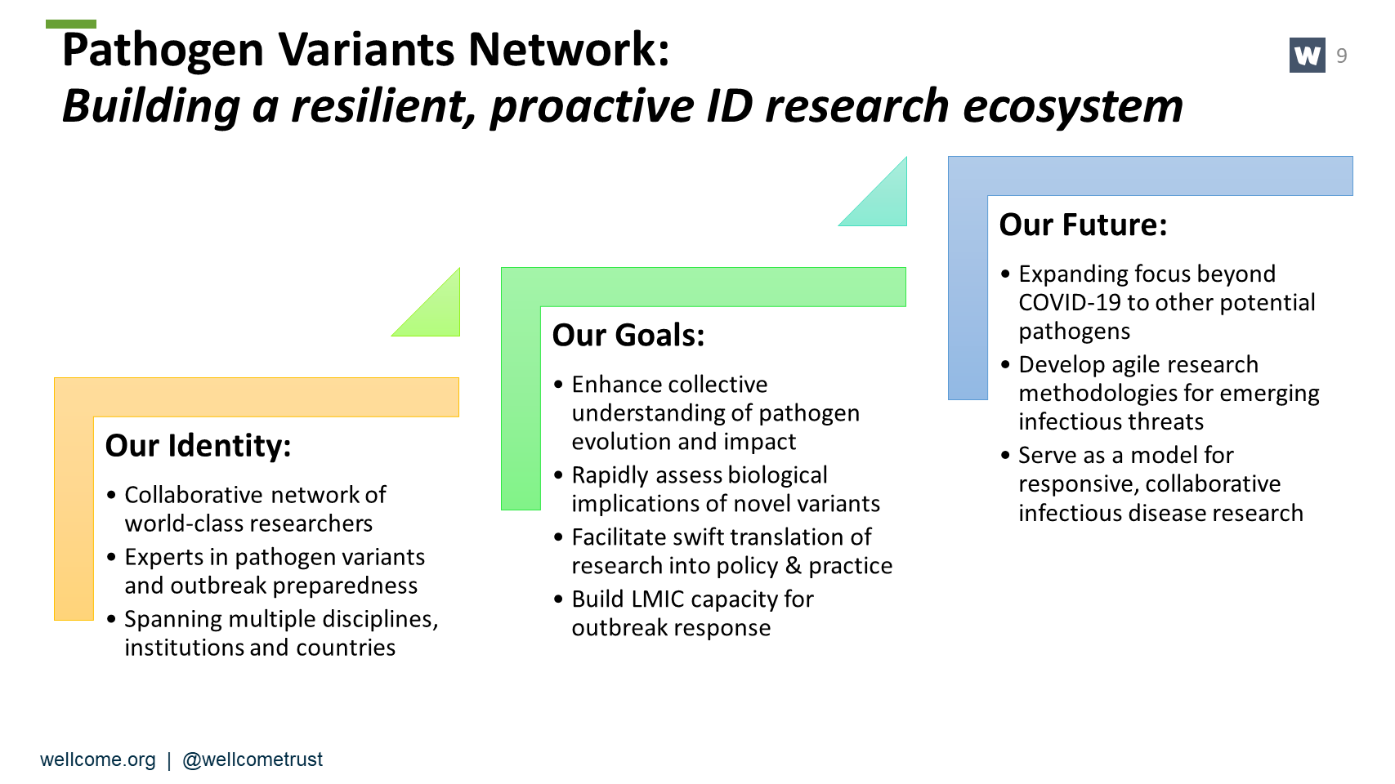

Slide 11
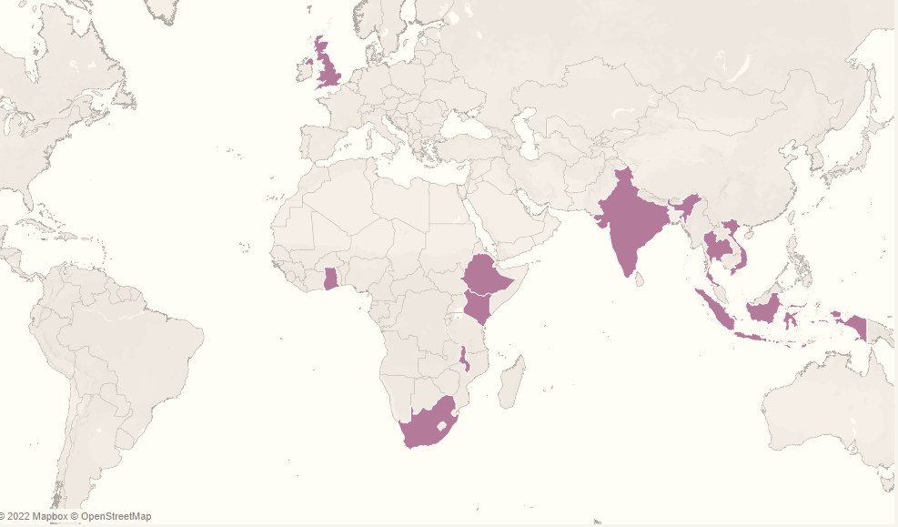
You are a global network

Slide 12

Your network, Your leadership
Take ownership:
  Propose and lead initiatives on emerging infectious threats
  Share your vision for the network's evolution
  Actively engage in shaping our collective research agenda
Drive the future:
  What emerging pathogens should we focus on?
  How can we best prepare for the next potential epidemic?
  Where can we get funding for collective proposals?
  What legacy do you want this network to leave in global health?
The Global Health Network/Wellcome
  Mere facilitators
  Provide platform for connection and collaboration
  Remove administrative and logistical burden
  Help identify potential synergies between projects
This Photo by Unknown Author is licensed under CC BY-NC

Slide 13
Plan for this year’s in-person meeting
Share research progress
Update on ongoing projects and key findings
Collaborate
Identify synergies and opportunities for joint efforts
Strengthen capacity
Shape the network's direction and impact
Enhance our collective ability to respond to emerging threats
Drive policy impact
Explore ways to translate our research into actionable policies
Plan for the future
Support early career researchers
Training session and poster presentations

Slide 14
…a year later, the world needs your work more!
Ebola, DRC
COVID-19, global
Mpox, multicounty
Ebola, Uganda
Marburg: Tanzania, Equatorial Guinea
Mpox, multicounty
H5N1, USA
Marburg
2018
2019
2022
2022
2023
2023
2024
2024
Pathogen variants network launched
Today

Slide 15
Thank you

