Slide 1
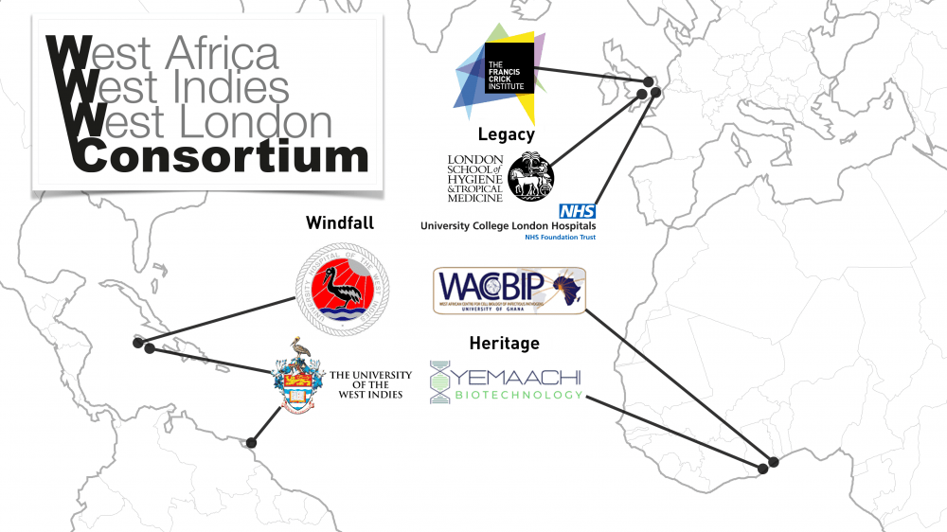

Slide 2

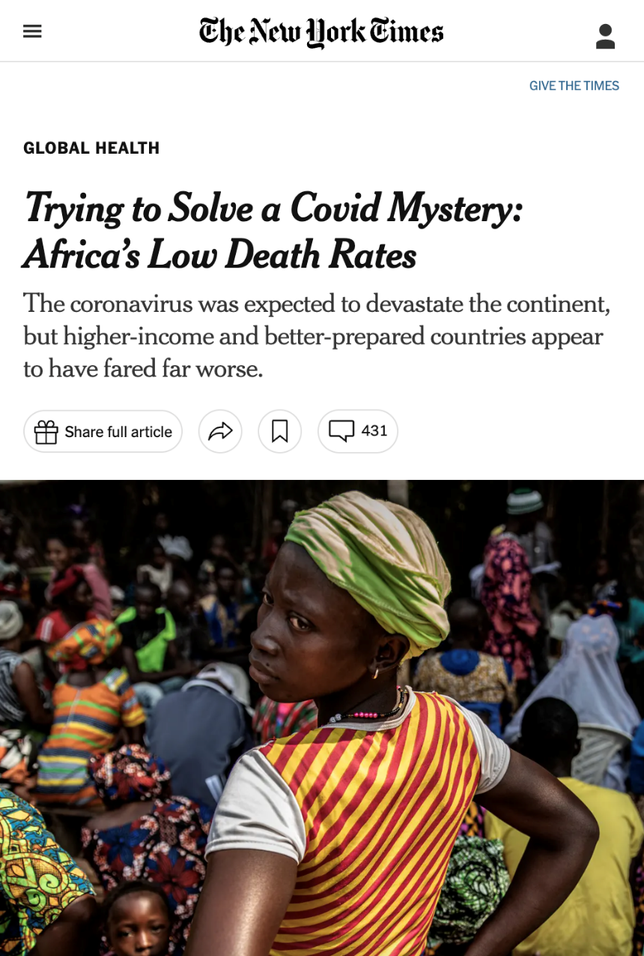
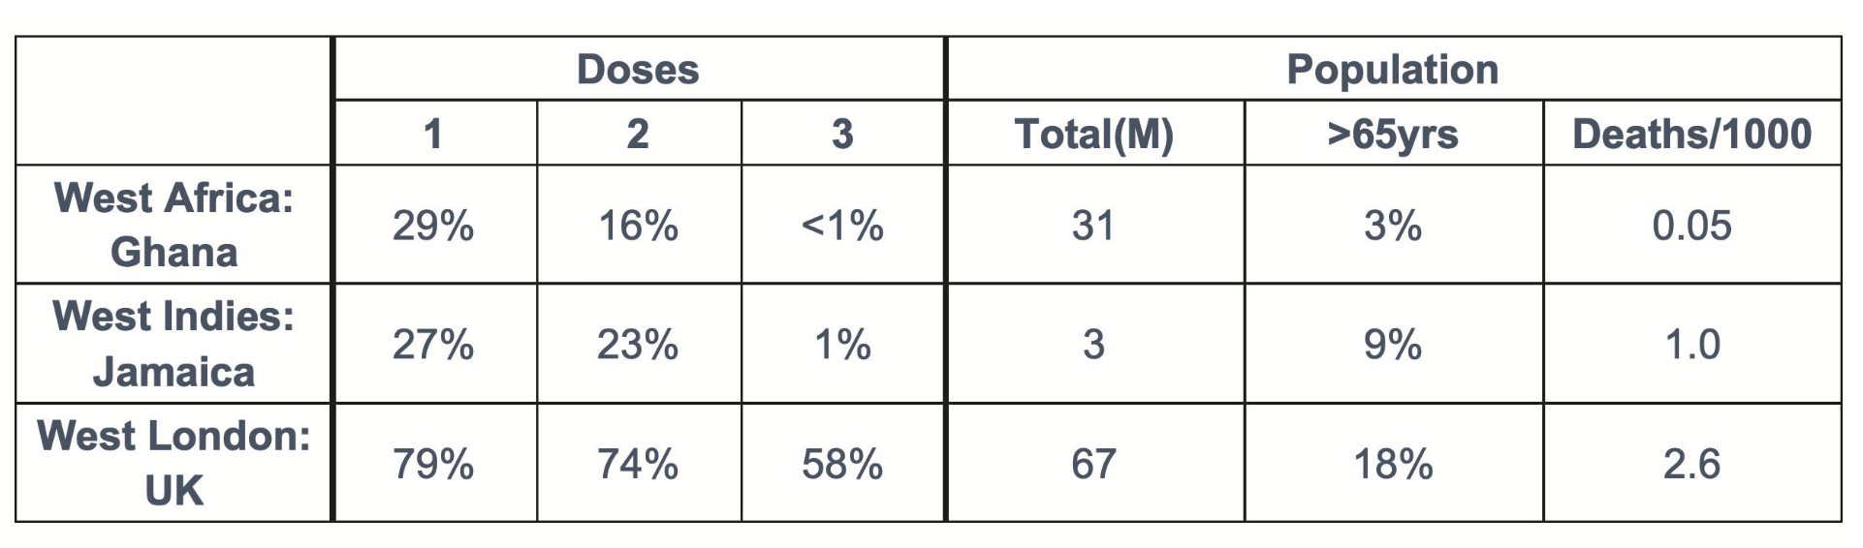

Slide 3
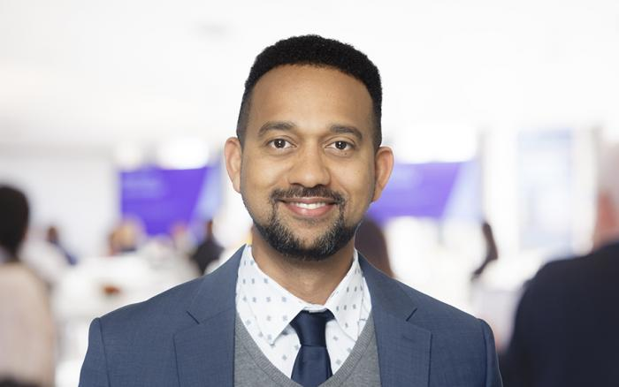
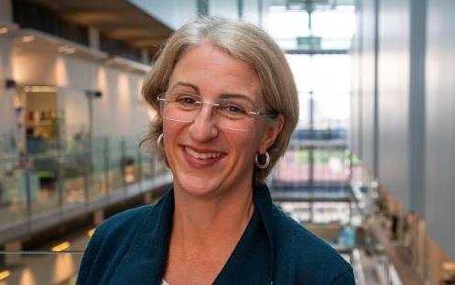
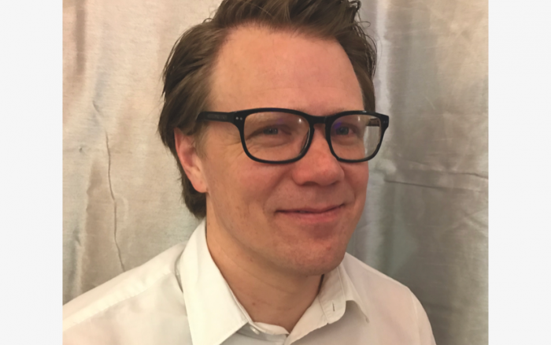





Yaw Bediako
Emma Wall
Joshua Anzinger

Slide 4
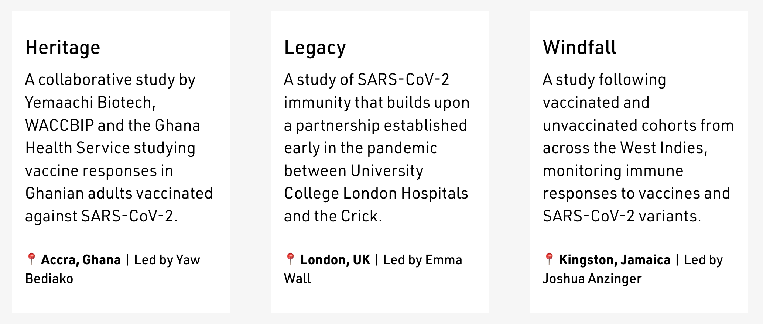

Slide 5
Aim 1: Harmonise our studies, control for mixed-ancestry,
and transfer knowledge & capacity between sites

Slide 6
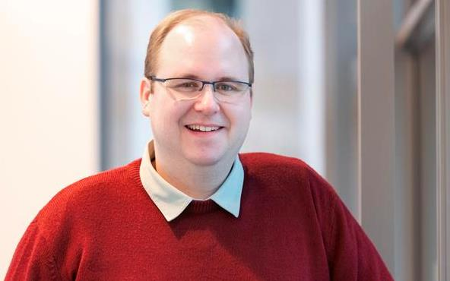

Aim 2: Test four hypotheses that may contribute to immune responses within and between our cohorts
  exposure to prior SARS-CoV-2 variants,
  to other bat & human coronaviruses
David LV Bauer
Christine VF Carrington

Slide 7
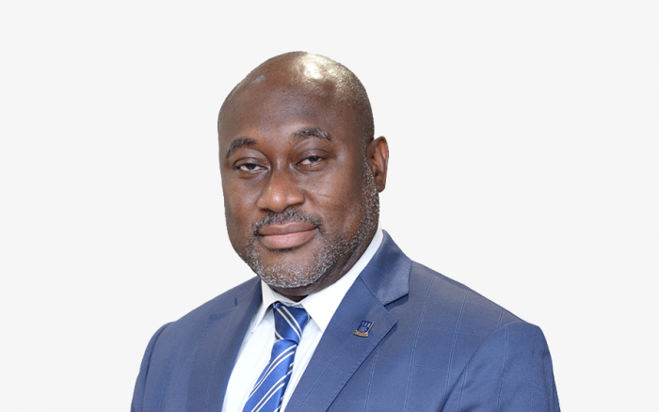


Aim 2: Test four hypotheses that may contribute to immune responses within and between our cohorts
  Malaria
  exposure,
  Host
  immunoreactivity
Gordon Awandare
Peter Quashie

Slide 8

Aim 3: Model immune responses to variants that incorporate individual-level data & apply to LMICs
Adam Kucharski

Slide 10
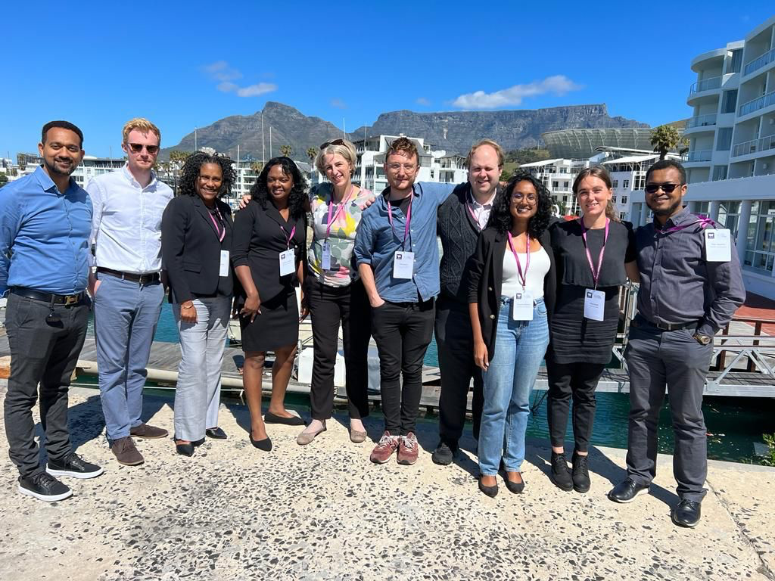

Slide 11
Pseudotype assays
Training:
February 2024

Slide 12
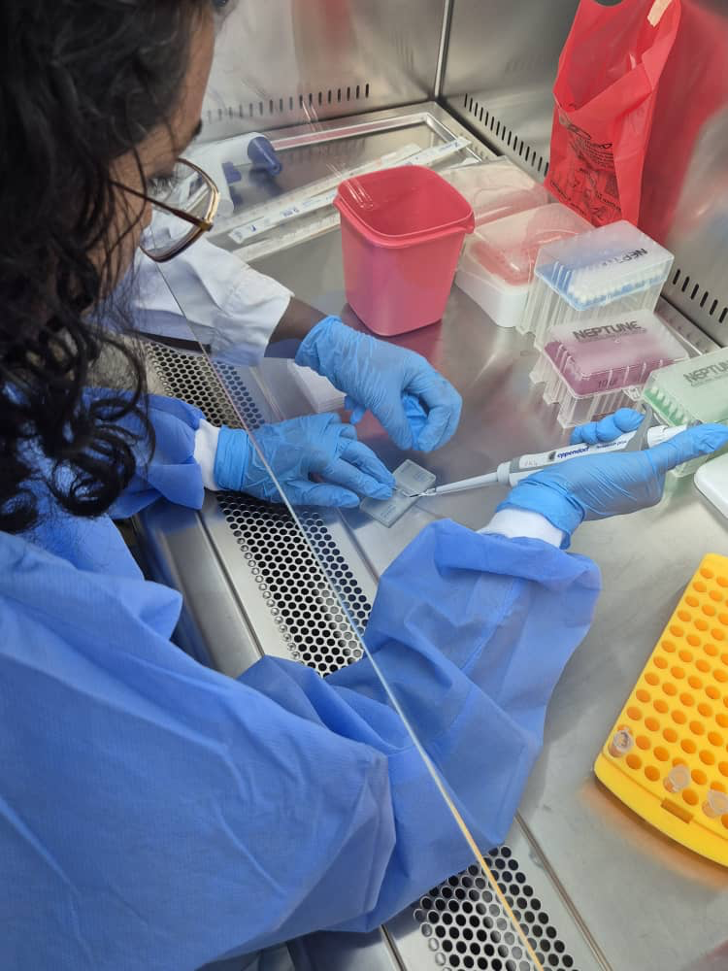
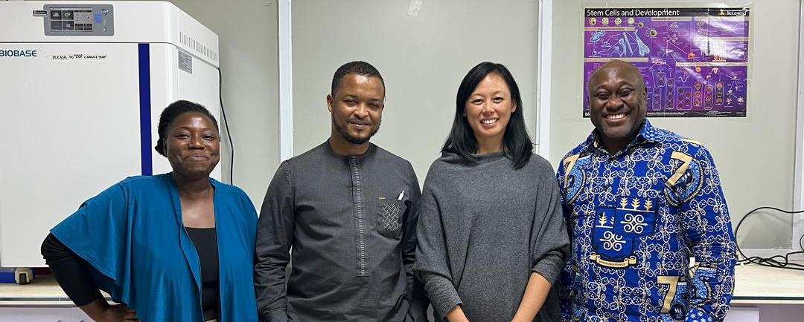
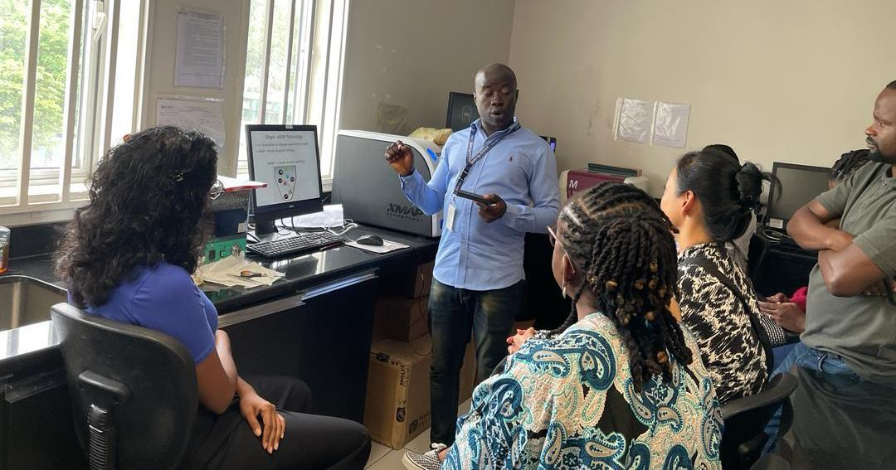
Pseudotype assays
Training:
February 2024

Slide 13
Live virus neutralisation
Training:
October 2024

Slide 14
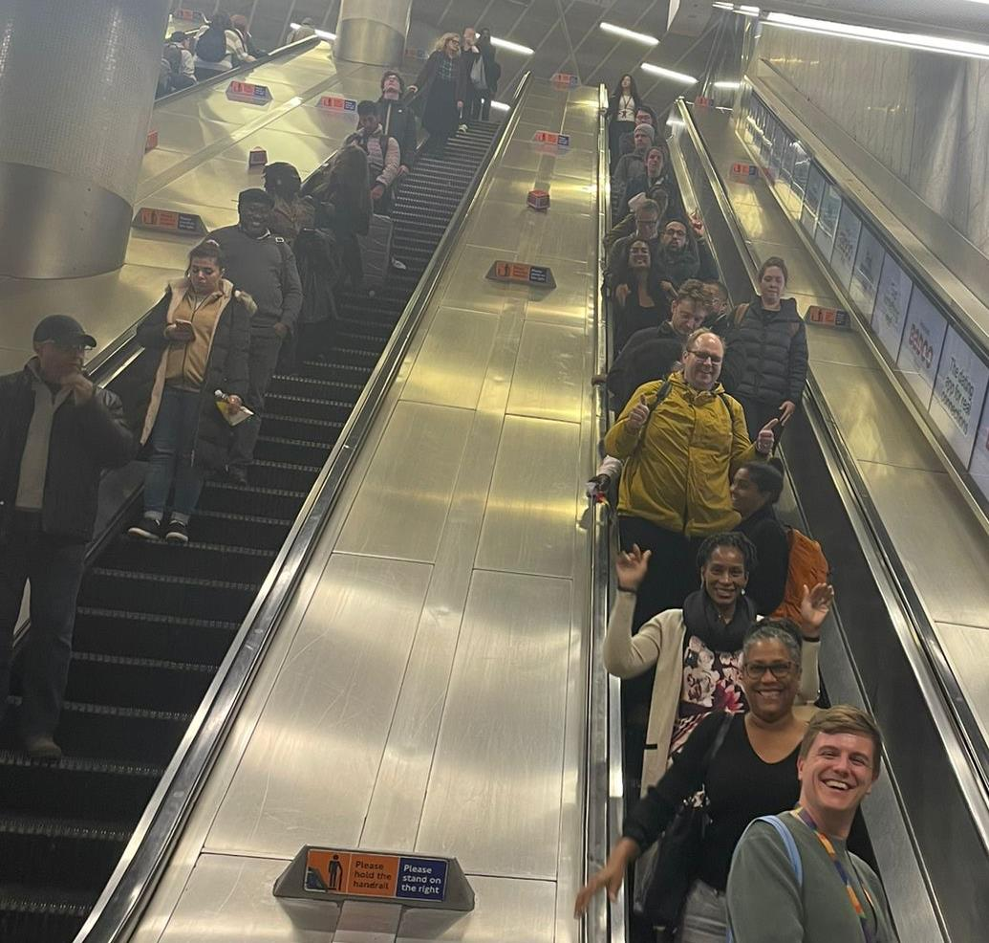
Live virus neutralisation
Training:
October 2024

Slide 15
Modelling capacity
Hosted Visit:
March 2024

Slide 16
Diagnostic-level datasets

Slide 17
Samples
Serology
Luminex
2020-21 Prospective Cohorts
Live Virus Neutralisation
Cytokines
Ghana
Jamaica
London
Pseudotype Neutralisation
Human CoV
2023-26 WWW Consortium
Pan/Bat-CoV
Anti-N/Anti-S
Synchronised Sampling:
Serum, PBMCs, Swabs, DNA, RNA
Synchronised Metadata:
Clinical history, infection surveillance
CyTOF
Malaria
Genomics
Discovery
Genotyping & HLA Typing
PhIP-Seq: Human Peptidome
Bat swabs / samples (inactivated)
Pan-CoV amplicons/metagenomics
PhIP-Seq: VirScan etc.

Slide 18
Progress on Aims
Aim 1: Harmonise our studies, control for mixed-ancestry,
and transfer knowledge & capacity between sites
Ethics amendments for harmonized studies complete
Windfall study restarted (Tamara Thompson-Emery & Josh Anzinger, UWI)
All 3 studies synchronized and recruiting (>140 participants / site)
Training & capacity transfer underway

Slide 19
Progress on Aims
Aim 2: Test four hypotheses that may contribute to
immune responses within and between our cohorts
Exposure to SARS-CoV-2 Variants
  Synthetic nanobody standard for neutralization / ELISAs distributed
  (Mary Wu & Svend Kjaer, Crick)
  Sourced local variants (A.27, Eta) & begin with neutralization assays on Legacy & Heritage cohorts (Yaw Bediako, Yemaachi)
  Monitoring new variant emergence (Wendy Barclay, G2P-GLOBAL)

Slide 20
Progress on Aims
Aim 2: Test four hypotheses that may contribute to
immune responses within and between our cohorts
Exposure to Bat & Seasonal CoVs
  Pan-CoV & metagenomics detection from local samples
  Luminex Commercial Human CoV
  Pan-CoV binding & sVNT from TAN Chee Wah (SEACOVARIANTS)
  VirScan / PhIPseq pilot (Maddie Shrotri)

Slide 21
Progress on Aims
Aim 2: Test four hypotheses that may contribute to
immune responses within and between our cohorts
Malaria Exposure & Immunoreactivity
  Luminex Malaria panel (Chris Drakeley, LSHTM)
  Luminex Human Cytokine Panel (commercial)

Slide 22
Progress on Aims
Aim 3: Model immune responses to variants that
incorporate individual-level data & apply to LMICs
Data sharing agreement & cloud platform agreements signed (Sept 2024)
Chronogram package published & tested across sites (Ed Carr, Crick/UCL)
  Greenwood et al., Bioinf Adv, 2024
Individual-level antibody trajectory models published (Kucharski, LSHTM)
  Russell et al., Lancet ID, 2024

Slide 23
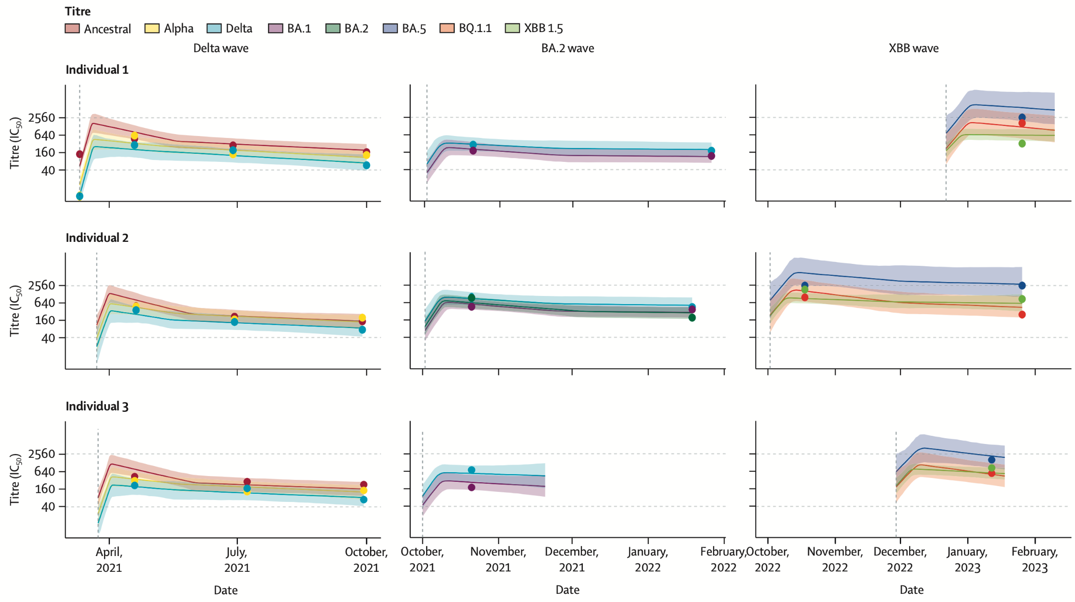
Antibody Trajectories :: Modelling
  Russell et al., Lancet ID, 2024
Notes:
Holy grail: linkage of data (clinical, virological, serological)
“Big data” style analysis

Slide 24
Antibody Trajectories :: Modelling
  Russell et al., Lancet ID, 2024
https://github.com/seroanalytics/epikinetics/
http://seroanalytics.org/epikinetics/
Alex Hill (LSHTM)
Notes:
Holy grail: linkage of data (clinical, virological, serological)
“Big data” style analysis

Slide 25
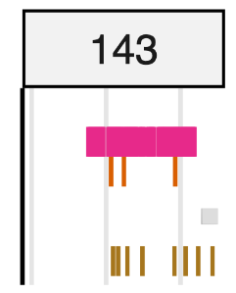
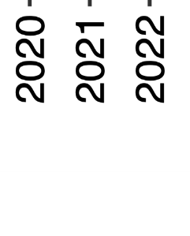

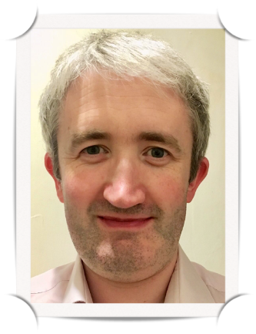

Chronogram :: Data Linkage
chronogram
ptID_1
Ed J Carr
Greenwood et al., Bioinf Adv, 2024
Notes:
Holy grail: linkage of data (clinical, virological, serological)
“Big data” style analysis

Slide 26
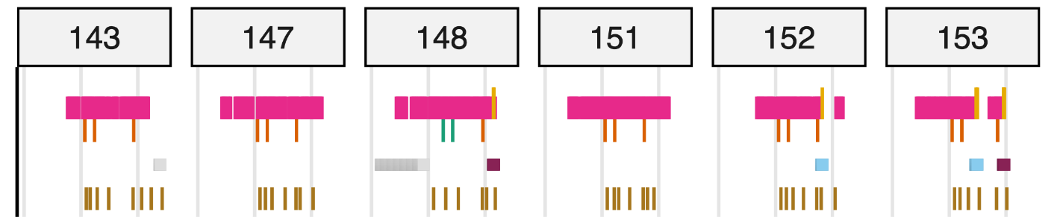




Chronogram :: Data Linkage
chronogram
ptID_1
ptID_2
ptID_3
ptID_4
ptID_5
ptID_6
Ed J Carr
Greenwood et al., Bioinf Adv, 2024
Notes:
Holy grail: linkage of data (clinical, virological, serological)
“Big data” style analysis

Slide 27
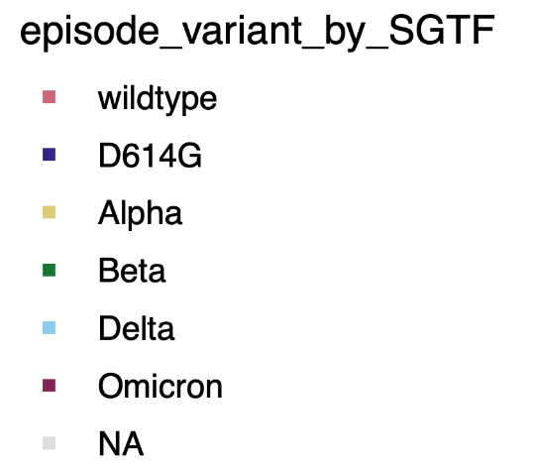
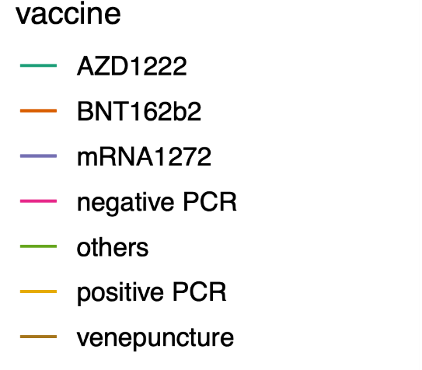
Chronogram :: Data Linkage
chronogram
ptID_1
ptID_2
ptID_3
ptID_4
ptID_5
ptID_6
Ed J Carr
Greenwood et al., Bioinf Adv, 2024
Notes:
Holy grail: linkage of data (clinical, virological, serological)
“Big data” style analysis

Slide 28
Chronogram :: Data Linkage
chronogram
ptID_1
ptID_2
ptID_3
ptID_4
ptID_5
ptID_6
Ed J Carr
Greenwood et al., Bioinf Adv, 2024
Notes:
Holy grail: linkage of data (clinical, virological, serological)
“Big data” style analysis

Slide 29
Chronogram :: Data Linkage
chronogram
ptID_1
ptID_2
ptID_3
ptID_4
ptID_5
ptID_6
Ed J Carr
Greenwood et al., Bioinf Adv, 2024
Notes:
Holy grail: linkage of data (clinical, virological, serological)
“Big data” style analysis

Slide 30
Samples
Serology
Luminex
2020-21 Prospective Cohorts
Live Virus Neutralisation
Cytokines
Ghana
Jamaica
London
Pseudotype Neutralisation
Human CoV
2023-26 WWW Consortium
Pan/Bat-CoV
Anti-N/Anti-S
Synchronised Sampling:
Serum, PBMCs, Swabs, DNA, RNA
Synchronised Metadata:
Clinical history, infection surveillance
CyTOF
Malaria
Genomics
Discovery
Genotyping & HLA Typing
PhIP-Seq: Human Peptidome
Bat swabs / samples (inactivated)
Pan-CoV amplicons/metagenomics
PhIP-Seq: VirScan etc.

Slide 31
Samples
Serology
Luminex
2020-21 Prospective Cohorts
Live Virus Neutralisation
Cytokines
Ghana
Jamaica
London
Pseudotype Neutralisation
Human CoV
2023-26 WWW Consortium
Pan/Bat-CoV
Anti-N/Anti-S
Synchronised Sampling:
Serum, PBMCs, Swabs, DNA, RNA
Synchronised Metadata:
Clinical history, infection surveillance
CyTOF
Malaria
Genomics
Discovery
Genotyping & HLA Typing
PhIP-Seq: Human Peptidome
Bat swabs / samples (inactivated)
Pan-CoV amplicons/metagenomics
PhIP-Seq: VirScan etc.

Slide 32

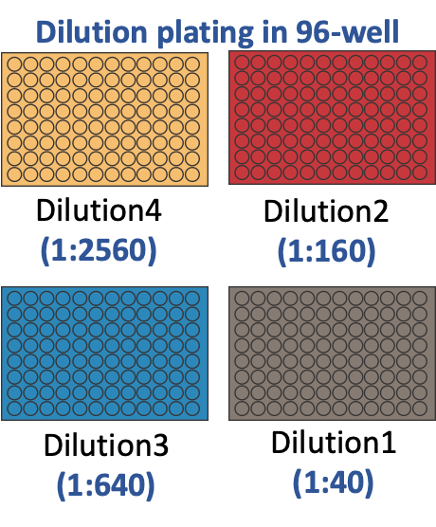
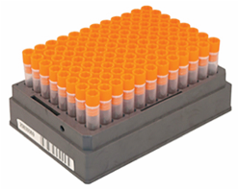
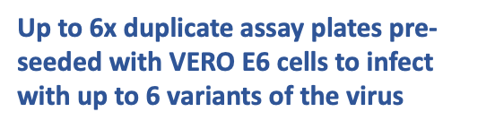

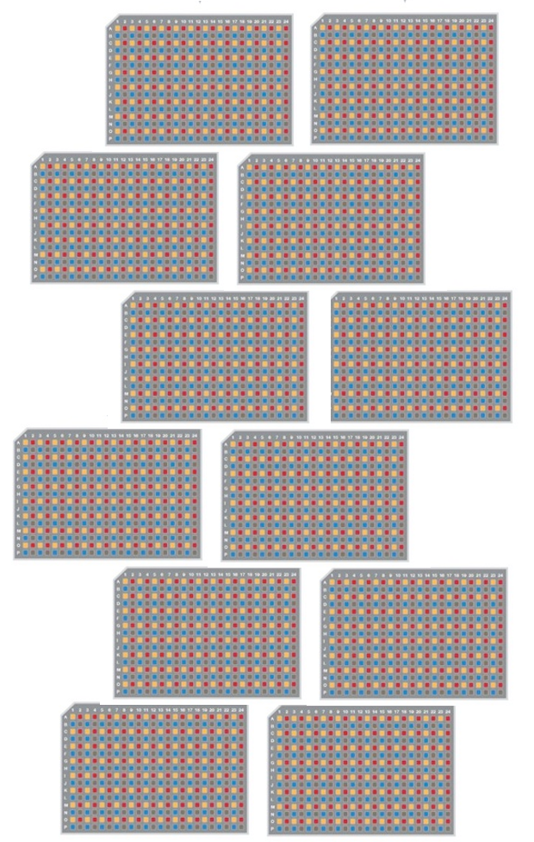

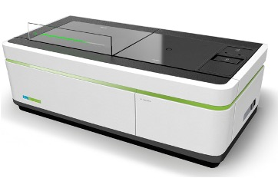
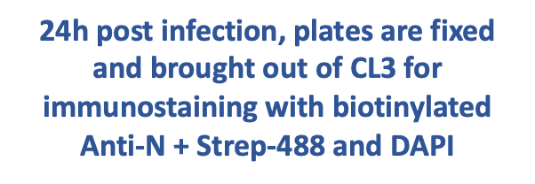

High-Throughput Live Virus Neutralisation Assay
In
Out

Slide 33
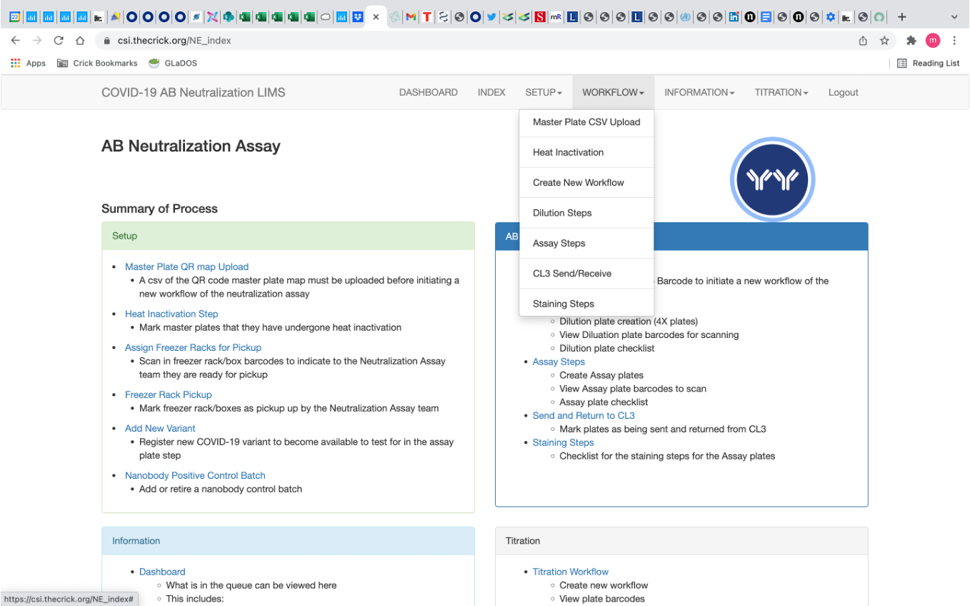
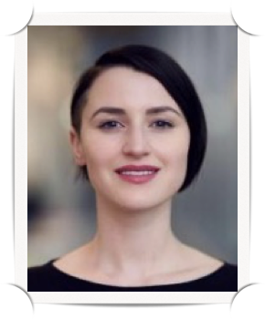
In
Chelsea Sawyer
Scientific Computing

Slide 34
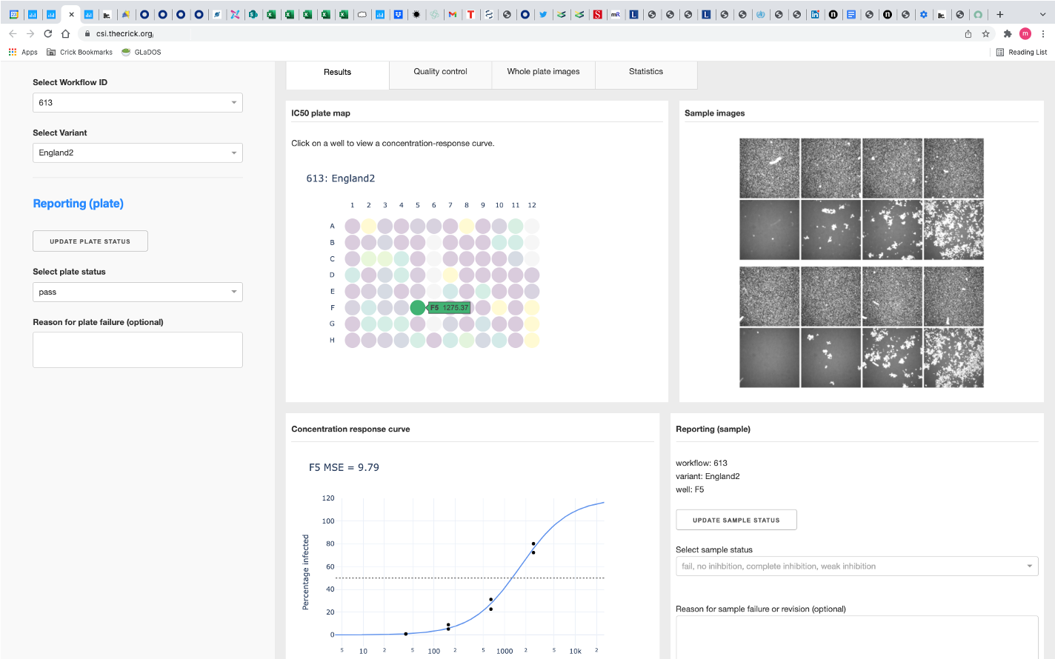
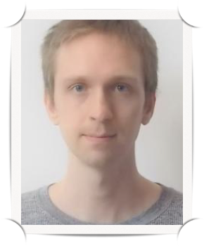
Out
Scott Warchal
High Throughput Screening

Slide 35
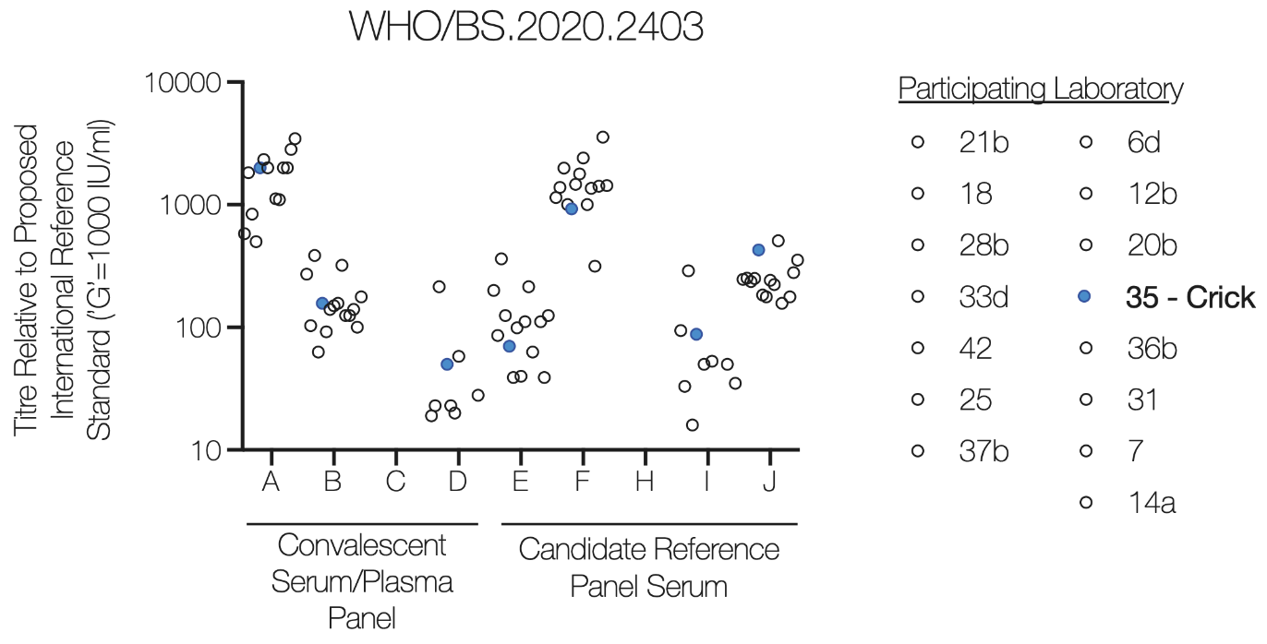
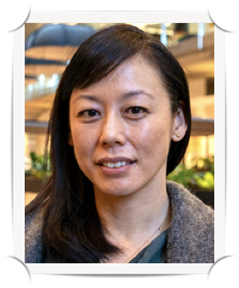
4,000 samples per week
GCP-grade assay
60,000 unique serum samples
240,000 unique results
Mary Wu
COVID Surveillance Unit

Slide 36
The LEGACY Study :: First Exposures
Notes:
Holy grail: linkage of data (clinical, virological, serological)
“Big data” style analysis

Slide 37
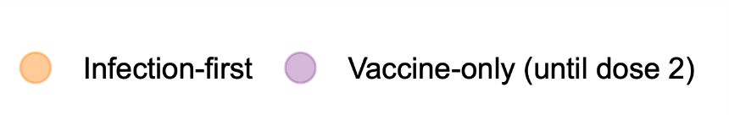
The LEGACY Study :: First Exposures
Dave Greenwood
Notes:
Holy grail: linkage of data (clinical, virological, serological)
“Big data” style analysis

Slide 38



The LEGACY Study :: First Exposures
Dave Greenwood
Notes:
Holy grail: linkage of data (clinical, virological, serological)
“Big data” style analysis

Slide 39
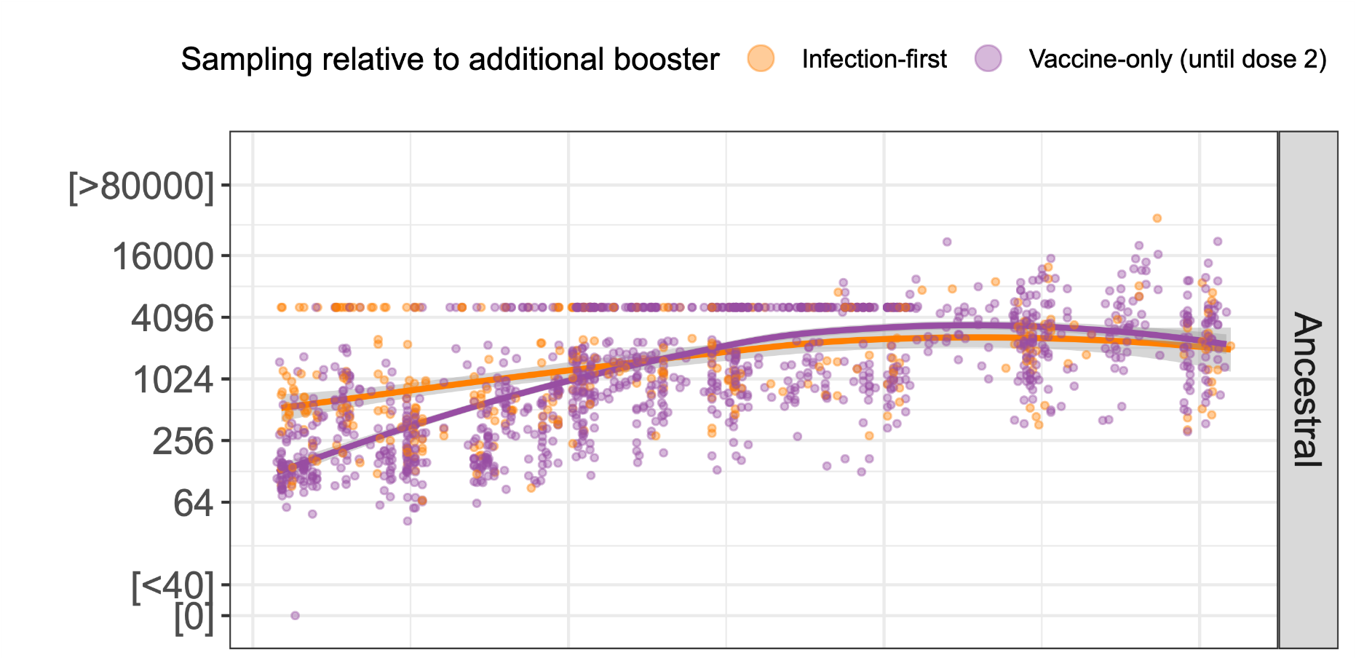
The LEGACY Study :: First Exposures
Dave Greenwood
Notes:
Holy grail: linkage of data (clinical, virological, serological)
“Big data” style analysis

Slide 40
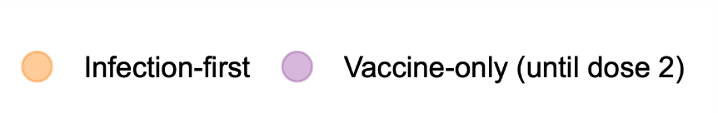
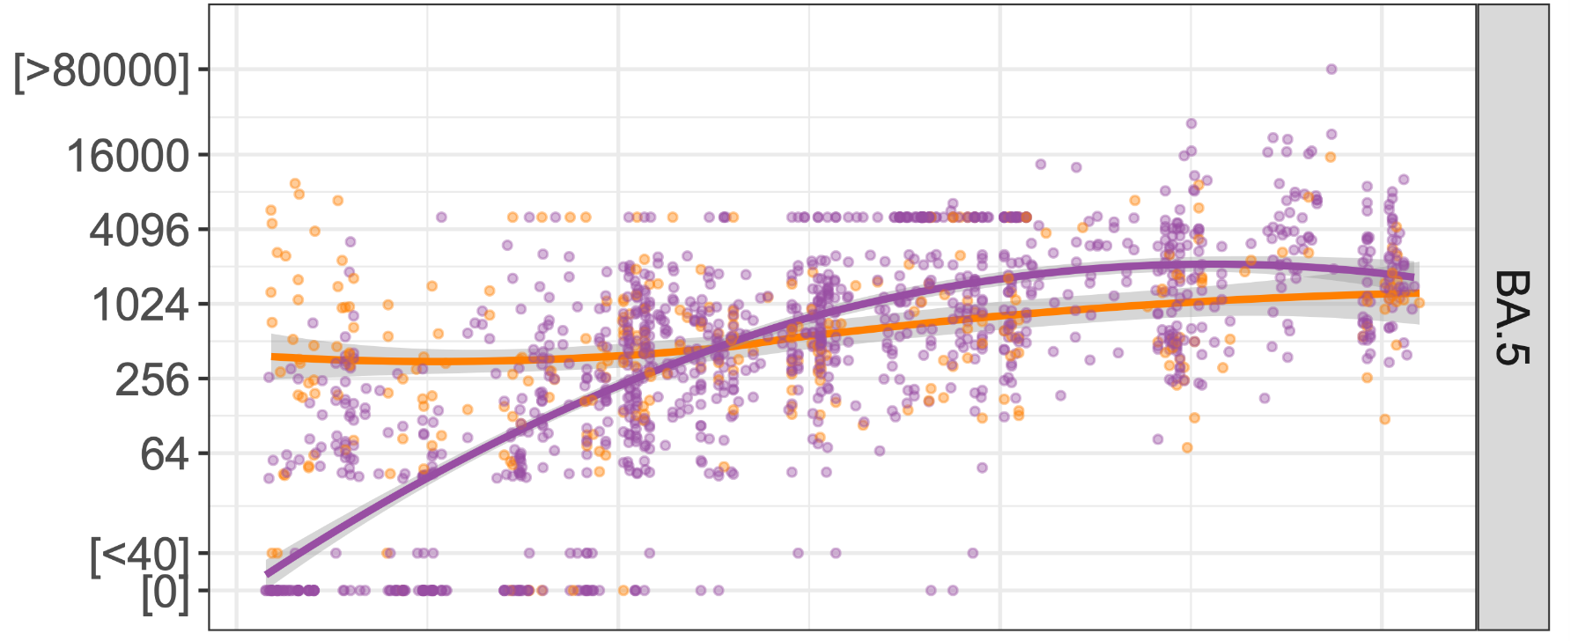
The LEGACY Study :: First Exposures
Dave Greenwood
Notes:
Holy grail: linkage of data (clinical, virological, serological)
“Big data” style analysis

Slide 41

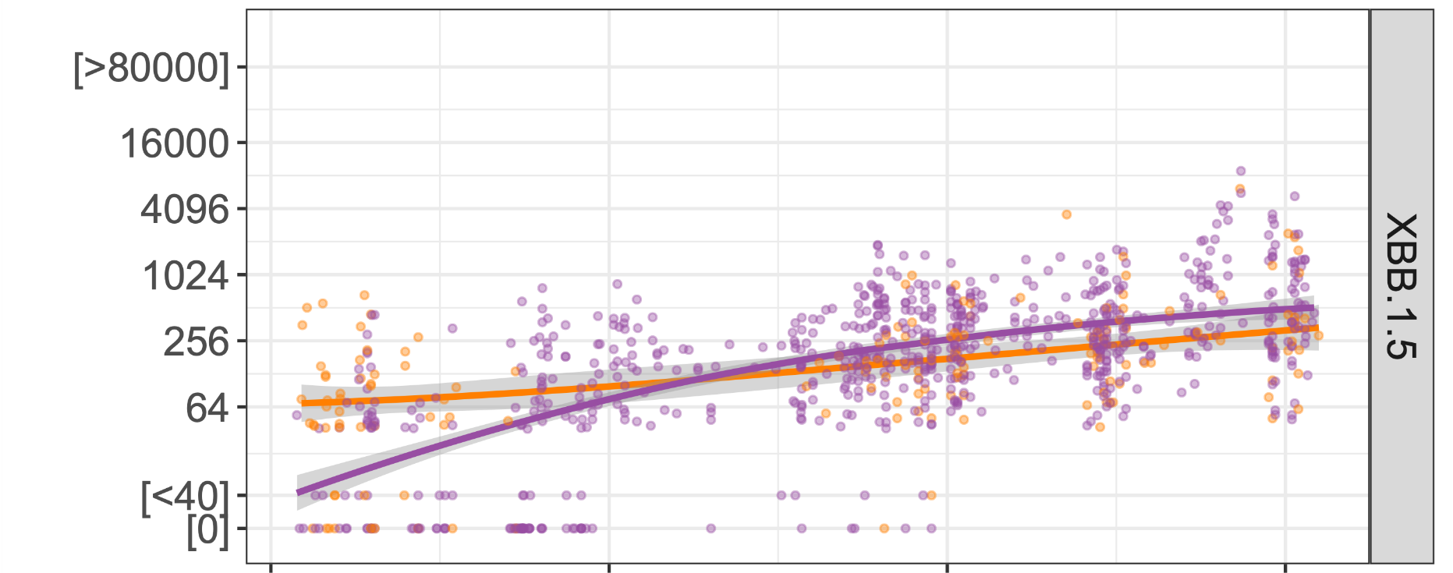
The LEGACY Study :: First Exposures
Dave Greenwood
Notes:
Holy grail: linkage of data (clinical, virological, serological)
“Big data” style analysis

Slide 42
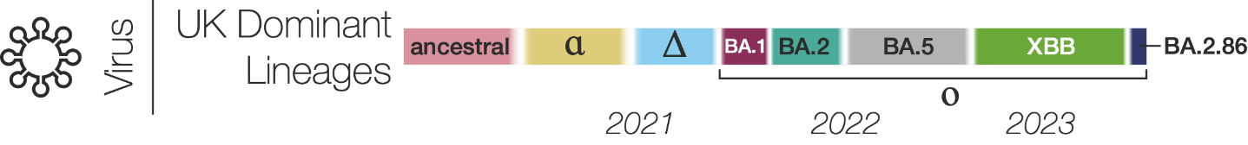
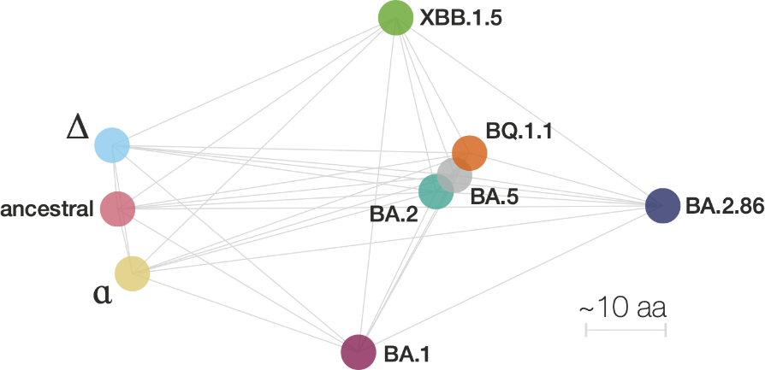
The LEGACY Study :: Dose 5
Shawe-Taylor et al.,
Lancet, 2024
Notes:
Holy grail: linkage of data (clinical, virological, serological)
“Big data” style analysis

Slide 43
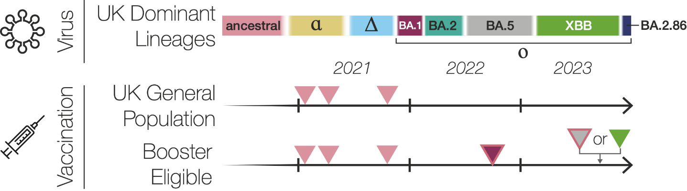
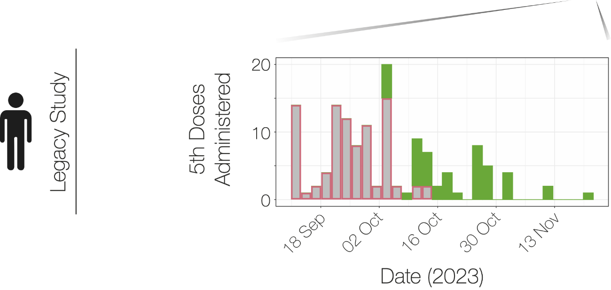
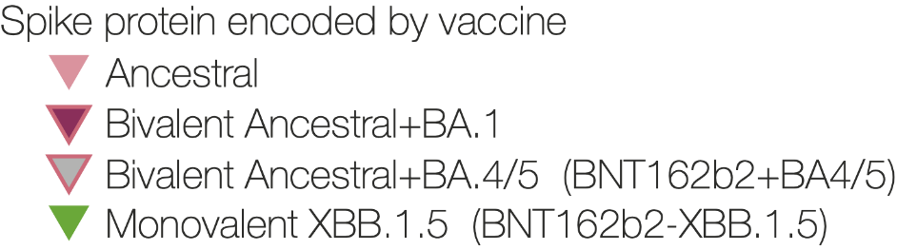
The LEGACY Study :: Dose 5
Shawe-Taylor et al.,
Lancet, 2024
Notes:
Holy grail: linkage of data (clinical, virological, serological)
“Big data” style analysis

Slide 44
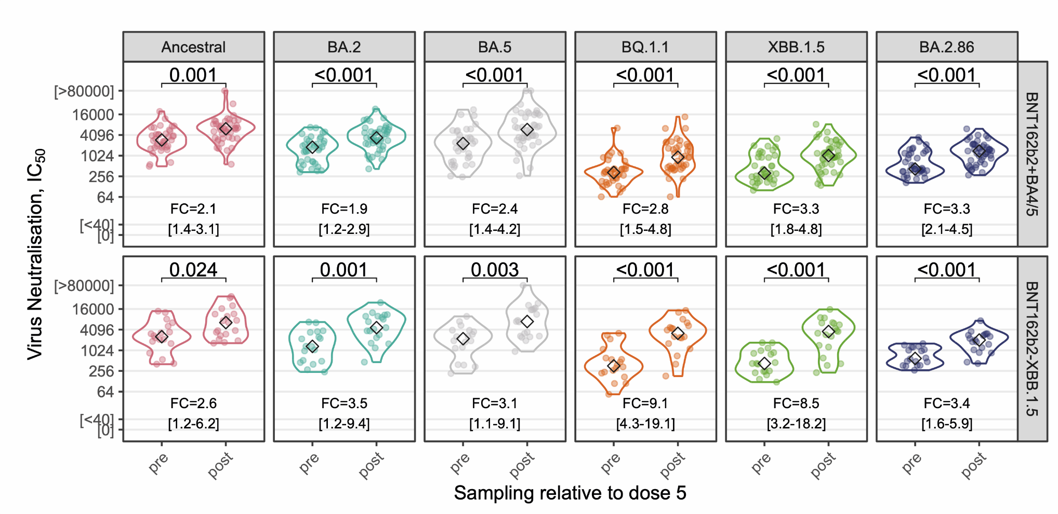
The LEGACY Study :: Dose 5
Shawe-Taylor et al.,
Lancet, 2024
Notes:
Holy grail: linkage of data (clinical, virological, serological)
“Big data” style analysis

Slide 45
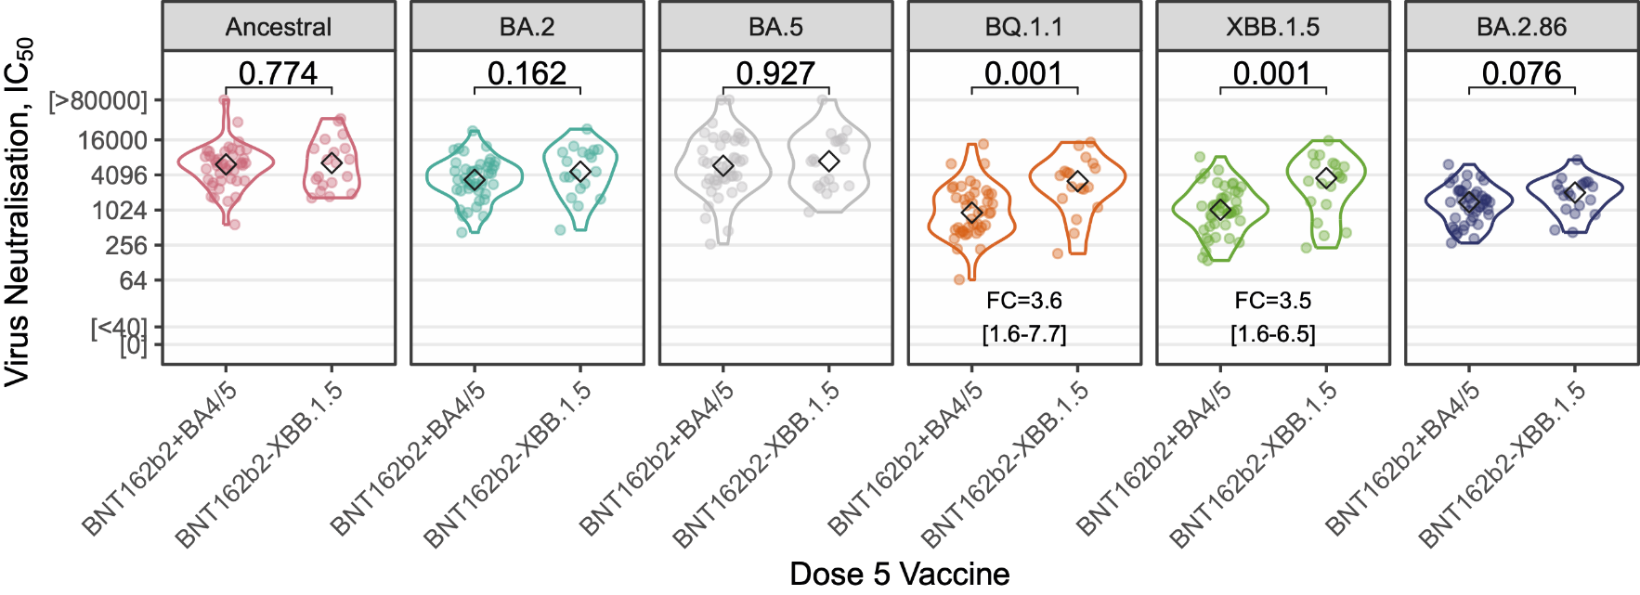
The LEGACY Study :: Dose 5
Shawe-Taylor et al.,
Lancet, 2024
Notes:
Holy grail: linkage of data (clinical, virological, serological)
“Big data” style analysis

Slide 46
WINDFall

Slide 47





Investigating SARS CoV-2 vaccine responses among Ghanaian adults
Yaw Bediako, PhD
CEO, Yemaachi Biotech
Research Fellow, WACCBIP, UG
Investor Presentation
2024

Slide 48
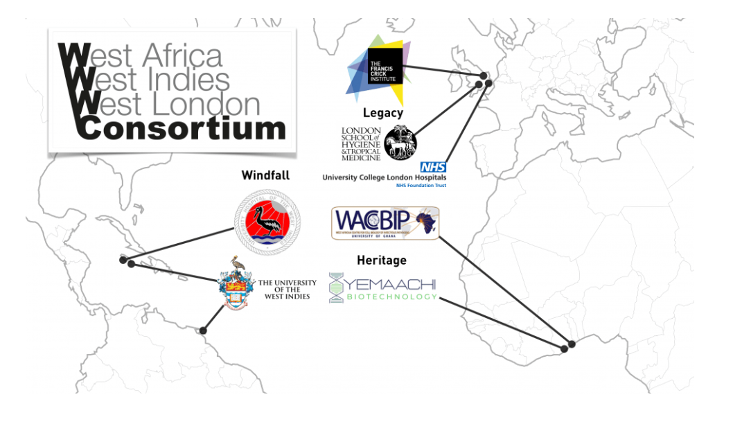


WWW

Slide 49

What determines the quality of vaccine response?
Vaccines demonstrate geographical variations in effectiveness
Differences in immune responsiveness
  Host genetics
  Environmental exposure
Can vaccines be engineered to work uniformly well everywhere?
How do COVID-19 vaccine responses differ between populations?
  What are the mechanisms that underlie such differences?

Slide 50














Investigating the mechanisms of altered vaccine responsiveness among African population
Day 0
1 week
3 weeks
6 weeks
3 months
6 months
12 months
Antibodies
Cytokines
T cell responses
Transcriptomics

Slide 51
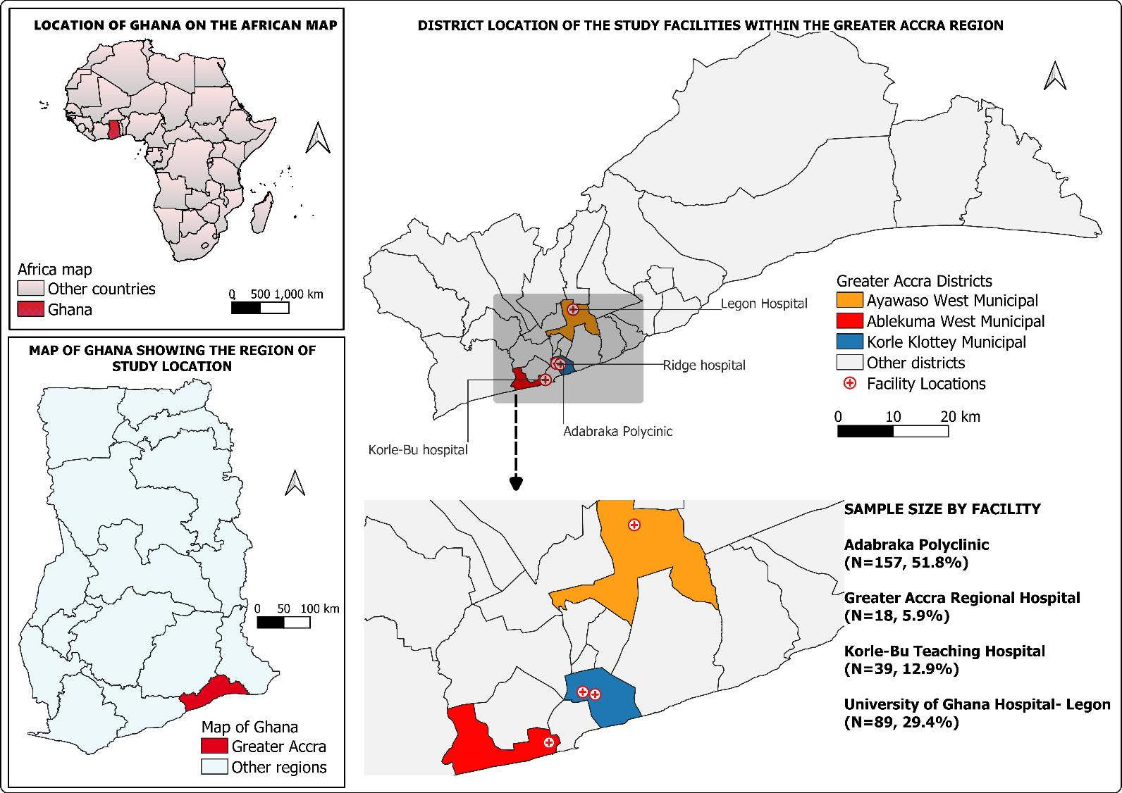
Study location:
Greater Accra Region
301 adults recruited
  7 timepoints completed
  >15,000 samples collected

Slide 52

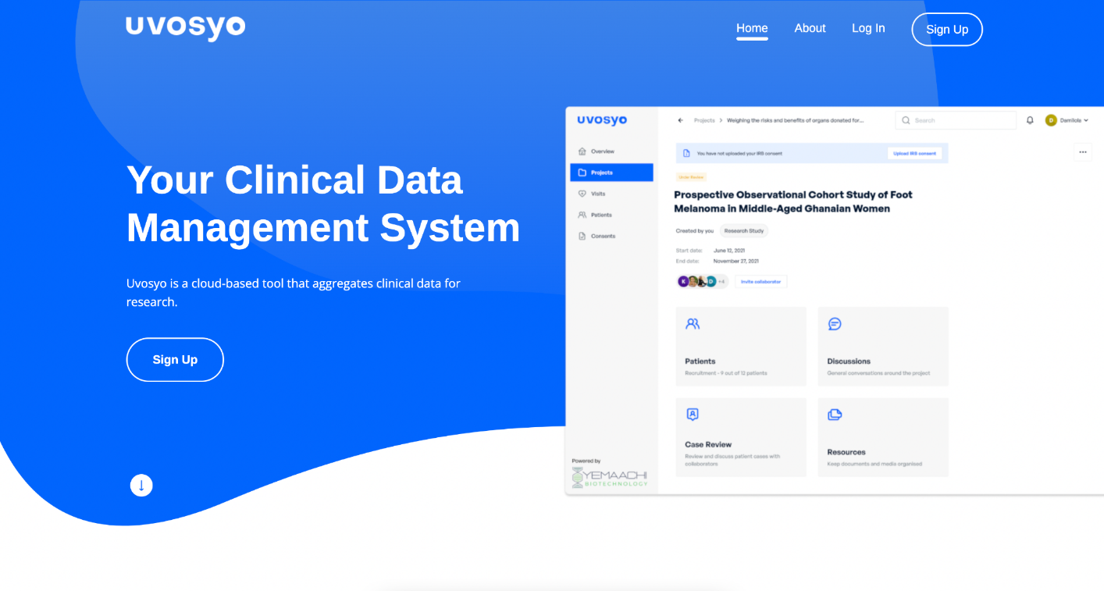
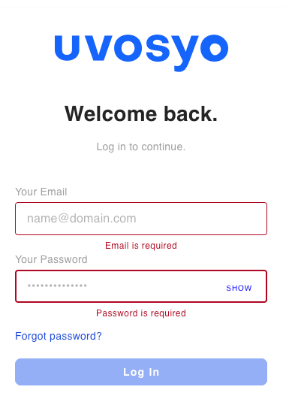
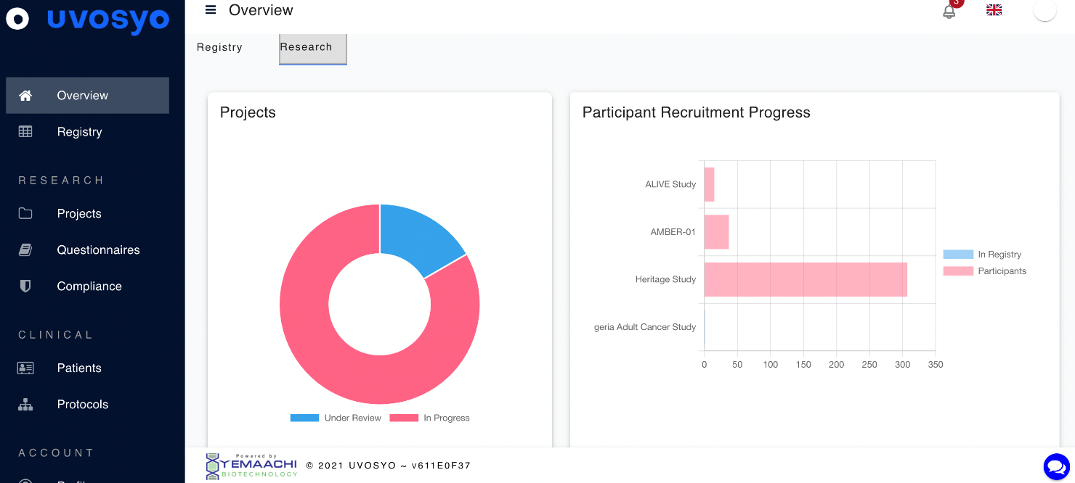

Slide 53

Demographic Descriptions (n =301)
Sex of participants
Female
Male
Age group
18-19
20-29
30-39
40-49
50-59
60+
Employment status
Formal
Informal
Student
Unemployed
Number of COVID-19 symptoms at baseline
None
1 symptom
2 symptoms
Co-morbidity
No
Yes
Auto-immune disease
No
Yes
Vaccine type
Astrazeneca
Pfizer BioNTech

Slide 54

SARS CoV-2 Positivity declines over time post vaccination

Slide 55

SARS CoV-2 Positivity declines over time post vaccination
Notes:
“leadership” do transformative science on the ground but also the experience, networks, and skills to anchor health and development R&D in their communities, design or co-design projects with local and global partners, and mobilize key institutions in their countries.

Slide 56

Cohort positivity mimics national trends

Slide 57

Cohort positivity less associated with global trends

Slide 58

Participants much more likely to be positive within first 3 weeks post vaccination

Slide 59

Factors associated with SARS CoV-2 positivity at time of vaccination

Slide 60

High percentage of prior SARS-CoV-2 exposure in Heritage
Serum level

Slide 61

Neutralisation titres boosted upon vaccination
Virus neutralization (IC 50)

Slide 62


Comparison between Heritage (Ghana) and Legacy (UK)
Heritage
Legacy
Heritage
Virus neutralization (IC 50)
Jan 2021
Jan 2023
Jul 2021
Jan 2022
Jul 2022
Legacy

Slide 63

Comparison between Heritage (Ghana) and Legacy study (UK)
Baseline
Month 3
Month 6
Month 12
Wild-type
A.27
Eta
Delta
Omicron BA.2
Heritage
Legacy
Heritage
Legacy
Heritage
Legacy
Heritage
Legacy

Slide 64


Neutralising antibody kinetics depends on previous exposure
aNP
aNN

Slide 65

Prior exposure explains differences between Heritage and Legacy
Adults in Ghana generated higher and more durable neutralising antibody titres following primary course COVID-19 vaccination than matched UK adults

Slide 66
On going work:
Determine the dynamics of the cellular responses to COVID-19 vaccine among Ghanaian vaccinees and compare these responses with those found in UK vaccinees
  Ex-vivo immunophenotyping
  Transcriptomic profiling
  Single cell sequencing; T and B cell receptor sequencing
Assess the impact of host genetic diversity on innate immune activation

Slide 67


Possible link between Malaria and lower COVID-19 mortality

Slide 68



Hot off the press:
Kesego Tapela
WACCBIP PhD (2024)

Slide 69



Recent malaria exposure associated with asymptomatic COVID-19

Slide 70











Thank YOU !!! – All study participants
Eliza Mari Kwesi-Maliepaard
Yakubu Alhasan
Joyce Ngoi
Aida Manu
Emmanuella Amoako
Seth Agyemang
HERITAGE Study Team
Peter Quashie & Lab
Joyce Ngoi & NGS lab
Kesego Tapela
Gordon Awandare
Emma Wall
Edward Carr
Mary Wu
David Bauer
Jean Langhorne
LEGACY Study team

Slide 71








Join us in building a global biotech company headquartered in Africa
Innovation shaped by Africa, for the World
@YemaachiBio
Yemaachi Biotech
www.yemaachi.com
Yemaachi Copyright 2023

Slide 72


Tapela et al.

