Slide 1






SEACOVARIANTS
Public Engagement
SCOPE
Dr. Mary Chambers
Head of Public and Community Engagement OUCRU
SCOPE@oucru.org

Slide 2
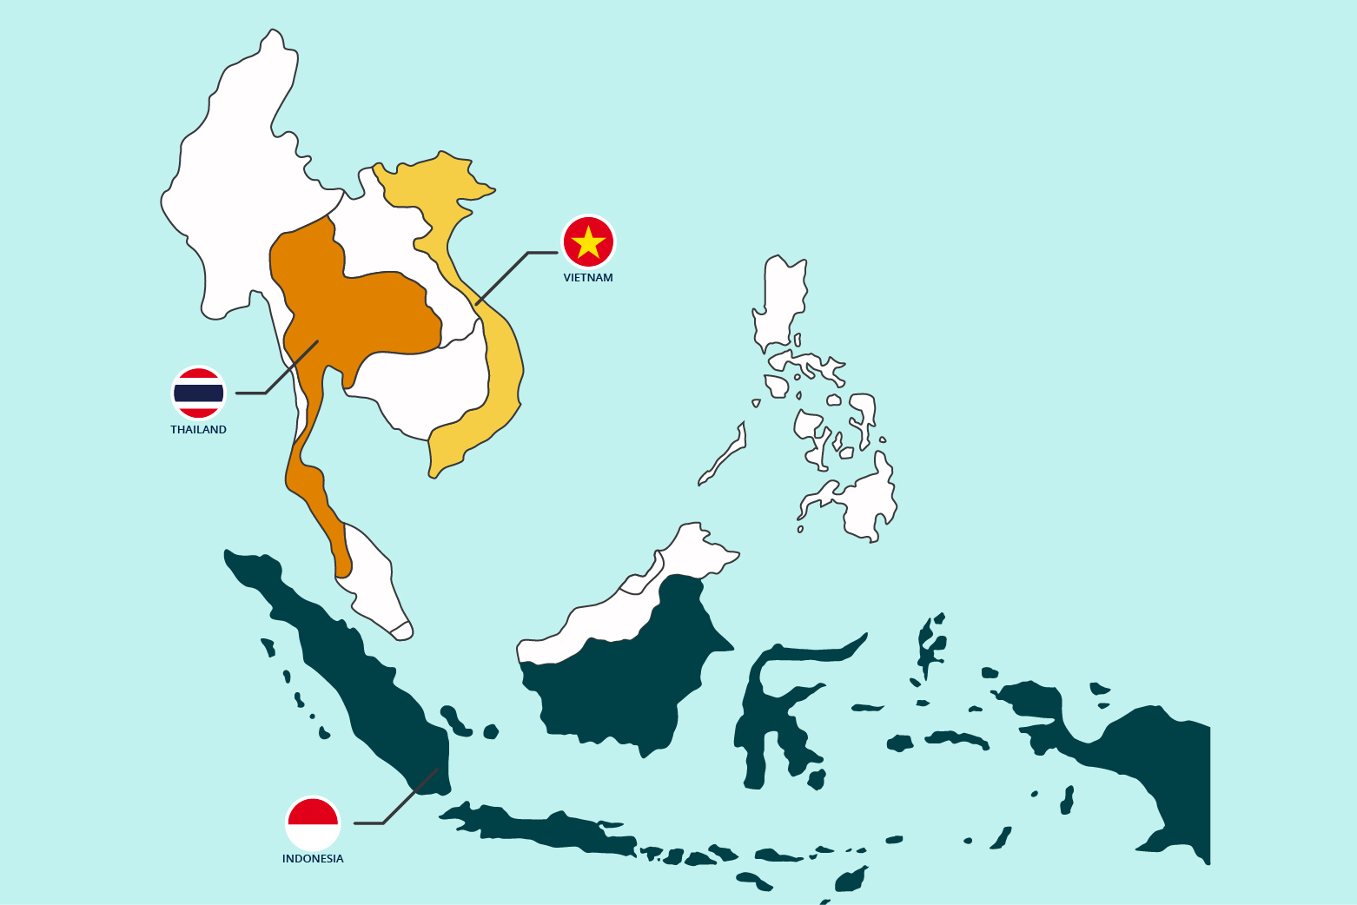
SCOPE
Hướng tiếp cận đa ngành
Embed public voices in the SEACOVARIENTS research approach
SCOPE -
Oxford University Clinical Research Units (OUCRU) in Vietnam & Indonesia, and
Mahidol Oxford Research Unit (MORU) Thailand
Strengthen Researcher-Policy/Practioner partnerships for pandemic preparedness
Develop platforms that involve the public, especially young people, in pandemic preparedness

Slide 3
Objective 1: Engaging key stakeholders to identify:
- Who played significant roles in public communication during the COVID19 pandemic (mapping)
- Who were most affected by the COVID19 pandemic, and which were the hard-to-reach groups
- How do policy makers/public health/ media want to work with researchers to better support their outbreak responses
Objective 2: Engagement framework
- Co-develop a framework that maps hard-to-reach groups and effective engagement/communication approaches for future outbreaks
Objective 3: Youth involvement
- Develop platforms for engaging young people in pandemic preparedness
Objectives

Slide 4
Key activities
Youth involvement: SCOPE framework development, participatory action research, youth-led engagement
1. Stakeholder mapping
5. Activities for further involvement with the key stakeholders
Country specific actions
4. Create an engagement framework
Identify potential stakeholders, including influential individuals and hard-to-reach groups
Capture key influential groups, hard-to-reach groups, their concerns, and engagement approaches
2. Stakeholder meetings -participatory mapping and analysis
3. Literature review
6. Review and report
Discussions with the stakeholder groups to identify who are other key stakeholders & what are their primary interests
Identify appropriate goals and engagement approaches that respond to the stakeholder’s concerns. Stakeholders’ concerns are issues that related to engagement and communication around pandemic and pandemic preparedness
SCOPE framework in SEA
Thailand, Indonesia and Vietnam contexts
Case study on youth involvement
SCOPE engagement teams: Thailand: MORU Indonesia: OUCRU Vietnam: OUCRU

Slide 5

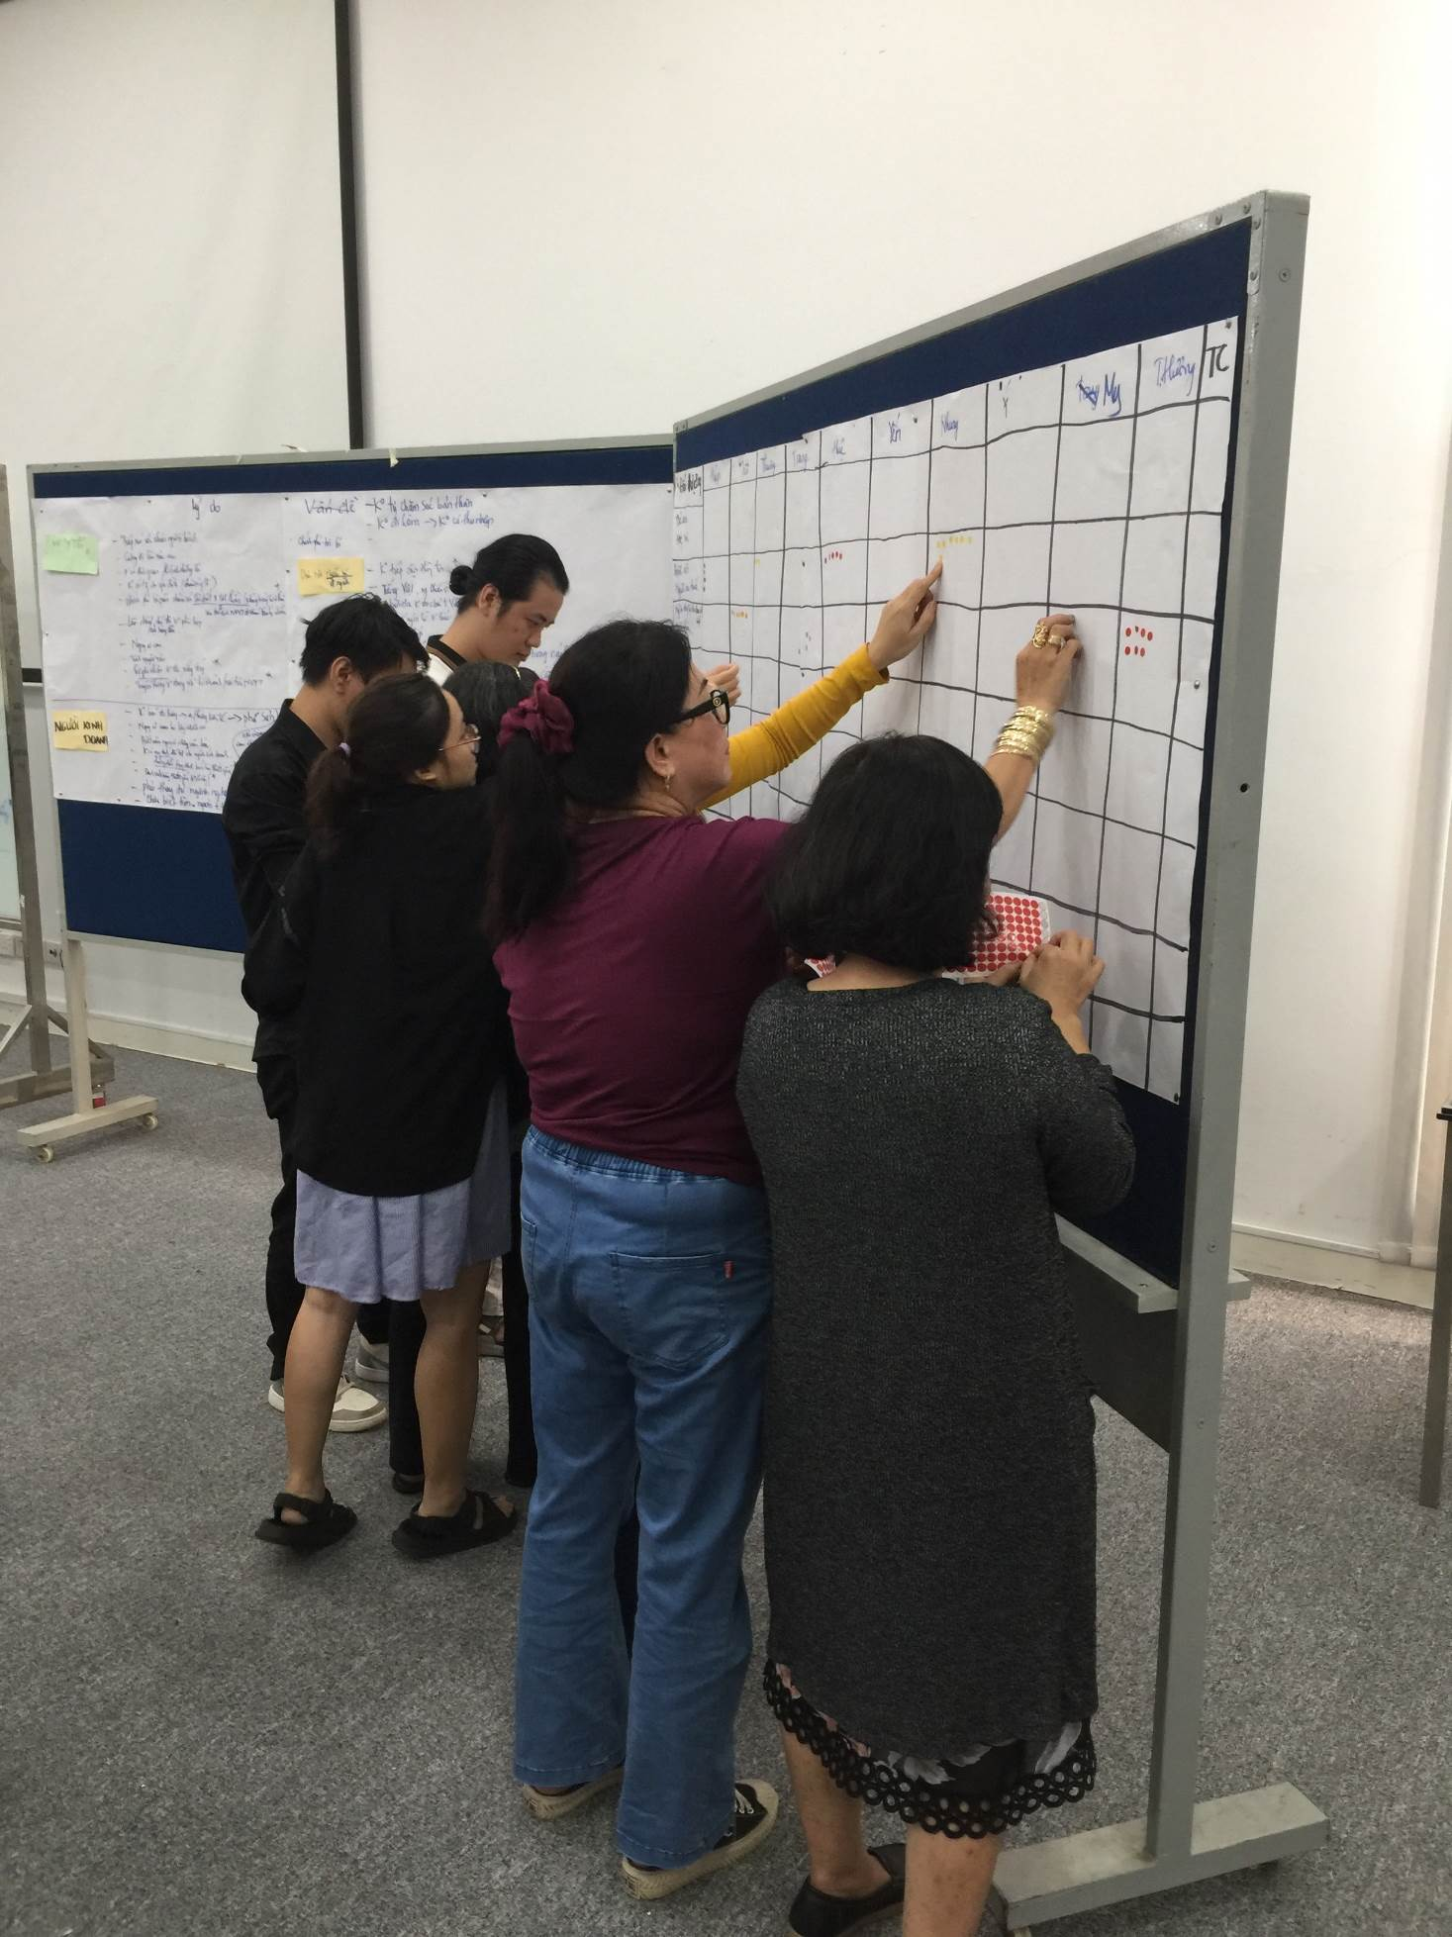
Outbreak Communication & Engagement Framework
A framework/tool that identifies key stakeholders involved in disease outbreaks.
          Individuals who played significant roles in managing and/or responding to public health communication & policies
      Impacted groups by the pandemic, in particular hard-to-reach/under served groups
      Identifies potential engagement approaches for more effective outbreak communication with the public, and in particular, hard-to-reach groups

Slide 6

SCOPE Outbreak Communication & Engagement Framework
A Tool For -
Science communicators, media practitioners, public health professionals
To help them recognise key stakeholders they should prioritise to engage with for effective public health communication strategies around an outbreak
Policy makers
To support design of activities promoting public understanding on pandemic preparedness and outbreak prevention
Communication during outbreaks
To help them consider engagement approaches that they could either include in their study design or use to engage with the public on an outbreak
Health researchers
Community-based and youth-led organisations
To help them identify ways of involving community and young people in public health programmes, health research activities

Slide 7
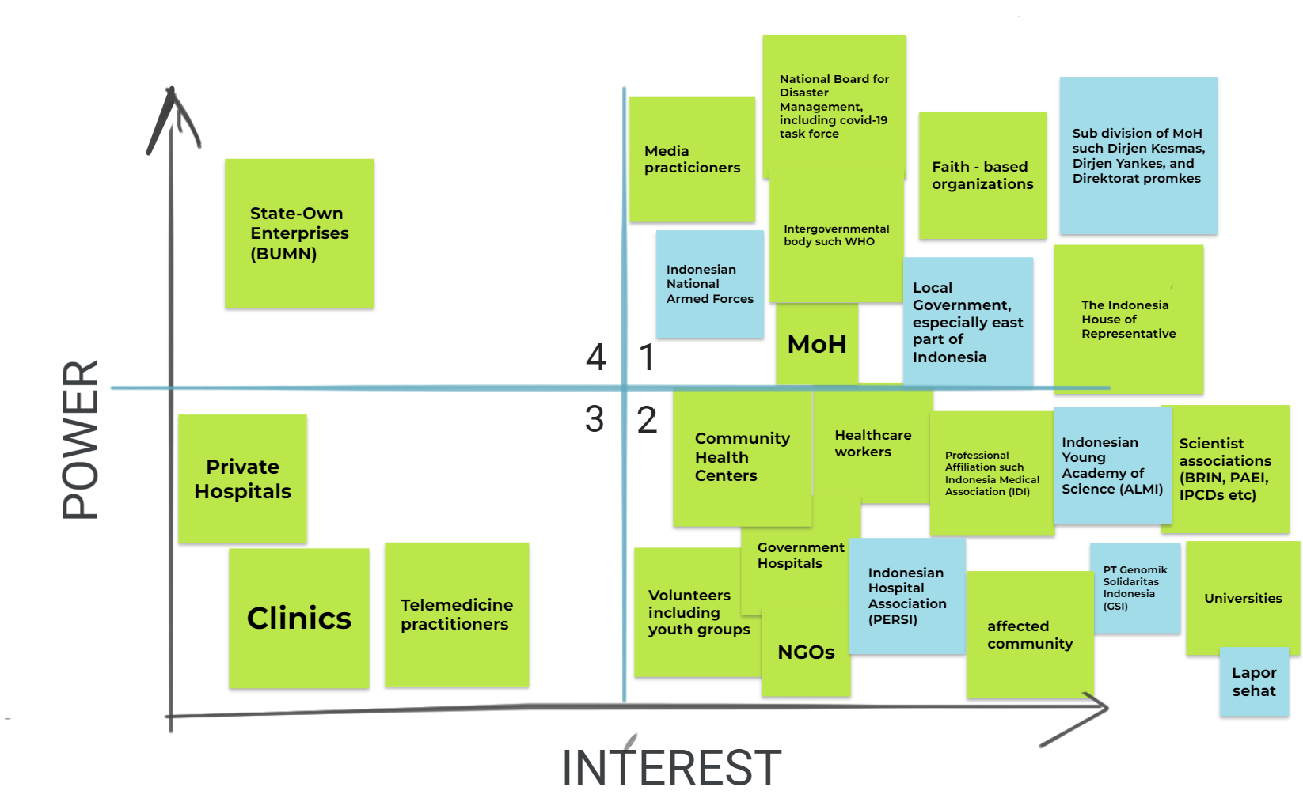
STEP 1: Stakeholder mapping
Identifying key actors during the COVID-19 pandemic
Stakeholder map from Indonesia

Slide 8
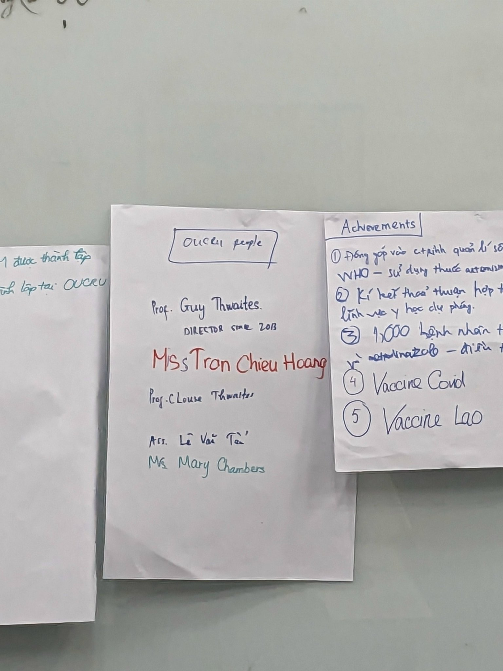
Step 2. Stakeholder meetings
A series of meetings with groups identified in Step 1 with the aim of:
Validating the stakeholder maps
Analyze communication roles during outbreaks
Identifying how researchers can support policy makers
Identify the communities that were most affected during the COVID-19 pandemic and those which were the hardest to reach with communications
Identify potential ways of engaging these communities in future outbreaks.

Slide 9
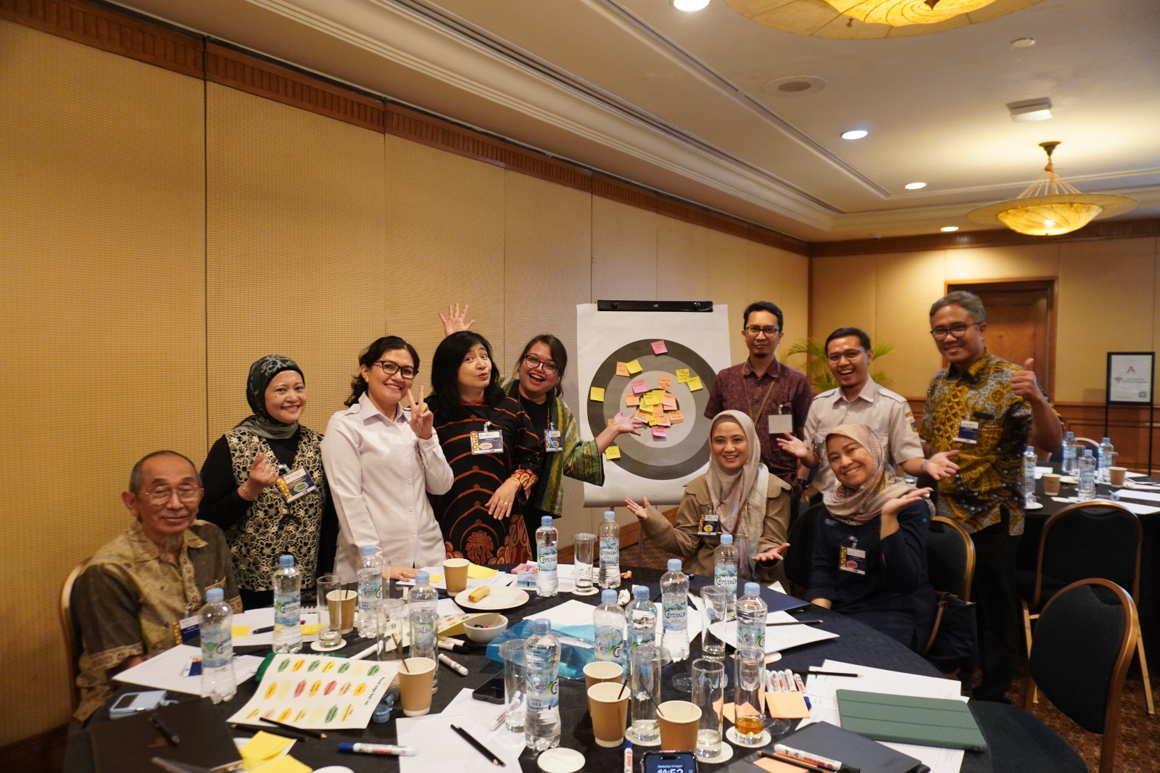

1st Stakeholder Workshop, Jakarta, Indonesia:
“Enhancing communication effectiveness to Address future outbreaks in Indonesia”
26 representatives from:
Ministry of Health, Provincial Health Office, Ministry of Communication & Information, WHO Indonesia, primary health centres, public laboratories, academics, iNGOs, journalists and COVID-19 volunteers
Co-hosted by Lapor Sehat (Citizen Empowerment for Humanity Foundation): a citizen reporting platform launched in March 2020 to facilitate the sharing of information about C19.

Slide 10
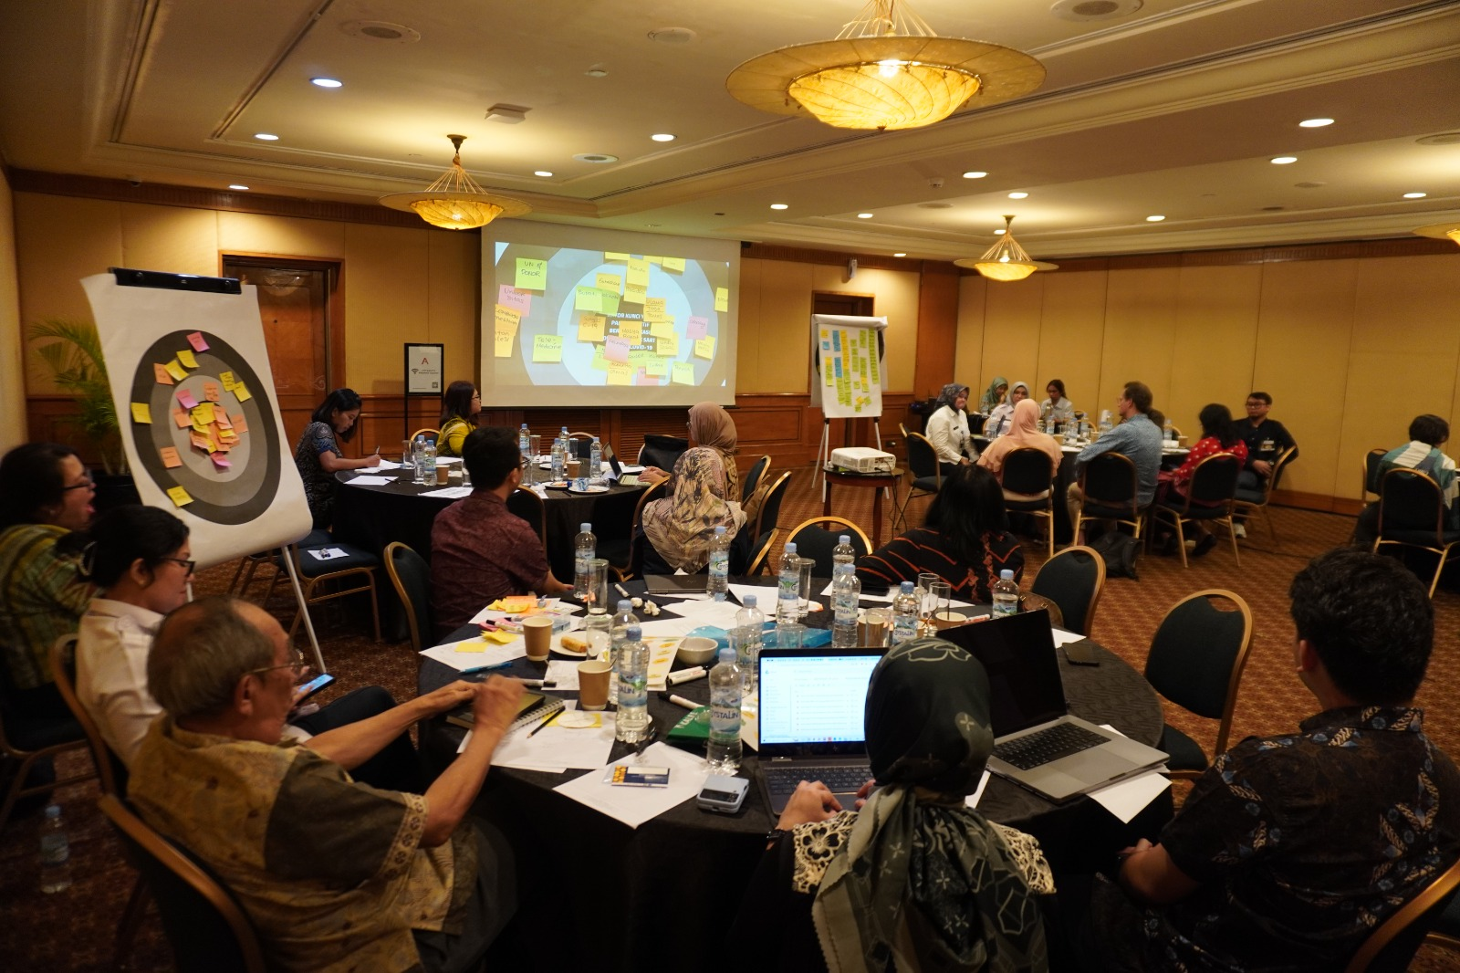
Who were the main actors in communications during C19 in Indonesia and what were their main concerns?
Which key actors were most effective in communicating during the pandemic?
Who were the hard-to-reach communities and individuals?

Slide 11
Senior stakeholder meeting in Vietnam
What was you / your organization’s role during the COVID-19 pandemic
17 participants who held senior positions and responsible for COVID19 response in their organisations.
From 4 sectors: Media & Press, Healthcare, Education, and Community-based organisations
What are your concerns regarding future emerging infectious diseases?
In your opinion, what types of support can scientists offer to address those concerns?
Which other stakeholders should be included in discussions about emerging infectious disease outbreak preparedness and responses?
Notes:
Participants in this workshop also gave feedback for YARG’s “HTR” results

Slide 12
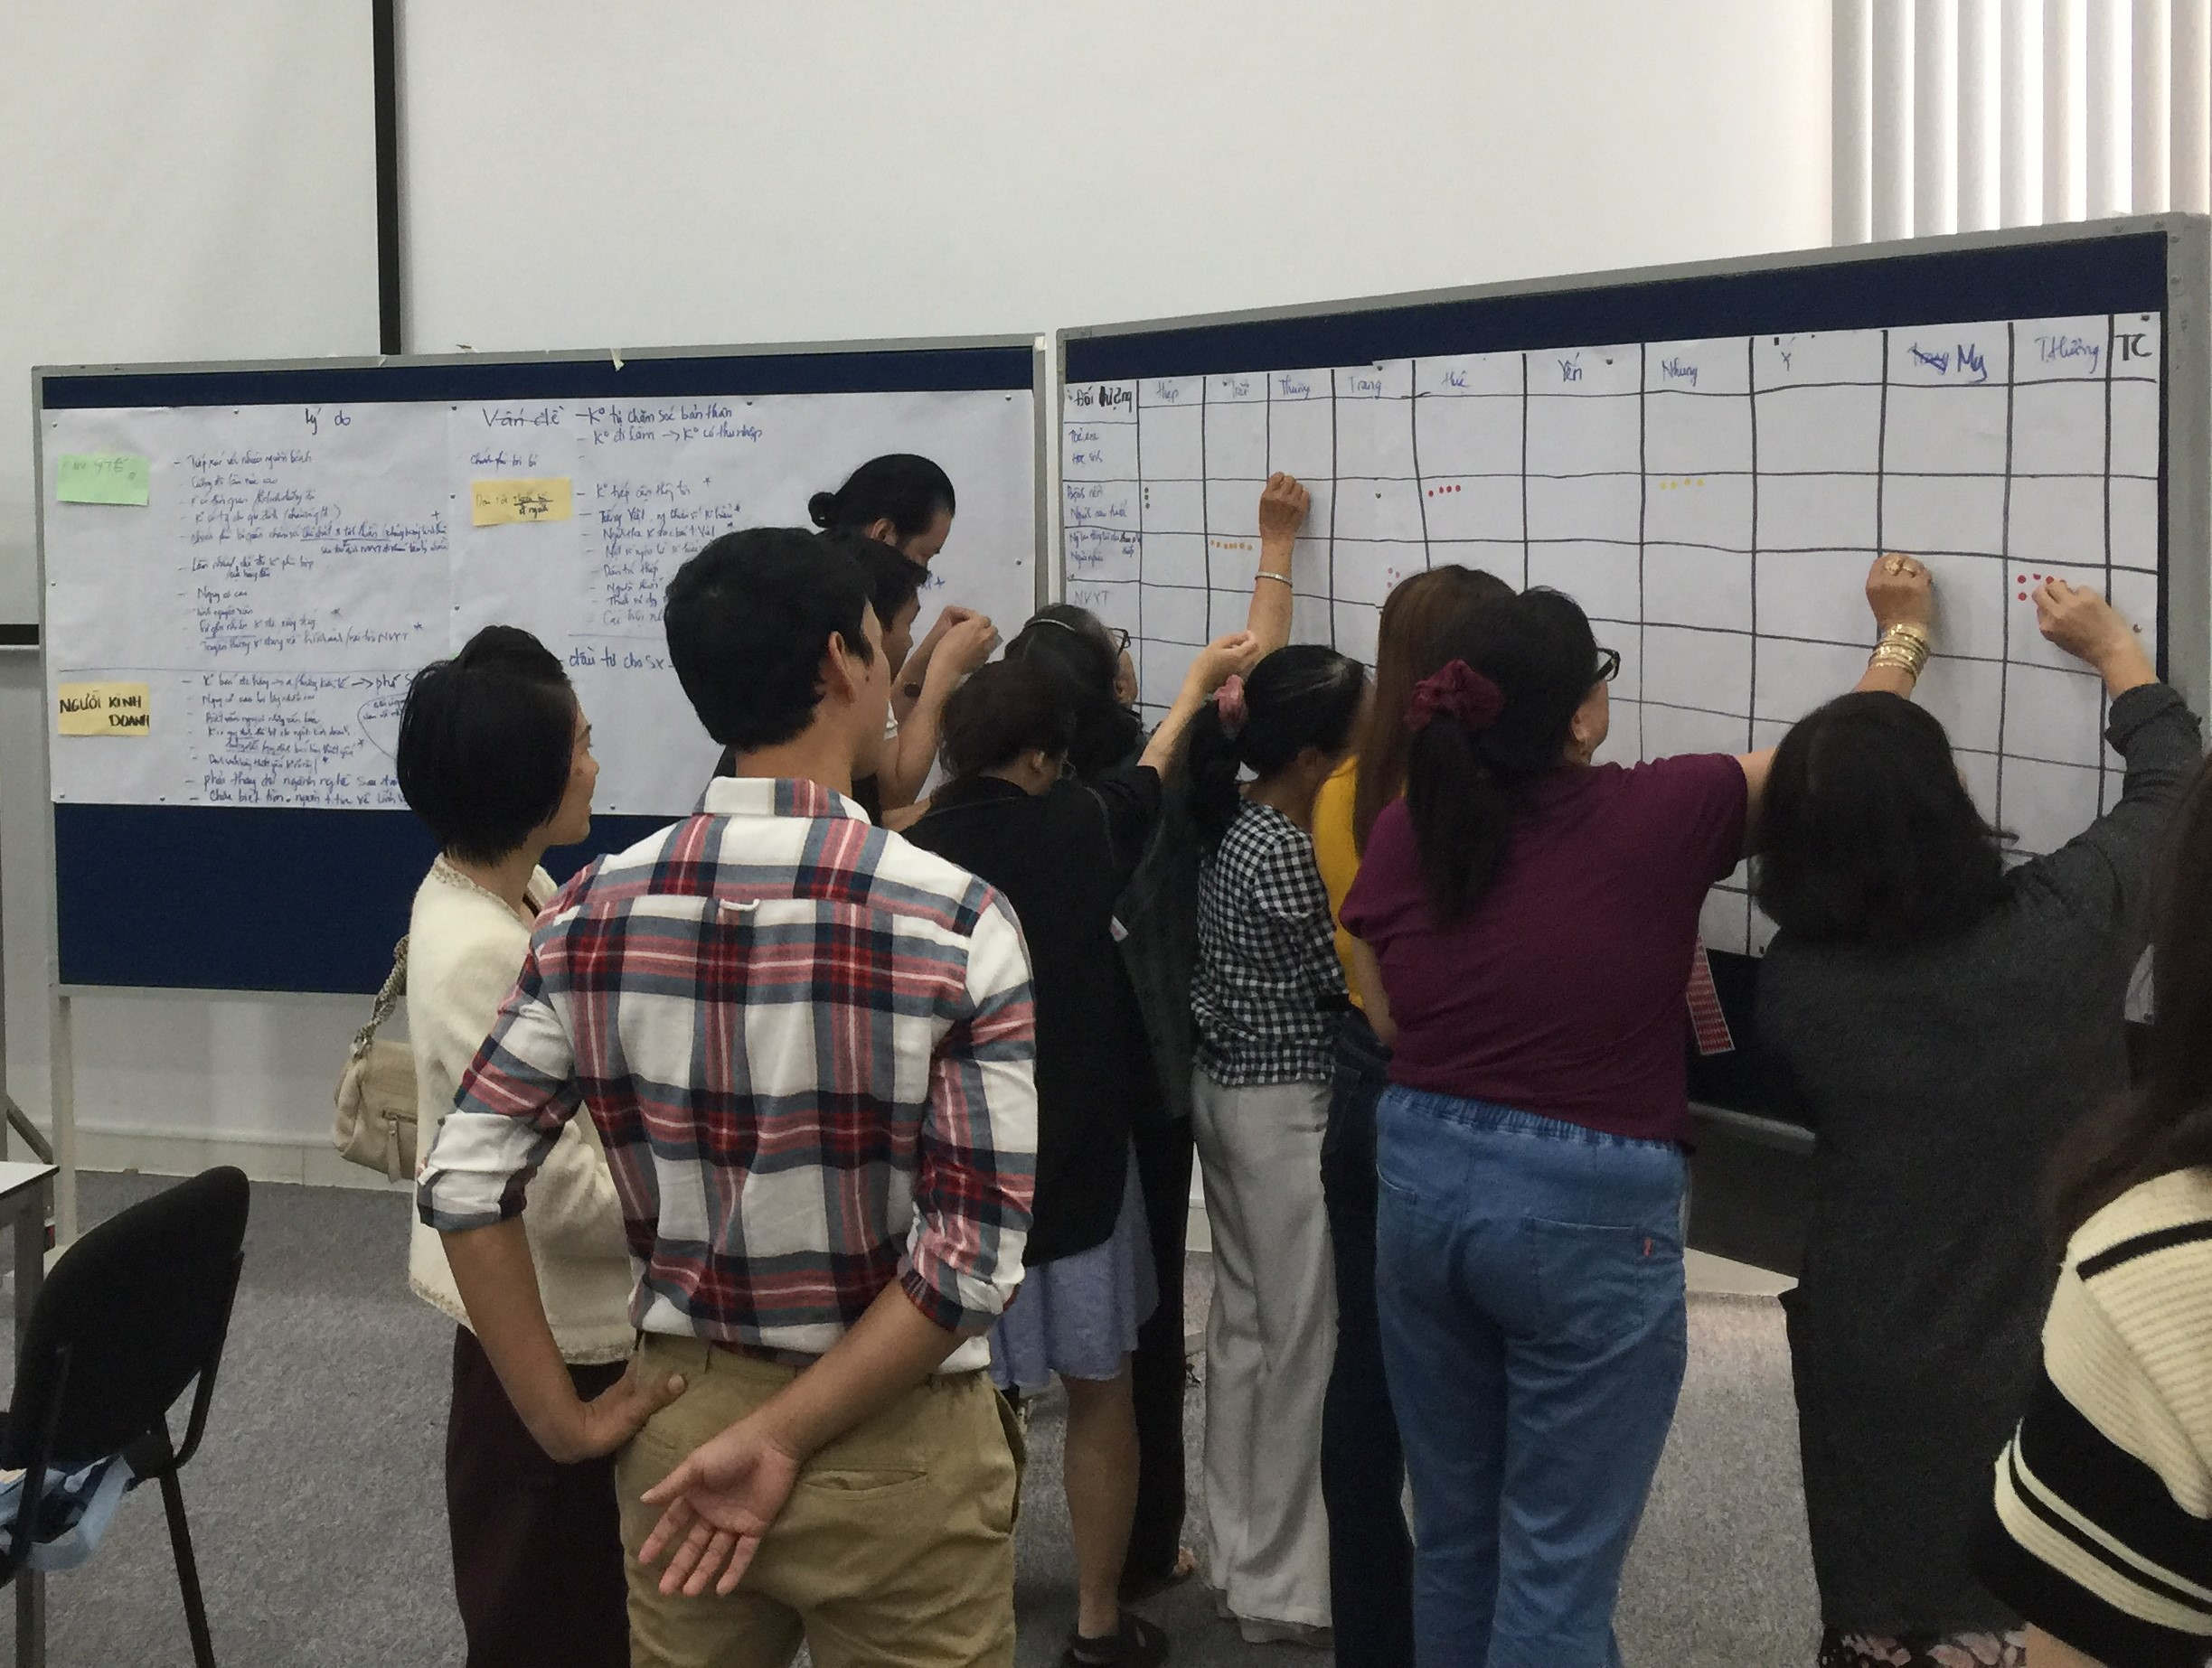
What groups/communities were affected during the COVID-19 pandemic?
All participants gave written consents for OUCRU to use their images.
Notes:
(5 seconds)
Picture of the HRAG event to illustrate one of the activities; HRAG participants ranked the groups, choosing the “most affected” communities.

Slide 13
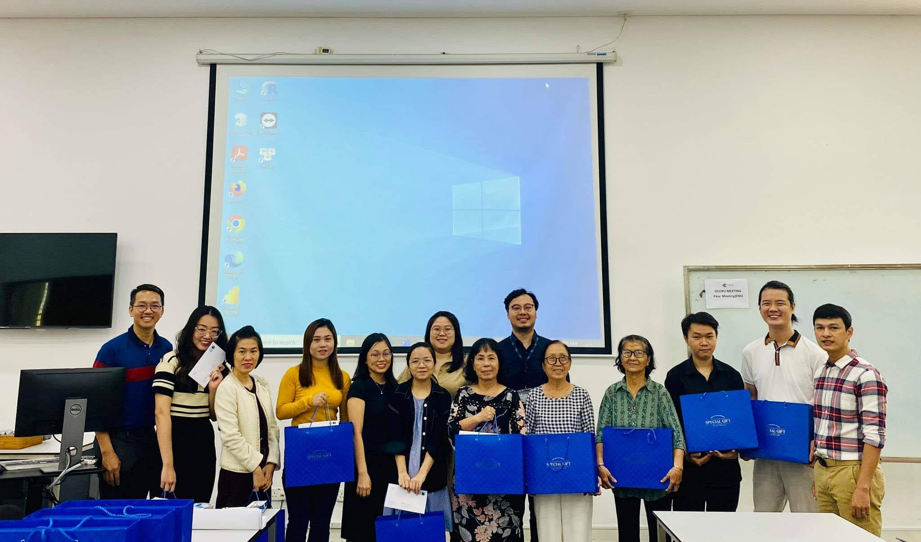
Stakeholder meeting with the Health Research Advisory Group (HRAG) Vietnam
An OUCRU advisory group
12 community members with diverse backgrounds
Regularly meet to advise and discuss OUCRU’s research
Which were the hard-to-reach groups during Covid-19 pandemic?
All participants gave written consents for OUCRU to use their images.
Notes:
(30-45 seconds) Very brief introduction
12 community members with diverse backgrounds (retired health workers & engineer, graduate student in Clinical Psychology, school nurse, yoga instructor, business admin, Ho Chi Minh City Center for Diseases Control staff,…)
Most reside in urban settings (HCMC)

Slide 14
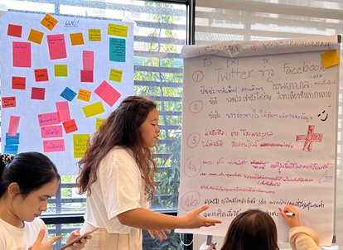
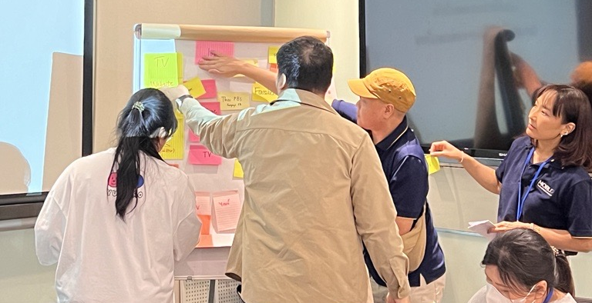

SEACOVARIANTS: Community Dialogues in Thailand
Conducted community dialogues with eight stakeholder groups from November 2023 to September 2024, involving a total of 117 participants.
Stakeholder group | Selection criteria
University students | Youth and education impact
Klong Toey community in Bangkok | Slum, low resource and elderly
Community Advisory Broad in Chiang Rai province | Remote area, religion, language barrier (minority)
Health Research and Ethics Interest Group (HREIG)- Community Advisory Broad in Bangkok | Member of public
Migrant workers in Samuth Sakhon province | Myanmar workers in urban
Disability group | Visual impairment musician
Residents in Pattani province | Muslim community-religious and believe
Tak Community Advisory Broad in Thai-Myanmar border | Migrant in Thai-Myanmar border

Slide 15
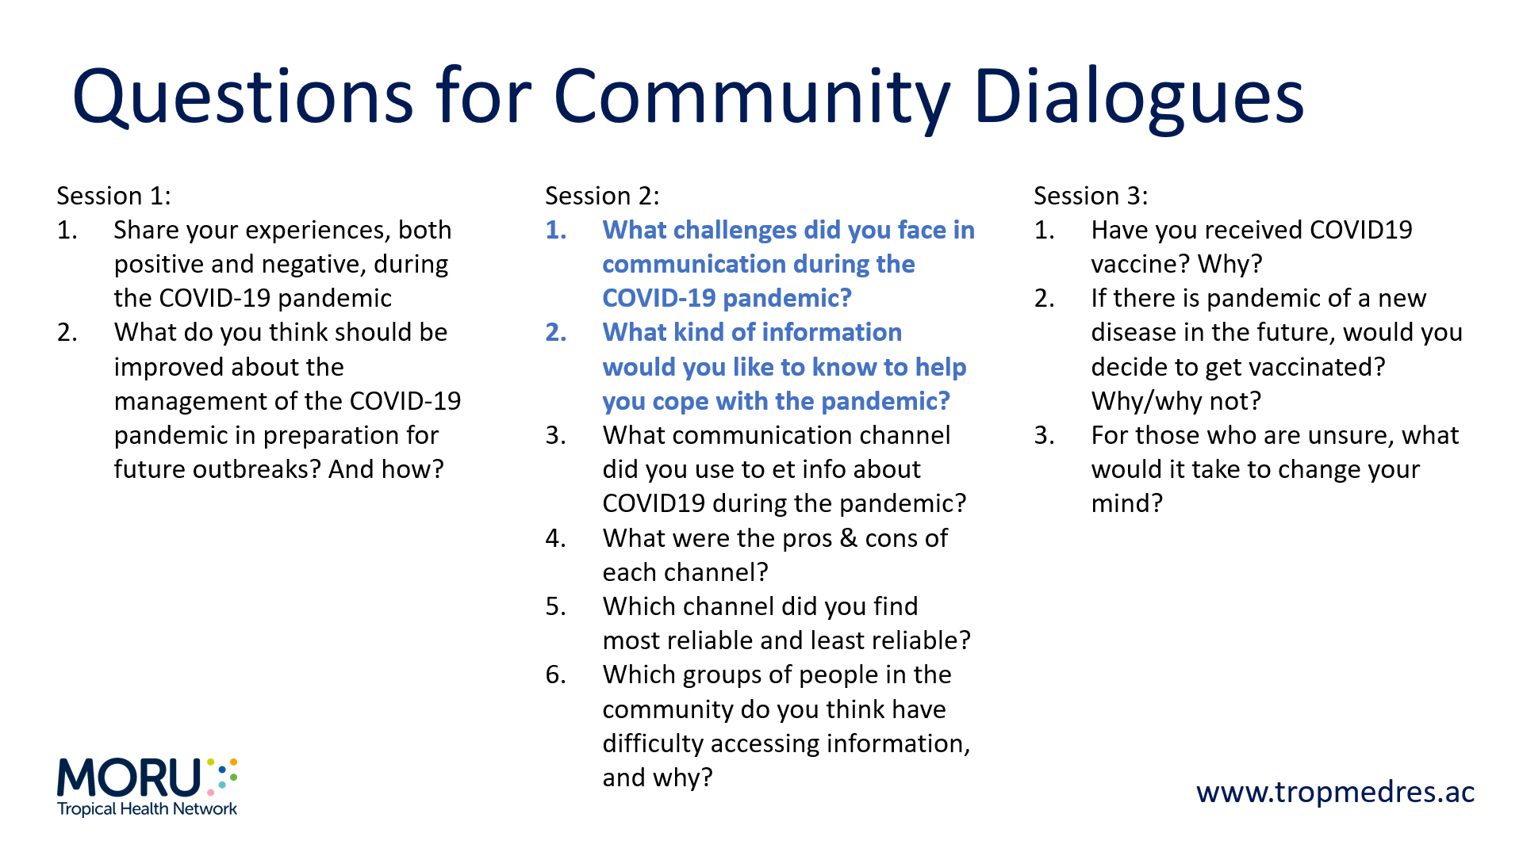
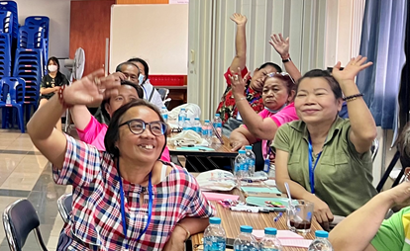

Slide 16


DISCUSSION OUTCOMES

Slide 17
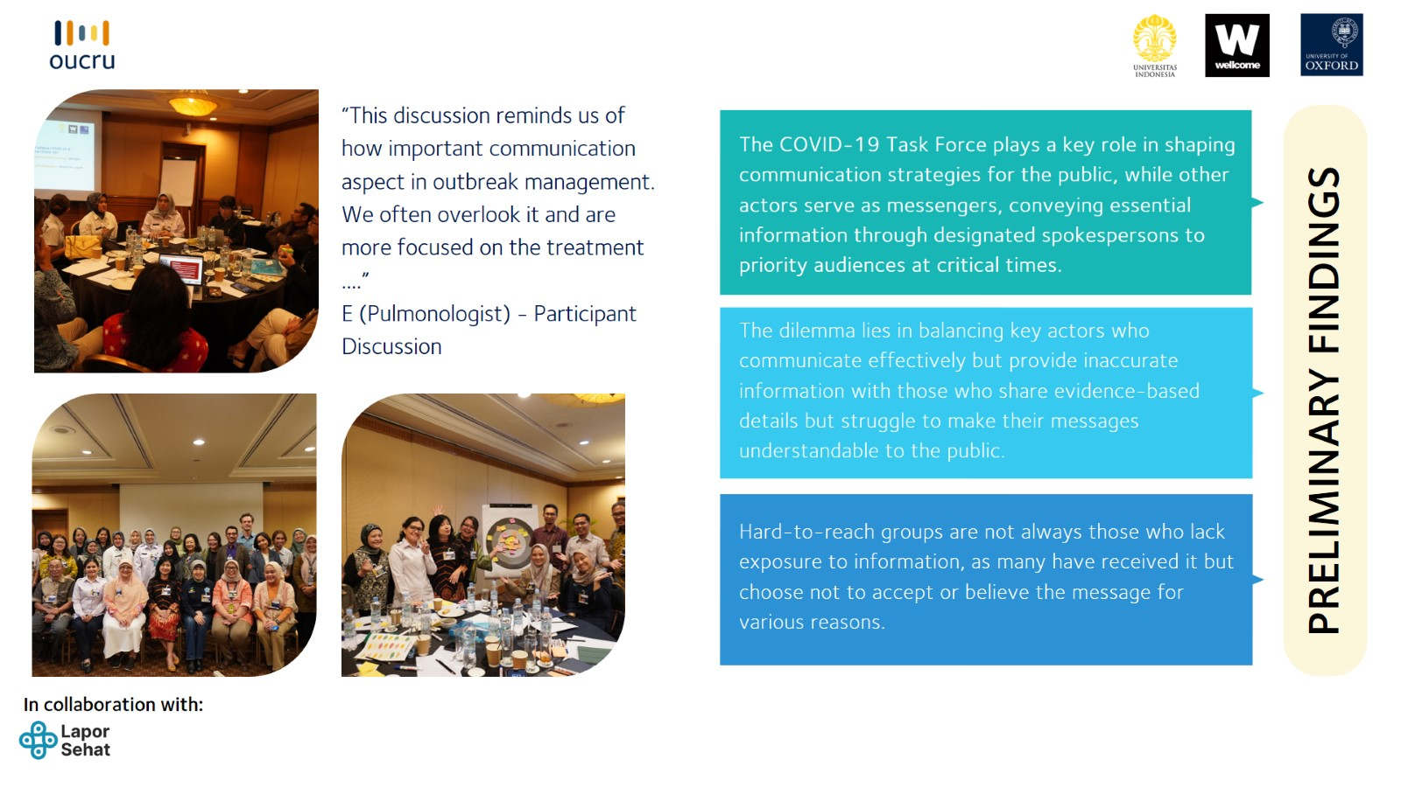
Feedback from stakeholders in Indonesia:

Slide 18
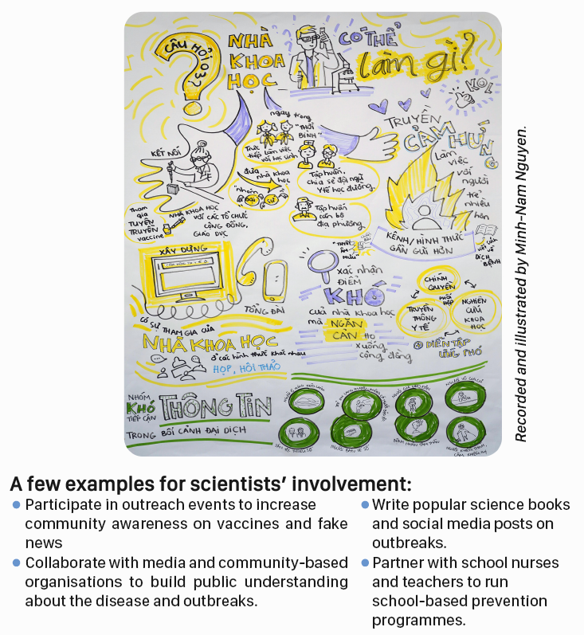
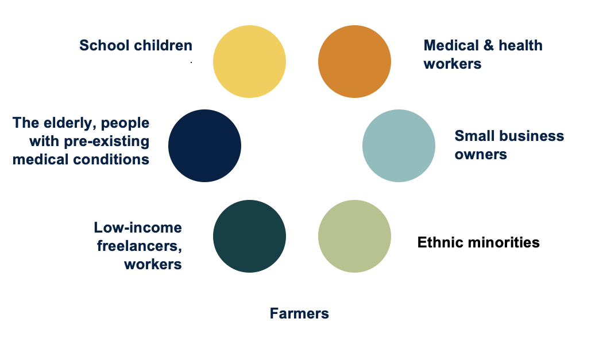
Feedback from stakeholders in Vietnam:
What groups/communities were most affected during the COVID-19 pandemic?
Notes:
Participants in this workshop also gave feedback for YARG’s “HTR” results

Slide 19
Feedback from stakeholders in Thailand:
1. Communication challenges during COVID-19 pandemic:
Trustworthy
-There were too many sources of information, coming from various places. For example, different medical doctors or experts provided conflicting information, and the information was shared without proper checking, causing public confusion.
The one-way communication approach
- The public receives information from the government, but the government does not receive any feedbacks from the public.
Accessibility
- Many channels were available, but certain groups—such as people with disabilities, the elderly, children, the economically disadvantaged, and those without access to technology—found it difficult to access news.
Mental health problem
- Excessive news consumption has caused anxiety and fear regarding the pandemic.

Slide 20
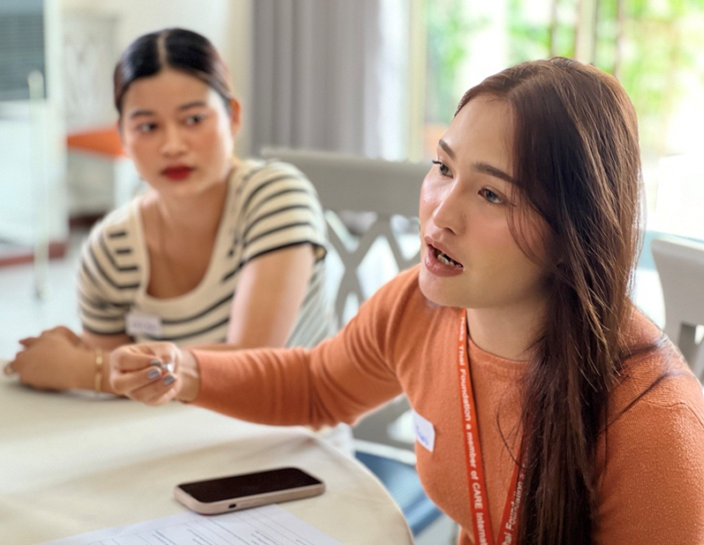
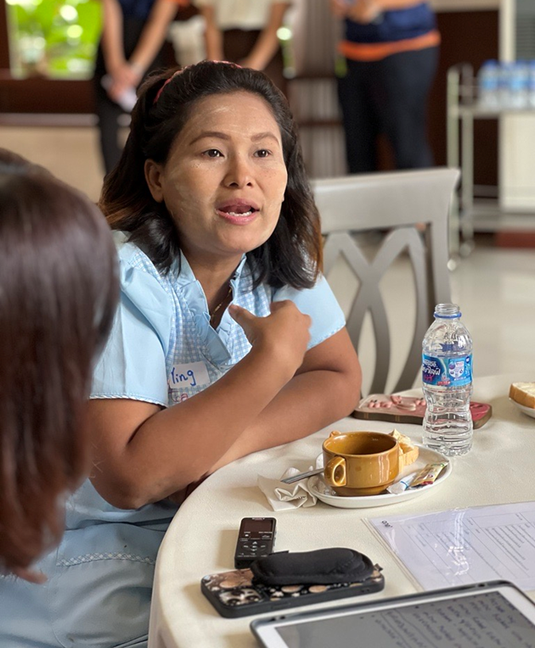
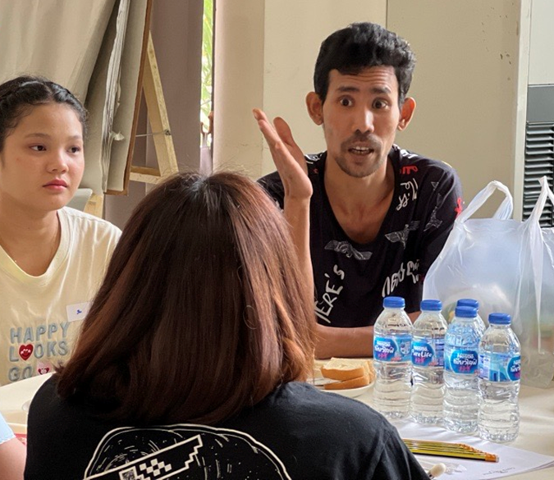
Feedback from stakeholders in Thailand:
2. Information required for future pandemic:
Disease knowledge: Symptoms, transmission and spread, prevention method and treatment.
Alternative treatment: herbal medicine.
Vaccine Information: Vaccine types, side effects, cost and long-term impact.
Accurate and up-to-date news and information.
Pandemic Management Guides: Create manuals for handling pandemic situation (similar to fire/emergency response guides).

Slide 21
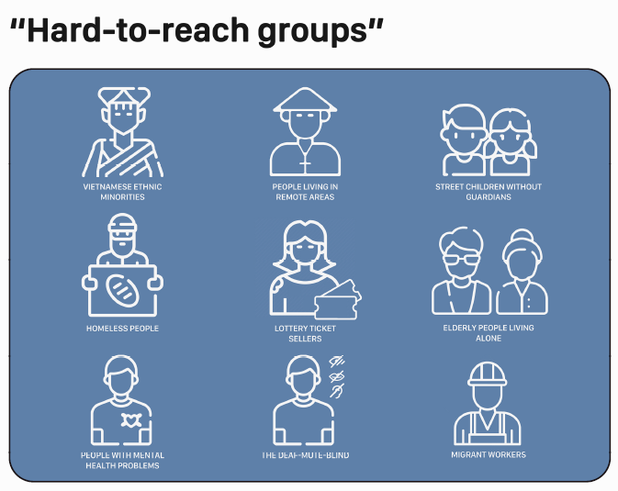
Identifying ‘hard-to-reach’ groups
Definition: Hard-to-reach groups during pandemics are individuals or groups of people facing barriers in receiving or responding to the disease’s information. They are also often ‘under-served!’
Barriers to receiving communications
Geographical barriers
Living alone with no connections
Constantly moving/relocating
Poor comprehension of information
Lack of education
Language barriers
Mentally impaired

Slide 22
7 university students aged 19-25, currently living in HCMC
Youth Action Research Group:
YARG
Supporting framework development
Conducting a literature review about engagement during outbreaks
Design and deliver engagement activities

Slide 23
NEXT STEPS
Oct-Nov 2024
Draft country specific frameworks
18-21 Feb 2025
Regional SCOPE workshop in Vietnam for external input into framework:
Inc’ policy makers & Regional WHO/UNICEF
2025
Ongoing YARG activities
Dec 2024
Online workshop to consolidate frameworks

Slide 24
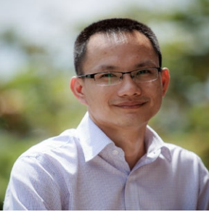
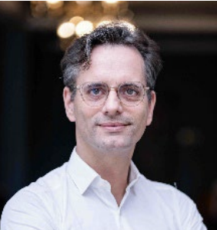
SCOPE team
SCOPE@oucru.org
Duy Thanh
Co-I SEACOVARIENTS & PCE Lead
Vice-Head PCE OUCRU Vietnam
Prof. Phaikyeong Cheah
Head of Ethics & Engagement MORU
SCOPE Lead for Thailand
Kanpong Boonthaworn (Kan), Natinee Kulpijit, Supanat Ruangkajorn (Ice), Tasawan Roomchaichote (Lek)
Public and Community Engagement Officers MORU Thailand
SCOPE Team for Thailand
Eva Simarmata
Public and Community Engagement Officer OUCRU-ID
SCOPE Lead for Indonesia
Bill Pham & Hoang Chieu
Senior Schools & Youth Engagement Officers OUCRU-VN
SCOPE Lead for Vietnam
Le Van Tan
PI SEACOVARIENTS
Raph Hamers
Co-I SEACOVARIENTS
Indonesia lead
All public participants gave written consents for OUCRU to use their images

