Slide 1
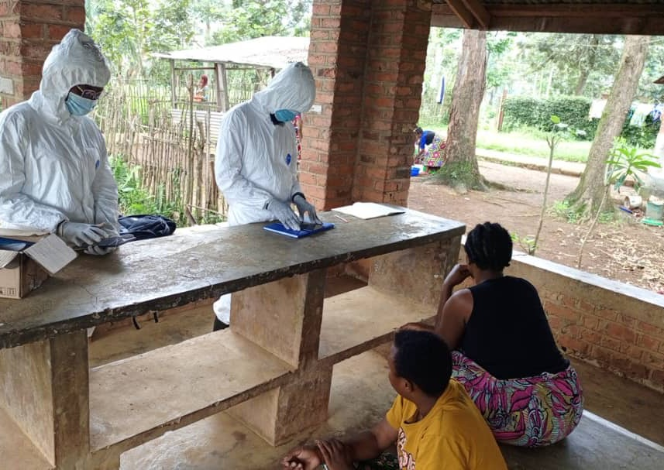
Identification of a Novel MPOX Virus in a remote area of South Kivu, DRC – Understanding the new characteristics and addressing the unknowns

Slide 2
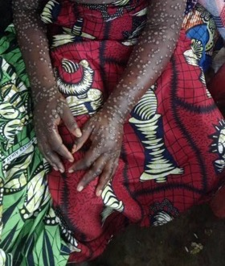
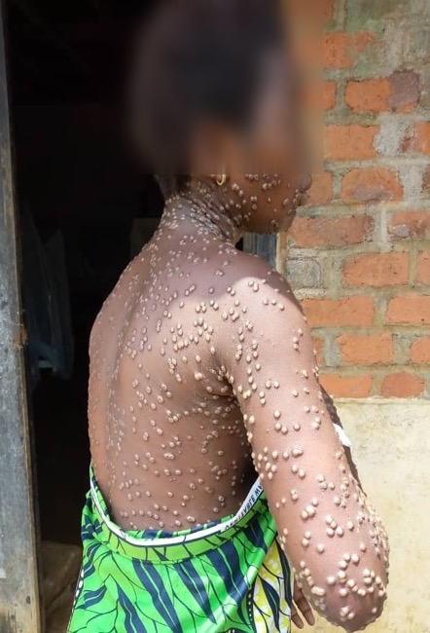
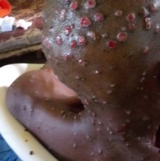
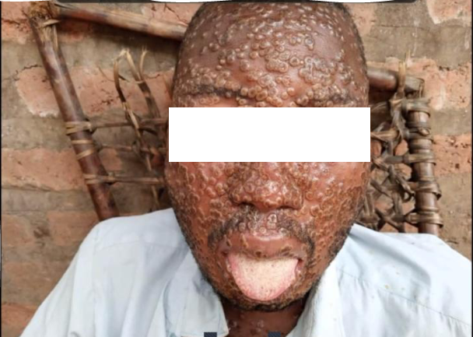
Working in South Kivu – exploring zoonosis in clade IIb but these cases had been seen
Clade I - bushmeat, household transmission limited
Clade II - Europe / USA sexual transmission (MSM) low mortality
This New South Kivu Strain – different dynamics and characteristics that 1a
Index case bar owner and who employed sex workers
Cases extended to clients and also person-to-person, mother to child. Child-child prevailing in areas
Dynamics are changing.

Slide 3
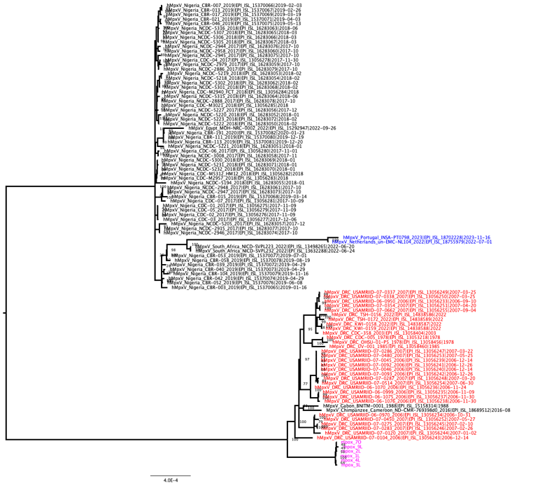
Phylogeny
Sequences are at the root of the clade 1 viruses (n=6)
Arrow indicate sequences which cluster with the 2023 Kinshasa sequences
Several SNPs were observed within the sequenced strains
OPG032 is deleted, similar to what has been found in all Clade II viruses
Clade II
Clade IIb 2022 outbreak
Clade I
Murhula et al, Eurosurveillance, 2024

Slide 4
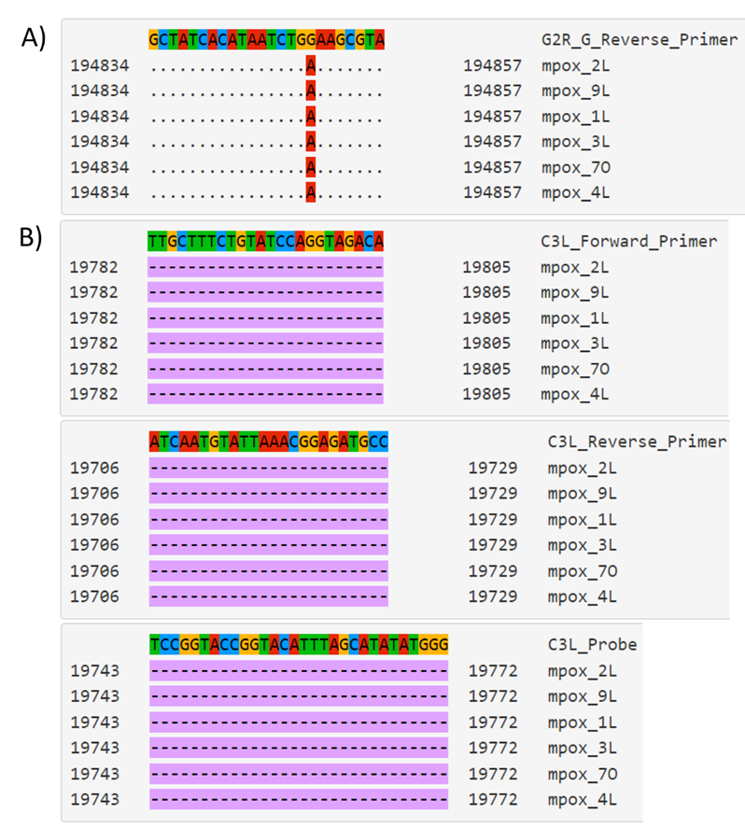

We found this was a new clade – now called clade Ib
https://www.eurosurveillance.org/content/10.2807/1560-7917.ES.2024.29.11.2400106

Slide 5
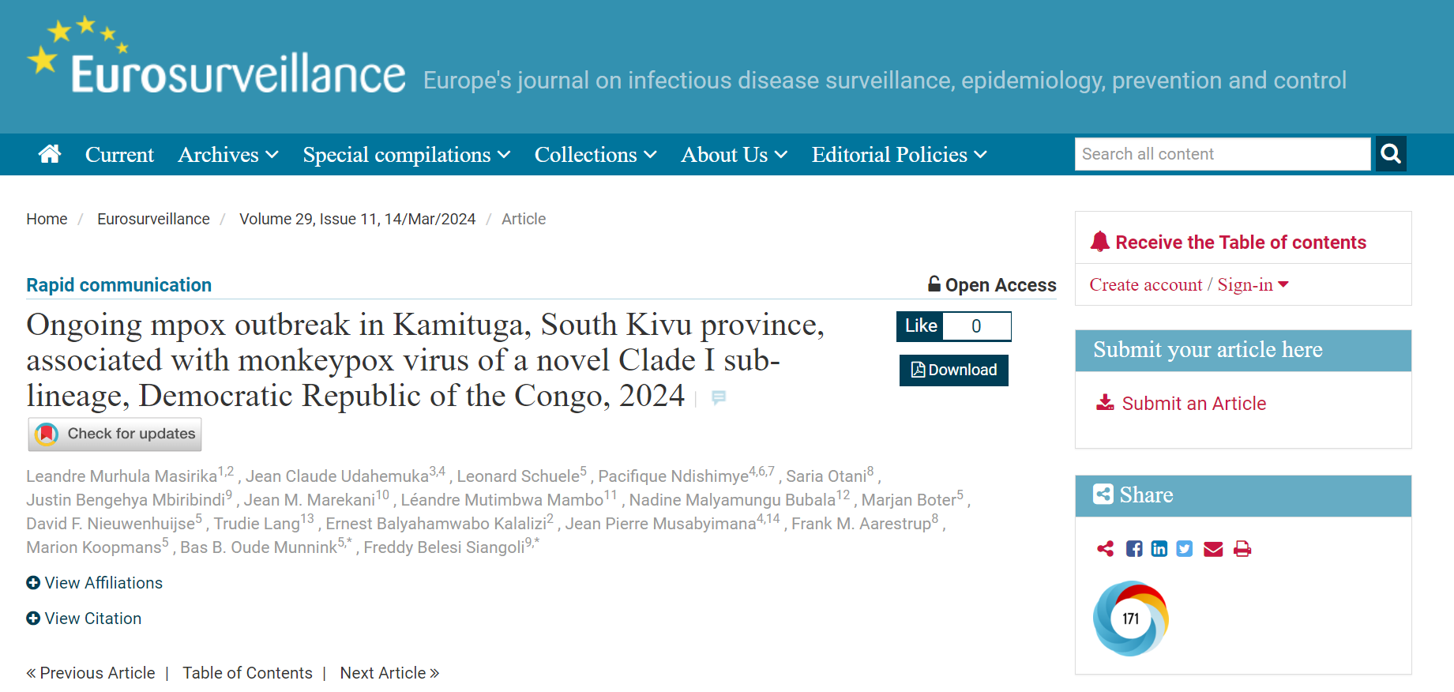
A Novel Clade I sublineage

Slide 6
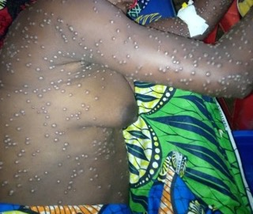
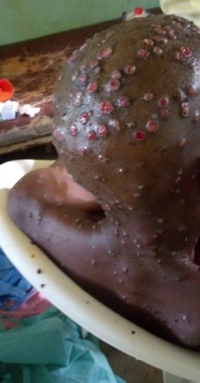
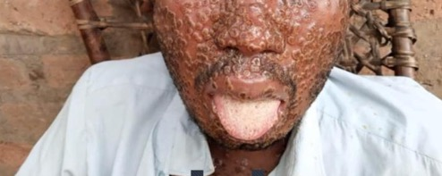
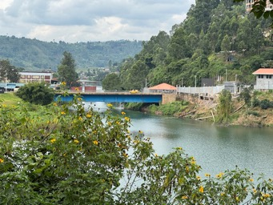
Many unknowns - whilst building a team
more serious and longer symptoms
Complications – such as ophthalmic
sexual and person-to-person
Transmission
Loss of pregnancies and transmission
in pregnancy
Only seeing severe disease – how many not presenting? Hidden due to high stigma
Working in partnerships & building capacity – supporting
Long term ability to lead local study and develop skills

Slide 8






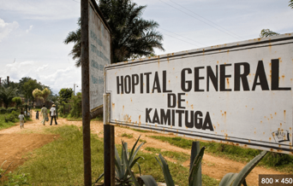



Acknowledgements
Leandre Murhula, Lwiro Center, DRC
Dr Pacifique ndishimye, TGHN, AIMS
Prof Wilfred Ndifon, AIMS Network, Rwanda
Prof Trudie Lang, TGHN/University of Oxford
Julien NIYINGABIRA, RBC
Dr Freddy Belesi Siangoli, DPS, DRC
All the staff and team at Kamatuga hospital and community care
RWA
DRC
DPS South Kivu province

