Slide 1




Can cross-protective airway-resident immunity be harnessed for SARS-CoV-2 variant protection in UK and Malawian populations with or without HIV infection?
MUCOSAL Group
Wellcome Pathogen Variants Network Meeting 2024
London

Slide 2
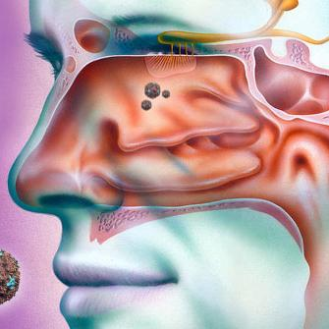
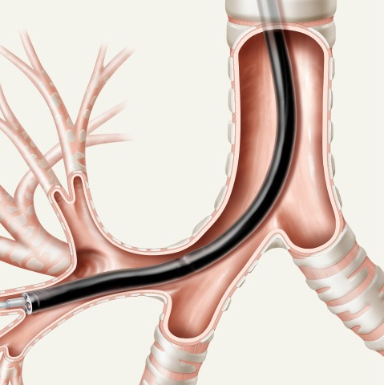

ImMUnologiCal memOry to reSpirAtory viraL infections in the airways (MUCOSAL)
Prof Daniela Ferreira & Dr Elena Mitsi

Slide 3
What we have learnt from studying the respiratory mucosa after bacterial & viral infection
Intramuscular vaccination does not induce cellular immunity (maybe transiently)
Enriched B and T cell mediated anti-viral immunity in the lower airways compared to blood
Airway SARS-CoV-2 specific T cells responses tend to last longer (better understanding of their longevity)
Evaluate the potentials of T and B cell mediated immunity to confer protection against future variants and reduce/block virus transmission?

Slide 4


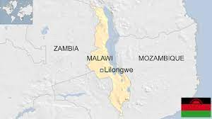
MUCOSAL
ImMUnologiCal memOry to reSpirAtory viraL infections in the airways
A longitudinal cohort study to better understand the Immunological memory across different respiratory viral infections in the upper and lower airways
2 recruitment sites (Oxford & Liverpool)
Compare findings between UK and Malawi cohort
UK
Malawi

Slide 5
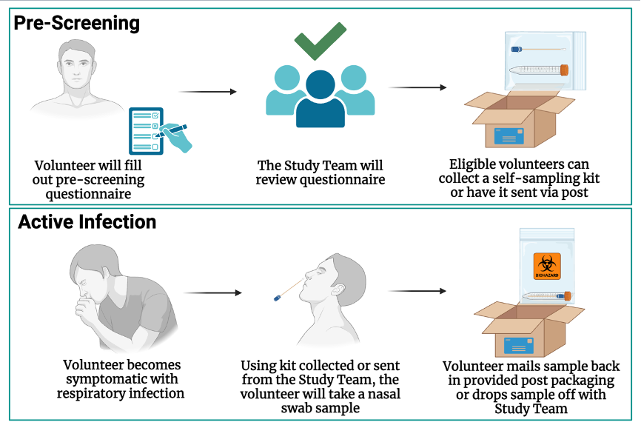
MUCOSAL – Recruitment strategy
Nasal swabs will be analysed for the presence of most common respiratory viruses
Enrolled into the study, those with confirmed infection for the following:
SARS-CoV-2
hCoV
RSV
Rhinovirus
HMPV

Slide 6
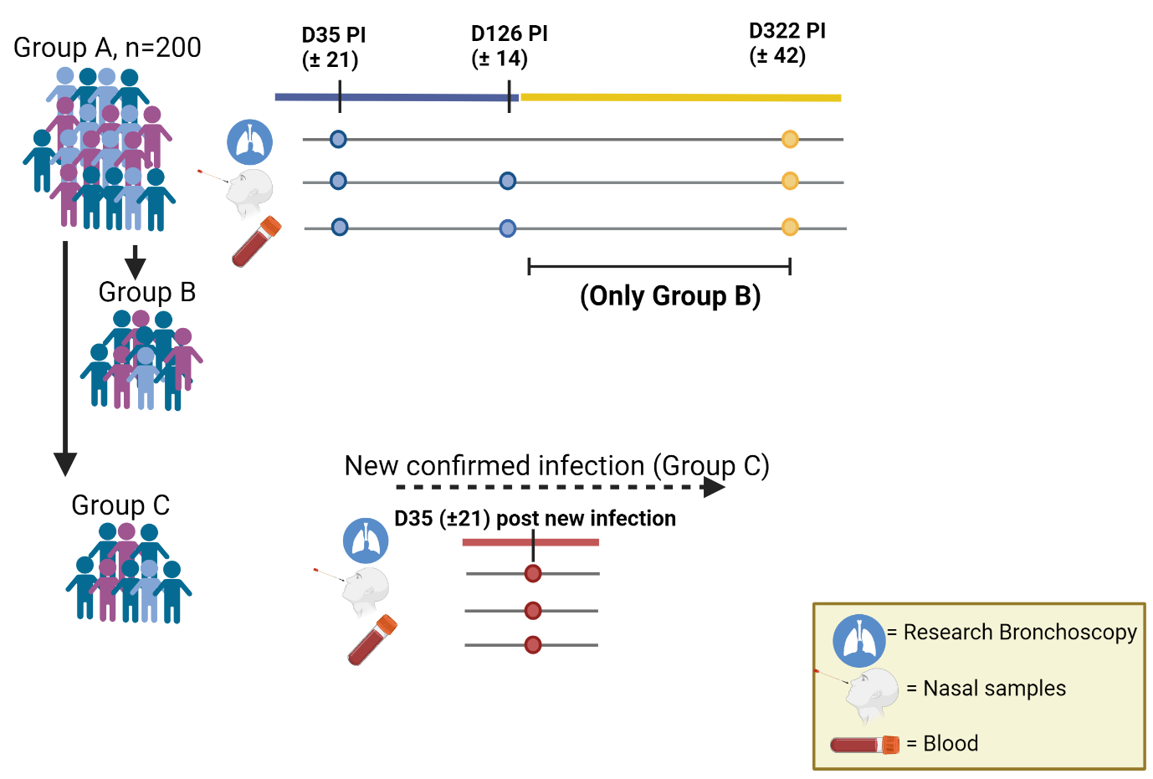
MUCOSAL – Study Design UK
Group A: Initial visit at D35 (± 21days PI & at 4 months PI
Group B: A subset from group A will be followed up to 12 months PI
Group C: New resp. infection or breakthrough infection within a year after the initial respiratory infection (subset)

Slide 7
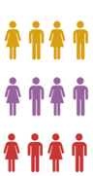
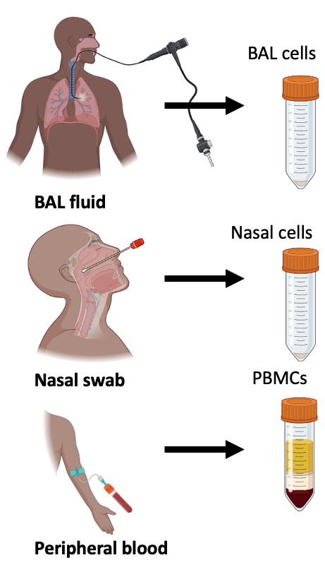
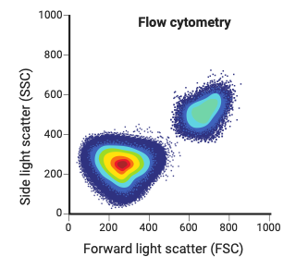
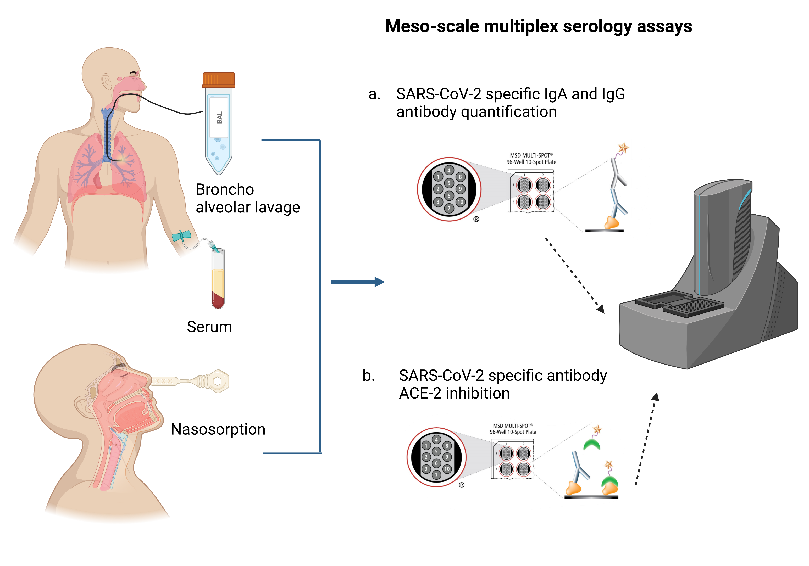
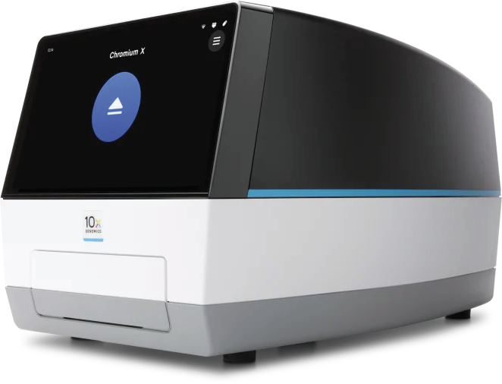
MUCOSAL – Study Design Malawi
Infection only
Flow cytometry
HIV-
Lower
Respiratory Tract
(LRT)
PLHIV ART<1wk
BAL cells
PLHIV ART>1yr
Multiplex serology
Upper
Respiratory Tract
(URT)
Nasal cells
Infection + Vaccination
Nasal lining fluid
HIV-
Systemic Circulation
PBMCs
Single-cell genomics
PLHIV ART<1wk
serum
PLHIV ART>1yr
53 per sub-group
Notes:
-Stimulate the cells with the different peptides and those stimulated cells are the ones we will call SARS-CoV-2 specific Tcells
-AIM: activation-induced marker (upregulate surface receptors; when certain cells are activated, they upregulate receptors on their surface) to either induce cytotoxic or helper functions
-ICS: Intracellular cytokine staining assay (produce cytokines)

Slide 8
MUCOSAL – Participant demographics Malawi
Characteristic | HIV- N = 34¹ | HIV+ on ART >1y N = 22¹ | p-value²
Age | 30 (24, 37) | 39 (30, 43) | 0.003
Sex |  |  | 0.025
Female | 16 (47%) | 17 (77%)
Male | 18 (53%) | 5 (23%)
Vaccination status |  |  | 0.038
Unvaccinated | 22 (65%) | 8 (36%)
Vaccinated | 12 (35%) | 14 (64%)
CD4 count | NA (NA, NA) | 516 (295, 642)
HIV viral load |  |  | >0.9
<40 |  | 3 (14%)
>40 |  | 4 (19%)
Not detected |  | 14 (67%)
¹Median (Q1, Q3); n (%)
²Wilcoxon rank sum test; Pearson's Chi-squared test; Fisher's exact test
Notes:
-Stimulate the cells with the different peptides and those stimulated cells are the ones we will call SARS-CoV-2 specific Tcells
-AIM: activation-induced marker (upregulate surface receptors; when certain cells are activated, they upregulate receptors on their surface) to either induce cytotoxic or helper functions
-ICS: Intracellular cytokine staining assay (produce cytokines)

Slide 9
Primary and Secondary Objectives
To assess the magnitude and longevity of antigen-specific T and B cell immune responses to respiratory viruses both in the respiratory mucosa and the periphery
Direct comparison of immune memory between nose and lung mucosa
To assess the ability of antigen-specific T and B cells to cross-react with other antigens
Identify correlates of protection
Assess changes in immune responses with age
Data comparison between UK and Malawi Cohort

Slide 10
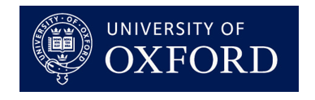


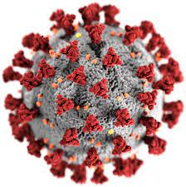
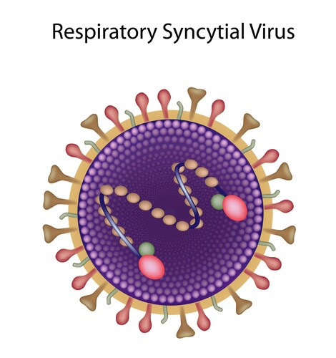
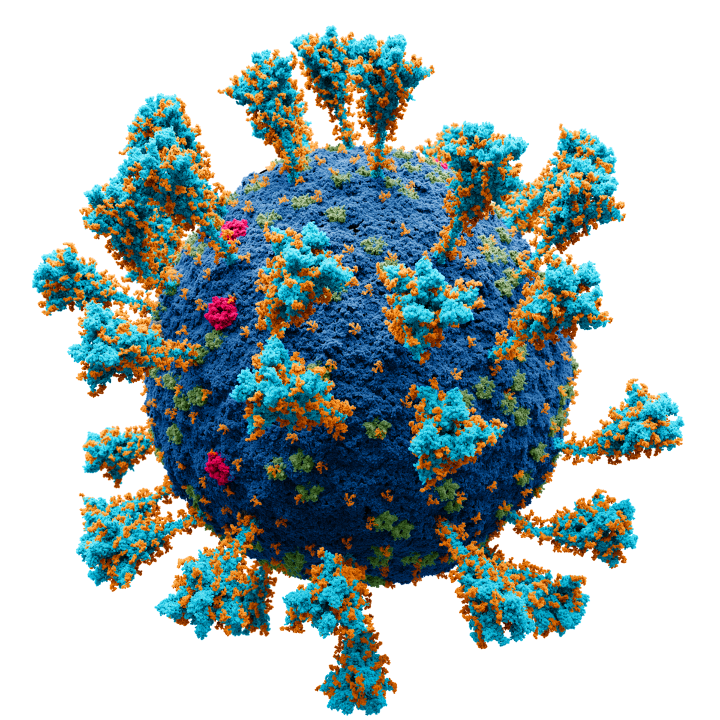
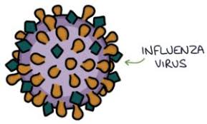
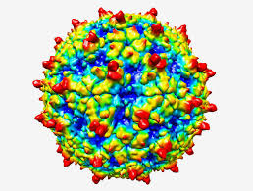
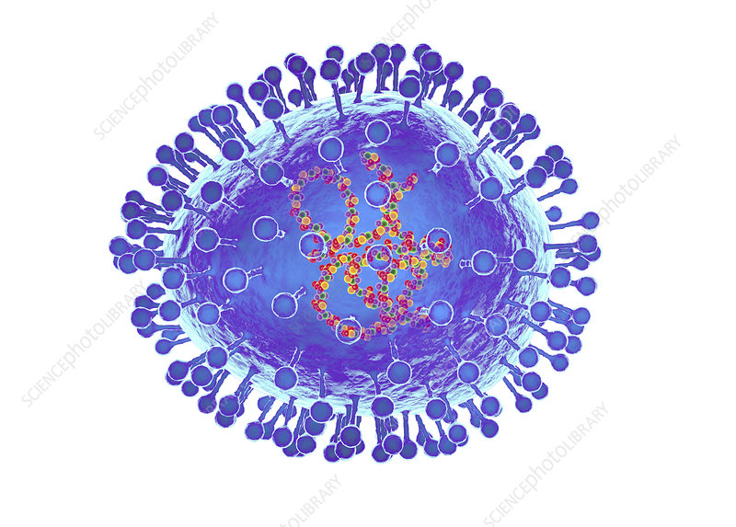

Respiratory virus and Immune system: Putting the puzzle together

Slide 11

Respiratory virus and Immune system: Putting the puzzle together

Slide 12
Can cross-protective airway-resident immunity be harnessed for SARS-CoV-2 variant protection in UK and Malawian populations with or without HIV infection?
Mariana Diniz
Maini Lab, Div of Infection and Immunity

Slide 13
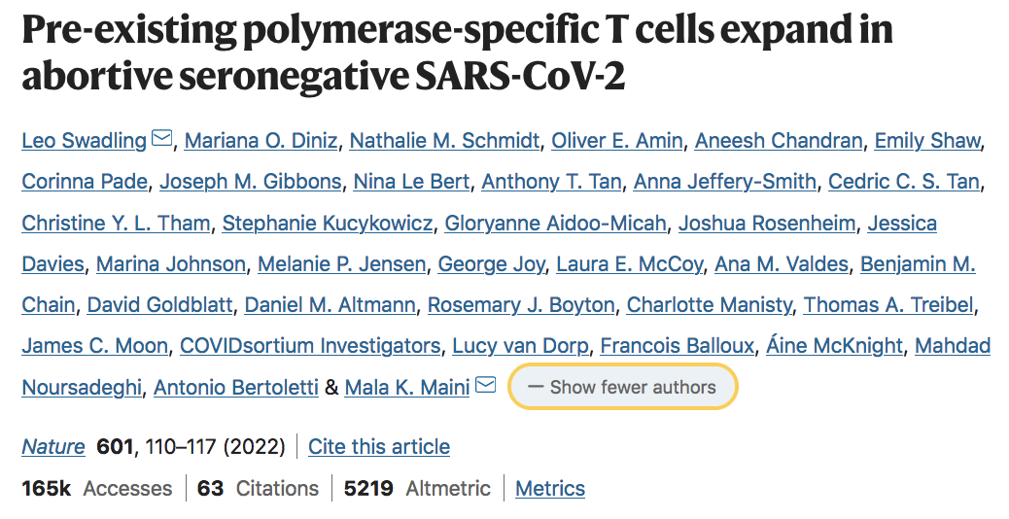
Cross-reactive immunity can contribute to early viral control
Pre-existing mucosal immunity:
Cross-reactive: broad protection including against future variants
Frontline effectors at the site of pathogen exposure
Rational for harnessing mucosal immunity locally

Slide 14
Pre-existing immunity can be detected in the airways
Pre-existing mucosal immunity:
Cross-reactive: broad protection including against future variants
Frontline effectors at the site of pathogen exposure
Rational for harnessing mucosal immunity locally

Slide 15
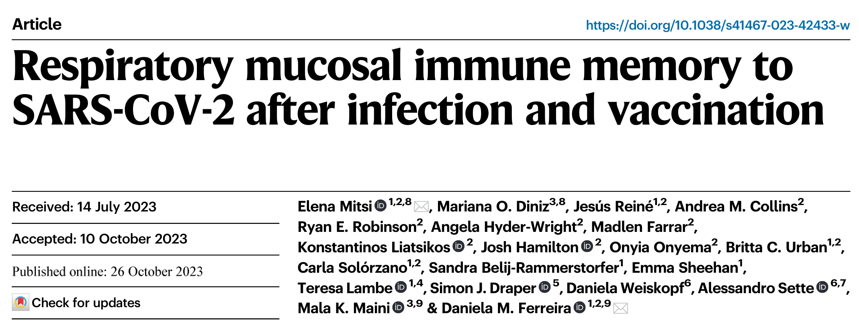
Harnessing airway cross-reactive immunity for a more efficient and broad control of infection
Pre-existing mucosal immunity:
Cross-reactive: broad protection including against future variants
Frontline effectors at the site of pathogen exposure
Rational for harnessing mucosal immunity locally
Spike-specific T cells detected with AIM assay (4-1BB⁺CD25⁺)

Slide 16
Investigate factors shaping airway cross-reactive immunity
to Sars-CoV-2
Investigate if cross-reactive immunity can be shaped by:
Background pathogen exposure in Malawi compared to the UK;
Prior exposure to SARS-CoV-2 infection +/- vaccination;
Immunocompromise resulting from pre-existing HIV infection.

Slide 17
Specific Objectives
Analysis of antigen-specific T and B cell immune responses in the respiratory mucosa and blood
T cell assays:
- Spike peptide pools (Wuhan, alpha, beta, delta and omicron)
- Non-structural protein peptides (highly conserved viral region - RTC)
Antibodies:
- Binding IgG and IgA against Spike (Wuhan WT, alpha, beta, gamma, delta and omicron)
- Pseudovirus neutralisation assay to measure cross-neutralisation against multiple VOCs
Standardisation of sample processing/preservation
Shared protocols and reagents, optimisation of assays
Preliminary data collection

Slide 18
Team
Team
MUCOSAL MLW Team
Kondwani Jambo
Henry Mwandumba
Rhona Mijumbi
Joseph Aston Phiri
Gloria Kapira
Aaron Chirambo
Dorothy Kazembe
Memory Mvula
Robert Nyirenda
Precious Chigamba
MLW Clinical Investigation Unit Team
MUCOSAL Uni.Oxford Team
Daniela Ferreira
Elena Mitsi
Hannah Shrader
Carla Solorzano Gonzalez
MUCOSAL UCL Team
Mala Maini
Mariana Diniz
Lucy Cooper

Slide 19
ImMUnologiCal memOry to reSpirAtory viraL infections in the airways (MUCOSAL)
Hannah Shrader

Slide 20

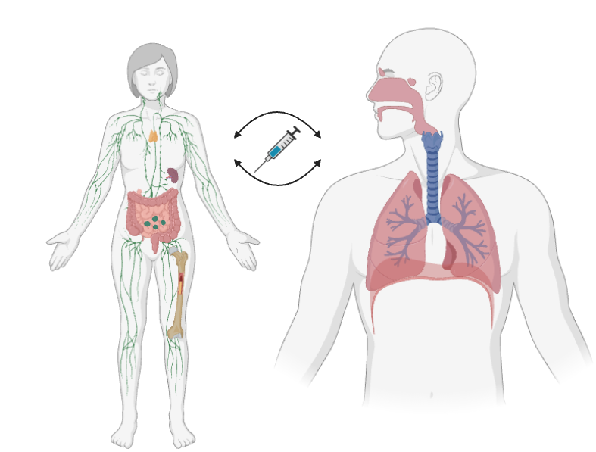

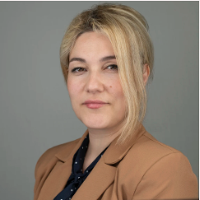
Introduction
Prof Daniela Ferreira
Dr Elena Mitsi

Slide 21
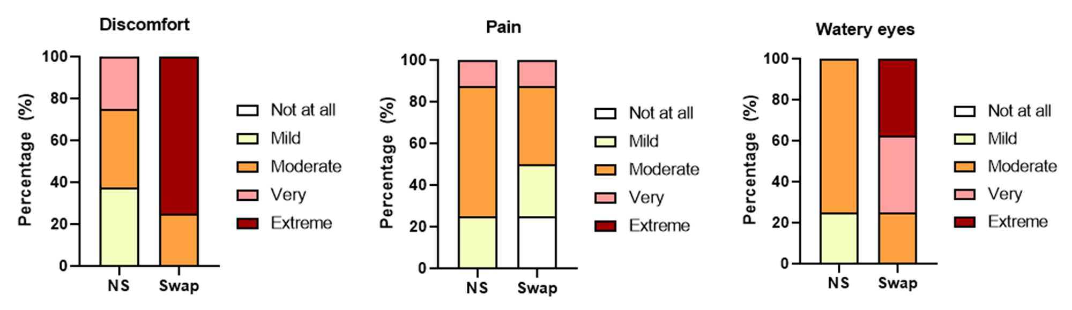
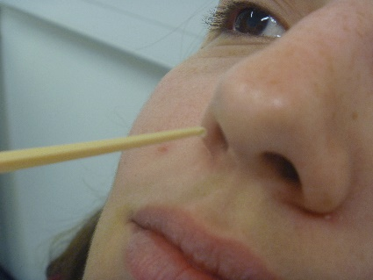
Collecting From the Upper Airway
FloqQ Swabs
Nasal Cuvettes
NC Swab
NC Swab
NC Swab

Slide 22
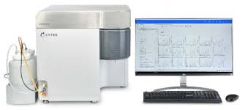
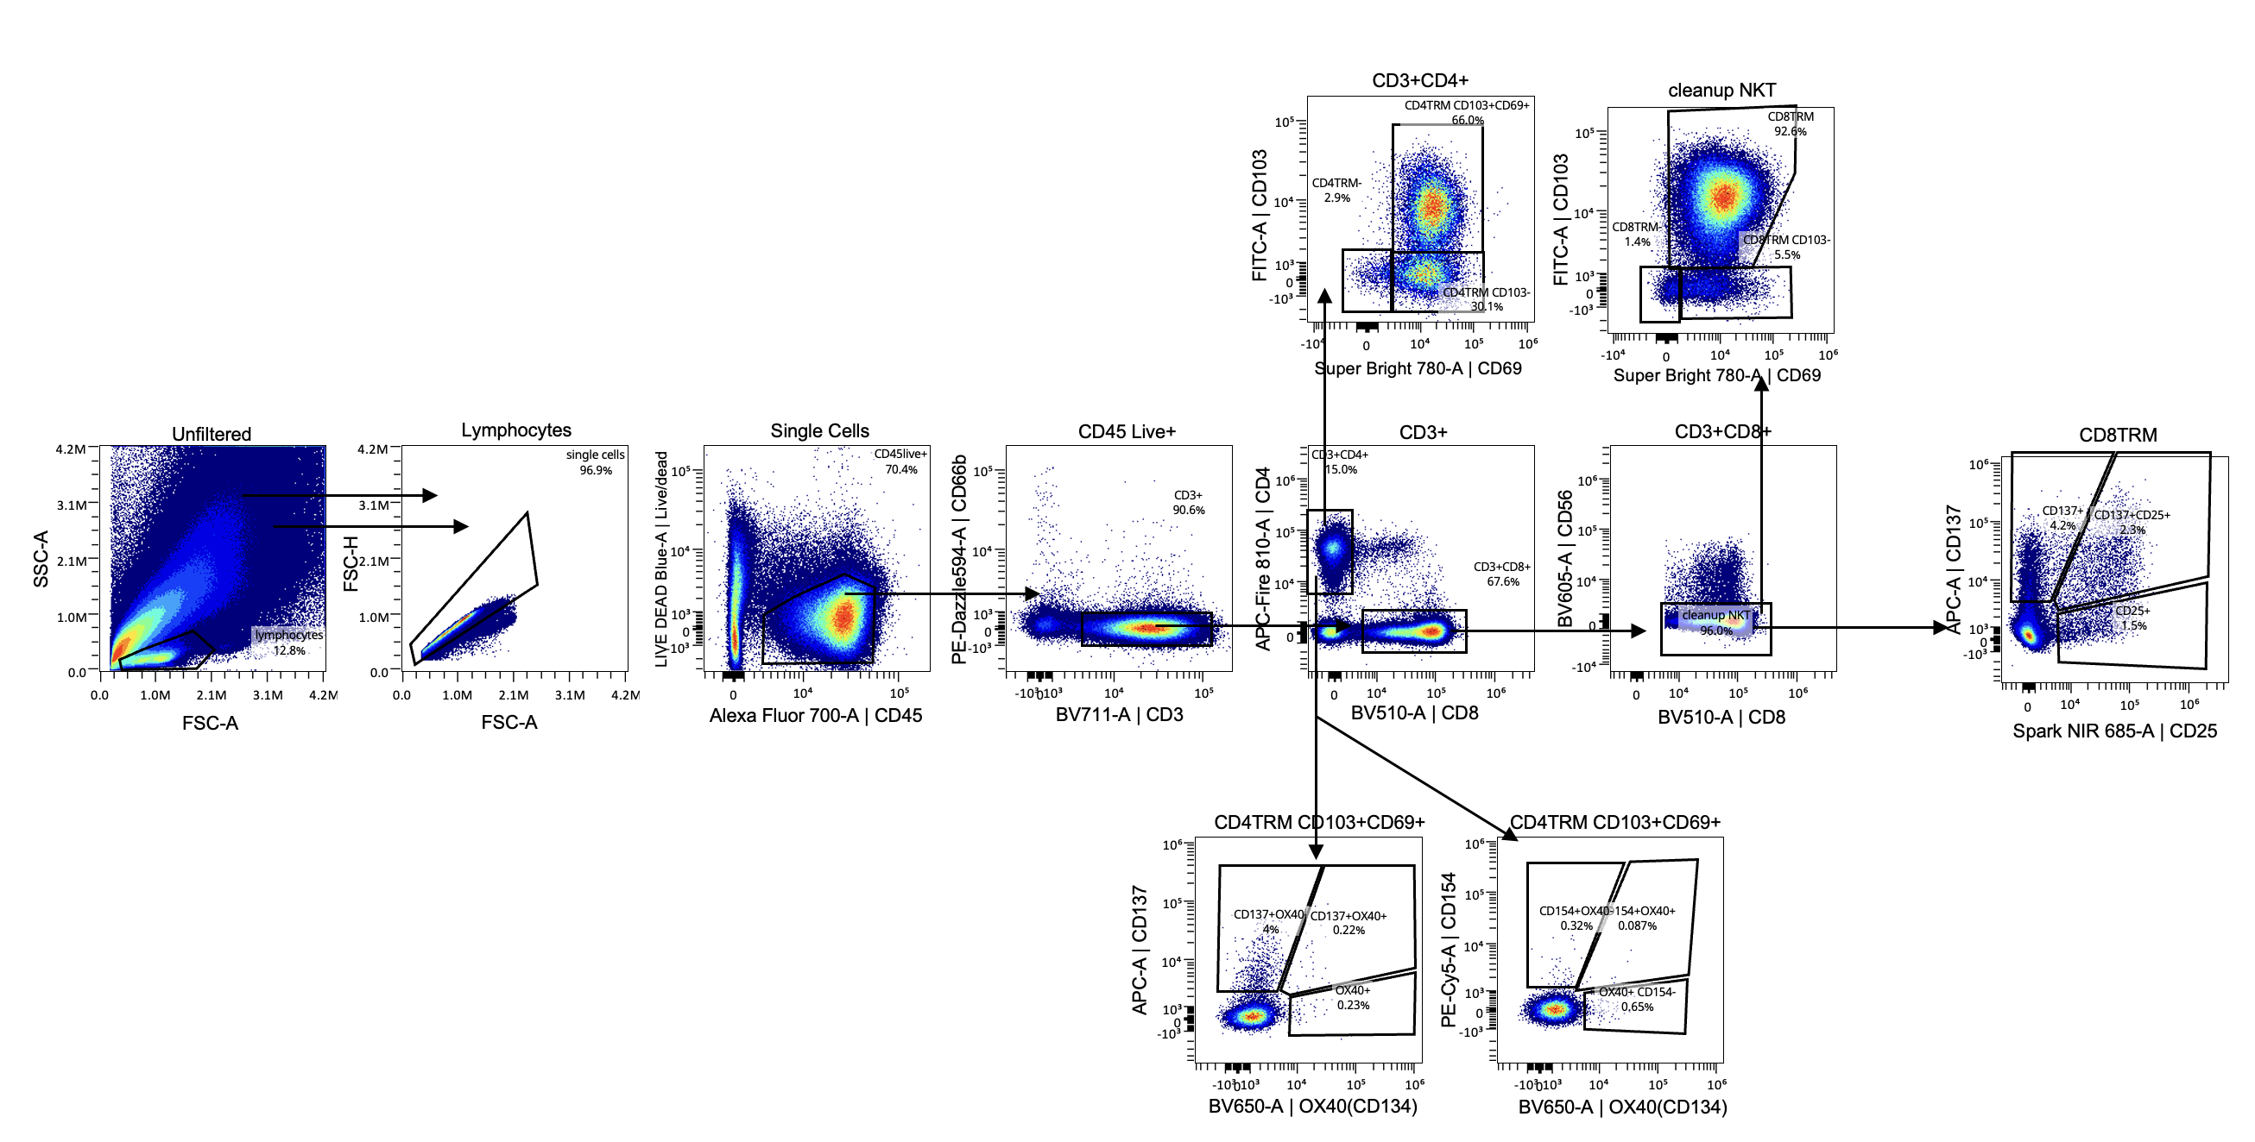
Analyzing Fresh vs Frozen Upper Airway Samples

Slide 23
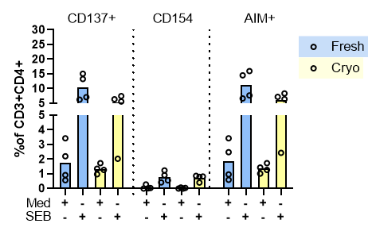
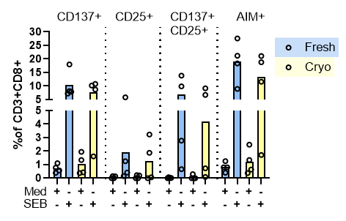
Analyzing Fresh vs Frozen Upper Airway Samples
Fresh and Frozen cells give comparable AIM responses, suggesting that samples can be frozen following collection and run collectively, preventing batch effects.

Slide 24
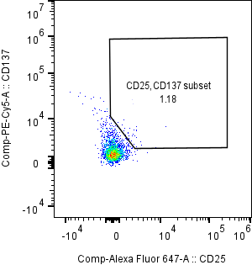
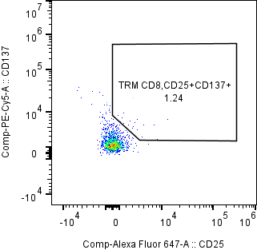
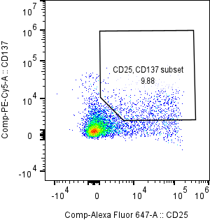
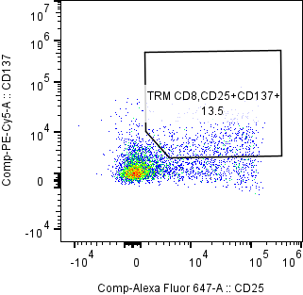
SARS-CoV-2 Antigen Specificity
S-specific CD8+ T cells
S-specific TRM CD8+ T cells

Slide 25
SARS-CoV-2 specific antibody responses in Malawian adults living with HIV
Joseph Aston Phiri
PDRA

Slide 26
Approach
Meso-Scale Discovery Multiplex serological assays
Notes:
-Stimulate the cells with the different peptides and those stimulated cells are the ones we will call SARS-CoV-2 specific Tcells
-AIM: activation-induced marker (upregulate surface receptors; when certain cells are activated, they upregulate receptors on their surface) to either induce cytotoxic or helper functions
-ICS: Intracellular cytokine staining assay (produce cytokines)

Slide 27
SARS-CoV-2-specific IgG antibodies in PLHIV and HIV- adults
Notes:
-Stimulate the cells with the different peptides and those stimulated cells are the ones we will call SARS-CoV-2 specific Tcells
-AIM: activation-induced marker (upregulate surface receptors; when certain cells are activated, they upregulate receptors on their surface) to either induce cytotoxic or helper functions
-ICS: Intracellular cytokine staining assay (produce cytokines)

Slide 28
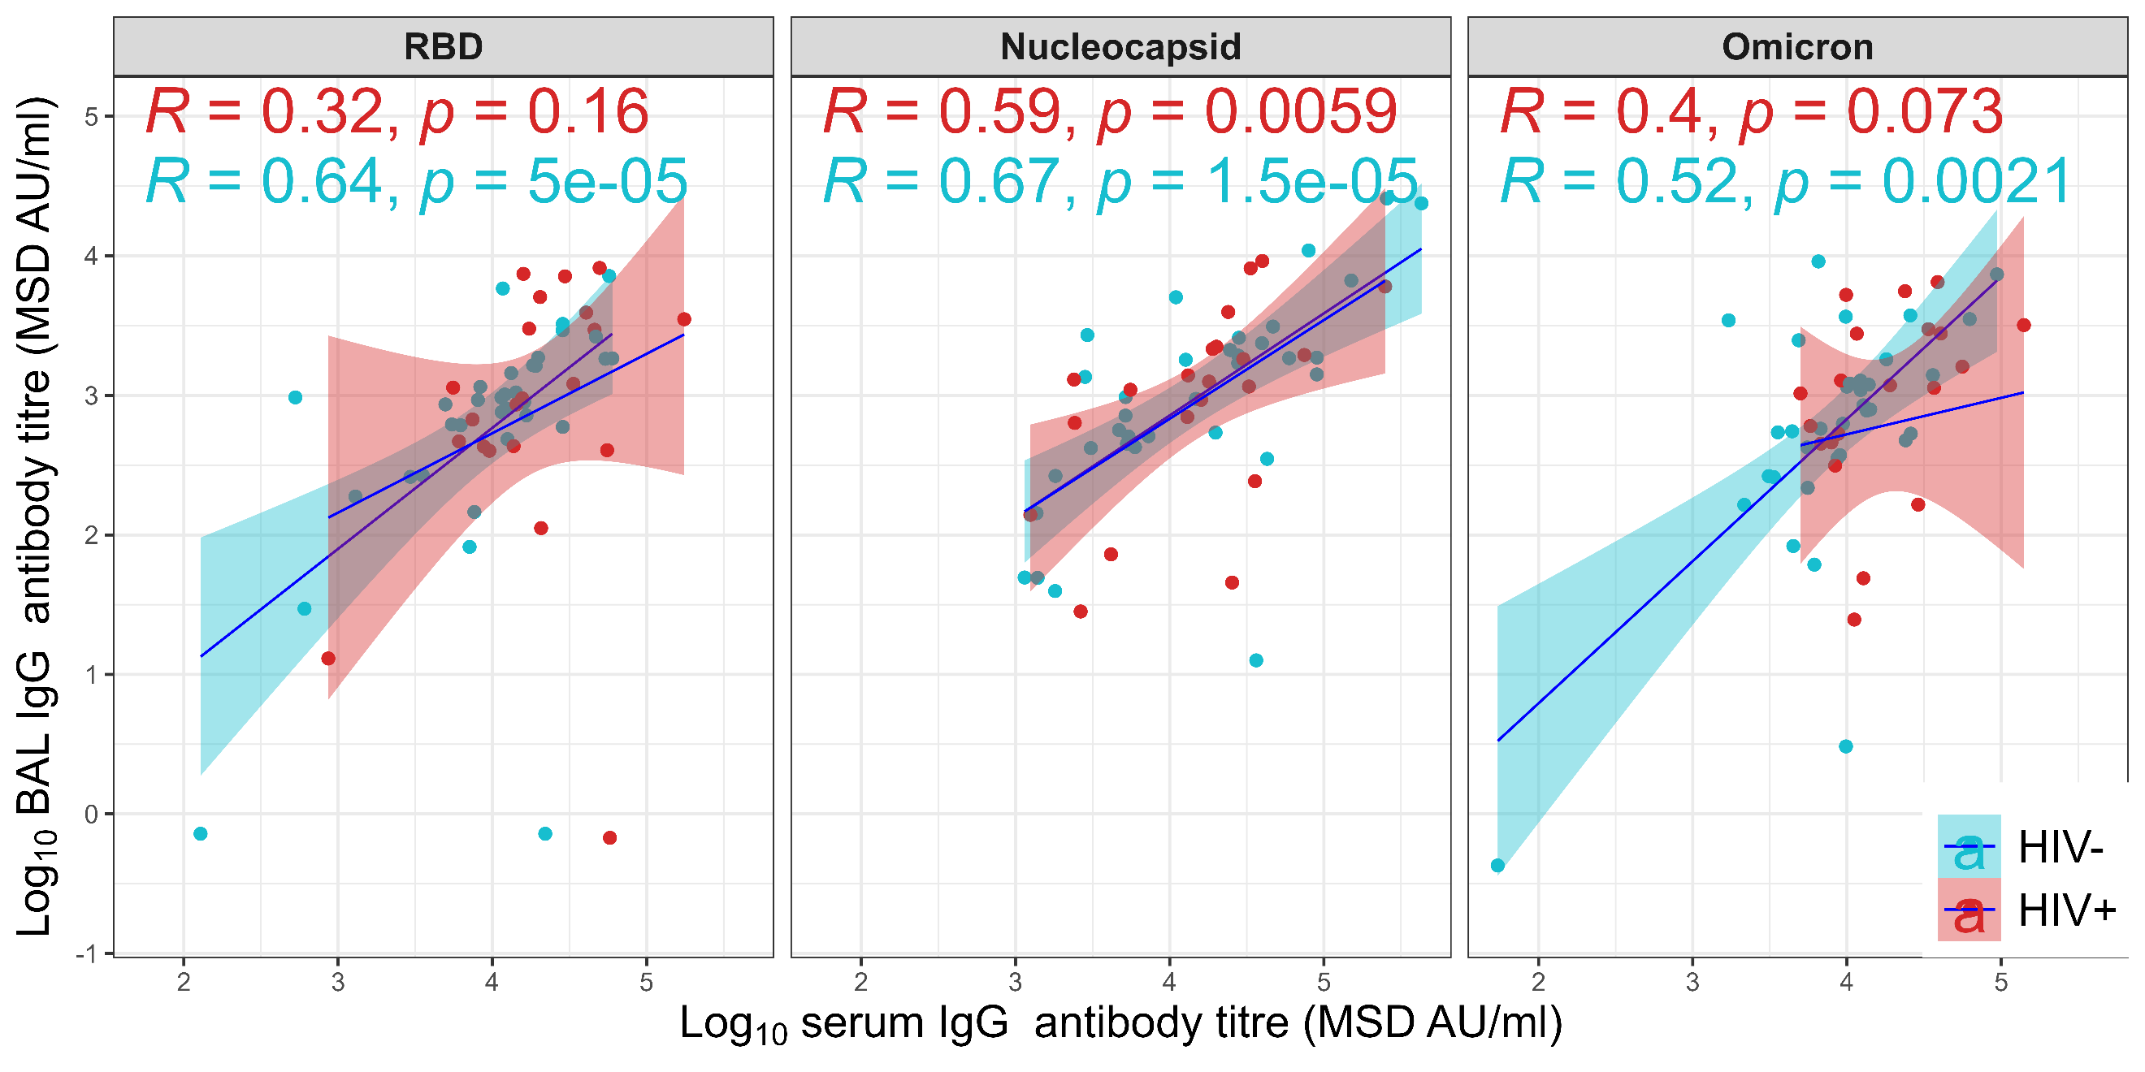
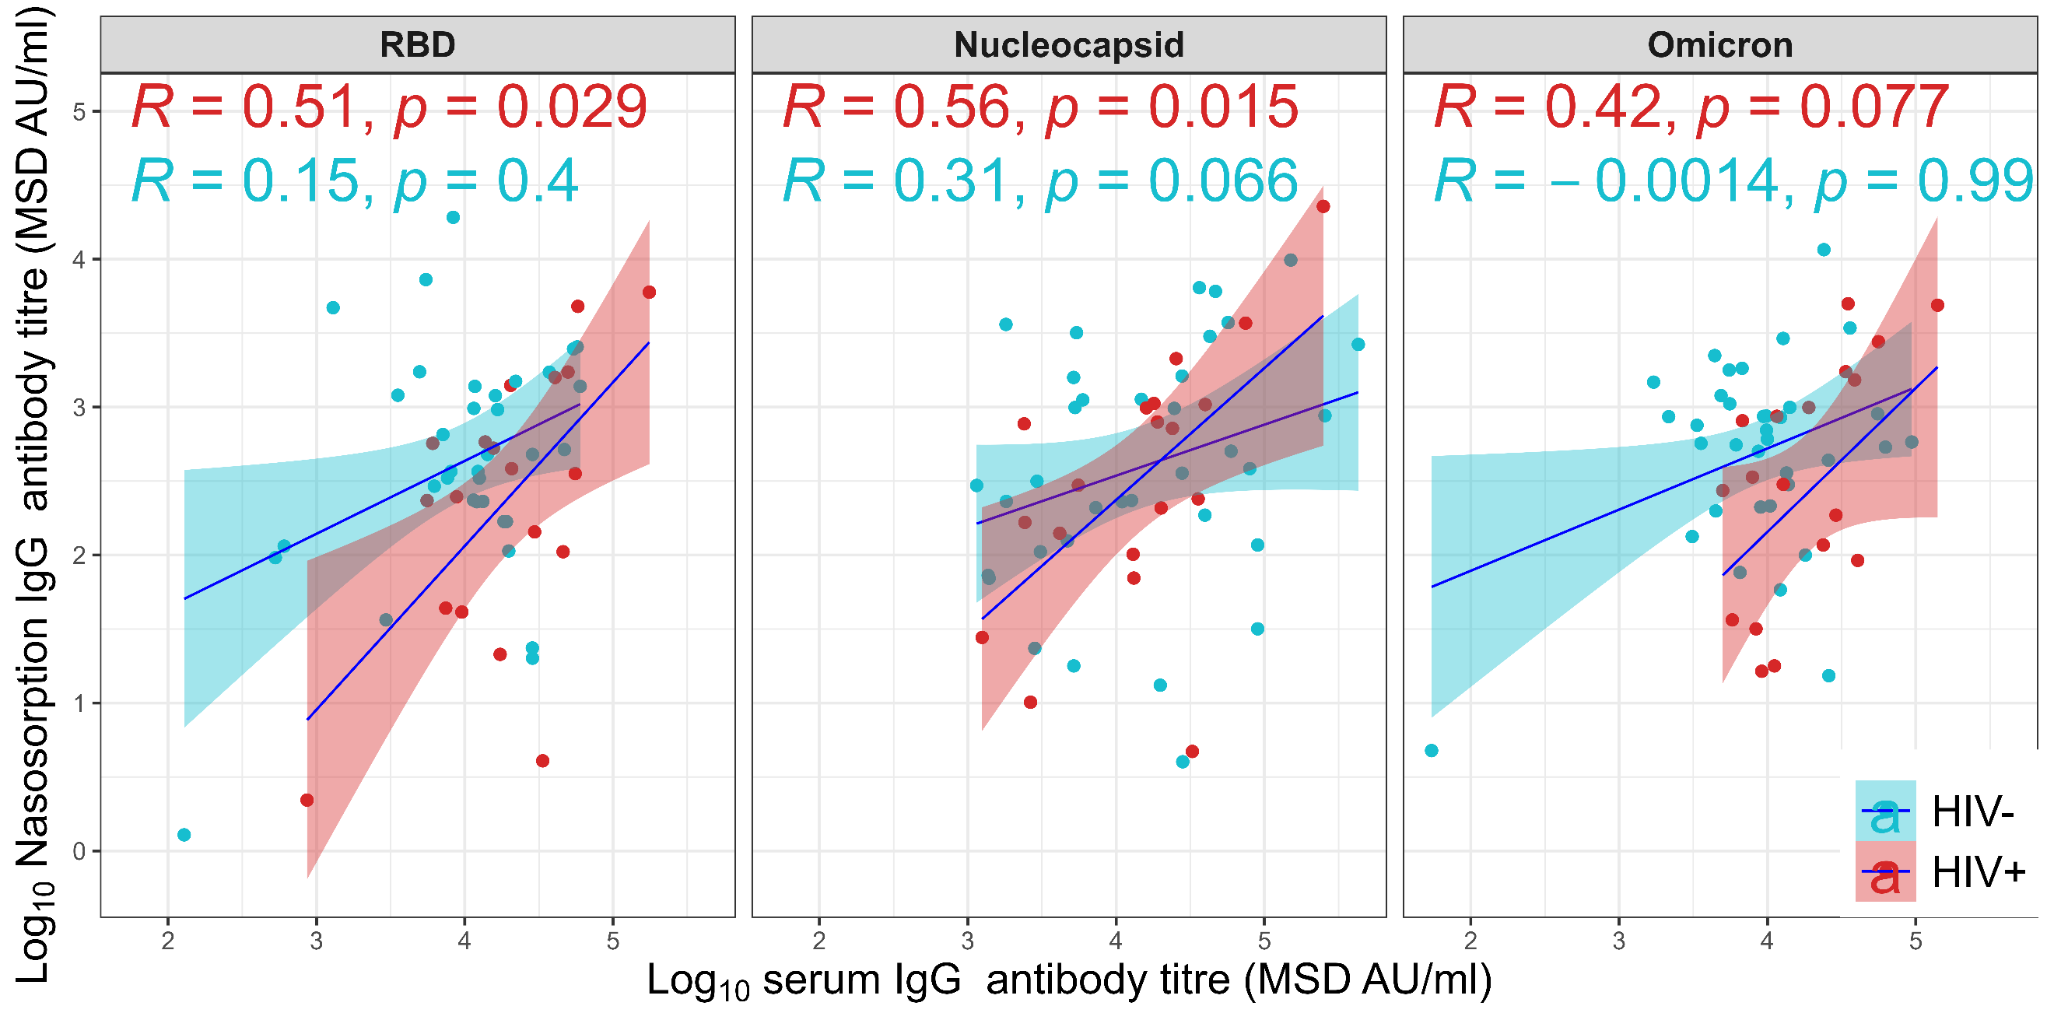
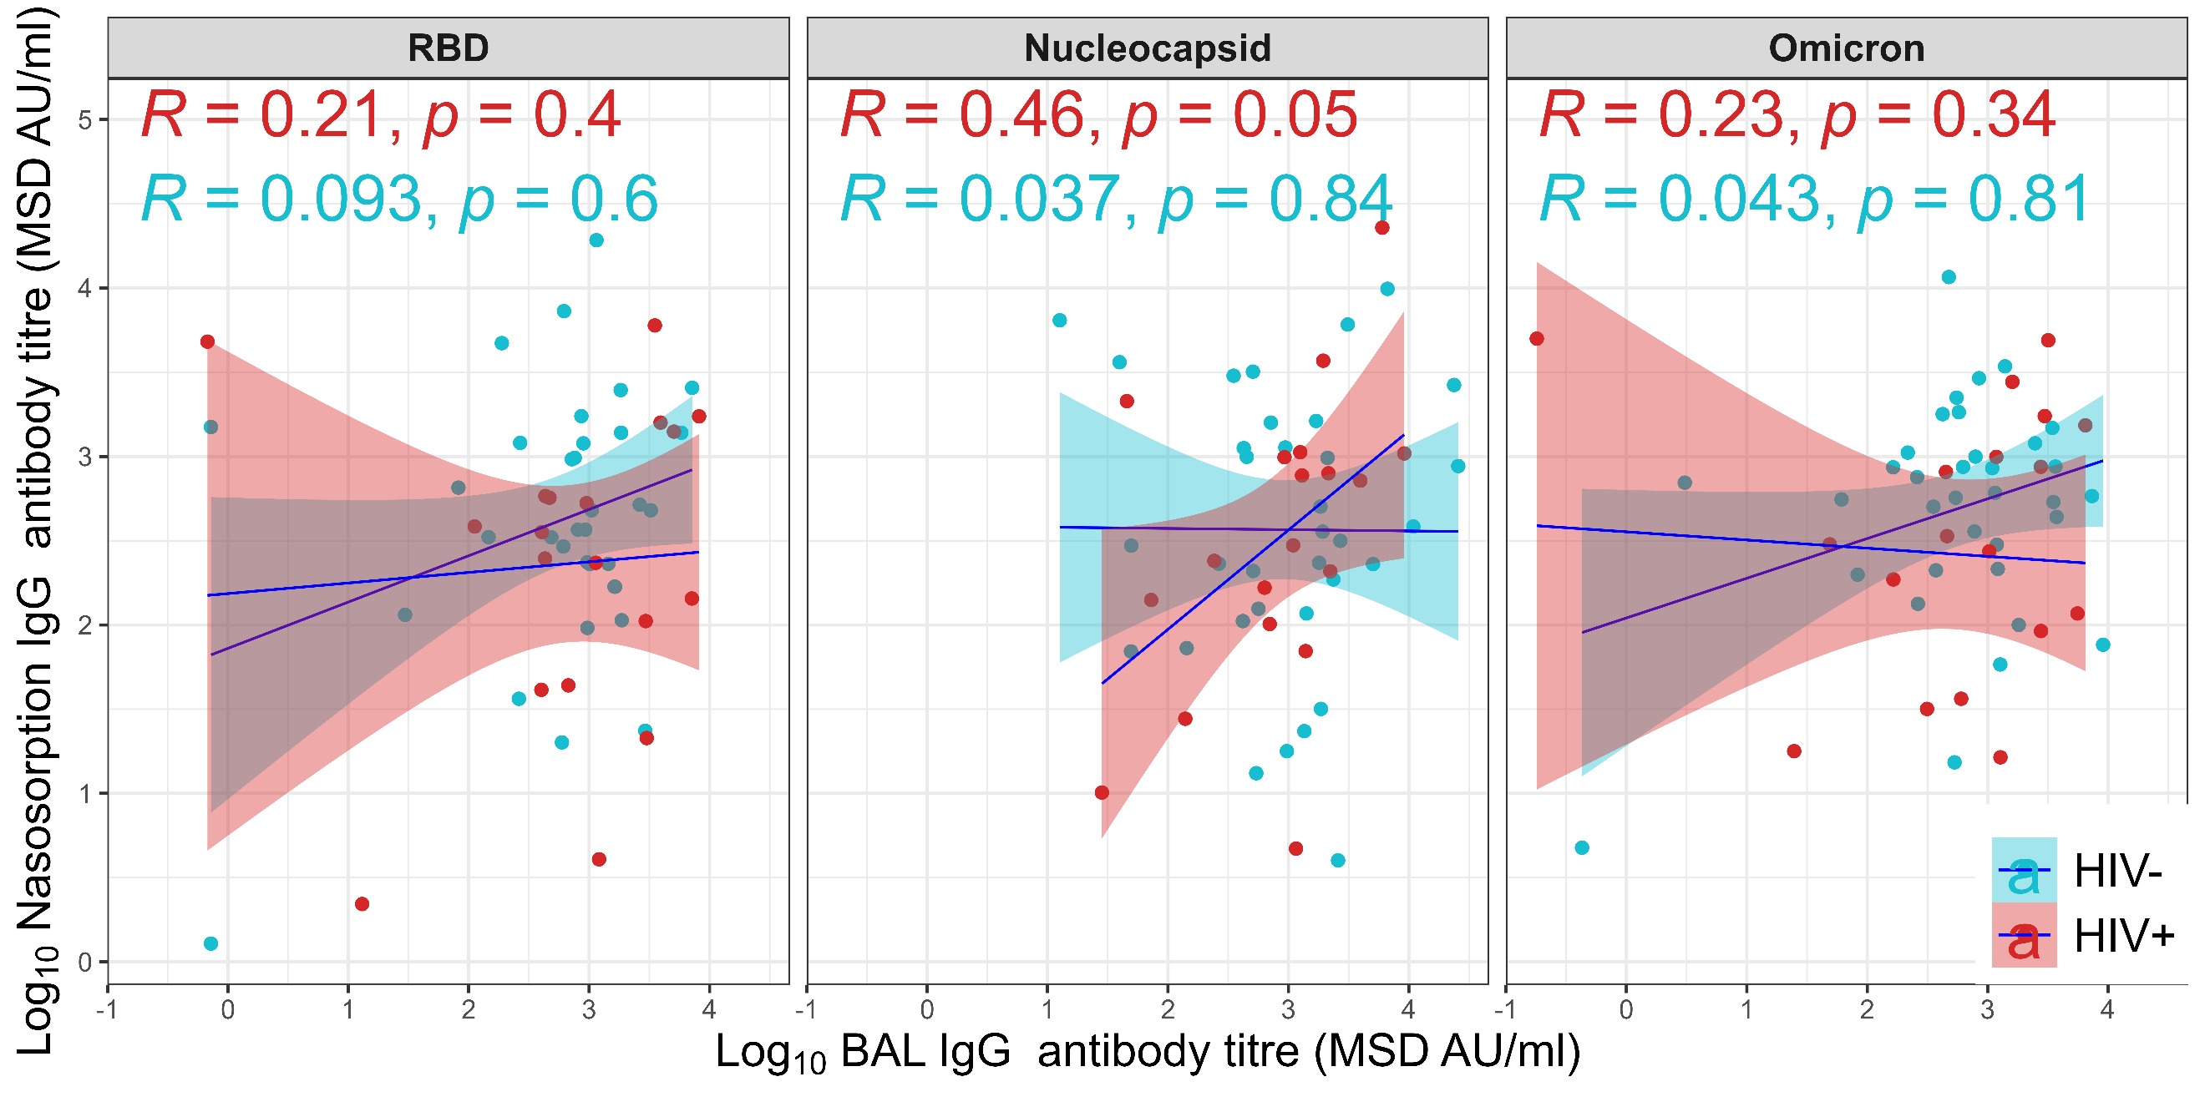
Association between SARS-CoV-2-specific IgG antibodies among serum, LRT and URT in PLHIV and HIV- adults
Stronger correlations between SARS-CoV-2-specific IgG antibodies in serum and LRT in HIV- adults than PLHIV.
SARS-CoV-2-specific IgG antibodies in serum strongly correlate with LRT than URT.
SARS-CoV-2-specific IgG antibodies in LRT poorly correlate with URT.
Notes:
-Stimulate the cells with the different peptides and those stimulated cells are the ones we will call SARS-CoV-2 specific Tcells
-AIM: activation-induced marker (upregulate surface receptors; when certain cells are activated, they upregulate receptors on their surface) to either induce cytotoxic or helper functions
-ICS: Intracellular cytokine staining assay (produce cytokines)

Slide 29

Acknowledgements
MUCOSAL MLW Team
Kondwani Jambo
Henry Mwandumba
Rhona Mijumbi
Gloria Kapira
Aaron Chirambo
Dorothy Kazembe
Memory Mvula
Robert Nyirenda
Precious Chigamba
MLW Clinical Investigation Unit Team
MUCOSAL Uni.Oxford Team
Daniela Ferreira
Elena Mitsi
Hannah Shrader
MUCOSAL UCL Team
Mala Maini
Mariana Diniz
Funders
Notes:
-Stimulate the cells with the different peptides and those stimulated cells are the ones we will call SARS-CoV-2 specific Tcells
-AIM: activation-induced marker (upregulate surface receptors; when certain cells are activated, they upregulate receptors on their surface) to either induce cytotoxic or helper functions
-ICS: Intracellular cytokine staining assay (produce cytokines)

