Slide 1
Wellcome Discovery Research
Opportunities for Early Career Researchers through Open Mode
Dr Emily Wheater
Research Manager, Early Career and Career Development Researchers

Slide 2

Wellcome is an independent and global charitable foundation
Our vision is a healthier future for everyone
Our mission is supporting science to solve the urgent health challenges facing everyone
​
Notes:
​

Slide 3
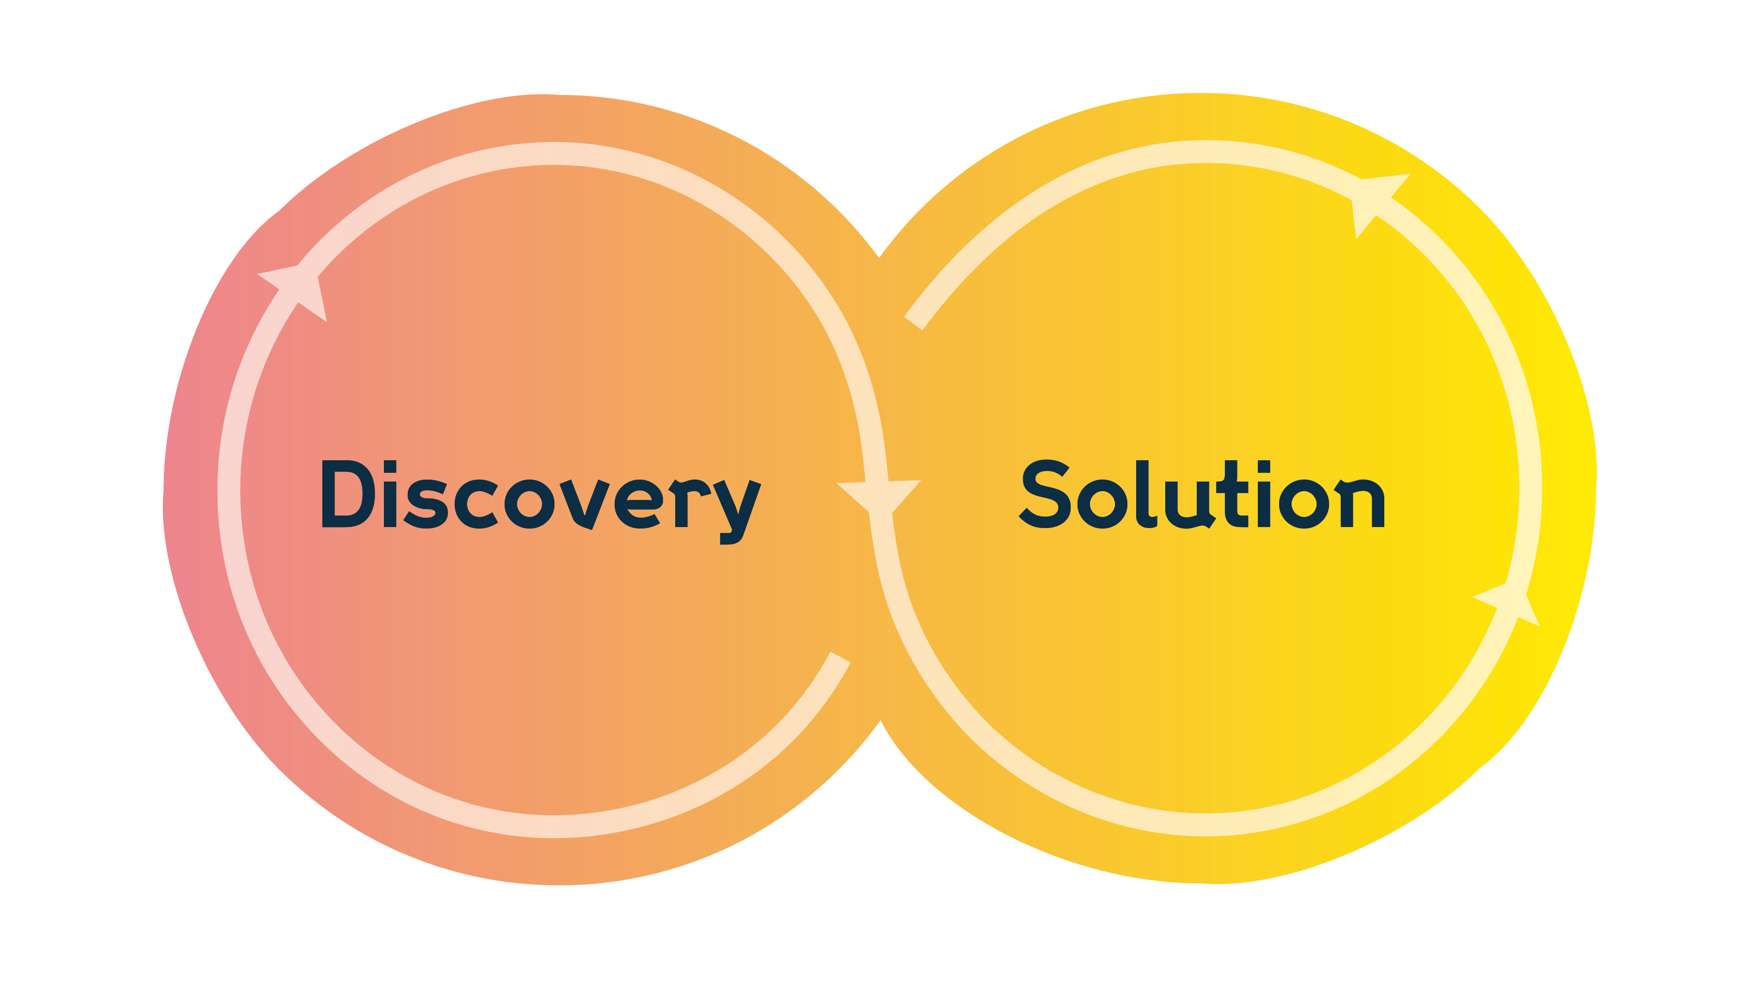





Discovering insights and accelerating solutions
Generate knowledge with
the potential to transform health in ways we
can’t always anticipate
Generate evidence for
much-needed action
and impact in the
shorter-term
Question, challenge, explore and expand what we know about life, health and wellbeing
Focus on urgent
health challenges where Wellcome’s experience, expertise and influence
can drive rapid change
wellcome.org | @wellcometrust

Slide 4
Discovery Research: Open-mode funding schemes
Designed to unlock researchers' potential and give them freedom, time and resource to take on big questions
Early post-doctoral
Late post-doctoral (towards independence)
Independent researcher
Early Career
Awards
(ECA)
Career
Development Awards
(CDA)
Discovery
Awards
(DA)

Slide 5
Discovery Research open-mode schemes
Late post-doctoral (towards independence)
Independent researcher
Early post-doctoral
Early Career
Awards
(ECA)
Career
Development Awards
(CDA)
Discovery
Awards
(DA)
For researchers ready to develop their research identity
Salary and up to £400,000 for research expenses
Usually for 5 years
  May be less in some disciplines
  Longer if held part-time
For researchers with potential to be international research leaders to develop their research capabilities
PI salary (if required) and resources needed for the programme of work (max 4 FTE)
Up to 8 years
For established researchers and teams to pursue bold and creative research
Investigator or team led
Single discipline or multidisciplinary
International standing in the field
Resources that are needed for the programme of work
Up to 8 years
wellcome.org | @wellcometrust

Slide 6
Early Career or Career Development Award?
Are you…
… developing your research identity?
… ready to lead your independent research?
Early Career Award
PhD or equivalent level of research experience
Up to 3 years post doc experience
Can undertake periods of clinical training; no more than 0.2 FTE on clinical duties (0.4 FTE for craft specialties).
Career Development Award
No time-post-PhD
Up to 3 years into first permanent position
Clinical health professionals must have completed their training
80% of research time to be spent on the award

Slide 7



We support research ideas from many areas
with a clear link to human life, health and wellbeing
Fundamental processes that underpin biology to understand more about how life works
Needs, values and priorities of the people and communities affected by disease and health disparities
Complexities of human health and disease including clinical and population-based approaches
Social, cultural, political and historical contexts
of human health and disease
Development of methodologies, conceptual frameworks technologies, tools or techniques that could benefit health-related research
While we do not support research that is exclusively translational, we encourage discovery research that has translational potential
Clarification: your research proposal does not need to align with one of Wellcome’s Health Challenge Areas

Slide 8

The assessment process
Three rounds a year
Shortlisting
Early Career Advisory Groups (6)
Written Expert
Review
Remit and eligibility checks
Early Career Awards
Early Career Interview Panel
Career Development Awards
Shortlisting
Discovery Advisory Groups (10)
Specialist
Subject area expertise
Written Expert
Review
Career Development Interview Panel
Discovery Awards
Discovery Award Interview Panel

Slide 9
The assessment criteria
Research Proposal
Research Environment
Applicant(s)
50%
of the overall
assessment
score
25%
of the overall
assessment
score
25%
of the overall
assessment
score

Slide 10
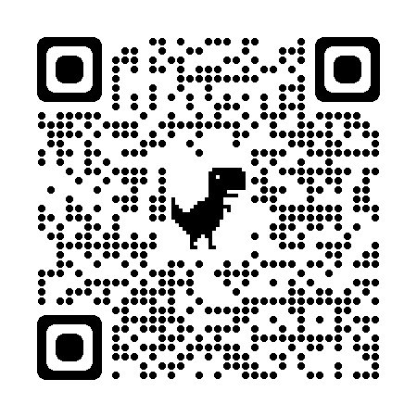
Research programme
Bold
Significant shift in understanding, potential to stimulate new and innovative research.
Creative
Tests new concepts, or novel approach.
High Quality
Well designed, feasible, supported by evidence.
Our top tips
Be proactive about getting feedback
Be objective and think about the audience
Make it as accessible as possible
Contingency plans
50%
of the overall
assessment
score
Check out our Guidance pages for how to write a grant

Slide 11
Applicant – Narrative CV
Outputs and contributions to knowledge – suitable for career stage and discipline:
Experience and autonomy
Relevant experience
Intellectual ownership & independence
Research outputs and contributions
New ideas, tools or techniques
To the wider research community
Career development
    Research skills and/or how these will develop
    Career development plans and/or contributions to the career development of others
25%
of the overall
assessment
score
Check out our Guidance pages for how to write a grant

Slide 12
Research Environment
How will the host environment support you?
How will you contribute to a positive
research culture?
How will you develop your leadership
and management skills?
Our top tips
Your sponsor
Your mentor
Your collaborators
25%
of the overall
assessment
score
Check out our Guidance pages for how to write a grant

Slide 13
What to do if your application is not successful
We will provide a rationale for the decision to reject your application
You can submit up to two applications on the same project
You need to make significant changes to the second application
There is no need to contact us first

Slide 14
How to reach us
For remit and eligibility queries
regarding a specific application:
Use the contact form on our website, or
email fundingsupport@wellcome.org,
call +44 (0)20 7611 5757 or access live
Chat through our scheme and call pages
For more information for Health Professionals: Discovery research schemes – Q&As for health professionals | Wellcome.
Learn how Wellcome Discovery Research funding can support research and researchers based in low- and middle- income countries Funding webinars for global researchers | Discovery Research | Wellcome
For more general updates:
Sign up to our monthly Research Update newsletter at wellcome.org/ResearchNewsletter
N.B. We will not discuss specific applications or provide tailored
pre-application advice

Slide 15
Questions?
e.wheater@wellcome.org

