Slide 1


Community Engagement and Involvement with Global Health Research
10th October 2024
Alun Davies

Slide 2

“Community engagement is not just a part of global health research; it's its heart and soul. It ensures that our efforts are not only scientifically sound but also socially relevant and culturally sensitive."
Dr. Tedros Adhanom Ghebreyesus,
Director-General of WHO, 2023
Notes:
For years I’ve been starting presentations and articles with “community engagement is increasingly recognized as important for health research
Now it’s become, and Tedros describes, “the heart and soul of research…

Slide 3
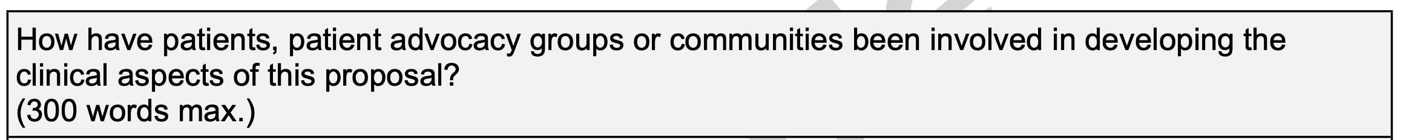
Engagement increasingly demanded by research funders
“NIHR champions community engagement and involvement (CEI) as a core principle of its global health research portfolio, alongside equitable partnerships and local research capacity strengthening. All applicants for NIHR global health research funding are required to plan for and undertake active and participatory CEI.” nihr.ac.uk
Wellcome Fellowship Application Form

Slide 4
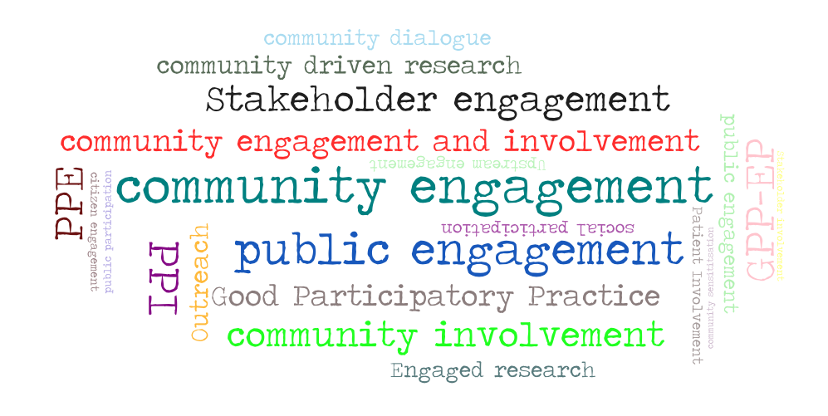
What is community/public/stakeholder engagement and involvement?
A range of (contested) terms
A range of activities
A range of goals
Notes:
Fragmented articulation of terminology and approaches
Across, funders, types of studies, and social, political and cultural contexts
Is likely to hinder access to resources and choices of appropriate approaches

Slide 5


Community?
A range of contested terms
Ethnicity? Religion?
Geographic area?
Common interest
Common health problem
md.faisalzaman from Worcester, MA, CC BY 2.0 <https://creativecommons.org/licenses/by/2.0>, via Wikimedia Commons
Public?
National health programme users
Global, continental, national, city?
TV and radio audience?
People in the street?
Voters, taxpayers?
Photo: AIDS 2016 Treatment Access march by Paul Kidd
CC BY-NC-SA 2.0 DEED

Slide 6
Who might stakeholders be? (tomorrow)
Contested terms
Stakeholders
Local community representative
Non-Governmental Org leader
Research Institute Director
Women’s group lead
Hospital manager
Health policy maker
Local chief or mayor
Minister of Health
Community
Public
Stakeholders
Clearly define who we mean

Slide 7
What is ‘engagement’ and ‘involvement’
Contested terms
NIHR
  Involvement – “An active partnership between patients, carers and members of the public with researchers that influences and shapes research”
  Engagement – “information and knowledge about research is provided and disseminated”
Other definitions
  Engagement – “inclusive participation that supports mutual respect of values, strategies, and actions for authentic partnership” (Ahmed et al 2010)
Contested terms – no universal definitions

Slide 8



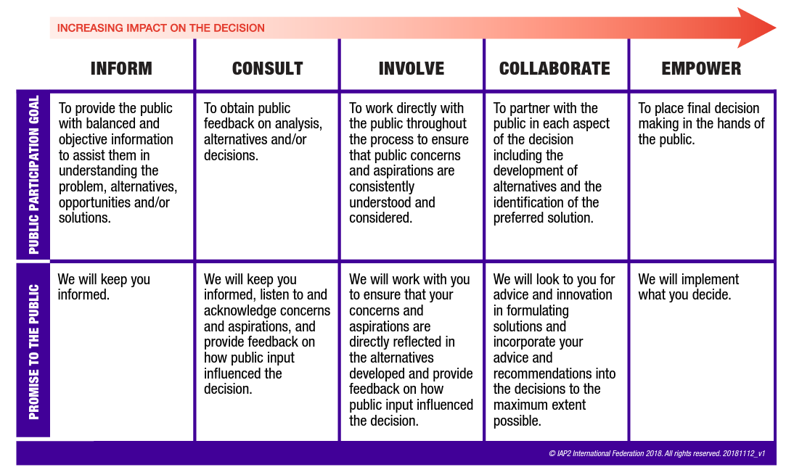
The spectrum of participation?
1-way communication
Engagement:
2-way communication
Source: IAP2

Slide 9
A range of goals
Understand community norms and views
Gain permission and community consent
Share the research findings
Identify local health priorities
Promoting understanding of research
Improve communications and consent materials
Strengthen long-term partnership
Facilitate community input into research design
Support young people locally to take up research careers
Identify and address ethical issues
Improve recruitment and retention rates
Assess/ensure acceptability and feasibility of research
Build relationships, trust and partnership;
expressing respect
Goals sourced from:
Good Participatory Practice – AVAC
Molyneux S, Bull S. et al. 2013
UK standards for Public Involvement

Slide 10
Good Participatory Guidelines (GPP)- engagement throughout the research lifetime
Before the research
During the research
After the research
Community input into research
Identify and solve challenges during the research
Maintain and build partnerships

Slide 11
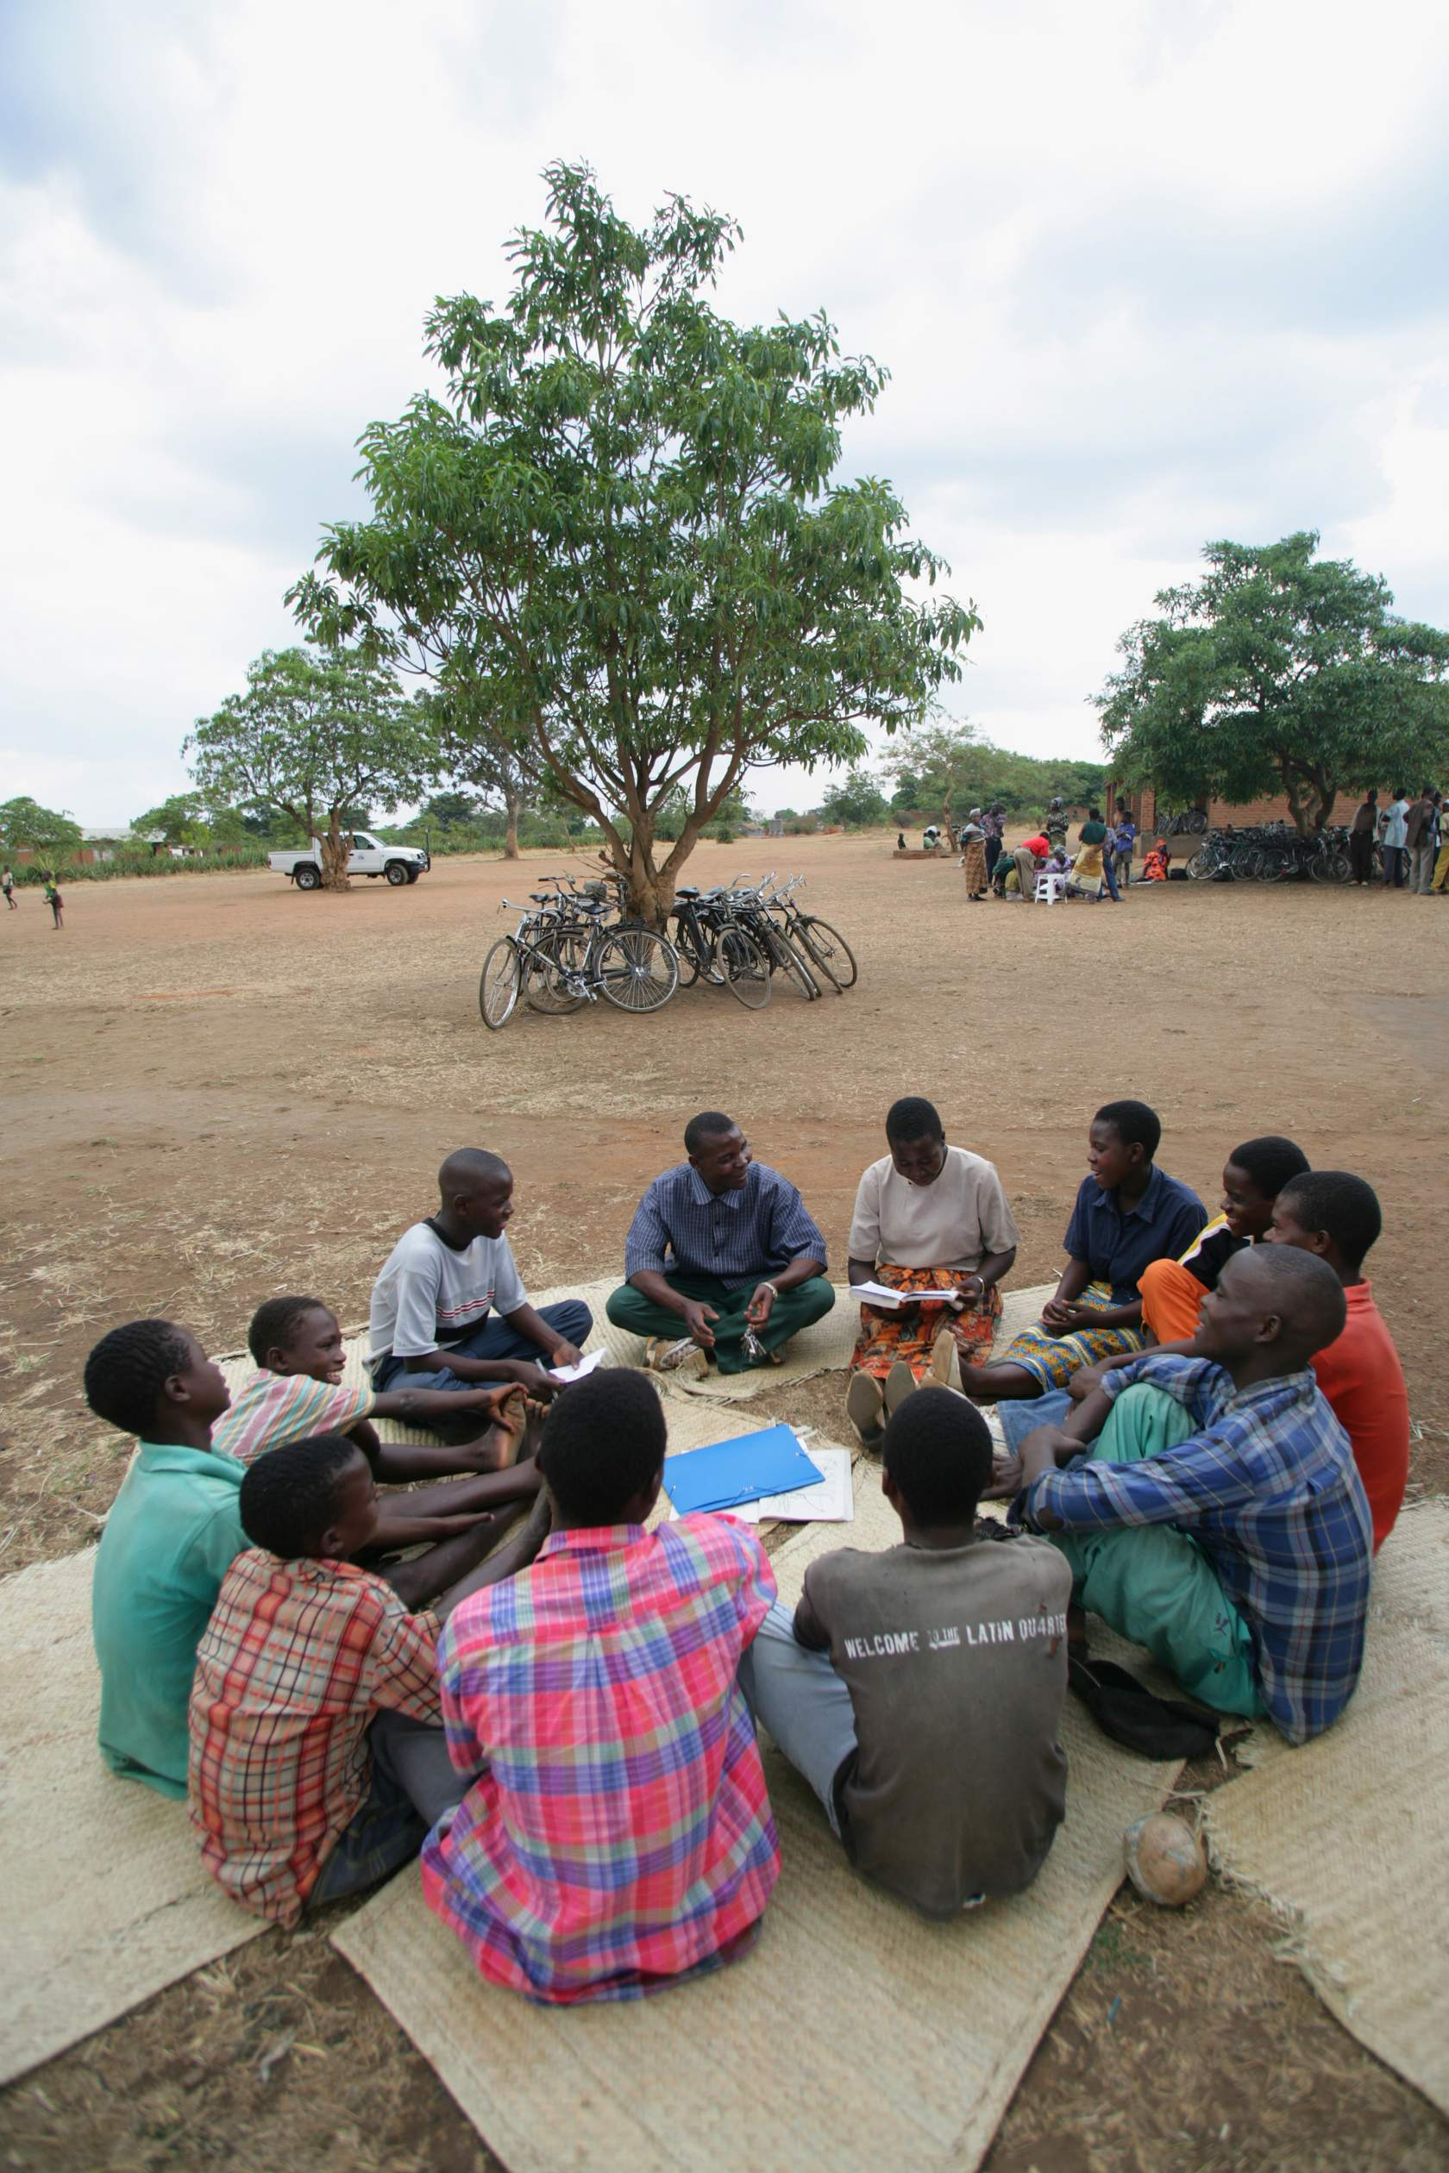








A range of methods – low cost at planning stages
Research priorities
Share plans
Explore concerns/
acceptability/feasibility
Gather ideas/insights

Slide 12

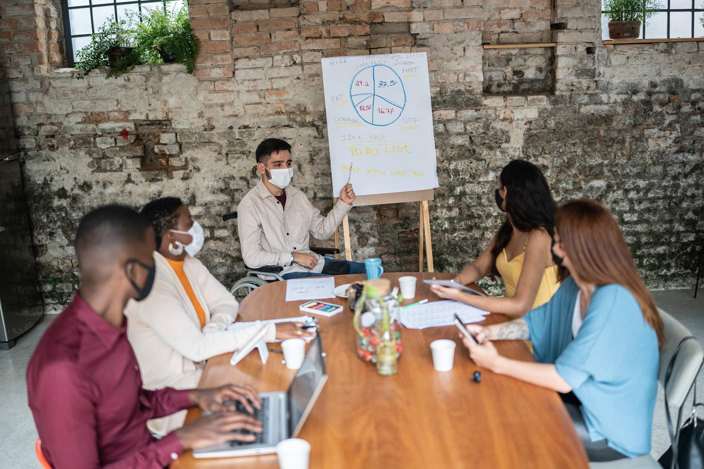
A Range of methods – Community Advisory Board
“… relatively well-known, confident, prominent and vocal leaders speaking on behalf of their communities, such as religious elders, local chiefs or elders, or leaders of women’s groups and other community-based or nongovernmental organizations.”
Long(er) term relationships – frequent meetings
YPAGs, Patient Groups (PPI) etc.
Funding depends on Pre-existing? Establishing a new CAB

Slide 13
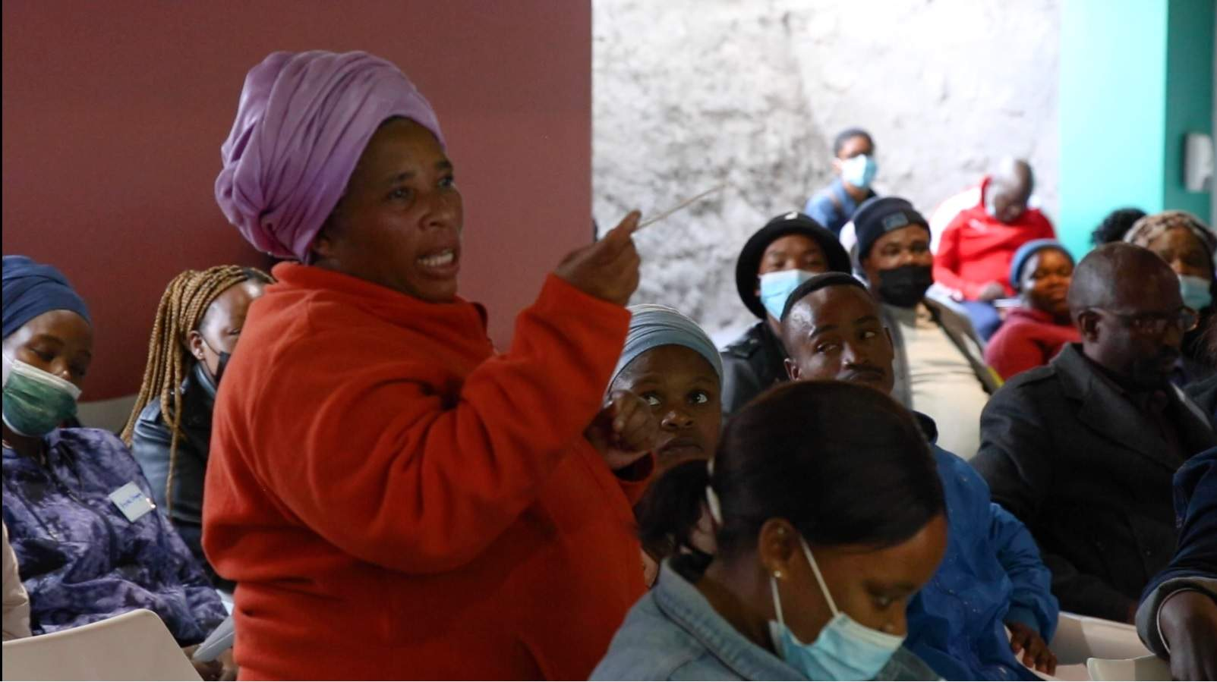

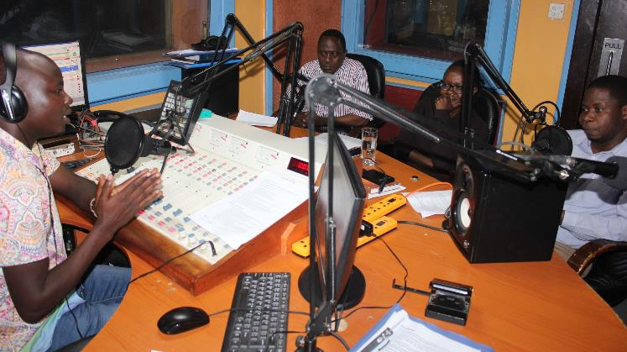
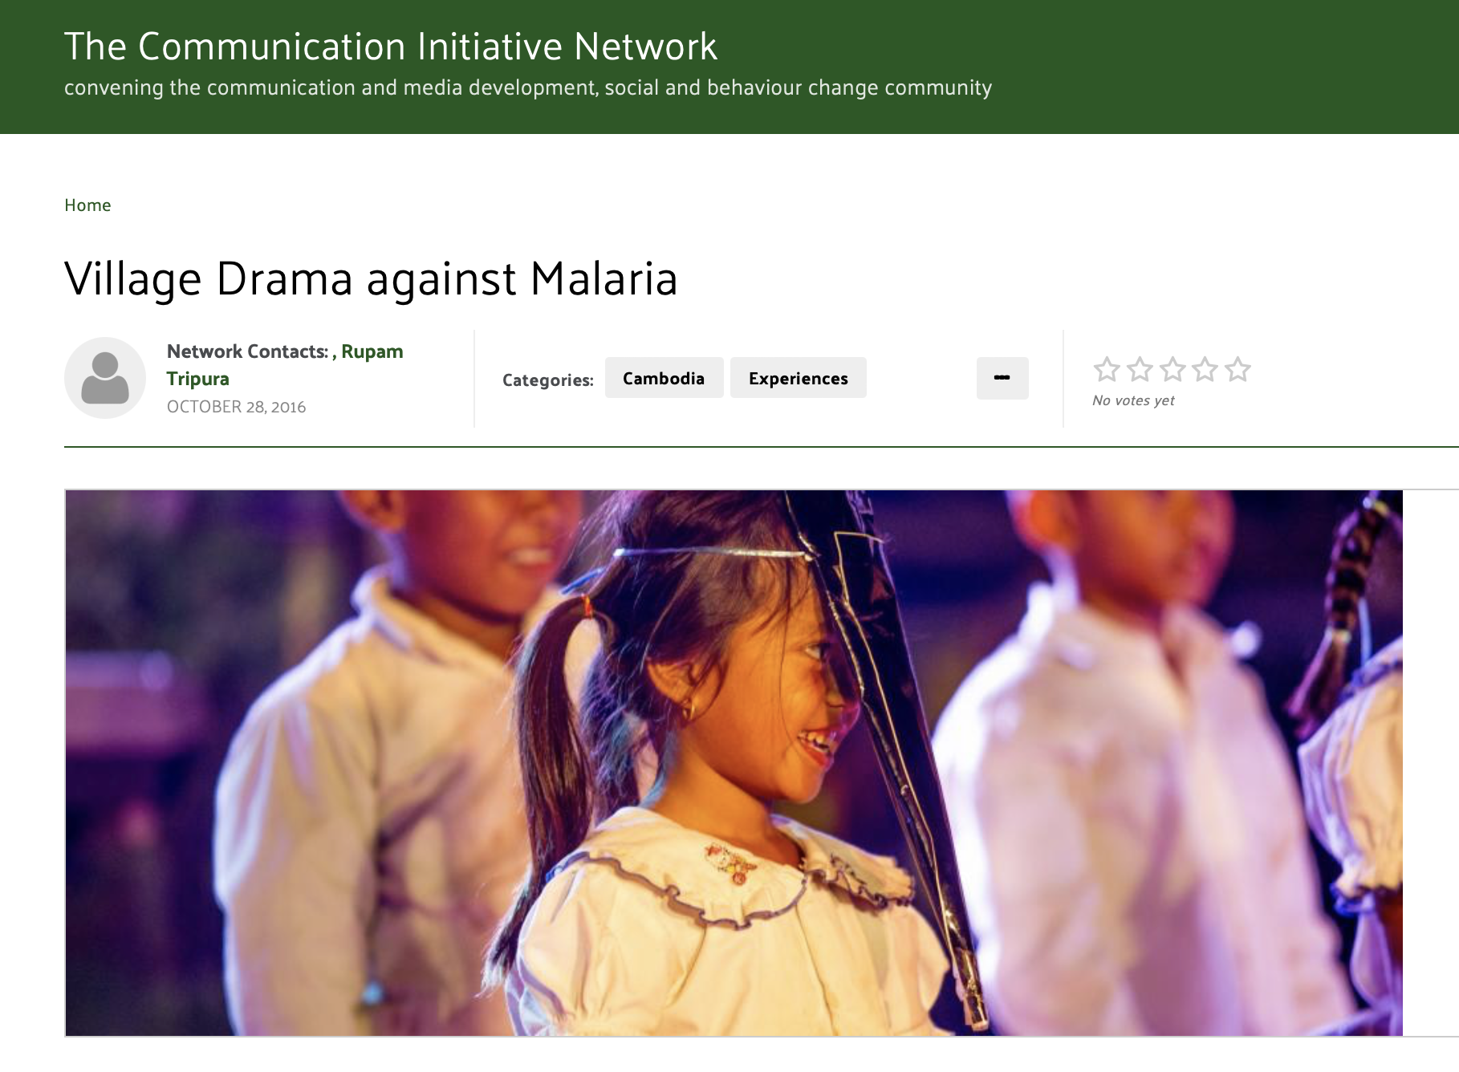

Forms of ‘Wider’ community/Public engagement
Requires funding
  Skilled staff
  Venues
  Community costs
  Partner costs

Slide 14
Deep or Wide CEI?
Deep CEI …………………………………………………..……
Wide CEI
A CEI strategy may combine both wide and deep approaches
…………….…... Shorter encounters
…………………………….…….……… Greater outreach
…………………………….…………. Less participatory
………. Raising public awareness
………………….. Greater representativeness
Forming longer-term relationships
Small outreach
More participatory
More opportunities for mutual learning
Limited representativeness
Meetings with hospital management
Community Advisory Board
Social media posting
Laboratory open day
Davies et al 2019

Slide 15



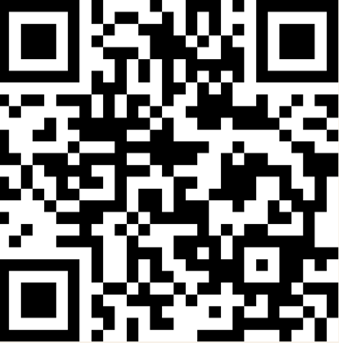






An Introduction and Practical Guide to Community Engagement and Involvement in Global Health Research
Authors
Gill Black
Rodrick Sambakunsi
Robin Vincent
Alun Davies
Noni Mumba
Helen Latchem

Slide 16

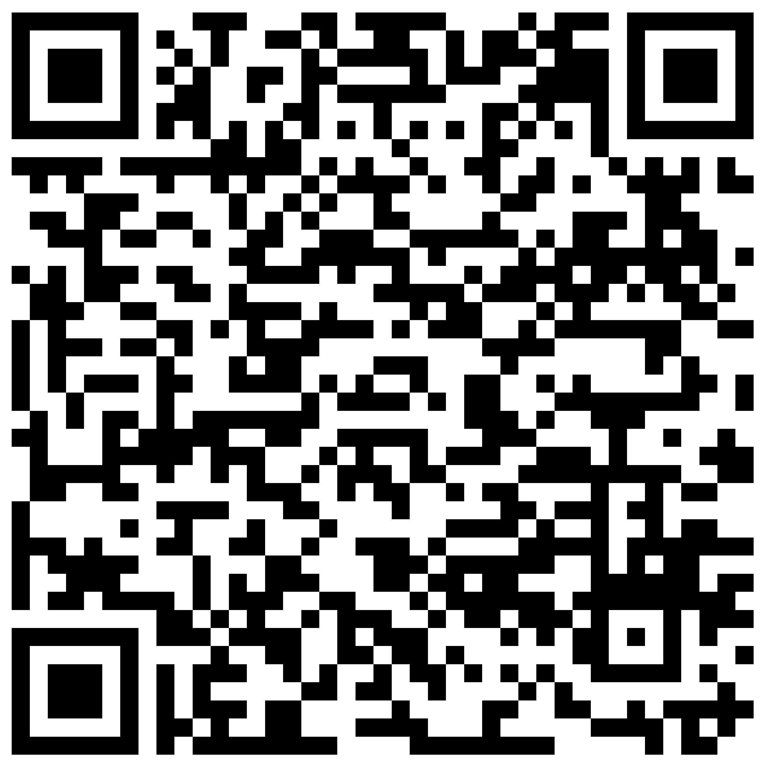

This practical guide outlines how to plan a Community Engagement and Involvement strategy for funding applications

