Slide 1
Management of outbreaks and incidents in prisons and places of detention (PPDs) National webinar Health and Justice Team, UKHSA

Slide 2
Multi-agency outbreak guidance
To support health and justice (H&J) partners to work together in the management of health protection incidents and outbreaks in prison and places of detention (PPD)
Guidance published by UKHSA but developed in collaboration with system partners – NHSE, HMPPS, HO, YCS, IPC
Provides overarching information on outbreak management, not specific disease guidance
Covers those who are resident or working in:
Prisons
Immigration Removal Centres (IRCs)
Children and Young People Secure Estate (CYPSE)
Approved Premises (probation)
Update includes new sections on CYPSE, IRCs and prevention including vaccination

Slide 3
Definition of an outbreak
An outbreak is defined as:
an incident in which 2 or more people affected by the same infectious disease are linked by time, place, or common exposure
a greater than expected rate of infection compared with the usual background rate for the place and time where the outbreak has occurred
Guidance can also be applied to support management of microbial contamination of food/water, single cases of a rare disease or clusters.

Slide 4
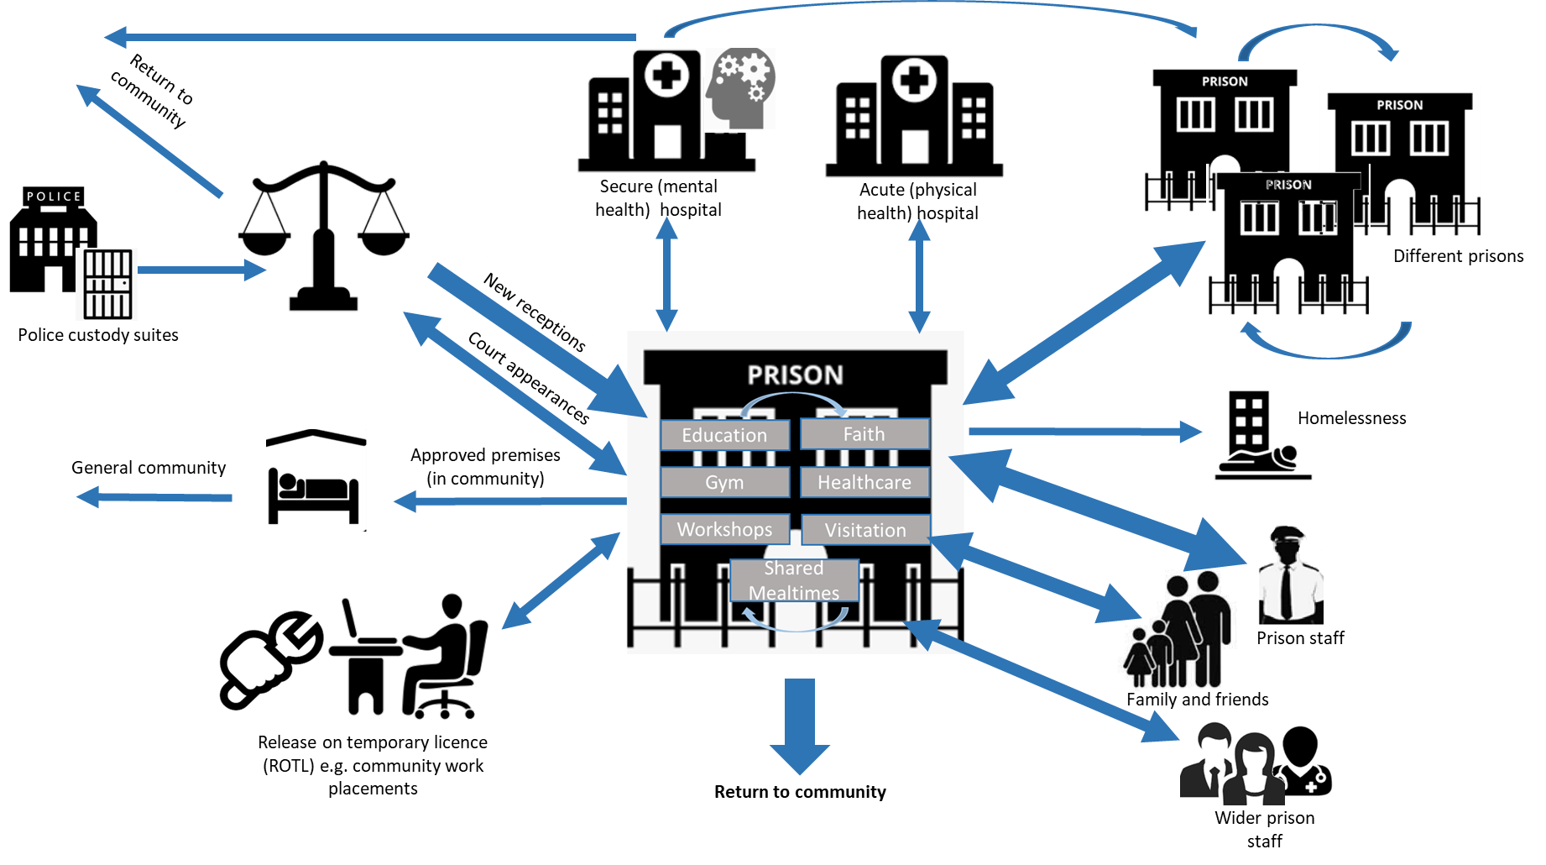
Why do we see outbreaks in PPDs?
PPD residents tend to experience higher burdens of disease
PPD settings exacerbate risk of transmission
Communal, crowded settings with high levels of movement
Poorer access to healthcare in the community
Engagement in high-risk behaviours e.g. injecting drug use
Social risk factors e.g. history of homelessness
Lower uptake of preventative measures such as vaccination

Slide 5
Key points described in the guidance

Slide 6
Sections in the guidance
Roles and responsibilities of partner agencies
Specific considerations for CYPSE and IRCs
Prevention and infection prevention and control (IPC)
Outbreak definitions
Required actions for different partner agencies
Establishment, membership and role of the incident management team
Population management (including specific setting considerations)
Communication, reporting and data sharing
8 Annexes e.g. outbreak management plan agreement, notification algorithm, HMPPS operational risk assessment template
Notes:
Cypse – balancing harms, IRC international health regulations

Slide 7
Notification
Vital that notification is made promptly to UKHSA local health protection team (24/7) – for some diseases this is required by legislation (notifiable diseases)
Notification can be done by Governors, directors, centre managers, health professionals or other responsible individuals
Notifications may include:
A case of a notifiable disease e.g. measles
A suspected or confirmed outbreak
Seemingly high/increasing cases of people with similar symptoms/infection
More than one infection circulating within the same group of people e.g. Covid-19 and flu
This may trigger…..
Notes:
Public health control of disease act

Slide 8
The incident management team (IMT)
Multi-agency forum established and chaired by UKHSA Health Protection Team (HPT)
Formally minuted with decisions and actions noted
Remains established for as long as required
All members have responsibility for managing and resourcing the outbreak
Core members include:
UKHSA health protection specialists
Nominated lead from the setting (HMPPS/HO)
Healthcare lead from the setting
Communication leads
Director of Public Health or representative
Administrative support
Notes:
But there can be other representatives e.g. environmental health, microbiology, hospital

Slide 9
Role of the incident management team (IMT)
Establish whether an outbreak or incident really exists, agree case definition and monitor epidemiological data
Public health risk
Assessment – including residents, staff and visitors
Decide on public health actions required and seek resources and operational support to implement
Agree on declaring outbreak closure
Act on lessons learnt, outbreak reports
Notes:
Essentially multi agency forum with expert PH oversight to guide action to stop the outbreak and reduce associated harms as soon as possible

Slide 10
Risk assessment
UKHSA HPT risk assessment
Considers epidemiological data e.g. number and timing of cases
Considers the vulnerability of the setting and people living and working within it e.g. age, pregnancy
Considers potential exposure and transmission opportunities
Assesses severity/potential severity e.g. is anyone hospitalised, is there a high risk of death
HMPPS operational dynamic risk assessment
To support population management decisions
Describes the current situation
Describes IMT public health advice
including advice to protect staff
Provides the IMT assessment of severity
Notes:
The imt will undertake risk assessment - UKHSA consultant leads and confirms the risk assessment using information provided from imt members
Hmpps RA only for hmpps sites
Setting – open prison vs reception

Slide 11
Public health advice
Must be mindful and try to balance harms, operational impacts and risks
Recommendations for implementation could include:
Isolation Cohorting
Reducing opportunities for mixing Testing
Provision of antivirals Vaccination
Gathering info on vaccination status Stopping visits
Restricting transfers in/out Enhanced cleaning
Personal protective equipment Contact tracing
PPDs should be aware of these potential for these recommendations and have plans in place that allow them to support e.g. contact tracing people who may have since left the PPD

Slide 12
Specific considerations for the CYPSE
CYPSE settings vary greatly in size, population density, staffing ratios and building design so have differing risks of large outbreaks and associated harms
Each of the settings in the CYPSE has different governance arrangements for population management
Previously healthy CYP are at much lower risk of harm from many infectious diseases than older adults with underlying conditions in prisons
CYP may be particularly vulnerable to harms associated with isolation (e.g self-harm and violence), so IMTs will ensure that health protection measures are proportionate to the setting-specific risk, including individualised risk assessment if required

Slide 13
Specific considerations for Immigration Removal Centres (IRCs)
More freedom of movement within the setting and between the setting and the community.
Different living conditions to those in prisons e.g. dormitory style accommodation
Individuals may only be in an IRC for a short period before returning to the community or removal to another country (IHR considerations).
Equitable access to healthcare e.g. culturally appropriate public health advice, translated materials, human rights (diagnosis -> treatment)

Slide 14
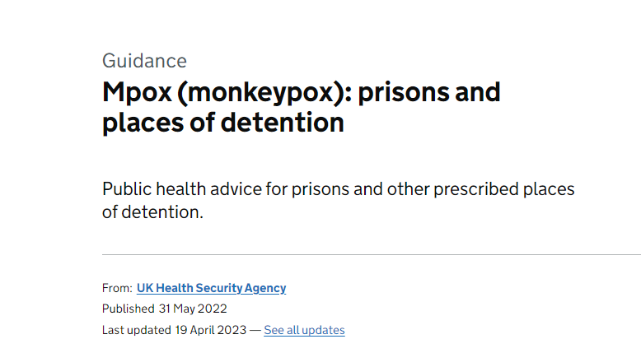
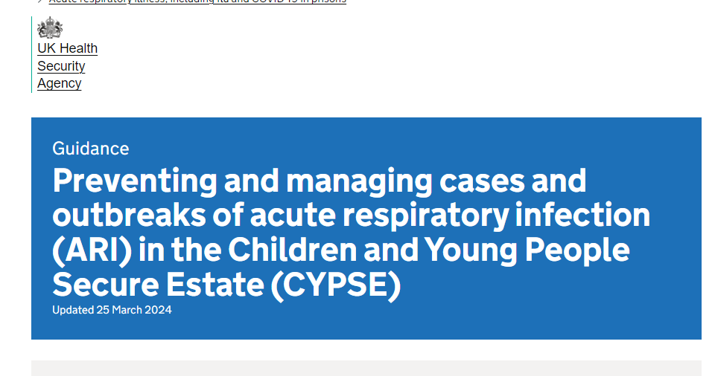
Agreed and documented plan – supported by other guidance

Slide 15
Lessons Learned: Responding to Measles in a private secure setting

Slide 16
Over view
Outbreaks of infectious diseases in places of detention are harder to manage owing to the logistics, their set up and close proximity in which large numbers of inmates reside with the potential for spread.
Since October 2023, a resurgence in measles cases has been observed across England.
In April 2024, East Midlands HPT led a multi-agency response to an outbreak of measles in a Category C prison accommodating 1715 males aged >18 years, the first to be reported during the current national outbreak.
We describe the public health management of this outbreak and share lessons learned, to inform future response to measles outbreaks in prisons.
This outbreak posed various challenges and issues which led to lessons learnt and recommendations

Slide 17
How the outbreak evolved
A 46-year-old male was transferred from HMP Wayland to HMP Five Wells on 19/03/2024
Moved wings during the incubation period
Inmate developed measles symptoms on 10/04 and a rash on 14/04
Case was confirmed for measles on 27/04
However, an IMT called 25th April to discuss as probable cases and swab and micro issues
A further 4 cases of measles in inmates identified, on the same wing as the first case during the infectious period
2 cases of measles in staff members from the same wing also confirmed
Source of infection for primary case unknown (liaison with other HPTs, prison)

Slide 18
IMT membership
Following notification of the index case an incident management team (IMT) was convened
Representation¹ from UKHSA, NHSE, ICB, HMPPS and LA
consultant in health protection (chair) - UKHSA
governor/director/centre manager/responsible individual or nominee - HMP FiveWells and HMPPS
health protection specialist/practitioner - UKHSA
nominated communications managers - UKHSA
director of public health (DPH) or representative – North Northamptonshire
administrative and secretarial support - UKHSA
head of health services for secure setting – HMP FiveWells
consultant microbiologist - UKHSA
NHS England Health and Justice commissioner – NHS
National Pharmaceutical Adviser Health and Justice Specialised Commissioning NHS England
Head of the Joint NHS/HMPPS OPD Pathway Programme
National experts health and justice – UKHSA
Laboratory Public Health Services Manager – UKHSA
¹ Appendix 2 IMT membership and contact list template

Slide 19
Response and Management
Regular liaison and 6 Outbreak Control meetings in total
A detailed risk assessment was completed
Standardised case definitions developed
Site visit and contact tracing undertaken
Vaccination of prisoners and staff advised
Urgent testing arranged for any suspected cases
Debrief held 16th August
Seven cases of measles were confirmed between 25th April and 17th May 2024 (four prisoners and three staff)

Slide 20
Case definitions
Confirmed case: a case with laboratory confirmation of acute infection with rash onset from 10th April in a prisoner or staff member at HMP Five Wells, or with an epidemiological link to the prison
Probable case: a clinically classical case of measles with rash onset from 10th April in a prisoner or staff member at HMP Five wells, or with an epidemiological link to the prison

Slide 21
Epidemiological Curve (n=9)

Slide 22
Control Measures: Isolation and Lockdown
Isolation of index case
Following confirmation of the second case, wing lockdown restrictions were implemented.
All contacts were isolated in their own cells
Prisoner transfers into and out of the wing were paused
Cohorting for exercise was established
Alternative arrangements for meal delivery and medication administration made
Social visiting restrictions, and limited staff movements

Slide 23
Control Measures: Vaccinations of Prisoners
Of the 7 confirmed measles cases identified 4 were unvaccinated, 2 had an unknown vaccination status and 1 case had 2 MMR vaccinations
All linked to the same wing where 65% (39/60) of prisoners were unvaccinated.
No vulnerable contacts were identified during the outbreak and no immunoglobulin was administered.
39 unvaccinated men on Whitchurch Wing
MMR Vaccination offered to 282 prisoners
MMR added to Covid vaccination clinics plus additional MMR clinics set up
117 (41%) received their first dose
106 (38%) declined
59 (21%) did not attend their healthcare appointment.

Slide 24
Summary: MMR status of prisoners
Location | Total number at location | Number vulnerable | Number not immunised at start of response | Number offered MMR | Number taken up offer of MMR | Number declined | Number DNA | Number outstanding
D2 | 60 | 3
D1 | 60
D3 | 60
D4 | 60
Prison | ? | ? | 313 | 282 | 117 (41%) | 106 (38%) | 59 (21%) | 20*
* Mainly new admissions from last few weeks

Slide 25
Control measures; Vaccination of staff Summary: MMR status of staff
Location | Total number | Number vulnerable | Number not immunised at start of response | Number interested in having MMR | Number taken up offer of MMR | Number declined | Number DNA
Prison | ? | Unknown | Unknown | 110 | 53
Local Authority& NHSE Commissioned Vaccination bus for staff (10-11th June)
Delays
Mobile vaccination risk assessment
Public liability documents
Situated in car park for ease of access

Slide 26
Control Measures 2
Raising awareness amongst staff and prisoners
Posters
Radio messages
Screen savers
PPE
IPC review on site
IPC training provided to staff

Slide 27
Challenges
Outbreak management was complicated
the dynamic nature of the setting
the characteristics of the prisoners
a lack of context specific guidance.
Risk assessment tailored and adapted around the prison’s regime
ensure staff and prisoners safety and wellbeing
Specific challenges included:
Lack of access to vaccination records
Vaccine procurement
Lack of fit-testing for prison staff
Contact tracing of exposed prisoners (esp unvaccinated), hosp and funeral
Isolating cases
Cohorting of wings/staff (vaccinated)
Lack of occupational health delivery of staff MMR vaccination
Microbiological - logistical issues, interpretation of results
Maintaining health and wellbeing of prisoners (exercise, meds, visitors)

Slide 28
Lessons learned
HMP Prison recommendations
Assess MMR status of prisoners on arrival
absence assume susceptible and offer catch-up – document response
Document/assess vulnerability/immunity of prisoners/staff
Agree pathways for community HNIG/Trust IVIG access/administration
Develop systems to protect most vulnerable at harm (support by staff with 2 x MMR, isolate/move from infected wing)
Compartmentalise prison access to dampen transmission during outbreaks
Fit testing kept up to date and documented
Use of iLog number for samples related to an outbreak, labelling
Audit stock of masks
Allowing ipads and concessions during lockdown
Safe exit from lockdown

Slide 29
Lessons Learned
System leadership recommendations - Delivering Staff vaccination (private prison):
At present only certain vaccines like Hep B are included in the Occupational health contracts for staff at prisons and places of detention.
No strategy for mass vaccination for MMR via Occupational Health services
Staff recommended to go to their GPs for routine vaccines - far from ideal in an outbreak situation
First dose of MMR offers 93 % protection against measles
The contracted OH provider does not provide MMR as an occupational vaccine and is not commissioned to do so.
No strategy for mass vaccination for MMR via Occupational Health services
OH provider has no access to staff medical records (held by GP surgeries), continuity of care?
HMPPS has an obligation to support, advise and offer guidance under the Health and Safety Act and Regulations

Slide 30
Solution
Proposed item on the Strategic Partnership Board agenda for operational position across DHSC, MoJ, NHS England, UKHSA and HMPPS
An enhanced Occupational Health offer for any pathogen where an immediate medical response is indicated (vaccination or other intervention)
Add as a Green book recommendation
Other issues to consider
If an OH provider is funded and can provide MMR:
Scoping out the demand,
Estimate costs for service delivery
Training/allocating registered immunisation nurses to site,
MMR vaccine procurement
MMR vaccine storage and handling (cold chain)
management of clinical records – communication of results to GP surgeries (and data management) required additional staff hours
Appointment of dedicated Immunisation Coordinators, dedicated vaccination area, and clinical waste disposal,
Vaccine consent (no guarantee that staff will agree to be vaccinated)

Slide 31
Conclusion
A focus on strengthening occupational health for staff is key for managing vaccine preventable infections in institutional setting
The lessons learned from this outbreak have informed an urgent testing pathway for prisons across the region
Guided management of another prison measles outbreak elsewhere in the UK
Prompt multidisciplinary engagement and effective communication were essential in ensuring the timely implementation of key control measures.
The outbreak lockdown measures were acceptable to prisoners and staff.

Slide 32
Outbreak Contingency Planning - A Coordinated Approach
11/11/2024
A brief Overview for HMPPS Staff
OFFICIAL
​

Slide 33
Outbreak Management – What Does This Mean?
Managing outbreaks of infectious disease requires teamwork, close liaison and a whole setting approach.
Governors or Directors, or Probation Senior Managers must contact the relevant UKHSA HPT for advice if they have concerns or have seen:
An incident in which 2 or more people affected by the same infectious disease are linked by time, place, or common exposure.
A greater than expected rate of infection compared with the usual background rate.
A single case of certain rare or high-consequence diseases,
A suspected, anticipated, or actual event involving microbial contamination of food or water.

Slide 34
Teamwork - The Incident Management Team (IMT) – What is it?
In the event of an Outbreak or Incident of Communicable disease the Health Protection Team (HPT) will stand up an IMT
An IMT is a multi-agency team who manage outbreaks of communicable disease.
All members of the IMT have joint responsibility for the operational management of outbreaks or incidents.
Representatives will make, resource and implement decisions.
Decisions are recorded, as are actions allocated to IMT members and minutes of meetings are circulated for information

Slide 35
Teamwork - The Incident Management Team (IMT) – What is it?
Who is invited to the IMT?
The IMT will normally be chaired by a representative of the HPT
• All operational issues will be informed/actioned by the governor or director attending the meeting
• Local hospital trusts will advise and participate in the IMT where numbers of individuals need
hospital care
What does the IMT Do?
The IMT will
• Review evidence.
• Complete public health and operational/custodial risk assessments
• Direct public health actions such as isolation, testing, vaccinations, contact tracing, or movement
restrictions.
• Determine the required resource implications.
• Collect contact details for all agencies involved.

Slide 36
The IMT membership will ensure:
Local contingency plans and risk assessments are up to date and fit for purpose.
Vaccines/prophylaxis/testing processes are understood and actioned as required.
That local access arrangements to healthcare, medicines and other essential activities are in place.
Contact tracing systems are in place, contact definitions, and how to manage contacts, including those no longer at the incident/outbreak setting, are understood. It will also define management roles, responsibilities and timeframes.
That adequate communication arrangements are in place, both internal and external,

Slide 37
The IMT membership will ensure:
The restriction of prisoner transfers, receipt of new receptions, or both as required
The implementation of (prison) internal movement restrictions, and/or cohorting involving affected/ unaffected wings/units/ areas
Measures are in place to protect the vulnerable and those at risk
That effective internal site to site communication processes are in place and actioned where external transfers cannot be avoided
That effective tripartite data sharing arrangements, in accordance with agreements between the MoJ, Public Health Wales and UKHSA, are in place

Slide 38
Supporting Outbreak Management: What is required?
Governors/Directors or Probation Senior Managers should ensure that:
• All relevant controls, mitigation measures and IPC measures are adhered to
• Where required, isolation and the provision and use of PPE are understood and implemented
and that all staff are aware of their responsibilities.
• Staff adhere with the Health and Safety at Work Act 1974.
• In partnership with healthcare teams and OH, both routine and seasonal immunisations
programmes are promoted and supported
• Enhanced cleaning measures are ready to be activated in response to cases of infectious
disease.
• With Healthcare teams, screening is in place for infectious disease as recommended by UKHSA
and core NHS service specification.
• Effective communication channels are in place to maintain continuous staff awareness.

Slide 39
Tuberculosis in prisons and places of detention Dr Claire Ferraro Public Health Speciality Registrar, Health & Justice Team 11th November 2024

Slide 40
Tuberculosis in PPD – epidemiology
Overall rates of TB incidence are increasing in England in recent years.
Inclusion health populations with social risk factors are at increased risk of TB
Latent TB infection prevalence in the recent Bio-Behavioural Survey (2023/24) in 8 prisons and 2 IRCs (2739 participants):
2% to 14% in prisons
17% to 19% in IRCs
NTBS 2023 | Population at risk | Number notified with TB | Rate per 100,000 | CI
All England and Wales: ALL TB | 60245216 | 4940 | 8.2 | (8.0 to 8.4)
TB reported in current or recent imprisonment (5 years) | 407058 | 111 | 27.3 | (22.4 to 32.8)

Slide 41
Tuberculosis outbreaks/clusters in PPD
Review TB outbreak reports, published by UKHSA and Public Health Wales to identify:
risk factors associated with TB transmission
key challenges and barriers, and enabling factors to managing outbreaks
common recommendations
Six reports collated:
 | Year of report | Type of Report | Type of Prison
A | 2017 | TB outbreak report | Trainer & Resettlement (Cat C)
B | 2018 | TB outbreak report | Reception, Trainer & Resettlement (Cat B or lower)
C | 2018 | TB outbreak report | Trainer YOI (Cat C or lower)
D | 2019 | TB outbreak report & epidemiological analysis | Reception, Trainer & Resettlement (Cat B or lower)
E | 2020 | TB cluster report & epidemiological analysis | Trainer & Resettlement (Cat C)
F | 2024 | TB outbreak Debrief Report | Trainer & Resettlement (Cat C)

Slide 42
Example: TB outbreak
Index case:
Infectious pulmonary TB disease
Diagnosed after 4 months of symptoms
Incident Management Team Meeting
Outbreak:
7 active TB cases among prisoners
Whole-genome sequencing very similar to index case (suggestive of transmission)
No staff cases
Contact tracing:
Initial contact tracing (x3 individuals)
Then whole-wing contact tracing (20/46 - 43% Latent TB)
Plus 53 dispersed contacts (1 active TB, 11 Latent TB, 20 loss to follow-up)

Slide 43
Recommendations – Outbreak Response
IMT leadership continuity assists in longer-term complex outbreaks
Epidemiological analytical support in IMT early on
e.g. design questionnaire on prisoner movements / activities within the prison estate helps identify close contacts
WGS can help confirm transmission

Slide 44
Recommendations – Contact Tracing
Promptly identify close contacts
Often challenging to accurately identify close contacts, stone in pond approach may delay important whole-wing screening if transmission risk is high
People who are identified as close contacts, who have been transferred / released, should be followed-up and offered testing
NDelius (probation case management service) helps identify close contacts who have been released
Delegate follow-up of dispersed contacts to other regional health protection teams

Slide 45
Recommendations – Infection Prevention & Control
Risk assess infectiousness of index case
Managing respiratory isolation in PPD settings
Discuss and agree balance of security risk with transmission risk to staff (e.g. escort and bedwatch by prison officers)
TB clinical team responsible for advising re de-isolation
UKHSA IPC guidance being reviewed and published (March 2025)

Slide 46
Recommendations - Communication
Clear communication alleviates anxiety and builds credibility to manage the situation effectively
Confidentiality of unwell prisoner and staff must always be protected
Multiple routes of communication required:
HPT Warn & Inform letters
Governor's messages
Verbal handovers should supplement written communication
Information provided in pictures or video format may be more accessible to prisoners with low level of literacy

Slide 47
Tuberculosis in secure settings
Clinical Reference Group task & finish group re TB in secure settings reviewing evidence and building expert-consensus recommendations:
Reception Screening
Latent TB infection testing
Increasing TB diagnosis within prison estate
Updated national guidance is in development (Spring 2025)

