Slide 1
Research Methods & Design
Dumisani Nkhoma
16th September, 2024

Slide 2
Contents
Definitions
Research methods
Qualitative Research
Quantitative Research
Observational & Experimental
Secondary research & levels of research
Study design components

Slide 3
Definitions
Research methodology
  Qualitative research: Systematic collection and analysis of non-numeric data. Usually useful to explain events in various levels of society
  Quantitative research: systematic collection and analysis of numeric data. Useful in describing patterns, associations and test hypotheses of numerically represented phenomena.
Research design
  A framework of processes and activities under each method, required to adequately answer research questions.

Slide 4
Difference between the two methods
 | QUALITATIVE | QUANTITATIVE
1 | Non-numeric data | Numerical data
2 | Holistic approach with a subjective interpretation | Specified approach with an objective interpretation
3 | Inductive | Deductive (general to specific)
4 | Sampling (purposive ) | Random (sample is large)
5 | Data collection flexible and non-structured | Data collection strict and structured
6 | Aims at initial or deeper understanding | Aims at quality of study results to be able to inform next course of action

Slide 5
Qualitative Research Methods
Ethnography methods
Explain cultural attributes by reviewing records, living within the environment, observing and interacting with characters
Gives a description of the social processes and norms
Narrative methods
Forms a cohesive story by reviewing a sequence of events and interviewing individuals
Gives a story with themes, bottlenecks and challenges
Phenomenological methods
Elaborates experiences from various aspects through interviews, observations and records
A network of information is laid out to explain events from an individual’s viewpoint

Slide 6
Qualitative Research Methods
Grounded Theory Methods
Used to describe and come up with theories. It is a culmination of concepts development until a full theory is developed
Case study
This involves a detailed description of a phenomena or entity to give an in-depth layout.
Historical methods
Examines past events to inform present and future patterns by going through documents, records etc. The end product usually being a description of past sequence of events e.g. biography

Slide 7
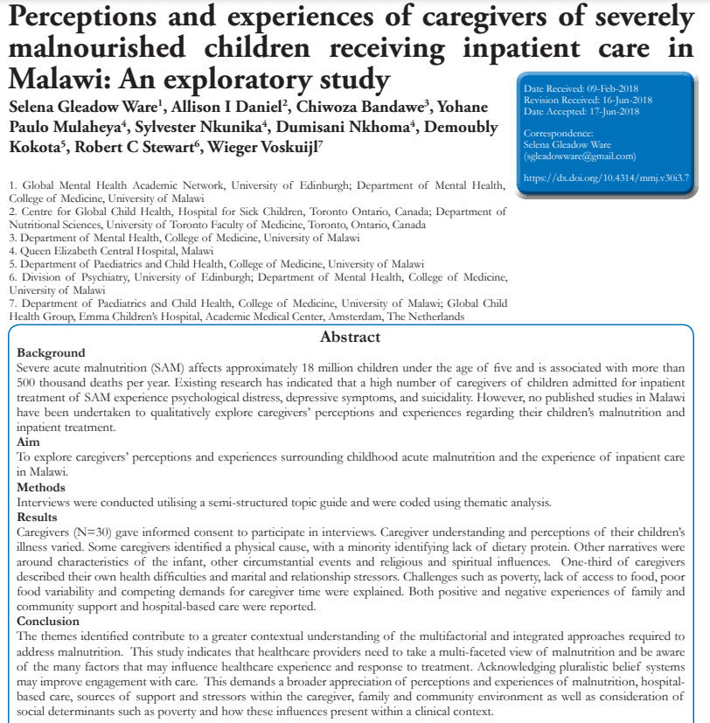
What was the research design used?

Slide 8
Quantitative Methods
Applications of research categorized by setting
Lab research: develop procedures to prevent, control and treat mechanisms of health-related phenomena
Population-based (field) research: study of distribution, determinants, control health-related phenomena in populations. Using suitable biostatistical techniques for generalization
Healthcare-facility (clinical) research: application of epidemiological principles in research based in healthcare facilities, e.g. randomized clinical trials
Study Designs Overview, 2024, Dr Amna R Siddiqui, KSU College of Medicine

Slide 9
Quantitative Research Methods
Quantitative
Observational
Experimental
Descriptive: Cross Sectional, Case series
Analytical: Cross-sectional, Case-Cohort, Cohort Studies
Randomized: RCTs (parallel, crossover, factorial)
Non-randomized (ITS, pre-post designs)
Secondary studies, ecological design

Slide 10
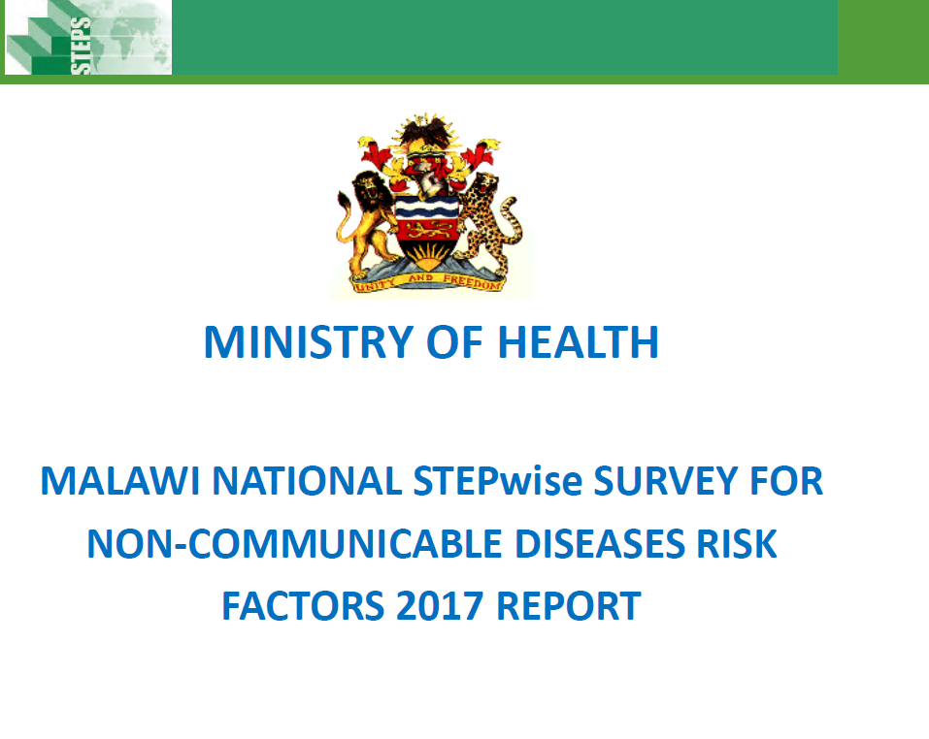
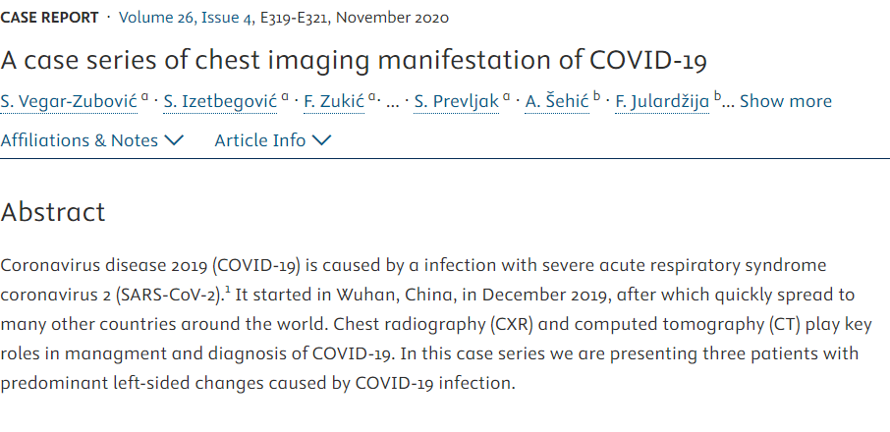
Observational Studies
Descriptive studies: describe the magnitude and distribution of a phenomenon in a given population at a given time
  No comparison for observations
  Examples include surveys, case reports, case series

Slide 11
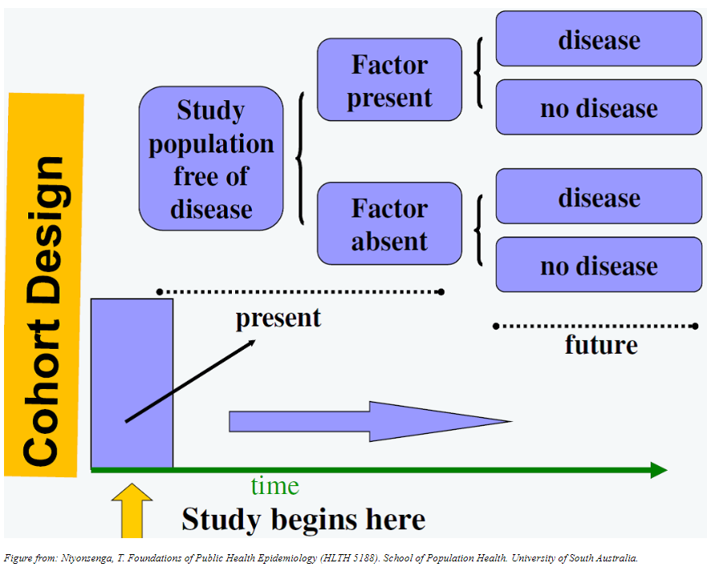
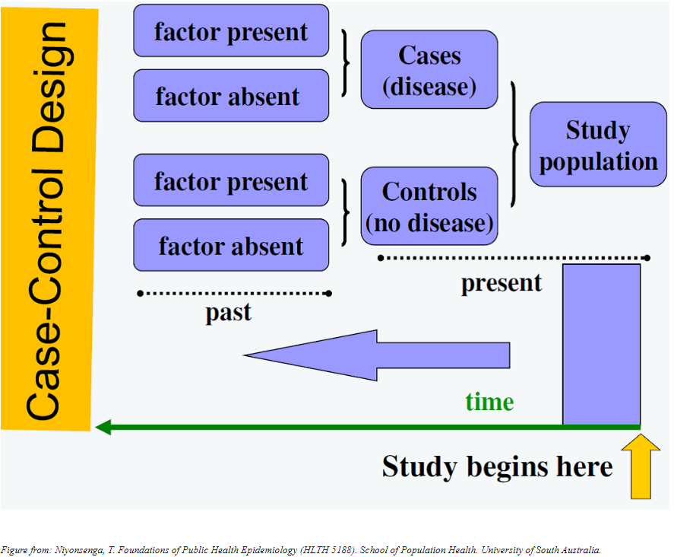
Observational Studies cont..
Analytical designs

Slide 12
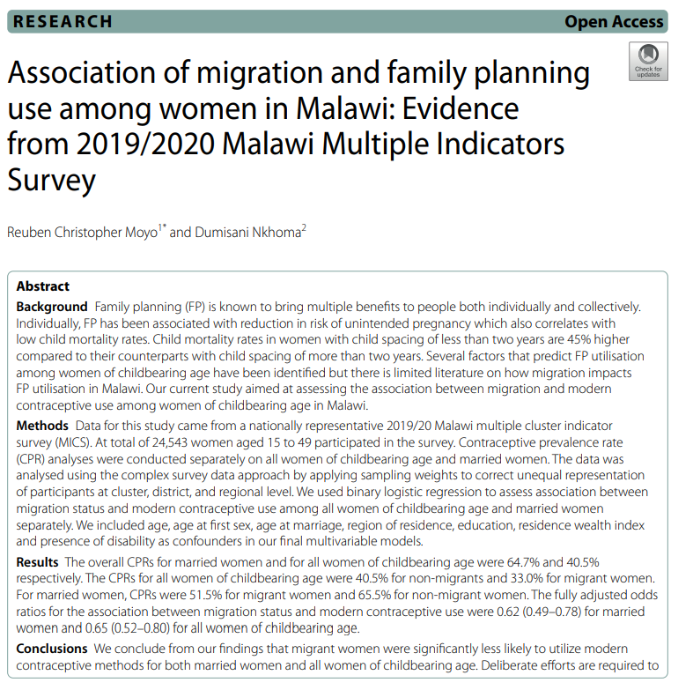
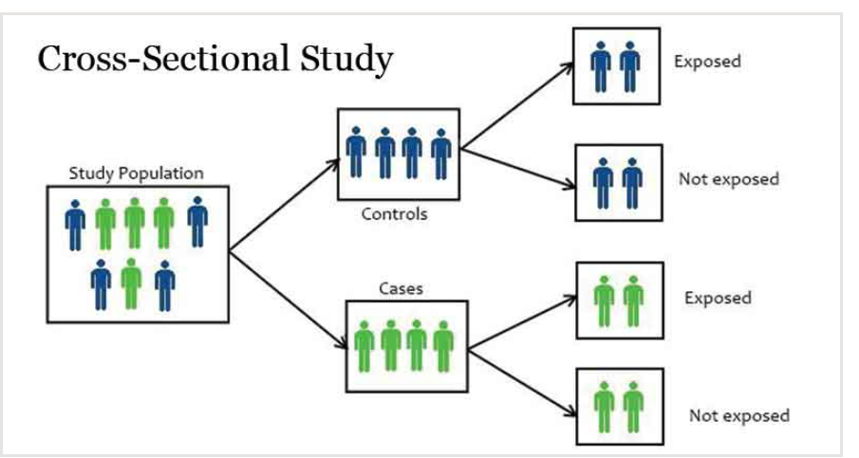
Observational Studies cont..
Analytical designs

Slide 13
Quantitative Research Method
Quantitative
Observational
Experimental
Descriptive: Cross Sectional, Case series
Analytical: Cross-sectional, Case-Cohort, Cohort Studies
Randomized: RCTs (parallel, crossover, factorial)
Non-randomized (ITS, pre-post designs)
Secondary studies, ecological design

Slide 14
Experimental Studies
Randomized
Non-Randomized
Gold standard for causality
Randomization done to flatten effect of confounders
Used to ascertain effectiveness of interventions
Types of randomized studies
  Participants allocation
  Blinding
  Study purpose
Good for implementation science research
Randomization not done
Types / examples
  Controlled clinical trial
  Before & after (single or controlled)
  Interrupted time series

Slide 15

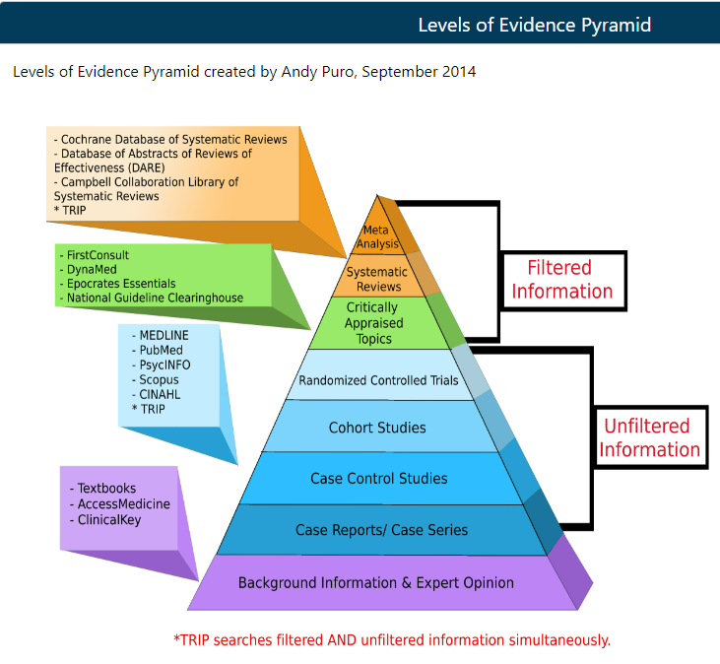
Secondary Data

Slide 16
Study Design Components

Slide 17
Study Design Components
Setting: location
Participants
Recruitment
Eligibility, recruitment strategy, consenting & other ethical needs
Sampling
Randomized vs non-randomized
Blinding, matching
Variables
Outcome
Exposure or intervention
Effect modifier, confounders, predictors

Slide 18
Data design components
Measurement and data sources
Validity & reliability, piloting & training
Sources of information
People: observations, self-reported, personal or group interviews
Records, documents & studies
Data quality issues
Study size calculations
Effect size, total and sample population, precision required (SD & p-value), test-statistic (Z scores)
Analysis
Explore data (including assumptions), relationships, hypothesis testing, additional analyses (interactions, sensitivity etc)

Slide 19
Thanks, any questions?

