Slide 1
Module 6: Data analysis,
Interpretation & Use
Christian Health Association of Malawi (CHAM)

Slide 2
6.1
Introduction to Data Analysis
Module 6

Slide 3
Learning Objectives
By the end of this session, participants will be able to:
Define data analysis, interpretation and use
Describe the processes for analyzing, interpreting and using data
Describe different examples of how to transform data into information
Explain the principles and uses of data analysis
Distinguish between descriptive and explanatory data analysis
Distinguish between quantitative versus qualitative variables
Notes:
REVIEW the learning objectives for this session.

Slide 4
How Data Analysis is Used
Introduction to data analysis
Notes:
EXPLAIN that this session will begin by reviewing the role of data analysis, interpretation, and use in the health information system. It will also look at the different ways in which data analysis is used to achieve the health system’s goals as well as improve patient outcomes and population health.

Slide 5
Review: From Data to Evidence and Knowledge
Data
Information
Comparing # of people who attend HTC during 2-week period around World AIDS Day vs. regular HTC attendance
Evidence
Comparing this over a number of years
Knowledge
Implementing interventions based on evidence; studying the results; developing best practices
# of people who attend HT services
Notes:
ASK participants to RECALL the relationship between data, information, evidence, and knowledge and how it is essential to being able to use data effectively for health care and health system decision making.

Slide 6
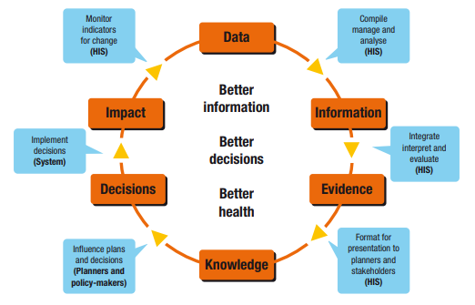
Review:
Health Information Cycle
Notes:
RECALL that this is the cycle that data goes through to become useful. Starting with data, it becomes information, evidence and knowledge. We can then base decisions on these, which leads to the impacts of those decisions, and adds further to the collection of data.
HIGHLIGHT that the purpose of the health information system is captured in the black text in the middle: better information, better decisions, better health.
POINT OUT the first blue box, “Compile, manage, and analyse (HIS)” and NOTE that they have gone through sessions on data management and using electronic HIS software to collect, process, and report data.
ASK participants to reflect on the title of this module (Data Analysis, Interpretation and Use) and IDENTIFY the steps in this cycle that they think will be addressed through the sessions in this module.
Answers:
Compile, manage, and analyse (HIS)
Integrate, interpret, and evaluate (HIS)
Format for presentation to planners and stakeholders (HIS)
Monitor indicators for change (HIS)
EXPLAIN that there is a specific process for analyzing, interpreting, and using data. GO ON to the next slide.

Slide 7
Data Analysis, Interpretation and Use
1. Define question
2. Select indicators
3. Conduct appropriate analysis
4. Compare to other findings
5. Interpret findings
6. Communicate findings
7. Use findings to inform decisions
What are feedback & review processes?
Data quality
Are defined indicators being tracked?
Who is reviewing the results?
Is the data being used?
Notes:
NOTE: This slide is animated. Only the Data Analysis process appears.
REVIEW process of data analysis, interpretation and use:
Defining a question. This defines the purpose of the analysis. It is the question that needs to be answered.
Define data needs and identify relevant indicators. As indicators are defined, the sources of data are identified and the calculation of the indicator confirmed.
Conduct appropriate analysis after accessing the raw data.
Reconciliation with other data sources and findings e.g. surveys. This step may not be necessary in all circumstances.
Interpret the findings. This require in-depth knowledge of the subject matter, programme and target population. In some instances, further discussions are required with community members.
Communication/Presentation of the results. Give feedback on findings to promote improved data quality and use.
Decision-making: The findings are used to inform a decision.
NOTE: Data quality is considered during all steps.
CLICK on the slide and EMPHASISE that there is a feedback mechanism in the process. ASK participants why feedback is important?
Answers:
We should make sure that when we are analysing the data that we provide feedback about the indicators,
When we present and discuss the data we should provide feedback about the analysis,
When we use the data to make decisions, we should provide feedback about the data presentation and discussion as well as the indicator tracking.
ENSURE their understanding before moving on to the next slide.

Slide 8
Data Analysis
The purpose of data analysis is to provide answers to questions about health policies and programs, patient care and treatment, and resource allocation.
Analysis is what turns raw data into useful information.
It is the process of inspecting, cleaning, transforming and organizing data with the goal of highlighting useful information, suggesting conclusions and supporting decision-making
Does not mean using a computer software package.
Notes:
EXPLAIN that data analysis means taking the data that you collect and looking at them in the context of the questions that you need to answer. For example, how would you know if your programme is meeting its objectives? How do clinicians know if their patients are adhering to and responding to treatment? How would policy makers know that treatment guidelines are producing the intended results?
STRESS that data analysis does not necessarily mean using a complicated computer analysis package.
EMPHASISE that even the greatest amount and best quality of data mean nothing if data are not properly analysed - or not analysed at all.

Slide 9
Data Analysis: What, Why, How?
How do we analyze data?
Why do we analyze data?
Use indicators to answer basic epidemiological questions
So that we may interpret and use health information to promote health and reduce disease burden
Support decision-making and appropriate planning
Ongoing monitoring and evaluation
Improved coverage and quality of care
What is data analysis?
Studying the distribution, frequency and determinants of health outcomes
Transforming data into information
Notes:
EXPLAIN the meaning (what), purpose (why) and outcome (how) of data analysis
ASK WHY we analyze data.
Answer: when we study (understand) the distribution, frequency & determinants of health problems & disease - then we can obtain, interpret & use health information to promote health & reduce disease (improve coverage & quality of care).
EXPLAIN that we will discuss the concepts of epidemiology in more detail later in this module.

Slide 10
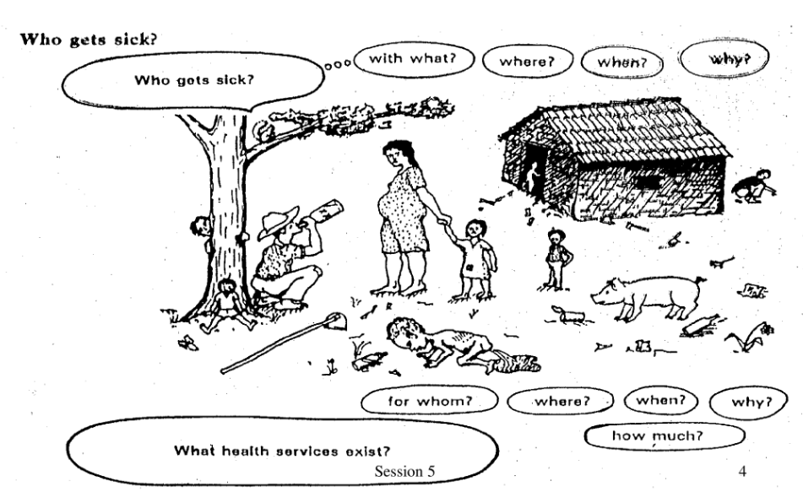
Data Analysis Helps to Answer the Following Questions
Notes:
ALLOW participants a few minutes to read the slide.
Then TELL participants that you will now go through some examples of how results from data analysis are used to answer some of these questions.
NOTE that we will learn more about the study of the distribution and determinants of disease in session 6.4 on epidemiology.

Slide 11
Data Analysis Helps Answer Programme Questions
Analysis is looking at the data in light of the questions you need to answer:
  How would you analyse data to determine: “Is my programme meeting its objectives?”
Question: Is my programme meeting its objectives?
Analysis: Compare programme targets and actual programme performance to learn how close to or far you are from those targets
Interpretation: Why have you achieved or not reached a target, and what does this mean for your program?
Answering this may require more data and information
Notes:
EXPLAIN that, for example, if you need to know whether your programme is meeting its objectives, or if it’s on track, you would look at your programme targets and compare them to the actual programme performance. This is analysis.
Later, we will take this one step further and talk about interpretation.
Interpretation is using the analysis to further explore your findings and understand the implications for your programme. For example, through analysis, you find that your programme achieved only 10% of its target; now you have to figure out why. In many cases, this means using additional information, such as vital statistics, population-based surveys, and qualitative data to supplement the routine service statistics.

Slide 12
Results from data analysis can be used to:
1. Support planning
2. Review programme activities and monitor performance
3. Understand a health issue
4. Monitor outbreaks
6. Track resources
Notes:
EXPLAIN that the next few slides provide some other practical examples of how the information coming out of data analyses can be used to answer different questions and inform a variety of decisions.

Slide 13
Data Use Example #1:
Strategic Planning
Strategic Plans outline the goals and objectives that a country or organization wants to achieve over time.
Strategic Plans answer the questions:
    What do we want to achieve (objectives)?
    How will we get there (activities)?
    When do we want to get there (future forecasting)?
    What will help us get there (resources)?
Strategic plans typically have monitoring and evaluation plans that allow stakeholders to track progress against targets over time.
Notes:
EXPLAIN that data are used in a number of steps in the planning cycle, most especially monitoring and evaluation.
EXPLAIN what strategic planning does and the main questions strategic plans answer using the points on this slide.
POINT OUT that strategic plans usually include monitoring and evaluation plans that can be used to track progress towards its overall goal or objectives.
DIRECT participants’ attention to Example #1: Strategic Planning on Handout 6.1.1: Ways to Use Data Analysis Results
WALK participants through the table from the HSSP so that they understand how it relates to planning and data use:
This table includes an indicator (% of health facilities with stock outs of tracer medicines) as well as a starting point (Baseline/recent estimates) and targets for three different periods.
At three different points in time, data analysis can be performed using data on stock outs from health facilities during a specified period.
The results of this data analysis will tell stakeholders if the activities laid out in the strategic plan are meeting targets. These targets indicate that the strategic plan is achieving its desired outcomes.
NOTE that they will learn more about indicators later in this module.

Slide 14
Data Use Example #2:
Program Review and Monitoring Performance
Information from data analysis allows programs to:
Identify unexpected changes
Determine potential explanations for unexpected changes
Determine if activities are leading to the intended outcome
Example: Malaria Cases and Deaths in South Africa
Why did the number of cases between 1998 and 2002 change?
What can the program do if results are different than expected or planned?
Notes:
EXPLAIN that we also use data for evaluation as a periodic, rigorous review of programme activities.
This review allows programs to determine if their activities are achieving the intended outcome.
If the data analysis does not show the expected progress, then the program can pose additional questions to determine why the results are different than expected
The program may also decide to change approach so that the program can move in the desired direction.
DIRECT participants attention to Example #2: Program Review and Monitoring Performance on Handout 6.1.1.
READ the title: Malaria Cases and Deaths in South Africa (1971-2007).
EXPLAIN that this chart looks at malaria cases and deaths. GIVE participants adequate time to read and understand the report excerpt and chart.
ASK: “Can you think about possible reasons for the changes in the number of cases between 1998 and 2002?” One of the reasons is presented on the graph but additional reasons are outlined the actual report.

Slide 15
Other examples
Monitoring disease trends e.g. cholera outbreaks
Analyzing a health issue e.g. mortality
Tracking supplies, resources etc

Slide 16
Types of Data Analysis
Introduction to data analysis
Notes:
EXPLAIN that now that we understand how data analysis can be used, our focus can turn to some of the core concepts of data analysis.

Slide 17
2 Types of Analysis: Descriptive
Descriptive analysis describes the population of interest including demographics and clinical characteristics
Example: how the average number of patients seen per month at a clinic varies over the course of the year, and the pattern of attendance by sex and age group
Descriptive analysis tells us what is happening but does not tell us why
Notes:
EXPLAIN that there are two different types of analysis: descriptive and explanatory.
EXPLAIN that the world of data analysis is vast and can be complex. In this course, we will focus on descriptive analyses as this is most often used in our setting.

Slide 18
2 Types of Analysis: Explanatory
Explanatory analysis attempts to explain patterns, identify causes or test a hypothesis
Example: an outreach team may wish to test an adolescent-targeted HIV education programme in secondary schools to see if it increases HIV testing among adolescents
Explanatory analysis would compare HIV testing trends for that target group before and after implementation of the new outreach strategy to see if the strategy worked. If it did, then we would know why.
Notes:
ENSURE that participants understand what is meant by hypothesis. According to the Cambridge Dictionary, it is an idea or explanation for something that is based on known facts but has not yet been proven. In statistics, it describes the question we would like to answer and therefore test in our analysis.
After the third bullet, ASK: if this explanatory analysis results showed that the programme did not work, then what would be the next step?

Slide 19

What is a Variable?
A variable is any characteristic or measure that describes a person, place, thing or idea.
Notes:
EXPLAIN the following:
They are called variables because the values of their characteristics can vary.
A variable may also be called a data item. Age, sex, business income and expenses, country of birth, capital expenditure, class grades, eye colour and vehicle type are examples of variables.
It is helpful to become familiar with the different types of variables because they are analysed in different ways. For example, we have already discussed the difference between quantitative data (numbers) and qualitative data (words). You can imagine that only certain analyses can be performed on one or the other. Let’s take a look at the different types of variables now. Then we will be in a good starting place for the next session – 6.2 on basic statistics.

Slide 20
Variables
Variables can be
Quantitative
Qualitative
A numerical value
The value is not a numerical value but descriptive
Notes:
EXPLAIN that we briefly discussed the difference between quantitative and qualitative data in module 2. In this session we will look at these in more depth:
Quantitative variables: Are numerical measures; a quantitative or numerical variable takes number values for which maths operations—addition, subtraction, multiplication, and division—make sense. The values of a quantitative variable are usually recorded as a unit of measurement, such as seconds or kilograms.
Qualitative variables: Are factors that places an individual into one of several categories or groups. It may or may not have a clear natural order.

Slide 21
Qualitative versus Quantitative Variables
QUALITATIVE
QUANTITATIVE
Categorical
Nominal
  No order
  E.g. sex, married/single, brown eyes
Ordinal
  Some order
  E.g. severity of a disease, degree of smoking
Numerical
Discrete
  Can only take on certain values (whole numbers)
  E.g. number of children
Continuous
  Can assume any value
  E.g. fractions
Notes:
EXPLAIN that there are some quantitative variables where only measurement in whole numbers makes sense. These are called discrete variables; they are used in cases where we are counting something that cannot, because of its nature, be divided. An obvious example of this would be people - because we cannot have fractions of people! A family or household, for example can have 5 or 6 members, but not 5.5 members. Another example is the number of patient visits to a clinic. It is possible for a clinic to have 40 visits in a day, but not 40.5.
Other quantitative variables can have any value, including fractional or decimal values - and can even include infinity. These are called continuous variables. Weight is one example of this. Weight can be rounded to the nearest kilogram (75 kg), or it can be written more precisely, by including decimal places (74.87 kg). This data is considered to be continuous because it can be any number, or fractional amount. Other examples are laboratory counts (e.g., bilirubin or haematocrit levels), blood pressure, body temperature, and many other physiological measures.
In terms of qualitative data, nominal variables are those that are grouped into categories which have no natural order. Some qualitative variables do have some order. These are called ordinal variables.
ASK: “What are other examples of quantitative discrete data where only whole numbers make sense?”
CD4 count: You can’t count half cells.
Numbers of: surgeries, condoms issued, IUCDs inserted, HIV tests done.
ASK: “What are other examples of quantitative continuous data where any number value, even fractional or decimal, makes sense?”
Distance to clinic.
Birth weight
Related to qualitative variables, ASK participants: “What are other examples of categorical data without a natural order?”
Sex
Type of motor vehicles: Cars, SUVs, trucks
ASK: “What are examples of categorical data with a natural order?”
BMI: Underweight - Normal - Overweight - Obese
Level of Education: Primary School - High School - University Undergraduate

Slide 22

Pair Activity: Name that Variable
Example | Type of Variable
CD4 Test Result
Pregnancy Test Result
Number of HIV Tests Performed
Waiting Time
HIV Clinical Stage
Notes:
ASK participants to complete the table on their own or with a partner. What kind of variables are these? For each example, indicate whether the variable is categorical nominal, categorical ordinal, quantitative continuous, or quantitative discrete.
CIRCULATE through the room to make sure that participants understand the task and to answer any questions.
After 2-3 minutes, randomly ASK some participants for their responses.

Slide 23
Activity: Name that Variable
Example | Type of Variable
CD4 Test Result | Quantitative (Numerical) - discrete
Pregnancy Test Result | Qualitative (Categorical) - nominal
Number of HIV Tests Performed | Quantitative (Numerical) - discrete
Waiting Time | Quantitative (Numerical) - continuous
HIV Clinical Stage | Qualitative (Categorical) - ordinal
Notes:
PRESENT the answers on the slide.

Slide 24


Group Activity:
Using Data for Decision Making
Review Case Studies
Discuss the following questions in your small group:
  What was the main decision being made in each case study?
  What data was used to inform the decision?
  Where did this data come from?
Notes:
60 minutes
REFER participants to turn to Handout 6.1.2: Case Studies: Using Data for Evidence-Based Decision Making.
REVIEW the instructions with participants, then DIVIDE participants into groups of 3-4 participants and GIVE them 30 minutes to work in their small groups.
MONITOR participants’ progress. Make sure they are focusing on the type of data being used to make each decision and where the data comes from.
ENCOURAGE participants to be thorough in their review of the data used in the case studies.
BRING the group together again after 30 minutes.
ASSIGN each group to review their responses for one of the case studies.
RECORD responses about type of data and where it comes from on a flip chart.
ASK participants what were the main points they learned from reviewing the cases.
After a brief discussion, SUMMARISE the discussion using the following points:
Decisions tend to rely on multiple types and sources of data, including but not limited to paper-based and electronic systems (e.g. EMR)
Data used most frequently in these decisions is patient data
Data from multiple paper-based and electronic systems (e.g. EMR) can be linked and support each other
Data tends to inform a course of action when it is analysed and interpreted

Slide 25
Key Points
Data analysis is a critical part of the decision making process.
Data analysis informs policy, programme management, patient care, and resource allocation.
Analysis turns raw data into useful information.
There are two types of data analysis: descriptive and explanatory.
Variables are quantities or measures that can vary from one unit of investigation to another.
There are two broad types of variables: quantitative and qualitative.
Notes:
REVIEW key points.

