Slide 1
Module 2: management of health data
Christian Health Association of Malawi (CHAM)

Slide 2
2.1
Introduction to Data Management
Module 2
Notes:
EXPLAIN that this session will provide an introduction to data management and its importance in health care.
EMPHASIZE that the e-learning module #2 on Data Management Concepts provides supplementary content to this session that will allow you to go a bit deeper into the subject and also to view it from different perspectives.
In some cases, you will see different terminology used than is provided in these sessions. It is important to understand that people with different backgrounds and experience may use different terminology to refer to concepts that you are already familiar with. This is ok! In fact, it is a part of the learning process. We hope that you will find that the e-learning modules both complement the training content and expand your understanding of effective data management and use.

Slide 3
Learning Objectives
By the end of this session, participants will be able to:
Define data management
Explain the importance of data management
Discuss the importance of data management standards
List the domains of data management standards
Define SOPs
Describe the steps of data management
Notes:
REVIEW the learning objectives for this session.

Slide 4
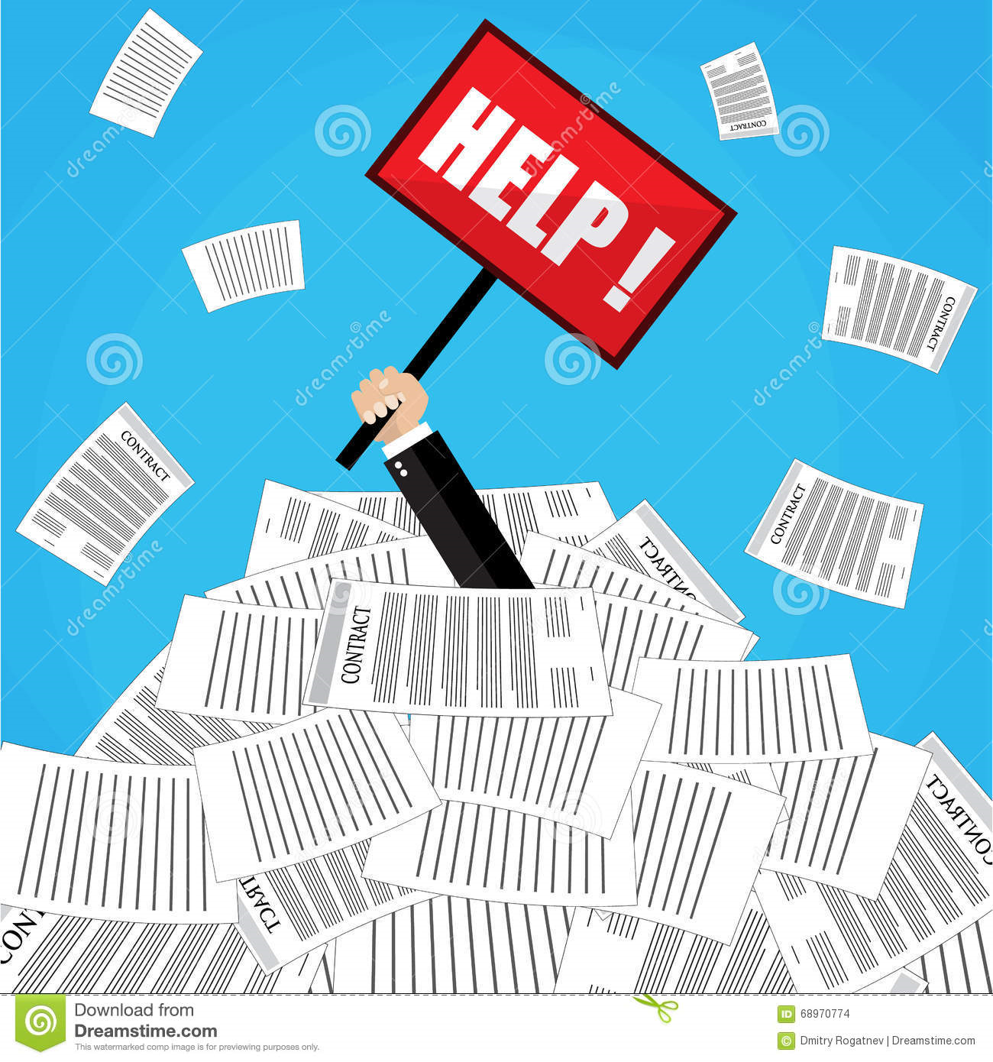
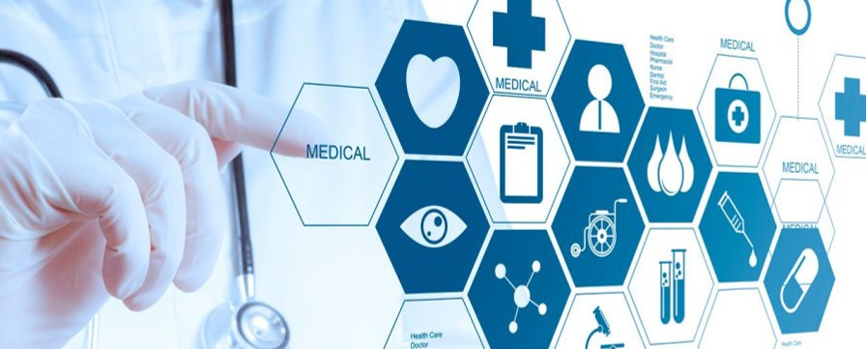
What Is Data Management?
A series of processes that includes collecting, storing, protecting, processing, and analysing data so that it may then be used as the basis for decision making.
Notes:
NOTE This slide is animated. Wait for participants to answer the question before clicking to reveal the answer.
ASK What is data management?
ALLOW a few responses and then CLICK to reveal the answer.

Slide 5
Importance of Data Management
Good data management practices ensure that data are high quality and readily available for decision making.
Data management entails putting personnel, policies, procedures, and organizational structures in place to ensure that data are:
Correct
Consistent
Secure
Available
Notes:
EXPLAIN the importance of data management as shown on the slide.

Slide 6
Data Management Standards: Definition
Data management standards are a collection of policies, procedures, and processes that define workflow, programme inputs and outputs, management structure, and the methods and frequency of performance evaluation.
Notes:
ASK participants what standards are.
Answer: a level or quality of execution.

Slide 7
Data Management Standards: Importance
Help ensure that important elements are present in the information system to ensure adequate functionality
Help identify weaknesses in the HIS
Make it possible to compare with other HIS
Based on experience and 'best practices'
              it works elsewhere; it can work here
Help to design the system, like a blueprint for development/construction
Allow for accurate planning and costing of information systems, and effective management.
Notes:
EXPLAIN that You may have seen documents on data standards in the past – they are long and detailed! For the purposes of this training, we will just introduce the concept of data management standards and go briefly into the 4 domains of these standards.
REMIND participants that the HIS objective outlined by the MOH is:
To generate quality information (accurate, complete, timely, relevant, and reliable) and make them accessible to all intended users through standardised and harmonised tools across all programs that avoid duplication and reduce the workload on data capture by already stretched human resource at the health facility level.

Slide 8
HIS Data Management Standards: Four Domains
4 DOMAINS
Management and governance
Data collection and processing
Data analysis, dissemination, and use
Data and decision support needs
Notes:
REVIEW the four domains of Data Management Standards.
Management and Governance: This domain refers to administrative policies, procedures, and processes that define workflow, programme inputs and outputs, management structure, and the methods and frequency of performance evaluation
Data and Decision Support Needs: This domain refers to designing the HIS with the end point in mind. That is, creating systems, tools, and processes that support data needs and decision making by users.
Data Collection and Processing: This refers to the ongoing, systematic gathering, organizing, cleaning, and aggregating of data for use.
Data analysis, dissemination and use: Refers to standard processes for turning data into information, and then using that data for decision making.
EXPLAIN that there are also standards and standard operating procedures currently under development by CMED/MOH. These will be disseminated when finalised.

Slide 9
Standard Operating Procedures (SOPs)
Step-by-step instructions to achieve a desired result
A way to ensure that tasks are done to attain the standard level of quality
MOH has a set of SOPs to provide guidelines for data management and other processes throughout the HIS, such as:
Data collection, reporting and storage
Data analysis, interpretation and use
Data access and release
Data quality assessment
Notes:
SAY Malawi has a set of SOPs that are in line with the FOUR DOMAINS.
EXPLAIN that many of these have recently been finalized and should be accessible to you as you bring the skills you’ve learned in this training back to your worksite. Your supervisor should be alert

Slide 10
4 Steps of Data Management
There are four steps of data management:
Step 1
Collection and storage
Step 2
Processing
Step 3
Reporting
Step 4
Analysis, interpretation, and use
Notes:
NOTE: This slide is animated. Wait until participants answer the question before clicking to reveal the answers.
ASK participants to pair up with the person next to them to list and order the steps of data management. ALLOW 3 minutes.
ASK a few groups to share their responses.
Then EXPLAIN that there are 4 steps in data management. We will be discussing each step in detail in sessions 2.2, 2.3 and 2.4.
NOTE: There is an entire module dedicated to Step 4: Analysis, interpretation and use. We will learn about this in module 6.

Slide 11
Data Collection and Storage
Data collection is the ongoing systematic gathering of health data needed to inform decision making.
Data collection tools and methods are chosen based on:
Frequency of decision making
Complexity of data collection
Cost of data collection
Notes:
DISCUSS data collection.
EXPLAIN that data are collected in two ways—routinely and non-routinely—and all national systems use both types of data for planning and managing their health services. We will go further into the difference between these two ways of collecting data in the next session on data collection.
At all levels, data need to be stored in a way that ensures confidentiality and that encourages regular analysis at the local level and regular use to improve service delivery. We will also discuss storage of data in more detail during the next session.

Slide 12
Data Processing
Extracting
Organising
Validating
Checking data consistency and quality
Cleaning
Aggregating
Notes:
EXPLAIN that after data are collected, they need to be processed, checked for quality, and transmitted to higher levels of the health system. Data processing includes many different activities, including the ones shown here on this slide.

Slide 13
Data Reporting
Regular preparation of data summaries
Transmitted to higher levels of the health system
Converted into electronic format which makes it possible to:
        Analyse
        Interpret
        USE
Notes:
NOTE: This slide is animated. Wait for participants to answer question before clicking to reveal the answers.
ASK what is the purpose of reporting?
ALLOW a few responses and then CLICK to reveal the answers on the slide.
EMPHASISE that regular reporting makes it possible to see changes and patterns that may indicate an urgent need to act.
ASK: “Can you think of some examples of changes or patterns that you’ve experienced when creating or reading reports?”

Slide 14
Data Analysis, Interpretation and Use
Data analysis: process of turning raw data into useful information.
Interpretation: process of drawing conclusions from that information.
Use: the process of basing decisions and actions on these conclusions.
Notes:
DEFINE terms.
GIVE examples.
REMIND participants that all of module 6 is dedicated to data analysis, interpretation and use.
ASK if there are any questions on the topic before moving on to the next slide.

Slide 15
Data Management in the Information Cycle
How do we collect data?
1 - Data collection
Data sources & tools
4 – Interpretation and Use
2 - Data processing
How do we use it?
Quality at Every Stage
What do we do with it?
Dissemination and Use
Data Management, Calculate Indicators
3 - Reporting
3 - Reporting
How do we present it?
Information Products
4 - Data analysis
Notes:
NOTE This slide is animated. Wait for participants to point out the steps of data management before clicking to reveal where they come in the information cycle.
ASK participants to describe the information cycle. LISTEN for:
The information cycle is an important foundation for this course
It shows us how data is transformed into information and evidence so that it can be used for decision making.
The health information system is the primary tool we use to manage data through some or all of these steps, whether paper-based or electronic.
We’ve also looked at the HIS inputs, processes and outputs associated with each phase of the cycle.
SAY Now that we are discussing data management, let’s see if we can point out where each of the steps of data management come in the information cycle.
CLICK to reveal each step.
EMPHASISE that reporting can take place both before and after analysis. Regular reports are read, which may spur the need for further analysis and reporting of those results. Remember, the ultimate goal of data management is data use, specifically informing the decision-making process for effective management of the health system.

Slide 16


Discussion:
What are some of the challenges you encounter when managing HIS data?
What are some possible solutions to overcoming these challenges?
Notes:
EXPLAN that now that we know the steps of data management, let’s discuss the challenges and possible solutions we encounter in carrying out these steps on a day-to-day basis.
ASK participants what regular challenges they experience in managing data.
Possible challenges may include:
Overlapping or inconsistent data collection tools
Not enough time to collect all necessary data
Not enough space on forms
Forms are not filled out entirely
No training provided for those collecting or entering data
Availability of tools
Different sites using different version of tools and therefore getting data on different indicators is challenging
Report generation is time consuming
Data analysis is limited
Internet access or power issues
Having identified some of the challenges in managing data in the HIS, now DISCUSS some possible solutions to overcome these challenges.
After some initial ideas have been presented, CLICK to reveal the ideas we will focus on in this discussion.

Slide 17
Key Points
What is data management?
What are the steps of data management?
Why are data management standards important?
What are the 4 domains of data management standards?
What are SOPs?
Notes:
ASK participants to answer the questions on the slide for review.
SUMMARISE with the following points:
Data management is series of processes that includes collecting, storing, protecting, processing, and analysing data so that they may then be used
Good data management practices ensure that data are of high quality so that they can effectively inform decision making
Data management steps include 1) collection and storage, 2) processing, 3) reporting, and 4) analysis, interpretation and use
Data management standards are a collection of policies, procedures, and processes that define workflow, programme inputs and outputs, management structure, and the methods and frequency of performance evaluation
The four domains of data management standards are: management and governance; data and decision support needs; data collection and processing; and data analysiss, dissemination, and use.

