Slide 1
DHIS2 OVERVIEW
DATA COLLECTION, STORAGE & ANALYSIS
Christian Health Association of Malawi (CHAM)

Slide 2
What Is DHIS2?
District Health Information Software (Version 2)
Web-based data-collection, reporting and analysis tool – Open Source

Slide 3
Data Flow: DHIS2 Mobile, DHIS2
Central data repository (DHIS2)
NATIONAL
AGGREGATE DATA
DISTRICT
DHIS2
DHAMIS
OLMIS
PATIENT OR FACILITY DATA
FACILITY/PATIENT
DHIS2 Mobile
EMR
LIMS
OLMIS
COMMUNITY
DHIS2 Tracker
cStock
Notes:
EXPLAIN that each of the three DHIS2 tools to collect, process, and report data from different levels of the health system. This section will look at the common building blocks of all DHIS2 products and how each of these DHIS2 tools collect data within the workflows at each level.

Slide 4
What does DHIS2 do?
Collects data
  What
  When
  Where
  Outputs Data
  Images
  Documents
  Reports
  Charts
  Maps

Slide 5
Key Benefits of DHIS 2
Robust data entry: user-friendly form fields & capture data on:
  Smartphones (e.g., Android, iPhone)
  Tablets
  PCs
Real-Time Data Visualization: DHIS2 automatically aggregates data through the geographic hierarchy
  Facility/Site Data → District Data → Zonal Data → National Data
  GIS/Mapping functionality
  Fully-automated, custom reports
  Charts and pivot tables

Slide 6
Basic Terminologies in DHIS 2
Organisation Unit: The entity or grouping of entities delivering health services. Malawi DHIS 2 entities are in 4 levels: National, Zone, District, Facility.
Data element: The smallest unit of data collection. Explains what we collect and analyze.
Data Set: A grouping of related data element desribing a particular area of data collection e.g. Malaria data set which collects all data required for Malaria. Data sets are as good as forms in DHIS 2
Period: Describes frequency of reporting e.g. monthly, quarterly an time of interest.

Slide 7
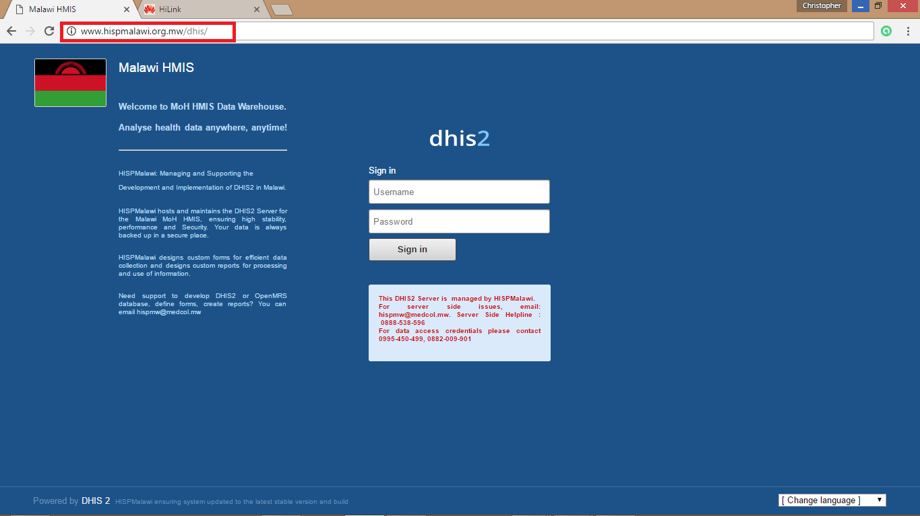
LOGGING INTO DHIS 2 https://dhis2.health.gov.mw

Slide 8
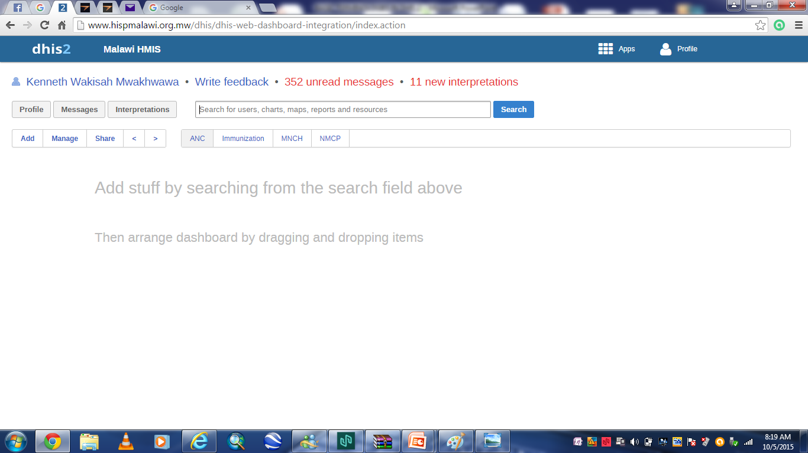

Slide 9
DATA ENTRY
To open the data entry window click on the Apps tab.
A drop down menu will appear listing the services provided by DHIS 2.
Click on the Data Entry option. The data entry module is where data is manually registered in the DHIS 2 database.
Data is registered for an organisation unit, a period, and data set (a set of data elements) at a time.
A data set often corresponds to a paper-based data collection tool / form.
To start entering data the first step is to open the correct form by following these steps:
  Locate the orgunit you want to enter data in tree menu to the left. Expand and close branches by clicking on the +/- symbols
  Select a data set from the dropdown list of data sets available to your selected orgunit
  Select a period to register data for.

Slide 10
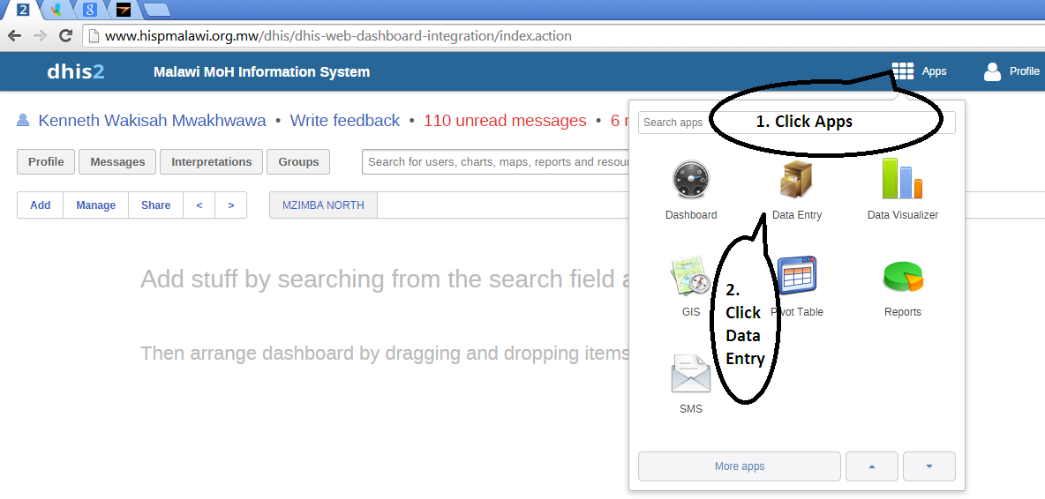

Slide 11
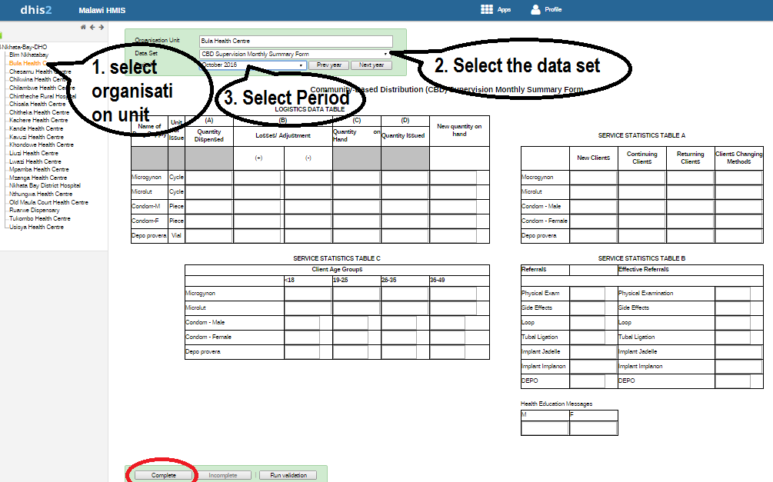

Slide 12
Entering data: Start entering data by clicking inside the first field and type in the value. Move to the next field using the Tab button. Shift+Tab will take you back one step. You can also use the "up" and "down" arrow keys to navigate between the form cells.
The values are saved immediately and do not require to be saved at a later stage. A green field indicates that the value has been saved in the system (on the server).
Input validation: If you type in an invalid value, e.g. a character in a field that only accepts numeric values you will get a pop-up that explains the problem
When you have corrected any erroneous values and are done with the form the recommended practice is to click on the Complete button below the form to register the form as complete. This information is used when generating completeness reports for facility, district, zone or the national level.

Slide 13
DATA ANALYSIS IN DHIS2

Slide 14
Reporting Rates
The reporting rate report produces statistics for the degree of completeness of data entry forms. The statistical data can be analysed per individual data sets or per a list of organisation units with a common parent in the hierarchy.
It provides a percentage value for the total completeness and for the completeness of timely submissions.

Slide 15
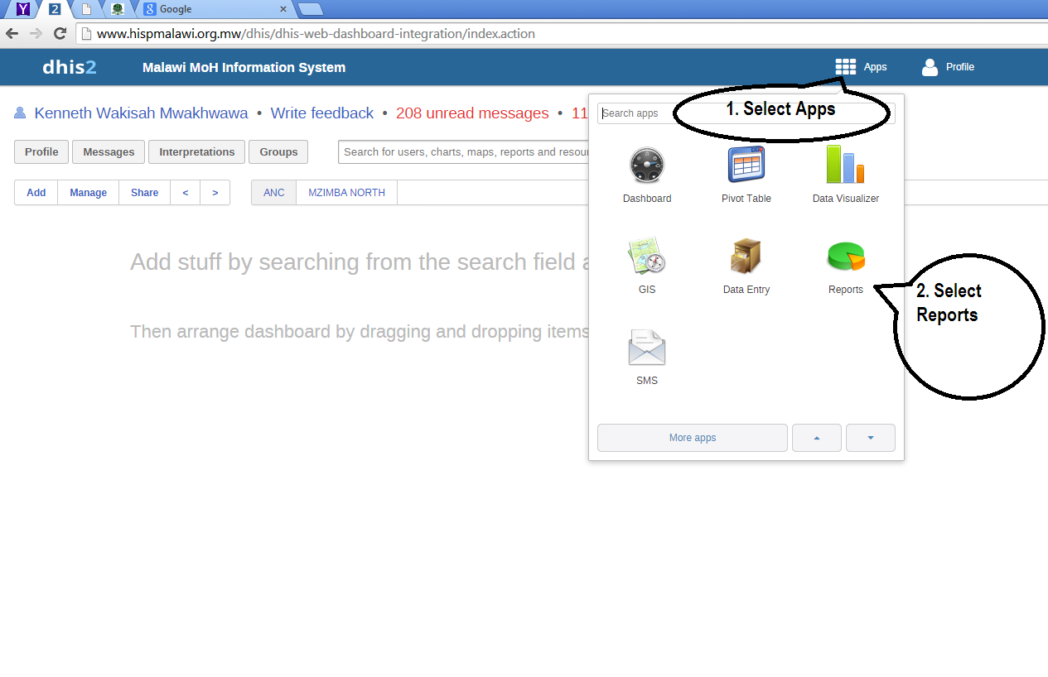

Slide 16
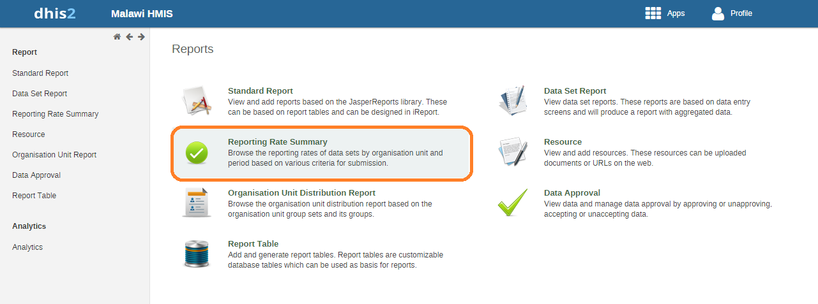

Slide 17
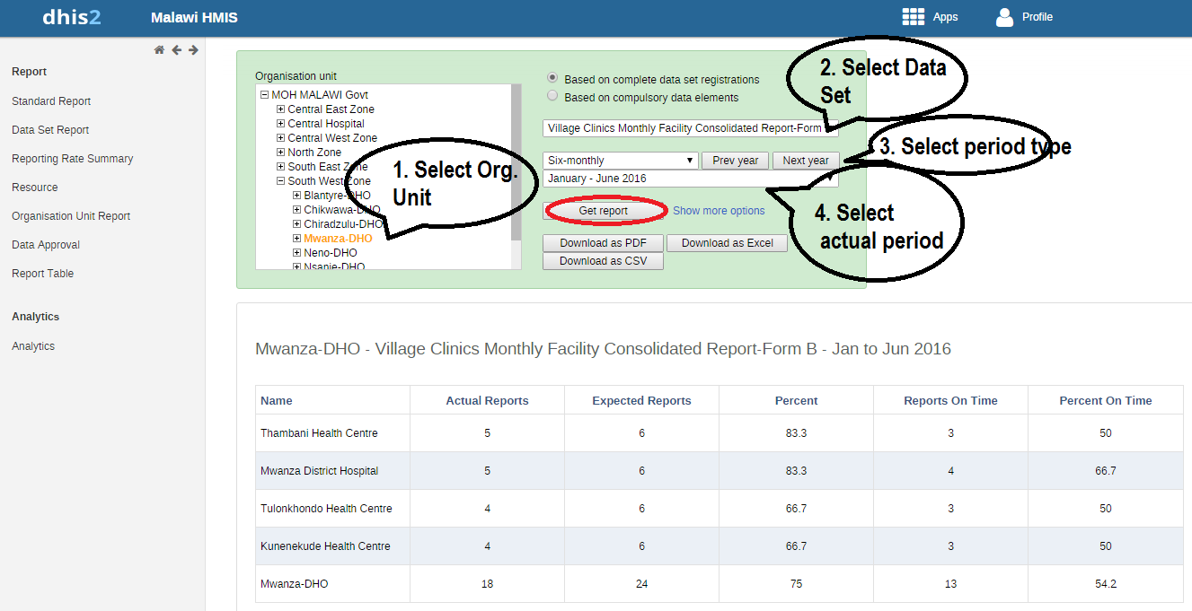

Slide 18
Data Set Report
Data set reports displays the design of data entry forms as a report populated with aggregated data (as opposed to captured low-level data).
This report is easily accessible for all types of users and gives quick access to aggregate data.

Slide 19
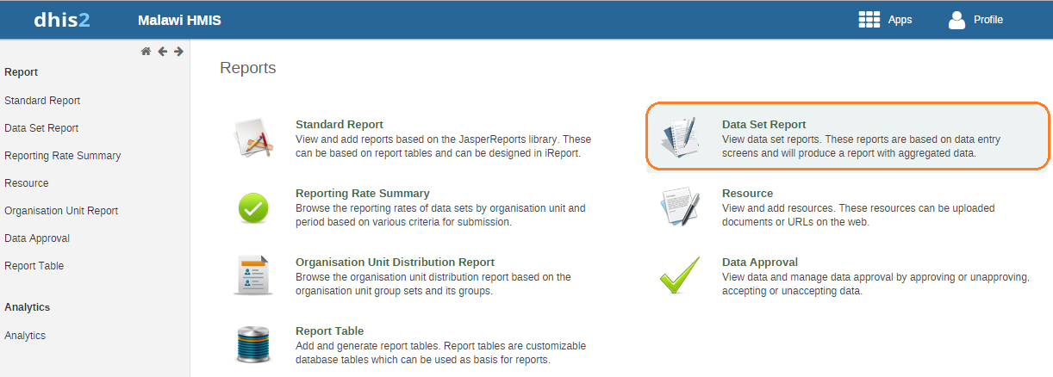

Slide 20
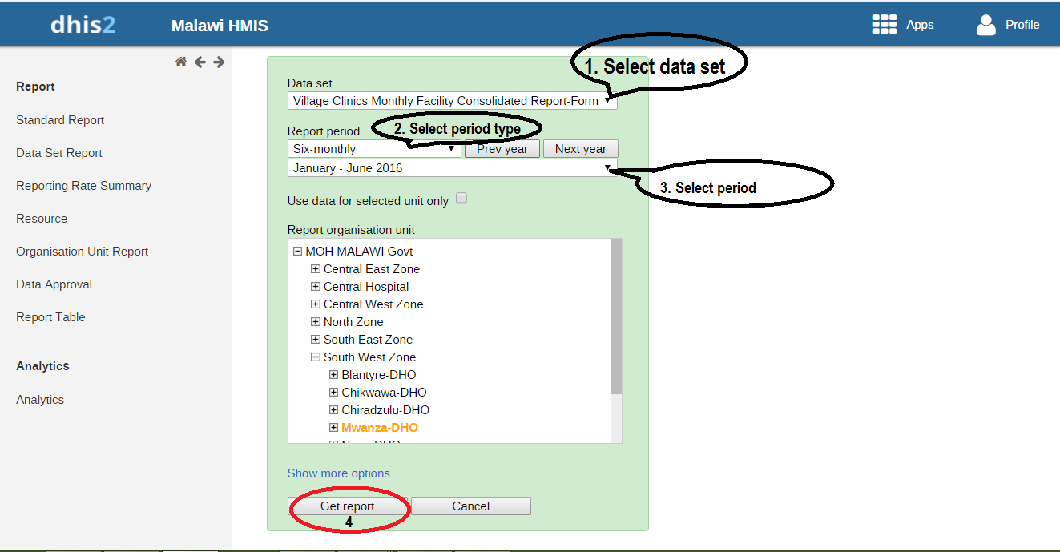

Slide 21
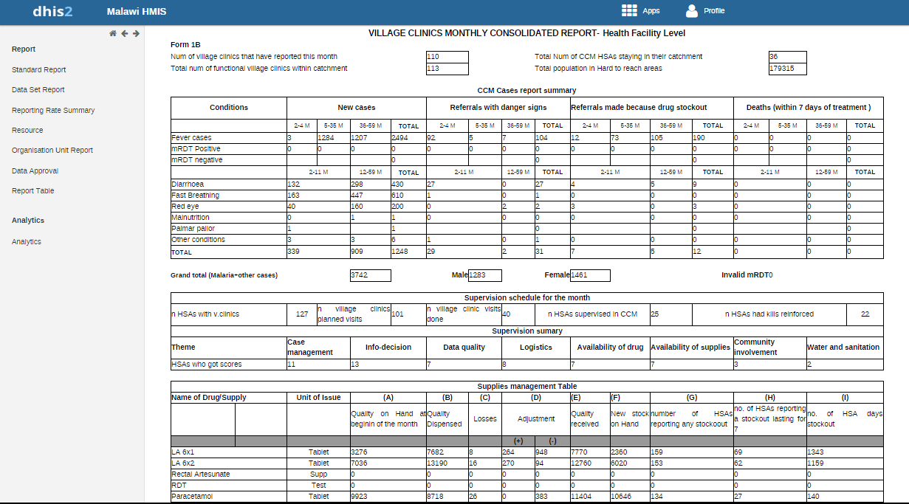

Slide 22
Pivot Table Overview
The pivot table module enables users to create pivot tables, using all available data dimensions in DHIS 2.
  A pivot table is a dynamic tool for data analysis which lets you quickly summarize and arrange data according to its dimensions.
Click on the Apps and select Pivot Table

Slide 23
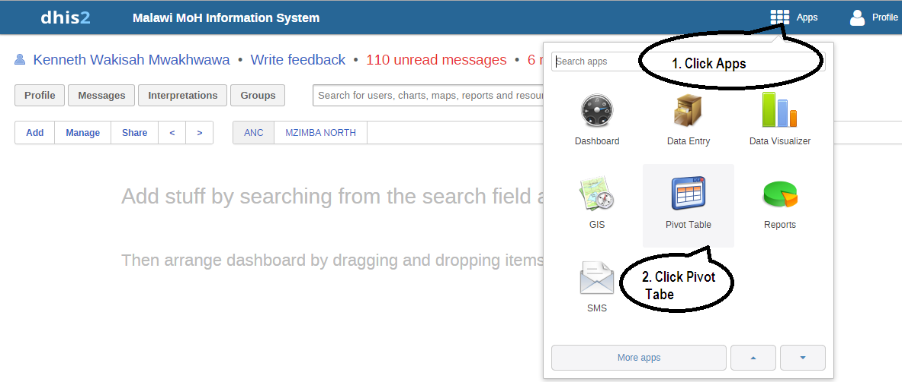

Slide 24
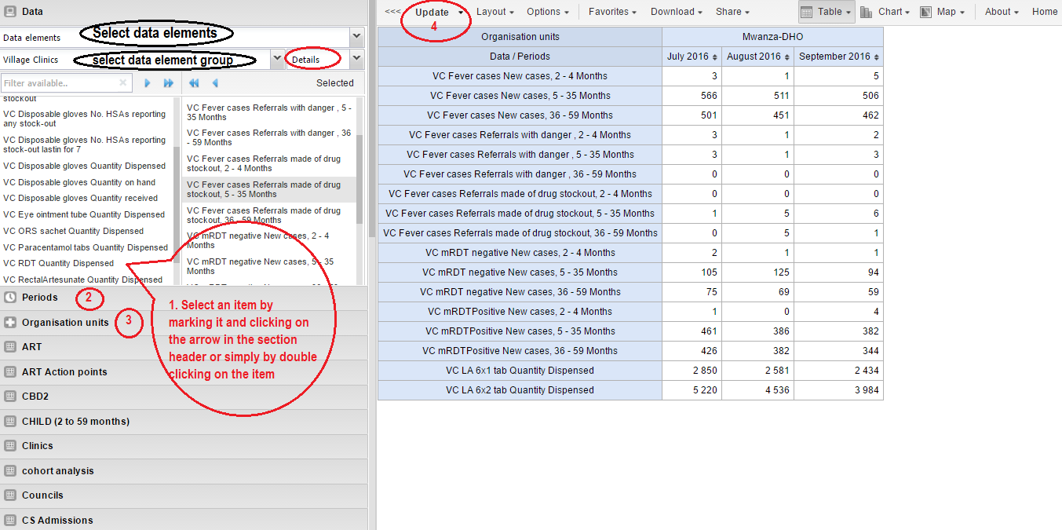

Slide 25
Downloading Data – Pivot Tables
You can download the data in the current pivot table by clicking on "Download" in the top menu.
The data can be downloaded in MS Excel and CSV format. The data table will have one column per dimension and contain names of the dimension items.
You can easily create a pivot table in Microsoft Excel from the downloaded Excel file by clicking on "pivot table" in the top panel, then clicking on "create pivot table", then marking the data range in the spreadsheet before clicking "OK".

Slide 26
Saving Table as Favorite
Once you have rendered a table you can save it as a favorite to be able to access it easily at a later point.
  Click on the "Favorites" button on the top menu to open up the favorites window. Click "Add new" and in the name field enter the desired name for your table. The chart will be visible only to yourself. For every favorite in the list you have four options to the right. You can rename the chart (grey button), overwrite the chart (green button), modify the sharing settings of the chart (blue button) or delete the chart (red button).
These favorite tables can later be included on your personal dashboard.

Slide 27
Data Visualizer
The data visualizer module enables users to easily create dynamic data analysis and visualizations through charts and data tables.
  You can freely select content (like data elements, periods and organisation units) for your analysis. This module can be accessed by going to “Apps then select Data Visualizer.“
The data visualizer is designed firstly to be easy-to-use - you can simply select the indicators, data elements, periods and organisation units you want to include and click "Update" to get your visualization.
The visualizer module provides eight different chart types, each with different characteristics.
  You can select the type of your chart by clicking on one of the icons in top left bar titled "Chart type".

Slide 28
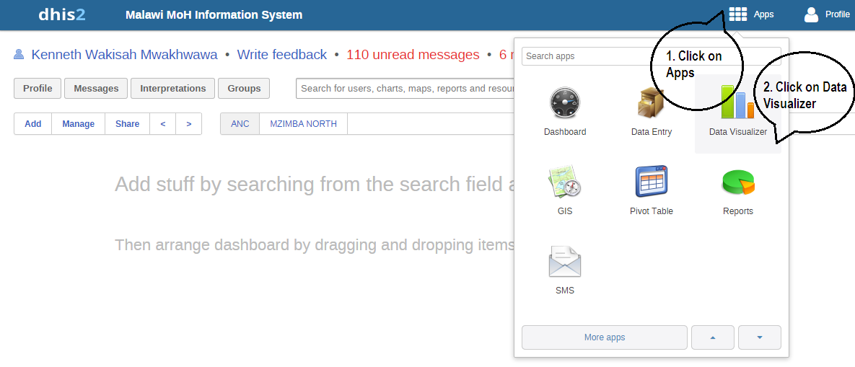

Slide 29
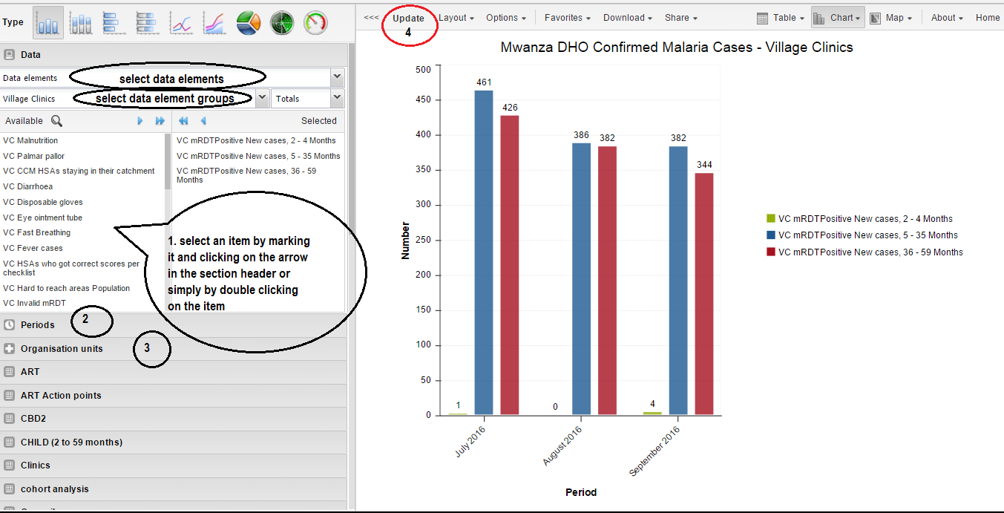

Slide 30
Saving chart as favorite
Once you have rendered a chart you can save it as a favorite to be able to access it easily at a later point.
  Click on the "Favorites" button on the top menu to open up the favorites window. Click "Add new" and in the name field enter the desired name for your chart. The chart will be visible only to yourself. For every favorite in the list you have four options to the right. You can rename the chart (grey button), overwrite the chart (green button), modify the sharing settings of the chart (blue button) or delete the chart (red button).
These favorite charts can later be included on your personal dashboard.

Slide 31
DHIS2 GIS
This is an app that allows visualization of data by associating it with the actual location of the organization unit on which the data was collected.
The data can be the data elements e.g. Number of pregnant women starting ANC in first Trimester (i.e. 0-12 weeks)
The data can also be indicators e.g. Percentage of under 1 year old children fully immunized

Slide 32
DHIS2 GIS- How does it work
One needs to edit the layers in GIS Module
Boundary layer- responsible for showing the boundaries e.g (between zones, DHOs etc
Facility layer – responsible for showing the facilities.
Google earth engine layer- this shows distribution of predefined data sets e.g population density, temperature etc
External layer – integration of other layers- these could be from other systems
Custom layers- user can define up to 4 custom layers

Slide 33
Thank You!!!!

