Slide 1
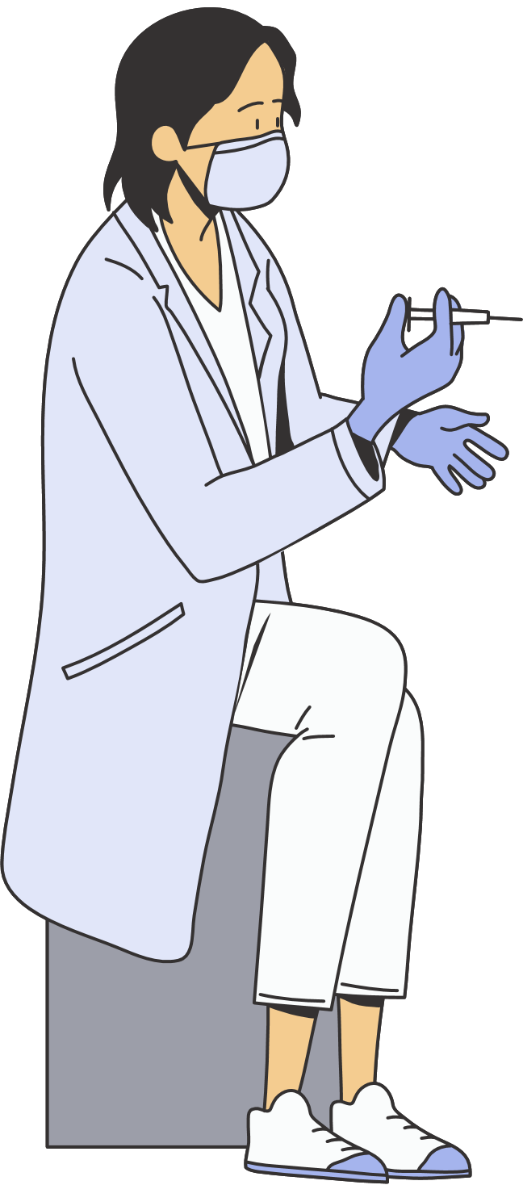
Japanese encephalitis
Polio
Hepatitis B
Rubella
Whooping cough
Measles
Pneumonia/Meningitis
Tetanus
Tuberculosis
Diptheria
SAR-COV (COVID-19)
FLIPBOOK
VACCINE-PREVENTABLE DISEASES

Slide 2
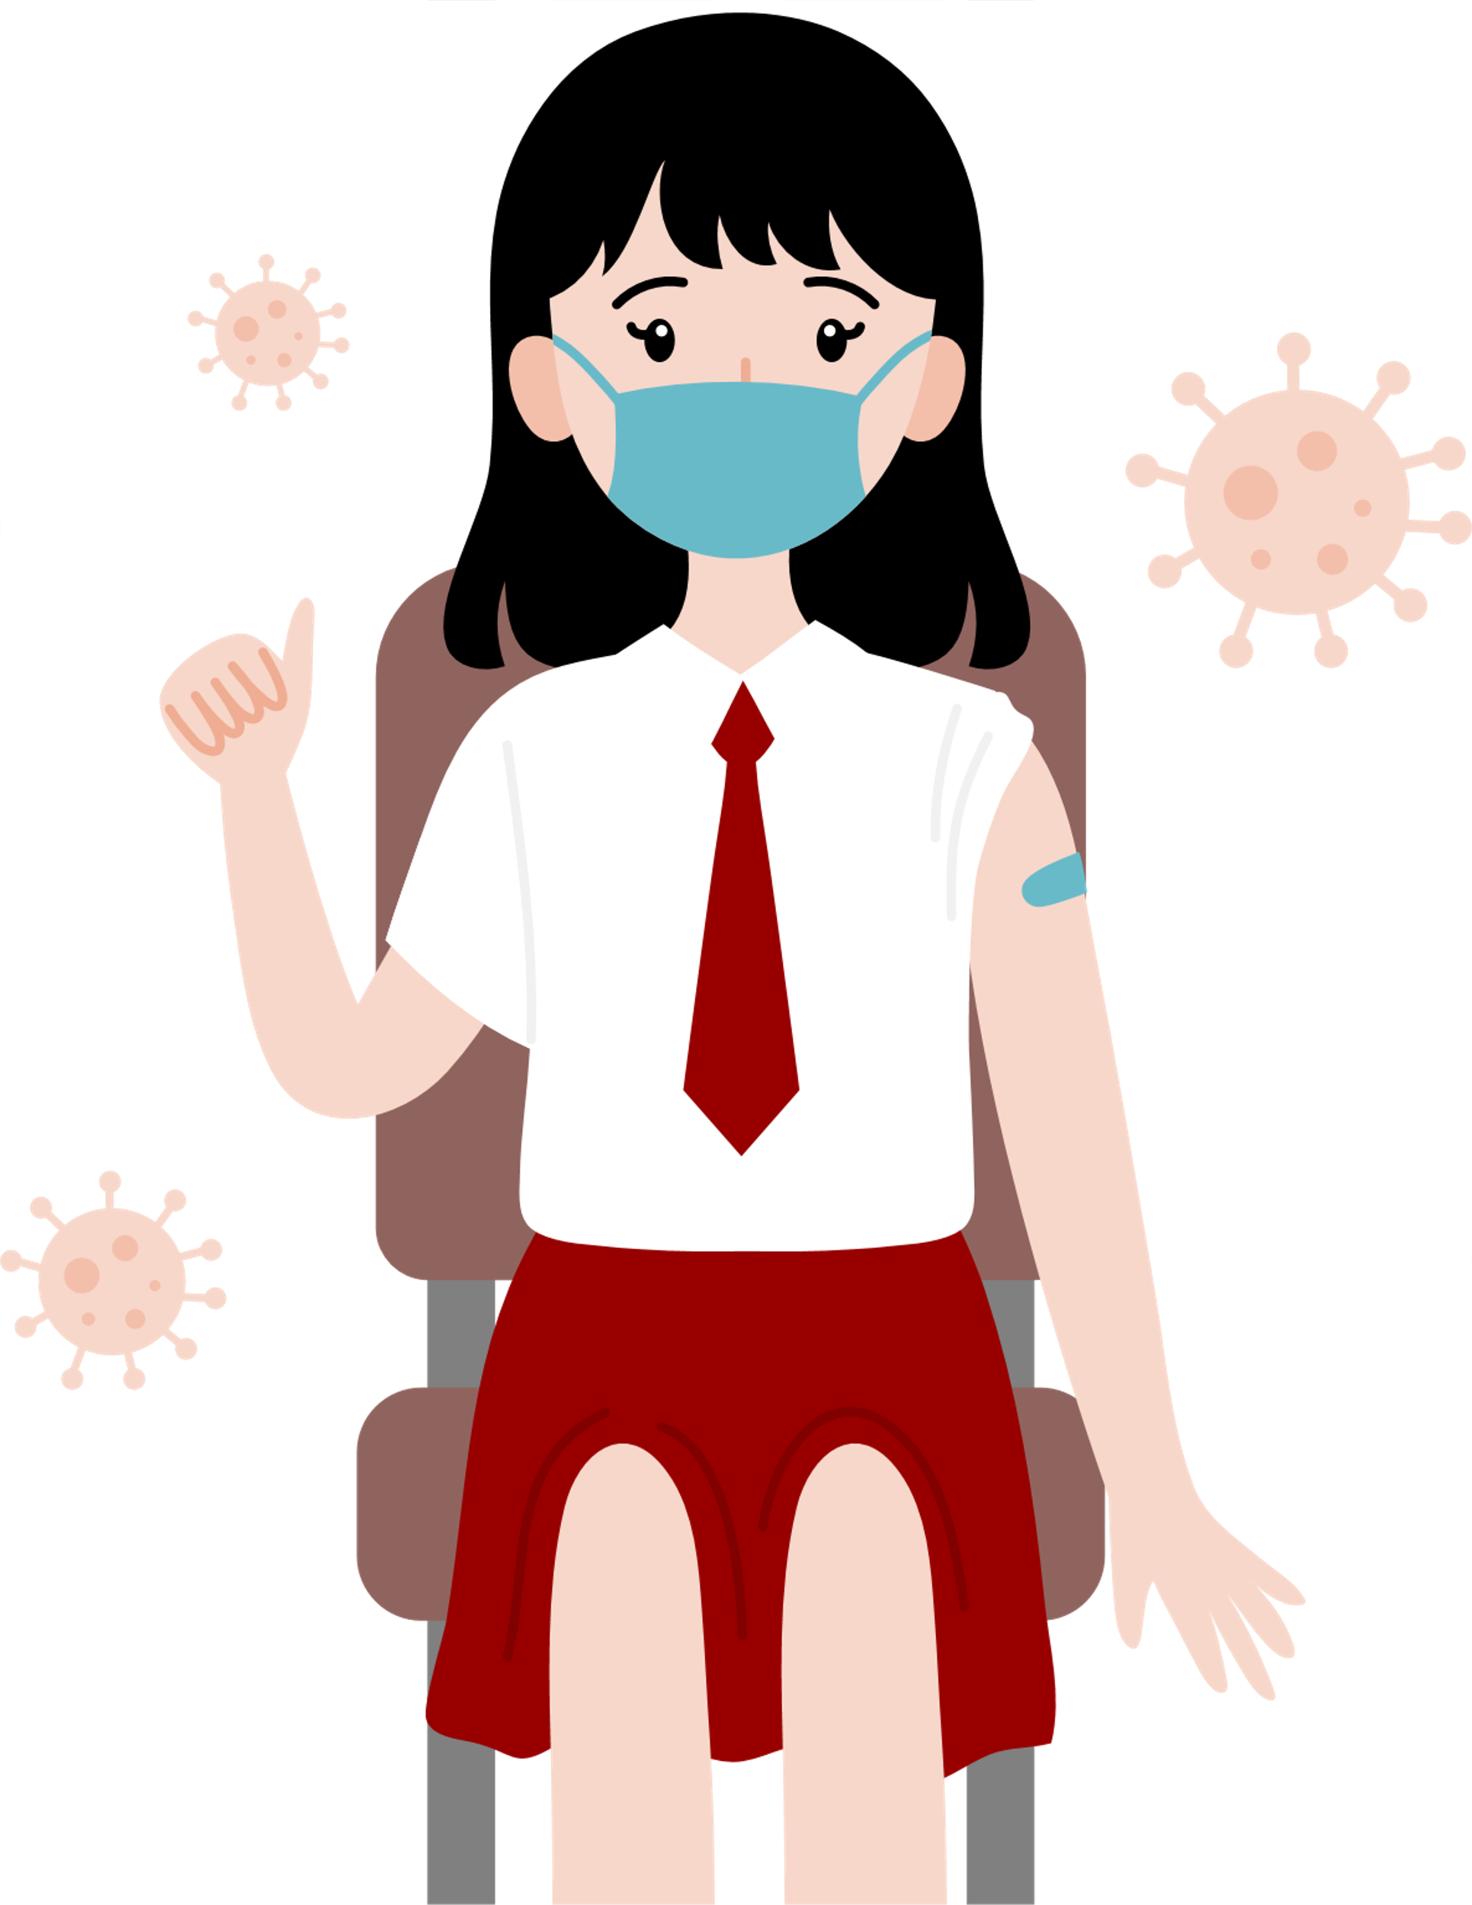
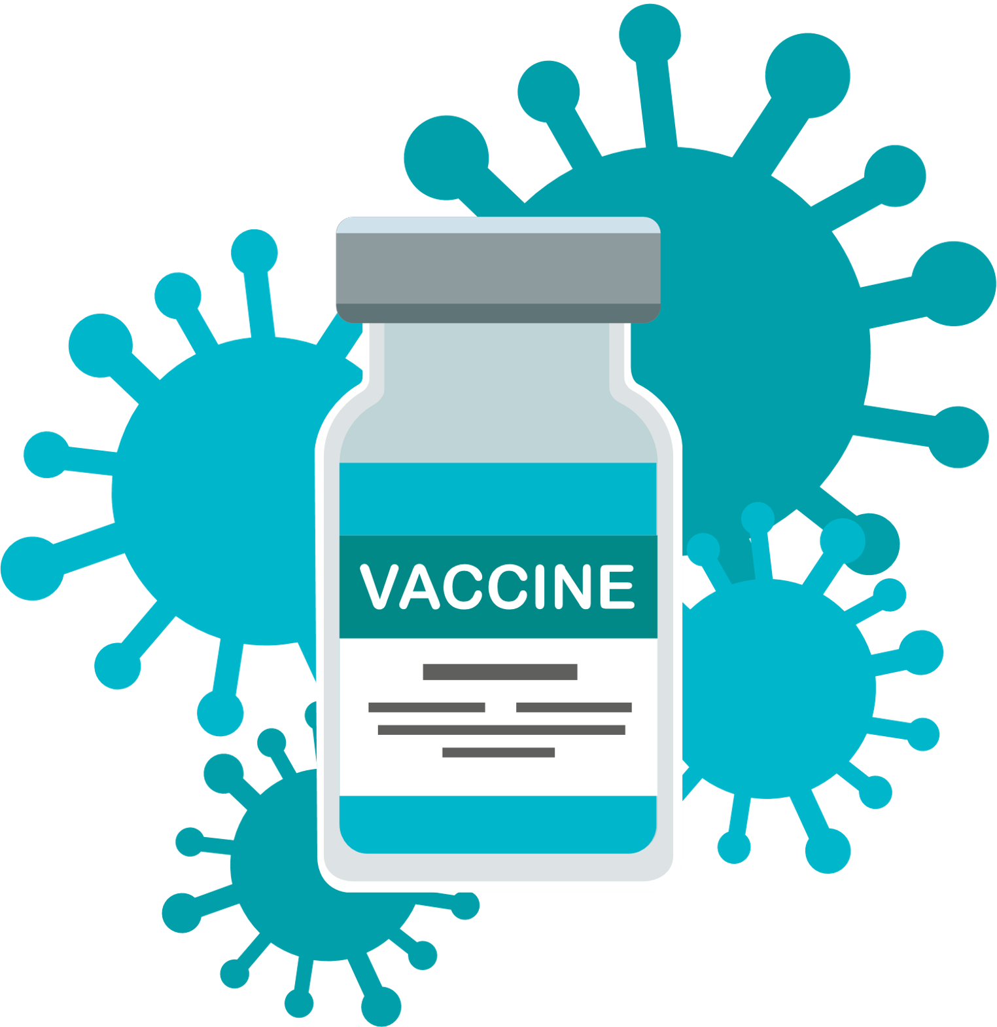
Immunization Basics

Slide 3
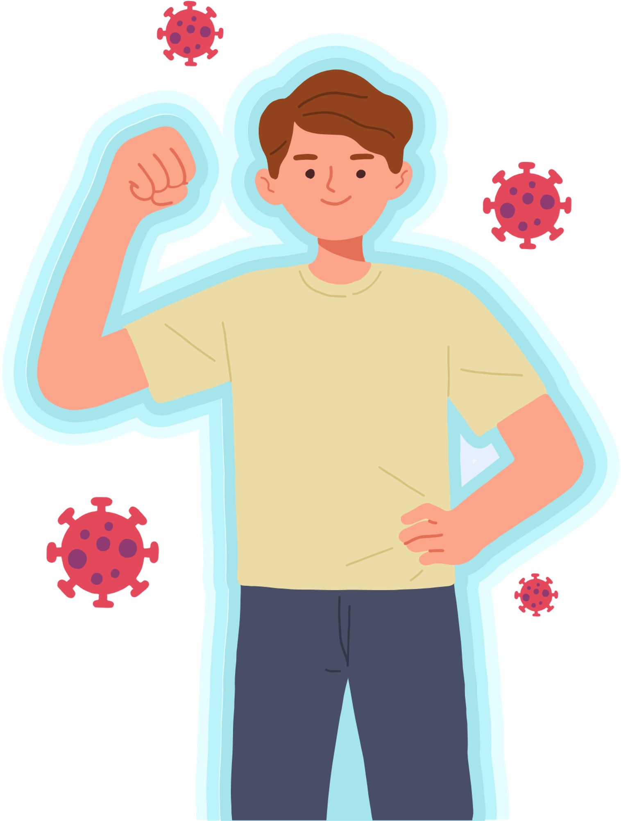
Immunization Basics
What is the immune system?
The immune system is a powerful army to protect your body against the invasion of bacteria, viruses, and fungus from the outside.
2.The immune system fights bacteria/viruses that enter the body and store information of how to fight them.
Everyone is born with innate immunity, but it is not enough to defeat all kinds of bacteria/viruses. Getting vaccinated will expose the body to the bacteria or virus so it will respond to them, hence strengthen the adaptive immune system. The adaptive immune system can provide long-lasting defense, sometimes even for a lifetime.
3. How to have a strong immune system .
Have a healthy diet.
Avoid stress.
Exercise regularly.
Avoid abusing stimulants.
Get fully vaccinated.

Slide 4
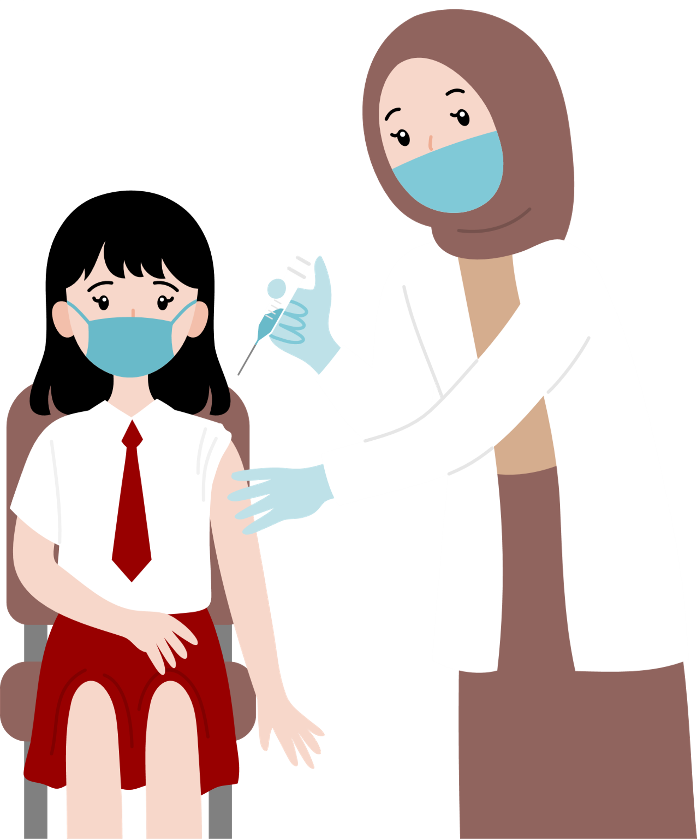
Vaccine Basics

Slide 5
Vaccine Basics
1. What is vaccination?
Vaccination contributes to the adaptive immune system and boosts immunity against certain diseases.
2. How vaccines are made?
Vaccines contain weakened or inactive bacteria or viruses, or a very small part of these germs that cannot develop or cause diseases.
3. Benefits of vaccination
Decrease the risk of common serious childhood diseases.
Reduce risks of complications, sequelae, and deaths when getting infected.

Slide 6
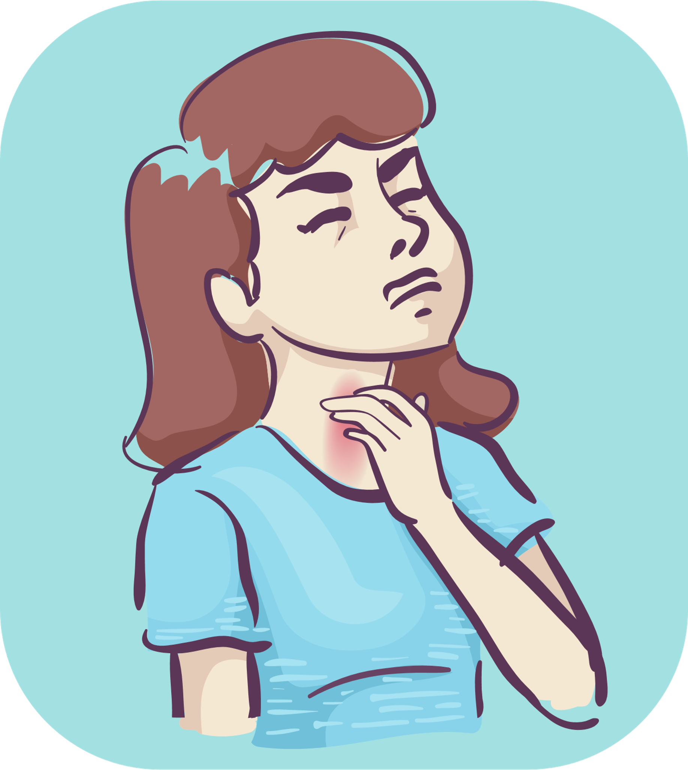
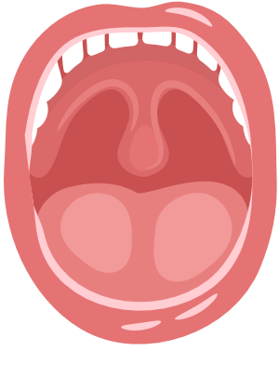
Diphtheria

Slide 7
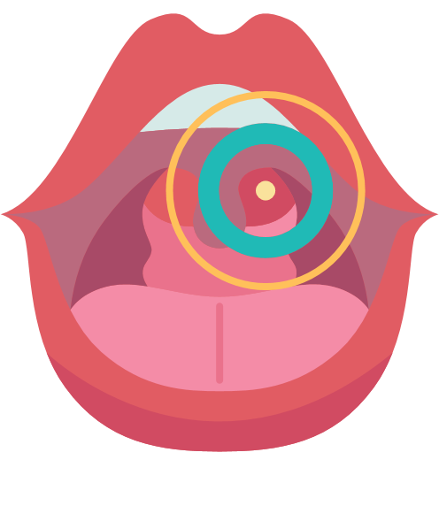
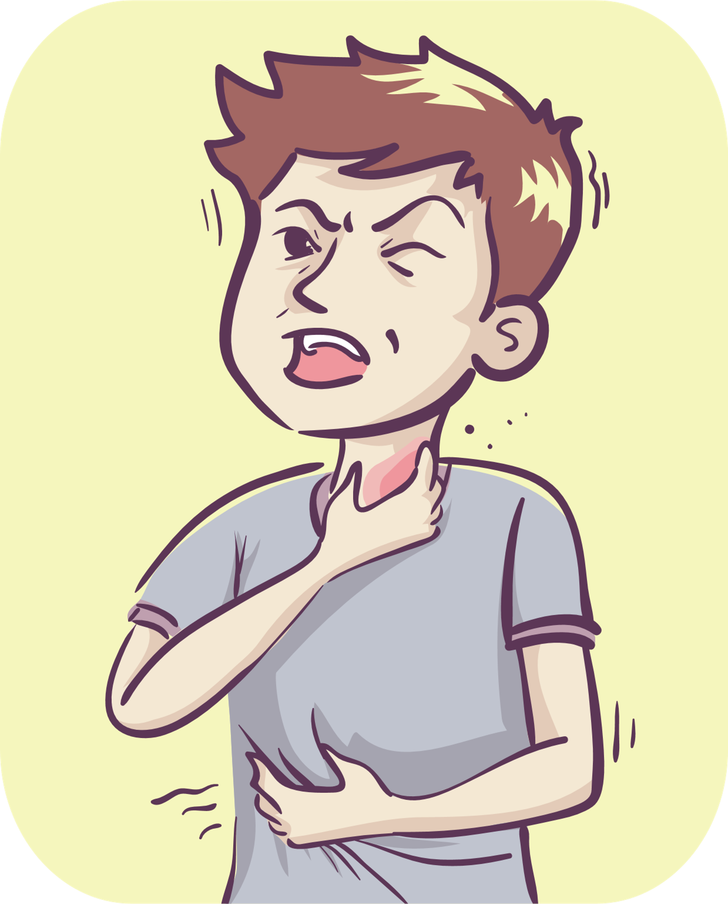
Diphtheria
1. Causes
Diphtheria is caused by strains of bacteria called Corynebacterium diphtheriae.
2. Symptoms
Low-grade fever, sore throat, and barking cough.
Thich, easy-to-bleed pseudomembranous in the throat with the color of ivory white, grey, or black.
Swollen neck and breathing difficulty.
3. Complications
Myocarditis, damage to the nervous system to the heart, and heart failure.
Kidney failure, acute tubular necrosis, bleeding from the marrow and adrenal cortex.
Blocking of airway.
Death can occur within 6-10 days.

Slide 8
Diphtheria
4. Transmission
The disease is transmitted from sick person to healthy person through the respiratory tract.​
Diphtheria bacilli can also enter the human body through open wounds on the skin.
5. Prevention
Decrease the risk of common serious childhood diseases.
Reduce risks of complications, sequelae, and deaths when getting infected.
6. Information about the vaccination

Slide 9
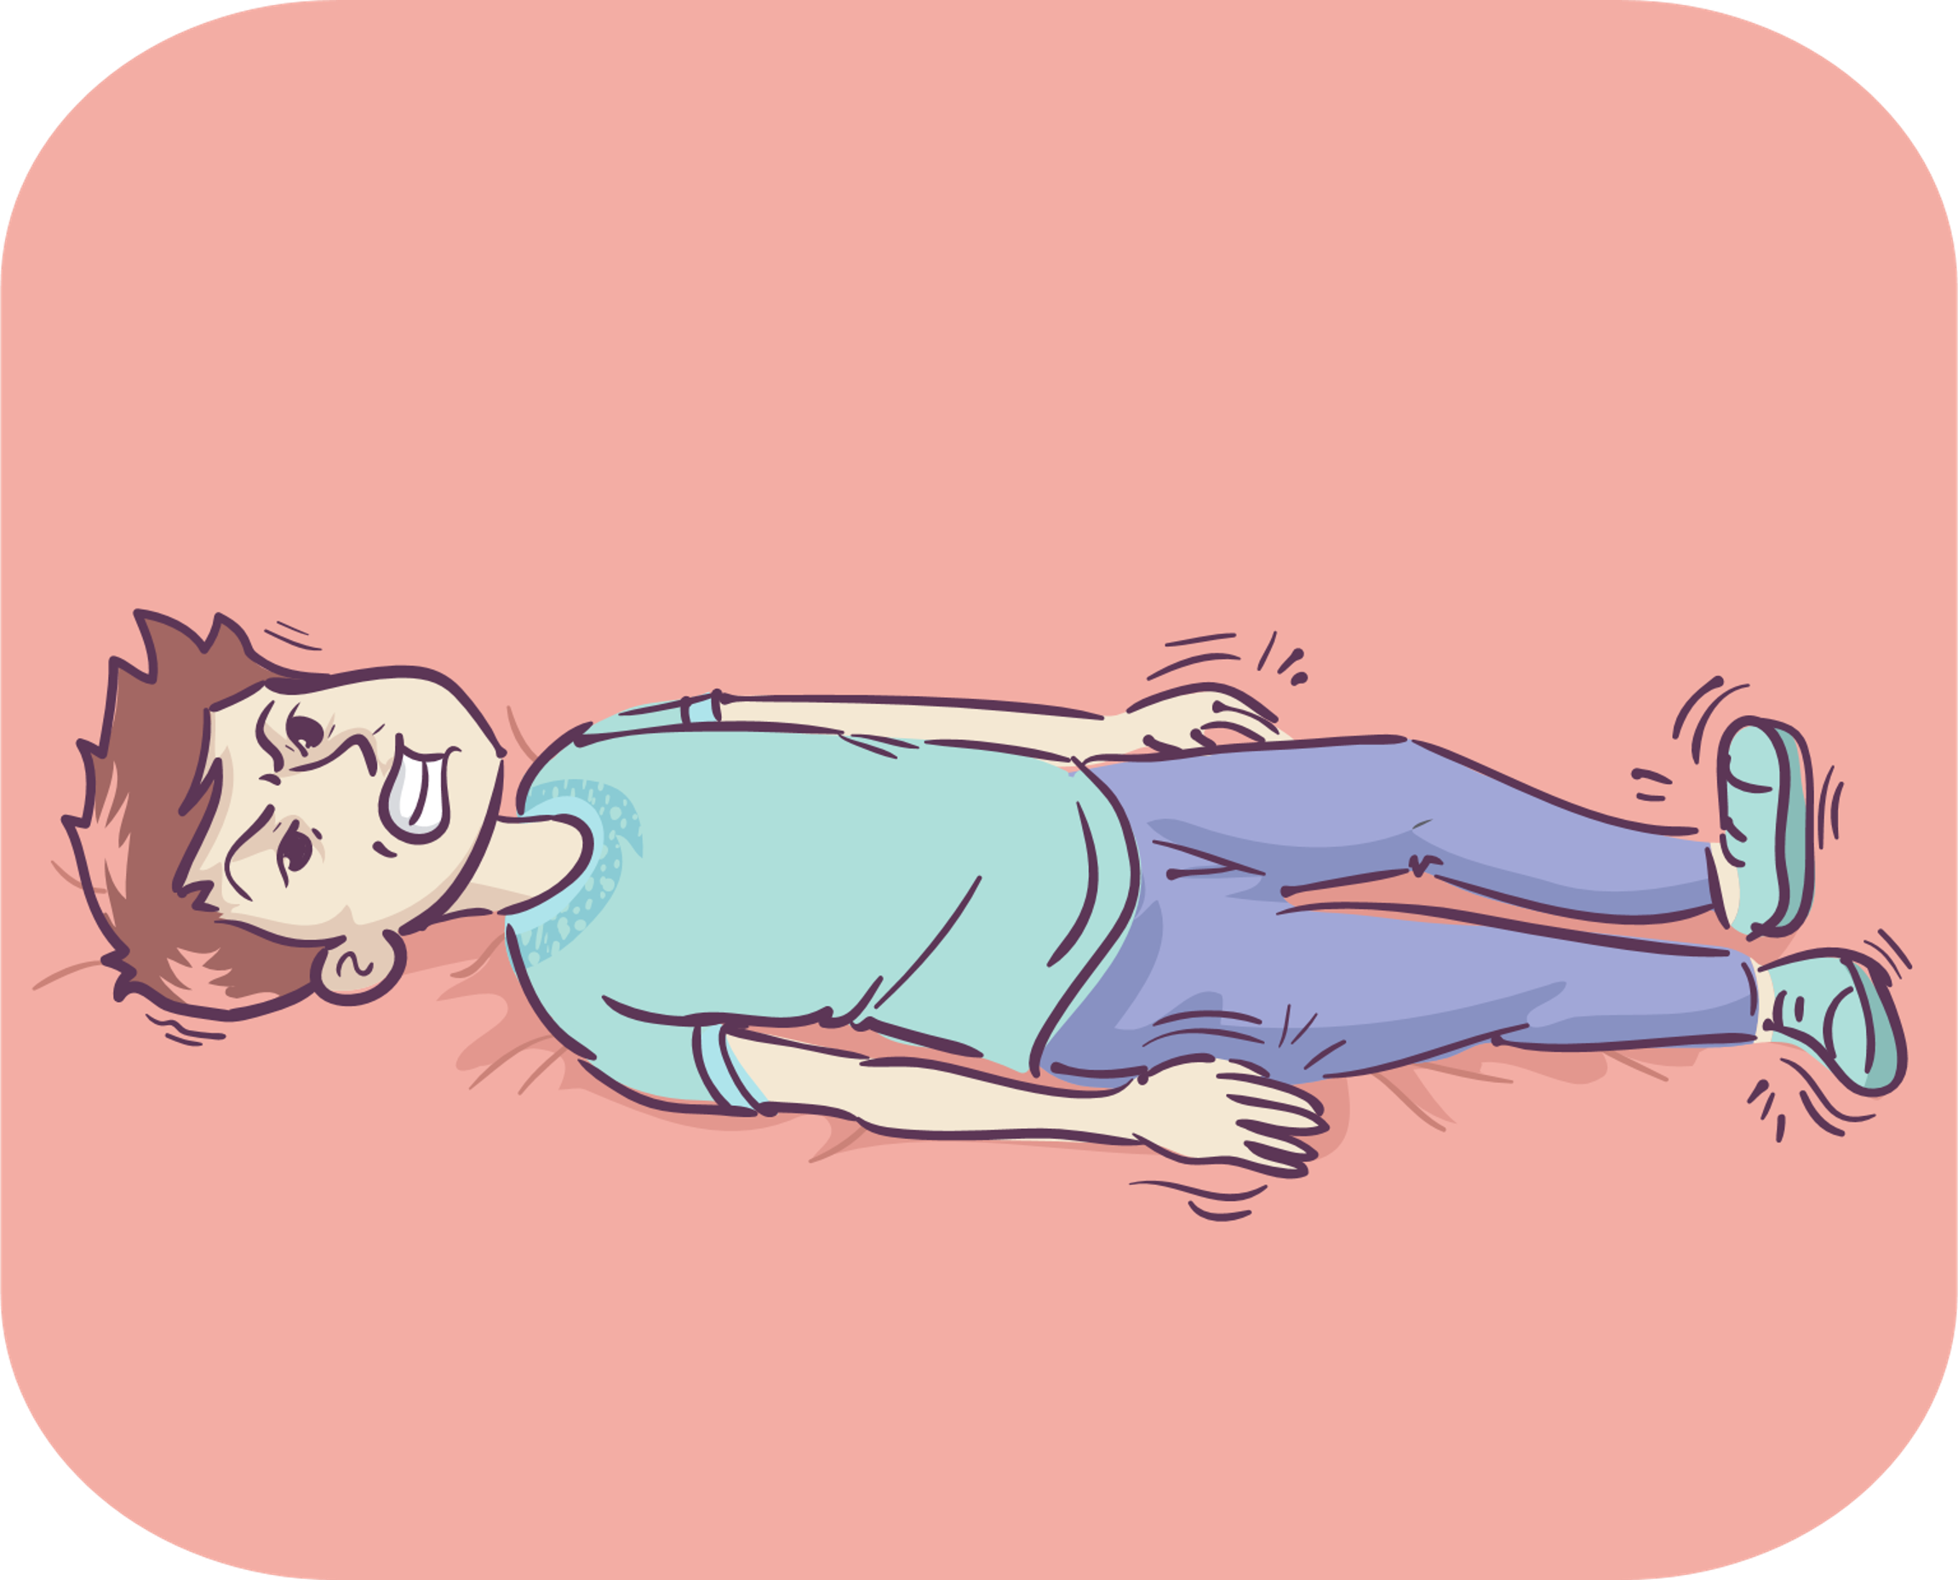
Tetanus

Slide 10
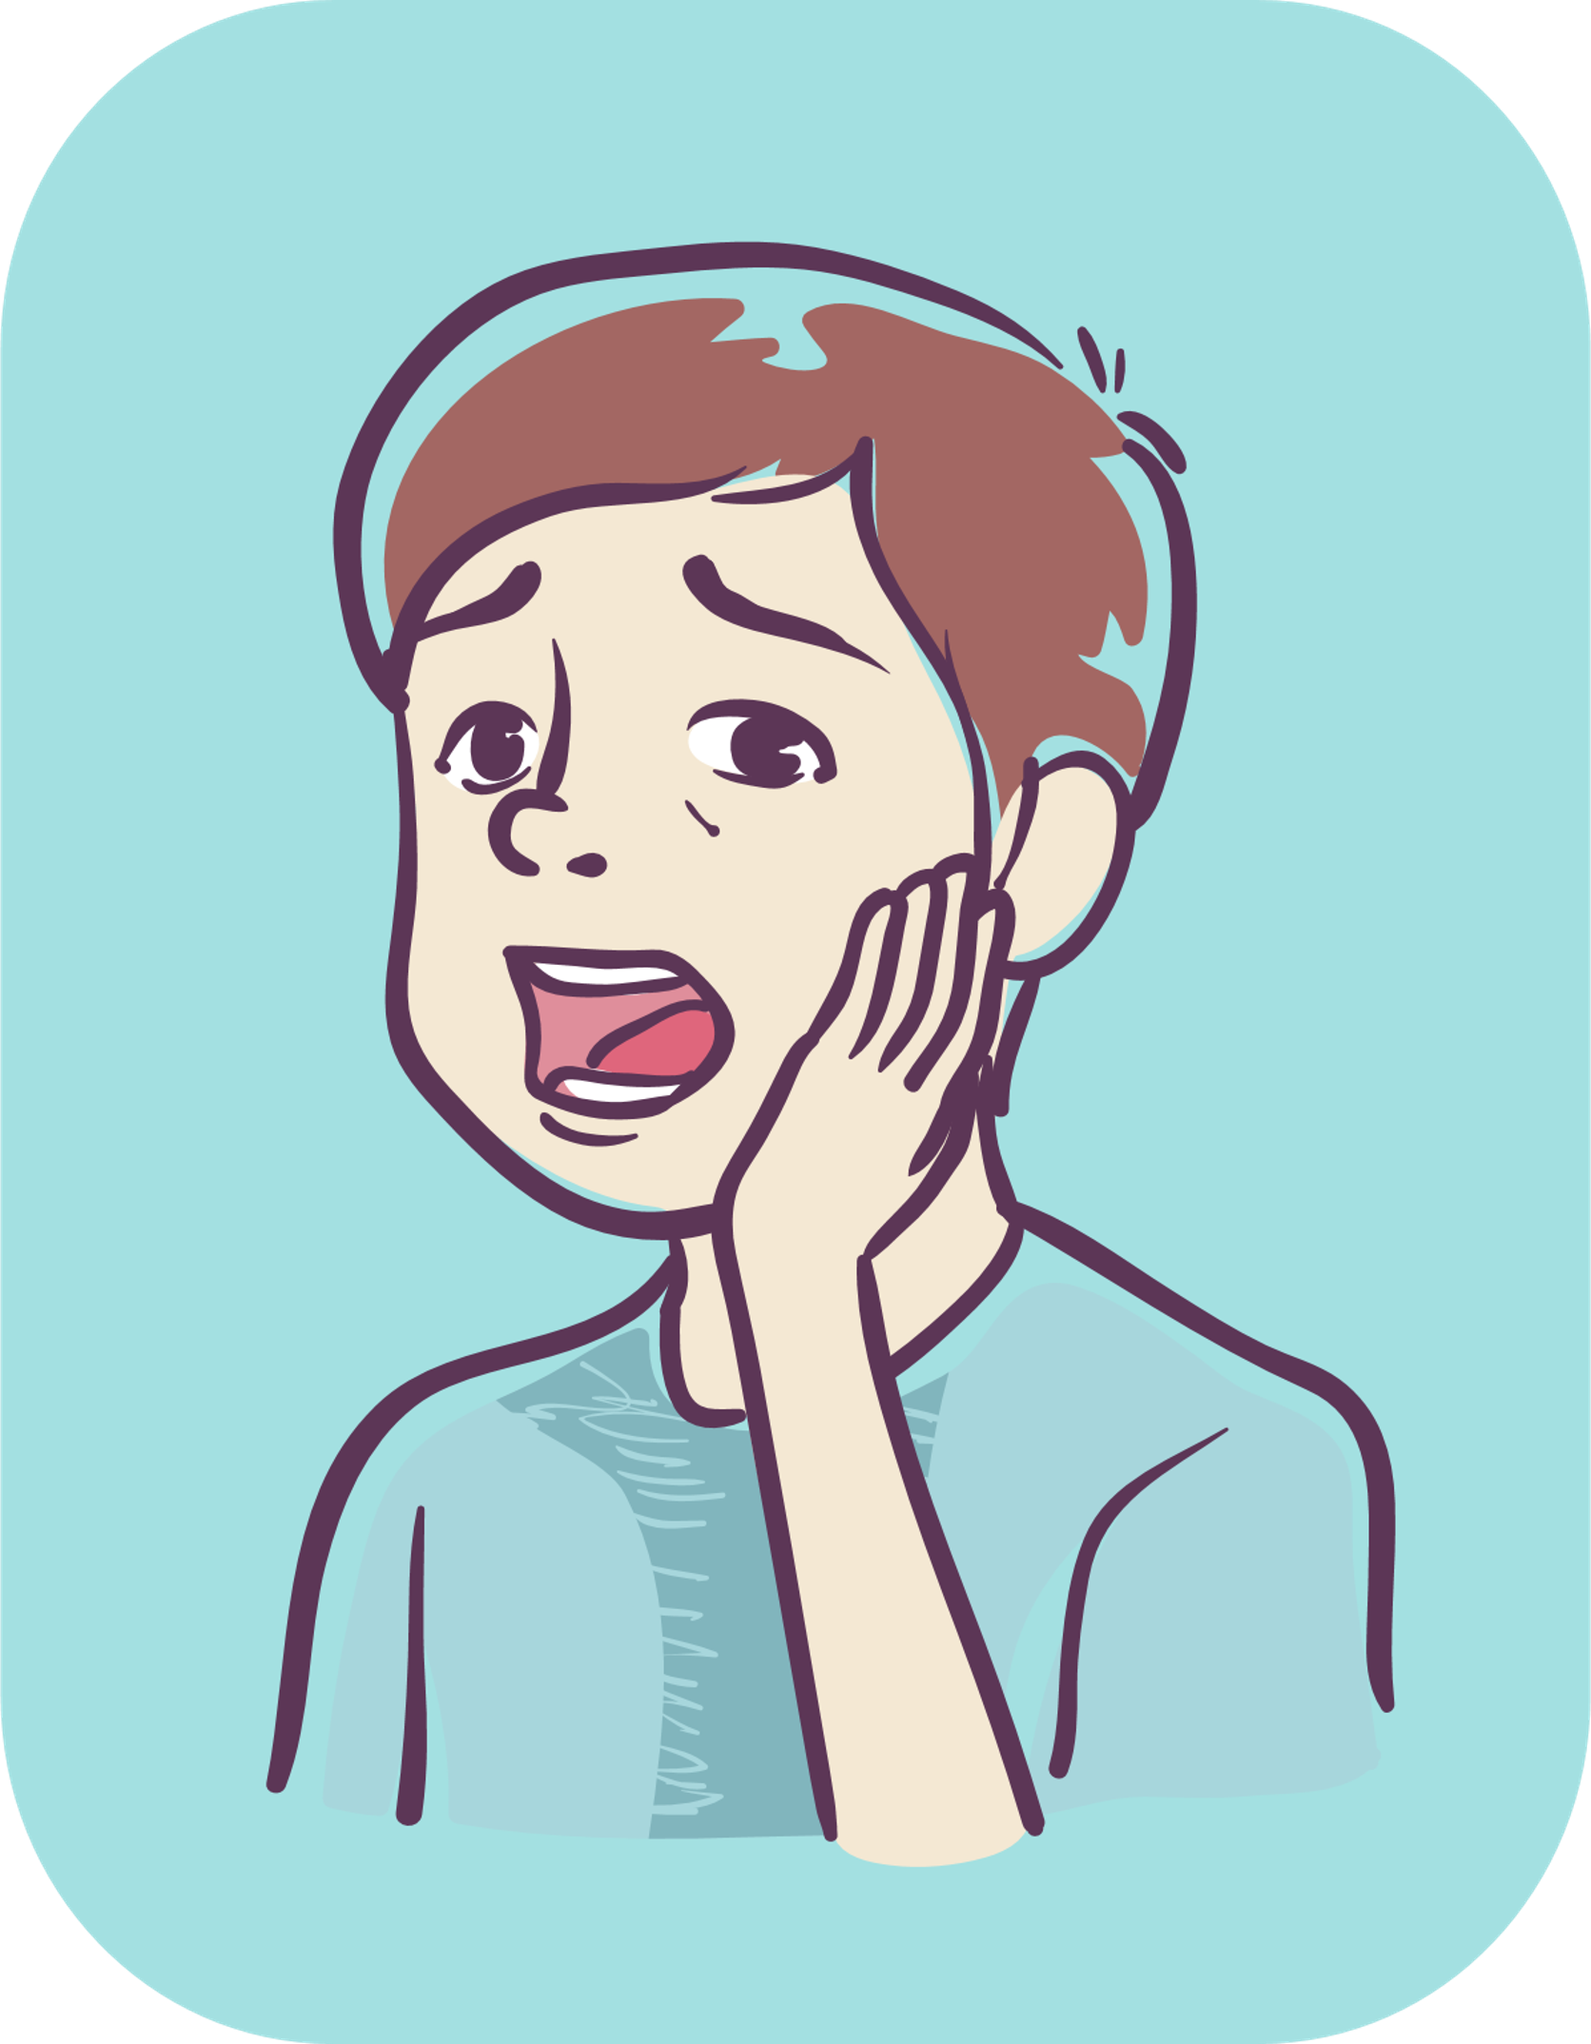
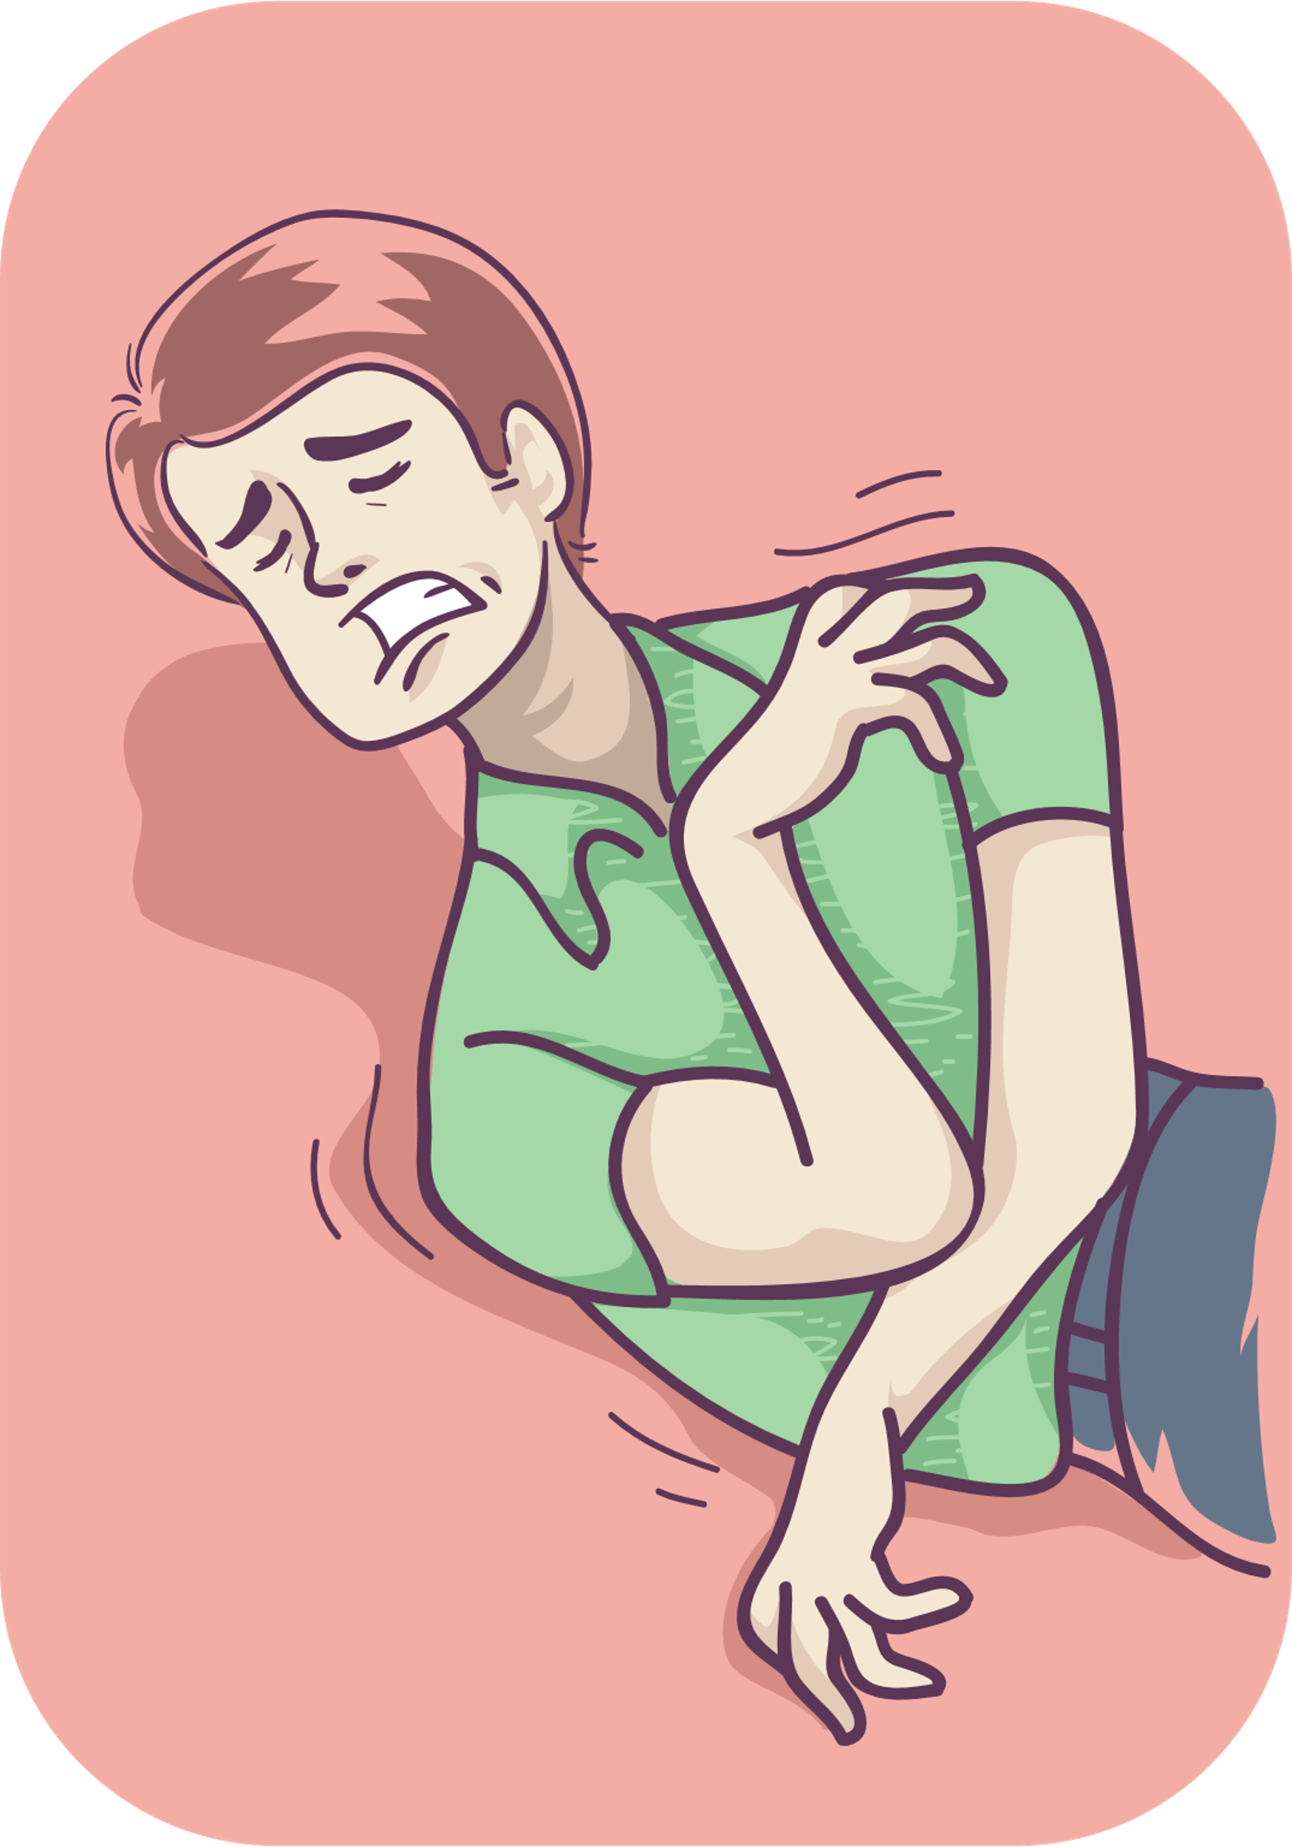
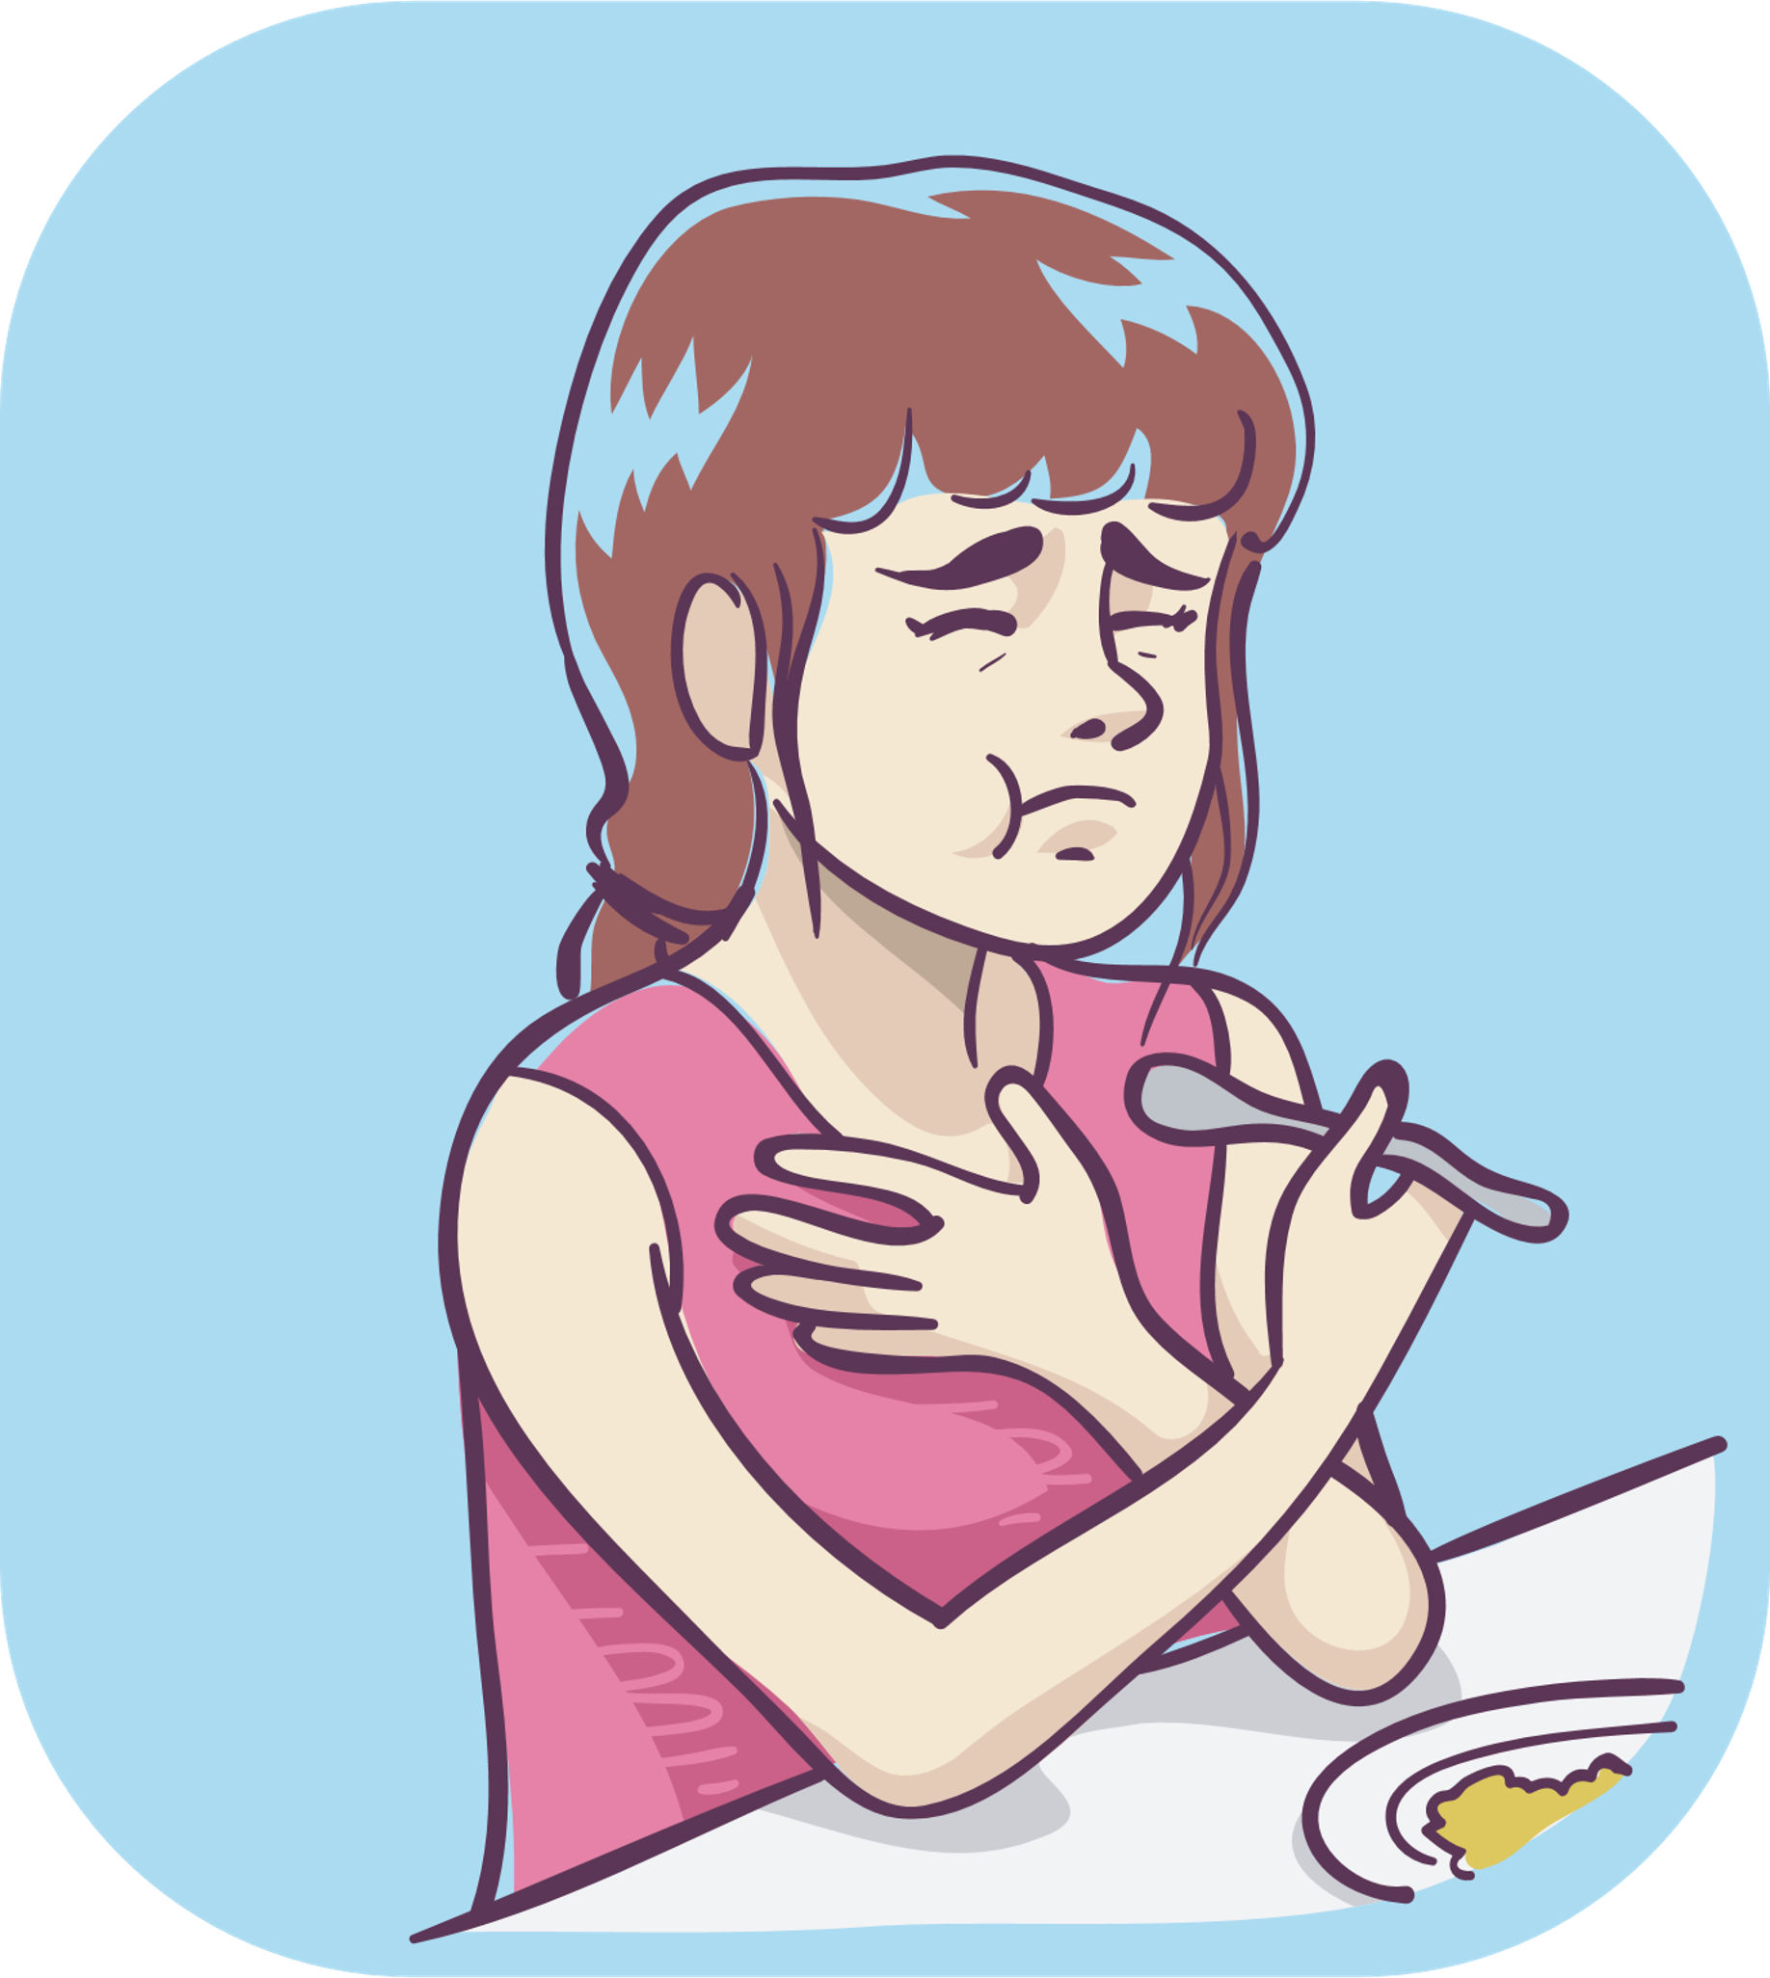
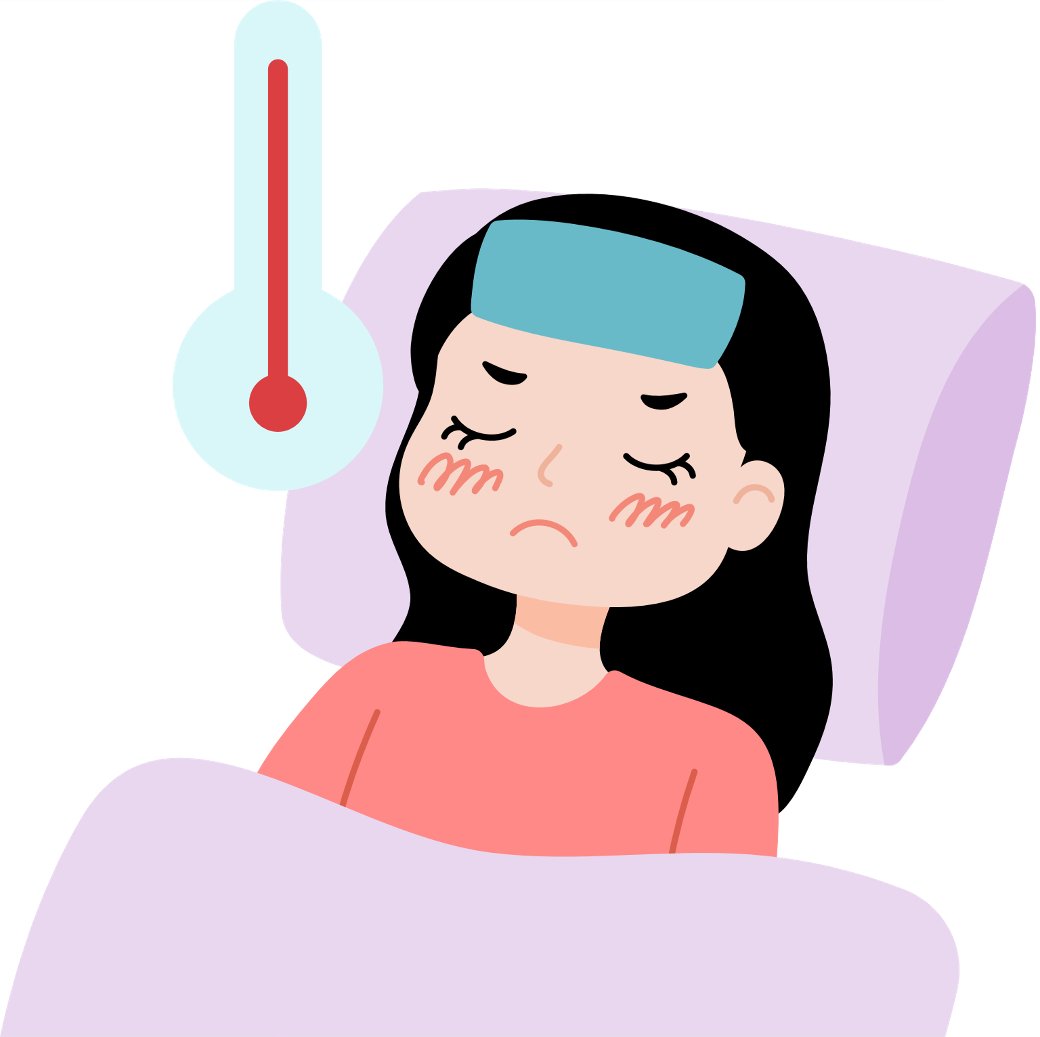
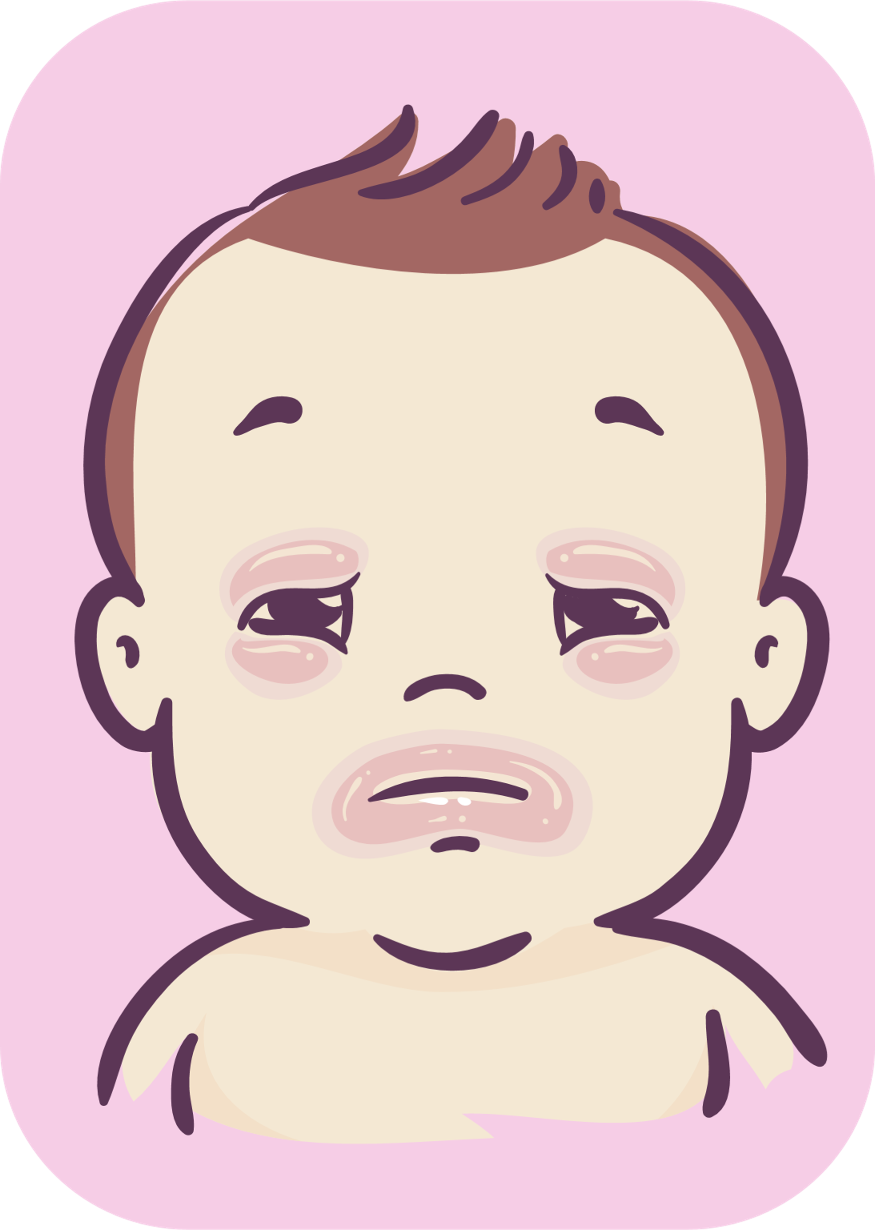
Tetanus
1. Causes
Tetanus is caused by the tetanus bacterium Clostridium tetani.
2. Symptoms
Jaw cramping
Seizures
Trouble opening
the mouth and swallowing.
Fever and sweating.
Infants: lockjaw, trouble sucking.
The incubation period is between 3 and 10 days, but it can be up to 3 weeks.

Slide 11
Tetanus
3. Complications
Seizures which can lead to fractured bones.
Arrhythmia, losing consciousness, and pneumonia.
Risks of getting other infectious diseases.
A high mortality rate in infants and the elderly.
4. Transmission
Spores of tetanus bacteria are everywhere, and they can enter the body through open wounds.
Tetanus is not transmitted directly from person to person.
Women are at a high risk of getting infected during giving birth or having abortions with unsterilized equipment.
Infants and children can get tetanus if the equipment used for umbilical cord cutting, umbilical care is not sterilized, or the wound is not properly taken care of.
5. Prevention
When the wound is dirty, you need to clean it and inject anti-tetanus serum in time.
Get tetanus vaccination even if you have been infected before.
Clean birth practices.
6. Information about the vaccination

Slide 12
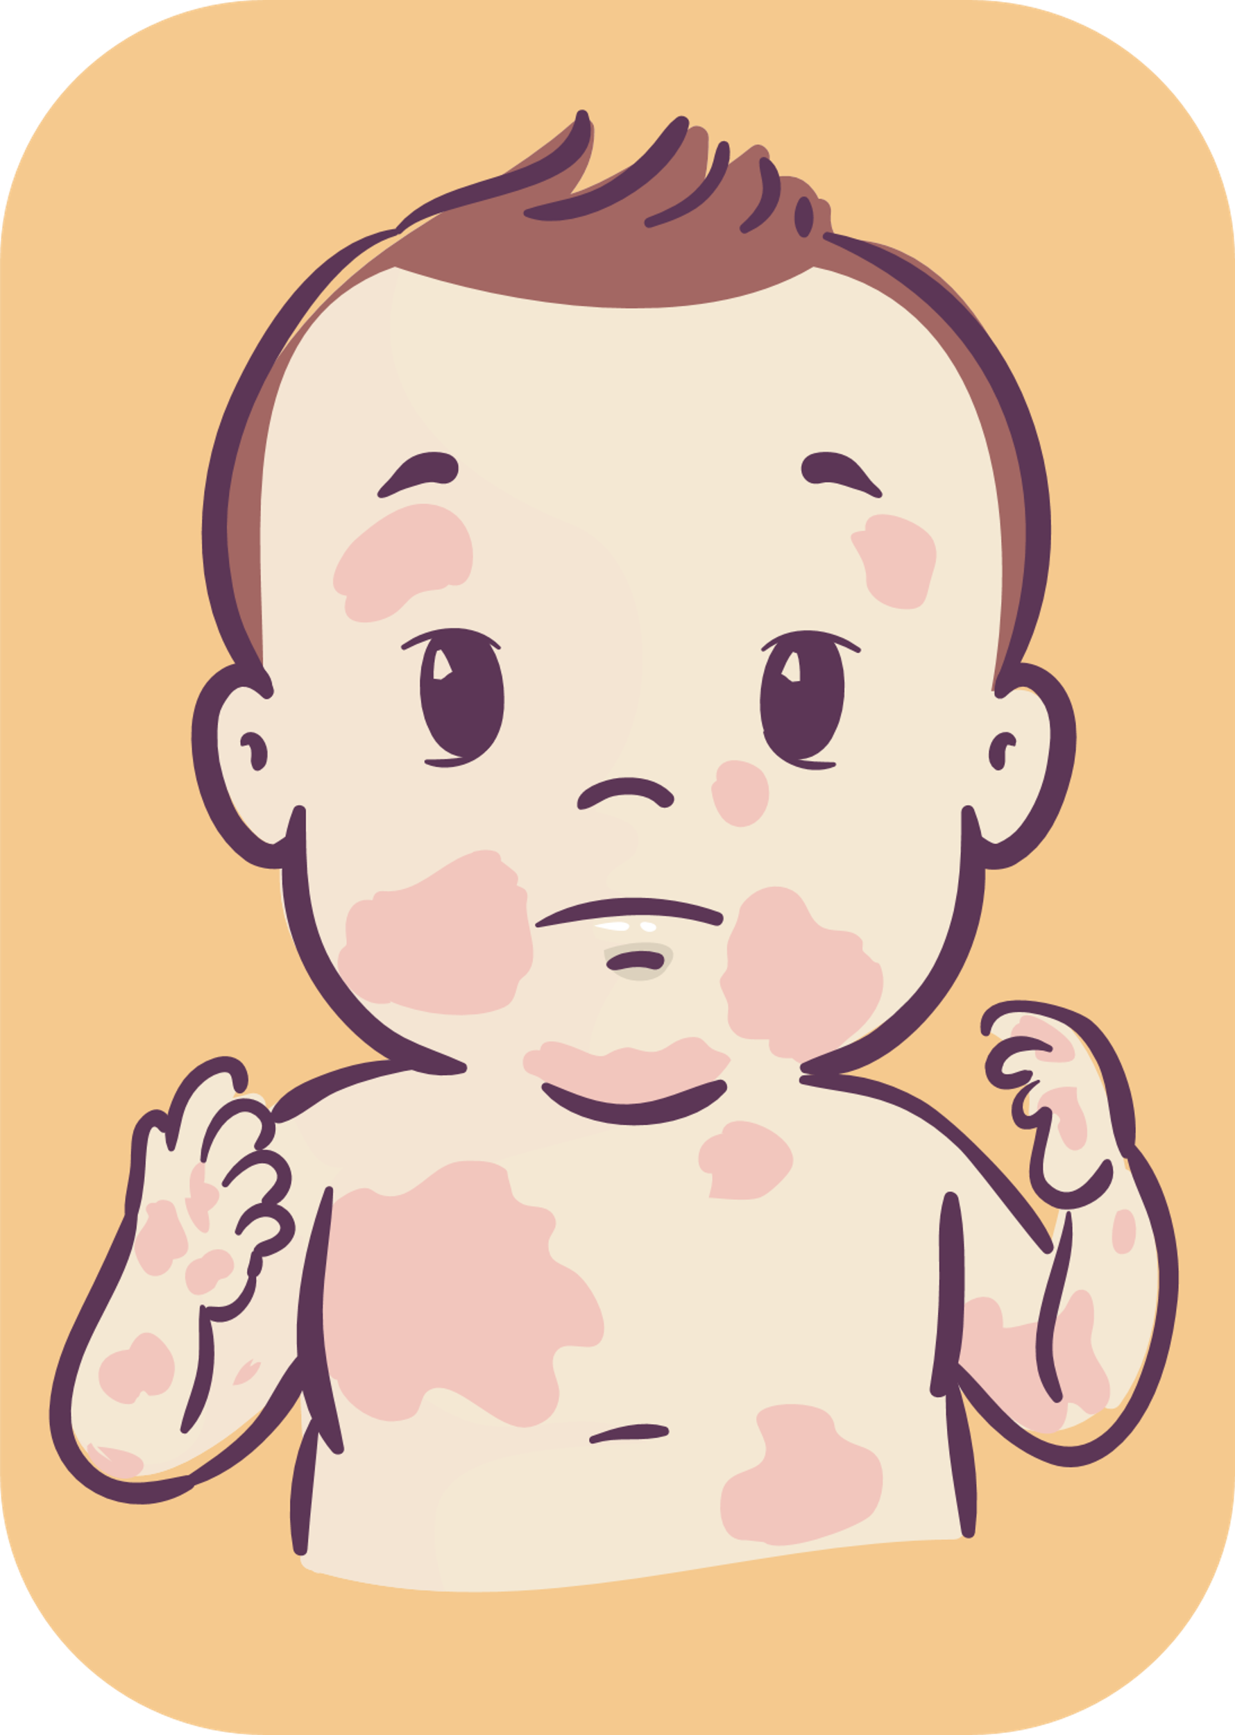
Measles

Slide 13
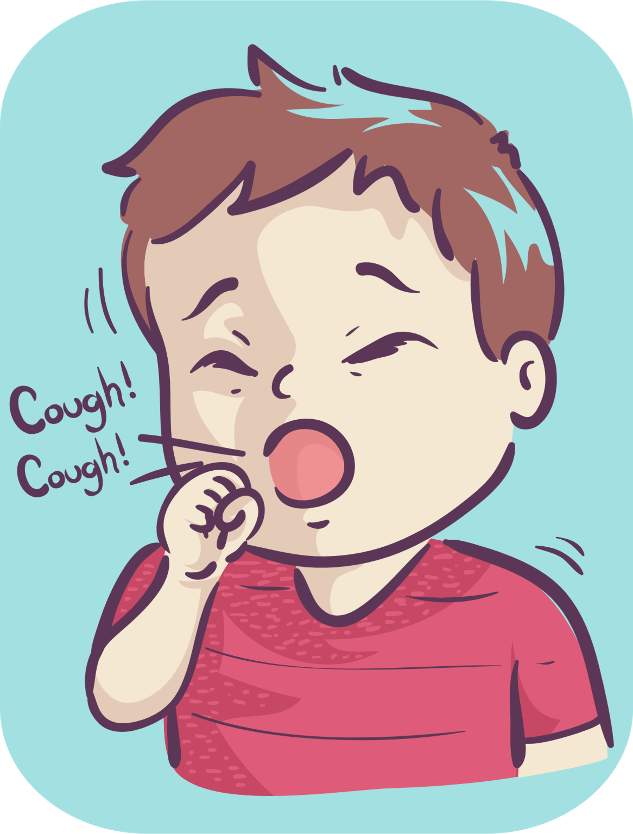
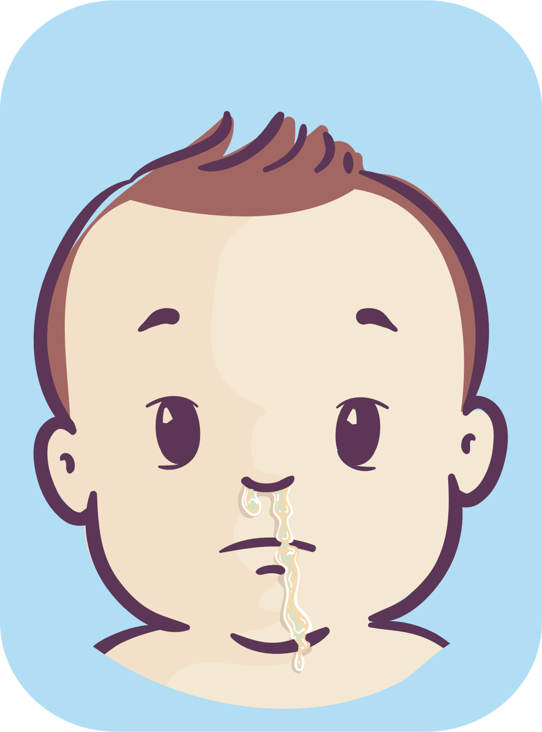
Measles
1. Causes
Measles is caused by a virus called morbillivirus.
2. Symptoms
Fever and rash
High-grade fever in 1-3 consecutive days
Cough
Runny noses
Red eyes, and watery eyes
Small white rash inside the mouth on the inner lining of the cheek
Macular and papular rash on the face, neck and spread to the whole body in 5-6 days.

Slide 14
Measles
3. Complications
Middle ear infection, pneumonia, and diarrhea.
Encephalitis.
Children with malnutrition have a risk of blindness and death.
Women during pregnancy have a risks of miscarriage, stillbirth, and premature.
4. Transmission
Measles is transmitted from person to person via respiratory droplets of saliva when coughing or sneezing.
An infected person can infect others within 1 week before and after the rash appears.
5. Prevention
Isolate infected patients and treat them for at least 5 days.
Wear masks while in contact. Get fully vaccinated.
6. Information about the vaccination

Slide 15
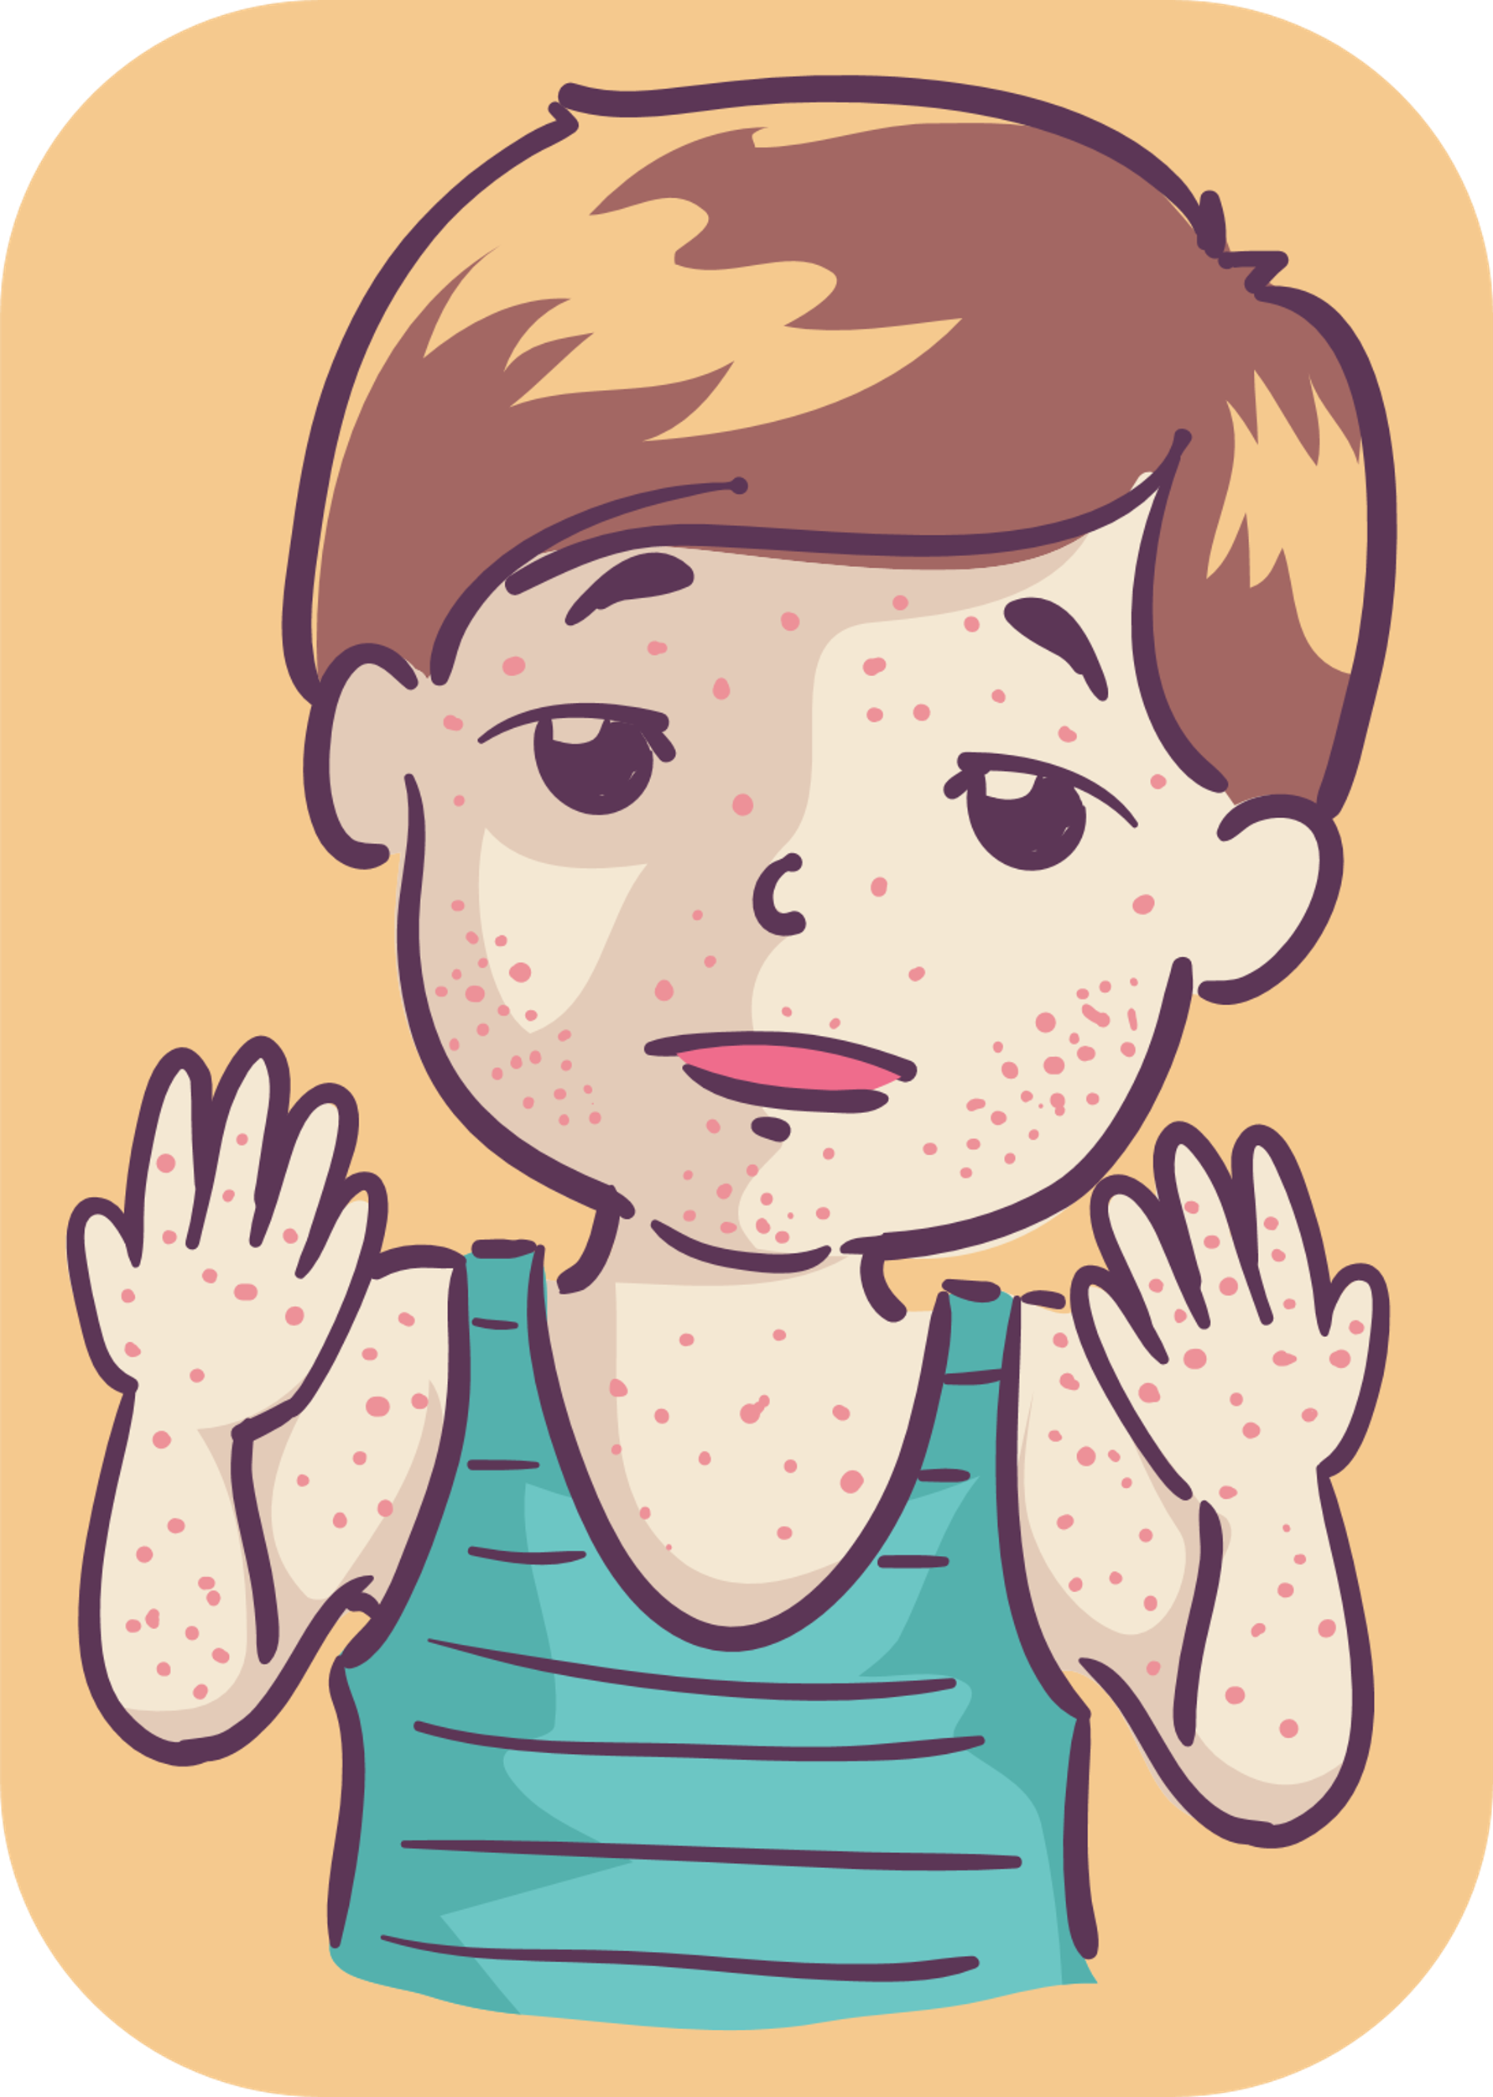
Rubella

Slide 16
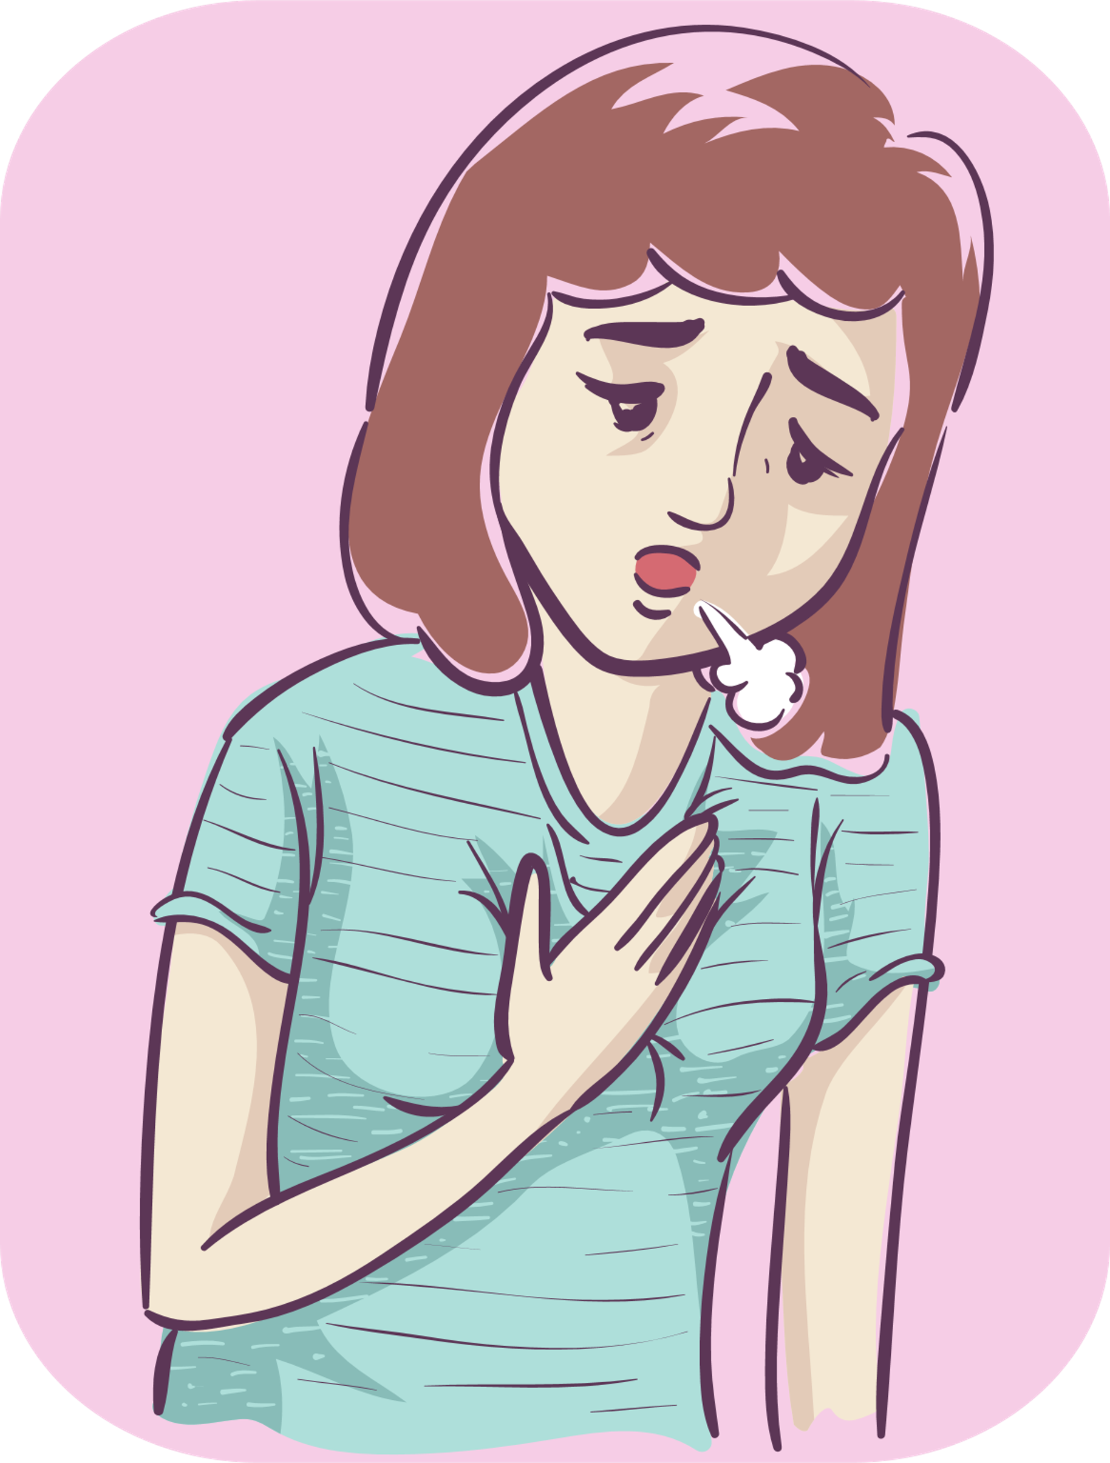
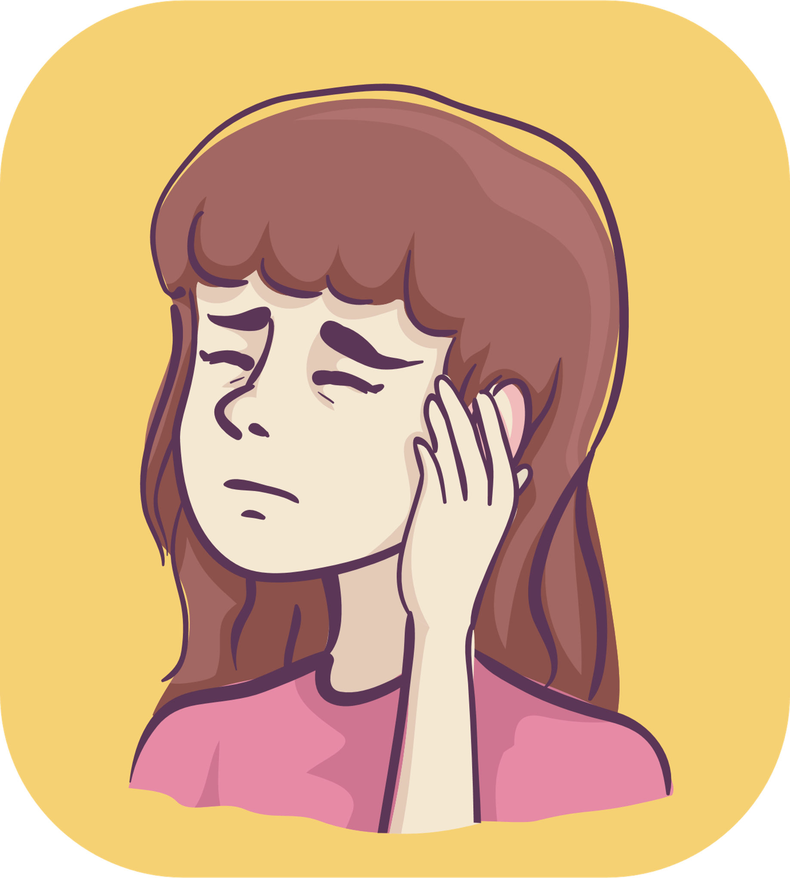
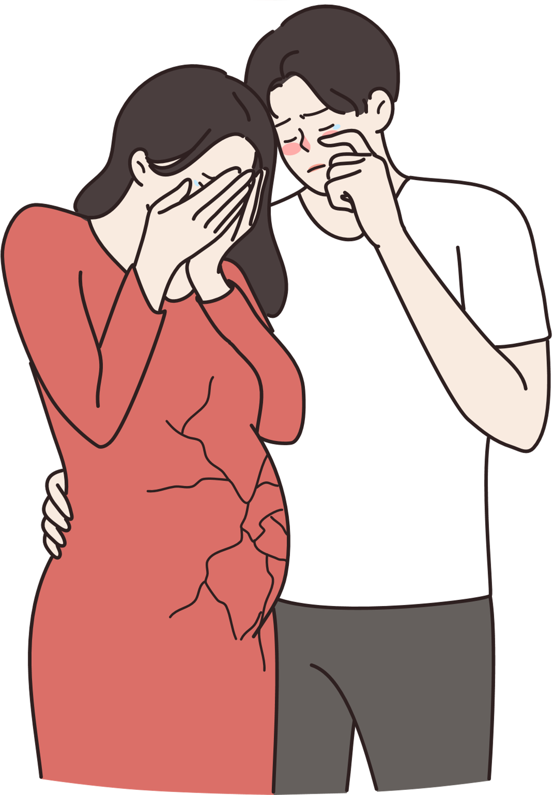
Rubella
1. Causes
Rubella is caused by a virus called Rubella.
2. Symptoms
Fever and rash
Respiratory inflammation
Swollen lymph nodes in the neck
Swollen behind the ears
3. Complications
It can cause miscarriage, stillbirth, or birth defects if a pregnant woman is infected, especially less than 3 months of pregnancy.
The disease is highly contagious and can cause a large epidemic.

Slide 17
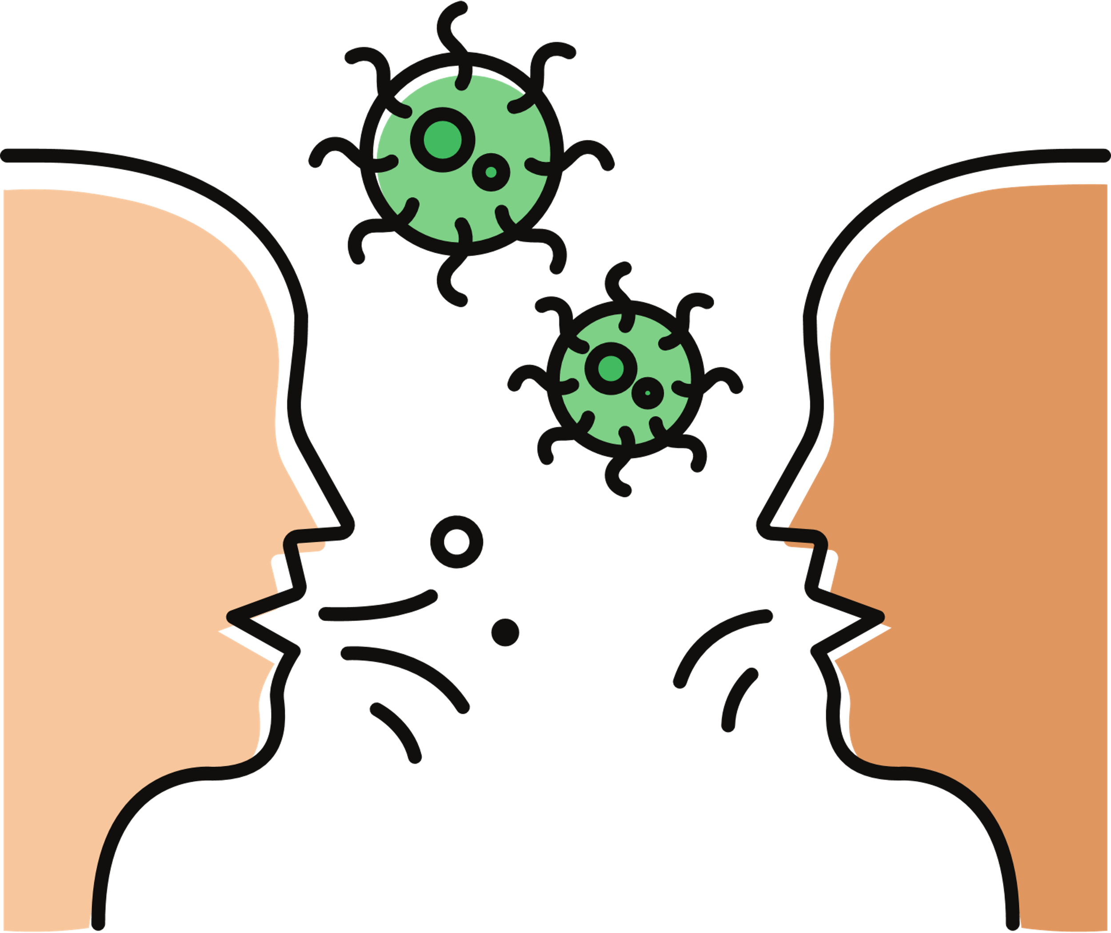
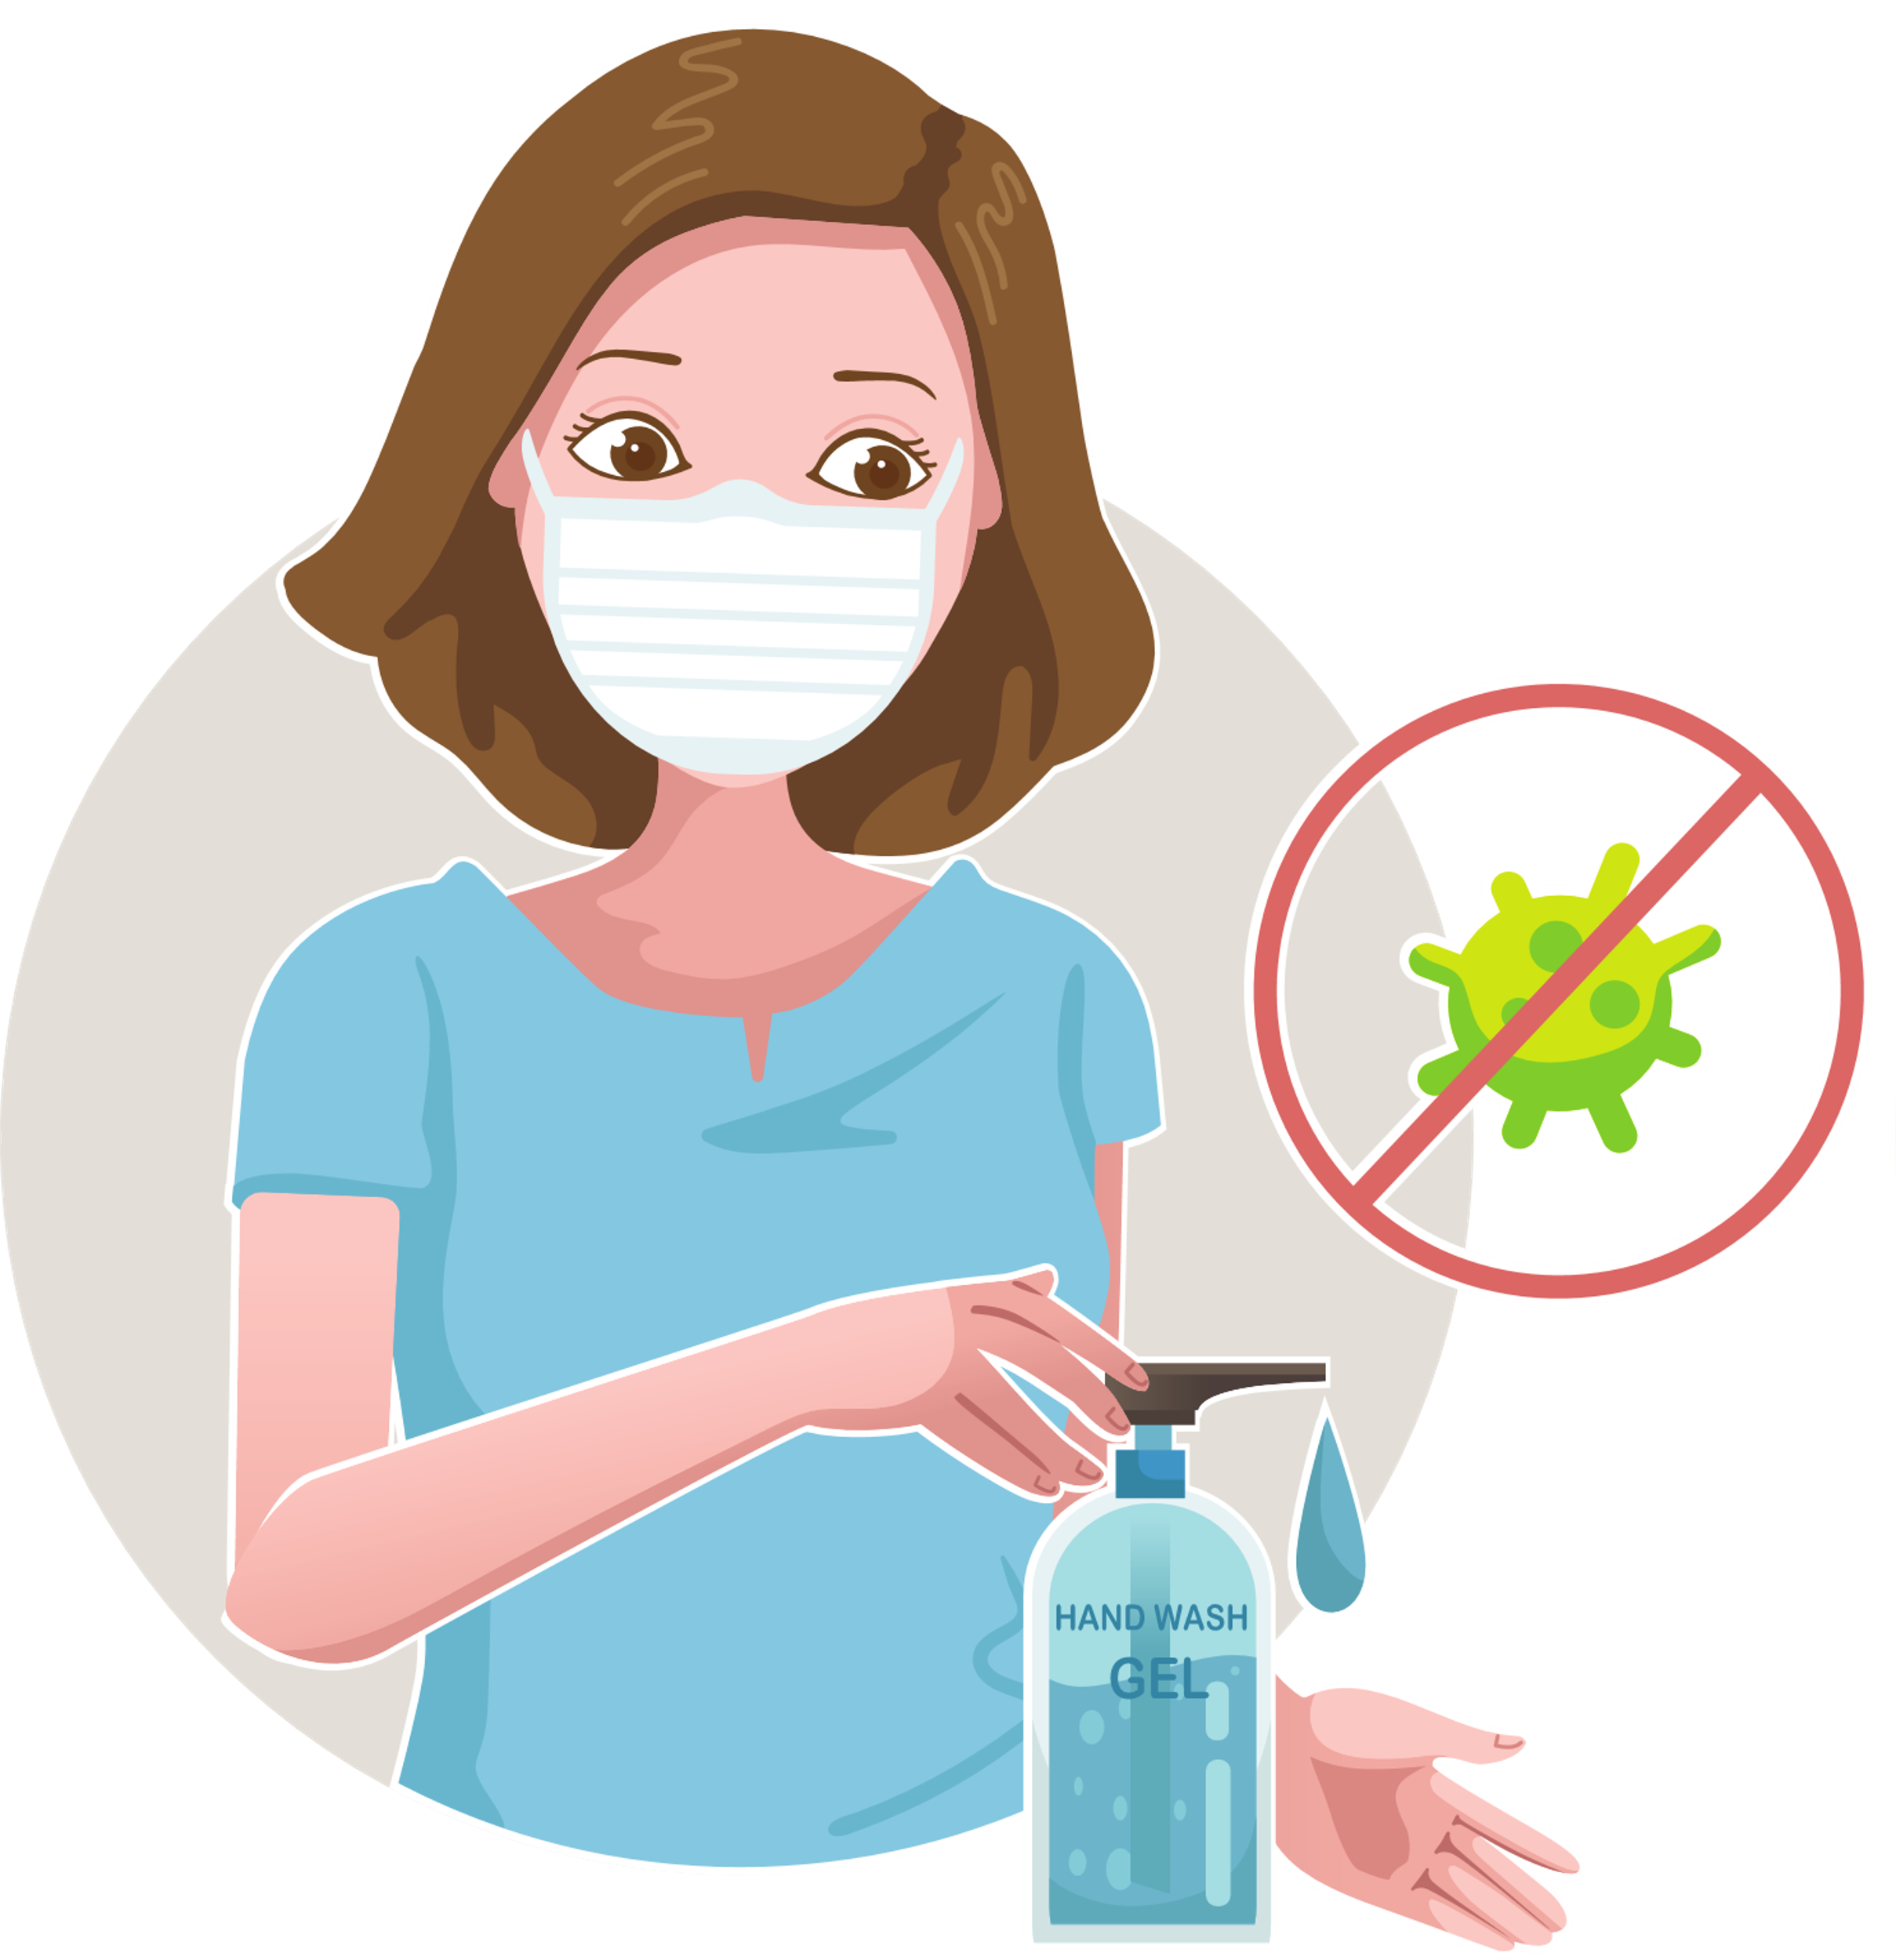
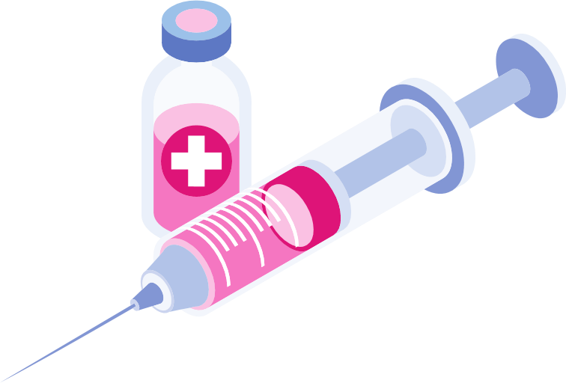
Rubella
4. Transmission
The incubation period is from 14 to 21 days, the average is 18 days.
The infectious period lasts from 7 days before to 7 days after the rash appears.
The disease is spread through the respiratory tract by inhalation or direct contact with the nasopharyngeal secretions of the patient.
People who are not immune can get the disease; people after getting the disease have sustained immunity.
Immunity from the mother to the baby can protect the baby for 6 to 9 months after birth, depending on the mother's antibody level.
5. Prevention
Improve personal hygiene
Disinfect and clean ventilation Isolate the patient for at least 7 days after rash appearance.
Wear a mask when in contact with the patient.
Get enough vaccinations to prevent the disease.
6. Information about the vaccination

Slide 18
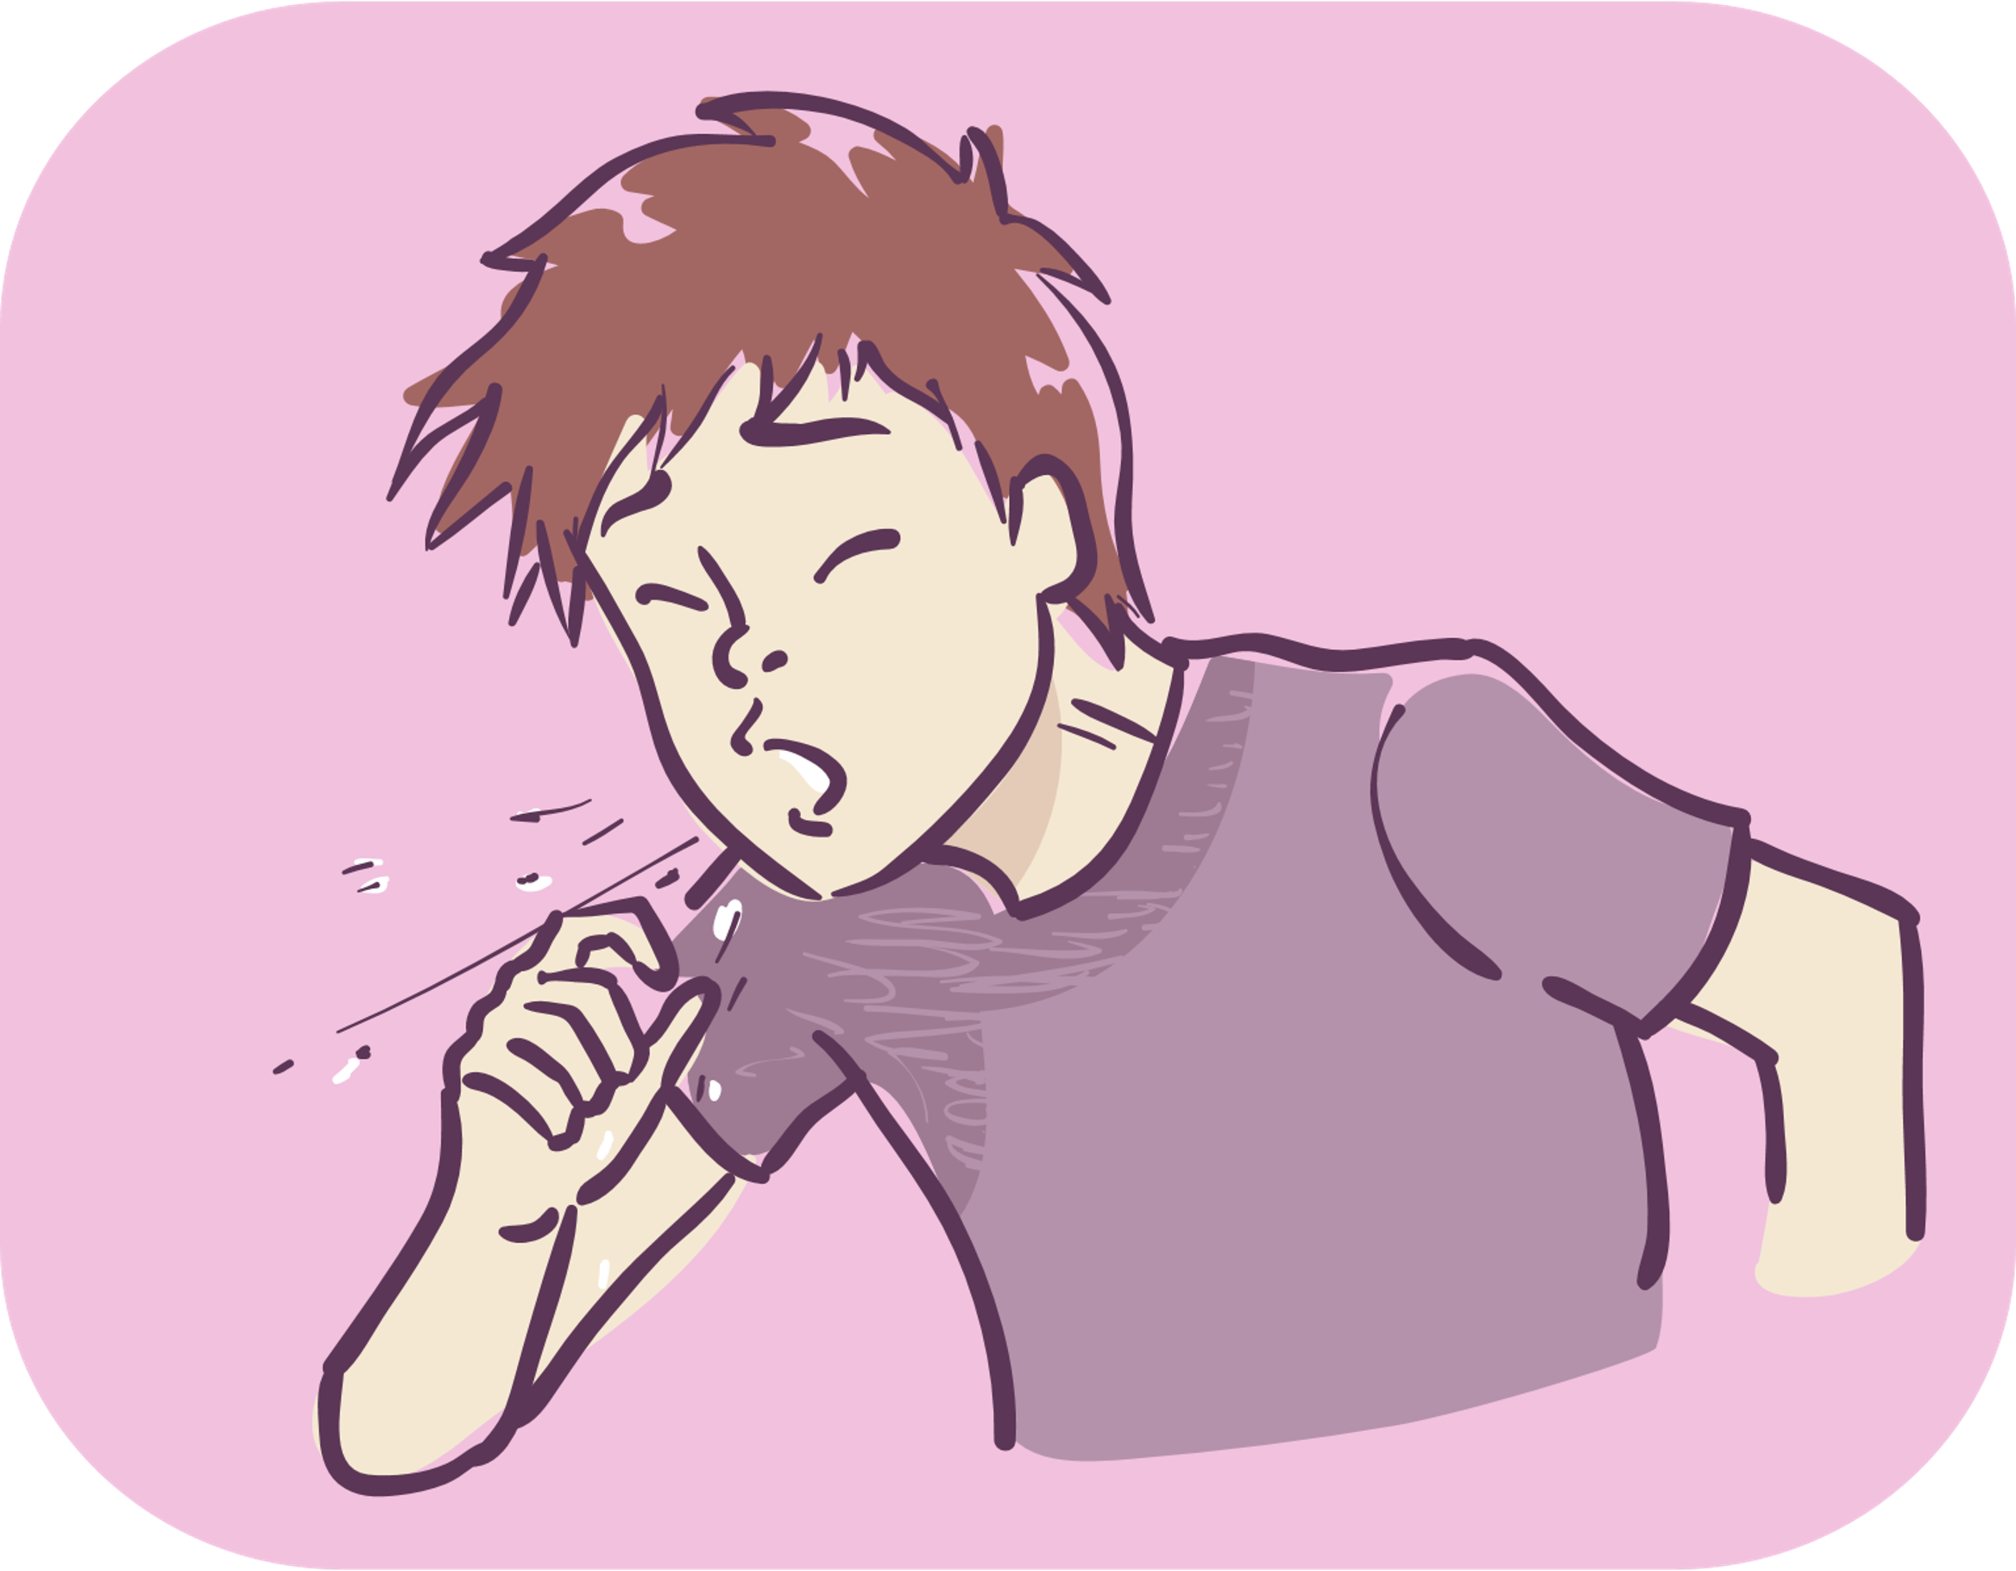
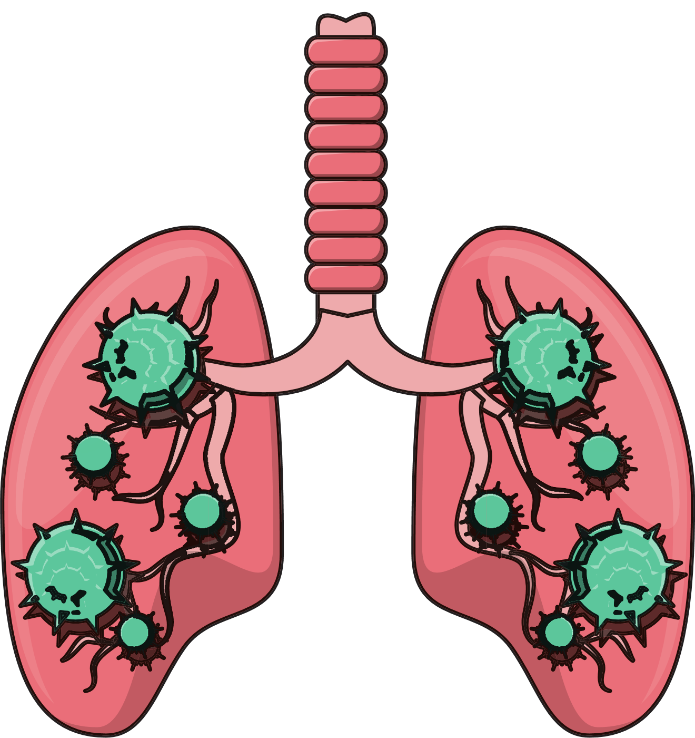
Tuberculosis

Slide 19
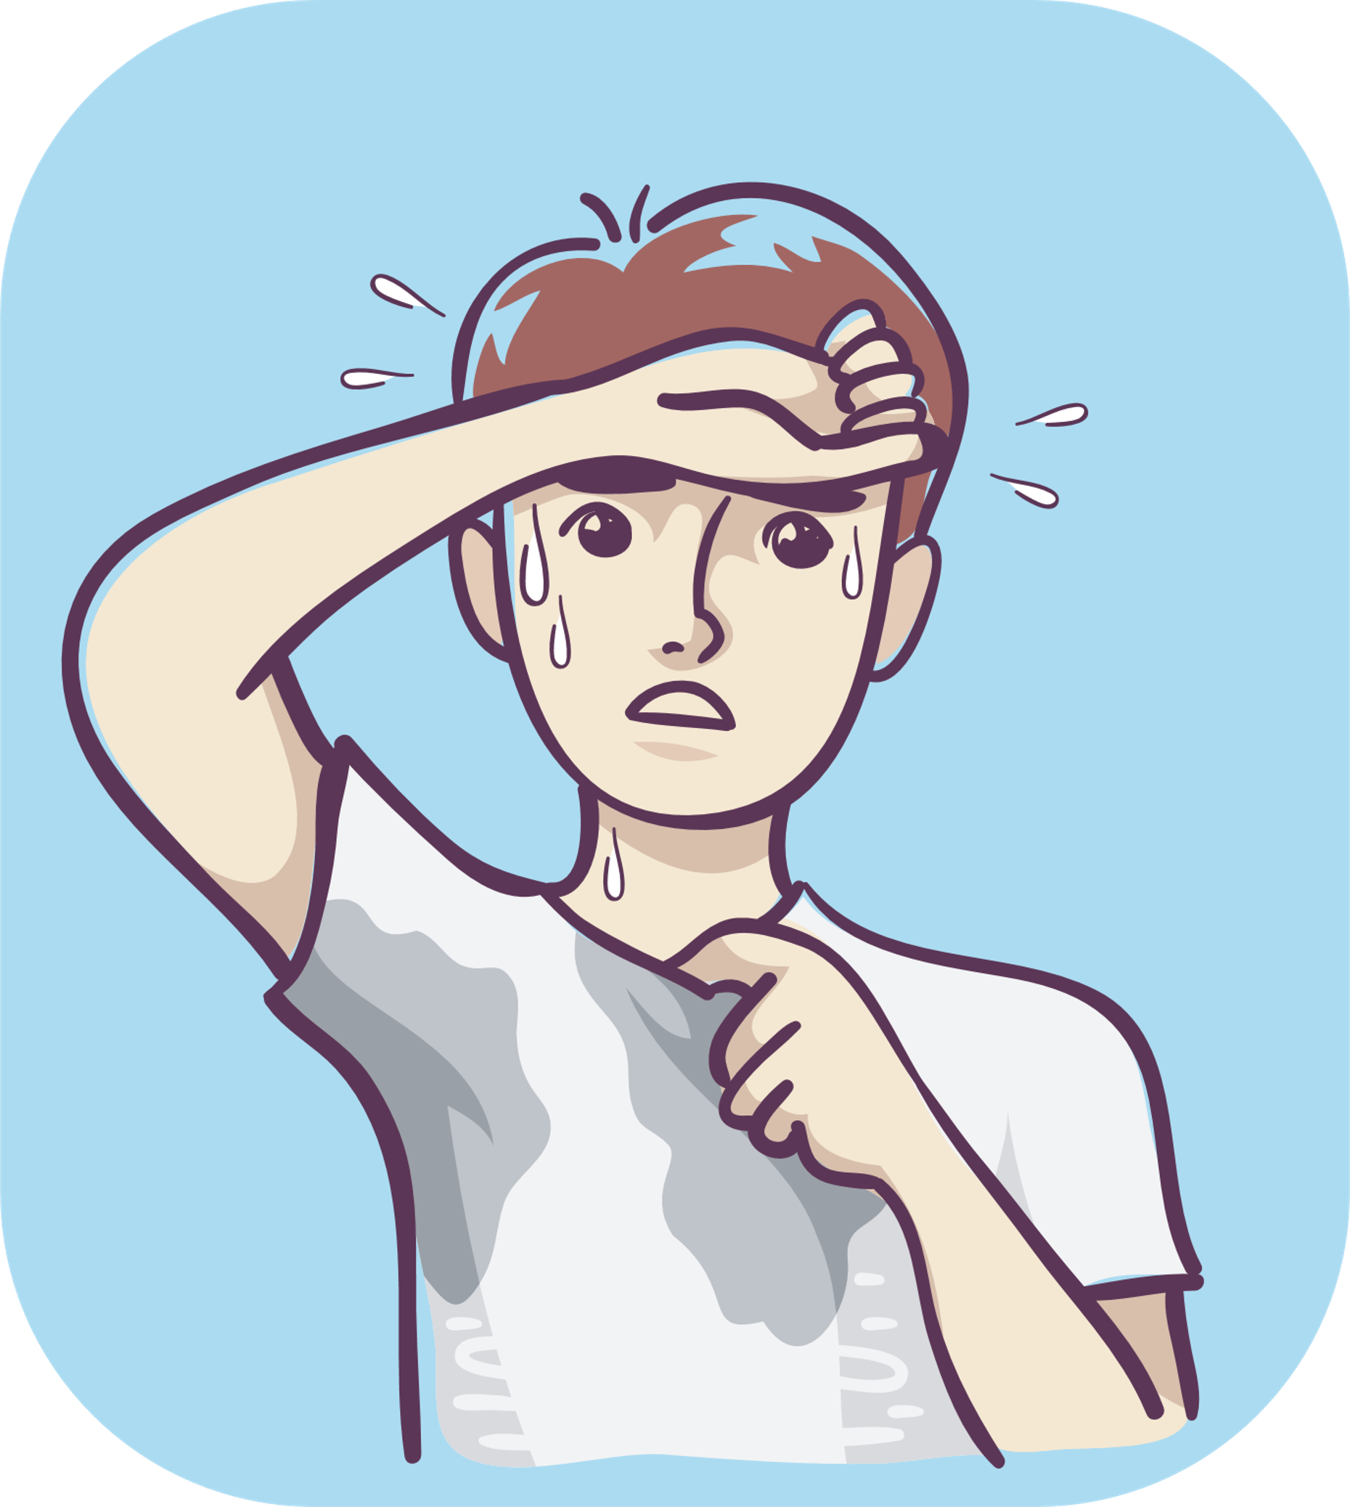
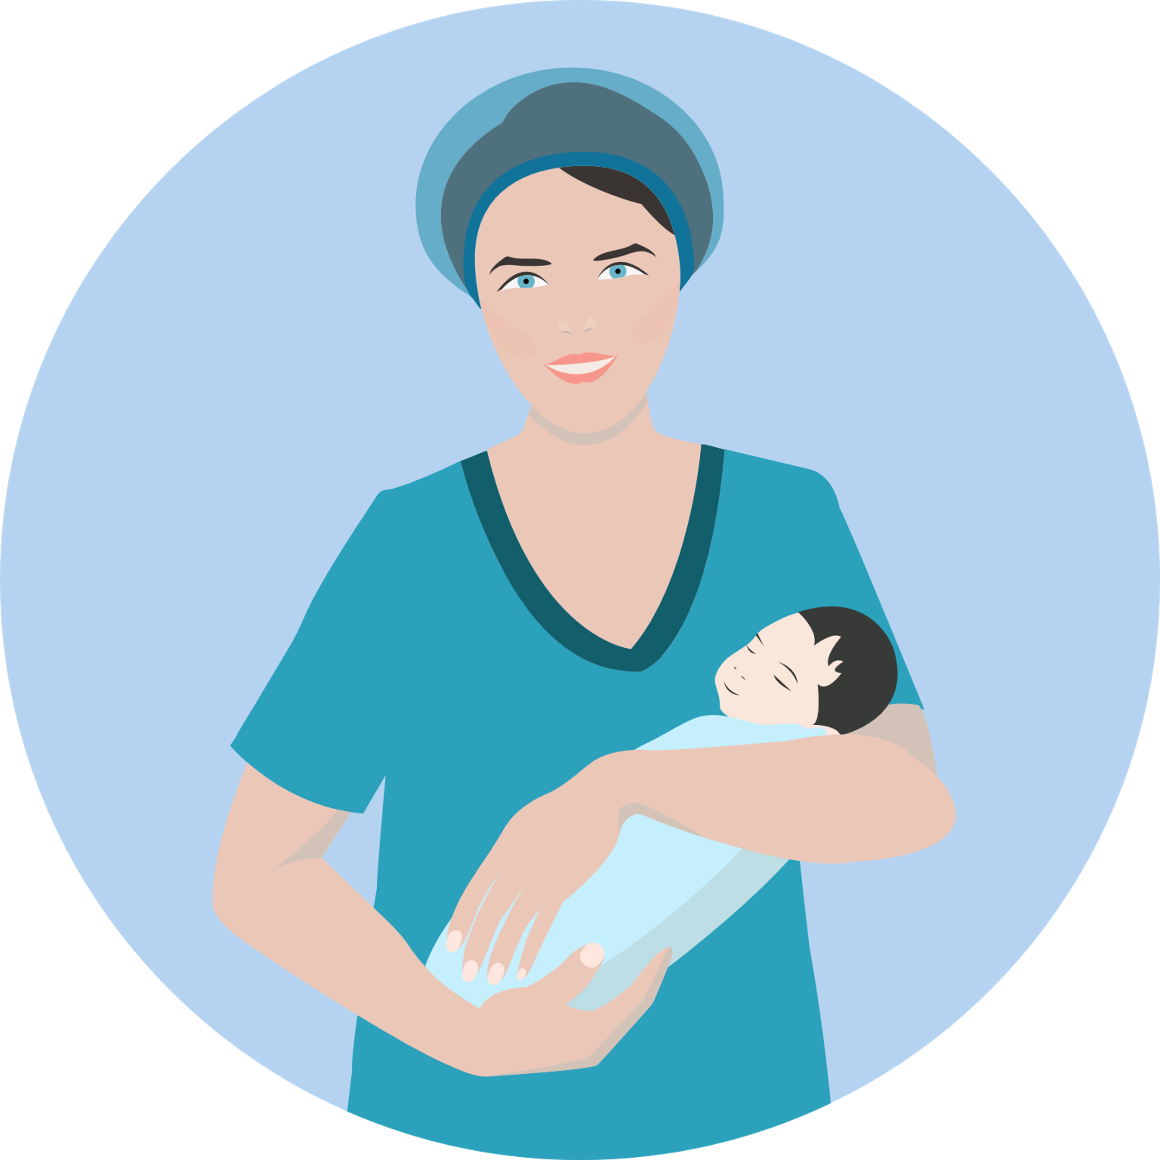
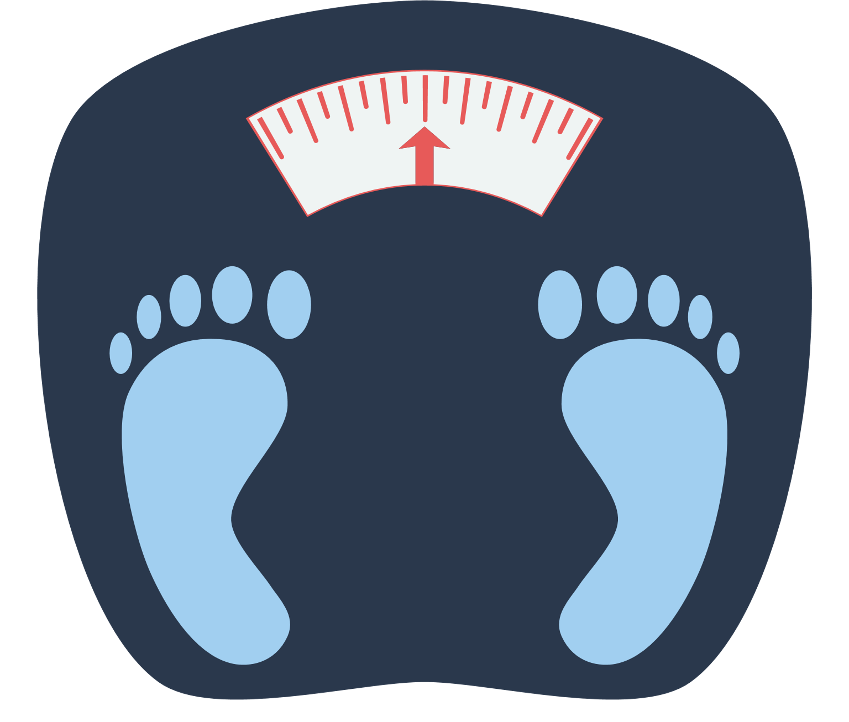
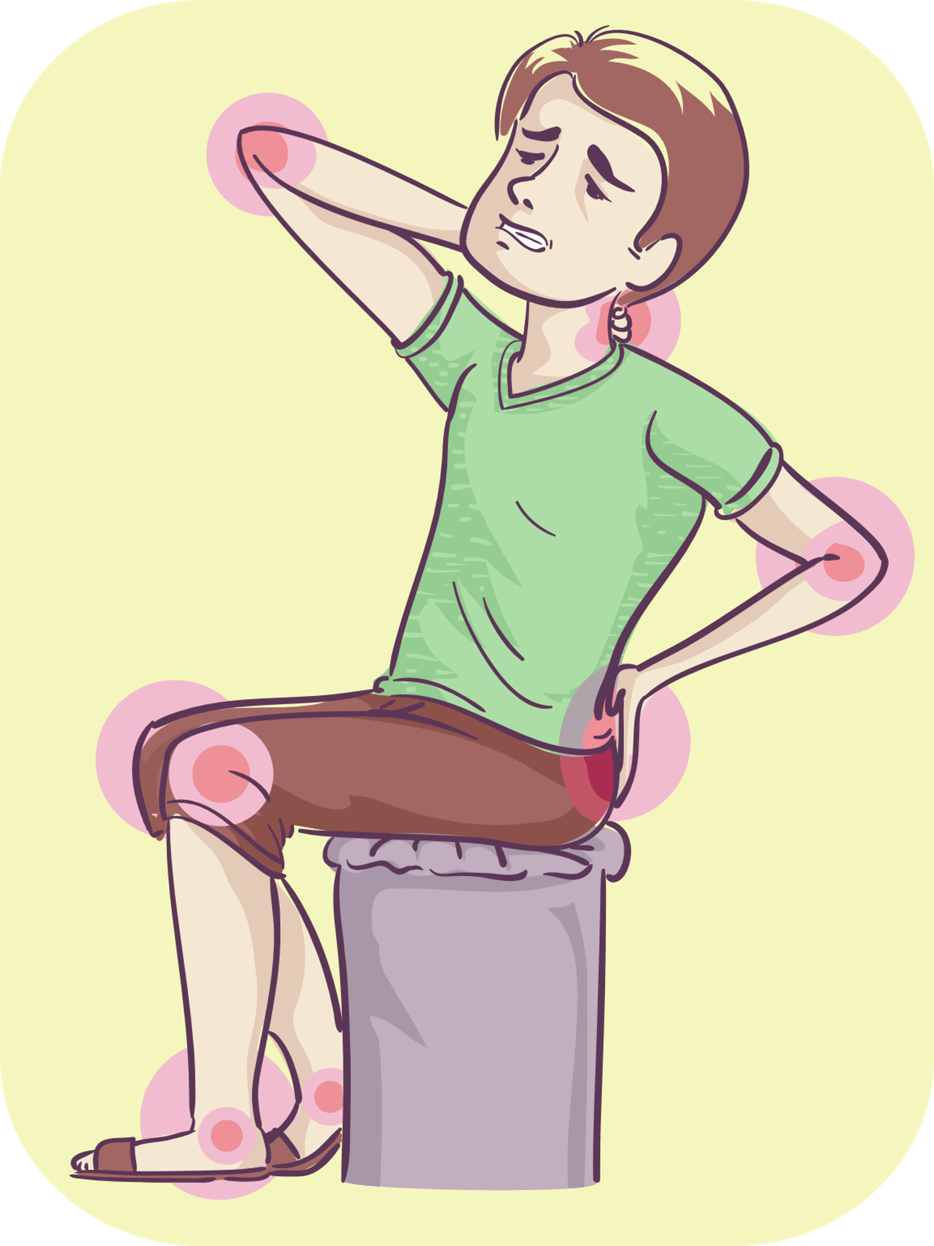
Tuberculosis
1. Causes
Tuberculosis (TB) is caused by a type of bacterium called Mycobacterium tuberculosis.
2. Symptoms
fever
fatigue
weight loss
night sweats
In children: failure to thrive and gain weight
Other symptoms depend on the part of the body that Mycobacteirum tuberculosis have entered.
Pulmonary tuberculosis: cough, coughing up mucus and blood.
Bone tuberculosis: ‌inflammation in joints. The incubation period is between 4 and 12 weeks or more.
Tuberculosis infection can last a lifetime, in some cases people who have latent TB infection never develop TB disease.

Slide 20
Tuberculosis
3. Complications
Fatigue, death, especially in HIV/AIDS patients.
4. Transmission
TB is transmitted from person to person via respiratory droplets, or from animals to humans through the use of fresh products from cattle infected with tuberculosis.
People who are infected with TB but do not develop the disease will not spread it to others.
TB patients can infect others even after a few weeks of treatment.
The risk of getting TB is high in children under the age of 3, the elderly, and HIV/AIDS patients.
5. Prevention
Detect through blood tests, subcutaneous tests, and periodic health check-ups.
Prevent by implementing regular diet and periodic health check-ups.
Prevent by vaccination against tuberculosis, especially in young children.
6. Information about the vaccination

Slide 21
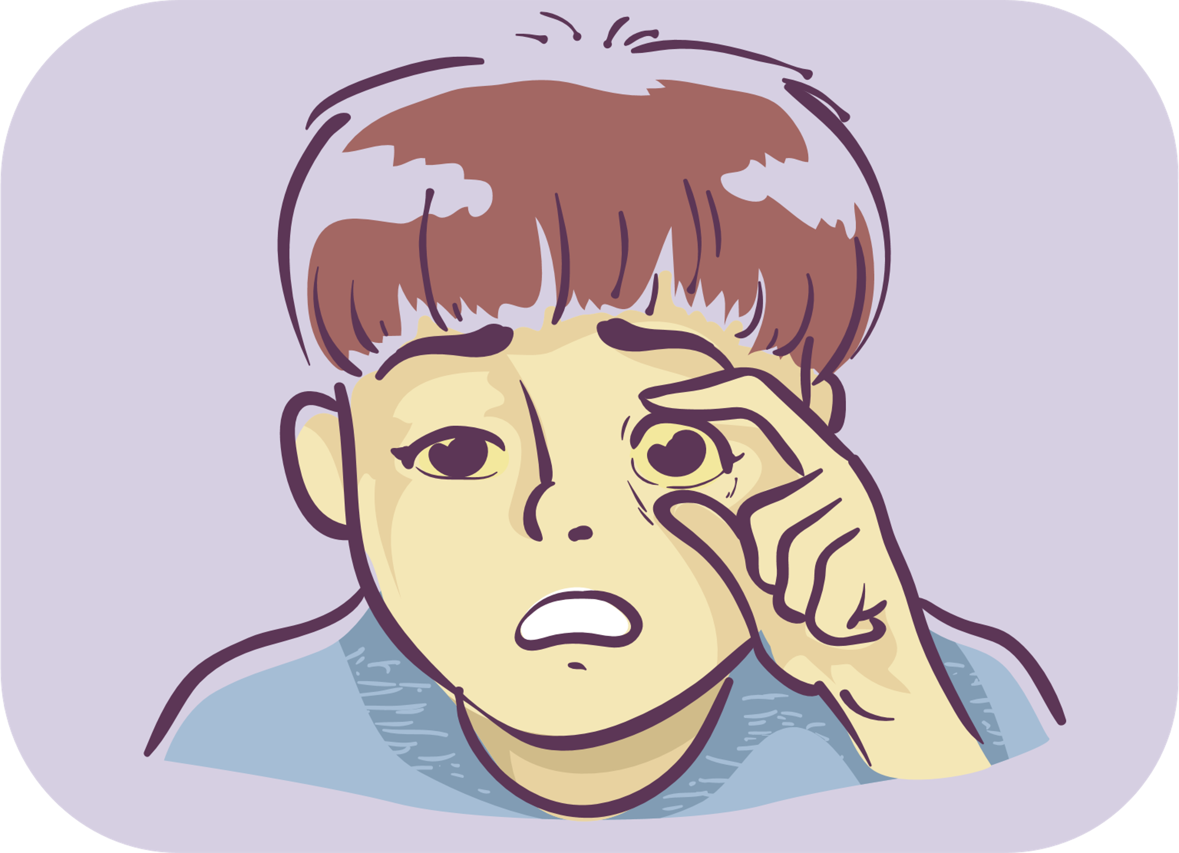
Hepatitis B

Slide 22
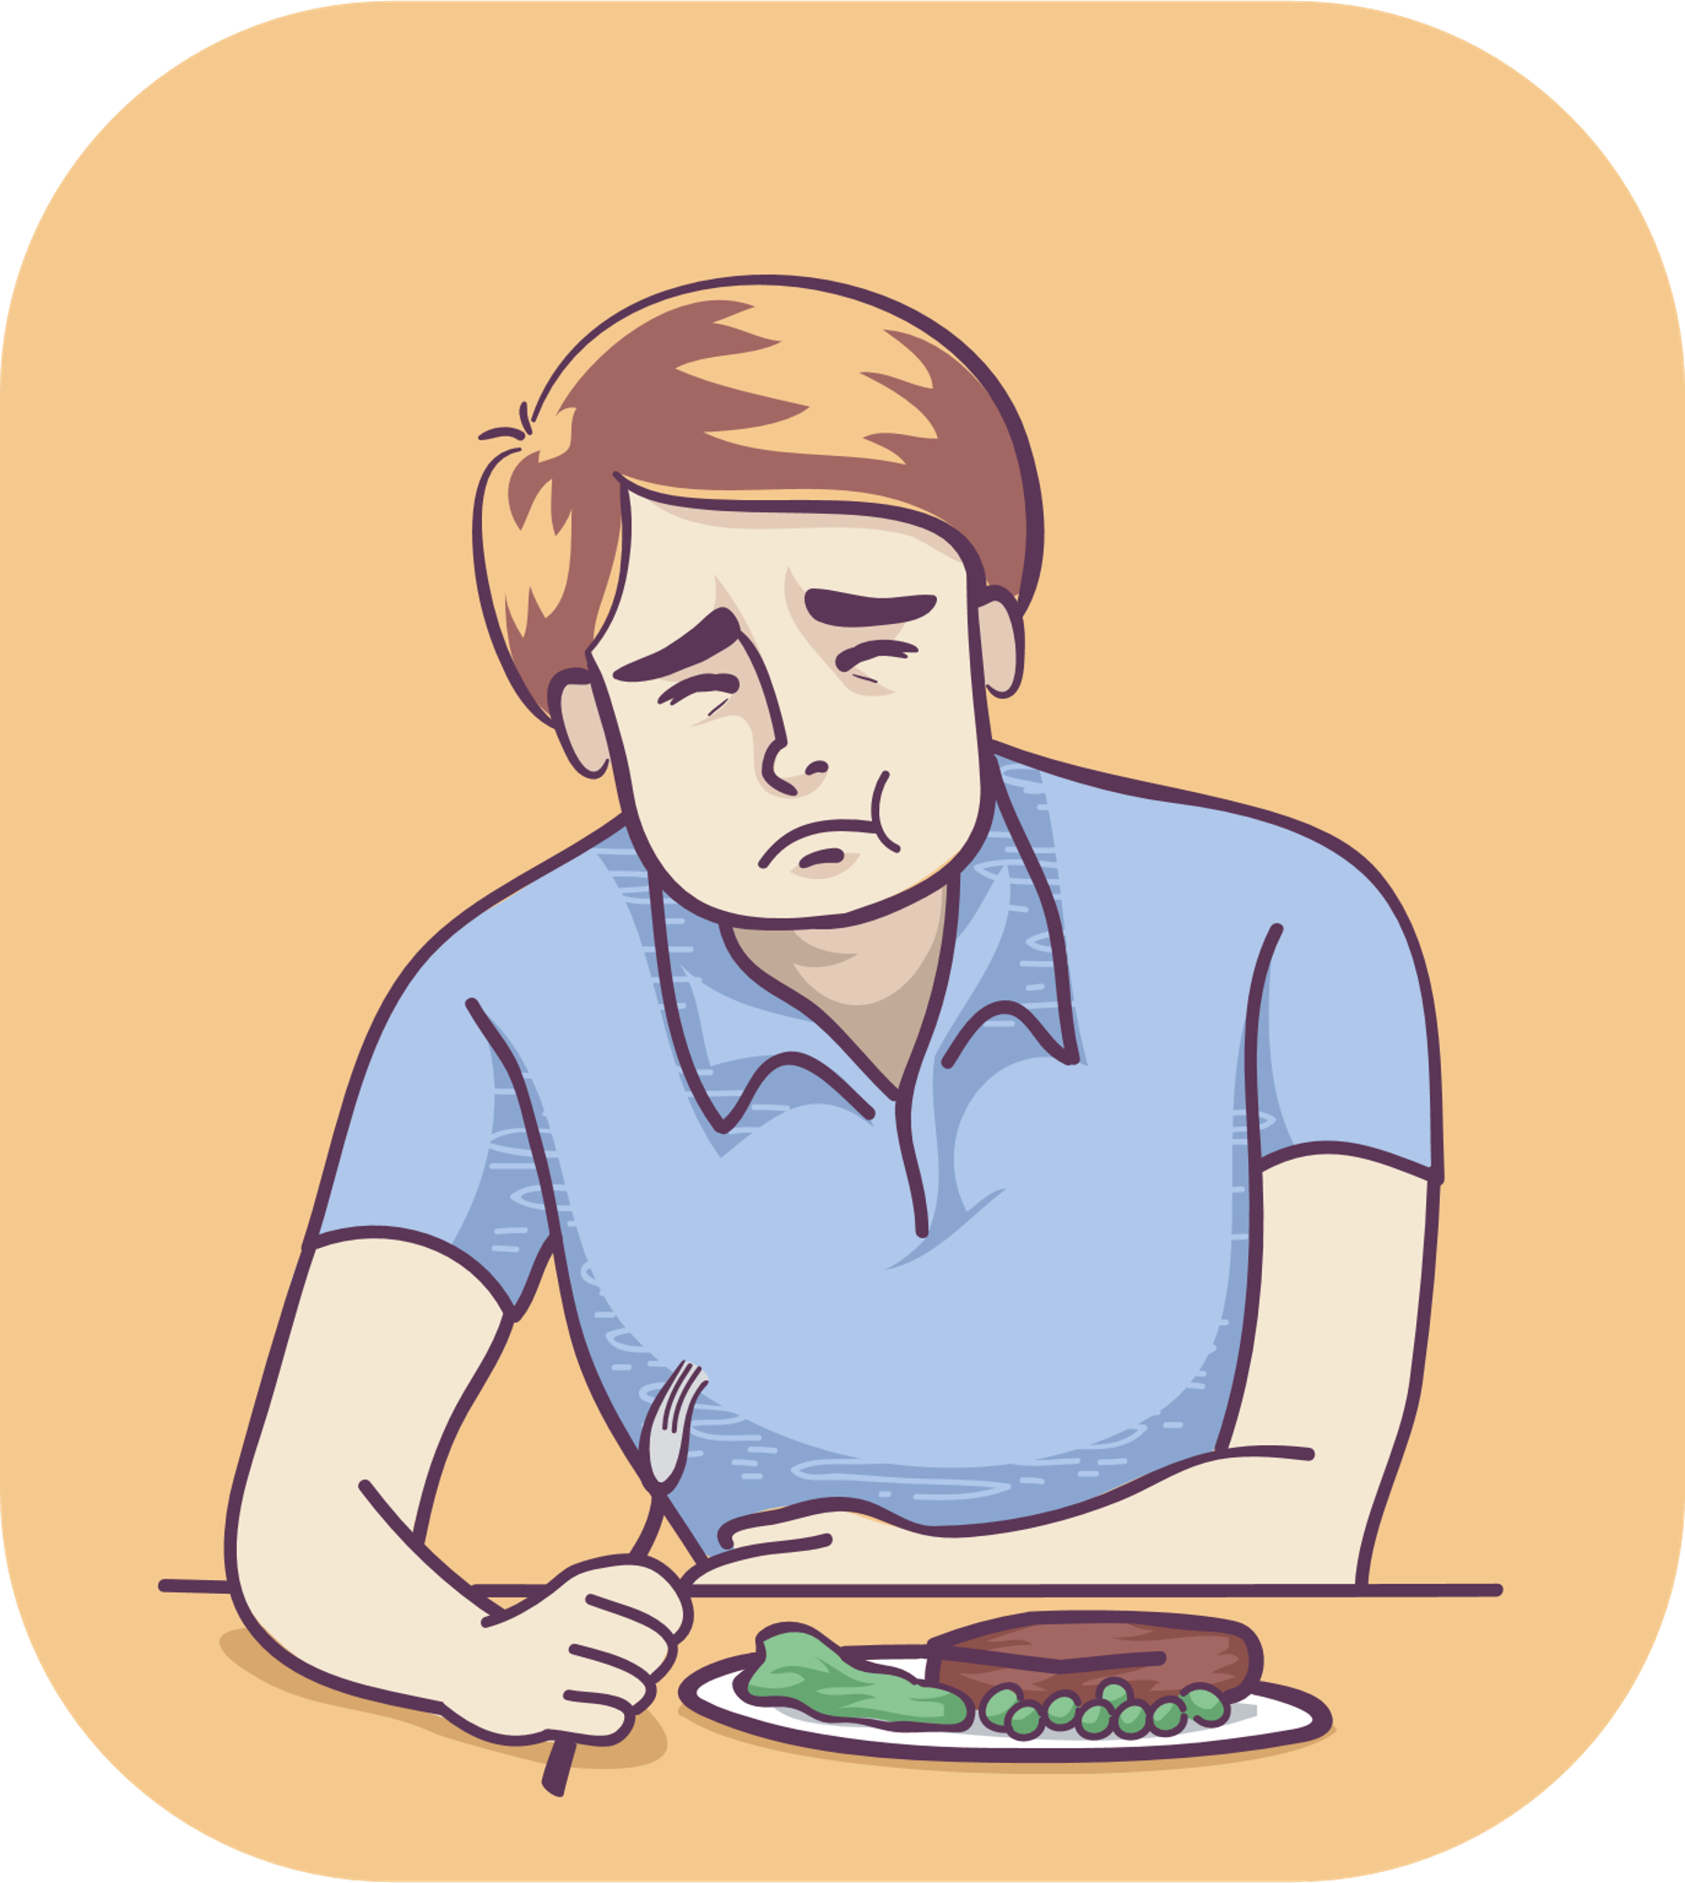
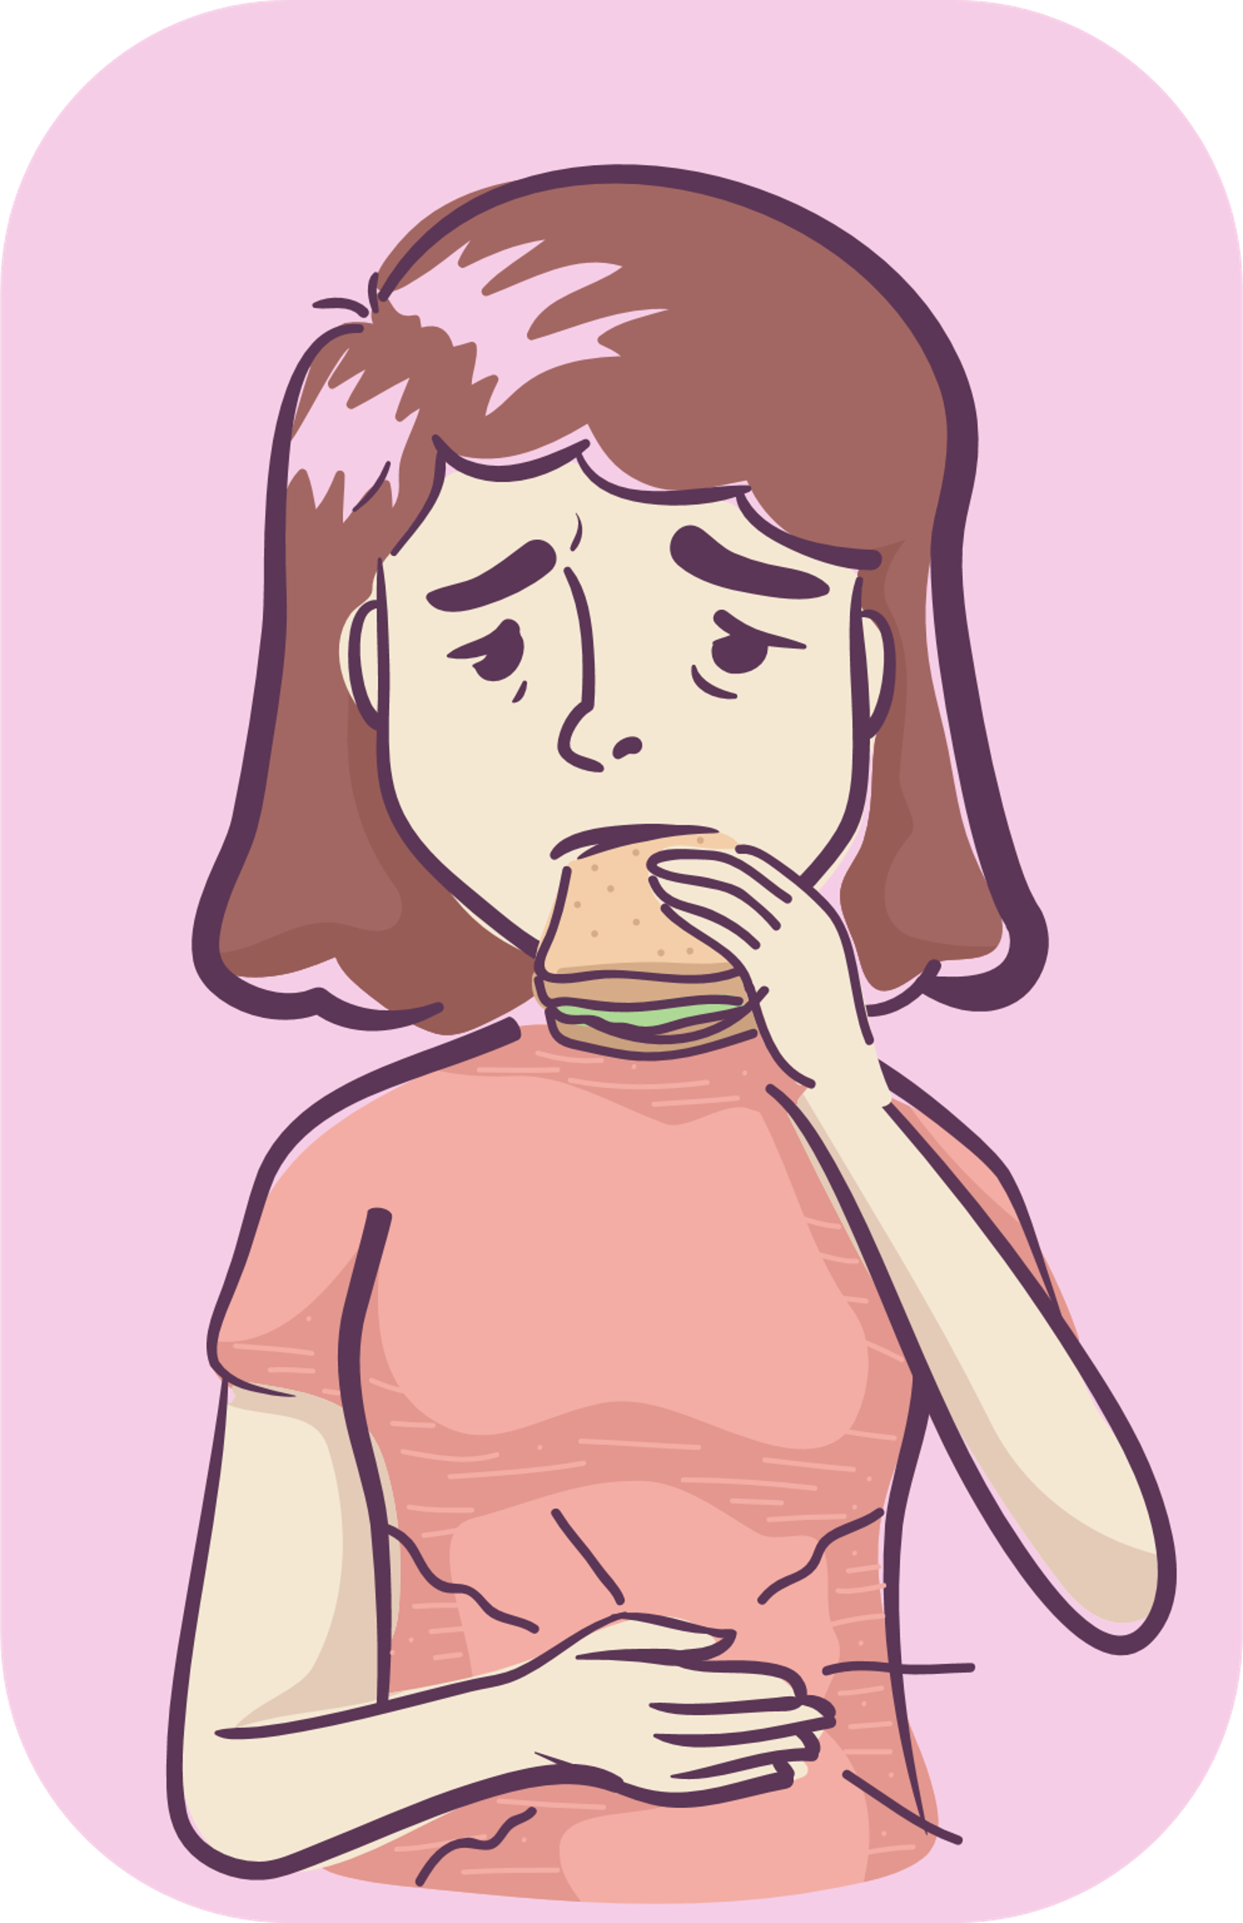
Hepatitis B
1. Causes
Hepatitis B is caused by the hepatitis B virus.
2. Symptoms
tiredness
anorexia
Stomach ache
dark urine
jaundice, and yellow eyes.
The incubation period is usually 6 weeks, but it can be up to 6 months.

Slide 23
Hepatitis B
3. Complications
Chronic hepatitis, cirrhosis, liver failure, and liver cancer.
A low rate of acute infection can be fatal.
Infants infected with Hepatitis B from their mothers are at a high risk of chronic Hepatitis B and dying from liver cancer and cirrhosis.
4. Transmission
Transmission from unsafe injection or needle stick injuries.
Mother-to-child transmission.
Transmission among children through open cuts, scratches, and sores.
Transmission through sexual activity.
5. Prevention
Detect from blood tests.
Use precautions while interacting with Hepatitis B patients.
Get vaccinated against Hepatitis B.
6. Information about the vaccination

Slide 24
Whooping cough

Slide 25
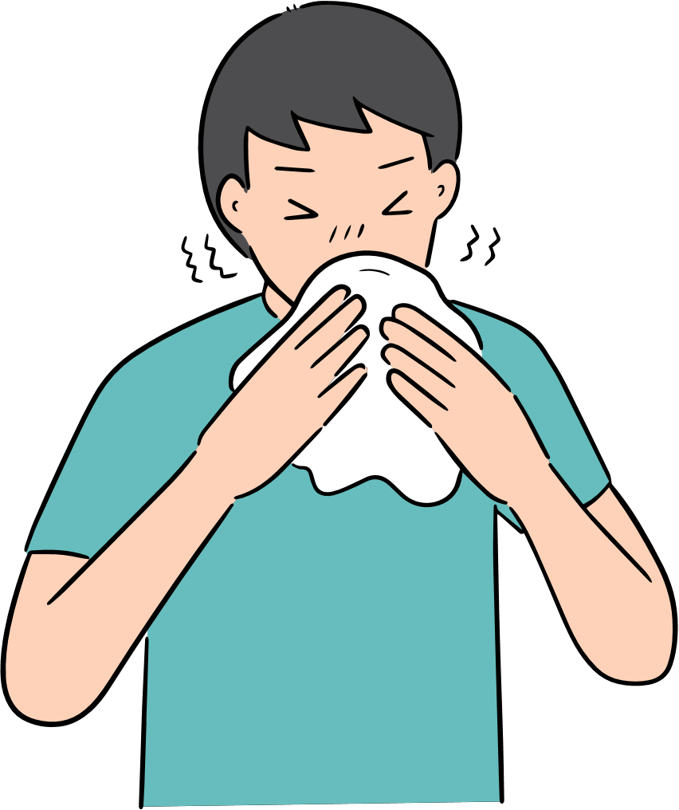
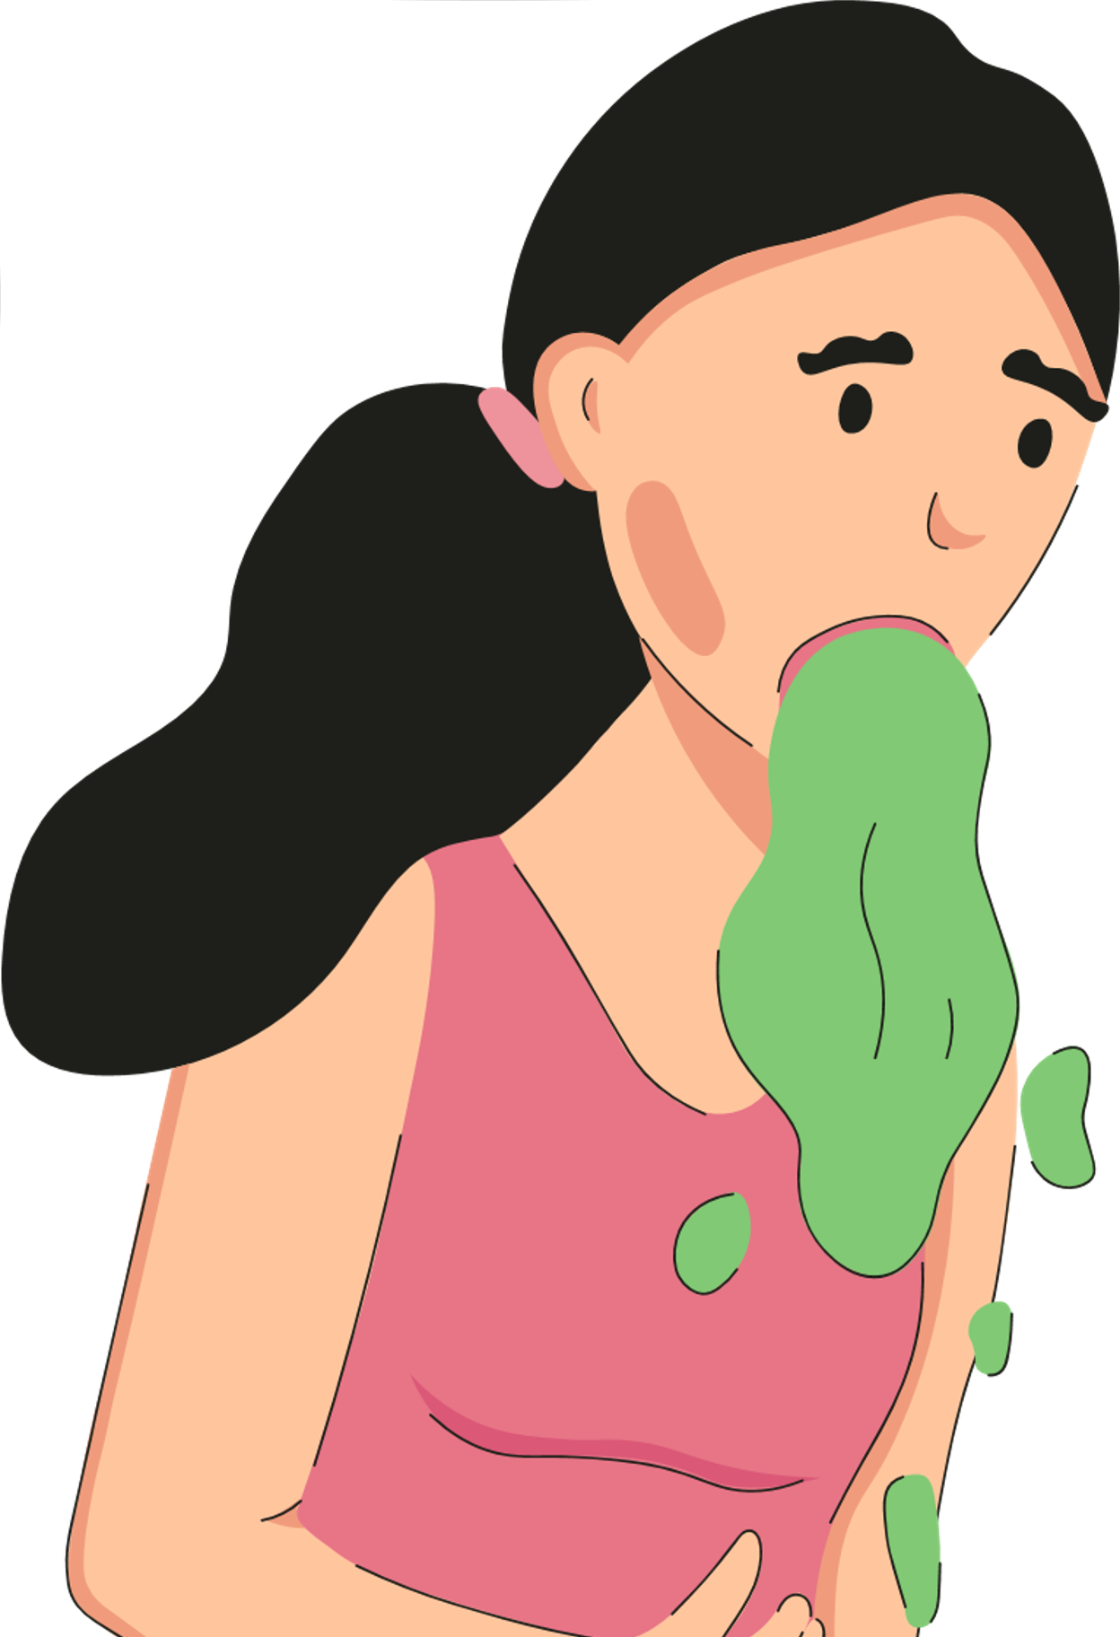
Whooping cough
1. Causes
Whooping cough is caused by a bacterium called Bordetella pertussis.
2. Symptoms
Onset stage (4 to 8 weeks):
Cough
Runny nose
Watery eyes
Sneezing
Fever
Worsening cough
Final stage:
Stridor, may stop breathing, cyanosis due to the lack of oxygen during coughing. Bloodshot eyes, vomiting, and exhaustion usually after coughing.
Recovery stage: cough-reducing and fever-reducing.
The incubation stage is between 5 and 10 days after exposure.
Bloodshot eyes
Vomiting

Slide 26
Whooping cough
3. Complications
Mild complications: loss of appetite, otitis media (middle ear infection) and dehydration.
More severe complications: seizures caused by fever or the lack of oxygen supply to the brain.
Severe complications: pneumonia and death, especially in children under the age of 1.
4. Transmission
The disease is transmitted directly and very easily through the respiratory droplets of saliva from an infected person to a healthy person when coughing or sneezing.
Most people exposed to the pathogen become infected, especially children.
In many countries, epidemics have a cycle of 3-5 years.
5. Prevention
Regularly wash hands with soap; cover your mouth when coughing or sneezing; practice daily hygiene with nose and throat; ensure the place is ventilated, clean, and well-lit.
Isolate the patient, wear a mask when in contact with the patient.
Get vaccinated according to schedules.
6. Information about the vaccination

Slide 27
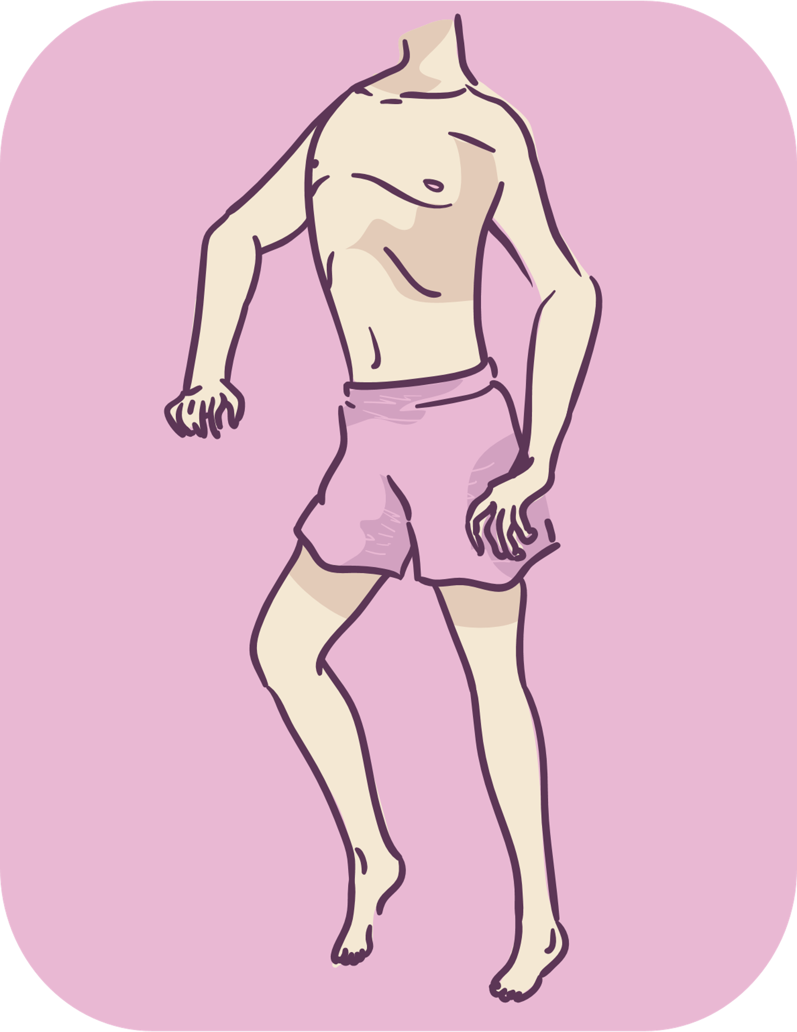
Poliomyelitis

Slide 28
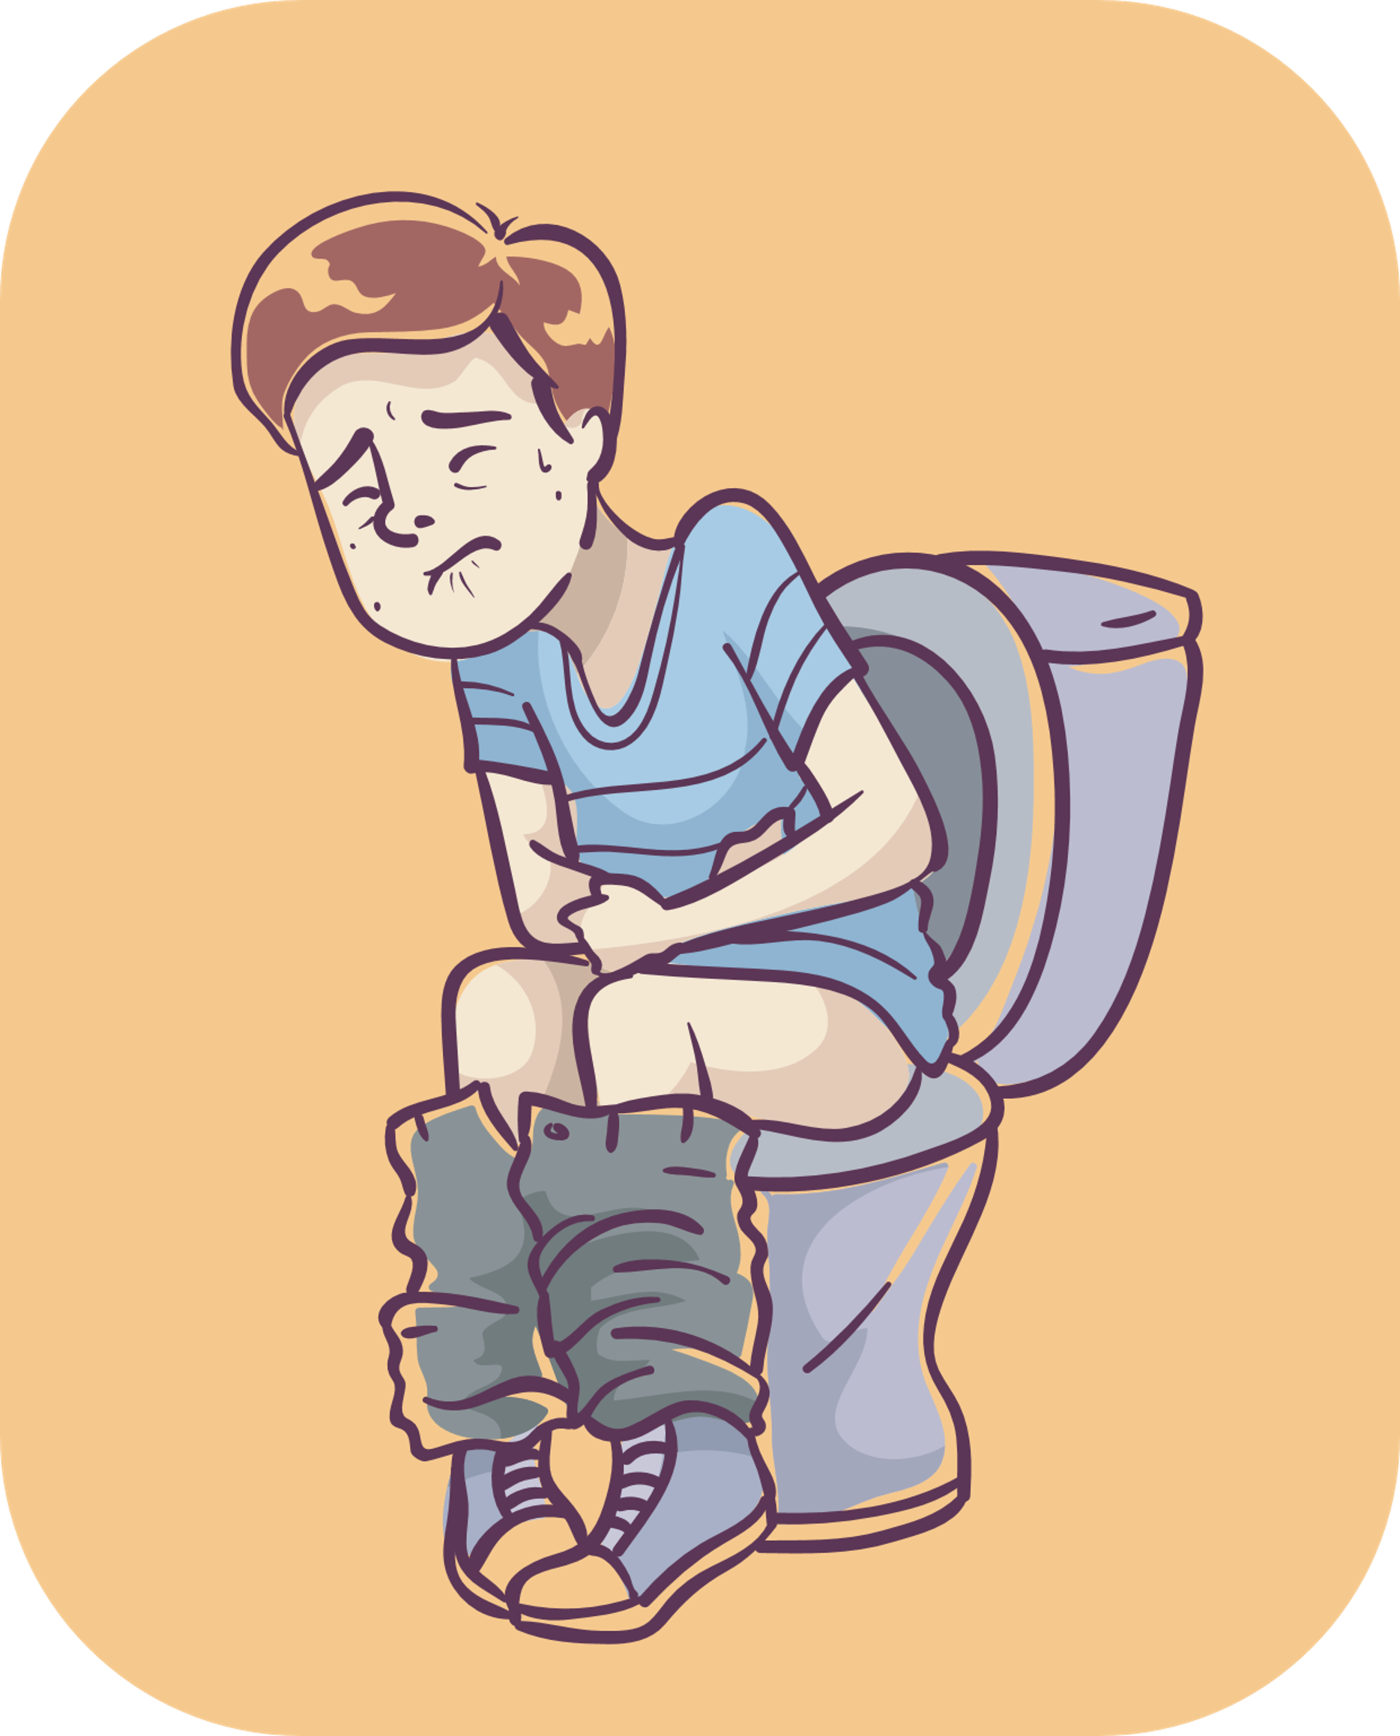
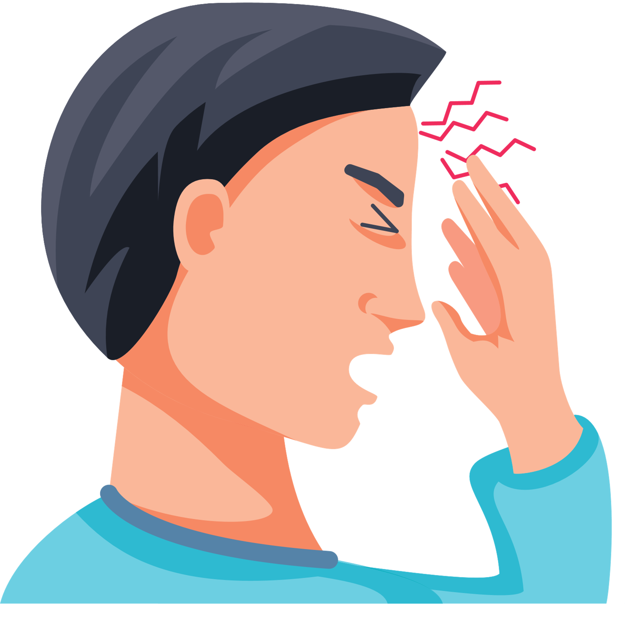
Poliomyelitis
1. Causes
Poliomyelitis is caused by the Polio virus.
2. Symptoms
A small number of people infected with the virus will have mild symptoms such as:
Fever
Diarrhea
Headache
Vomiting
Pain in the limbs that are about to be paralyzed
Gradual appearance of posterior symmetrical flaccid paralysis ( a weakness or paralysis of the muscles)

Slide 29
Poliomyelitis
3. Complications
Can cause paralysis of the respiratory muscles, respiratory failure, and death.
Paralysis cannot be reversed without proper treatment.
4. Transmission
Gastrointestinal transmission (fecal/oral).
Viruses enter the body through food and water carrying pathogens.
This disease is very contagious, most children living under the same roof with the patient is infected with the virus.
Patients are able to fight off the virus 10 days before and 10 days after onset.
Healthy people carrying the virus can also become a source of infection.
5. Prevention
Prevent by oral or polio vaccination.
6. Information about the vaccination

Slide 30
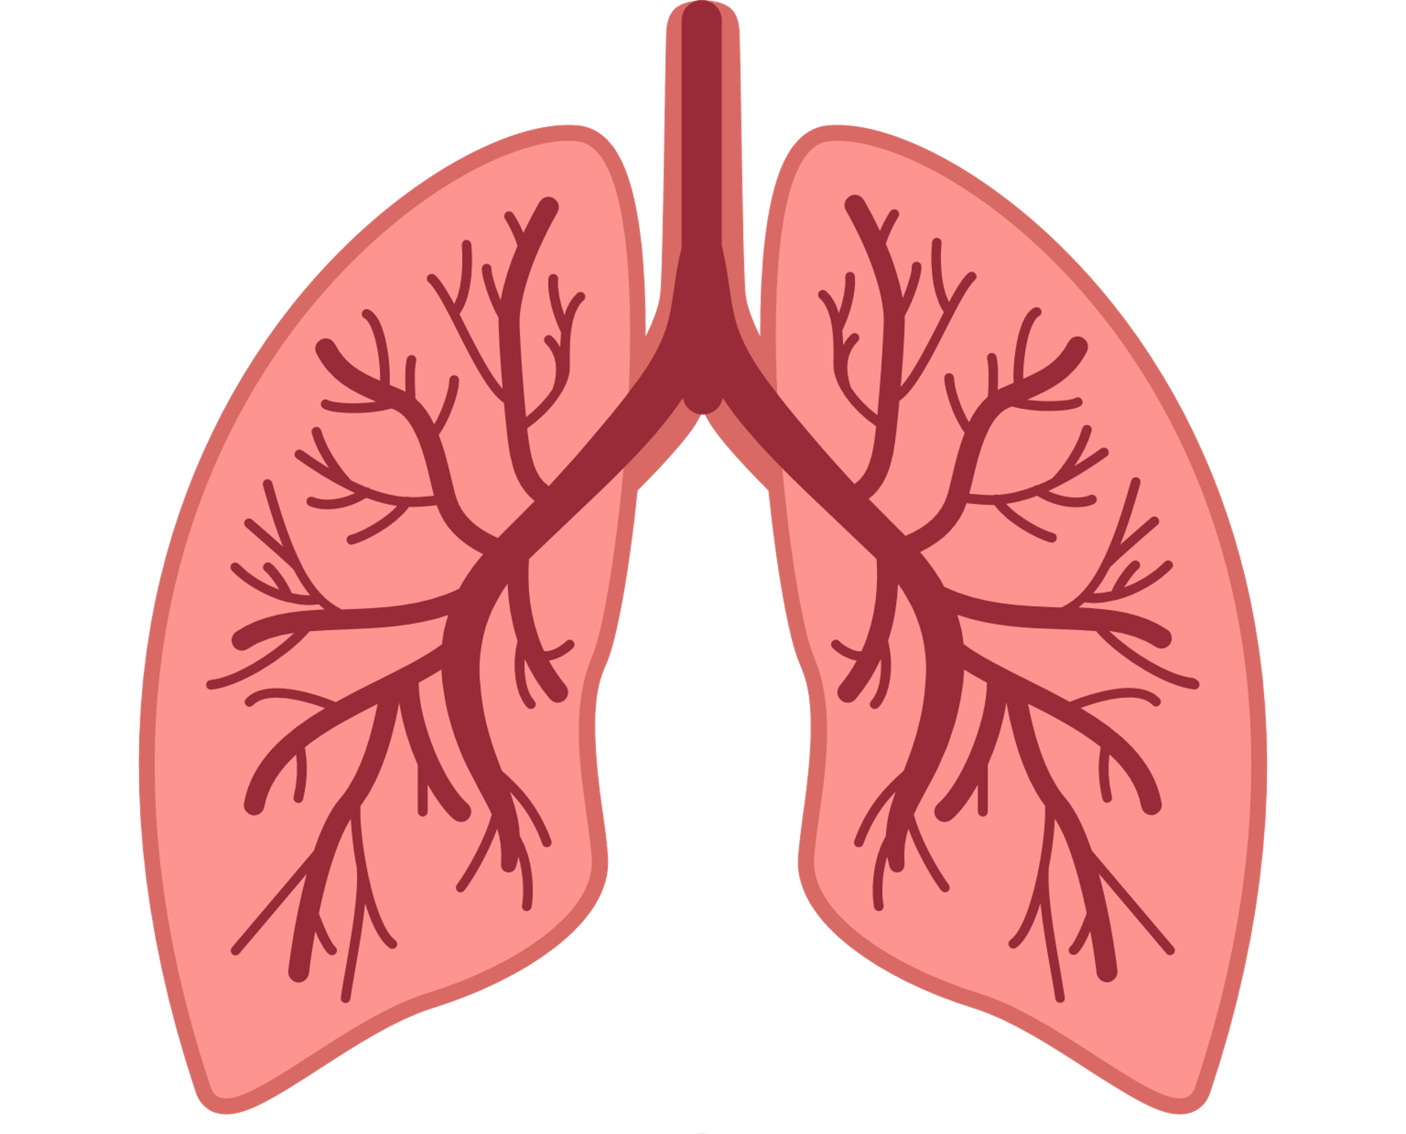
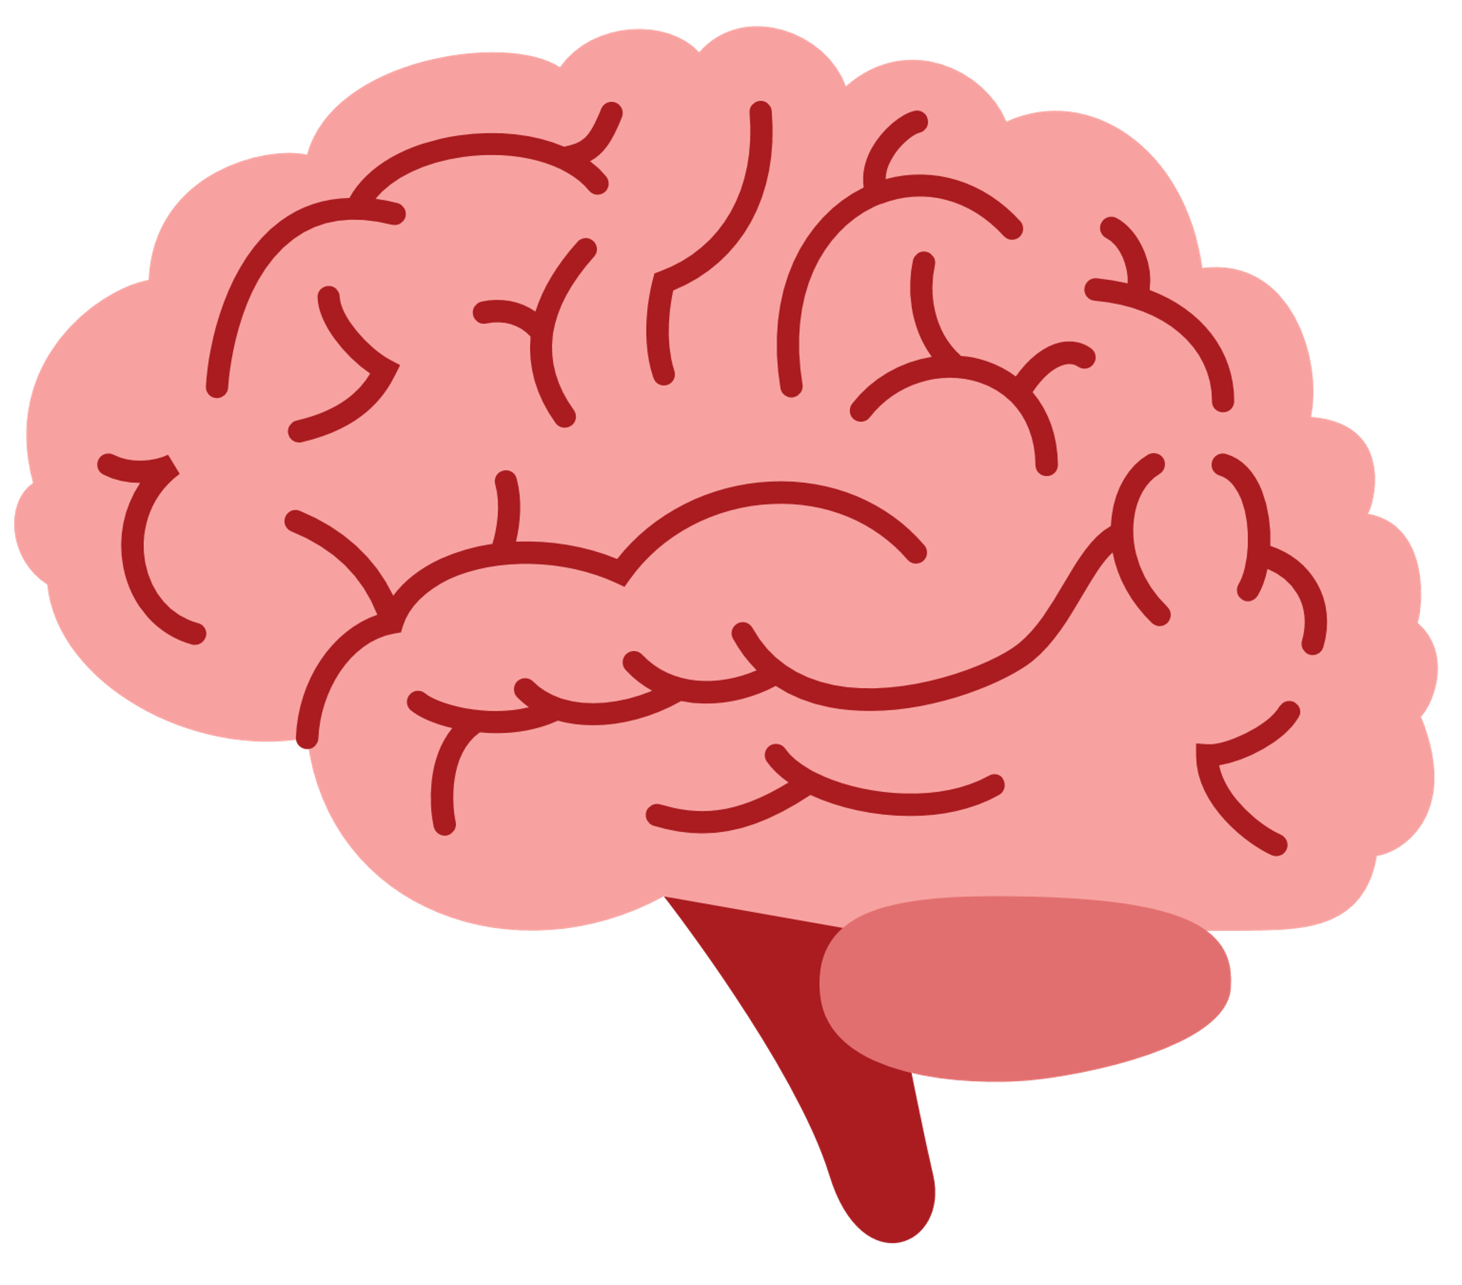
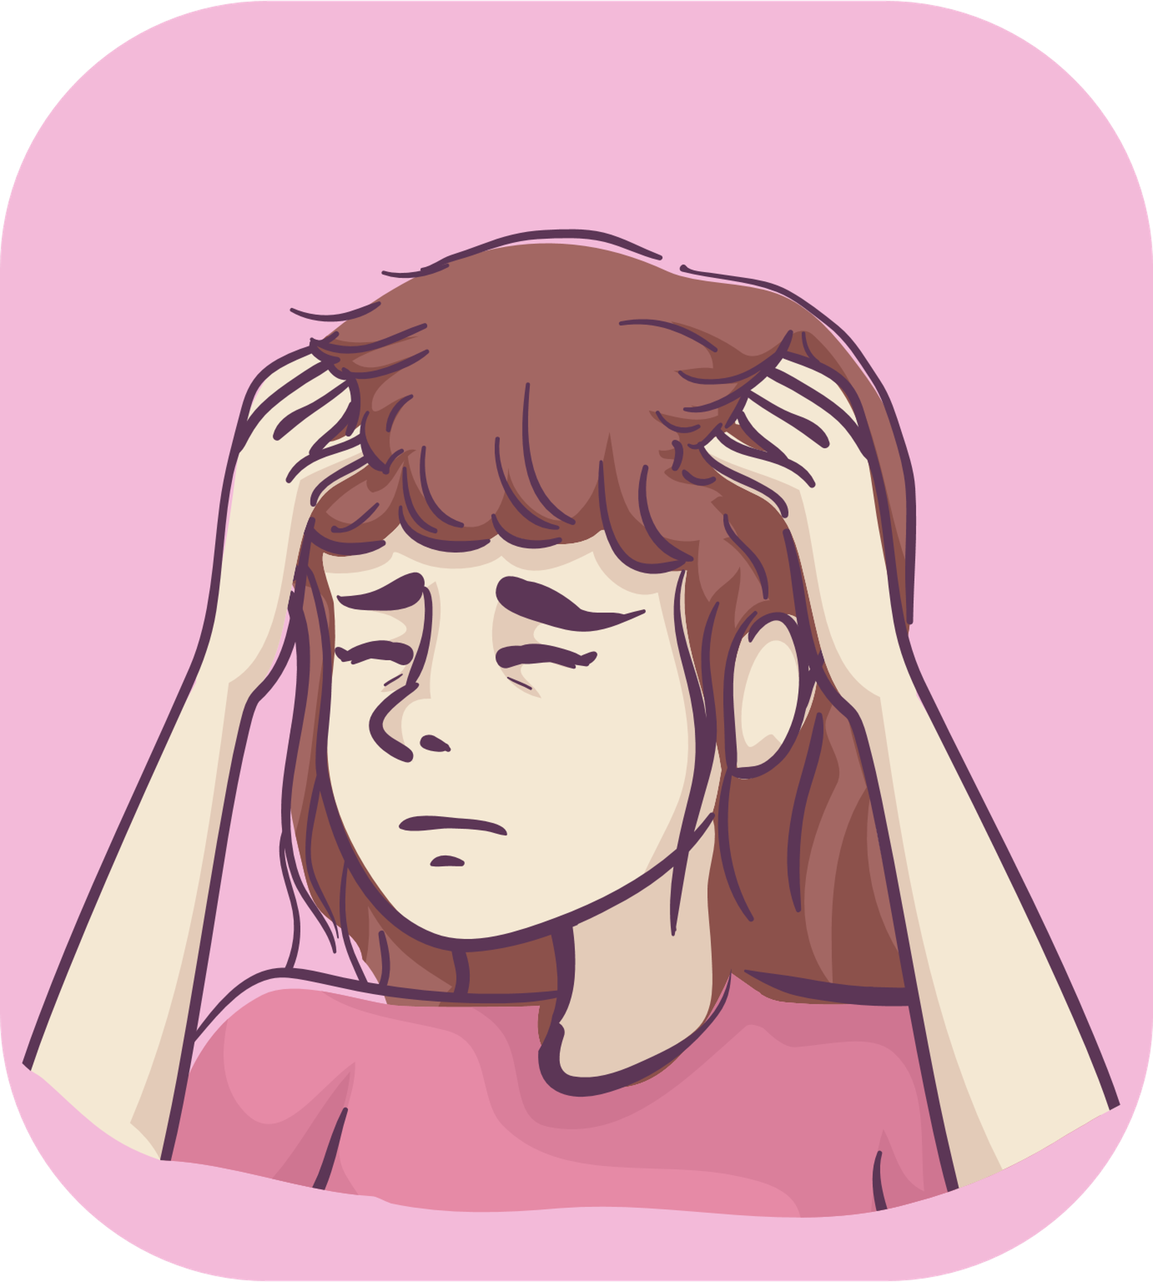
Pneumonia/Meningitis

Slide 31
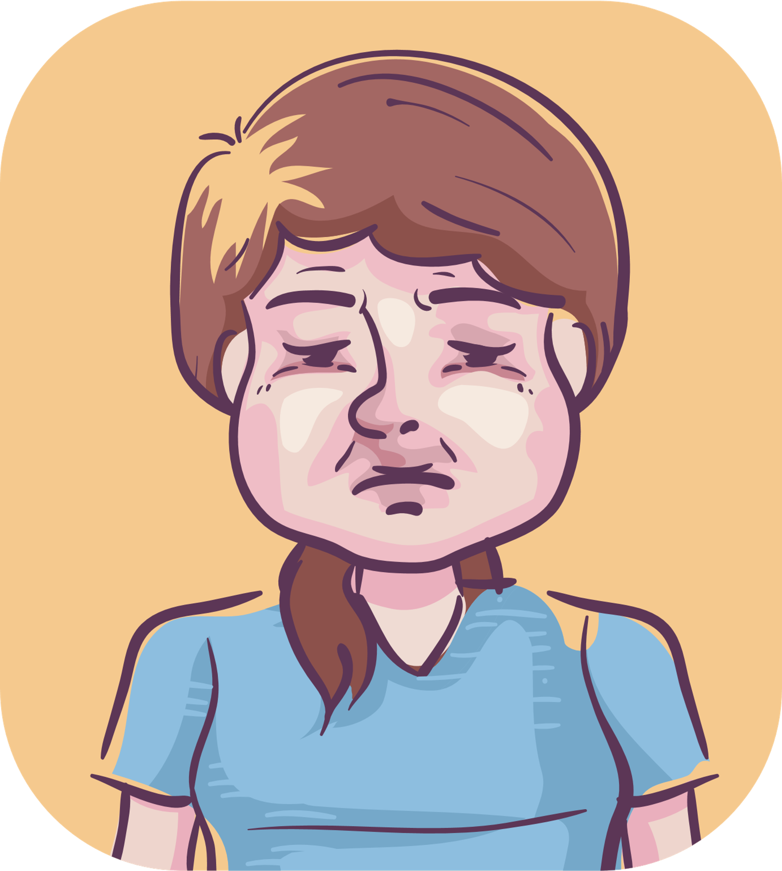
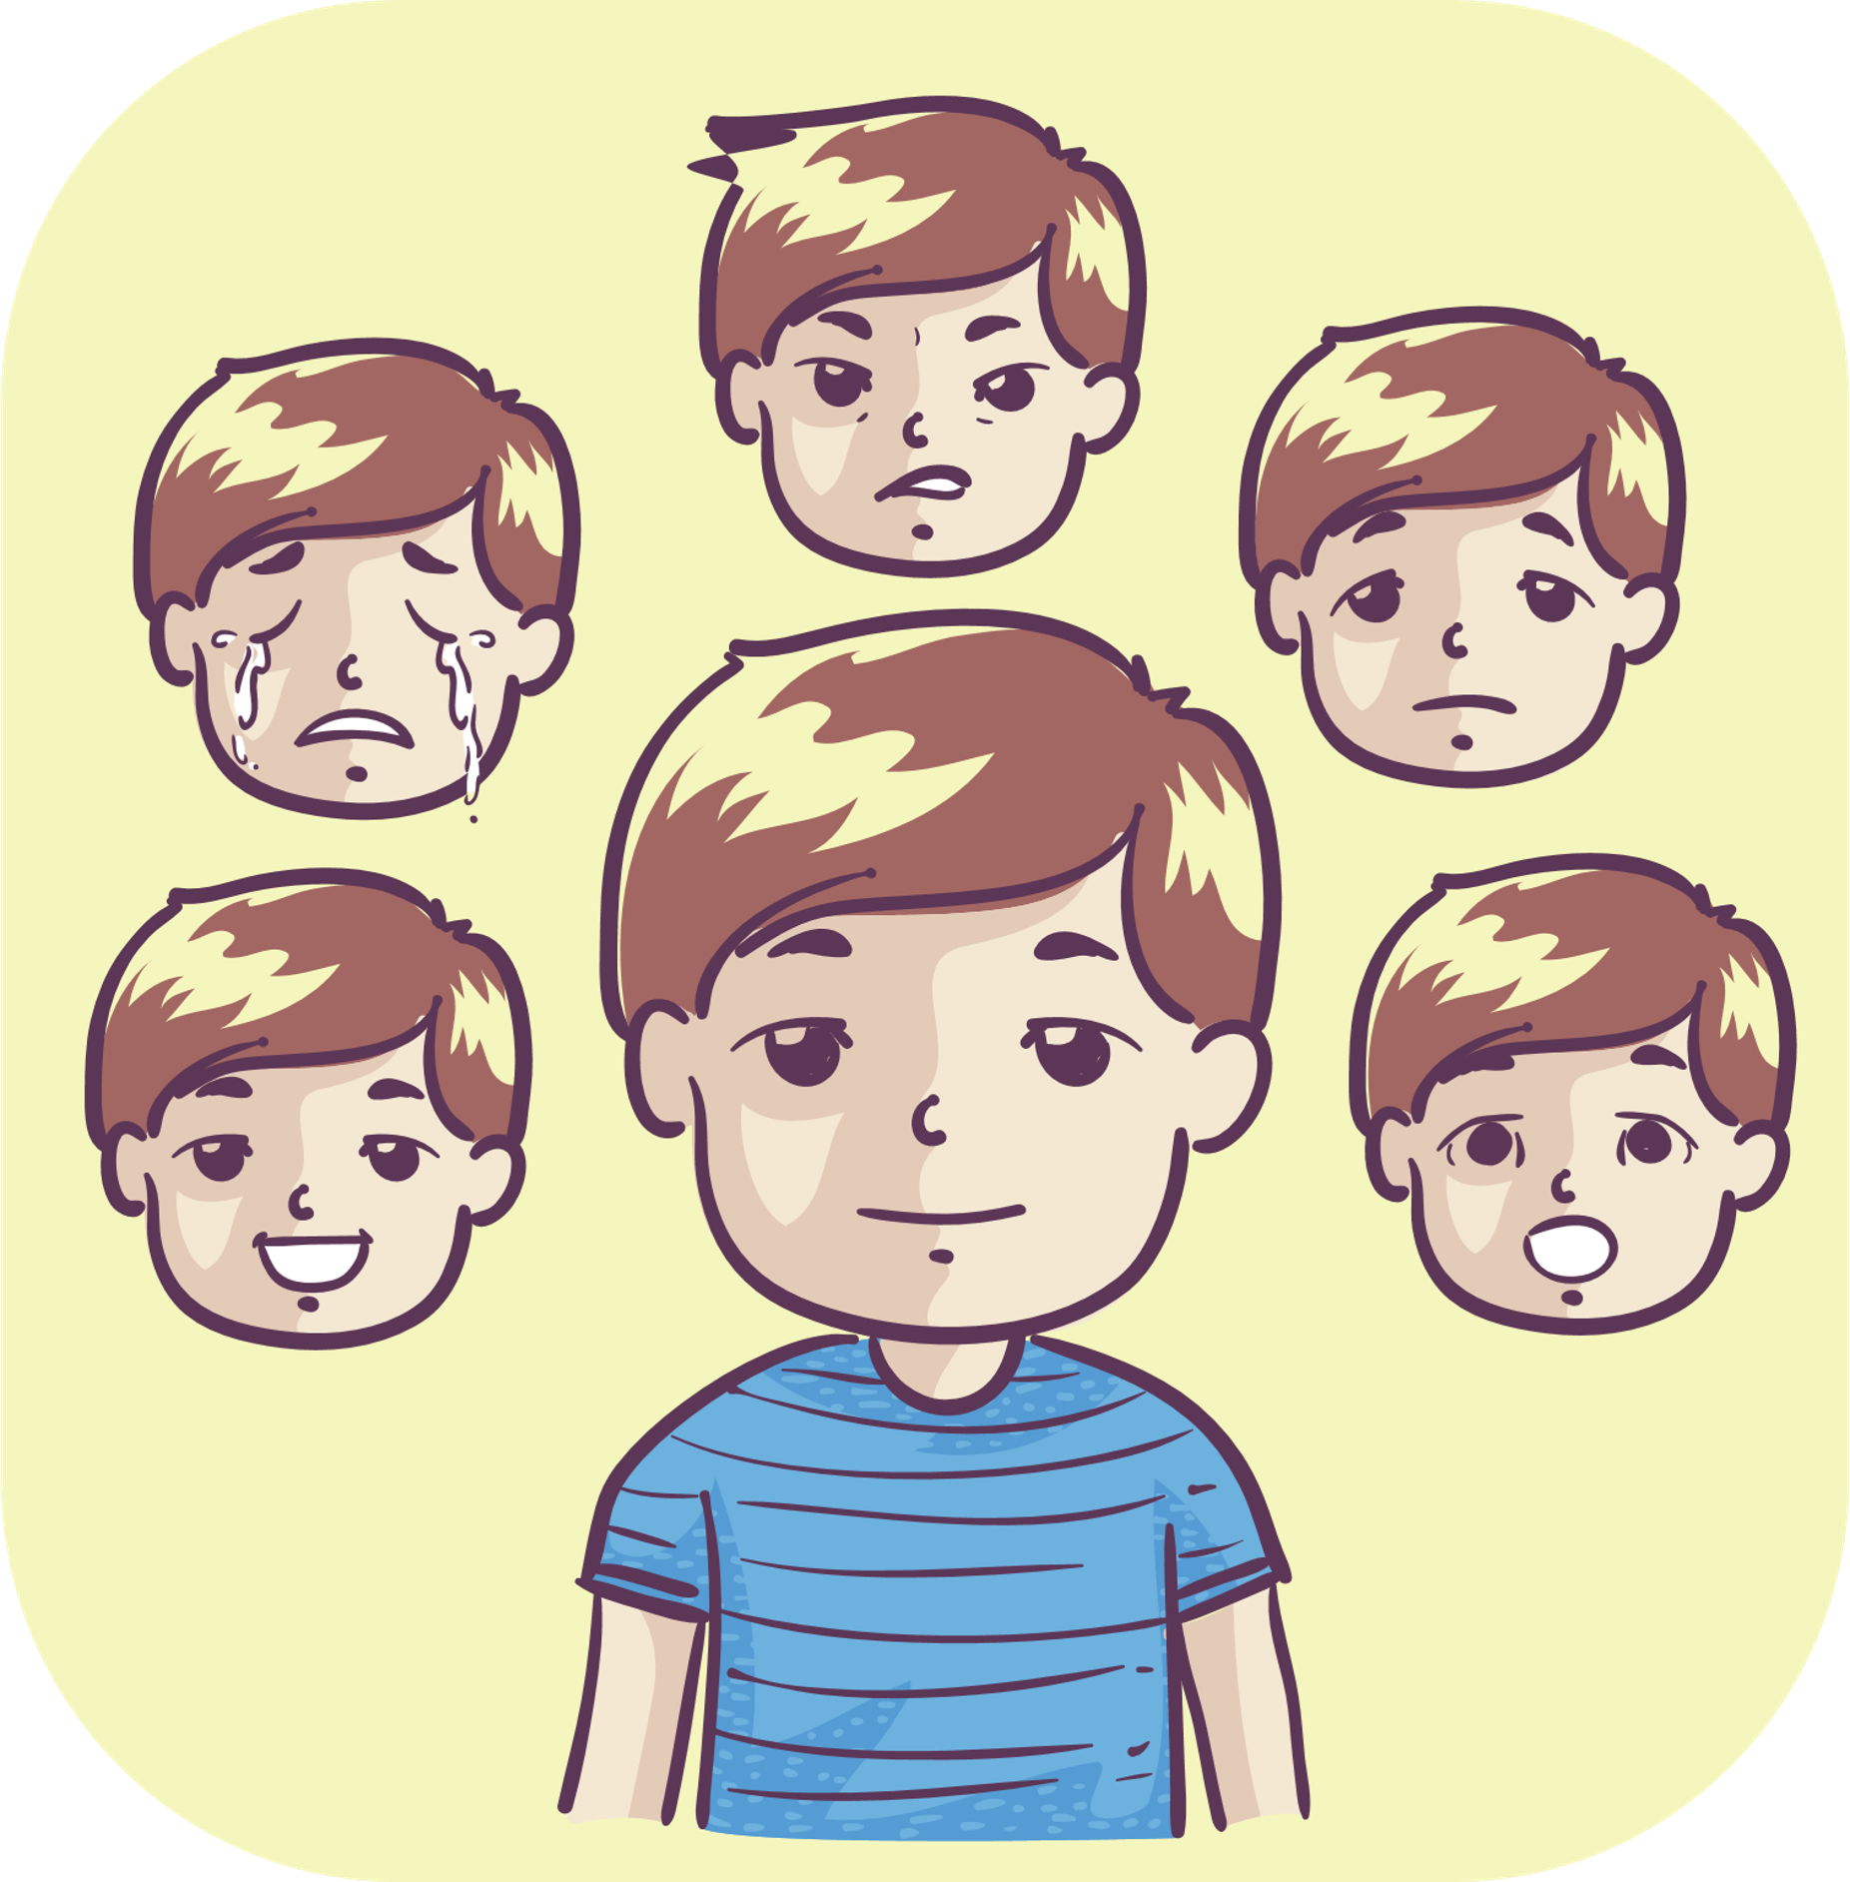
Pneumonia/Meningitis
1. Causes
Pneumonia can be caused by a bacteria (commonly the pneumococcus bacteria), fungus or by a virus (commonly the influenza virus or rhinovirus). Meningitis can be caused by several species of bacteria, viruses, fungi and parasites.
2. Symptoms
Cough
High fever
Trouble
breathing
Cyanosis due to edema (inadequate oxygen in the blood)
Airway blocking or vomiting
Young children can have:
Seizures
Mild to severe mental disorders

Slide 32
Pneumonia/Meningitis
3. Complications
Hib meningitis can leave permanent neurological sequelae (complications involving the brain which include cognitive, sensory and motor deficits), brain damage, deafness, and mental confusion.
The mortality rate of Hib meningitis ranges from 5% to 10%.
4. Transmission
The disease is transmitted directly from one person to another through droplets of saliva when coughing and sneezing.
People infected with HIB without symptoms can still spread the disease to others.
Children from 6 months to 2 years old are at the highest risk.
5. Prevention
Take antibiotics as directed by your doctors.
Prevention is effective by giving Hib vaccine to young children.
6. Information about the vaccination

Slide 33
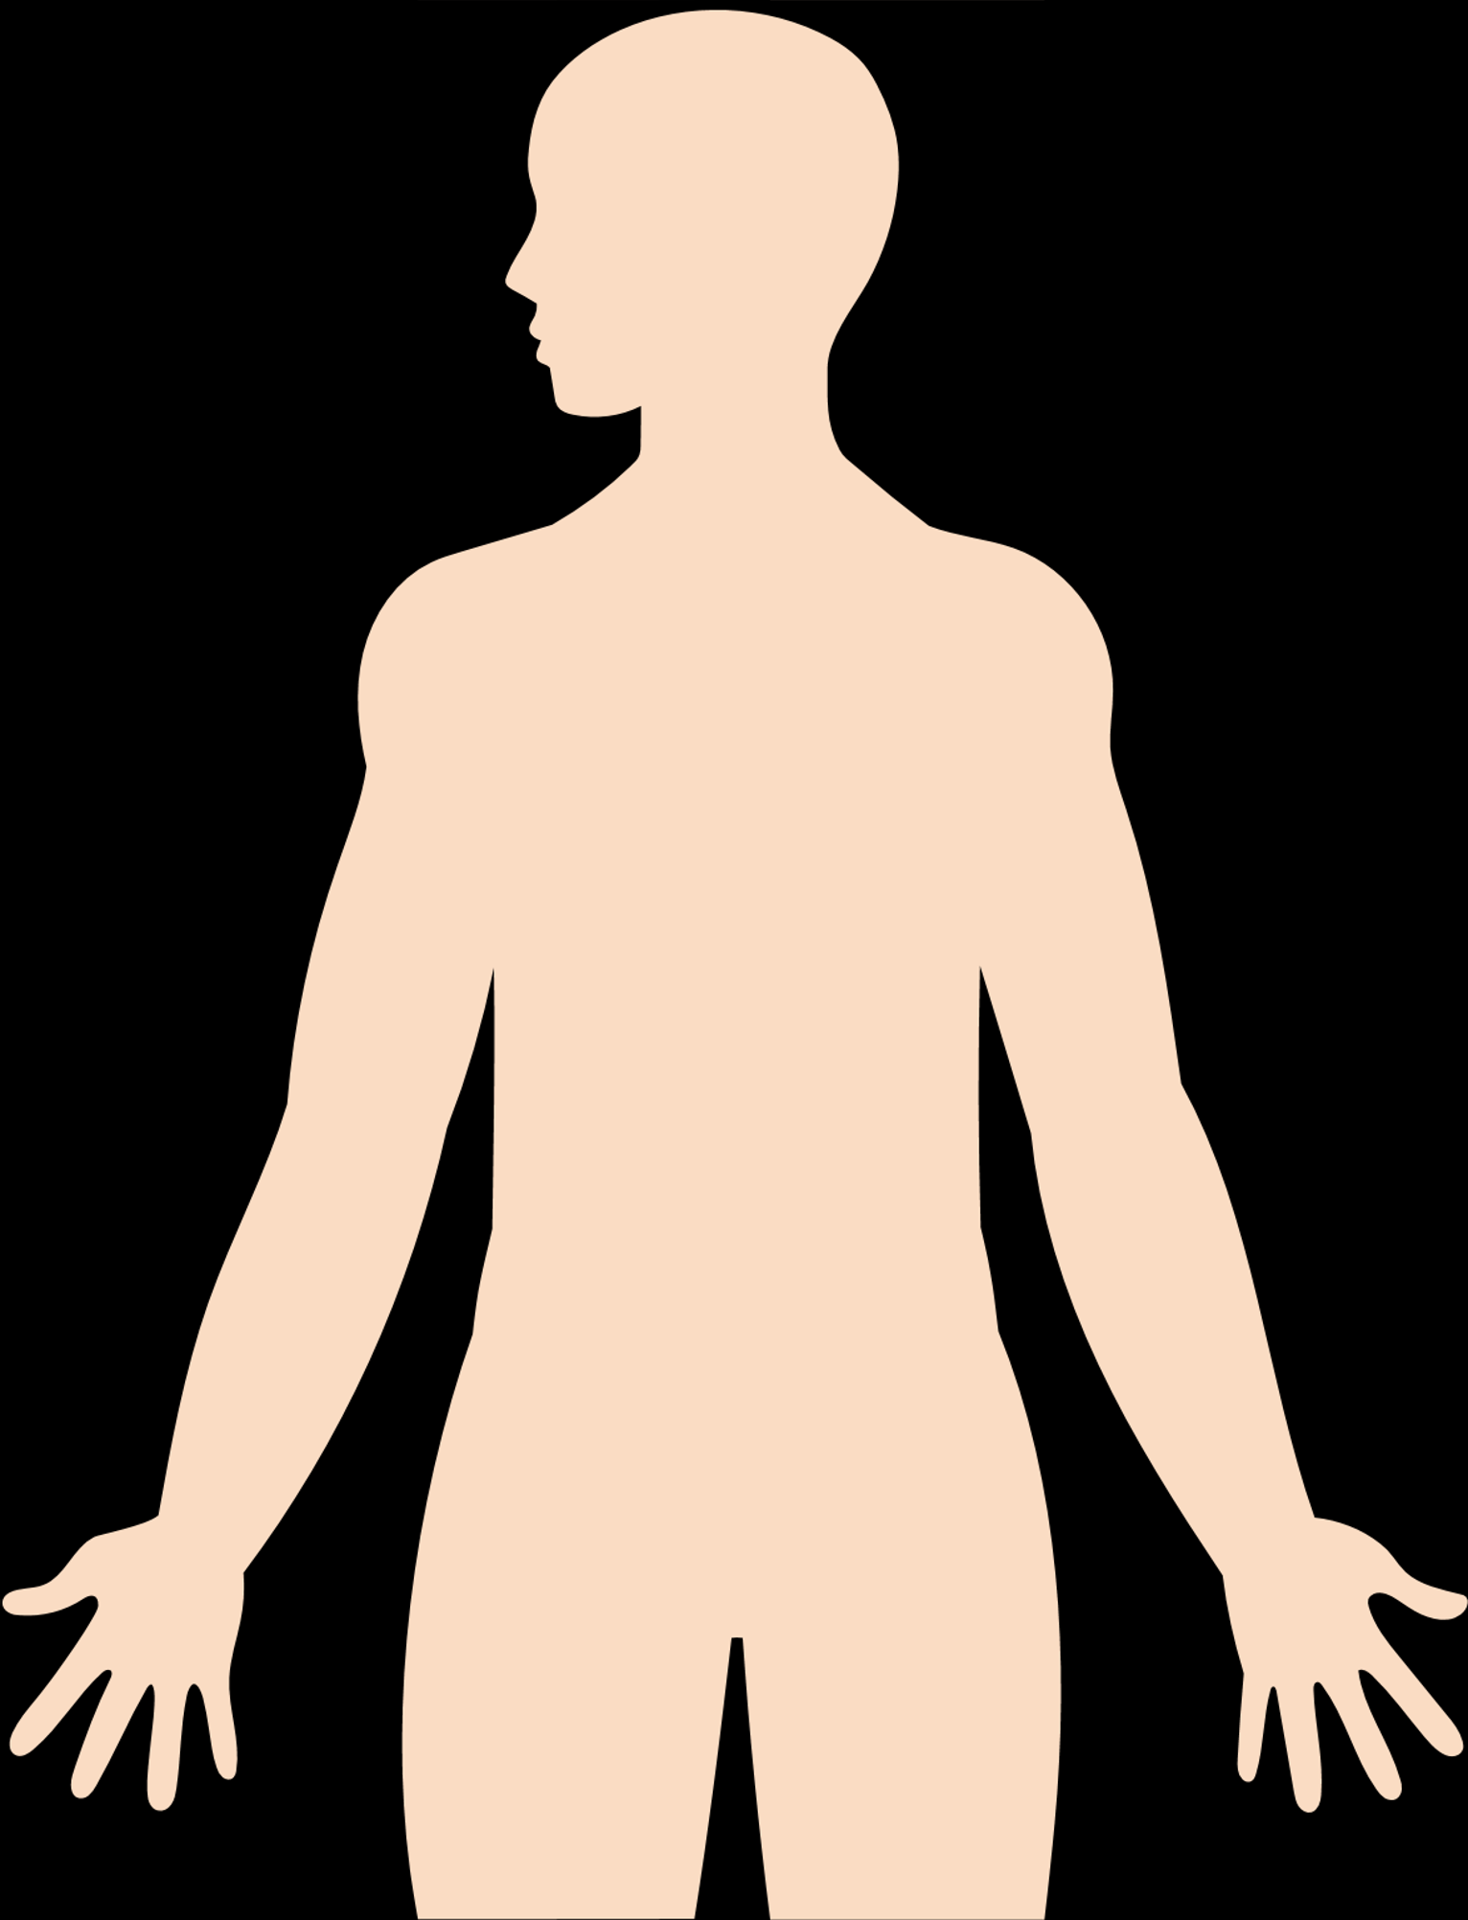
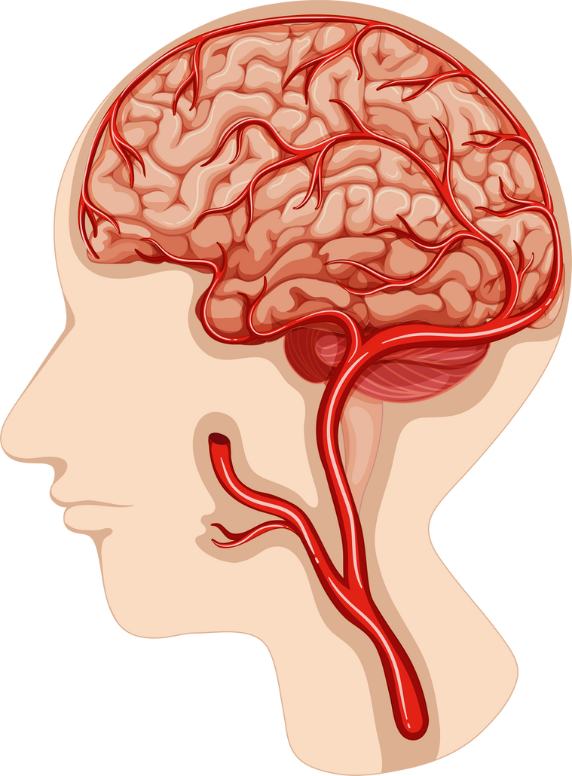
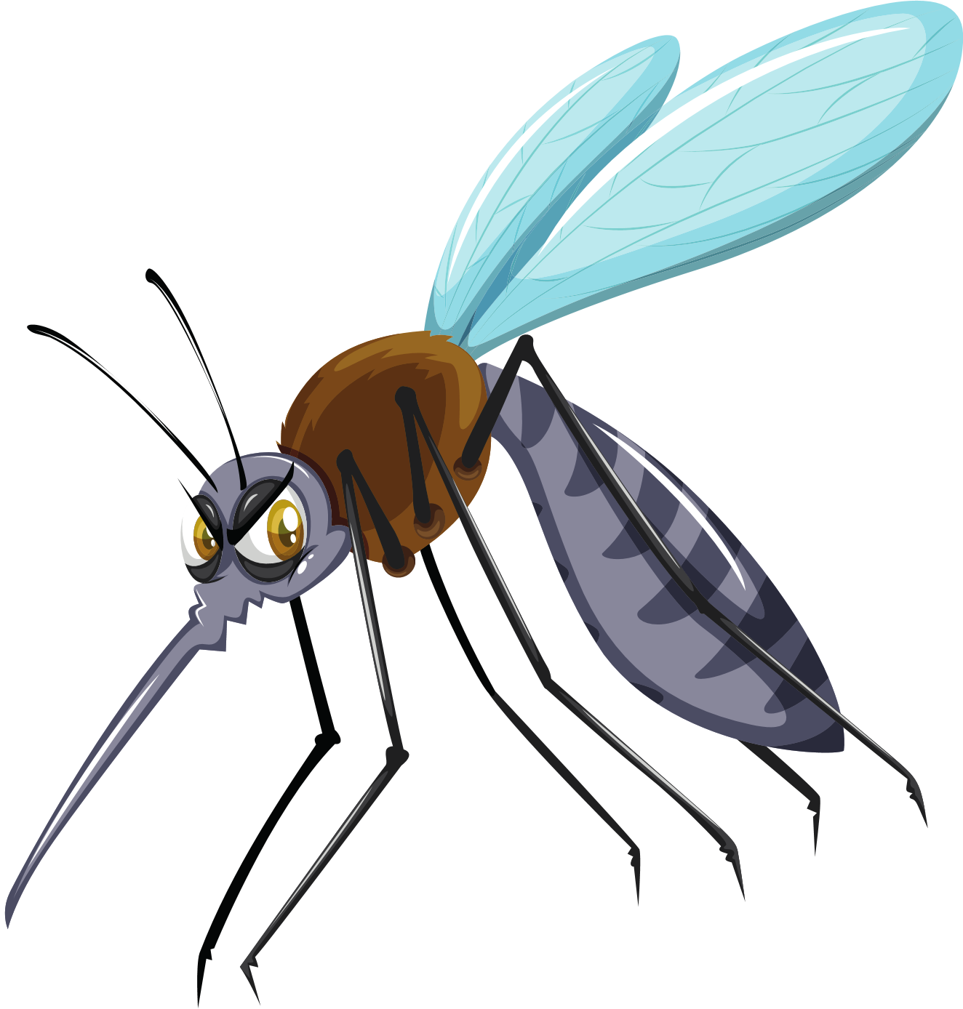
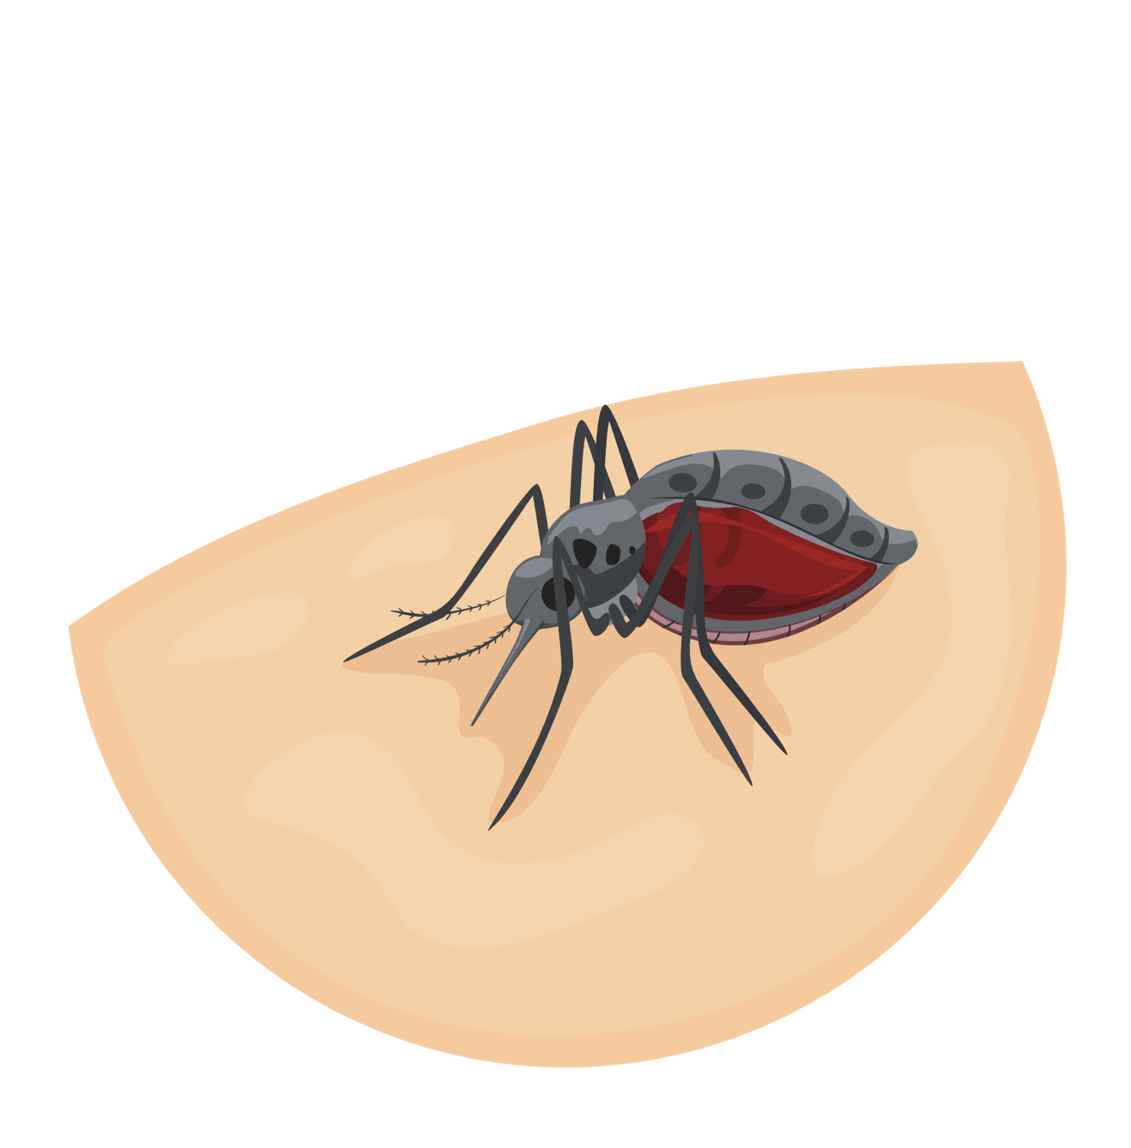
Japanese encephalitis

Slide 34
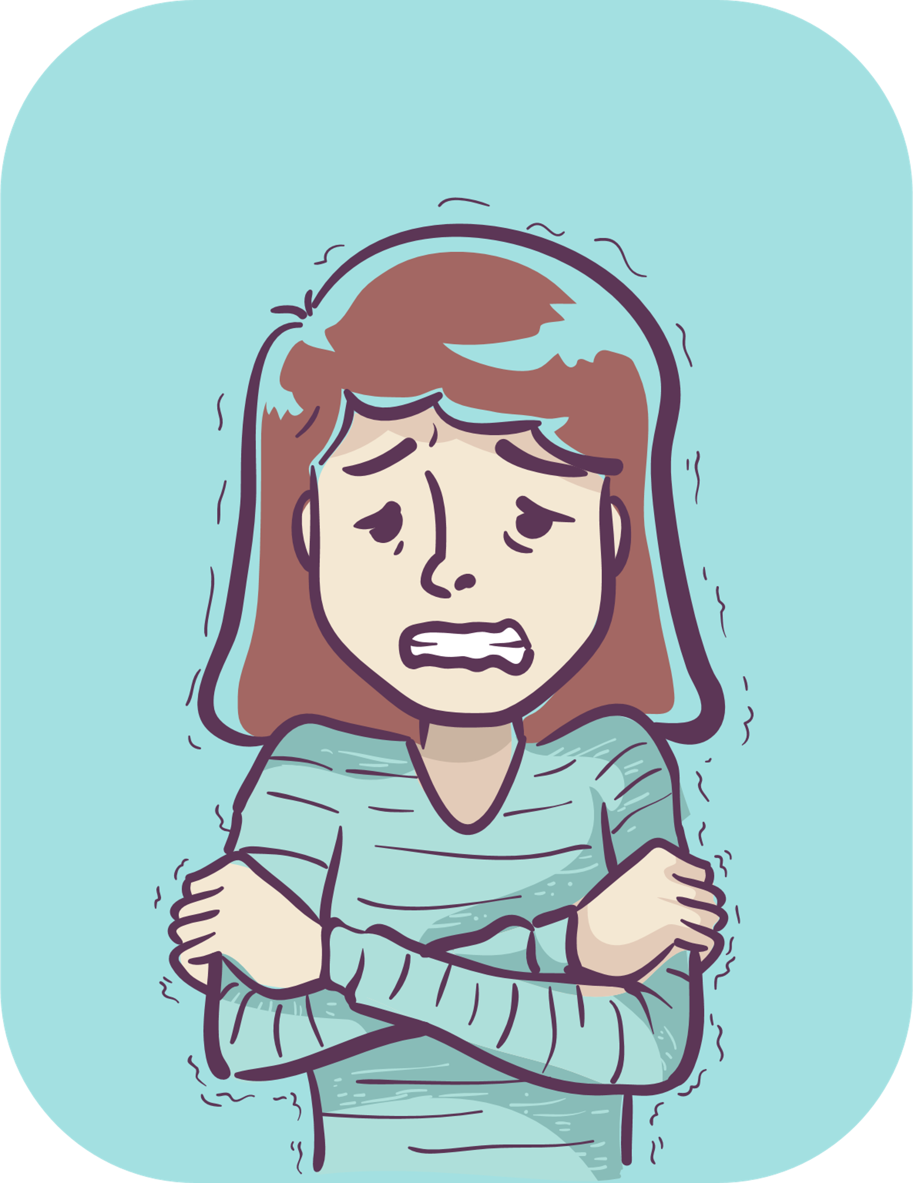
Japanese encephalitis
1. Causes
Japanese encephalitis is caused by the Japanese encephalitis virus, which is transmitted through mosquitoes.
2. Symptoms
Most have mild symptoms or no symptoms.
The incubation period is 4-14 days
Sudden fever
Chills
Headache
Fatigue
Nausea and vomiting
In children, abdominal pain may occur in the early stages of the disease.
After 3-4 days, the patient has an acute brain syndrome: convulsions, lethargy, coma, hyperactivity or abnormal behavior.

Slide 35
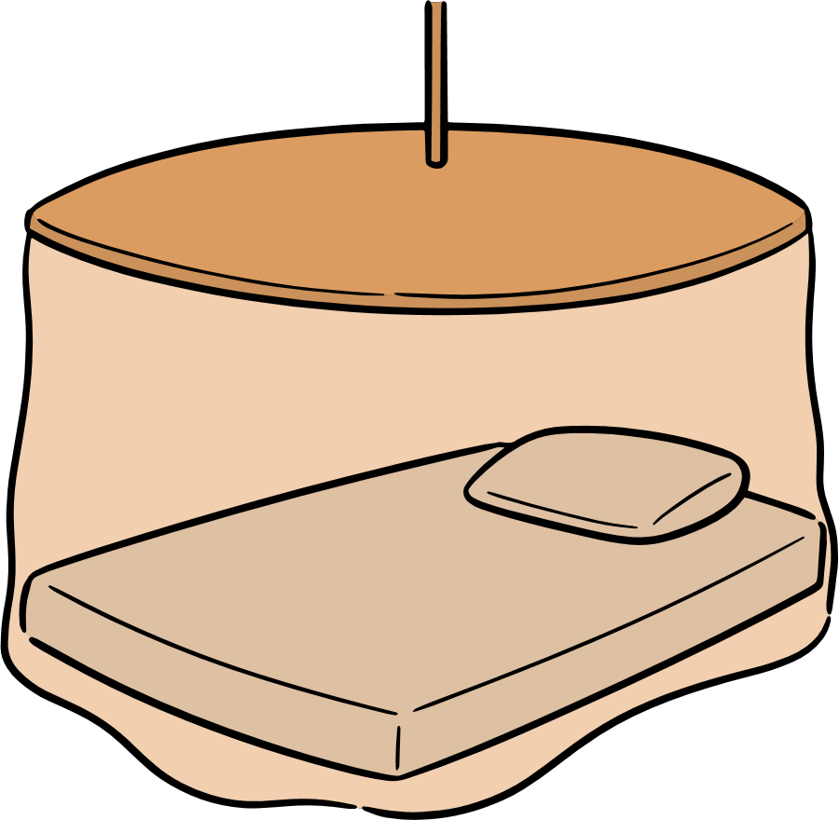
Japanese encephalitis
3. Complications
The disease leaves brain sequelae such as paralysis, mental disorders, deafness, blindness.
Severe cases can lead to death, especially in children under the age of 5.
4. Transmission
Birds and domestic animals can be reservoirs of the virus.
Mosquitoes bite infected animals and then transmit the disease to children.
People living in the suburbs, especially in the wet rice cultivation area, are at a high risk of contracting the disease.
5. Prevention
Sanitize the environment of housing and livestock barns
Hang mosquito nets while sleeping
Repel and get rid of mosquitoes
Place the barn far away from home, do not let children play near it
Wash your hands regularly with soap
Ensure food safety, isolate and limit contact with the patient
Get enough shots of vaccination.
6. Information about the vaccination

Slide 36
SARS-CoV-2 (COVID-19)

Slide 37
SARS-CoV-2 (COVID-19)
1. Causes
. SARS-CoV-2 stands for Severe Acute Respiratory Syndrome Coronavirus 2 and i is caused by a Coronavirus.
2. Symptoms
The disease may have no symptoms or range from mild to severe symptoms.
Mild symptoms:
Fever,
dry cough,
fatigue,
sore throat,
stuffy nose,
headache,
muscle aches,
Numbness of
the tongue.
Moderate symptoms:
Fever,
cough,
trouble breathing,
rapid breathing,
sore throat,
headache,
diarrhea,
conjunctivitis,
loss of taste,
smell,
skin rash.
Severe symptoms:
Cough,
shortness of breath,
pale skin,
severe respiratory failure,
groaning,
chest indrawing,
coma,
seizures.

Slide 38
SARS-CoV-2 (COVID-19)
3. Complications
Acute respiratory failure
Sepsis
Septic shock
Pulmonary infarction (caused by lack of blood supply) , stroke, delirium
4. Transmission
Infected people cough and sneeze without covering their mouths, leading to the release of droplets into the air, spreading the virus to healthy people.
A healthy person touches or shakes hands with someone who has the Corona virus, causing the virus to transmit from one person to another.
A healthy person comes into contact with a surface or object that has the virus on it, and then touches his or her nose, eyes, or mouth.

Slide 39
SARS-CoV-2 (COVID-19)
5. Prevention
Do not go to the pandemic area.
Implement 5K (Face mask, Medical declaration, No gathering, Distance, Disinfect)
Personal hygiene, wash your hands often.
Ensure food safety, only have cooked foods.
Keep the body warm, increase health by having a healthy routine of eating, resting, living, and doing exercises.
Increase air circulation in living areas and workplaces.
Clean and disinfect living and working areas regularly.
Get vaccinated against COVID-19 according to the indications and instructions.
6. Information about the vaccination

