Slide 1
eLearning course
Prison Health: Vaccination for People Working in Prisons

Slide 2
Introduction to the course
[15 minutes]

Slide 3
Welcome to the course!
3 minutes
a short video of the course creators reading out the following message welcoming participants to the course:
‘Welcome to the eLearning course ‘Prison Health: Vaccinations for People Working and Living in Prisons’. This course is brought to you by RISE-Vac, a project on vaccinations in prison spanning six European countries. Before developing this course, we asked a sample of custodial and healthcare staff working in prisons what they wanted to learn regarding vaccination. The course was developed with this feedback in mind. We hope it provides you with the knowledge you require about vaccination and its importance in the prison context.
At the end of the course, you will receive proof of attendance which will count towards your continued professional development. The course will encompass 2 modules and will be assessed through quizzes. You will learn about how living and working in a prison can expose you to infectious diseases and why vaccination is important in order to protect yourself and those around you. You will also learn effective communication strategies for talking about vaccination and addressing concerns people might have.
We hope you enjoy the course, and if you have any feedback, please provide this in the space provided at the end of the course. Now you can take this opportunity to introduce yourselves in the comments section below this video. Thank you!’

Slide 4
Why vaccination in prisons matters
3 minutes
People living and working in prisons are at a higher risk of coming into contact with infectious diseases, a number of which can be prevented by vaccination. Ensuring high vaccination rates in prisons can be highly effective in preventing disease outbreaks and protecting the people working and living in prisons, as well as their friends and family, and people in the wider community.

Slide 5
Learning outcomes
3 minutes
By the end of this course, you will:
Understand what vaccines are and the diseases they can help prevent
Understand how living and working in prison may expose you to infectious diseases
Understand the vaccine schedule in your country and how it applies to people living and working in prisons
Be vaccine confident and able to address questions/concerns regarding vaccines, in particular from people living in prisons

Slide 6
Course Structure
3 minutes
1. Vaccine Preventable Diseases most relevant for People Living and Working in Prisons [1 hour and 55 minutes]
1.1 Why are infectious diseases important in prisons?
1.2 How does vaccination protect prison staff and people living in prison?
1.3 Hepatitis B
1.4 HPV
1.5 Influenza
1.6 COVID-19
1.7 Want to learn more?
1.8 Quiz
2. Effective Vaccine Communication [1 hour and 45 minutes]
2.1 How to communicate on vaccines effectively
2.2 Ten Key Vaccine Facts
2.3 Common vaccine perceptions and how to address them
2.4 Useful resources
2.5 Final quiz
3. Important information (particularly for non-medical staff) [2 hours 30 minutes]
3.1 What are viruses and bacteria?
3.2 Introduction to the immune system
3.3 What are vaccines and how do they work?
3.4 How is safety and effectiveness of vaccines assessed and monitored?
3.5 Measles, Mumps and Rubella
3.6 Diphtheria, Pertussis and Tetanus
3.7 Polio
3.8 Pneumococcal disease
3.9 Meningococcal disease
References can be found at the end of the document.

Slide 7
Glossary
3 minutes
Scientific vocabulary:
Microorganism = a very small living thing that can only be seen under the microscope.
Pathogen = an infectious microorganism, such as a virus or bacteria, which causes disease.
Immune system: our body’s network of cells which protects us from disease, by fighting pathogens in our body.
Infection = when a pathogen enters and damages human cells and starts to multiply. Our immune system will then start to fight against this infection. Not all infections will cause disease, if our immune system is able to fight and control the infection quickly.
Infectious disease = illness caused by an infection which our body isn’t able to fight as quickly. Illness appears as a set of symptoms.
Symptom = physical changes caused by an infection. This could include a sore throat, headache, high temperature, or other physical changes.
Vaccine vocabulary:
Vaccine dose = one shot, or injection, of a vaccine.
Booster dose = an additional shot or injection given after the first dose of vaccine to provide full immunity
MMR = vaccination for the diseases measles, mumps and rubella
HPV = human papillomavirus. This is the virus that causes cervical cancer.
BCG = vaccination against tuberculosis (the letters stand for Bacillus Calmette-Guérin, named after the scientists who first developed the vaccine)
Disease vocabulary:
Pneumonia = infection of the lungs resulting in difficulty breathing and which can be fatal. Pneumonia can be caused by many different pathogens.
Meningitis = infection of the brain and/or nervous system which can be fatal. Meningitis can be caused by many different pathogens.

Slide 8
Knowledge assessment quiz
4 minutes
Which of the following factors make people living in prison more likely to be vulnerable to infectious diseases before entering prison?
Shared or unclean needle use
Higher prevalence of homelessness
Limited access to health education
All of the above
Name some of the living conditions in prison which make people living in prison more likely to be vulnerable to infectious diseases. [open answer]
Which disease in particular is more likely to spread through shared or unclean needle use (from injecting drugs or tattooing, for example)?
Hepatitis B
Influenza
COVID-19

Slide 9
Knowledge assessment quiz
4 minutes
4. Prison staff are not affected by higher levels of infectious diseases circulating in prison. (True/False)
5. Vaccination can help protect not only individuals, but also their family, visitors, and the rest of community at large. (True/False)
6. How can hepatitis B spread?
Through unprotected sex
Through fights in prison involving blood or biting
Through tattoos done using unclean needles
Through sharing needles with others who who have hepatitis B infection
All of the above

Slide 10
Knowledge assessment quiz
4 minutes
7. HPV infection can have no symptoms, meaning individuals might not know they are infected. (True/False)
8. HPV only causes cervical cancer and so does not affect men. (True/False)
9. Why does flu (influenza) spread more quickly in prisons?
Because many people living in prisons are men.
Because people living in prison live very close together, often sharing cells with poor air circulation (ventilation).
Because prisons are often cold.

Slide 11
Assessment: final quiz
4 minutes
10. Pregnant people can protect themselves as well as their unborn child from some diseases by getting vaccinated. (True/False)
11. Which of the following are effective communication strategies when talking about vaccines?
Using inclusive terms (‘we’ instead of ‘you’)
Keeping key message simple
Telling the truth
Not repeating vaccine myths
All of the above
12. People living in prison may perceive vaccine side-effects as being riskier than they actually are, or diseases as being less risky than they actually are. (True/False)

Slide 12
Assessment: final quiz
4 minutes
13. When people express a distrust of authorities or governments, it is important to…
Be reassuring and open to listen to their opinion
Tell them they are wrong
Ignore them
14. Conspiracy theories are often popular when…
People are happy
People fear they are losing control of a situation
People go on the internet a lot

Slide 13
Knowledge assessment quiz
4 minutes
15. How confident would you feel in talking to someone about vaccines?
Not confident at all
Somewhat confident
Confident
Very confident
16. How would you rate your knowledge of vaccines and vaccine-preventable diseases?
Little/no knowledge
Some knowledge
Quite knowledgeable
Very knowledgeable

Slide 14
Knowledge assessment quiz
4 minutes
17. Please select the option which best applies to your role:
Custodial staff
Healthcare staff (trained in vaccination)
Healthcare staff (not trained in vaccination)
Other staff (please specify)

Slide 15
1. Vaccine Preventable Diseases most relevant for People Living and Working in Prisons
[1 hour 55 minutes]

Slide 16
Module content
1 minute
In this module, we will cover:
Why are infectious diseases important in prisons?
How does vaccination protect prison staff and people living in prison?
Key vaccine-preventable diseases in the prison setting, including:
Hepatitis B
Influenza
HPV
COVID-19
You will also have the option of learning more about other vaccine-preventable diseases including measles, mumps, rubella, tetanus, diphtheria, polio and whooping cough (pertussis).
National vaccination schedules

Slide 17
Article 1. Why are infectious diseases important in prisons?
1 minute
People living in prison are more vulnerable to infectious diseases than those living outside prison. In this article, we will explain why that is the case. This is relevant for staff who work in close contact with people living in prison.

Slide 18
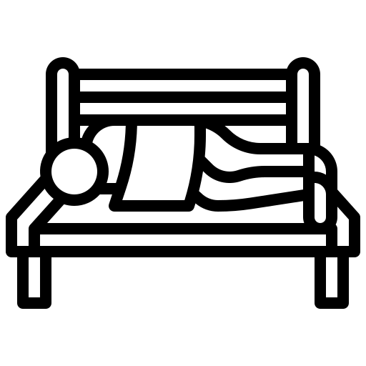
Article 1. Why are infectious diseases important in prisons? (Before prison)
3 minutes
There are a number of factors which make people living in prisons more likely to be vulnerable to infectious diseases. Some of these are related are related to their lives before entering prison. On average, people living in prison are more likely to have experienced some of the things highlighted below than people who did not go to prison. This will not apply to everyone living in prison.
Before prison
Shared or unclean needle use
Unprotected sex
Limited access to healthcare
Higher prevalence of homelessness
Contaminated drug use
Limited access to health education
Underlying health conditions
Poor personal hygiene (linked to homelessness)

Slide 19
Article 1. Why are infectious diseases relevant in prisons? (Before prison)
5 minutes
These behaviours or circumstances make people living in prison more vulnerable to infectious diseases before coming into custody. Here’s some short explanations as to why:
Homelessness: People who have experienced homeless are likely to have missed key health appointments such as vaccinations. Poor hygiene and health are also associated with homelessness, increasing the likelihood of infectious diseases.
Unprotected sex: People living in prison are more likely to have come into contact with diseases such as HPV or HIV through unprotected sex or through having multiple sexual partners, for example because of sex work.
Shared or unclean needle use: People living in prison are more likely to have come into contact with hepatitis B or C, or other diseases, through needle use such as injecting drugs or tattooing.
Contaminated drug use: Taking drugs contaminated with soil, for example, may lead to tetanus infection.

Slide 20
Article 1. Why are infectious diseases relevant in prisons? (Before prison)
5 minutes
Underlying health conditions: People living in prison are more likely to have underlying health conditions, such as heart problems, asthma, arthritis, cancer or diabetes.
Access to healthcare: People living in prison are more likely to come from communities with lower access to healthcare. This can lead to people missing healthcare appointments such as vaccinations.
Access to health education: People living in prison are more likely to come from communities with lower access to health education. This could lead to knowledge of the benefits of health interventions such as vaccination.
All of these factors mean that before even entering prisons, this population are more likely to suffer from a number of infectious diseases and less likely to be vaccinated than the general community.

Slide 21
Article 1. Why are infectious diseases relevant in prisons? (In prison)
3 minutes
Once people arrive in prison, there are a number of factors related to the prisons themselves, and behaviours commonly seen in people living in prisons, which make people living in prisons more vulnerable to infectious diseases. These will not apply to everyone living in prison.
In prison
Shared or unclean needle use
Overcrowding
Unprotected sex
Limited access to healthcare
High turnover of people
Limited access to health education
Poor ventilation
Sharing of cells, showers and toilets
Contaminated drug use
Poor hygiene

Slide 22
Article 1. Why are infectious diseases relevant in prisons? (In prison)
5 minutes
These behaviours or circumstances make people living in prison more vulnerable to infectious diseases once they’re living in prison too. Here’s some short explanations as to why:
Poor ventilation: Prison building are often old with few windows which can be opened to allow the air to flow through and recycle. This means that infectious diseases which spread through the air, such as COVID-19 or influenza, can spread much more quickly and easily in prisons.
Poor hygiene: Cleaning materials are sometimes not made avaliable to prisoners due to fears of self-harm. However, all prisoners should have access in a managed way. Also, in some prisons, people living in prison don’t have access to appropriate facilities, like toilets, in their cells. Both of these things lead to lower levels of hygiene in prison cells..
Overcrowding: Prisons often have too many people in the building. This high density of people makes it easier for infectious diseases to spread from one person to the next.
Sharing of cells, showers and toilets: Infectious diseases can easily spread through people using the same spaces and touching the same surfaces without cleaning in between.

Slide 23
Article 1. Why are infectious diseases relevant in prisons? (In prison)
5 minutes
Unprotected sex: People living in prison are more likely to have come into contact with sexually transmitted diseases, such as HPV, through unprotected sex. Access to protection, such as condoms, can be limited in prisons.
Shared or unclean needle use: People living in prison are more likely come into contact with hepatitis B or C, or other diseases, through needle use such as injecting drugs or tattooing. Needles are harder to disinfect in prisons as people often don’t have access to cleaning materials.
Contaminated drug use: Taking drugs contaminated with soil, for example, may lead to tetanus infection. Drugs are not permitted in prisons and so are often smuggled in from unidentifiable sources, making their quality questionable.
High turnover of people: People move from prison to prison as they serve their sentence. Staff also go in and out of prison. This flow of people through the prisons means many opportunities for infectious diseases to enter prisons.

Slide 24
Article 1. Why are infectious diseases relevant in prisons? (In prison)
5 minutes
Access to healthcare: People living in prison are more likely to face difficulty in accessing healthcare services such as vaccination, treatments or testing for diseases.
Access to health education: People living in prison are restricted in what information they can access. This means that people may not know about the benefits of vaccination or other health measures.
All of these factors mean that once living in prisons, people may face more difficulty in accessing healthcare such as vaccinations, and may be exposed to more infectious diseases in the prison environment.

Slide 25
Article 1. Why are infectious diseases relevant in prisons?
3 minutes
You may have noticed a significant overlap between these factors. This means these circumstances or conditions are present both before people enter prison, and continue whilst they are in prison, sometimes for different reasons.
Before prison
In prison
Higher prevalence of homelessness
Overcrowding
Limited access to health education
Unprotected sex
High turnover of people
Poor personal hygiene (linked to homelessness)
Limited access to healthcare
Sharing of cells, showers and toilets
Contaminated drug use
Underlying health conditions
Shared or unclean needle use
Poor hygiene
Poor ventilation

Slide 26
Article 1. Why are infectious diseases important in prisons?
5 minutes
All of the behaviours and circumstances we have just learned about help explain why people living in prisons are more at risk of being infected. All of these factors put together meant that typically there are many infectious diseases circulating around prisons at any time. This means that prison staff, as well as people living in prison, are at more at risk of coming into contact with infectious diseases than people who don’t live or work in prisons.
As well as being at risk of coming in to contact with infectious disease themselves, prison staff are at risk of carrying these diseases with them into to the community, especially to their family or close friends, but also the wider community.
Below is a representation of a prison staff member coming into contact with people living in prison who are infectious (in pink). These people infect other people living in prison and prison staff. Prison staff then leave the prison, go home to their family or close ones and pass this disease onto them.

Slide 27
Article 1. Why are infectious diseases important in prisons?
5 minutes
Infectious diseases also spread in the opposite direction.
People entering prison (staff, visitors or people newly incarcerated) can bring in infections from the community into prisons. As we have seen, prisons are enclosed environments in which infection easily spreads, therefore, sometimes one case can quickly result in a large outbreak. We also have seen that people living in prison often suffer from underlying health conditions, if that’s the case they could become very ill when infected.

Slide 28
Article 2. How does vaccination protect prison staff and people living in prison?
5 minutes
We have seen why infectious diseases are more likely to occur in prisons, and how this can put the lives of prison staff, people living in prison, both their relatives, and the wider community, at at risk.
Many infectious diseases are now preventable through vaccines. Vaccination can help avoid serious disease if someone does become infected; and it also makes it less likely that they will pass a disease on to other people around them.
Taking the previous example of the prison staff who becomes infected and makes their family sick when they go home, in this case, despite being exposed to a disease in their work in the prison, the staff member does not get infected and does not pass the disease onto their family. This is because they are vaccinated and so protected against the disease.

Slide 29
Article 2. How does vaccination protect prison staff and people living in prison?
5 minutes
Notice how not only does the prison staff member not get infected because they’re vaccinated, but other people living in prison are also able to protect themselves from getting sick because they are vaccinated too. This means there will generally be fewer infections in the prisons, which means as a whole, the people living and working in the prison will be healthier and less likely to become ill.
Also notice that some of the prison staff member’s family are not protected by vaccination. This could be because their immune systems may not be strong enough to get vaccinated. For example, people with certain cancers are not able to be vaccinated, or very young babies could be too young to be vaccinated. However, because the prison staff member is vaccinated, they do not pass any disease onto their family.

Slide 30
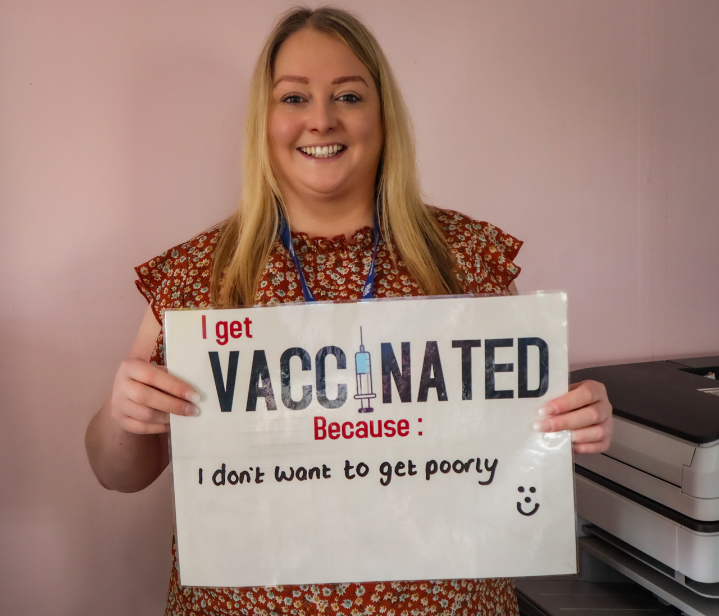
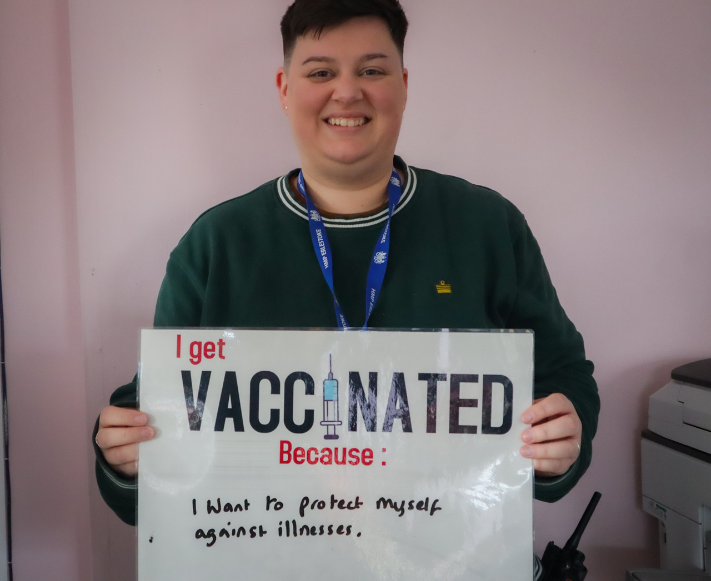
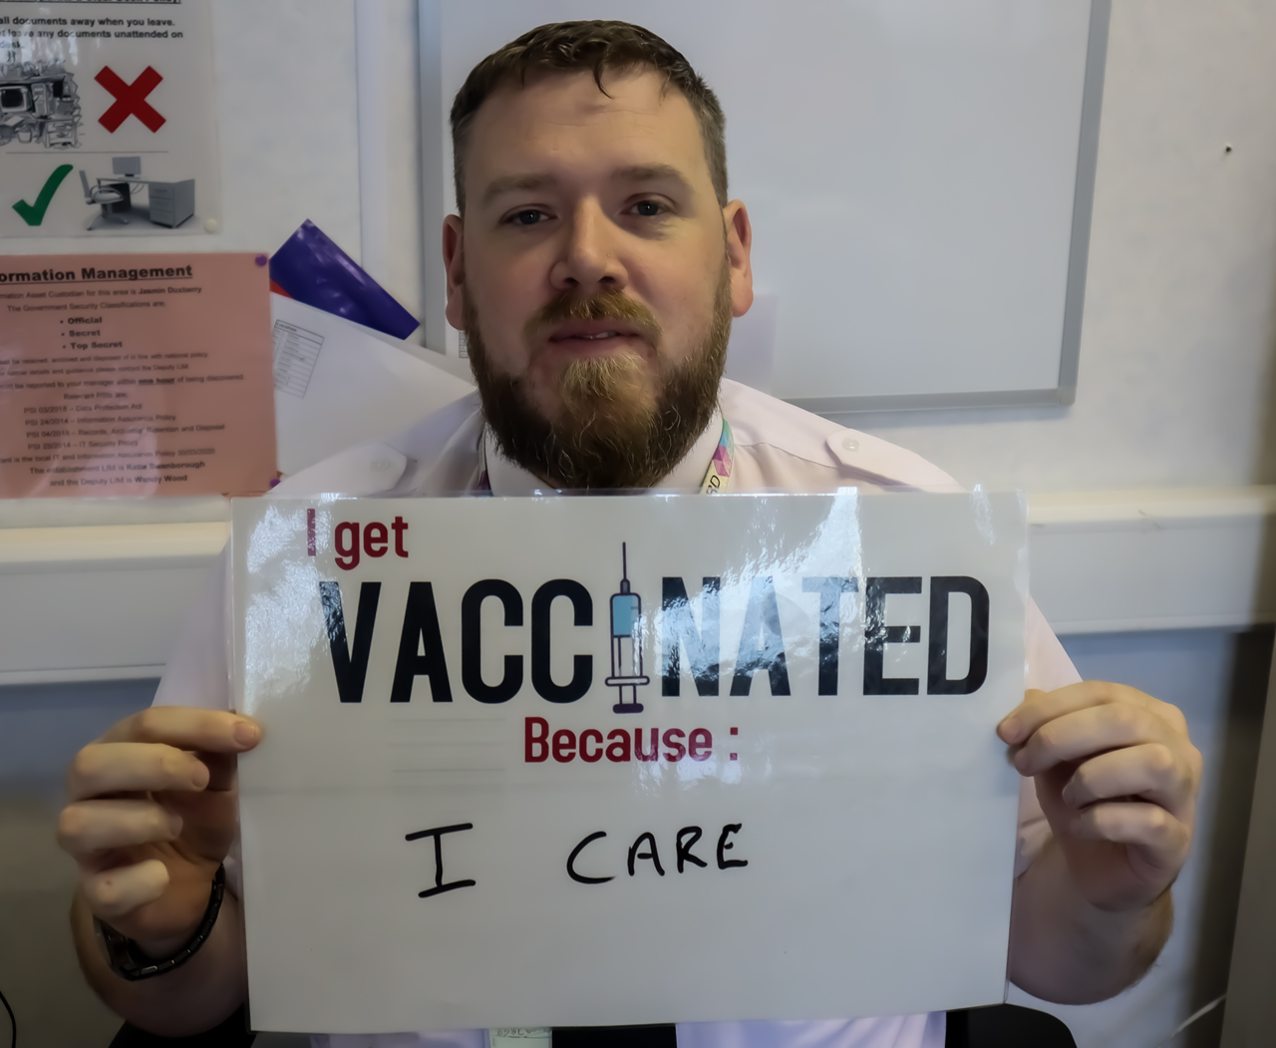
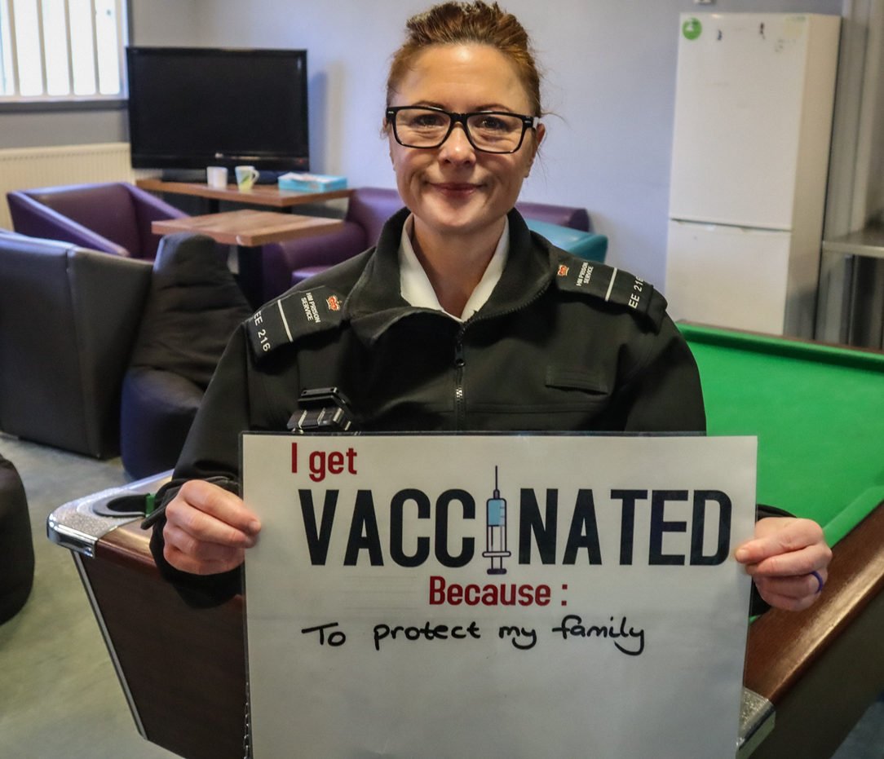
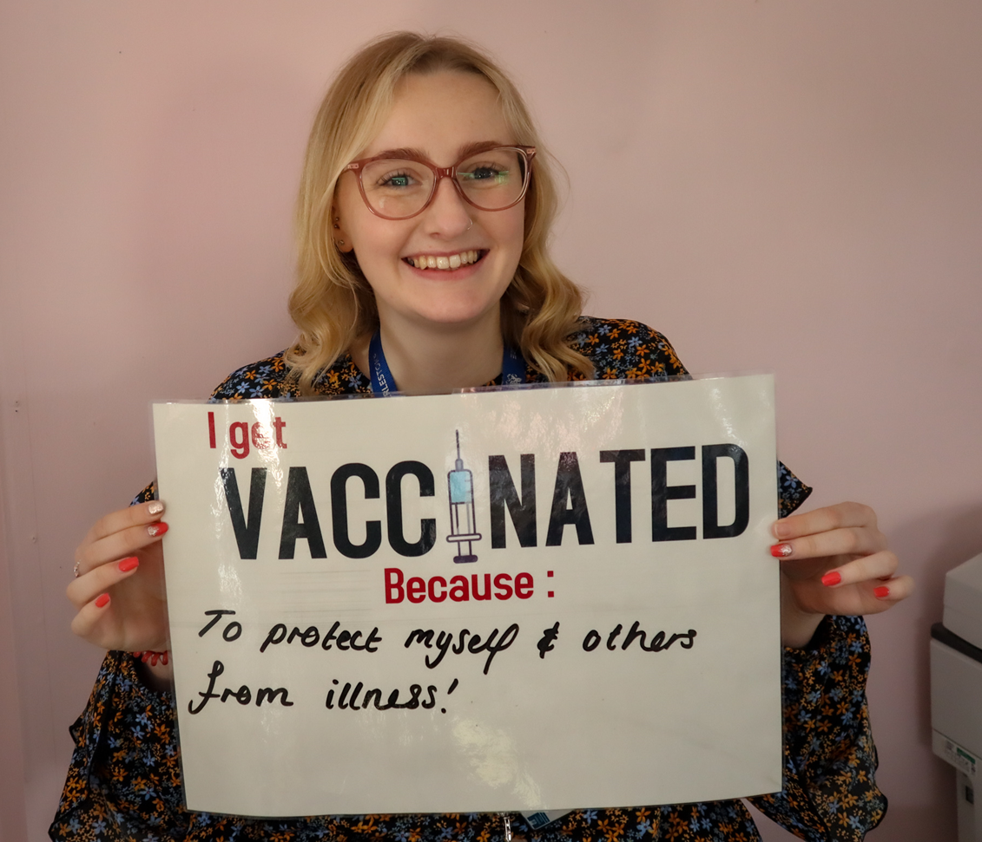
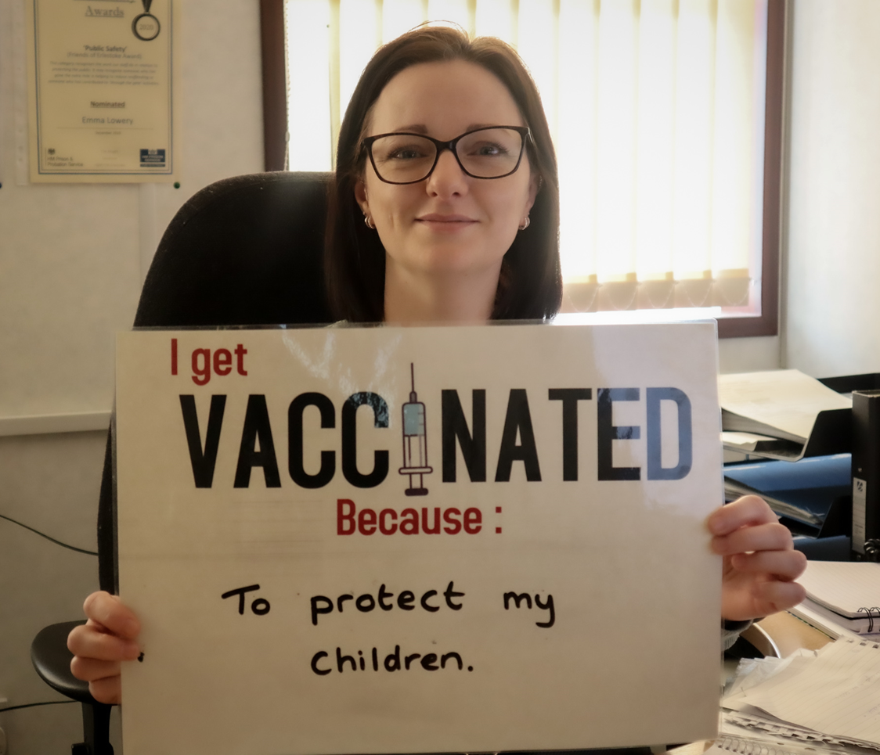
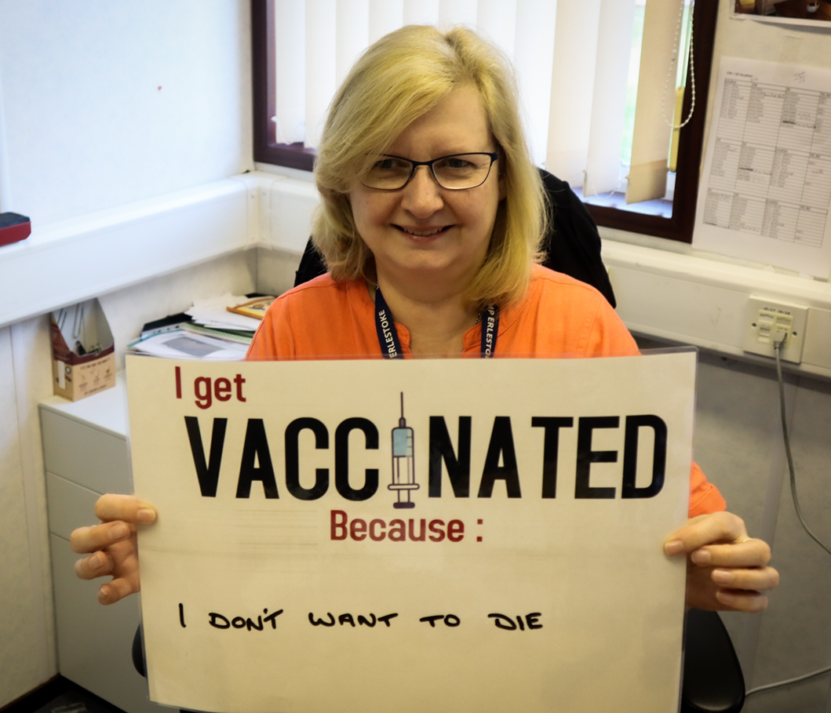
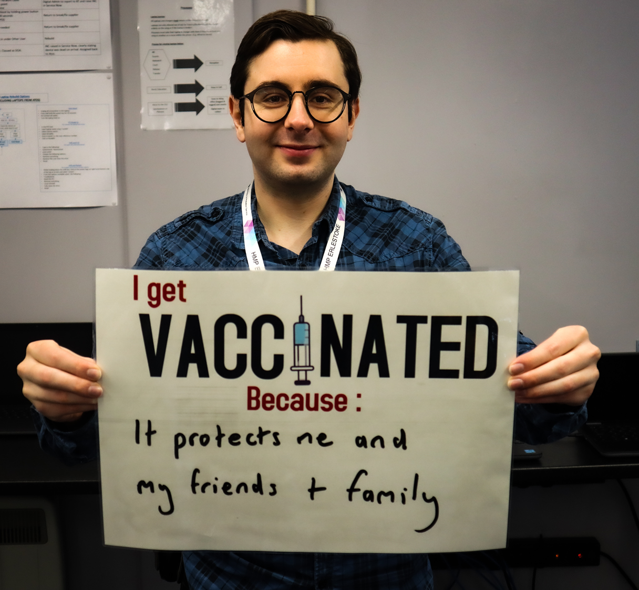
Article 2. How does vaccination protect prison staff and people living in prison?
2 minutes
Let’s hear about why some prison staff choose to get vaccinated:

Slide 31
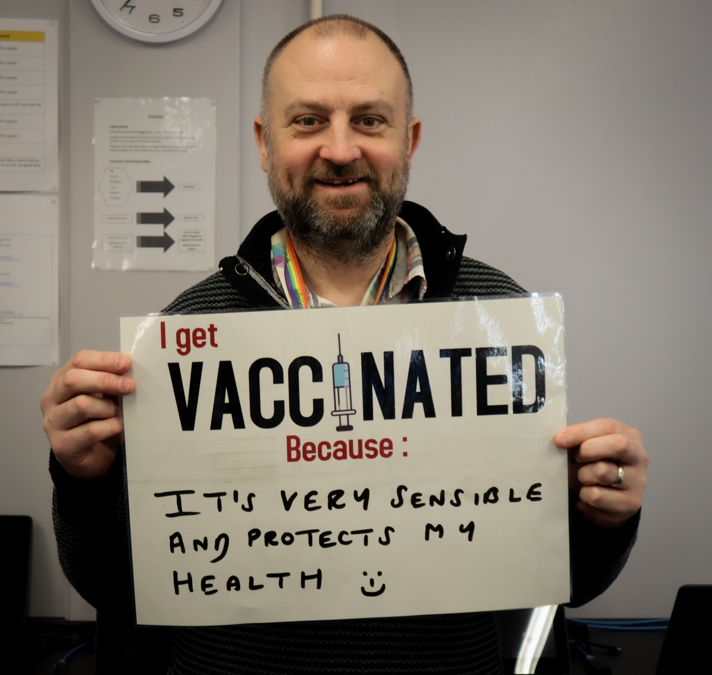
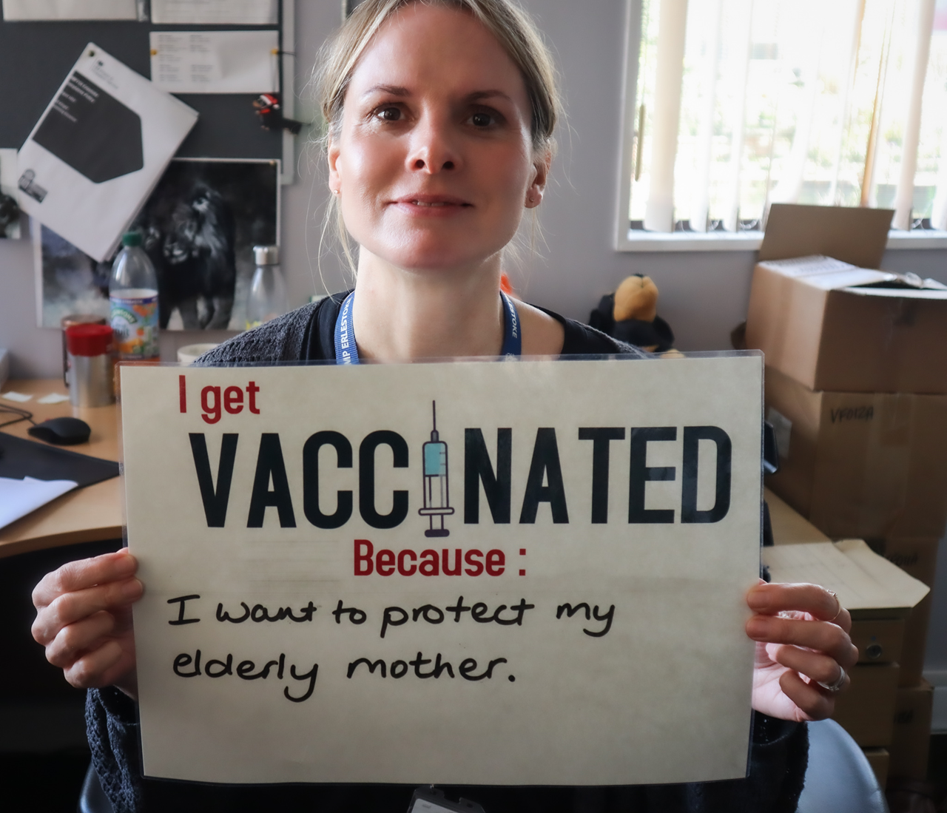
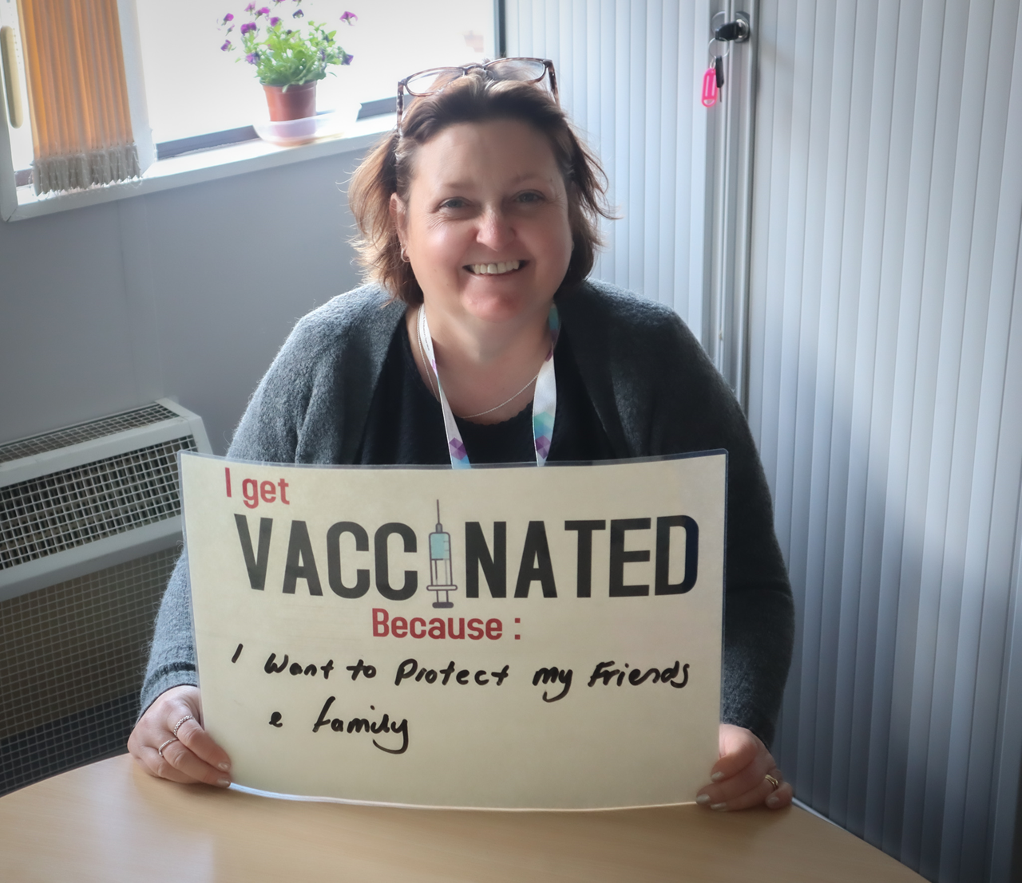
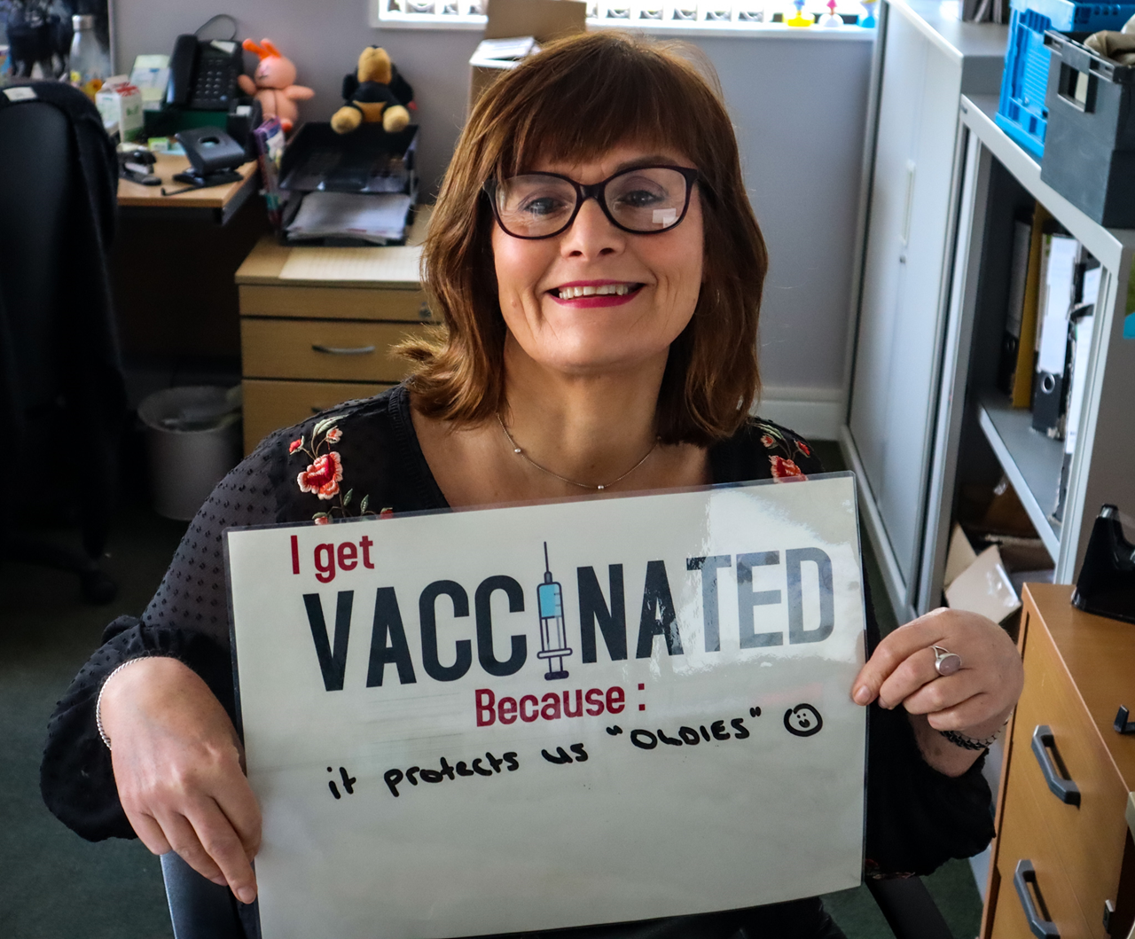
Article 2. How does vaccination protect prison staff and people living in prison?
2 minutes
Let’s hear about why some prison staff choose to get vaccinated:

Slide 32
Article 2. How does vaccination protect prison staff and people living in prison?
3 minutes
We will now dive a little deeper into some of the most common infectious diseases in prisons which can be prevented through vaccination: hepatitis B, HPV, influenza and COVID-19.
This section will take you through what these infectious diseases look and feel like, what vaccines are available against them, and how safe and effective these vaccines are.
At the end of this section, you will also be able to access your national immunisation schedule to understand which vaccines are given in your country.

Slide 33
Article 3. Hepatitis B
3 minutes
Hepatitis B infection can cause liver cancer. Hepatitis B is transmitted through contact with bodily fluids such as blood, and during unprotected sex. It is not a very common infection in the community, however it is far more common in prisons.
Hepatitis B is a very serious disease which can result in life-threatening liver problems, such as liver cancer of liver failure. It is very important as prison staff to be aware of how to protect yourself from hepatitis B and how to prevent possible infection in prisons.

Slide 34
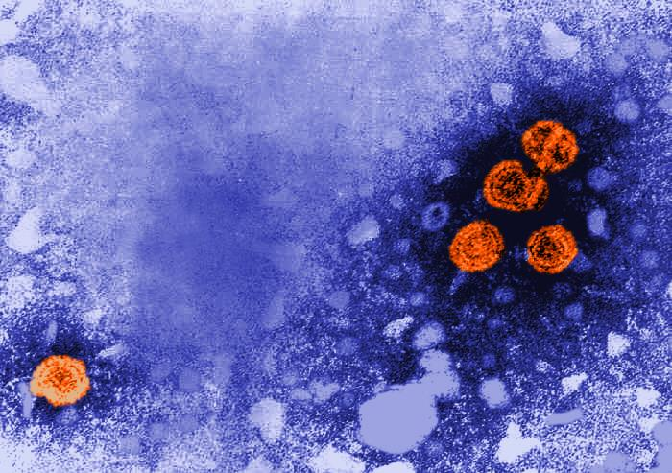
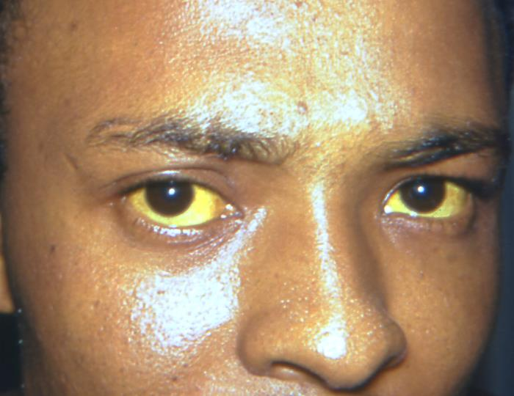
Article 3. Hepatitis B
3 minutes
The disease: Viral liver disease, and in some cases, liver cancer. Viral means it is caused by a virus.
How does it feel? People who are infected with hepatitis B can have high temperature, tiredness, pain in the tummy area, feeling of being sick, yellowing of the skin and eyes, and patches of raised and itchy skin. Some people who are infected have no symptoms.
What is severe disease like? People who are infected with hepatitis B for a long time with no treatment can develop to fatal liver cancer or liver failure. Hepatitis B caused an estimated 820,000 deaths worldwide in 2019.
How does it spread? Hepatitis B can spread through contact with bodily fluids of an infected person. This can include through unprotected vaginal, anal or oral sex, injecting drugs using shared or unclean needles, being injured by a used needle or another infected object, having a tattoo or piercing with unsterilised equipment, or specific contact with blood or saliva.

Slide 35
Article 3. Hepatitis B
3 minutes
Who is at risk of getting it? People who have liver or kidney disease, people who are HIV positive, people who work or live in an environment of heightened risk such as a prison, and people who have high-risk behaviours, such as being frequent drug users or sex workers, are more at risk of being infected with hepatitis B.
Why does it matter in prisons? Things we see more commonly in the prison population, such as being HIV positive, shared pr unclean needle use, or unprotected sex, also make you more likely to be infected with hepatitis B. Within prisons, people might share needles for drug use or tattooing, or be having unprotected sex, which further increases the spread of hepatitis B. Studies indicate that persistent hepatitis B infection is up to ten times higher in prison than in the general community. Incidents in prisons can also expose people living in prison and prison staff to hepatitis B infection, such as contact with infected people’s faeces, or fights when there might be contact with an infected person’s blood or saliva (eg. through biting).
How effective is the vaccine? Vaccination is highly effective against hepatitis B and offers 98 - 100% protection against infection. The vaccine schedule usually requires three doses in order to be completed.
How safe is the vaccine? Hepatitis B vaccine is a very safe vaccine. Common side effects include soreness, redness and swelling of the arm where the shot was given, headaches or fevers. Serious side effects, such as anaphylaxis, are incredibly rare, around 1 in 1 million.
Did you know?
Vaccine schedules for hepatitis B all require three doses, and can be standard or accelerated. Due to the high turnover of prison populations, the accelerated programme, in which booster doses of vaccine are given at shorter intervals, is often used in prisons. It is more effective as it means people are more likely to complete their full vaccination course before leaving the prison and be protected against hepatitis B.

Slide 36
Article 4: HPV
3 minutes
Human Papillomavirus, known as HPV, is a sexually transmitted infection which can have very severe complications, including cancer. Because it takes a long time to develop into cancer, and often does not cause any symptoms in the meantime, vaccination is key to ensure that people are protected from this disease. Other precautions, such as using protection during sex and getting regularly tested for HPV through cervical smear tests, are also key for preventing the disease.

Slide 37
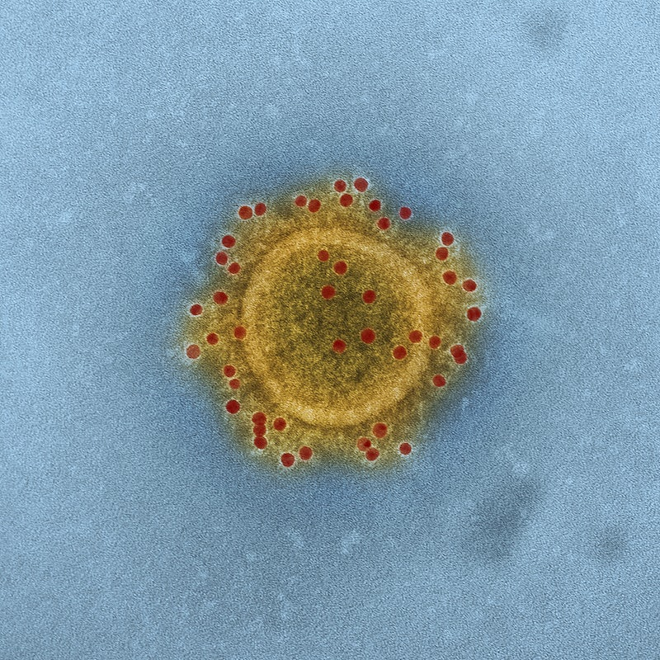
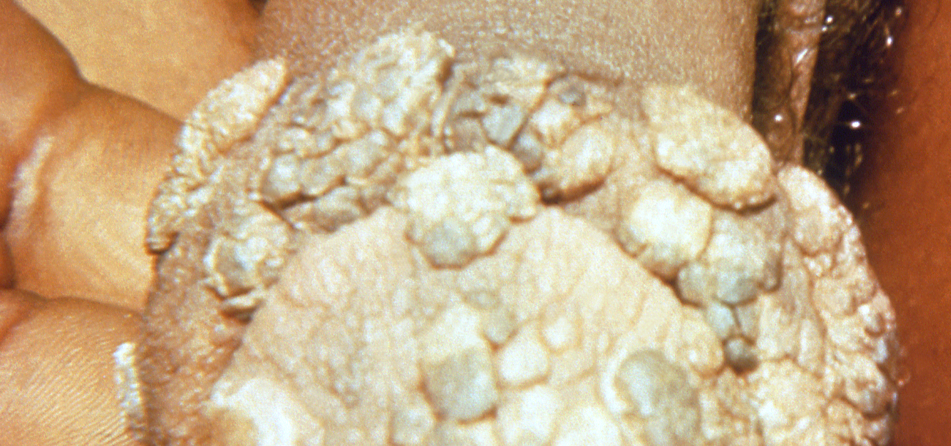
Article 4: HPV
3 minutes
The disease: Genital warts and/or cancer.
How does it feel? People who are infected with HPV might have genital or skin warts, but people can also have no symptoms so may not know they are infected.
What is severe disease like? People infected with certain types of HPV for along time with no treatment can develop cervical cancer, penile cancer, head and neck cancer, and anal cancer. Approximately 99% of all cervical cancers are caused by HPV.
How does it spread? HPV is incredibly common - most people in unvaccinated populations will get some type of HPV in their life. It is spread through skin-to-skin contact of the gential area, including penetrative and oral sex.

Slide 38
Article 4: HPV
3 minutes
Who is at risk of getting it? People who have weak immune systems or are HIV positive are at higher risk of HPV infection ,as well as people with high-risk behaviours, such as having multiple sexual partners.
Why does it matter in prisons? Previous studies have found that rates of cervical cancer are approximately 100 times higher in prisons than in the general community. Risk factors to HPV infection overlap with risk factors for incarceration (high-risk behaviours such as having multiple sex partners, being HIV positive, smoking). Furthermore, national HPV screening programmes, which can detect HPV before it causes cancer, are often not available to women living in prison.
How effective is the vaccine? Vaccination is 99% effective in preventing cervical cancer and cell changes which could lead to cancers, and genital warts. The vaccine schedule can require between one and three doses, depending on your country.
How safe is the vaccine? The HPV vaccine is a very safe vaccine. Common side effects include soreness where the needle went in, a slightly raised temperature and a headache. Serious side effects include hives and difficulty breathing and are rare (about 1 in 10,000).
Did you know?
There are over 100 different strains of the HPV virus. Some of these cause genital warts, others skin warts, and others are linked to cancer. Some cause no disease at all.

Slide 39
Article 5. Influenza
3 minutes
Influenza, usually referred to as the flu, is a disease which is usually most widespread in the winter. It can range from a mild flu symptoms such as a cough, headaches and chills, to fatal pneumonia, depending on the person who gets sick. It is a very important disease which puts a huge strain on national health systems worldwide in the winter months. As such, it is very important to ensure high vaccination rates in those most vulnerable to severe flu symptoms in order to protect them.
Influenza is a virus which is constantly changing. This is why we need to get a different vaccine every year, as this vaccine is changed every year to protect against the strains predicted to be circulating in that year’s flu season. Prisons are an environment where the flu can spread very easily. This is because prisons are usually crowded without much ventilation or fresh air. Also, people living in prisons are often more likely to have severe complications from the flu because of their age or underlying health conditions.

Slide 40
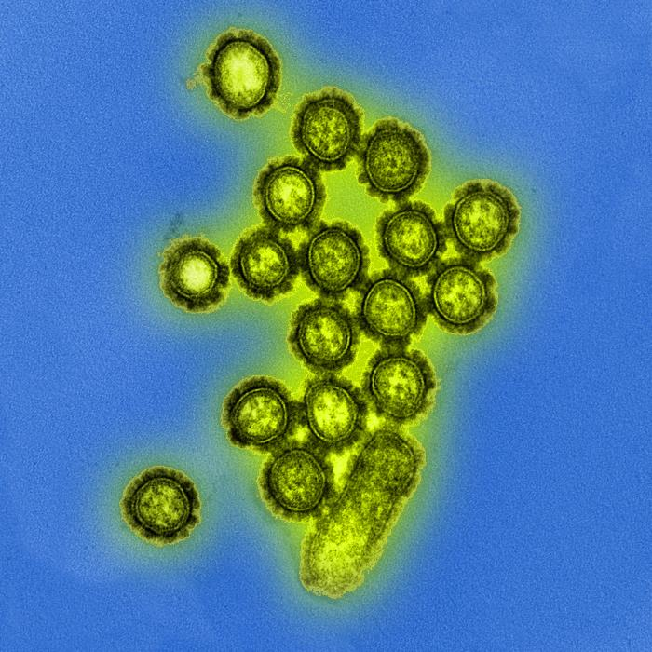
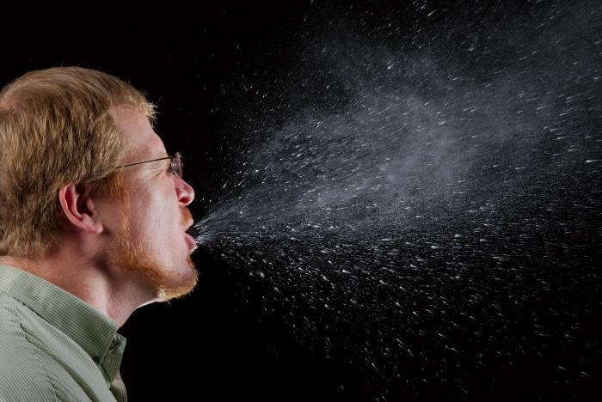
Article 5. Influenza
3 minutes
The disease: Flu
How does it feel? People who have the flu can have a sudden high temperature, an aching body, feel tired or exhausted, a dry cough, sore throat, headache, difficulty sleeping and loss of appetite, diarrhoea or tummy pain, feeling sick and being sick.
What is severe disease like? People who are very ill can develop pneumonia and may die. Influenza is responsible for 290 000 to 650 000 deaths every year.
How does it spread? Flu spreads through contact with coughs and sneezes of an infected person. The influenza virus can live on surfaces and hands for 24 hours. Infected people can avoid spreading it by washing their hands and covering their mouth with a tissue when coughing.

Slide 41
Article 5. Influenza
3 minutes
Who is at risk of getting it? Everyone is at risk of getting flu, but some people at more at risk of serious complications, succ as older adults, young children, people with long-term health conditions or a weak immune system.
Why does it matter in prisons? Because of the close living conditions (such as sharing of cells) and bad ventilation in prisons, infections which spread through the air, such as flu, can spread very quickly in prisons. When staff members become sick in the winter months from flu, staff members have to take time off work, which increases pressure on remaining colleagues to run the prison safely.
What vaccines are there against influenza? The flu vaccine changes every year. There are several different types of flu vaccine available. Which vaccine is given depends on age and current recommendations. It can be given as an injection or, less commonly, as a spray up the nose.
How effective is the vaccine? Vaccination effectiveness differs every year depending on which flu strains are circulating, but is generally around 50%. One dose of influenza vaccine is required on a yearly basis.
How safe is the vaccine? The flu vaccine is a very safe vaccine. Common side effects include soreness where the needle went in, a slightly raised temperature and muscle aches.
Did you know?
The World Health Organisation (WHO) makes recommendations for the strains to be included in the flu vaccine each year based on advice from an international group of experts who constantly analyse flu activity and monitor different winter flu seasons across the world.

Slide 42
Article 6. COVID-19
3 minutes
COVID-19 is a disease which first appeared in 2019. It went on to spread throughout the world and cause a global pandemic which brought many countries to a halt as people had to stay in their homes and socially distance themselves from others. Vaccines which are very effective against severe forms of the disease were rapidly developed by scientists everywhere and have allowed the world to go ‘back to normal’ for the most part.
COVID-19 can very easily spread in prisons because of the crowded living conditions and poor ventilation. As such, it is important to maintain a high level of protection in prisons.

Slide 43
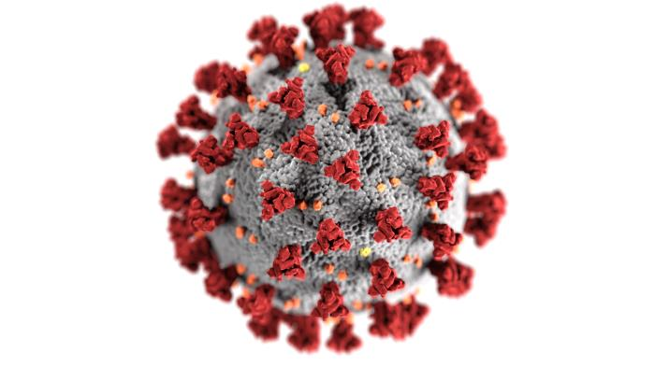
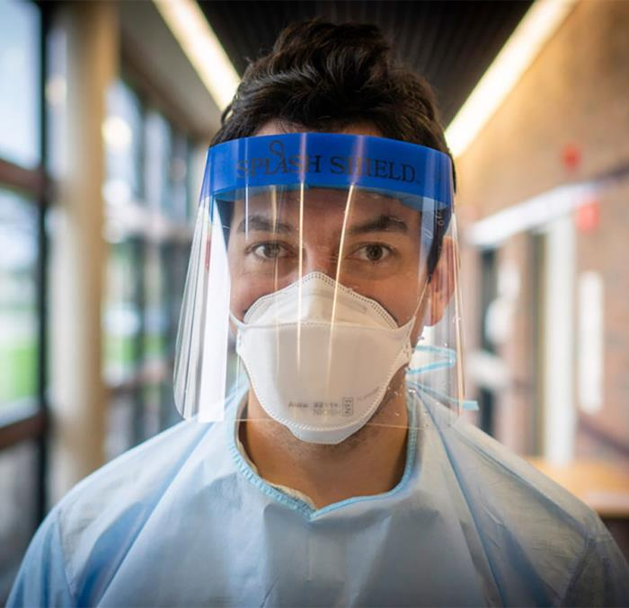
Article 6. COVID-19
3 minutes
The disease: COVID-19
How does it feel? People who have COVID-19 can have a high temperature, cough, sore throat and headache, feel tired, have aches and pains in their body, or lose their sense of taste or smell.
What is severe disease like? People who get very ill with COVID-19 may have difficulty breathing, shortness of breath, chest pain, loss of speech or mobility, or be confused. In these cases, people can die from COVID-19. A long-term complication of COVID-19 is long COVID, which includes symptoms such as shortness of breath, ‘brain fog’, and fatigue.
How does it spread? COVID-19 can spread through contact with coughs or sneezes of infected people, and from being in confined spaces with an infected person for a long time.

Slide 44
Article 6. COVID-19
3 minutes
Who is at risk of getting it? Everyone is at risk of getting COVID-19, but some people at more at risk of serious complications, such as older adults, people with weakened immune systems, and people with health conditions such as diabetes or heart problems.
Why does it matter in prisons? Because of the close living conditions (such as sharing of cells) and bad ventilation in prisons, infections which spread through the air, such as COVID-19, can spread very quickly in prisons. When staff members become sick in the winter months from COVID-19, staff members have to take time off work, which increases pressure on remaining colleagues to run the prison safely.
What vaccines are there against COVID-19? Several different COVID-19 vaccines have been developed and licensed for use, and different vaccines have been used in different countries.
How effective is the vaccine? Vaccination effectiveness varies between vaccine types and depends on which COVID-19 variant is circulating. COVID-19 vaccines are between 70% - 100% effective at preventing severe disease or hospitalisation. However, immunity from the vaccine isn’t long lasting and needs to be boosted with booster doses of the vaccine.
How safe is the vaccine? Common side effects include redness, hardness or swelling where the needle went in, feeling tired, headaches, aches, mild flu-like symptoms. More serious or long-lasting side effects to COVID-19 vaccines are possible but extremely rare.
Did you know?
COVID-19 has two characteristics which led to it causing a pandemic: it is both very transmissible and can cause very severe disease. This means it spreads quickly through the population, and can lead to very severe disease or death, meaning it is very important we protect ourselves from the disease.

Slide 45
Article 7. Want to learn more?
1 minute
If you would like to know more about the following topics, you can read more about them here:
What are viruses and bacteria?
How does our immune system work?
What are vaccines and how do they work?
How is safety and effectiveness of vaccines assessed and monitored?

Slide 46
Article 7. Want to learn more?
5 minutes
Every country has a slightly different vaccination schedule, chosen by national experts and scientific advisors according to which diseases are more common in their countries and which vaccines they choose to offer. This schedule explains at what age babies, children and adults should receive their vaccinations. If you want to learn more about your country’s vaccination schedule, click through the links on the left to access your country’s vaccination schedule.

Slide 47
Article 7. Want to learn more?
1 minute
If you’d like to know more about other vaccines and the disease they can prevent, click below to learn more about:
MMR (Measles, Mumps and Rubella)
Diphtheria, Pertussis and Tetanus
Polio
Pneumococcal Disease
Meningococcal Disease

Slide 48
3 minutes
Assessment: quiz
Which of the following statements is true?
People living in prison are more likely to be frequent needle users, which increases their risk of getting hepatitis B.
People living in prison are more likely to get infected with diseases transmitted through the air like COVID-19 or flu because prisons are often overcrowded and badly ventilated.
People living in prison are less likely to be vaccinated because of poor access to healthcare systems before prison entry and whilst living in prison.
All of the above.
People working in prison are at higher risk of infections than the general population, and could pass these on to their families or close ones. (True/False)

Slide 49
5 minutes
Assessment: quiz
3. Vaccination only protects individuals from diseases and not others around them. (True/False)
4. Vaccinating yourself can prevent infection
For yourself
For the people you work with
For your family and friends
For the community at large
All of the above
5. Flu vaccination only is only beneficial for people living in prison to stop them from getting sick. (True/False)
6. Do you have access to your vaccination records? Do you know where to access them? If so, click on your national vaccination schedule to check if you are up to date with your vaccines or not. [open answer]

Slide 50
Assessment: quiz (answers)
All of the above: people living in prison are more likely to have come into contact with hepatitis B because of sharing needles with other people who might be infected. Outbreaks of diseases such as flu are more likely to happen in prison because the buildings often have bad air circulation (ventilation) and are very crowded. Finally, people living in prison are more likely to have come from background where they have had poor access to healthcare systems than the general community.
True. Prison staff are likely to come into contact with more infectious diseases than other professions because of how closely they work with other people (both staff and people living in prison). On top of this, prisons are already environments where diseases such as flu or hepatitis B are likely to be circulating. If they are not vaccinated, prison staff can transmit these diseases to their family and friends, as well as anyone else they know or meet outside of prison.
False. Vaccination can protect you from disease, but can also stop you from passing the disease on to someone else, thereby protecting them.
All of the above. Vaccination can help you protect everyone in the community from infectious diseases, including yourself.
False. There are higher levels of staff absences during winter months when flu levels are high. By getting vaccinated against the flu, you can protect yourself by making sure you don’t get sick. You can also make sure that you don’t have to take long amounts of time off work because you are sick, which will put less pressure on your colleagues at work.

Slide 51
2. Effective Vaccine Communication
[1 hour 45 minutes]

Slide 52
Article 1. How to communicate on vaccines effectively
5 minutes
Communication strategies are incredibly important when discussing vaccination. Vaccines can seem threatening, invasive or unnecessary to many people. It is important to acknowledge this when discussing vaccinations. People living in prison in particular may have different preconceptions or beliefs about vaccination which are important to address. Some key concepts when communicating on vaccines are:
Communicate what has been achieved: vaccines have prevented millions of deaths across the world. We must carry on vaccinating to continue to do so.
Don’t repeat vaccine myths: this can inadvertently reinforce the misinformation which you want to correct.

Slide 53
Article 1. How to communicate on vaccines effectively
5 minutes
Use inclusive terms: using terms such as ‘we as members of the community’ or ‘we as people living and working in this prison’ can make people living in prison more receptive to your message.
Underline scientific consensus: reminding people that the large majority of scientists advocate for the safety and efficacy of vaccines can further increase confidence in vaccines.
Keep key messages simple: do not use acronyms and use plain language to explain your point - this should take less than thirty seconds and be easy to remember.
Tell the truth: dishonesty will lead to distrust. It is always important to be open and transparents about things you don’t know, or things scientific authorities don’t know. For example, it isn’t true to say that vaccines are 100% safe because we know they may cause side-effects; but it is true to say that the benefits of vaccination far outweigh any risks.

Slide 54
Article 1. How to communicate on vaccines effectively
4 minutes
Below is a video from Paula, who works for the Prison Reform Trust in the UK and has lived experience of imprisonment. She talks us through what she considers to be effective communication strategies around vaccinations for people living in prisons.

Slide 55
Article 2. Ten Key Vaccine Facts
1 minute
Below are ten key facts about vaccination which are key to bear in mind when talking about vaccination.

Slide 56
Article 2. Ten Key Vaccine Facts
3 minutes
Vaccination helps save lives. Smallpox was one of the most devastating diseases known to humanity and caused millions of deaths before vaccination was invented. It is believed to have existed for at least 3000 years. Since 1980, thanks to vaccination, smallpox no longer exists.
Vaccination can protect others as well as you. Some people have weaker immune systems, for example because of cancer treatment or HIV. They are more at risk of infection and serious disease should they become infected. By getting vaccinated, you can stop diseases spreading through the community to them and potentially save their lives.

Slide 57
Article 2. Ten Key Vaccine Facts
3 minutes
Vaccinations can almost always be caught up if they were missed in childhood. Vaccination schedules are important; children are often at risk of serious consequences from infectious diseases, so it’s important to gain immunity to these early through vaccination. However, it is almost never too late to receive vaccinations.
Vaccines provide us with a safe way to gain immunity to diseases. Immunity to diseases can also be gained by getting infected, getting sick and recovering from the disease - however the risk of serious consequences is far higher from getting the disease than from getting vaccinated.

Slide 58
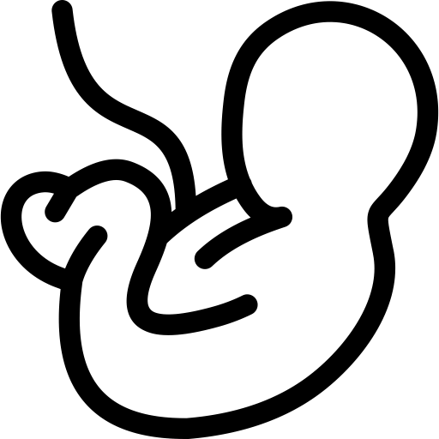
Article 2. Ten Key Vaccine Facts
3 minutes
Vaccines are very important in pregnant people. Getting vaccinated during pregnancy is important to stop certain diseases from infecting the foetus. Infections during pregnancy can result in lifelong complication for children when they are born. Pregnant people can also be at greater risk of getting severely ill from diseases such as COVID-19 or flu.
Vaccine schedules, on average, take up about 0.1% of a baby’s capacity to deal with pathogens. On average, children can mount immune responses to about 10,000 different pathogen molecules; a normal childhood vaccine schedule involves exposure to about 126.

Slide 59
Article 2. Ten Key Vaccine Facts
3 minutes
Vaccinations have been around for a long time. The first vaccine was discovered in 1796. Since then vaccines have undergone revolutionary changes in their development and testing. Now, at least 25 diseases are preventable thanks to vaccines.
Vaccination is considered to be the most cost-effective life-saving intervention in recent history after clean water. This means, after water, it is the intervention that has saved the most lives per £ / € / L spent on it.

Slide 60
Article 2. Ten Key Vaccine Facts
3 minutes
Vaccines are mostly made up of water. To learn more about what else is usually in a vaccine, click here.
The safety and effectiveness of vaccines is rigorously assessed throughout the vaccine manufacturing process. There are many steps which a vaccine must go through before it is approved for use.

Slide 61
Article 3. Common vaccine perceptions and how to address them
3 minutes
Distorted risk-perception: people living in prison may view risk differently to many other people in the community. This means that they may see things as more or less dangerous, or threatening, than others would. Here are two examples of how this could related to vaccinations:

Slide 62
Article 3. Common vaccine perceptions and how to address them
3 minutes
‘I have been through many hard things in my life. I will take the risk of getting infected with the disease rather than getting the vaccine, as I know that I will be fine and not get sick.’
This person does not think that diseases which can be prevented by vaccines pose any threat to them. As such, they would be rather get the disease and fight it off themselves rather than get the vaccine.
Thanks to vaccines, some diseases which were previously very common are now quite rare. This means that day-to-day, we don’t see how dangerous these diseases can actually be. However, these diseases are still very serious if people are not protected through vaccination; for example, following a drop in MMR vaccination, deaths from measles significantly increased around 2018.
1 in 5000 people who get measles are likely to die. This risk is very high. Whilst we can’t ever say that a vaccine is risk-free as we know if may cause some side effects, the benefits of being protected against very serious diseases such as measles through vaccination far outweigh the risks.

Slide 63
Article 3. Common vaccine perceptions and how to address them
3 minutes
‘Bad things always happen to me, I’ve been incredibly unlucky so far in my life. If there are side effects to a vaccine, I’m sure I will be one of the unlucky people to get them.’
This person feels they will be the person to suffer from vaccine side effects, because they feel they have had a lot of bad luck throughout their life - which has eventually led to them living in prison.
Vaccines go through many tests before they are licensed to check they are safe. After they are licensed, they are monitored and their safety continues to be tested. This means that even if a vaccine has been in use for over twenty years, it is still being monitored for side effects.
I understand why you might feel this way and think this might be the case. However, vaccines are a very low-risk way of protecting ourselves from very high-risk and serious diseases.

Slide 64
Article 3. Common vaccine perceptions and how to address them
3 minutes
Distrust: people’s general mistrust of authorities and those whom they perceive to be working for authorities is a common underlying feeling in vaccine hesitancy. This can include a general perception that vaccination is used as a tool for powerful people to oppress disadvantaged groups. When people have felt mistreated by authorities, for example in prisons, it is important to understand why people don’t trust authorities.

Slide 65
Article 3. Common vaccine perceptions and how to address them
3 minutes
‘Vaccination is used by powerful people to oppress marginalised groups in society’
It is important to listen to concerns amongst marginalised populations such as people living in prison, and acknowledge historical events when this population has been marginalised and has suffered as a consequence.
Infectious disease often affect marginalised groups in society, such as people living in prisons, people experiencing homelessness, or asylum seekers, more than the general community. Declining vaccination can worsen health inequalities and increases the levels of infectious disease experienced by these groups. Taking up vaccination is an empowering step towards breaking down barriers between these groups and the rest of society.
I understand why you might feel this way, as often in the past, people living in prison have not been treated in the same way as the general community. However, by refusing vaccination, you are denying yourself your right to health. Not being vaccinated will make you more likely to get ill and be unwell, and pass illnesses onto other people in your community, making them ill too.

Slide 66
Article 3. Common vaccine perceptions and how to address them
3 minutes
Conspiracy theories: Often, conspiracy theories can become more common when people fear that they may be losing control because of a certain events. They exist to explain the facts of a situation in a way which is different to the accepted norm. They also focus blame on a specific group of people. People may choose to follow conspiracy theories in order to escape inconvenient facts.

Slide 67
Article 3. Common vaccine perceptions and how to address them
3 minutes
‘Pharmaceutical companies are only interested in making money and are not trying to help people’
Most of the basic research into the early stages of vaccine development involves universities and independent researchers. Vaccines are scrutinised by doctors and independent scientific experts, as well as government health officials, before they are approved and licensed. Pharmaceutical companies, like all private companies, must make financial profit to continue to work effectively. However, vaccines which are not safe will not be licensed by governments, and so pharmaceutical companies would not be able to make a profit on unsafe vaccines. It is in their interest to produce safe vaccines which will protect people from disease.

Slide 68
Article 3. Common vaccine perceptions and how to address them
3 minutes
‘Vaccinations are made to harm marginalised groups like people in prisons.’
Marginalised groups often experience health inequalities, such as lower access to healthcare services, treatments or testing. This means that people in these groups are often more affected by infectious diseases than the general community. People living and working in prisons are among those who can benefit most from getting vaccinated, because they are more often exposed to infectious disease than the rest of the population. States have an obligation to ensure that vaccines are safe, accessible and affordable to all who need them.

Slide 69
Article 3. Common vaccine perceptions and how to address them
3 minutes
Reactance: reactance describes a person’s tendency to defend their freedom and autonomy when they feel that others are trying to impose their will on them, for example through health advice or vaccination.
People living in prison are likely to be more sensitive around their freedom and anything which might be infringing on it due to the fact that their liberty has already been restricted by the state. Arguments relating to reactance may therefore be common in this group.

Slide 70
Article 3. Common vaccine perceptions and how to address them
3 minutes
‘I reject vaccines because it is my choice and I am free to do so.Vaccination violates my right to decide what goes into my body.’
It is important to acknowledge people’s right to decide on their medical care. People should not be coerced or forced into medical decisions, including vaccination.
It is your right to make your own decision on your medical care. Choosing to get vaccinated is empowering, as it helps protect you from serious illness. Your choice to get vaccinated also helps you to protect your loved ones and other people close to you from getting sick. By getting vaccinated, you are exercising your human right to health.

Slide 71
Assessment/Reflection
7 minutes
Case study: you are talking to one of the people who lives in the prison you work in. They are telling you that they think that vaccines only exist for big pharmaceutical companies to make money, and that they don’t want to get vaccinated because they are strong enough to fight the disease off naturally. How would you answer them?

Slide 72
Assessment/Reflection: Suggested Answer
Suggested answer: It’s important start by reassuring whoever you are having this conversation with first, and listening to what they have to say. Always approach the conversation openly and without judging. You can explain that vaccines are developed by pharmaceutical companies but it is independent scientist, and national governments who make the final decision on whether it will be licensed or not. As such, pharmaceutical companies will only be able to sell vaccines which are safe and effective at stopping disease. Pharmaceutical companies will make financial profit from vaccines, but ultimately vaccines are developed to protect us from diseases and save lives. If they weren’t necessary, the government wouldn’t recommend that we get them.
Vaccines have worked really well to decrease levels of disease in the population. This means that we often don’t see the real effects of diseases which can be prevent by vaccines, like measles. This makes them seem harmless or not threatening. However, without vaccination, more people would die from diseases like measles. It’s estimated that one in 5000 people who get measles will die. So these diseases are very serious and can be deadly if we don’t protect ourselves through vaccination.

Slide 73
Article 4. Useful Resources
3 minutes
Vaccine communication:
More attitude roots and how to address them (Jitsuvax)
How to respond to vocal vaccine deniers in public (WHO)
Vaccine information:
Guide to COVID-19 vaccinations (British Society for Immunology)
Oxford Vaccine Knowledge Project
Vaccine resources, including translations (British Society for Immunology)
Vaccines Explained (WHO)
COVID-19 Vaccines Explained (Wellcome)

Slide 74
Assessment: final quiz
4 minutes
Which of the following factors make people living in prison more likely to be vulnerable to infectious diseases before entering prison?
Shared or unclean needle use
Higher prevalence of homelessness
Limited access to health education
All of the above
Name some of the living conditions in prison which make people living in prison more likely to be vulnerable to infectious diseases. [open answer]
Which disease in particular is more likely to spread through shared or unclean needle use (from injecting drugs or tattooing, for example)?
Hepatitis B
Influenza
COVID-19

Slide 75
Assessment: final quiz
4 minutes
4. Prison staff are not affected by higher levels of infectious diseases circulating in prison. (True/False)
5. Vaccination can help protect not only individuals, but also their family, visitors, and the rest of community at large. (True/False)
6. How can hepatitis B spread?
Through unprotected sex
Through fights in prison involving blood or biting
Through tattoos done using unclean needles
Through sharing needles with others who who have hepatitis B infection
All of the above

Slide 76
Assessment: final quiz
4 minutes
7. HPV infection can have no symptoms, meaning individuals might not know they are infected. (True/False)
8. HPV only causes cervical cancer and so does not affect men. (True/False)
9. Why does flu (influenza) spread more quickly in prisons?
Because many people living in prisons are men.
Because people living in prison live very close together, often sharing cells with poor air circulation (ventilation).
Because prisons are often cold.

Slide 77
Assessment: final quiz
4 minutes
10. Pregnant people can protect themselves as well as their unborn child from some diseases by getting vaccinated. (True/False)
11. Which of the following are effective communication strategies when talking about vaccines?
Using inclusive terms (‘we’ instead of ‘you’)
Keeping key message simple
Telling the truth
Not repeating vaccine myths
All of the above
12. People living in prison may perceive vaccine side-effects as being riskier than they actually are, or diseases as being less risky than they actually are. (True/False)

Slide 78
Assessment: final quiz
4 minutes
13. When people express a distrust of authorities or governments, it is important to…
Be reassuring and open to listen to their opinion
Tell them they are wrong
Ignore them
14. Conspiracy theories are often popular when…
People are happy
People fear they are losing control of a situation
People go on the internet a lot

Slide 79
Assessment: discussion group
Organise a discussion group with other staff members in your prison, including with a member of medical staff. Discuss any questions you might have about vaccines and diseases in prisons, and which communication strategies you think might be most effective and you could implement in your prison. Does your prison have high vaccination rates? If not, could you work together to improve this?

Slide 80
Assessment: reflective exercise
10 minutes
What do you feel you have learned from this course? What did you not know before which has surprised you? Would you like to learn more about vaccinations in prison, or in general? [open answer]

Slide 81
Assessment: final quiz (answers)
All of the above. Shared or unclean needle use, homelessness and limited access to health education are all more common in people living in prison before they enter prisons - although this does not mean all people living in prison will have lived through these things before coming into prison. Other factors from before entering prison which can make people living in prisons more likely to be vulnerable to infectious diseases include limited access to healthcare services, unprotected sex, poor hygiene (linked to homelessness), contaminated drug use or underlying health conditions.
Poor ventilation (air circulation), overcrowding, sharing of cells, showers and toilets, contaminated drug use, high turnover of people, unprotected sex, limited access to health care, limited access to health education, shared or unclean needle use, or poor hygiene all make infectious diseases more likely in prisons.
Hepatitis B spreads through contact of bodily fluids - this could be during unprotected sex, shared needle use, or for example during bloody fights, when biting or contact of blood might occur.

Slide 82
Assessment: final quiz (answers)
4. False. Higher levels of infectious diseases circulating in prisons mean prison staff are more likely to come into contact with infectious disease than people who don’t work or live in prisons. Vaccination can offer protection against many of these diseases.
5. True. Vaccination can stop the spread of disease, meaning that people working in prison are less likely to infect their family or friends if they are vaccinated. Similarly, people living in prison can also prevent spreading any infections to their visitors or family through vaccination. Also, prison staff can ensure they don’t bring any infections from outside the prison into the prison population if they are vaccinated, protecting the people they work with.
6. Hepatitis B spreads through contact of bodily fluids - this could be during unprotected sex, shared needle use, or for example during bloody fights, when biting or contact of blood might occur.

Slide 83
Assessment: final quiz (answers)
7. True. HPV infection can cause genital warts or skin warts, but often it doesn’t have any symptoms. If HPV infection isn’t detected and treated for a long time, it can develop into cancer. Vaccination helps protect against infection with HPV.
8. False. HPV causes the large majority of cervical cancer (around 99%). However, it can also cause head and neck cancer, penile cancer and anal cancer.
9. Because people living in prison live very close together, often sharing cells with bad air circulation (ventilation). These living conditions mean that diseases which spread through the air, such as COVID-19 and flu, can spread a lot quicker and easier in prisons, infecting more people.

Slide 84
Assessment: final quiz (answers)
10. True. Vaccination against diseases such as flu and pertussis is recommended during pregnancy to help protect both the pregnant person and the unborn child from these infections and their complications.
11. All of the above. All of these strategies are important when talking about vaccines to create an open environment for conversation and discussion. It is important to keep message simple and understandable, to never lie (always check information instead of guessing if you’re not sure), and to not repeat vaccine myths, as repetition can reinforce the belief in people’s minds.
12. True. Anyone can have distorted risk-perception, but this could be particularly common in people living in prison - presenting itself either as ‘I am strong enough to fight off the disease myself without the help of vaccines’ or ‘I will be the unlucky person to suffer from a vaccine side effect’.

Slide 85
Assessment: final quiz (answers)
13. Be reassuring and open to listen to their opinion. This is an important first step in any conversation about vaccines - as Paula said in the video, always approach the discussion as an open conversation, never judging or shutting down opinions expressed by people.
14. People fear they are losing control of a situation. This is most commonly when conspiracy theories tend to take hold - when an alternative explanation can make sense of a set of inconvenient or uncomfortable facts or events. These alternative explanations often lay blame for situations on groups of people in power, for example.

Slide 86
Conclusion
3 minutes
Thank you for your time and interest in this course! We hope you have learned a lot about vaccinations and their importance in prisons. The resources page is available if you would like to read more about vaccines in your own time.
We would really appreciate any feedback you have on this course: what you would change, what you enjoyed, and anything we may have missed. We will be working to improve this course with your feedback!
Opportunity for feedback
(built-in FutureLearn feedback tool)

Slide 87
IMPORTANT INFORMATION FOR NON-CLINICAL STAFF

Slide 88
2. The Immune System & Vaccines
[105 minutes]

Slide 89
Course description: Module content
1 minute
In this module, we will cover…
What are viruses and bacteria
Introduction to the immune system
What are vaccines and how do they work
Vaccine Schedules in RISE-Vac countries
How is safety and effectiveness of vaccines assessed and monitored

Slide 90
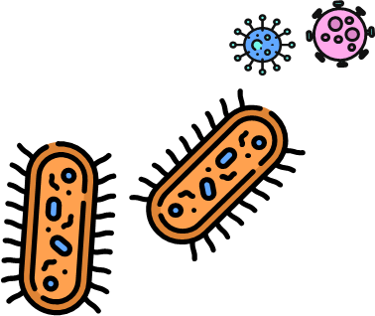
Article 1. What are viruses and bacteria?
1 minute

Slide 91
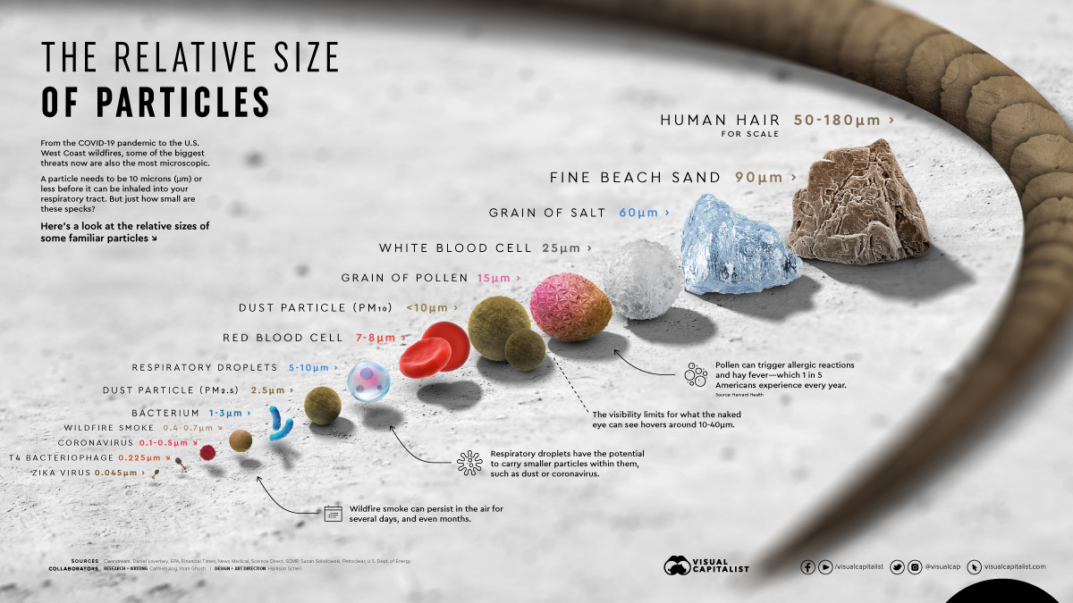
Article 1. Viruses and bacteria
3 minutes
Viruses and bacteria are infectious agents which are so small that they can only be seen under a microscope. Both viruses and bacteria are usually smaller than human cells. A scale of a human hair down to a virus is represented below. Viruses are usually smaller than bacteria.

Slide 92
Article 1 Viruses and bacteria
3 minutes
Bacteria and viruses don’t always cause disease. In fact, over 70% of bacteria do not cause disease and can be incredibly useful to us. For example, some bacteria turn milk into yoghurt. There are also trillions of bacteria living in our gut, skin or mouth which help us digest food and kill other bacteria.

Slide 93
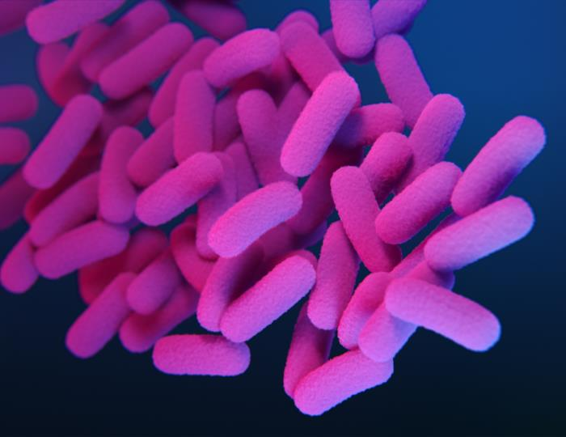
Article 1 Viruses and bacteria
3 minutes
However, certain types of bacteria and viruses, called pathogens can cause infection. During an infection, pathogens damage the cells in our body, which can cause symptoms like fever or sore throat. We can come into contact with these pathogens almost anywhere - they may be on surfaces which we touch, in food we eat, in the air we breathe or in other people’s bodily fluids.
Virus
Bacteria

Slide 94
Assessment: quiz
7 minutes
Viruses are usually smaller than bacteria. (True/False)
70% of bacteria causes serious disease. (True/False)
Some bacteria are beneficial to humans and help us (True/False)
Pathogens can cause infections and disease in humans (True/False)

Slide 95
Assessment: quiz (answers)
True! Viruses are always almost smaller than bacteria - and both viruses and bacteria are far smaller than human cells. They are all too small to be seen with the naked eye. Some viruses are so small that they can actually infect bacteria!
False. 70% of bacteria don't cause disease - these bacteria can even be beneficial to us, like the ones living in our gut or that turn milk into yoghurt.
True! We have trillions of bacteria living in our intestines, stomachs, on our skin... The bacteria in our intestines help us digits certain foods more effectively, and even help us gain certain nutrients from food we otherwise wouldn't get!
True! Not all bacteria and viruses cause disease, but the ones that do are grouped together under the term 'pathogens'.

Slide 96
Article 2 The immune system
3 minutes
Our immune system is made up of cells called white blood cells, such as B cells and T cells. These cells circulate around the body, often in our blood, to detect any intruders, such as viruses and bacteria, and kill them. Our white blood cells protects us against disease.
Virus
White blood cell
Bacteria
White blood cell

Slide 97
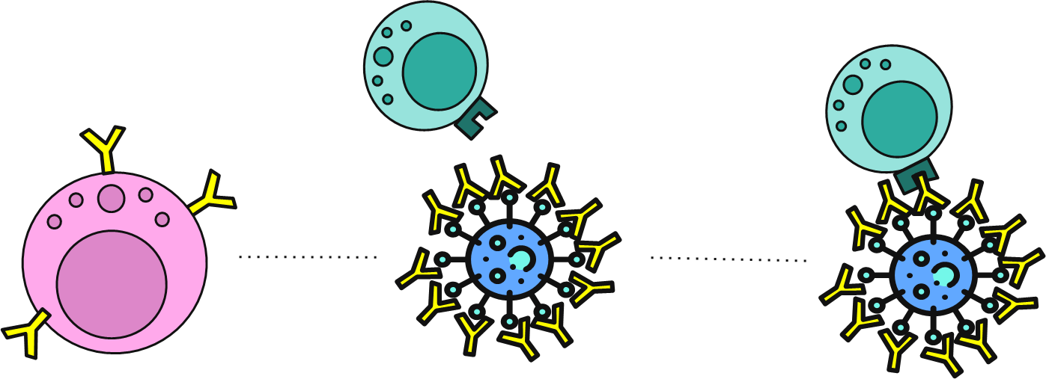
Article 2 The immune system
3 minutes
Once our white blood cells have encountered a specific virus or bacteria once, they are able to remember it. This means that in the future, when the virus or bacteria starts to infect our body again, there is no delay for our white blood cells to develop their specific response. Instead, memory white blood cells are quickly deployed to contain the infection. This quick reaction means we may get less ill. This is described as developing immunity to a pathogen.

Slide 98
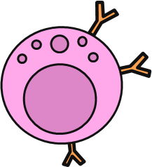
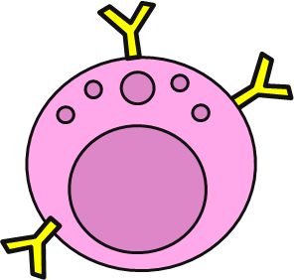
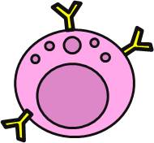
Article 2 The immune system
5 minutes
When our immune cells encounter pathogens that our body has never encountered before, our white blood cells can become overwhelmed and we can become very ill. However, when our immune system has already encountered this pathogen and we have already developed immunity to it, our memory white blood cells are better prepared to successfully fight it off. This immunity means we don’t get as ill as we did when we come into contact with the pathogen the first time. It also means that we are less likely to spread the disease to others around us.
Immunity often doesn’t last all of our lives. Over time, pathogens change, and so if we meet a virus or bacteria that has changed a lot since we last encountered it, we may be less good at recognising it and therefore at fighting it off. Our immune system also ages and becomes less good at recognising pathogens over time.

Slide 99
Assessment: quiz
5 minutes
Immunity to a disease means that we have gotten ill from it previously, and so next time we encounter it, we won’t get as ill because our memory white blood cells are ready to fight it. (True/False)
You’re less likely to transmit a disease to others if you have developed immunity to it. (True/False)
Immunity to a pathogen always lasts for our whole lives. (Trust/False)

Slide 100
Assessment: quiz (answers)
True! Memory white blood cells develop after we encounter pathogens. they roam around our body and are quickly reactivated next time the pathogen appears, ensuring we don't get as ill from the infection.
True! Immunity to a disease means that our immune system is able to contain it more quickly next time it encounters it. This means that the pathogen can't cause severe disease and we're less likely to transmit the disease to others around us.
False. Immunity can last our whole lives in some cases, but often our memory cells will age and become less effective at fighting the disease with time.

Slide 101
Article 3. What are vaccines and how do they work?
3 minutes
As we have just seen, being exposed to a virus or bacteria usually allows us to develop immunity in the form of memory white blood cells, which can protect us quickly in the future when we encounter the same virus or bacteria without getting ill. However, the first time our immune system encounters this virus or bacteria, we may get very ill. In some cases, these symptoms can be very serious and have severe consequences.

Slide 102
Article 3. What are vaccines and how do they work?
3 minutes
Vaccination is the safest way to gain immunity against a pathogen that your body has not encountered yet.
Vaccines contain a harmless form of the pathogen that causes the disease you are being protected, or immunised, against. This can be a dead or very weakened bacteria or virus, or a part of a bacteria or virus that cannot attack your body’s cells. When the cells in your immune system encounter this, they develop specific memory white blood cells against the pathogen. Because only a harmless form of the pathogen is in the vaccine, it can’t destroy your cells or make you very ill, however, you gain immunity against the pathogen, which can protect you from severe disease when you do encounter it in the future.

Slide 103
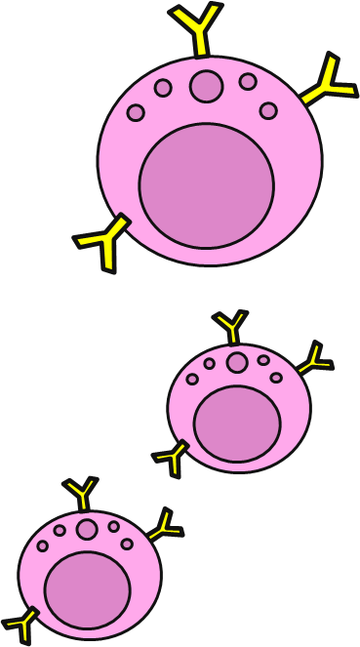
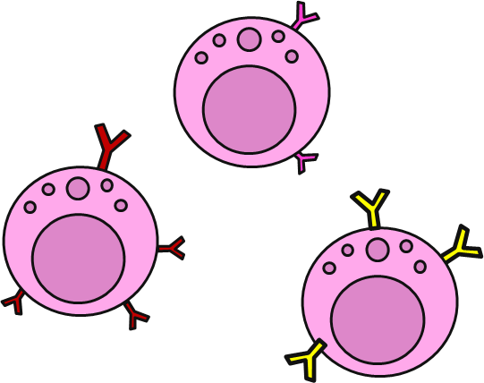
Article 3. What are vaccines and how do they work?
3 minutes
Researchers study viruses and bacteria for a long time before selecting key ingredients to put in the vaccine. Sometimes, these are proteins from the outside of the pathogens. Sometimes, they kill the bacteria or virus, so that only the outside shell of the virus or bacteria remains. These chosen parts of virus or bacteria cannot cause any disease, but they can be recognised by our immune system to help build up our specific defenses and memory white blood cells.

Slide 104
Article 3. What are vaccines and how do they work?
5 minutes
Vaccines contain a few different ingredients to ensure they are able to trigger a reaction from our body, and that they remain effective and stable over their shelf life. These are the ingredients which make up a vaccine:
Water
The main ingredient.
Preservatives and stabilisers
Maintain vaccine quality, safe storage and prevent contamination.
Active ingredient
A very small amount of a harmless form of the bacteria or virus you are immunising against.
Adjuvant
Help vaccine work better by creating a stronger immune response to the vaccine. Only found in some vaccines. Pose no risk to health in the very small quantities used.
Residual traces
…of substances that have been used during vaccine manufacture, measured as parts per million or billion in the final vaccines.

Slide 105
Water
The main ingredient.
Preservatives and stabilisers
Maintain vaccine quality, safe storage and prevent contamination.
Active ingredient
A very small amount of a harmless form of the bacteria or virus you are immunising against.
Adjuvant
Help vaccine work better by creating a stronger immune response to the vaccine. Only found in some vaccines. Pose no risk to health in the very small quantities used.
Residual traces
…of substances that have been used during vaccine manufacture, measured as parts per million or billion in the final vaccines.

Slide 106
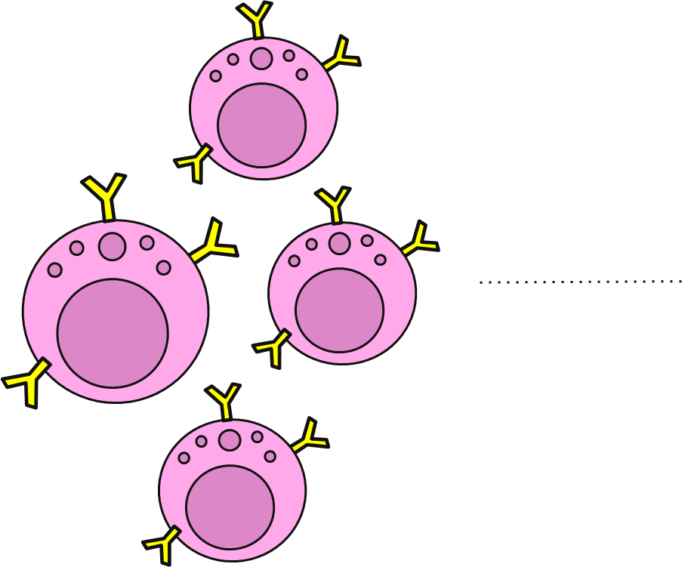
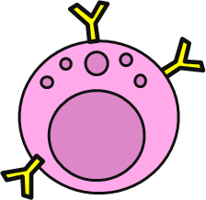
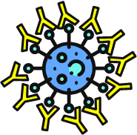
Article 3. What are vaccines and how do they work?
3 minutes
This means that next time your immune cells encounter the virus or bacteria, for example if someone who is ill coughs or sneezes near you, your memory white blood cells can immediately produce antibodies to contain the virus or bacteria, prevent serious infection and stop you from getting ill. As well as not getting ill, you also become less likely to pass the disease onto others around you.

Slide 107
Article 3. What are vaccines and how do they work?
3 minutes
Because immunity is not often life-long, depending on the pathogen we are trying to fight off we may need more than one dose of vaccine over our lifetime. These ‘booster’ doses of vaccines stimulate our specific memory white blood cells and ensure that they are still active in our immune system.
The next section explains the vaccination schedule established in each country to protect us against the most important vaccine-preventable diseases.

Slide 108
Assessment: quiz
7 minutes
Vaccines stimulate your immune system to produce memory white blood cells (True/False)
Vaccines contain the whole pathogen to stimulate your immune system. (True/False)
The main ingredients in vaccines are preservatives and stabilisers. (True/False)
Booster doses of vaccines are only for people with weak immune systems. (True/False)
You’re less likely to transmit a disease to others if you have developed immunity to it. (True/False)

Slide 109
Assessment: quiz (answers)
True! Vaccines stimulate your white blood cells and expose them to a specific pathogen, which will generate memory white blood cells specific to that pathogen.
False. Vaccines never contain the whole pathogen. The pathogen has either been killed beforehand, or only a small fragment of the pathogen is included in the vaccine.
False. The main ingredients in vaccines is water. Preservatives and stabilisers are added to some vaccines where necessary, but only make up a very small amount of the total vaccine.
False. For many diseases, everyone needs booster doses to ensure they can maintain the memory white blood cells and remain immune to the disease. We'll learn more about this in the next section of the course.
True! Because you don't develop severe disease when you're vaccinated, you're far less likely to be able to transmit the disease to other if you have become infected or come into contact with the pathogen.

Slide 110
Article 4. How is safety and effectiveness of vaccines assessed and monitored?
2 minutes
There are many phases which a potential vaccine (called a vaccine ‘candidate’) must pass through before being approved and used in humans. Every vaccine undergoes these tests, also known as trials, before it is licensed. The results and outcomes of these trials are published for anyone to review, and are always reviewed by scientific researchers, as well as independent experts, to ensure that there is no bias in the decision making process. Once a vaccine has been licensed, it is subject to continuous safety monitoring to ensure it is still safe and effective at preventing disease.

Slide 111
Article 4. How is safety and effectiveness of vaccines assessed and monitored?
5 minutes
Step 1: Small-scale studies
Step 2: In vitro non-clinical trials
Step 3: In vivo non-clinical trials
These studies take place in laboratories when researchers are trying to find promising new vaccine candidates. These don’t involve cells, animals or humans.
If the vaccine candidate passes the first studies, it is tested in cells grown in laboratories.
If it is safe and effective in those cells, it is tested in laboratory animals, such as mice or rabbits.
What is being assessed?
Promising activity: Does the vaccine candidate have potential to protect against the disease?
Scalability potential: Could the vaccine candidate be produced in large quantities at pace?
Safety: Is the mechanism of action safe?
Storage: What conditions of storage would the vaccine need?
Promising activity: Does the vaccine candidate trigger the desired immune response?
Safety: Is the vaccine candidate safe for human cells?
Promising activity: Does the vaccine candidate trigger the desired immune response? Does the vaccine protect against disease in animals?
Safety: Is the vaccine candidate safe? Does it cause any side effects? How serious are these?
Dose ranging: What dosage of active ingredient is best for developing immunity whilst remaining safe?

Slide 112
Article 4. How is safety and effectiveness of vaccines assessed and monitored?
5 minutes
Step 4: Phase I clinical trials
Step 5: Phase II clinical trials
Step 6: Phase III clinical trials
These studies usually involve less than one hundred and evaluate a safe dosage range and identify possible side effects.
These studies involve hundreds of volunteers and evaluate vaccines which have been found to be safe in phase I.
These studies involve thousands of volunteers and evaluate vaccines which have been found to be safe in phase II.
What is being assessed?
Safety: Is the vaccine candidate safe? Does it cause any side effects? How serious are these?
Schedule: How many vaccine doses need to be given, and at what age?
Dose ranging: What dosage of active ingredient is best for developing immunity whilst remaining safe?
Safety: Is the vaccine candidate safe? Does it cause any side effects? How serious are these?
Schedule: How many vaccine doses need to be given, and at what age?
Dose ranging: What dosage of active ingredient is best for developing immunity whilst remaining safe?
Safety: Is the vaccine candidate safe? Does it cause any side effects? How serious are these?
Efficacy: How well does the vaccine candidate protect against disease?
Lot consistency : Is every vaccine produced the same?

Slide 113
Article 4. How is safety and effectiveness of vaccines assessed and monitored?
5 minutes
Step 7: Evaluation & decision
Step 8: Commercial manufacturing
Step 9: Continuous monitoring
Independent regulatory boards assess the vaccine safety and efficacy from the trials and decide if it should be licensed.
Production is upscaled to produce vaccine doses on an industrial level.
For the whole of their life course, vaccines are regularly monitored and undergo trials to ensure their safety profile remains acceptable.
What is being assessed?
Safety: Is the vaccine candidate safe? Does it cause any side effects? How serious are these?
Efficacy: How well does the vaccine candidate protect against disease?
Lot consistency: Is every vaccine we produce the same?
Safety: Is the vaccine safe? Does it cause any side effects? How serious are these?
Lot consistency: Is every vaccine we produce the same?
Safety: Is the vaccine safe? Does it cause any side effects? How serious are these?
Lot consistency: Is every vaccine we produce the same?
Effectiveness: How well does the vaccine protect against disease and spread?

Slide 114
Assessment: quiz
5 minutes
Safety is assessed in every stage of vaccine development. (True/False)
The first step in vaccine development is to test the vaccine candidate in animals. (True/False)
Typically how many volunteers are involved in phase II clinical trials?
Hundreds
Under one hundred
Thousands
Vaccines are monitored for their safety and effectiveness for the whole of their shelf life after they are approved for use. (True/False)

Slide 115
Assessment: quiz
True! Safety is an incredibly important aspect of vaccine development. Vaccines are assessed for safety from the very beginning of their research. Safety monitoring continues through every stage of development and after they are licensed and in use in the population.
False. Vaccine candidate are first research in small scale studies and then in cells grown in the lab. Once they have been shown to be safe in these two environments, they are tested in animals to further assess safety and effectiveness.
Hundreds. Less than one hundred volunteers are usually involved in phase I clinical trials. Phase II clinical trials involve hundreds, and phase II trials involve thousands.
True! Vaccines will continue to be monitored and data will continue to be collected on their safety profile and effectiveness at preventing diseases. This data is reviewed by scientists and independent experts who can then publish the results or advise governments if needed.

Slide 116
ADDITIONAL DISEASES

Slide 117
Article 5. MMR
3 minutes
The MMR vaccine protects against three diseases: measles, mumps and rubella. These diseases typically affect children but can also occur in adults. These three diseases are very infectious and caused severe complications and deaths, often in children, before vaccination was introduced.
Vaccination has been very successful at reducing measles, mumps and rubella disease down to very low numbers. However, vaccination rates have fluctuated over the years, and we have seen a significant increases in cases of measles in recent years because of a prolonged period with lower vaccination rates.
As such, it is very important to ensure that protection against measles, mumps and rubella is maintained through vaccination. Because measles is very contagious, measles can quickly and easily spread in prisons, so vaccination is very important to prevent outbreaks.

Slide 118
Article 5. MMR
Measles
3 minutes
The disease: Measles
What causes it? A virus called Measles morbillivirus.
How does it feel? People who have measles can have a high temperature, a runny or blocked nose, be sneezing coughing, have red, sore and watery eyes, have white spots on the inside of their mouth and a rash spreading from the face and behind the ears to the rest of their body.
What is severe disease like? People who are very ill with measles can develop lung infections (pneumonia), brain or nervous system infection (meningitis), can become blindness or have seizures. In these cases, people can die from measles. About 1 in 5000 people who are infected with measles will die.
How does it spread? Measles is very contagious, meaning it can spread very quickly and easily through contact with coughs or sneezes from an infected person, or being in a confined space with an infected person for a long time.

Slide 119
Article 5. MMR
Measles
3 minutes
Who is at risk of getting it? Unvaccinated children and adults, or people with serious long-term health conditions.
Why does it matter in prisons? Because of close living conditions (such as sharing cells) and bad ventilation, infections which spread through the air, such as measles, can spread very quickly in prisons.
What vaccines are there against measles? Measles vaccination is usually given with mumps and rubella in a combined vaccine known as MMR.
How effective is the vaccine? Vaccination is approximately 96% effective at preventing measles. MMR vaccination schedule usually required two doses.
How safe is the vaccine? The MMR vaccine is a very safe vaccine. Common side effects include redness, hardness or swelling where the needle went in and occasionally a fever or rash. There are no reported serious side effects from MMR vaccine, other than the risk of severe allergic reaction (anaphylaxis) which is incredibly rare (estimated about one in a million).
Did you know?
Measles is one of the most infectious diseases we know. On average, one infected person will spread the disease to 9 out of 10 people in their surroundings.

Slide 120
Article 5. MMR
Mumps
3 minutes
The disease: Mumps
What causes it? A virus called Mumps orthorubulavirus.
How does it feel? People who have mumps can have a high temperature, headache, joint pain, or painful swelling in the side of their face under the ears. Some people who are infected many not show any symptoms.
What is severe disease like? People who are very ill can develop meningitis, pancreas infection, swelling of the testicles and low sperm count in men, and deafness. In these cases, people can die from mumps.
How does it spread? Mumps can spread through contact with coughs or sneezes of infected people, and from being in confined spaces with an infected person for a long time.

Slide 121
Article 5. MMR
Mumps
3 minutes
Who is at risk of getting it? Children and adults who are not vaccinated against mumps.
Why does it matter in prisons? Because of the close living conditions (such as sharing of cells) and bad ventilation in prisons, infections which spread through the air, such as mumps, can spread very quickly in prisons.
What vaccines are there against mumps? Mumps vaccination is usually given at the same time as measles, mumps and rubella vaccination as the MMR vaccine.
How effective is the vaccine? Vaccination is approximately 86% effective at preventing mumps. MMR vaccination schedule usually required two doses.
How safe is the vaccine? The MMR vaccine is a very safe vaccine. Common side effects include redness, hardness or swelling where the needle went in and very rarely temporary swelling behind the ears (1% of cases). There are no reported serious side effects from MMR vaccine, other than the risk of severe allergic reaction (anaphylaxis) which is incredibly rare (estimated about one in a million).
Did you know?
Mump often affects testicles in men - usually causing abnormal swelling of one testicle, but sometimes both are affected.

Slide 122
Article 5. MMR
Rubella
3 minutes
The disease: Rubella.
What causes it? A virus called Rubivirus rubellae
How does it feel? People who have rubella will usually have a spotty rash spreading from their face and behind their ears to their neck and body. They could also have aching joints, a high temperature, coughing, sneezing, headaches and a sore throat.
What is severe disease like? People who get very ill from rubella can have brain inflammation and blood disorders. If pregnant people become infected with rubella during early pregnancy, this is very likely to result in severe damage to the foetus.
How does it spread? Rubella can spread through contact with coughs or sneezes of infected people, and from being in confined spaces with an infected person for a long time.

Slide 123
Article 5. MMR
Rubella
3 minutes
Who is at risk of getting it? Unvaccinated children and adults. Unvaccinated pregnant people are at high risk of damage to their foetus if they become infected with rubella.
Why does it matter in prisons? Because of the close living conditions (such as sharing of cells) and bad ventilation in prisons, infections which spread through the air, such as rubella, can spread very quickly in prisons.
What vaccines are there against rubella? Rubella vaccination is usually given at the same time as measles, mumps and rubella vaccination as the MMR vaccine.
How effective is the vaccine? Vaccination is approximately 89% effective at preventing rubella. MMR vaccination schedule usually required two doses.
How safe is the vaccine? The MMR vaccine is a very safe vaccine. Common side effects include redness, hardness or swelling where the needle went in and very rarely temporary joint pain and swelling (1% of cases). There are no reported serious side effects from MMR vaccine, other than the risk of severe allergic reaction (anaphylaxis) which is incredibly rare (estimated about one in a million).
Did you know?
Rubella is also known as ‘German measles’ in some contexts - not because of any association with Germany, but instead the word ‘German’ comes from ‘germanus’, meaning similar. The rash from rubella is similar to that of measles, but they are different diseases.

Slide 124
Article 6. Diphtheria, Pertussis and Tetanus
3 minutes
Vaccination against diphtheria, whooping cough and tetanus is often given in a combined vaccine. In childhood, other vaccines such as Haemophilus influenzae (Hib), hepatitis B and polio may be added to the combination vaccine too.
Diphtheria and whooping cough can spread easily in prison environments due to the poor ventilation and crowded spaces which exist in prisons. Tetanus can easily be contracted from unclean needles or open wounds, which can easily occur in prisons.
We will learn more about these diseases below.

Slide 125
Article 6. Diphtheria, Tetanus and Pertussis
3 minutes
Diphtheria
Disease: Diphtheria.
What causes it? A bacteria called Corynebacterium diphtheriae.
How does it feel? People who have diphtheria can have a high temperature, sore throat, swollen glands in their neck, difficulty breathing and swallowing, and a thick grey-white coating on their throat, nose and tongue. Diphtheria can also cause pus-filled blisters and ulcers.
What is severe disease like? People who are very ill with diphtheria can become paralysed, resulting in difficulty breathing and swallowing. In these cases, people can die from diphtheria.
How does it spread? Diphtheria spreads through coughs and sneezes, and sharing of cups, plates, cutlery, clothing or bedding with an infected person.

Slide 126
Article 6. Diphtheria, Tetanus and Pertussis
3 minutes
Diphtheria
Who is at risk of getting it? People living in conditions with poor hygiene and people who are not vaccinated are most at risk of diphtheria.
Why does it matter in prisons? Due to close living conditions (such as sharing cells) and bad ventilation in prisons, infections which spread through the air, such as diphtheria, can spread very quickly in prisons.
What vaccines are there against diphtheria? Diphtheria vaccine is almost always given in combination with tetanus vaccination. It can also be given in the same shot as polio, pertussis, Haemophilus influenzae, and hepatitis B.
How effective is the vaccine? Vaccination is almost 97% effective at preventing diphtheria. Diphtheria vaccination requires booster doses to maintain protection.
How safe is the vaccine? The diphtheria vaccine is a very safe vaccine. Common side effects include soreness where the needle went in, or the development of a small painless lump which eventually disappears. Serious side effects, which can occur in reaction to any vaccine, include severe allergic reactions such as difficulty breathing. These are incredibly rare (1 in 1,000,000).
Did you know?
In some countries, diphtheria is now rare thanks to high vaccination rates; however, outbreaks still occur regularly, particularly in closed settings such as detention settings.

Slide 127
Article 6. Diphtheria, Tetanus and Pertussis
3 minutes
Whooping cough
Disease: Whooping cough (sometimes referred to as pertussis)
What causes it? A bacteria called Bordetella pertussis.
How does it feel? People who have whooping cough will be sneezing and coughing, and have a runny nose. Whooping cough usually develops into severe coughing attacks, during which people can gag or vomit after coughing.
What is severe disease like? People who are very ill with whooping cough can have problems breathing, develop pneumonia, and brain damage. In these cases, people can die from whooping cough.
How does it spread? Whooping cough spreads through contact with coughs and sneezes of an infected person.

Slide 128
Article 6. Diphtheria, Tetanus and Pertussis
3 minutes
Whooping cough
Who is at risk of getting it? People who smoke, children, older adults, and people who aren’t vaccinated. Babies who are too young to get their vaccination are most at risk.
Why does it matter in prisons? Because of the close living quarters and bad ventilation in prisons, infections which spread through the air, such as whooping cough, can spread very quickly in prisons.
What vaccines are there against whooping cough? There are two types of vaccine against whooping cough - acellular and whole cell. Whooping cough vaccination is usually given at the same time as diphtheria and tetanus. It can also be given in the same vaccine as polio, Haemophilus influenzae, and hepatitis B.
How effective is the vaccine? Both vaccines are very effective at preventing disease. Efficacy of the whole cell vaccine used was found to be 94% against getting whooping cough, and the acellular vaccine is likely to be similar. It is even higher against death from whooping cough. Whooping cough vaccination requires booster doses to maintain protection.
How safe is the vaccine? The whooping cough vaccine is a very safe vaccine. Common side effects include soreness where the needle went in, or the development of a small painless lump which eventually disappears. Serious side effects can include severe allergic reactions such as difficulty breathing, and are incredibly rare. In addition, in just over 1% of children, there may be extensive swelling of the upper part of a limb following the fourth dose of acellular vaccine. This should only last a few days.
Did you know?
Whooping cough is named after the distinctive ‘whoop’ noise which people suffering from the disease make when they breathe in.

Slide 129
Article 6. Diphtheria, Tetanus and Pertussis
3 minutes
Tetanus
Disease: Tetanus
What causes it? A bacteria called Clostridium tetani.
How does it feel? People who are infected with tetanus experience lockjaw, painful muscle spasms, a high temperature, sweating and a rapid heartbeat.
What is severe disease like? People who are severely ill from tetanus can have difficulty breathing and swallowing because of the muscle spasms. In these cases, people can die from tetanus infection.
How does it spread? Tetanus cannot spread from person to person. It can get into the body through cuts and grazes, burns, animal bites, body piercings, tattoos and injections, eye injuries and injecting contaminated drugs.

Slide 130
Article 6. Diphtheria, Tetanus and Pertussis
3 minutes
Tetanus
Who is at risk of getting it? People who frequently use needles and people who are in frequent contact with soil. People with extensive wounds or burns and unvaccinated people are at risk of tetanus infection.
Why does it matter in prisons? Tetanus can occur through shared needle use, which often occurs in prisons, or through open wound infection. Injecting drugs which have been mixed soil to make them go further is also a source of tetanus infection in prisons.
What vaccines are there against tetanus? Tetanus vaccination is almost always given in combination with diphtheria vaccination. This is because both vaccines are more effective at preventing disease when given together. It can also be given in the same shot as polio, pertussis, Haemophilus influenzae, and hepatitis B.
How effective is the vaccine? Vaccination is almost 100% effective at preventing tetanus. Booster shots are required to maintain protection against tetanus disease. Importantly, if tetanus vaccination is administered very soon after contact with the bacteria, it can prevent serious disease.
How safe is the vaccine? The tetanus vaccine is a very safe vaccine. Common side effects include soreness where the needle went in, or the development of a small painless lump which eventually disappears. Serious side effects can include severe allergic reactions such as difficulty breathing, but are incredibly rare (usually about 1 in 1,000,000).
Did you know?
Tetanus is not spread from person-to-person, and can survive outside of the body. This means that if you want to be protected from the disease, you must be vaccinated.

Slide 131
Article 7. Polio
3 minutes
Polio has been known to occur for thousands of years, however cases of the disease started to increase around the end of the 1800s. By the 1950s, countries like the UK were reporting thousands of cases of children who had become paralysed because of polio, and hundreds of deaths from the disease. The effect was devastating; as we will see now, polio is a disease which mostly affects children and can leave them with life-long complications.
Vaccination against polio has been very effective and has significantly decreased incidence of the disease. However, in many countries, polio still exists in the environment (such as water sources) and so continuing protection through vaccination is key to stop this disease from taking hold again.

Slide 132
Article 7. Polio
3 minutes
Disease: Polio
What causes it? A virus called Poliovirus.
How does it feel? About 70% of people infected do not have any symptoms. For the 30% who do, initial symptoms are a high temperature, extreme tiredness, headaches, vomiting, a stiff neck, and muscle pain.
What is severe disease like? One in 200 people infected with polio are irreversibly paralysed (usually in the legs). Among those paralysed, 5–10% die when their breathing muscles become paralysed.
How does it spread? Polio usually spread through contact with the faeces (poo) of an infected person. It can also spread through droplets from a sneeze or cough of an infected person, although this is less common. Those who are infected can spread the disease for up to six weeks even if they don’t seem to be sick or showing any symptoms.

Slide 133
3 minutes
Article 7. Polio
Who is at risk of getting it? Polio mainly affects children under 5 years of age. However, anyone of any age who is unvaccinated can contract the disease.
Why does it matter in prisons? Close living quarters and poor hygiene measures in prisons increase the spread of polio.
What vaccines are there against polio? There are two vaccines against polio, called IPV and OPV. They both protect against polio. IPV is given as an injection, whereas OPV is given as a drop on the tongue.
How effective is the vaccine? Three doses of vaccination will be 99% effective in preventing polio. Booster doses are required to maintain protection against polio.
How safe is the vaccine? Both polio vaccines are considered to be safe. Common side effects include soreness where the needle went in. There are no reported serious side effects from IPV vaccine, other than the risk of severe allergic reaction (anaphylaxis) which is incredibly rare (estimated about one in a million).
*** OPV is vaccine made by weakening the polio virus so that it can’t cause disease. However, in some very rare cases, the virus can change back to be able to cause disease. This usually does not affect the person who has received the vaccine - they will still be protected against polio and usually won’t get sick. However, this person may excrete the now active polio virus in their faeces. This means that if unvaccinated people come into contact with this person’s faeces, they may become infected with polio. ***
Did you know?
Polio was widespread in the first half of the 1900s. Many famous people, such as the US President Franklin D. Roosevelt, the artist Frida Kahlo, or the singer Joni Mitchell, suffered from polio and had life long complications from it.

Slide 134
Article 8. Pneumococcal disease
3 minutes
Invasive pneumococcal disease is caused by a group of over 90 bacteria. It generally affects the very young and older adults.
Vaccination against pneumococcal disease has been introduced only recently (since the mid 2000s), so it is possible that many people may have missed or not received this vaccine. Because different types of bacteria affect different age groups, the vaccines given to children are different to those given to older adults. Therefore, it is important that people receive the correct pneumococcal vaccine recommended for their age.
Prisons are likely to see pneumococcal disease outbreaks because people live in crowded conditions, many times without appropriate ventilation, meaning that the bacteria can easily spread through the air or shared surfaces. People living in prisons could also be at higher risk of severe complications from pneumococcal infection, particularly if they have underlying health conditions.

Slide 135
Article 8. Pneumococcal disease
3 minutes
Disease: Pneumococcal disease. This may present as pneumonia, meningitis, blood poisoning, or an ear infection.
What causes it? A group of bacteria called Streptococcus pneumoniae.
How does it feel? People can be infected with the bacteria in different parts of the body, which leads to different symptoms and illness. For lung infection (pneumonia), symptoms include high temperature, coughing up mucus, shortness of breath, wheezing, loss of appetite, and aching body. For brain/nervous system infection (meningitis), symptoms can include high temperature, being sick, a rash, headache, drowsiness and dislike of bright lights. For ear infection, symptoms include pain inside the ear, difficulty hearing, high temperature, and discharge (such as pus) from the ear.
What is severe disease like? If people do not receive treatment, pneumonia and meningitis can be fatal. The bacteria Streptococcus pneumoniae can also enter the blood, leading to blood poisoning, also known as sepsis.
How does it spread? Whooping cough spreads through contact with coughs and sneezes of an infected person, or being in confined spaces with an infected person for a long time.

Slide 136
Article 8. Pneumococcal disease
3 minutes
Who is at risk of getting it? Babies, older adults, and children and adults with serious long-term health conditions, such as kidney, lung or heart problems, are at risk of serious pneumococcal disease.
Why does it matter in prisons? Due to close living quarters and poor ventilation in prisons, infections which spread through the air, such as pneumococcal disease, can spread very quickly in prisons.
What vaccines are there against pneumococcal disease? There are two types of pneumococcal vaccine. The type of vaccine you’re given depends on your age and health. Pneumococcal Conjugate Vaccine (PCV) is used in children. Pneumococcal Polysaccharide Vaccine (PPV) is used to vaccinate older adults and people at risk due to underlying health conditions.
How effective is the vaccine? Vaccination is approximately 90% effective in children, and 50% - 70% effective in adults. Booster doses can be required to maintain protection against pneumococcal disease.
How safe is the vaccine? Pneumococcal vaccines are very safe vaccines. Common side effects include redness, hardness or swelling where the needle went in and a slightly raised temperature. There are no reported serious side effects from pneumococcal vaccine, other than the risk of severe allergic reaction (anaphylaxis) which is incredibly rare (estimated about one in a million).
Did you know?
Many people, especially children, are healthy carriers of Streptococcus pneumoniae. This means the bacteria lives in their throat but does not cause them any disease. However, they can still pass the bacteria on to others, in whom it may cause disease.

Slide 137
Article 9. Meningococcal disease
3 minutes
Meningococcal disease is caused by a group of bacteria. Different strains of bacteria infect different age groups more or less; strains B and C tend to infect younger children, whereas strains A, C, W and Y affect older adults more. As such, there are different vaccines against meningococcal disease which are given at different ages; it is important to ensure you have received the recommended vaccines for your age to ensure you are protected.
‘Closed’ settings, such as households, prisons or university accommodation are badly affected by meningococcal outbreaks when they occur. This is because people are in close contact with each for long periods of time in these conditions. Meningococcal vaccination is very important in prisons to protect both people living and working in prison from outbreaks.

Slide 138
Article 9. Meningococcal disease
3 minutes
Disease: Meningococcal disease. This may present as meningitis or blood poisoning.
What causes it? A group of bacteria called Neisseria meningitidis.
How does it feel? People who have meningococcal disease may have painful neck stiffness, a high temperature, feel sick, vomit, have cold extremities, have a headache, show a dislike of bright lights, have a rash which doesn’t fade when a glass is pressed on it, or be drowsy and confused.
What is severe disease like? People who are very ill may develop cerebral palsy (movement and coordination problems), deafness, brain damage, and may need to have their legs or arms amputated. In these cases, people can die from meningococcal disease.
How does it spread? Meningococcal disease can spread through contact with coughs or sneezes of infected people, and from being in confined spaces with an infected person for a long time.

Slide 139
Article 9. Meningococcal disease
3 minutes
Who is at risk of getting it? Adults with serious long-term health conditions, particularly spleen problems or weak immune systems, are at higher-risk of serious meningococcal disease. There are usually more infections in the winter months than the summer.
Why does it matter in prisons? Because of the close living conditions (such as sharing of cells) and bad ventilation in prisons, infections which spread through the air, such as meningococcal disease, can spread very quickly in prisons.
What vaccines are there against meningococcal disease? There are three different vaccines against meningococcal disease, which protect against strains C, B and A, C, W and Y respectively. Typically the vaccines against meningococcal disease B or C are given in childhood. Sometimes, the meningococcal disease A, C, W and Y vaccine is given to older adults.
How effective is the vaccine? Vaccination is approximately 90% effective in children, and 50% - 70% effective in adults. Booster doses can be required to maintain protection against meningococcal disease.
How safe is the vaccine? Meningococcal vaccine is a very safe vaccine. Common side effects include redness, hardness or swelling where the needle went in and a slightly raised temperature, tiredness or nausea. There are no reported serious side effects from meningococcal vaccine, other than the risk of severe allergic reaction (anaphylaxis) which is incredibly rare (estimated about one in a million).
Did you know?
University accommodation often sees meningococcal outbreaks because of lots of people coming together from different places and living close together. Vaccination is often recommended or advised for new university students.

Slide 140
References
Images
CDC Public Health Library
Hepatitis B
NHS - Hepatitis B
WHO - Hepatitis B
CDC - Hepatitis B
England Learning for Health - Hepatitis B
Dolan, K., Wirtz, A.L., Moazen, B., Ndeffo-Mbah, M., Galvani, A., Kinner, S.A., Courtney, R., McKee, M., Amon, J.J., Maher, L. and Hellard, M., 2016. Global burden of HIV, viral hepatitis, and tuberculosis in prisoners and detainees. The Lancet, 388(10049), pp.1089-1102.
HPV
NHS - HPV & HPV vaccine
WHO - HPV vaccine & cervical cancer
Oxford Vaccine Knowledge Project - HPV vaccination
Escobar N, Plugge E. Prevalence of human papillomavirus infection, cervical intraepithelial neoplasia and cervical cancer in imprisoned women worldwide: a systematic review and meta-analysis. J Epidemiol Community Health. 2020 Jan;74(1):95-102. doi: 10.1136/jech-2019-212557. Epub 2019 Oct 23. PMID: 31649041.
Influenza
NHS - Influenza vaccine
WHO - Influenza
CDC - Influenza vaccine
England Learning for Health - Influenza
COVID-19
NHS - COVID-19
WHO - COVID-19 & COVID-19 vaccine side-effects
Gavi - COVID-19 vaccine effectiveness
Vaccination Schedules
Cyprus - France - Germany - Italy - Moldova - UK
Vaccine Facts
WHO - Smallpox - Antigen response - Cost-effectiveness
Vaccine Communication
WHO - Best practice Guidance for Responding to Vocal Vaccine Deniers
Vaccine Communication
Jitsuvax: Distorted Risk Perception - Distrust - Conspiracy Theories - Reactance
Vaccine Safety and Monitoring
WHO - COVID-19 Vaccine Safety
British Society of Immunology - COVID-19 Vaccines
MMR
England Learning for Health - MMR
WHO - Measles
NHS - Measles - Mumps - Rubella
CDC - MMR - Mumps
DTP
NHS - Diphtheria - Pertussis - Tetanus
Europea.eu - Diphtheria
England Learning for Health - DPT
Oxford Vaccine Knowledge Project - Tetanus

Slide 141
References
Polio
NHS - Polio
WHO - Polio
England Learning for Health - Polio
Pneumococcal Disease
NHS - Pneumococcal Vaccine
CDC - Pneumococcal Disease
England Learning for Health - Pneumococcal Disease
Meningococcal Disease
NHS - Meningitis & Meningococcal Vaccines
CDC - Bacterial Meningitis
England Learning for Health - Meningococcal Disease

