Slide 1

Case Study:
Developing Neurology Training in Zambia
Deanna Saylor, md, mhs
Associate professor
director, Hopkins global neurology program
Neurology Grand Rounds
November 1, 2023

Slide 2
Poll 1
How many neurologists do you have in your country?
  None
  < 10
  11-100
  101-1000
  > 1000

Slide 3
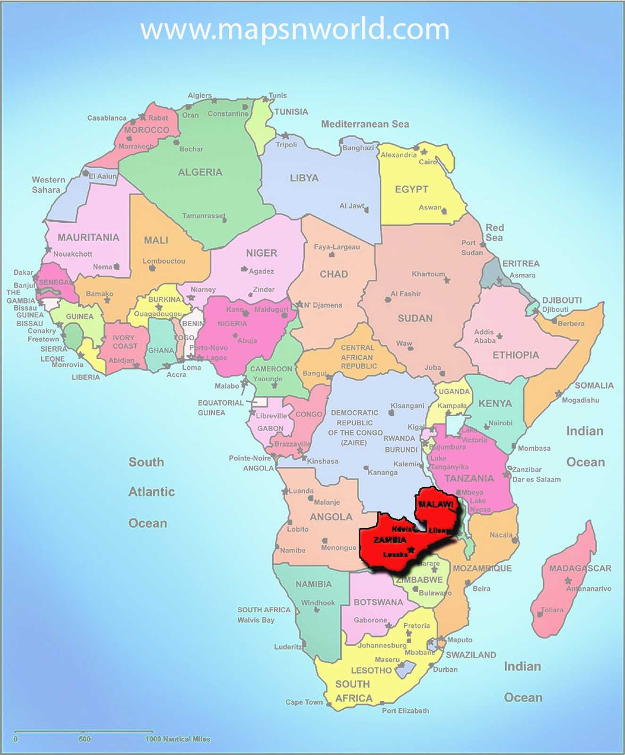
Zambia
- ~20 million people
  75% live on < $1/day
  11.5% HIV prevalence
    7th highest in the world
  One of the highest TB burdens in the world
  ~1/3 the recommended number of doctors
    2009: 808 doctors, recommended 2300
  4 expatriate neurologists
    3 predominantly research

Slide 4
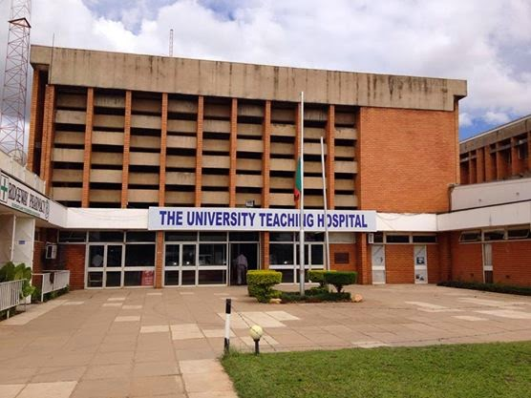
University Teaching Hospital, Zambia
- Largest hospital in Zambia
  1655 beds + patients in hallways, aisles, etc
- National referral hospital
- Primary teaching hospital in Zambia
- No inpatient neurology service
  Neurology patients cared for on internal medicine service

Slide 5
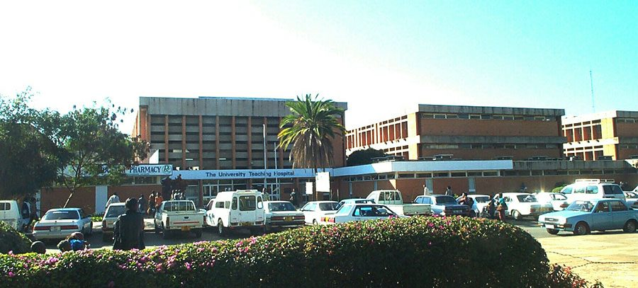
University Teaching Hospital, Zambia
Neurologic resources
  CT
  MRI
  EEG
  EMG/NCS
  LP

Slide 6
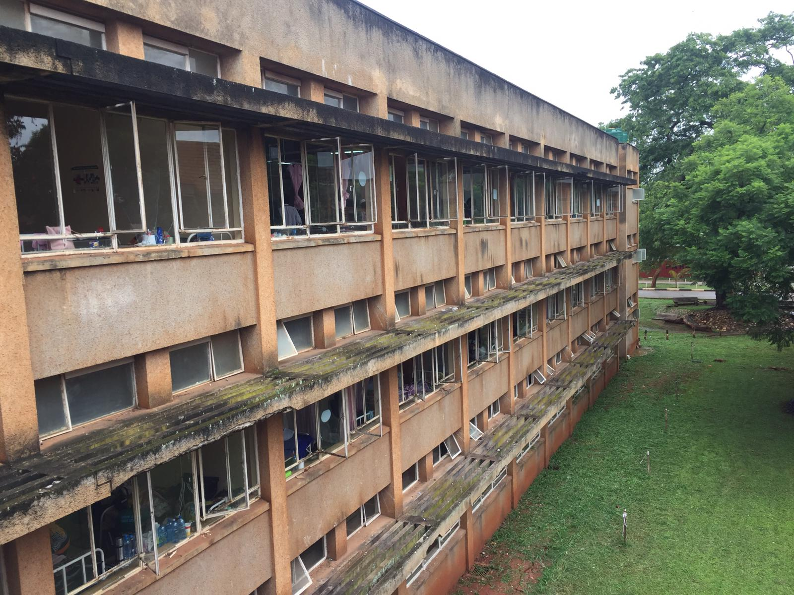
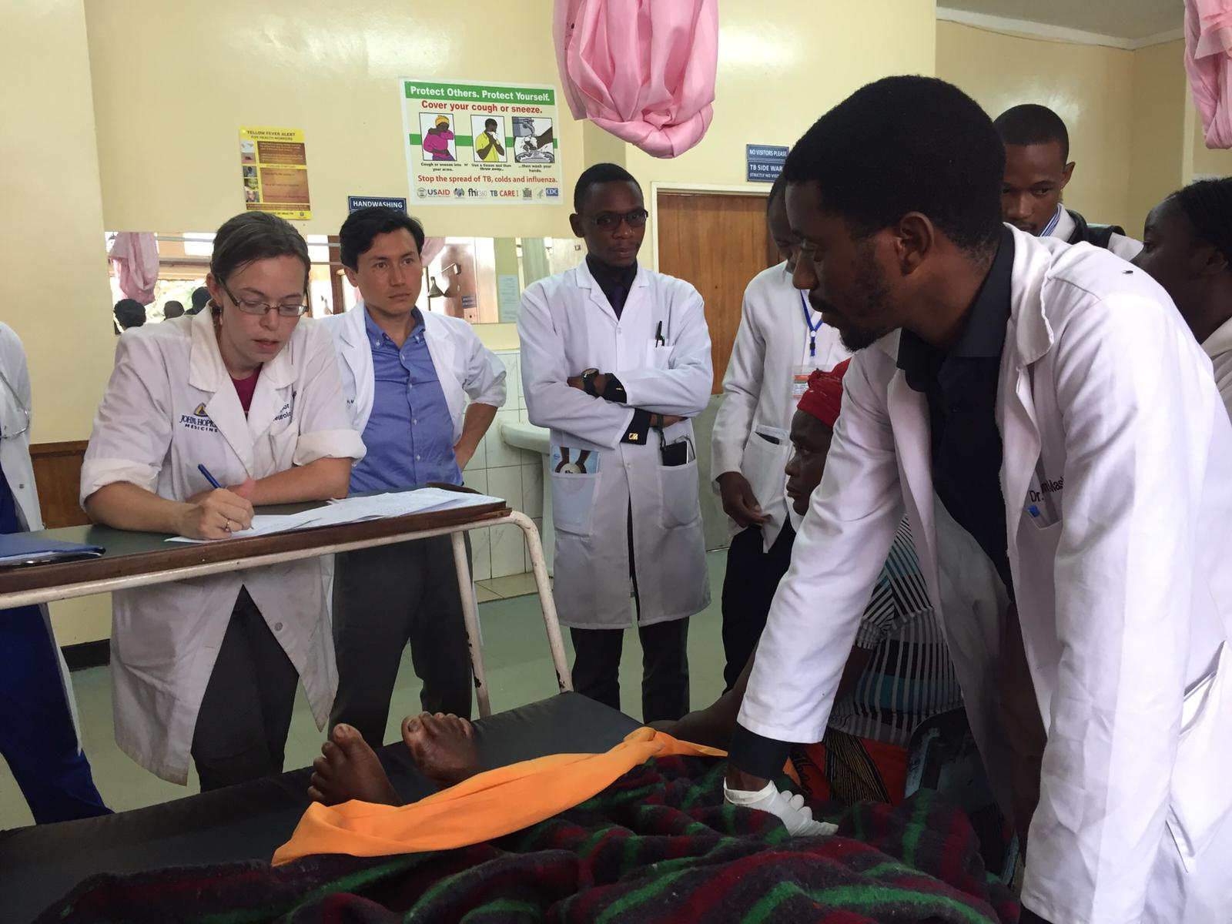
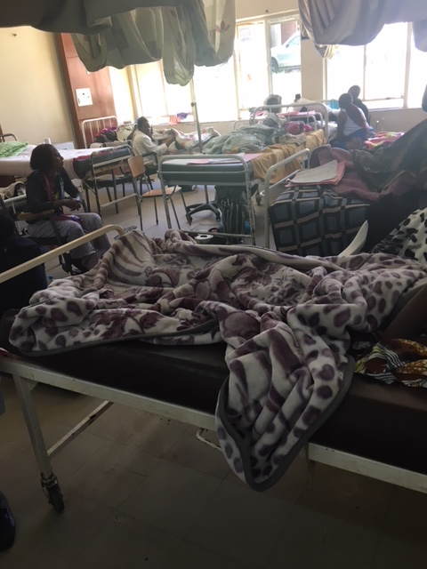

Slide 7
As a result, some days you just feel like you don’t have the right tools for the situation…

Slide 8
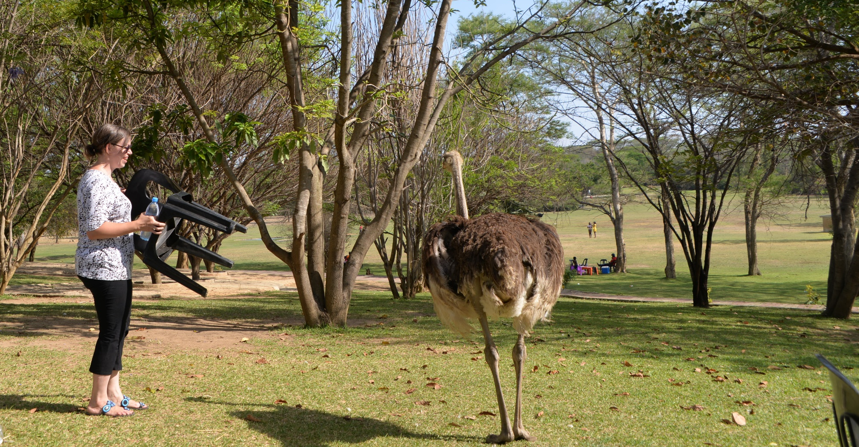
But we persist!

Slide 9
Poll 2
Do you have a post-graduate neurology training program (e.g. specialist training, neurology residency) in your country?
  Yes
  No

Slide 10
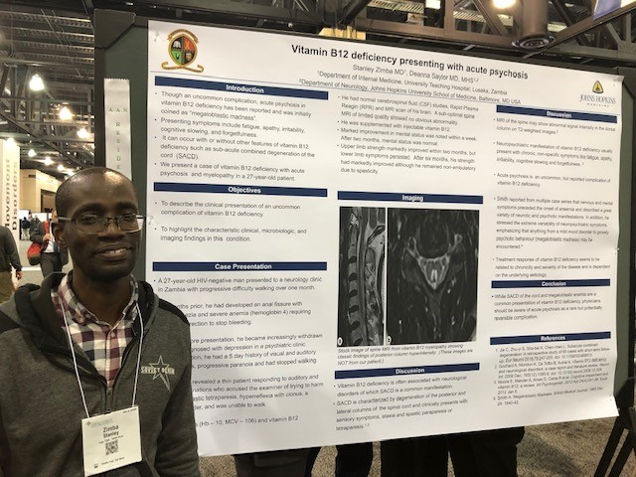
Neurology Training Program
Structure
  3 years of internal medicine + 2 years of neurology
  Blend traditional Zambian post-graduate training with traditional US post-graduate training
    Master’s degree program with courses, assessments
  Intentionally creating an academic/
  research focus

Slide 11
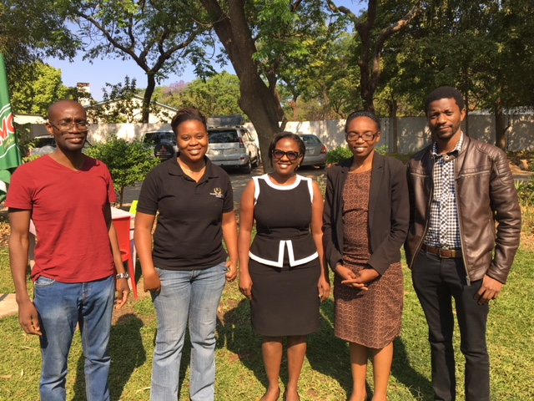
1st Day of Neurology Training

Slide 12
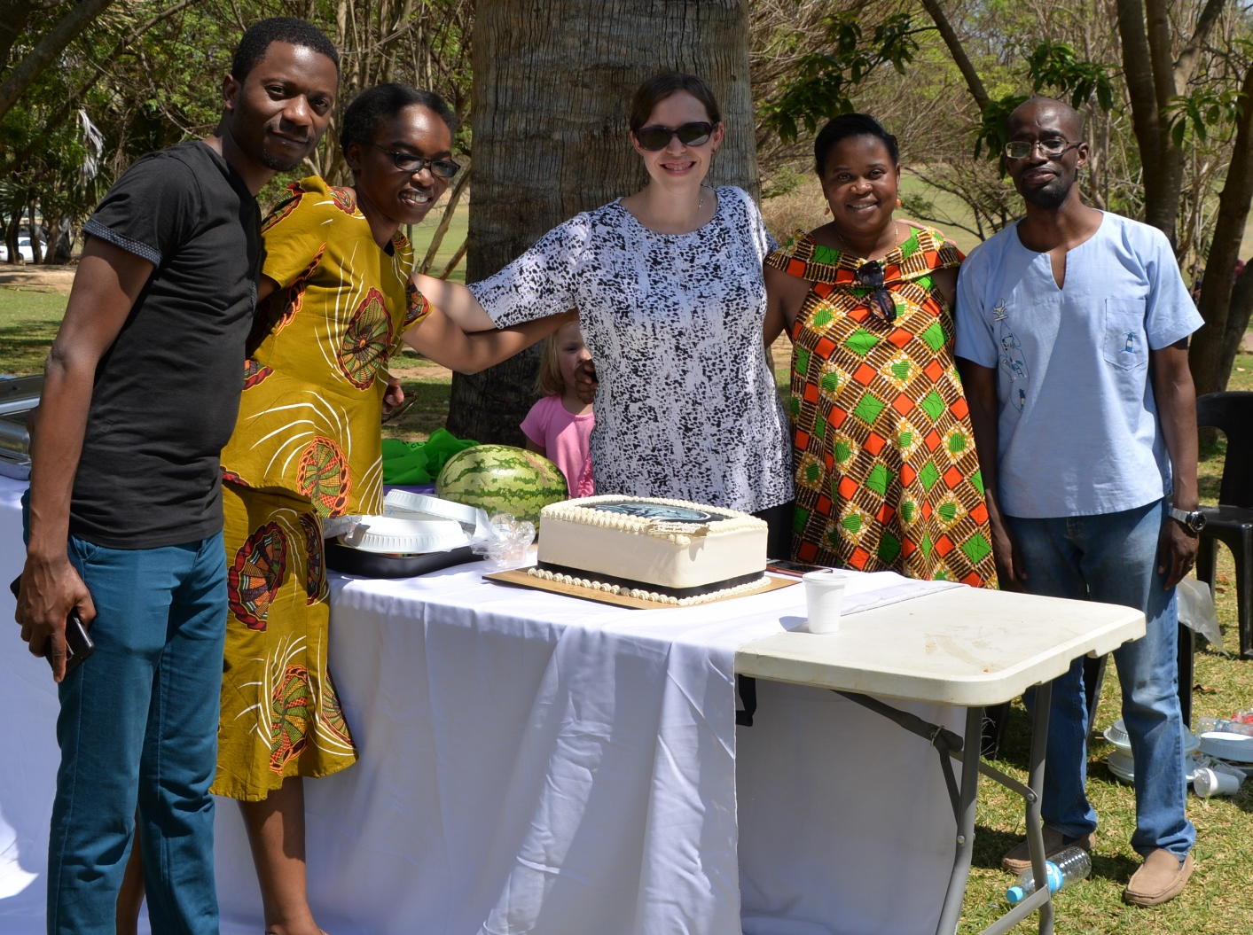
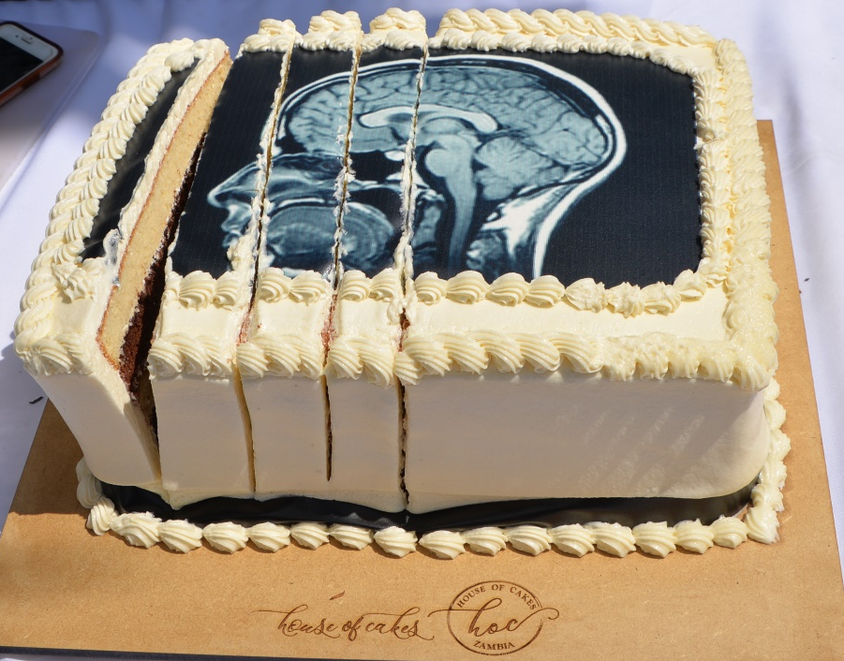
End of 1st Year Celebration

Slide 13
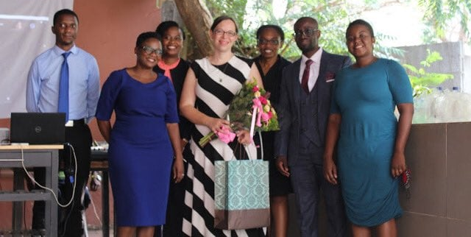
1st Graduation

Slide 14
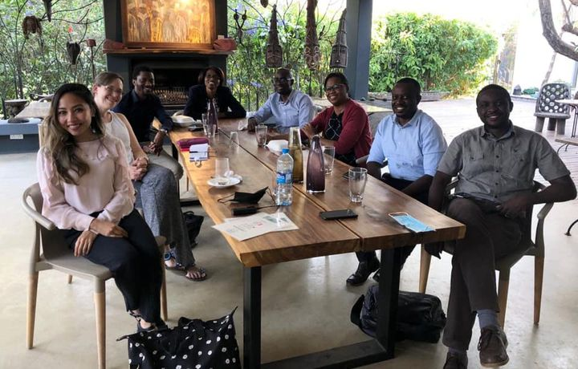
The Future & Sustainability
12 graduates → 10 adult and 2 pediatric neurologists
7 current trainees (6 adults and 1 pediatric neurology)
First 6 graduates all serving as junior faculty within the program
  Most recent 6 graduates have been relocated to other hospitals to begin neurology services
REGIONAL IMPACT
Two post-graduate trainees joined in January 2023:
- one from Liberia who will be the FIRST neurologist in Liberia
one from Tanzania who will be the first neurologist outside of Dar es Salaam
Another trainee joining from Ethiopia next month

Slide 15

Questions?
deanna@jhmi.edu

