Slide 1
Training in Research Management
Choosing Stakeholders & Stakeholder Analysis for a Research Project
Elinor Wanyama Chemonges
29th June 2023
EACCR3 is part of the EDCTP2 programme supported by European Union under grant agreement CSA 2020NOE-3102

Slide 2
Learning Outcomes
Participants should be able to understand :
The purpose and approach to stakeholder analysis
Key factors to consider when conducting a stakeholder analysis.
Process of stakeholder analysis.
EACCR3 is part of the EDCTP2 programme supported by European Union under grant agreement CSA 2020NOE-3102

Slide 3
Key Definitions
Stakeholders in a research are actors (persons, programs or organizations/institutions) with a vested interest in the research/ outcomes or policy being promoted.
Stakeholder analysis: Is an approach or set of tools for generating knowledge about actors
EACCR3 is part of the EDCTP2 programme supported by European Union under grant agreement CSA 2020NOE-3102

Slide 4
Importance of stakeholder analysis?
To understand how actors have influenced processes that led to development of policies and practices by analyzing past experiences.
It is a strategic management tool: to assess the feasibility of future policy directions;-1) to facilitate the project implementation -2) to develop strategies for stakeholders’ engagement
EACCR3 is part of the EDCTP2 programme supported by European Union under grant agreement CSA 2020NOE-3102

Slide 5
Why stakeholder analysis?
To identify the key actors and ;
Assess their knowledge, interests, positions, alliances, and importance related to the research/or research outcome (policy).
Allow for effective/free interaction with key stakeholders and;
Increase support for a given research and its outcomes.
EACCR3 is part of the EDCTP2 programme supported by European Union under grant agreement CSA 2020NOE-3102

Slide 6
Stakeholder Characteristics to analyze -1
Knowledge of the research/or outcomes - policy,
Levels of interests/ or influence and power/importance related to the research/or policy,
Position for or against the research/or policy,
Potential alliances with other stakeholders,
EACCR3 is part of the EDCTP2 programme supported by European Union under grant agreement CSA 2020NOE-3102

Slide 7
Stakeholder Characteristics to analyze -2
Ability to affect or be affected by the research/ or policy process (through power and/or leadership)
Ability to detect and act to prevent potential misunderstandings about and/or opposition to the research and its outcomes.
Potential to guide the implementation of the research.
EACCR3 is part of the EDCTP2 programme supported by European Union under grant agreement CSA 2020NOE-3102

Slide 8
Four-step process for Stakeholders analysis
Identify the stakeholders.
2. Create a Stakeholder Map.
3. Identify Stakeholder Allegiance.
4. Create a Stakeholder Management Strategy.
EACCR3 is part of the EDCTP2 programme supported by European Union under grant agreement CSA 2020NOE-3102

Slide 9
1. Stakeholder Identification
Stakeholder
SStakeholder
Stake in the project
impact
What do we need from them
Perceived attitudes/risks
Stakeholder Magt strategy
Responsibility
take in the project
impact
What do we need from them
Perceived attitudes/risks
Stakeholder Magt strategy
Responsibility
Stakeholder | Stake in the project | impact | What do we need from them | Perceived attitudes/risks | Stakeholder Mgt strategy | Responsibility
EACCR3 is part of the EDCTP2 programme supported by European Union under grant agreement CSA 2020NOE-3102

Slide 10
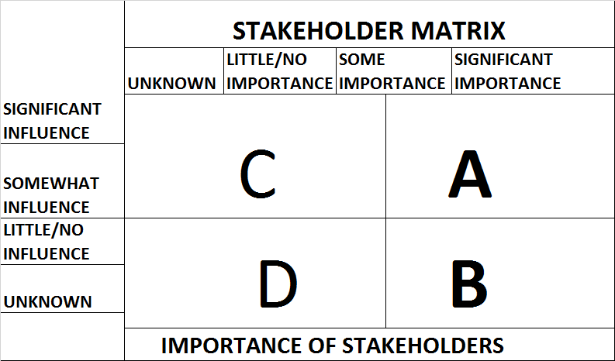
2. Stake holder Matrix
INFLUENCE OF STAKEHPLDER
EACCR3 is part of the EDCTP2 programme supported by European Union under grant agreement CSA 2020NOE-3102

Slide 11
3. INTERPRETATION OF THE ANALYSIS

Slide 12
4.Identify Stakeholder Allegiance
ASSESSMENT | DEFINITION | HOW TO MANAGE
ADVOCATES | Drivers for the change | Use as promoters
FOLLOWERS | Have low understanding | Keep informed and positive
INDIFFERENT | Yet to take definitive position | Seek their views on key issues and address concerns
BLOCKERS/OPPONENTS | Shows resistance to the project | Use conflict management techniques

Slide 13
Thank you

