Slide 1
Understanding Theory of Change (ToC)
Amito Hellen Christine (PhD)
Consultant
28th June, 2023
Training in Research Management for UVRI

Slide 2
Introduction
Started in USA in the 1990s
Context of improving evaluation theory and practice in the field of community initiatives.
Draws on two streams of development and social programme practice,
Part of a broader program analysis or program theory
ToC approaches have increasingly become mainstream
Note: ToC “include a big picture analysis of how change happens in relation to a specific thematic area.

Slide 3
Definition
ToC is a method that explains how a given intervention, or set of interventions, is expected to lead to specific development change, drawing on a causal analysis based on available evidence.
Or
Defines the pieces and steps necessary to bring about a given long-term goal.
Or
A comprehensive description and illustration of how and why a desired change is expected to happen in a particular context.

Slide 4
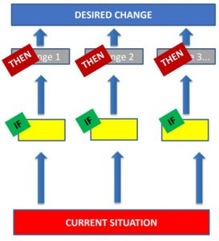

Slide 5
Purpose of ToC
Definitions of ToC vary widely
Organisations and donors also view ToC as having a variety of purposes,
ToC approaches can be understood across a continuum.
Technical tool Thinking Political literacy

Slide 6
Cont… Summary
Strategic planning: ToC helps organizations practically to map the change process and its expected outcomes and facilitates project implementation. For these purposes, ToC is often used in conjunction with logframe approaches.
Monitoring and evaluation: ToCs articulate expected processes and outcomes that can be reviewed over time. This allows organisations to assess their contribution to change and to revise their ToC.
Description: ToC allows organisations to communicate their chosen change process to internal and external partners. A simple description of an organisation’s ToC can be understood as minimal way of engaging with ToC.
Learning: helps people to clarify and develop the theory behind their organisation or programme.This relates to an understanding of ToC as a thinking tool.

Slide 7
Questions that Theory of Change Answers
While developing a theory of change, we need to ensure that it addresses following six question:
Situation analysis/external context?
Who are the beneficiaries?
What are the expected results/benefits?
What is the expected time period to achieve the results?
What are the proposed interventions?
Why, and based on what evidence, can we believe that the theory of change will achieve the expected results (assumptions)?

Slide 8
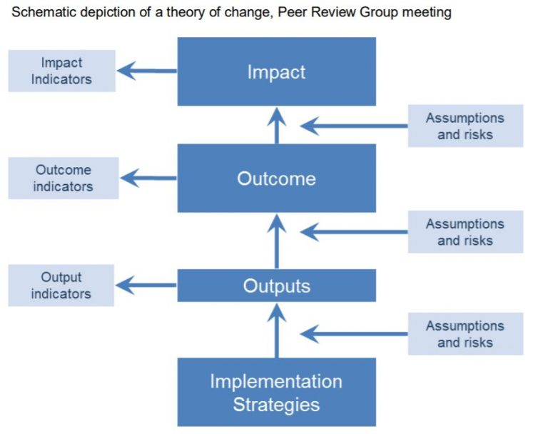
Source: United Nations Children’s Fund, Supplementary Programme Note on the Theory of Change, Peer Review Group meeting, 11 March 2014, UNICEF, New York, 2014,

Slide 9
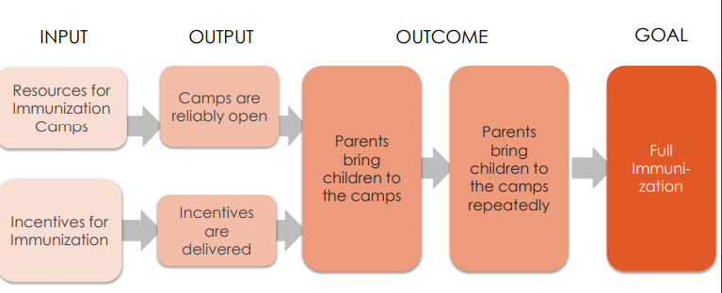
Systematically laying out the theory-connecting program to the goal.

Slide 10
Application of ToC in programmes/projects
A theory of change starts by identifying a clear ultimate goal and working backward to establish preconditions for reaching that goal.
A theory of change is developed in the course of the planning stage and useful for monitoring and evaluation.
It helps in specifying a range of conditions that help programs deliver on the desired outcomes
A good ToC helps to: develop better key evaluation questions, identify key indicators for monitoring, identify loopholes in available data, prioritize further data collection as well as provide a framework for data analysis and reporting.
Helps to answer the following questions during the program: what is the programme, goal, objectives, outcomes steps that lead to outcomes, assumptions associate with each other and how to measure outcomes.

