Slide 1
Goal and Introduction to Monitoring & Evaluation (Developing deliverables & Milestones)
Amito Hellen Christine (PhD)
Consultant
Training in Research Management for UVRI, 27th June 2023

Slide 2
Presentation
Introduction M & E
What is M&E ?
why should we do it?

Slide 3
Introduction

Slide 4
Introduction
Project management is the use of specific knowledge, skills, tools and techniques to deliver something of value to people.
Projects are temporary efforts to create value through unique products, services, and processes.
Projects are amalgamations of tasks, activities, and deliverables that must be structured and executed carefully to achieve a desired outcome.
Before an outcome is achieved, each aspect of a project must go through phases of initiation, planning, and execution.
This process is known as the project management lifecycle, and it is the lifeblood of successful projects.
Notes:
To understand project management, we must look deeper into what constitutes a project.
When we break them down more specifically

Slide 5
Introduction Cont.
Project planning is a procedural step in project management, where required documentation is created to ensure successful project completion.
Project planning is at the heart of the project life cycle, and tells everyone involved where you’re going and how you’re going to get there.
Provides a basis to establish the business requirements, costs, schedules, deliverables, resource plans.
Often the most challenging phase for a project manager.

Slide 6
Introduction (Ctd)
Project planning phase has two interchangeable terms that continuously crop up i.e. “deliverables” and “milestones”
Both set out waypoints that allow a project’s progress to be judged and provide a focus for a team to work towards, but are they the same?
Deliverables & milestones are common tools to determine and verify the progress and measure the outcome of a project.
Help to increase the visibility and the impact of the project by disseminating its outcome.

Slide 7
Deliverable
Is a product or service that denotes the completion of a project phase or
Is the output or the result of the project activities
E.g can be the designs or videos that have been created in that phase
Milestone
Is the completed project phase or the measurable & important accomplishment necessary to achieve a goal or
Specific events in a projects life cycle.
E.g can be the step of creating advertising content.
Some project milestones may not have tangible deliverables, while some may have several deliverables at intervals.
However, the more likely you are to measure the deliverables, the easier it is to track the forward progress of the milestones.

Slide 8
What is M & E?

Slide 9
What is M&E?
Shouldn’t our work speak for itself?
Just a way to make more work?
Funders don’t trust us?
Is our activity on track?
Are we doing the right thing?; Right and efficiently?
Are there better ways of doing it?

Slide 10
Monitoring is the continuous assessment of a programme or project in relation to the agreed implementation schedule
Evaluation is a systematic assessment of an all elements of a program to assess its worth or relevance,
M & E is a process of continued gathering of information and its analysis, in order to determine whether progress is being made towards pre-specified goals and objectives

Slide 11
Monitoring
Continuous: day-to-day, routine, on going activities
Documents progress using selected indicators/activities
Focuses on inputs, activities and outputs
Provides warning signs to managers
Looks at process at the output level
Evaluation
Periodic: important milestones (mid-term or end of project)
Provides in-depth/comprehensive analysis Compare planed with actual achievements
Focuses on outcomes and impacts
Provides managers with strategy and policy options if corrective action is needed
Considers results at outcome level

Slide 12
why should we do it?

Slide 13
Importance of M & E
Tracking resources & provide feedback on progress
Improve program implementation - managers
Informing future decisions based on accurate, evidence based information
Promoting accountability
Demonstrating impact
Identify lessons learned
Preserve institutional memory

Slide 14
Common Terms of M & E
Term | Description
Inputs | resources required to achieve outputs, including money, equipment and human resources
Activity | Work performed in line with the plan
Outputs | tangible results of the input – cattle treated, farmers trained, agents established.
Outcomes | how the outputs have contributed to an expected change in the situation which was to be addressed by the project
Objectives | contribute to the overall goal and allows measurement of the success of the programme
Impact | the long term result of the outcome. The impact includes the overall social, economic, and other developmental effects that the outcomes of the programme have had the community.
Indicators | measure the achievements of the outputs, outcomes and objectives.

Slide 15
Tools or M & E Planning
M & E Plan
M & E framework or Logical Framework (Logframe)
Theory of Change

Slide 17
Developing an M & E plan

Slide 18
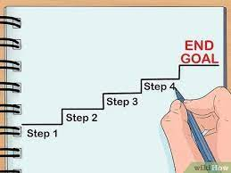
What is a plan ?
It’s a detailed way of doing or to achieve something.
A method devised for making or doing something or achieving an end,

Slide 19
What is an M & E Plan?
An M & E plan is a document that helps to track and assess the results of the interventions throughout the life of a program.
Or
Is like a roadmap that describes how you will monitor and evaluate your program, as well as how you intend to use evaluation results for project improvement and decision making.

Slide 20
When and Why?
M & E plan should be created right in the beginning when the project interventions are being planned.
Helps to define, implement, track and improve a M & E strategy within a particular project(s).
Helps to ensure that there is a robust system in place to monitor every little intervention and activity of the project and evaluate their success.
Helps to identify opportunities and barriers as a team in the planning stage with a focus on problem-solving and maximizing impact.

Slide 21
Steps in developing and M & E plan
Helps understand what to measure
Develop Objectives
Indicators
Specific, Measurable, Relevant Timely
Outcomes and Outputs
Data Collection
Surveys, interviews FGD, etc
Sources & methods
Who is responsible
Data Analysis
How will it be analysed and the which tools
How & whom to report
Reporting & Dissemination
Knowledge and learning
Feedback and Learning Plan
Note: Essential component of the project or program

Slide 22
Designing an M & E Plan
Identify the focal problem and the need for a project
Plan for the project
Identify the goal, objectives, inputs/activities, indicators, data collection methods & timelines
M & E questions, Key players, Roles and Responsibilities
Define an M & E framework - understand the scope of the project and choose one that best fits the purpose. Three types of M&E frameworks
Theory of Change which shows a bigger picture of all the underlying processes and possible pathways leading to long term behavioural changes
Logical Framework (LogFrame)/Logic Model – which focuses only on one specific pathway that a project deals with and creates a neat and orderly structure
A results framework which emphasises on results to provide clarity around the key project objectives
Plan for dissemination and Donor Reporting

Slide 23
M&E Plan Components
Introduction : program context, - national, community,, purpose , description of development process,
Program Description : problem statement , goals and objectives and interventions
M&E Frameworks: Conceptual, Logic, Results
Indicators : Presented in a both a Matrix & Indicator Reference Sheets and based on logic and donor requirements
Data sources, collection & reporting systems
Plans for data use & dissemination
Capacity needs for Plan implementation

Slide 24
An M&E Plan should be
Practical
Accessible to intended users
Feasible, realistic, & diplomatic
Legal & ethical
Accurate
Reveal technically correct information

Slide 25
M & E Plan template

Slide 26
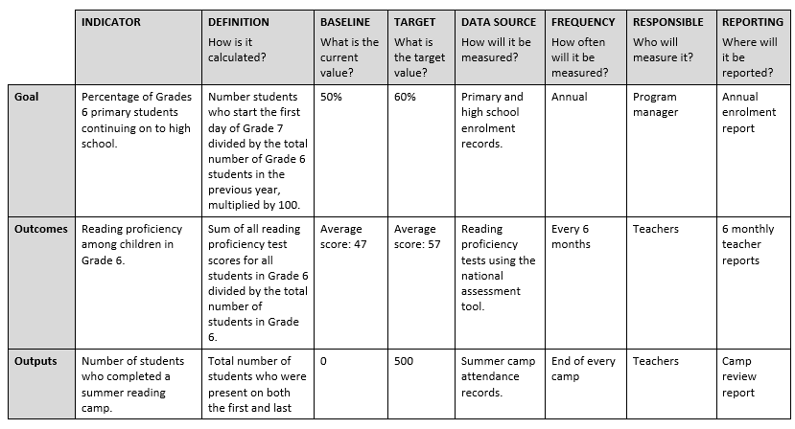

Slide 27
Group work: Developing an M&E Plan
Break up into groups and develop an M & E plan on your chosen area of focus (problem)
Shall present the work in groups and refine it as we go along

