Slide 1
Indicators
Amito Hellen Christine (PhD)
Consultant
28th June, 2023
Training in Research Management for UVRI

Slide 2
Introduction
Definition – Indicator
A variable that measures one aspect of a program or project that is directly related to the program’s objectives.
Or
A precise information needed to assess whether intended changes have occurred.

Slide 3
Intr…
Value changes from baseline to a new value after the program – calculated again,
It’s a measurement – measures value of change
Single aspect of a programme or project – input, an output, or an overarching objective
Should be narrowly defined in a way that captures this one aspect as precisely as possible.
Note: Recommends one or two indicators per result, at least one indicator for each activity, but no more than 10 to 15 indicators per area of significant program focus.

Slide 4
Intr…
Quantitative (numeric) or Qualitative (descriptive observations).
Quantitative indicators - numeric presented as numbers or percentages.
Qualitative indicators are descriptive observations and can be used to supplement the numbers and percentages provided by quantitative indicators complement by adding a richness of information about the context in which the program has been operating.
Provide M&E information crucial for decision making at every level and stage of program implementation.

Slide 5
Intr….
inputs indicators measure the specific resources that go into carrying out a project or program (e.g., amount of funds allocated to the health sector annually)
outputs indicators measure the immediate results obtained by the program (e.g, no of multivitamins distributed or no of staff trained).
Outcomes indicators measure whether the outcome changed in the desired direction and whether this change signifies program “success” (e.g, contraceptive prevalence rate or percentage of children 12 to 23 months who received DTP3 immunization by 12 months of age).

Slide 6
General guidelines for selection of indicators
Select indicators requiring data that realistically can be collected with the resources available.
Select at least one or two indicators (ideally, from different data sources) per key activity or result.
Select at least one indicator for each core activity (e.g., training event, social marketing message, etc.).
Select no more than 10–15 indicators per area of significant program focus.
Use a mix of data collection sources whenever possible.

Slide 7
Rule of Thumb in selecting indicators
Context - understand the issue and response when selecting indicators
Indicator frameworks - used repeatedly to measure the same condition or event, - international standard/reporting requirements
Measure only the condition or event it is intended to measure
Reflect changes in the state or condition over time
Be defined in clear and unambiguous terms- easy to interpret and explain, timely precise, valid, and reliable
Be independent, meaning that they are nondirectional and can vary in any direction.

Slide 8
Steps
Clarify the results – good indicators start with good results, study activities,
Develop a list of possible indicators –create an initial list,
Assess each possible indicator,
Select the best indicators – narrow the list

Slide 9
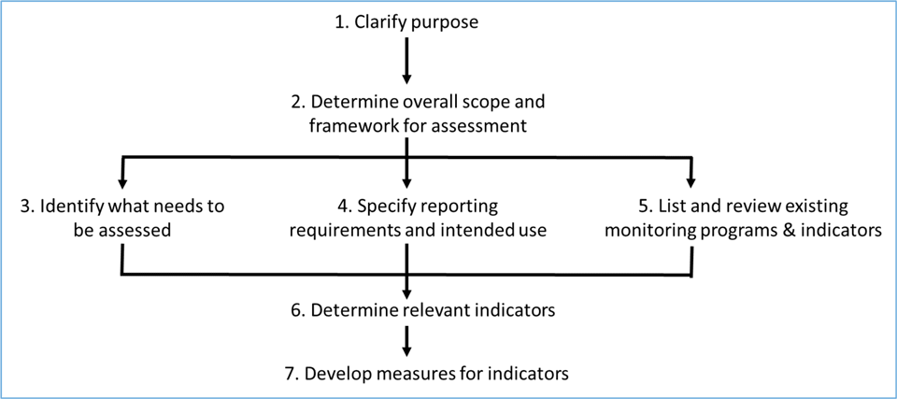
Figure 1 illustrates steps in indicator selection that help to ensure that indicators are appropriate for their intended purpose.

Slide 10
Challenges
1. Choosing an indicator that the program activities cannot affect
A program that planned to train health care providers in AIDS prevention and treatment services in an effort to expand access to these services.
Authors of the M&E plan selected the UNAIDS indicator the proportion of health care facilities with adequate conditions to provide care.
Many elements can affect this indicator, such as supervision, availability of supplies and equipment, and the drafting of appropriate treatment protocols
None of these factors would be addressed by the planned training program.
In using this global indicator, the planners overlooked the fact that it did not accurately reflect their program activities.

Slide 11
Cont…
2. Selecting an indicator that does not accurately represent the desired outcome
E.g. IR states “expanded access to antiretroviral (ARV) treatment for pregnant women to prevent mother-to-child transmission (PMTCT) of HIV,”
what would an appropriate indicator be?
No, this would not be an appropriate indicator because it tells us how many women are pregnant out of all women on ARVs, rather than how many HIV-positive pregnant women are on ARVs.
The numerator for this indicator is the number of women on ARVs who are pregnant and the denominator is the number of women who are on ARVs.
Answer would be: percentage of HIV-pregnant women who are on ARVs be appropriate
Reason: numerator is the number of HIV-positive pregnant women who are on ARVs and the denominator is the total number of HIV-positive pregnant women.

