Slide 1
Project Implementation and Close out
by
Dr Bernard Kikaire

Slide 2
Processes for Success
Setting the Tone for Success
Holding a kick-off meeting for the trial is likely to ensure that the team feel involved with the trial
Ensuring that each member of the team understands what they are responsible for delivering
Keeping the trial team informed of what is going on throughout the trial (and not just on the task the team member is performing)
Developing a culture within the team where the team communication is free and open. Implement a process for measuring progress and taking corrective action

Slide 3
Progress Reporting
Reports
Highlight reports
Meetings
On-line systems

Slide 4
Change Control
We can check the impacts of the changes on the rest of the trial
We can plan to implement the changes
We can inform the stakeholders of the changes and manage their expectations

Slide 5
Managing Performance
Comparing Progress with the Plan
If progress is delayed, what do you do?

Slide 6
Taking Action
Identifying the Causes of Problems
Brainstorming and Problem Solving
Prioritise the solutions
Communicate the Issues to Stakeholders

Slide 7
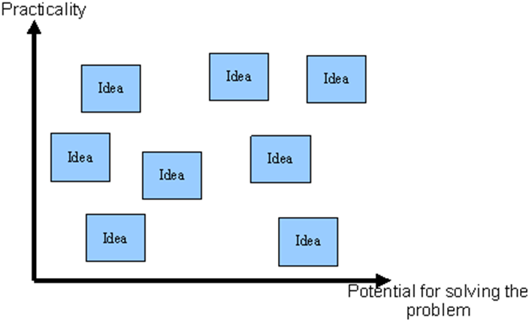
Priortising Solutions

Slide 8
Examples of solutions
Changing our Resource Utilisation
Increasing our Control on the Project
Modifying The Plan
Use contingency
Renegotiate the scope or timescale of the trial

Slide 9
Project Close out
Ensure all the work linked to the trial is completed.
Capture what you have learnt from this trial and to identify how you might implement it on a future trial.

Slide 10
Thank you

