Slide 1
Managment of activities during research implementation
P-People
R-Resources
A-Activities
I-Information
S-Self
E-Environment
Managing of information (Research Data)

Slide 2
Research Data
Research data is any information that has been collected, observed, generated or created during our research
Research data management' is simply the effective handling of information that is created in the course of research
Effective data management is carried out for the entire lifecycle of the data
From the point of creation through to dissemination, publication and archiving.
Aspects of data management will usually continue long after the initial research project has ended?
EACCR3 is part of the EDCTP2 programme supported by European Union under grant agreement CSA 2020NOE-3102

Slide 3
Managing of Information
Before the study - At proposal stage
During the study - During implementation of the research project
After the study - Dissemination and publication
Management of information should be clear at the on-set at all stages
EACCR3 is part of the EDCTP2 programme supported by European Union under grant agreement CSA 2020NOE-3102

Slide 4
Data life cycle

Slide 5
Study data
Collect data
Store data
Share data
EACCR3 is part of the EDCTP2 programme supported by European Union under grant agreement CSA 2020NOE-3102

Slide 6
Extraction of data
Most readers assume that data is natively digital, but digital is only one of the latest entrants to the data sphere. Scientists and researchers also use other formats
Paper (e.g. notebooks and journals)
Images (e.g. photographs, scans, and/or film)
Audio (tape or otherwise)
Surveys
Lab equipment measurements
Samples
EACCR3 is part of the EDCTP2 programme supported by European Union under grant agreement CSA 2020NOE-3102

Slide 7
Research data Management
RDM is effective handling of information created during research (Importance of RDM)
Data can be easily lost if not saved properly.
Managing research data correctly saves time and money.
Data that can be referenced, verified, and validated - increasing accuracy and quality
Sharing data can also often lead to developments and insights from its readers, even if they are outside the original research team.
Managing research data helps spot errors, especially if data is accessible to your team
Funding agencies increasingly turn to data and reproducible results to approve research grants.
EACCR3 is part of the EDCTP2 programme supported by European Union under grant agreement CSA 2020NOE-3102

Slide 8
Challenges in RDM
Improper storage of data
Leads to data being disposed of carelessly due to research team’s negligence. Depending on the funder and/or sponsor, this may actually be a violation
Failure to document technical data
Team deviating from the proper standards of data documentation. This will make the findings of the research irreproducible, as any work that seeks to replicate the research will be riddled with inconsistencies
No copy of the data
If later publications request access to the data—either to validate or recheck the findings of the report. Maintaining data elsewhere, such as personal servers, also presents problems, including legal ones.
EACCR3 is part of the EDCTP2 programme supported by European Union under grant agreement CSA 2020NOE-3102

Slide 9
Sources of Research data
Observation - this data needs real-time documentation as it is impossible to “redo” or recapture again if not recorded.
Derivation - uses existing data to arrive at another piece of data (such as traffic volume from the observation)
Experimentation - cause-and-effect relationship and can be used via statistical projection to apply to a larger set.
Simulation - a test model used to imitate a process or a system over time to find what would happen in several conditions
Reference - a type of secondary data source. Peer-reviewed journals, gene sequence databanks, or open-source code are typical examples.
EACCR3 is part of the EDCTP2 programme supported by European Union under grant agreement CSA 2020NOE-3102

Slide 10
Benefits of RDM
Research excellence
High quality data
Data sharing, replication, re-use
Long-term sustainability and accessibility
Data security
Reputational benefit
EACCR3 is part of the EDCTP2 programme supported by European Union under grant agreement CSA 2020NOE-3102

Slide 11
Organizing data
Consistency and logic are the top two reasons researchers organize their data - members can easily find and use
Here are some ideas to get your data organized.
Place files in the appropriate folder
Use hierarchy - Use a few folders at the top for broader subjects, then more subfolders as needed for more specific topics.
Check for existing practices - If your team or institution already has a file structure and naming convention, see if you can adopt it so you don’t have to start from scratch
EACCR3 is part of the EDCTP2 programme supported by European Union under grant agreement CSA 2020NOE-3102

Slide 12
Organizing data..
Stick to convention - In any case, stick to your file naming convention to prevent confusion, especially for newcomers to the team or the workspace.
Archive completed work - To streamline your work further, make sure superseded data is archived, not replaced completely
Maintain a backup - Your data should be backed up, whether they are primarily saved on your local hard drive, on your intranet, or on the cloud. Your backups should have a backup, which means cloud storage, which syncs automatically with files on your local machine
EACCR3 is part of the EDCTP2 programme supported by European Union under grant agreement CSA 2020NOE-3102

Slide 13
Storing data
Should be taken seriously from the start of research
For both digital and non-digital data
Data processing and short term storage should be written into the research data plan
End point storage and archiving dependent on the nature of the data and funder requirements
EACCR3 is part of the EDCTP2 programme supported by European Union under grant agreement CSA 2020NOE-3102

Slide 14
Storing data..
Filing system
Locked cabinets, locked office, accessible only by investigator and research coordinator
Cloud based storage
Databases-password protected
EACCR3 is part of the EDCTP2 programme supported by European Union under grant agreement CSA 2020NOE-3102

Slide 15
Data sharing and Preservation
Data will outlive the project, so you should plan for ways to share and preserve your data for posterity. Data preservation is part of the research data lifecycle.
Though there are slightly varying models of data lifecycles (Ball, 2012), the research data lifecycle involves the movement of data from creation to preservation and reuse, ad infinitum.
Research data should not be siloed
Sharing is not only a good source of feedback but it is also a way to increase funding interest, garner citations, and build reputation
Researchers can share data using a variety of means
EACCR3 is part of the EDCTP2 programme supported by European Union under grant agreement CSA 2020NOE-3102

Slide 16
Data sharing..
Approaches vary, depending on:
Research environment and discipline
Funder requirements
Multiple routes to sharing research data include:
Depositing with a specialist data centre, data archive or data bank
Submitting them to a journal to support a publication
Depositing them in an local research group or institutional repository
Making them available online via a project or institutional website
Making them available informally between researchers on a peer-to-peer basis
Store them in a USB flash drive, which can be borrowed by colleagues.
Otherwise, you can use FTP upload on a server, such as to your institution’s repository.
Another way includes cloud sharing
EACCR3 is part of the EDCTP2 programme supported by European Union under grant agreement CSA 2020NOE-3102

Slide 17
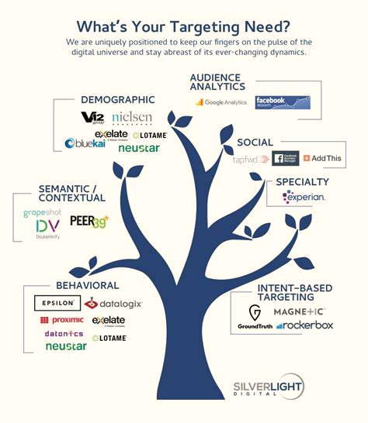
Sharing data..
Data ownership
Who is allowed access to the data for:
Quality control
Analysis
Future use
Assure data is deidentified
How to share? (Dropbox, email)
Third parties
Data Transfer Agreement (DTA)
The free picking future
EACCR3 is part of the EDCTP2 programme supported by European Union under grant agreement CSA 2020NOE-3102

Slide 18
Why share data?
Who benefits from sharing data
Researchers
Funders
The public
Research community
Research participants
EACCR3 is part of the EDCTP2 programme supported by European Union under grant agreement CSA 2020NOE-3102

Slide 19
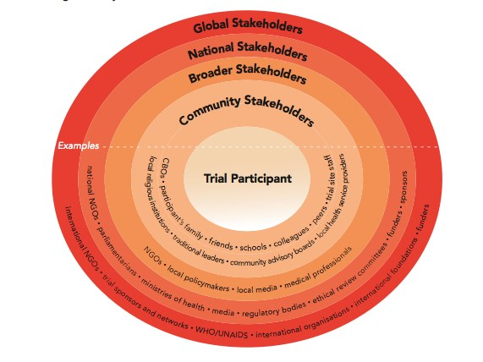
Layers of Stakeholders
EACCR3 is part of the EDCTP2 programme supported by European Union under grant agreement CSA 2020NOE-3102

Slide 20
Managing information with Stakeholders
What information for which stakeholders
Provide ongoing information
Sponsor/ funder specific requirements for what information they want (regular reporting)
CAB
EACCR3 is part of the EDCTP2 programme supported by European Union under grant agreement CSA 2020NOE-3102

Slide 21
Community advisory Boards (CAB)
Protecting participants rights
CABs have a responsibility to report back to the communities they represent
Assist in the development of educational programs
Valuable in the development and implementation of the research
protocol development
Informed consent review
Ethics dialogue
Advice on recruitment strategies
CABs should NOT
Be members of the research team
Actively recruit study participants
Study
CAB
Community
EACCR3 is part of the EDCTP2 programme supported by European Union under grant agreement CSA 2020NOE-3102

Slide 22
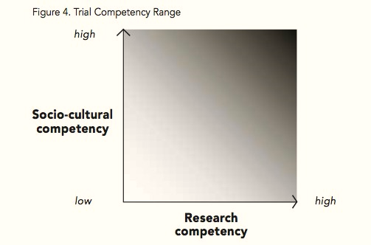
Key to effective dissemination
Know your audience
Choose the right format
Use clear and engaging language
Provide evidence and context
EACCR3 is part of the EDCTP2 programme supported by European Union under grant agreement CSA 2020NOE-3102

Slide 23
Managing information after the study
Dissemination to participants and the community
After the study, our work is critically reviewed through accepted scientific and professional channels, eg, publication in peer reviewed journals, conference presentations, radio talk shows etc
How do you disseminate the information, who does it and when
EACCR3 is part of the EDCTP2 programme supported by European Union under grant agreement CSA 2020NOE-3102

Slide 24
Guidelines for
Publications
Authorship
Agreements on policies
EACCR3 is part of the EDCTP2 programme supported by European Union under grant agreement CSA 2020NOE-3102

Slide 25
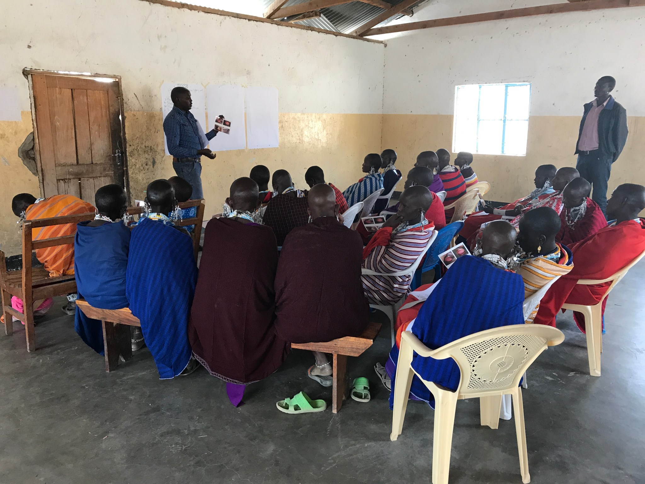
Retention and Archiving Policy
How long will the info be retained?
Disposal/ destruction? Who is responsible? When should it be done
Are there permanent records that need to be transferred to archives?
EACCR3 is part of the EDCTP2 programme supported by European Union under grant agreement CSA 2020NOE-3102

Slide 26
EACCR3 is part of the EDCTP2 programme supported by European Union under grant agreement CSA 2020NOE-3102

Slide 27
Group Work
Review grant calls and list areas for negotiation
Identify four areas of negotiation that are likely to be relevant to your particular proposed research and consortium
State and explain why you have identified these four areas and why you think they would be relevant
Describe how you would approach the negotiation with the funding agency in these areas
Share experiences on keeping and challenges of storing research data
Have you been involved in dissemination activities, how did you go about it?
EACCR3 is part of the EDCTP2 programme supported by European Union under grant agreement CSA 2020NOE-3102

