Slide 1
Risk management and mitigation in Research project
By Benjamin Watyaba

Slide 2
Introduction
The goal of project management is to ensure that a project reaches its objective within the predefined quality, timeframe, and cost.
Challenges:
Reasons internal to the project, related to poor project definition:
Poor definition of the objective,
Insufficient resources,
Insufficient competencies,
Poor planning, etc.
Reasons external to the project, the materialization of risks that are unpredictable:
Change in the environment of the project,
Accident,
Unexpected decisions by stakeholders,
Technical failure, etc.

Slide 3
Definitions
Risk: An uncertain event or set of events that will have an effect on the achievement of objectives if it occurred. This can have a positive or a negative outcome.
An opportunity: An uncertain event that could have a favorable impact on objectives
A threat: An uncertain event that could have an adverse impact on objectives.
The risk management process makes the risks visible and helps manage them in a transparent way.

Slide 4
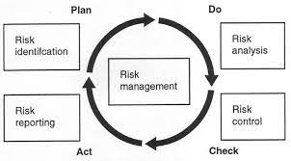
Risk management

Slide 5
1. Risk Identification
Project risks may be identified by different methods:
Review of documentation
Information gathering from the stakeholders
A Cause-and-Effect Analysis can be done by taking each of the department’s objectives and identifying issues (both positive and negative) that may impact the objectives.
SWOT analysis
Expert judgment.

Slide 6
Categorization of risks
Identified risks should be classified:
Technical
People
Financial
Political
Regulatory
Organizational
Competitor
A risk breakdown structure (RBS) with an increasing level of detail.

Slide 7
2. Risk Assessment/analysis
The impact of each risk on the project is quantitated by estimating the probability of occurrence of the risk and its severity
UVRI uses a 4x4 matrix to plot the likelihood and impact and therefore assess risk exposure

Slide 8
4x4 matrix
Impact
VH/L | VH/M | VH/H | VH/VH
H/L | H/M | H/H | H/VH
M/L | M/M | M/H | M/VH
L/L | L/M | L/H | L/VH
Very High
High
Medium
Low
Low Med High Very High
Likelihood

Slide 9
Risk assessment
The top right corner of the matrix is known as the, “top quadrant.” These are the risks with the highest likelihood and impact and would tend to be the areas where action plans would be focussed to either mitigate against a threat or maximise an opportunity.
Risk mitigation has a cost and not all risks can be mitigated. The result of risk prioritization is the list of risks that will be in the risk mitigation plan. The other risks will be maximized as accepted.

Slide 10
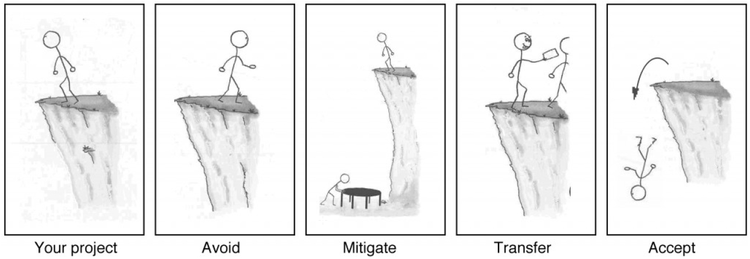
3. Risk response planning
The four possible ways to respond to risk. Source: Barron & Barron Project Management for Scientists and Engineers

Slide 11
Possible responses
Avoid: The Most preferred way to handle risk. It implies changing the situation so that the risk can no more happen or with a negligible probability.
Mitigate: Most common way to handle risk. It consists in taking actions to minimize the damage caused by the materialization of the risk. The action may also reduce its probability of occurrence.

Slide 12
Possible responses
Transfer: The risk still exists and has the same probability of occurrence, but the damage done will not be paid by the project. Buying insurance is a way to transfer risk.
Accept: It is for a risk that cannot be transferred, mitigated or avoided. The impact will not be reduced if it happens, but at least a plan can be defined about how to handle its consequences without creating additional damage (contingency planning). This is typically done by governments when they get prepared for catastrophic events like tsunamis, forest fires, or hurricanes.

Slide 13
4. Opportunity response planning
Similarly, there are four ways to respond to opportunities.
Exploit: The resource is directly exploited to reduce the time to complete the task or its cost.
Enhance: The opportunities can be enhanced by investing more money to obtain more or to finish earlier.
Share: The benefit of the opportunity may be shared with a third party that is able to take more benefit from the project. It may be the case if a partnership or a joint venture is created.
Accept: The opportunity is taken advantage of, but is not actively pursued.

Slide 14
5. Risk monitoring and controlling
Once the risks have been identified and a risk mitigation plan has been established, it must be implemented and its implementation must be monitored.
Any evolution in the probability of risks’ occurrence and severity should also be followed-up.
The identified risks and associated mitigation plan should be made visible to the project team either in the physical project room or on the project intranet.

Slide 15
Thank you

Slide 16
sources
Project Management, Barron M & Barron AR, OpenStax-CNX, http://cnx.org/content/col11120/1.10/, 2016
Managing project risks. Project skills. P. Newton www.free-management-ebook.com, 2015
ISO 31000 Risk management, ISO International Organization for Standardization, [HTML]
UVRI Risk Management Manual, 2019.

