Slide 1
Budgeting and Funding for Research
What funders look out for
                By : Deborah Alibu
                Senior Accountant UVRI

Slide 2
Training objectives
1. Understand what is meant by a budget
2. Know how to effectively budget for research projects;
3. Know the cost items/activities to budget for in a research grant, and
4. Be aware of the underlying principles of budgeting

Slide 3

Budgeting
What is a budget ??

Slide 4
Definitions
A budget is a financial plan for a specified period
It is an estimate of expenses a research project will incur, usually broken out by category, for the purpose of providing a roadmap that the party should follow (True Tamplin)
A financial document used to project future income and expenses.
A budget plans future spending on planned activities for a research project

Slide 5
Uses of Budgets
The research project budget is the engine that drives your project’s funding.
It communicates to stakeholders how much money is needed and when it’s needed
The other part of the importance of a project budget is that it’s an instrument to control research project costs.
The budget, which is part of your project plan, acts as a baseline to measure your performance as you collect the actual costs once the research project has started

Slide 6
Levels of budgeting
At journal level –a budget can be as easy as maintaining a daily tally of income and expenses.

Slide 7
At Organizational level
Estimation of the cost of completing a research activity in a given period
The maximum budget allowable is usually communicated during the grant call process

Slide 8
Budget composition
For EDCTP research projects, a budget is part of the agreement
( Annex2) and it will have these categories:
Personnel costs
Direct research costs
Indirect costs/Over heads
Total

Slide 9
How to Budget:
Popular budgeting methods Include:
Activity Based Budgeting
Incremental Budgeting
Zero Based Budgeting

Slide 10
Methods Cont:
Activity Based Budgeting
A method of budgeting where activities that incur costs are recorded, analyzed and researched Every activity in a research proposal that may incurs a cost is scrutinized for potential ways to create efficiencies. Budgets are then developed based on these results.

Slide 11
Methods Cont:
Incremental budgeting
Incremental budgeting begins with the current budget and adds or subtracts increments from those amounts to create new spending figures. It is often considered the most conservative approach among all budgeting methods.

Slide 12
Methods Cont:
Zero Based Budgeting
A technique where managers must start from scratch (zero) when preparing their budgets. This allows budgeters to remove any unnecessary budget lines that may no longer be applicable or relevant after the end of the budget period eg a fiscal year.

Slide 13
Validating budgets
Funders will look out for :
Compliance to the maximum amount as allowed by the funder.
Eligible Costs Categories (e.g., salaries, supplies, equipment…) per year, in some cases by quarter.
Credible Justification of costing of items
Clarity in the definition of tasks and logical lay out of tasks
The match between the research project scope and the budget
Realistic Budgets that show that the timelines and milestones determine the actual resources and costs required to complete these!

Slide 14
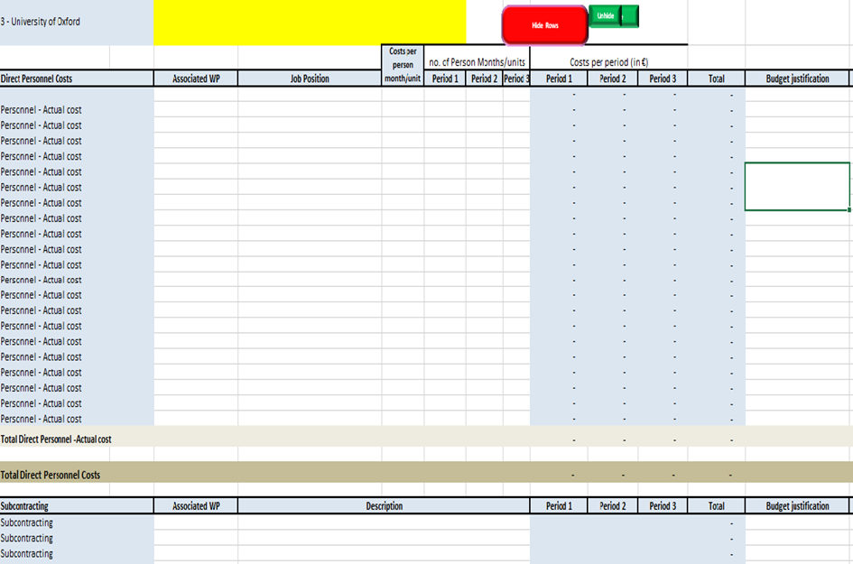
Working with templates
Some funding agencies have templates
Templates will have sections with in-built formulas e.g
personnel costs,
Travel (International & Inland) ;
Goods & services )
Other Direct Costs
Indirect Costs etc
This makes budgeting even easier

Slide 15
Working with templates-2
It is the role of the PI/Co-Pi to get the itemisation at proposal stage right since the final amounts stated in the proposal and award letter may not change
Always good to work with the grants/finance officers to help you check your budgets before submission process
However, budget justification should be written to capture the mind of the funding agency

Slide 16

Generating a budget
Collect the components necessary to build a budget including :-
1.Direct and indirect costs,
2. Fixed and variable costs,
3.Labor and materials,
4.Travel ( inland & international) ,
5.Equipment (depreciation) and space,
6.Licenses/Insurance and
7. whatever else may impact your project expenses.

Slide 17
5 steps to follow:
1. Use Historical Data
To accomplish a specific objective or goal. Looking back at similar projects budgets is a great way to get a head start on building your budget.
2. Reference Lessons Learned
Learning from the successes and mistakes of previous grants provides a clear path to more accurate estimates

Slide 18
3. Leverage Your Experts
Tap into the available experience and knowledge—be they mentors, other project managers or experts in the field can help you stay on track and avoid unnecessary pitfalls.
4. Confirm Accuracy
Once you have draft budget, you’re not done. You want to look at it and make sure your figures are accurate. Seek help of experts and other members of the project team to check the budget and make sure it’s right

Slide 19
5. Baseline and Re-Baseline the Budget
Your project budget is the baseline by which you’ll measure the research project’s progress once it has started. You may want to re-baseline as changes occur in your research project. Once such project changes are approved you will need to re-baseline (make changes) and seek the approval of the new budget to effect.

Slide 20
Group work
Working in our groups :
1.List
2.Categorise;
3.Cost the budget items to be included in a research project titled:
INTRODUCING MEDICAL BIOINFORMATICS IN POC – VL IN THE EAST AFRICAN CONSORTIUM FOR CLINICAL RESEARCH

Slide 21
          Thank you
          Mwebale
          Asante Sana
          Murakoze
          አመሰግናለሁ

