Slide 1
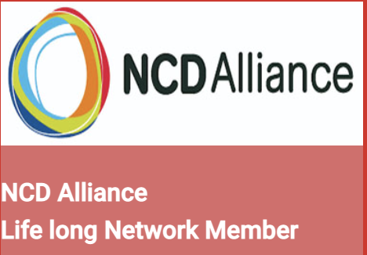
Prof Dr. Bindu Menon
M.D. (Med.), D.M. (Neuro), DNB. (Neuro),
PGDCN (Neuro), (London), FRCP (Edinburgh),
MNAMS. FICP, FIAN, FWSO, FAAN
Prof and HOD Neurology
Apollo Speciality hospitals
Secretary Dr. Bindu Menon Foundation
www.drbindumenon.com
Patient and public involvement and reducing the treatment gap: Our experiences
Research committee
Speciality group EC member
Neuroepidemiology

Slide 2
If you want to know how well a pair of shoes fit should you ask the
Maker?
or
Wearer?

Slide 3
Poll 3
Do you go out of your usual line of history taking to find out more about your patient with regards to non health related problems due to their disease?
Yes
No

Slide 4
Patient and public involvement and reducing the treatment gap
Scope of the problem
Geographical isolation/illiteracy
Poor health awareness
False reassurance of low risk/Attitudes
Post disease care
Poverty
Important preparatory steps
A platform for functioning
Implementation road map
Education and feedback
Outreach activities
Media engagement
Electronic tools
Support groups.
Public Patient involvement
Trouble shoots
At every step

Slide 5
Segment your Population

Slide 6
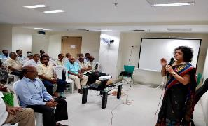
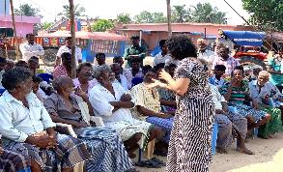
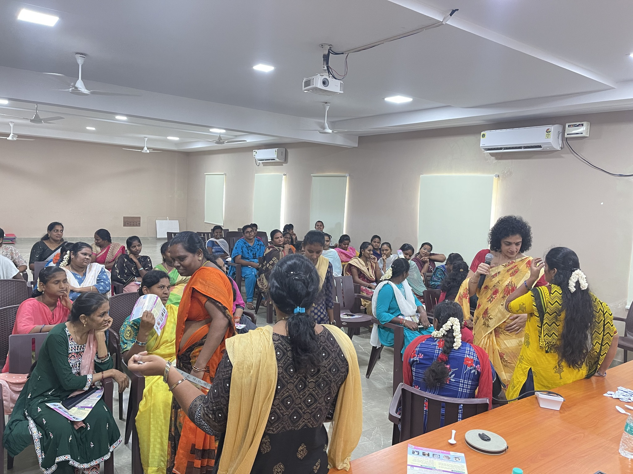
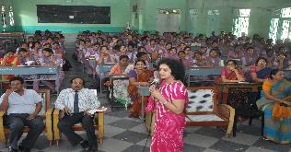
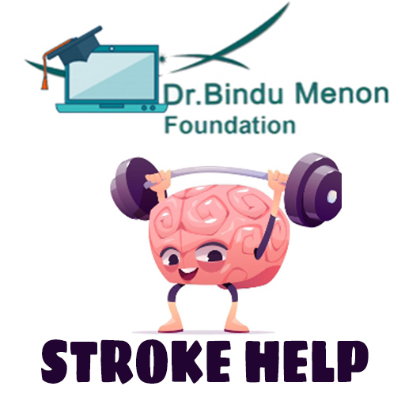
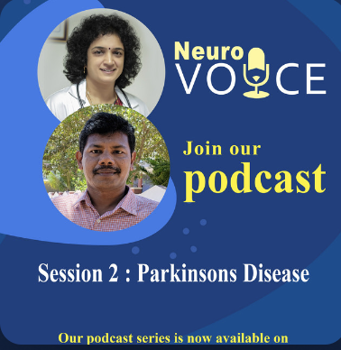
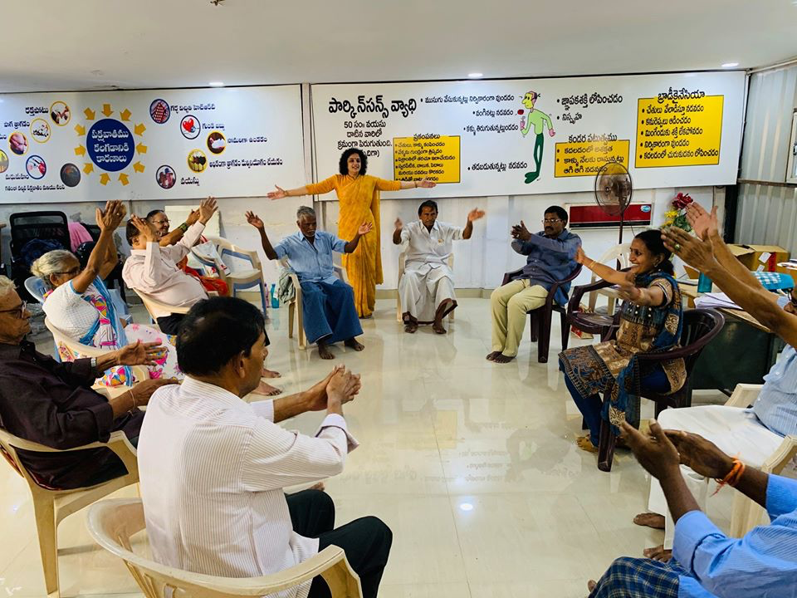
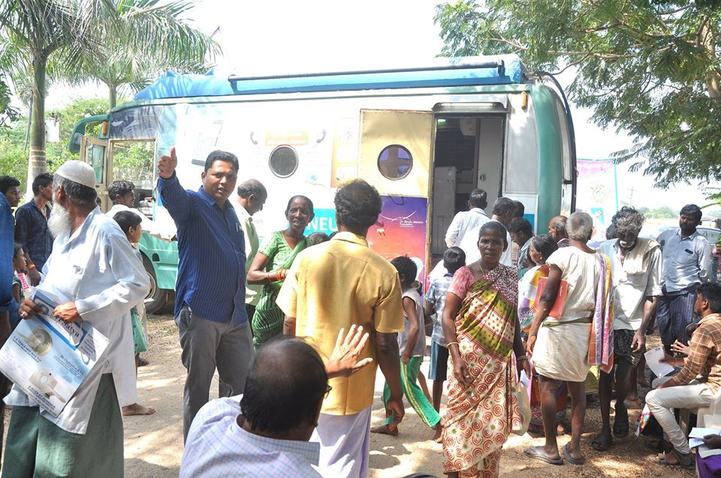
Schools/colleges/organisations
Neurology Health Hub
Persons of importance
Stroke mnemonic
General Public
Stroke prevention campaign
Teleawareness programme
Women
EDuWAND
Patient and public involvement and reducing the treatment gap
Empowering patients
Promising strategies
Health apps
Caregivers
Podcast, Media
Rural Resource poor
Neurology on wheels
Disease specific
Support groups

Slide 7
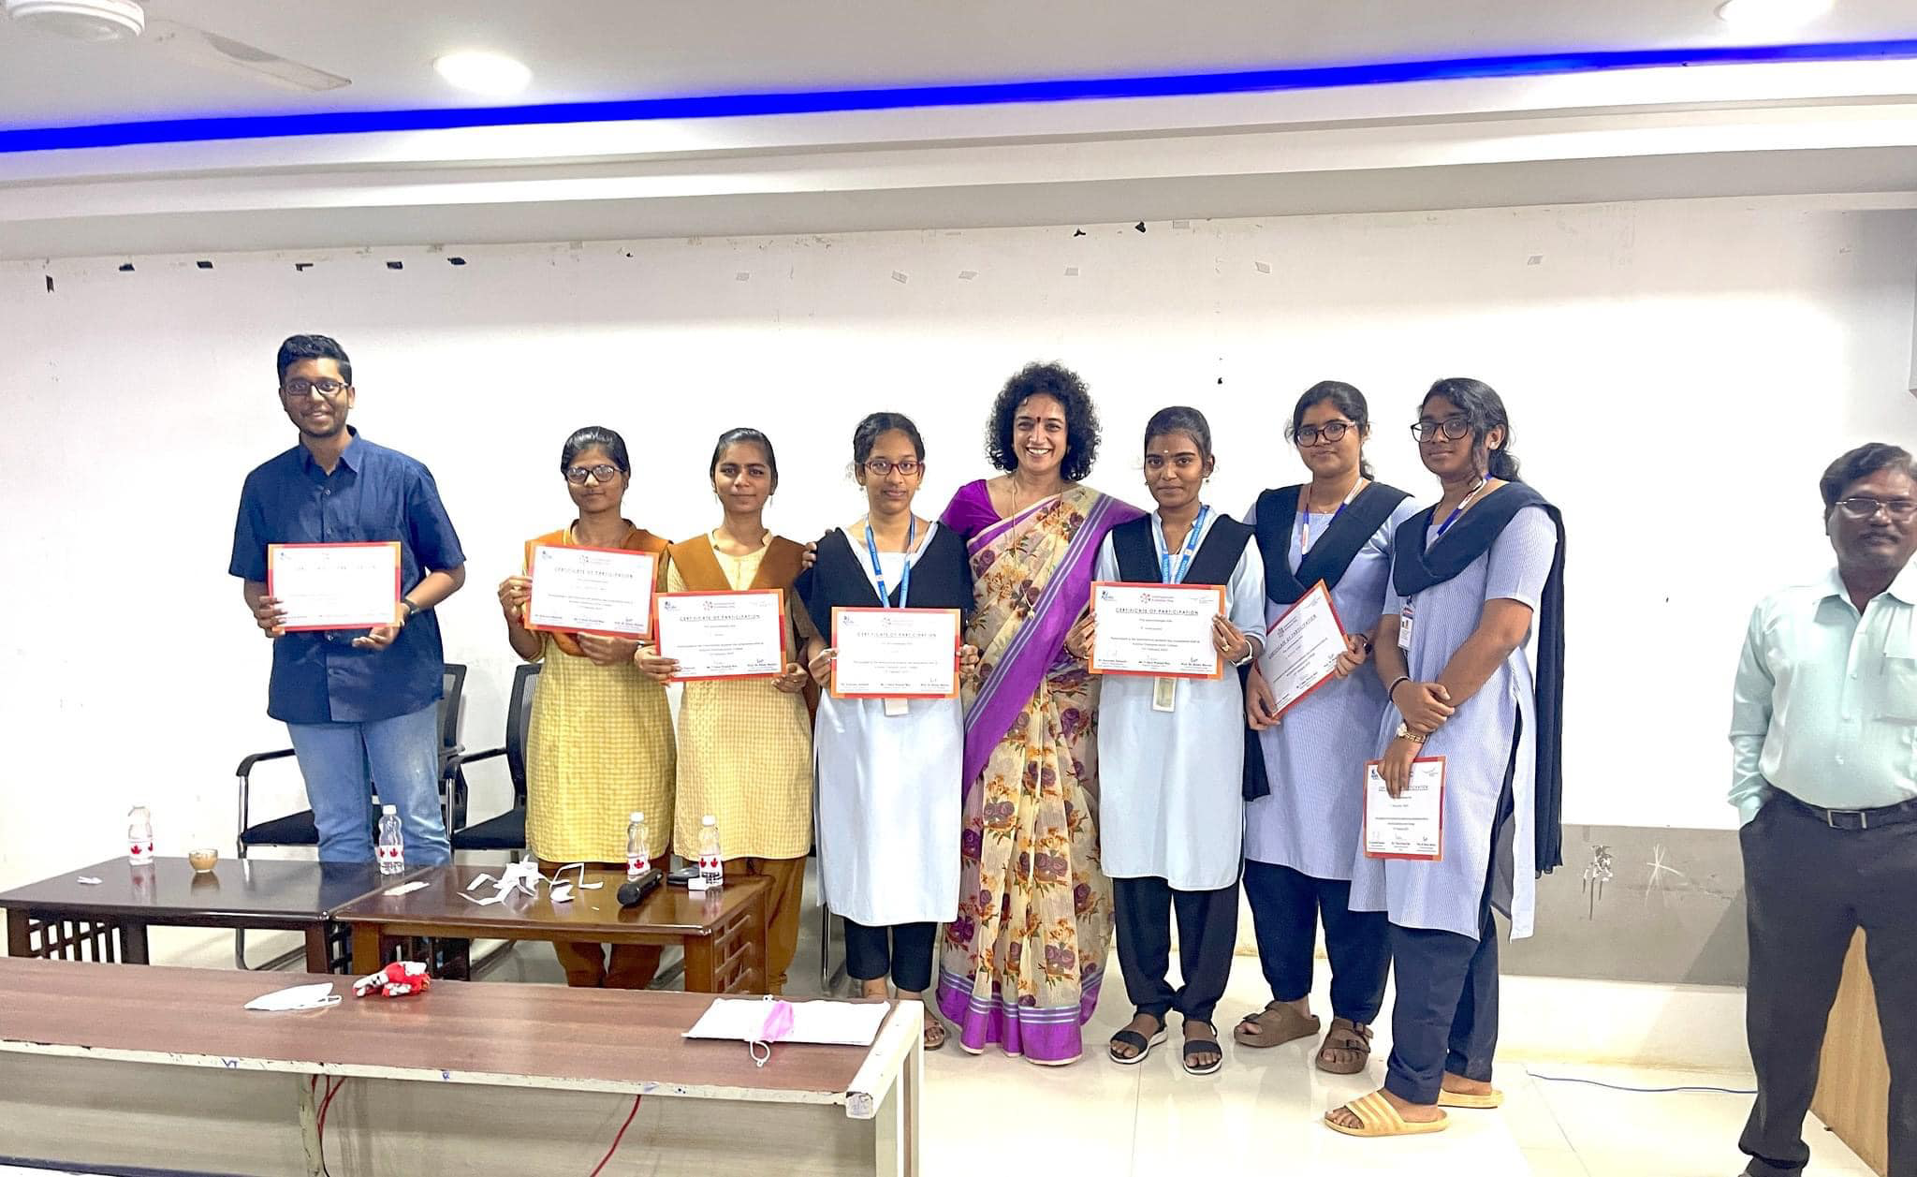
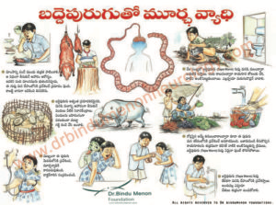
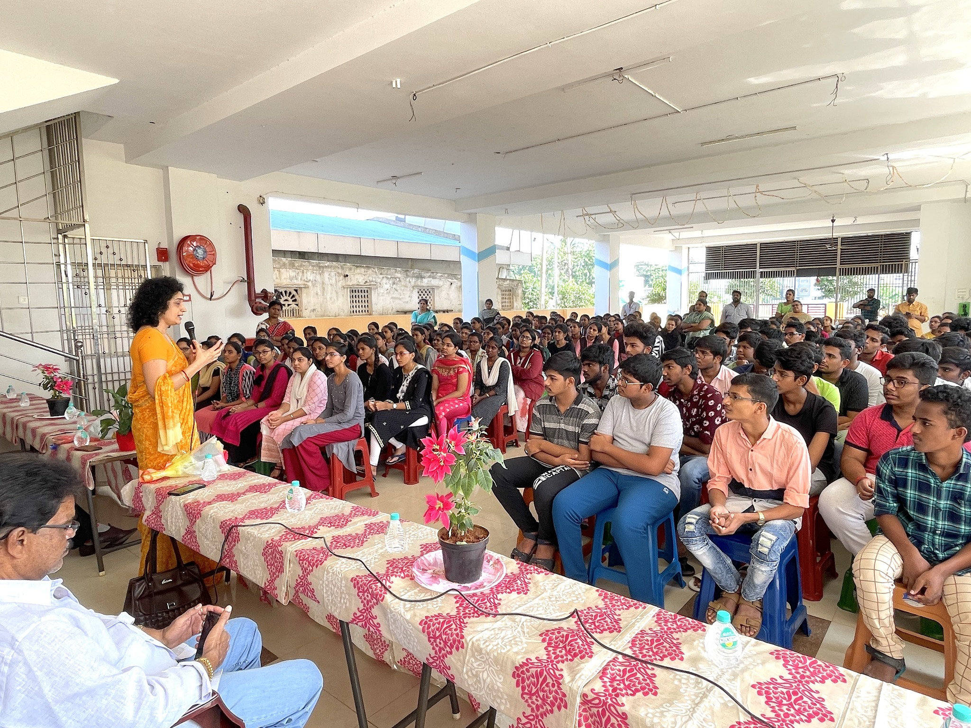
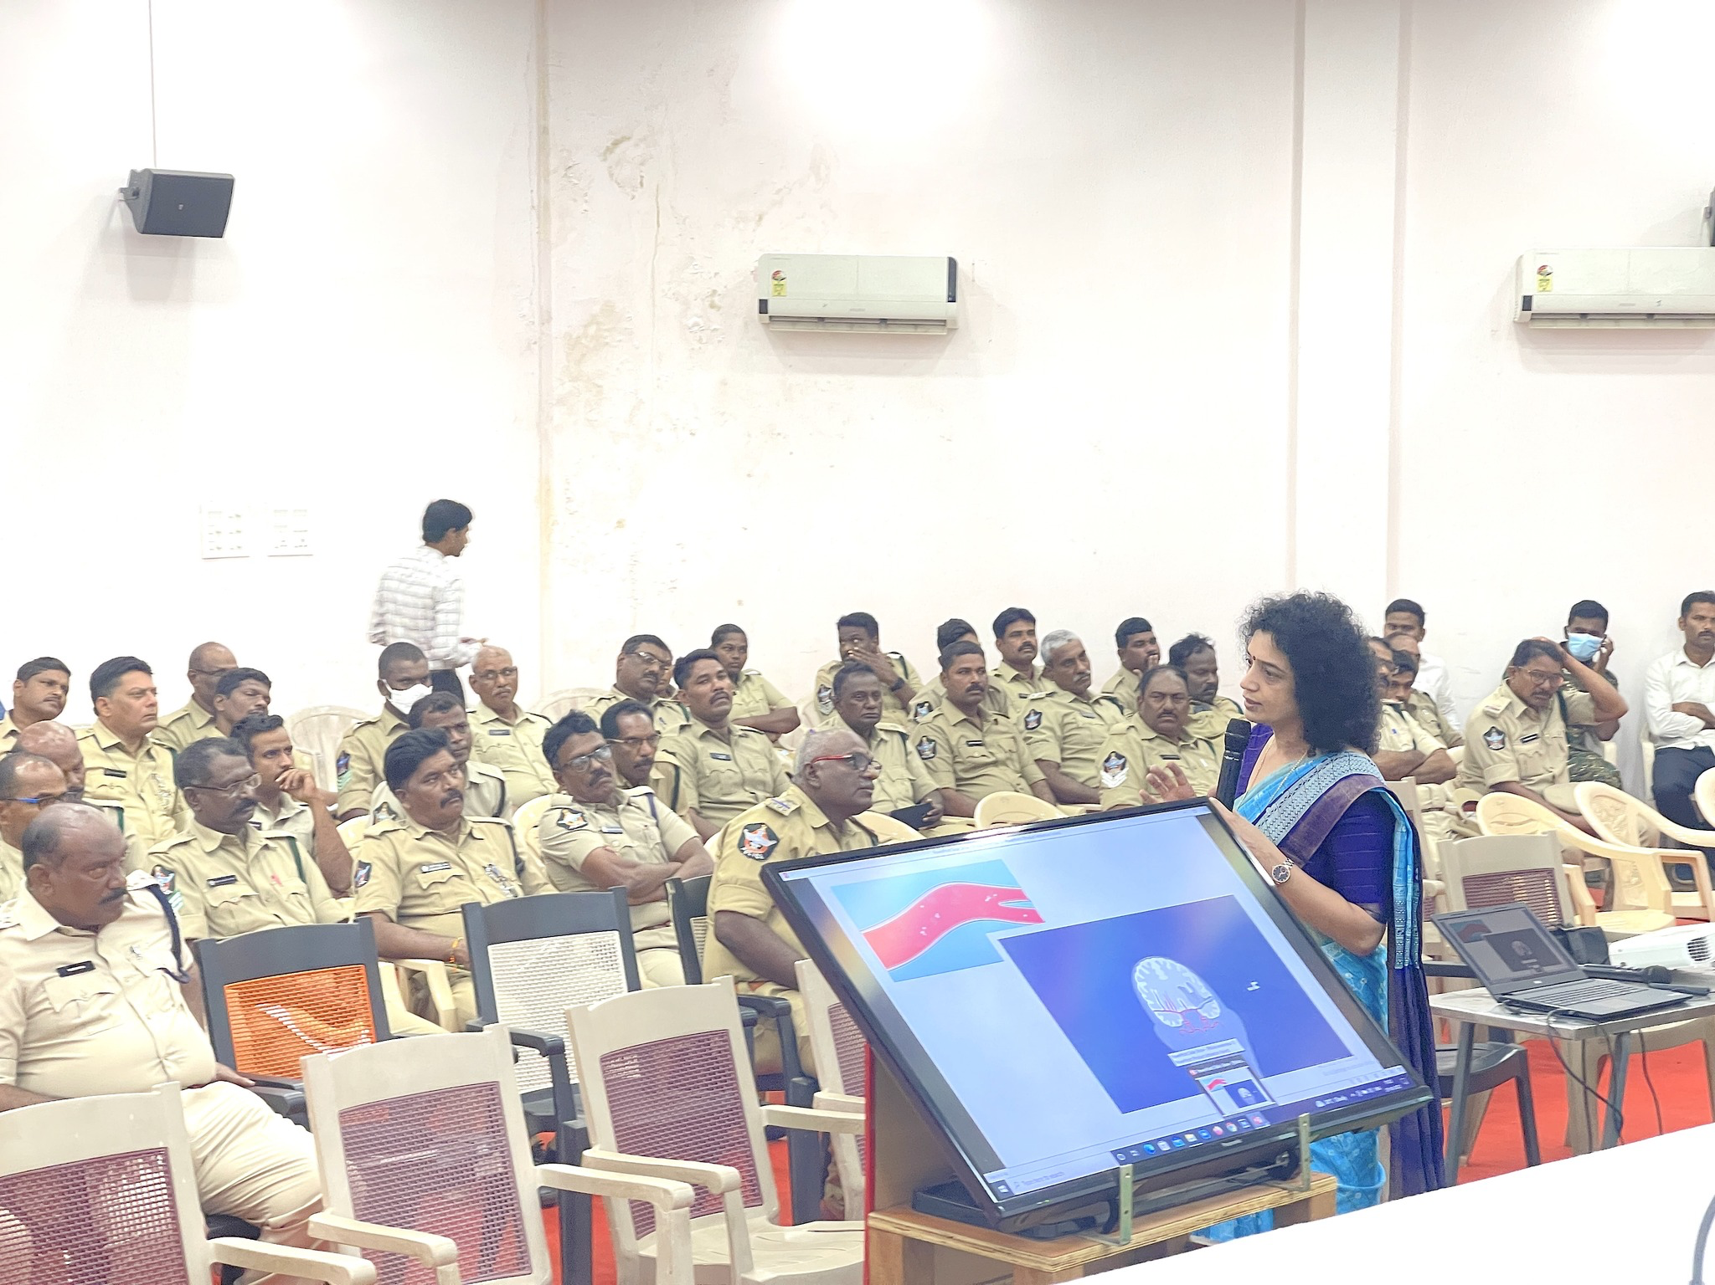
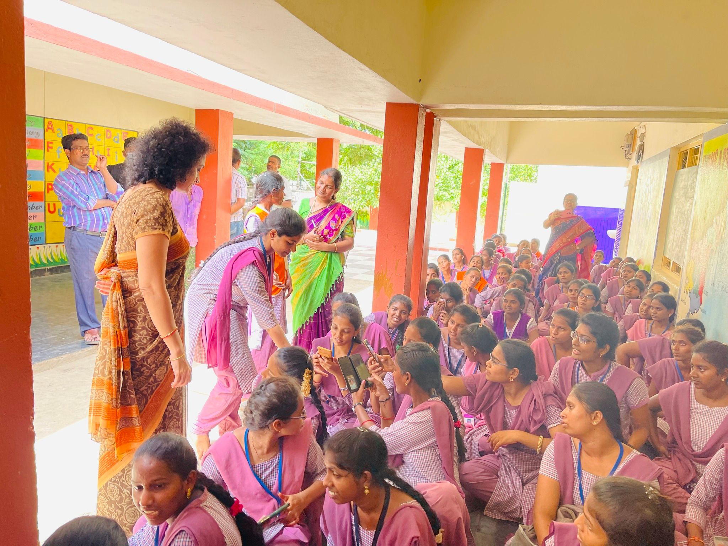
Schools/
Colleges/
Organisations
Neurology Health Hub
Need of the project
Primordial and primary prevention
Outline of project
Questionnaire is distributed
Awareness Programme is held
Posters pamphlets, comics is distributed
Games, competitions are held
Collaboration and impact
DMHO
DVEO
Commissioner of intermediate education
Principal
Teachers
Students
Lions, Rotary, Red cross

Slide 8
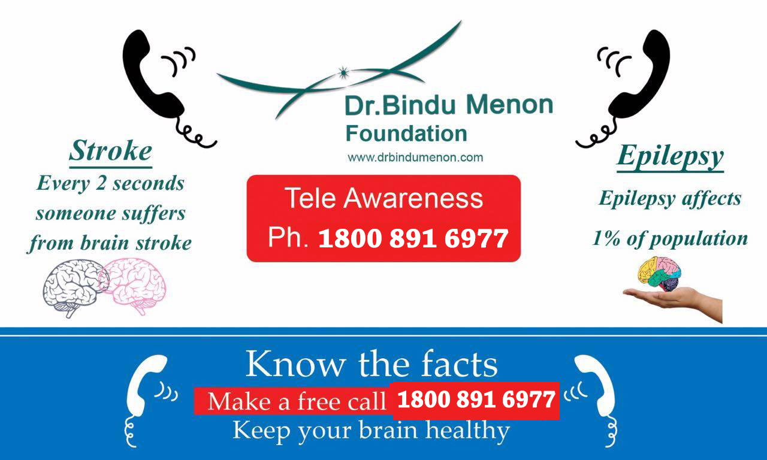
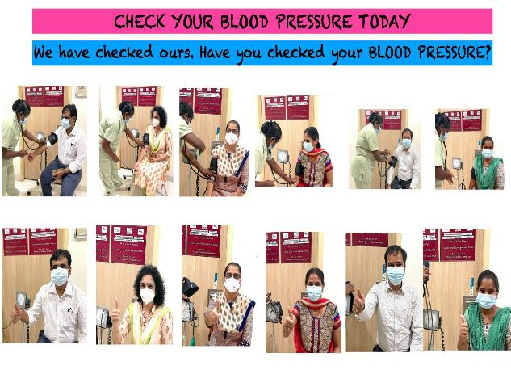
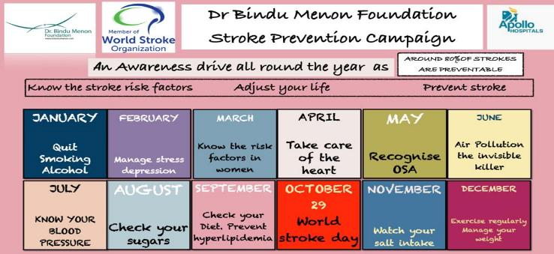
Stroke mnemonic
Stroke prevention campaign
Teleawareness programme
Need of the project
Primordial/primary prevention
Awareness of stroke, epilepsy and migraine
Outline of project
Stroke Prevention campaign FB page was created and activity for 1 year
Stroke mnemonic in Telugu
Toll free number for recorded information
Collaboration and impact
Celebrity
General public
Social media users
Across all ages
Sharing and forwarding

Slide 9
EDuWAND
EDucating Women About Neurological Diseases
Women
EDuWAND
Need of the project
Educating a woman would in turn educate the whole family.
Outline of project
1) Brain health
2) Risk factor identification
3) Risk factor prevention
4) FAST and local language (Telugu stroke mnemonic.
5) Preparedness during a stroke attack.
Collaboration and impact
Self help women group
Organisations with women employees

Slide 10
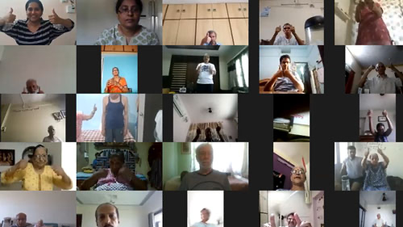
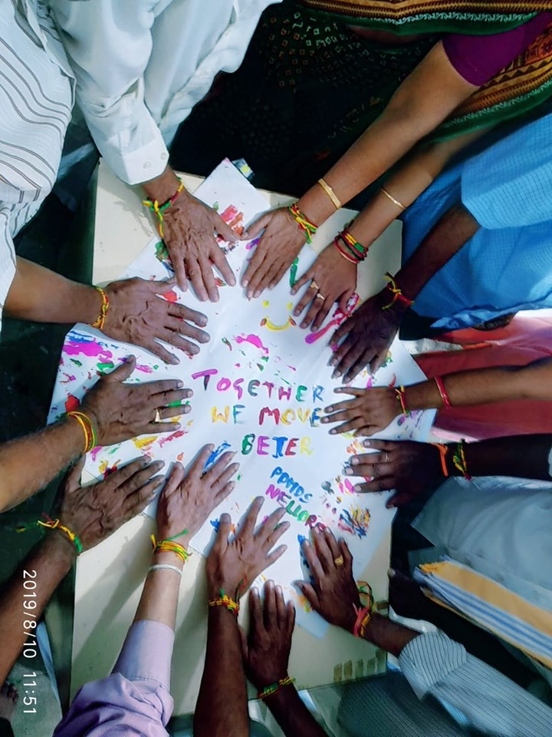
Disease specific
Support groups
Need of the project
A platform for patients to connect to others who are suffering with same disease
Outline of project
1) Weekly online exercise sessions
2) Phone counselling
3) Information
4) Online sessions for caregivers
Collaboration and impact
Patients and caregivers
Across pan India

Slide 11
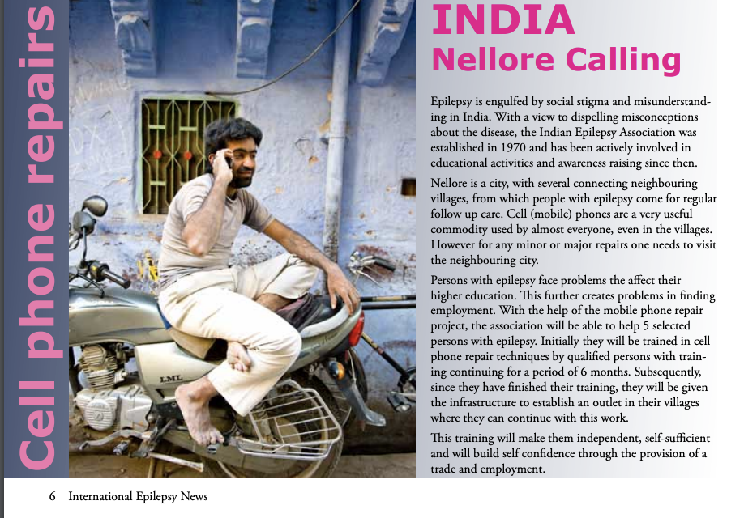
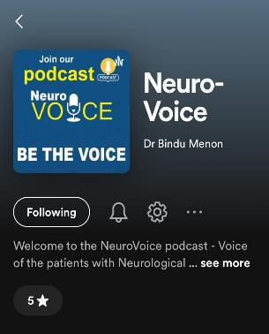
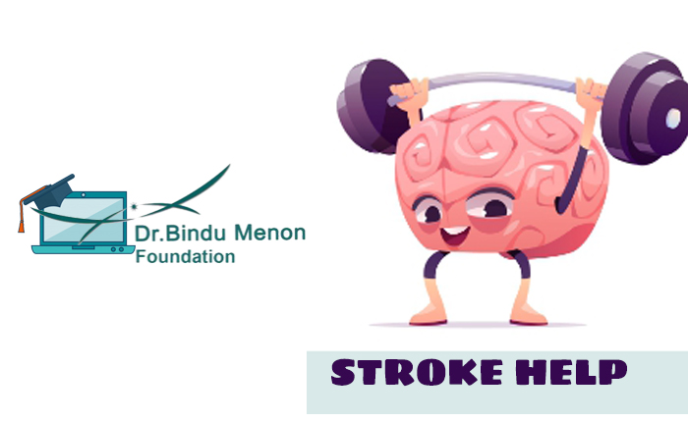
Caregivers
Podcast, Media
Promising strategies
Health apps
Need of the project
Opportunity to speak out
Opportunity to earn and seek job
Outline of project
1) Empowering patient
2) Lobbying with collector
3) Giving a voice to the patient
/caregiver.
4) Connecting with health provider
with health apps
Collaboration and impact
Patients
Caregivers
Legislative

Slide 12
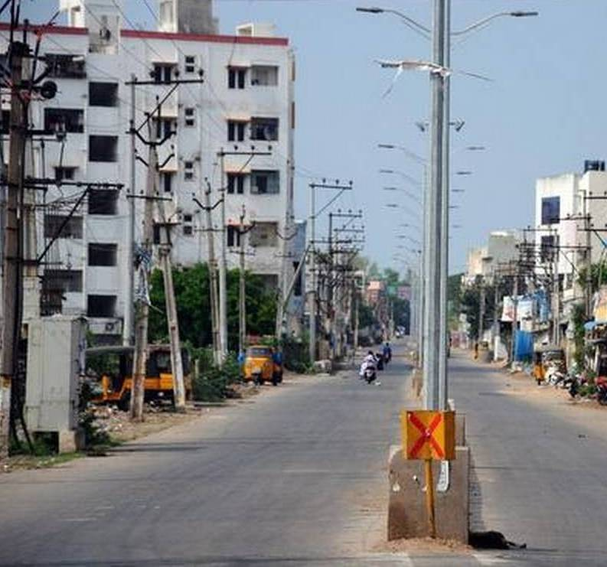
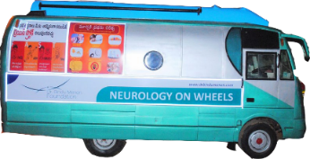
Geographic isolation Neurology on wheels
WE REACH
WE TEACH
WE TREAT
Ministry of Statistics and Policy Implementation
Reaching out to the rural community

Slide 13
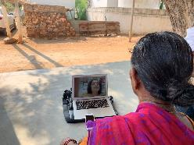
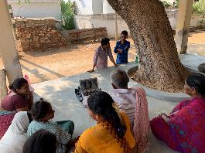
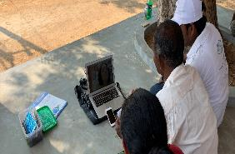
Continuum of care
Prevention
Pre hospital
We care
Post stroke care
Acute stroke care

Slide 14
Poll 4
Should the patient and their caregivers be involved while planning guidelines for patient care
Yes
No

Slide 15
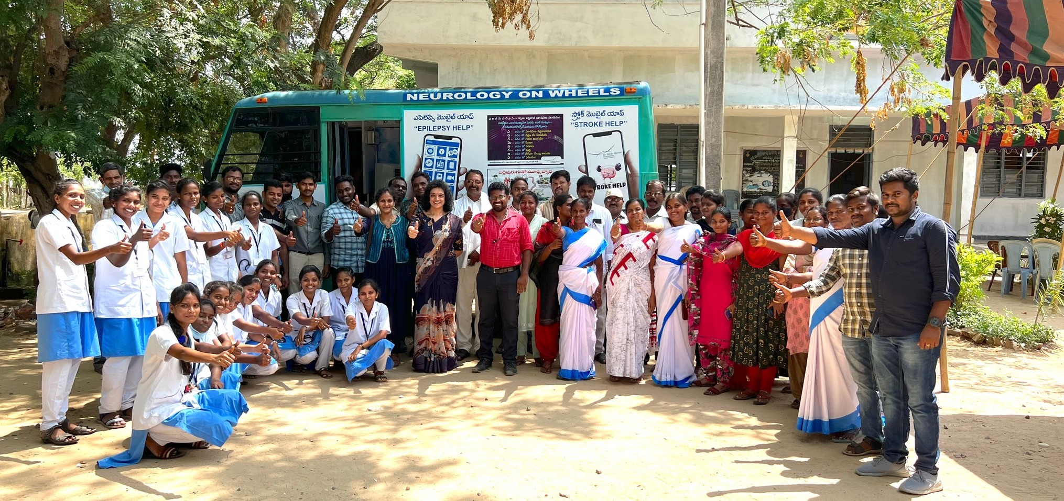
Thank you

