Slide 1




patient & public engagement in research
Dr Ava Easton (PhD)
Chief Executive, Encephalitis Society
Hon SENIOR Fellow, Dept. of Clinical Infection, Microbiology and Immunology, University of Liverpool, UK

Slide 2

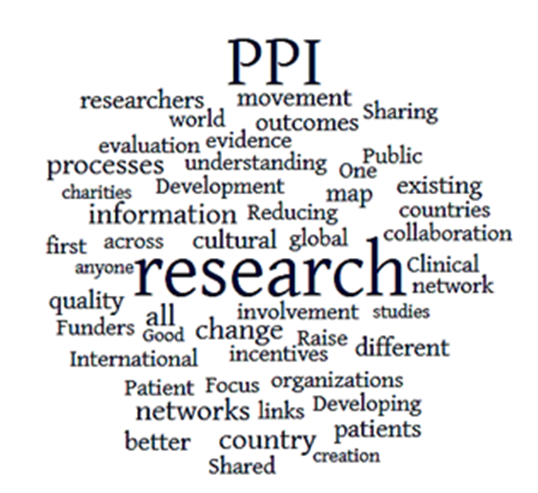
Welcome
This presentation will give you an overview of what patient and public involvement (PPI) is along with some examples of PPI in action.

Slide 3
What do we mean by patient and public involvement?
Involvement - research being carried out ‘with’ or ‘by’ members of the public rather than ‘to’, ‘about’ or ‘for’ them
Participation – where people take part in a research study
Engagement – Where information and knowledge about research is provided and disseminated

Slide 4
why?
Offers a different perspective from rest of the research team
Potential to improve the research quality and relevance
Moral imperative, as research targeting populations or services, publicly funded
Standards for research

Slide 5

National Institute for Health Research states…
“We expect the active involvement of members of the public in the research that we fund. We recognise that the nature and extent of active public involvement is likely to vary depending on the context of each study or award.
Members of the public will review your research proposal and they also sit on our funding and commissioning boards and panels to support our decision-making.”

Slide 6
The NIHR have produced standards and it is envisaged that all funded studies will eventually be expected to apply and report against these standards going forwards. The COVID-CNS study will be using them too.

Slide 7

“No matter how complicated the research, or how brilliant the researcher, patients and the public always offer unique, invaluable insights. Their advice when designing, implementing and evaluating research invariably makes studies more effective, more credible and often more cost efficient as well.”
Professor Dame Sally Davies
Dame Sally Davies s a British physician and academic administrator. She was the Chief Medical Officer for England, and the Chief Scientific Adviser at the Department of Health

Slide 8

Video Exemplar of PPI in A patient organisation

Slide 9
What A PPI panel might do…
Attend
Attend PPI panel meetings For the duration of the study.
Provide
Provide a patient or public perspective on discussions.
Respond
Respond to written or verbal communications about the study between meetings.
Maintain
Maintain the confidentiality of discussions and information relating to the study, meetings and any related activities.
Report
Report to the panel any studies or information which highlights patient related issues that may inform the work of the group.
Explore and gather
Explore and gather feedback from patients/families in respective organisations.
Feedback
Provide feedback on study materials and information.
Disseminate
Help with dissemination of study findings and any new materials/information for public policy and practice.

Slide 10


Patient and public involvement in action
Https://www.Liverpool.Ac.Uk/covid-clinical-neuroscience-study/patient-and-public-involvement/
https://braininfectionsglobal.tghn.org/community/ppcei/

Slide 11
1978-2017, 61 studies in 34 LMIC.
Most common stage for involvement was research planning
Most common level of involvement was collaboration
Most studies documented no evidence of effectiveness nor impact of PPI
Impact where mentioned was from the researcher’s point of view
PPI needs more focus and should be reported upon fully and evaluated at the end of research studies
Notes:
This recent paper by Cook et al states that this issue of tokenism I spoke of earlier is even more acute when considering research undertaken in low to middle income countries. The paper which came out in 2019 was a systematic review of 61 papers looking at patient and public involvement in health research in 34 low to middle income countries, looking at papers between 1978 which was the inception date of The Who declaration that I mentioned earlier and December 2017.
They looked at 4 aspects of research: pre research where this was about identifying prioritising and commissioning research ; Planning which was about designing and managing research; undertaking research and finally post research which involved disseminating implementing and evaluating impact. They coded each of these 4 aspects against 3 levels of involvement . The first being consultation which is asking the public for their views and using them to inform decision making comma the second being collaboration which was about ongoing partnerships between research teams and members of the public where the decisions about the research was shared comma and finally user controlled research which is research that's actively controlled directed and managed by patients and the public.
They found that the majority of research including PPI was primary research so either developing or piloting interventions with some qualitative research and some looking at research methods and design or research priorities.
The most commonly cited impacts of patient and public involvement included increased relevance to the community, empowerment of participants, and alterations in trial design . Further benefit reported was improved quality of the results as a result of patient and public involvement.
Some studies reported difficulties of patient and public involvement focusing on the extra time and money required to have patient and public involvement in their study and this is a concern that I share as certainly this BIglobal study has resulted in a good deal more time and money then was costed into the original study. So if funders and researchers want to genuinely engage with PPI they need to cost it at full cost analysis.
Patient and public involvement was found to be secondary to reporting the study results and was relegated often to only a few sentences in the paper if any at all.
Of particular note in this systematic review was that the authors found that most of the impact reported was from the researcher’s perspective and not those of the patients, and was often reported as an aim rather than an evidence based outcome. Indeed in some cases they noted the impact was not reported at all, with Research teams simply not reporting patient and public involvement in research publications following their studies . Interestingly this poor reporting of patient and public involvement isn't unique to research in low to middle income countries as a further paper by Mockford et al and Brett identified similar problems in high income countries also .
It was heartening however that PPI was being used in studies and particularly in studies in low to middle income countries . Of particular note in their research was that in low to middle income countries most of the PPI was during the planning stage of the research and not simply using patients and the public to disseminate study research already conducted.
There is a long established literature setting out both Consumerist and Democratic reasons for involving patients and the public in research however this systematic review by Cook and colleagues found a third reason dominated, and that was one of Pragmatism - particularly where PPI was being involved in low to middle income countries, for example they found PPI enabled study researchers to liaise at a grassroots level with local leaders in their local dialects and also to remain alert to local sensitivities . They were identifying topics relevant to the community and gained access and acceptance into those communities. Their involvement of PPI also ensured that gatekeepers supported the research and facilitated access to the populations of interest . All of these are critically important roles for PPI in research particularly in low to middle income countries albeit not exclusively.
So this review suggests that there are lots of positive gains to be had from involving communities from low to middle income countries in research and that some of the complexities in those communities are things that PPI can help with through facilitating communication with local communities and adapting interventions for different cultures.
In conclusion patient and public involvement is still relatively new even in countries with a well established research tradition and it may take more time for it to gain traction in countries without this tradition. Patient and public involvement does happen in low to middle income countries health research but it is generally described using a different terminology and rarely are detailed patient and public involvement strategies published. At present the impact of PPI on both the participant and research is poorly documented and there is significant work needed to encourage closer engagement with end users of research. Cook and her colleagues conclude that in order to improve this low to middle income country research funders and Journal publishers should make patient and public involvement an explicit requirement and work also needs to be done on adapting pre existing PPI tools for use in low to middle income countries and encouraging their use.

Slide 12
Notes:
So with guidance lacking on how or when patient and public involvement should be incorporated… This paper describes a ppi process that occurred during the design and initiation of an international treatment clinical trial in multiple sclerosis. Whilst not perfect, and there is an accompanying commentary paper that outlines some of this study's limitations, this paper does give a nice overview of what good PPI might look like in practice.
Indeed their paper concludes by saying“ in the increasingly global framework of modern clinical trials, cultural and contextual differences between countries affect the relevance, design, conduct, analysis, and influence of research. The same cultural and contextual differences also pose challenges for designing effective PPI , which must be well planned, well resourced, and timely to be used to the greatest possible effect”.
I did note however that none of the patients or public involved in the study were authors of the paper so maybe we still have some way to go…

Slide 13
Other resources
https://www.nihr.ac.uk/documents/ppi-patient-and-public-involvement-resources-for-applicants-to-nihr-research-programmes/23437
https://healthtalk.org/patient-and-public-involvement-research/the-value-and-impact-of-patient-and-public-involvement-in-research
https://www.bmj.com/content/363/bmj.k5147

Slide 14


Many thanks for listening ava@encephalitis.info
@encephalitisava
Notes:
Thank you for listening.

