Slide 1
Identifying and addressing the excess burden of neural tube defects from CHAMPS Ethiopia: Transforming data to action
sScan webinar series, 12th October 2022
Lola Madrid
CHAMPS-Ethiopia site lead and Clinical Assistant Professor in Epidemiology

Slide 2
Outline
The size of the problem: prevalence of neural tube defects in Ethiopia
Prevalence of neural tube defects by type in Ethiopia
Mortality attributed to neural tube defects
Conclusions and Challenges with current estimates
The way forward in Ethiopia

Slide 3
The size of the problem: prevalence of NTDs in Ethiopia

Slide 4
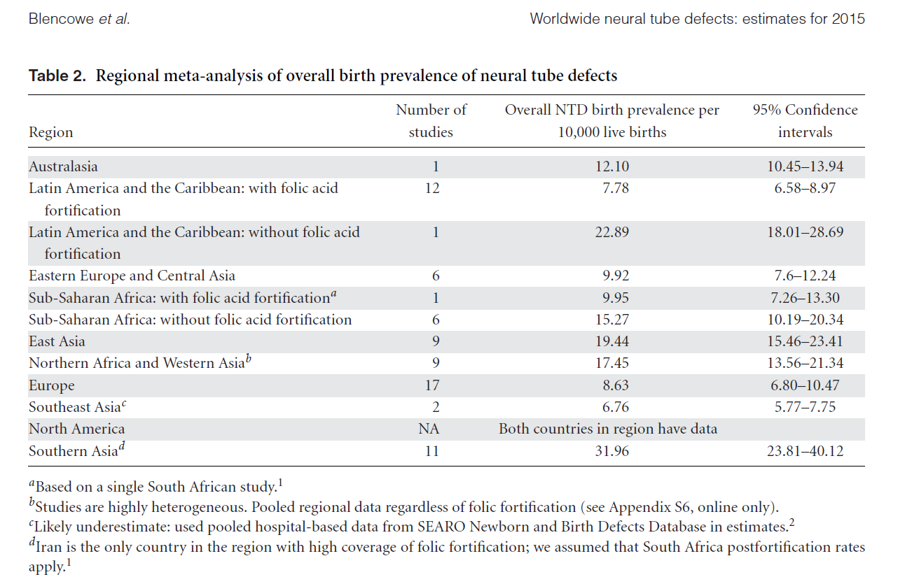
NTD prevalence - worldwide
Notes:
There is not real data on prevalence of NTD due to lack of robust birth defects surveillance in those countries where the prevalence is the highest. A worldwide systematic review of estimated global figures of NTD burden for 2015 done by Blencowe and colleagues, found 75 articles showing prevalence of NTD. They split it regions with folic acid fortification and without. We can see the difference in prevalence in same regions with and without fortification showing the impact of food fortification in such regions. In Sub-Saharan Africa, according to these estimates, countries such as South Africa with fortification had a prevalence of <1 pwe 1000 live births and the pooled prevalence estimated through other 6 studies in countries without food fortification was 1.5 per 1000 liver births.

Slide 5
NTD prevalence - worldwide
Notes:
This is another way to see the same, and we can see that SSA, as per the studies included in this review, was the 4th with the highest prevalence after Southern Asia, East Asia and West Asia and Nothern Africa. This SR estimated 260,100 NTD-affected birth outcomes worldwide (prevalence 18.6 (15.3–23.0)/10,000 live births).. Approximately 50% of cases were elective terminations of pregnancy for fetal anomalies or stillbirths. Only 6 studies from sub-Saharan Africa and only one from Ethiopia (hospital-based)

Slide 6
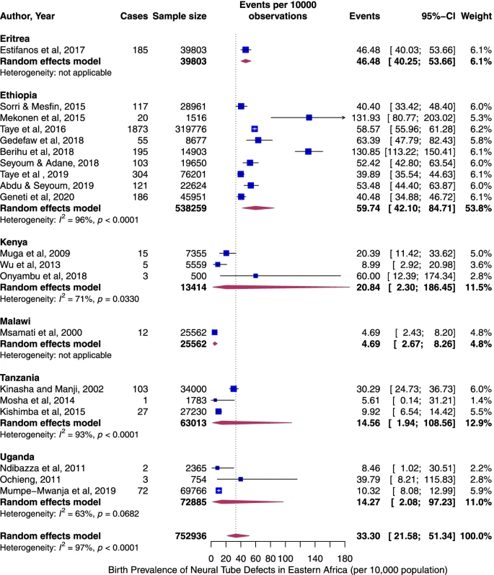
NTD prevalence – Eastern Africa
Birth prevalence of neural tube defects in eastern Africa: a systematic review and meta‑analysis. Paddy Ssentongo et al. BMC Neurology (2022) 22:202
Notes:
Let’s narrow a bit the scope of the prevalence and let’s focus now in the prevalence in Eastern Africa. This meta-analysis included 20 studies consisting of 752,936 individuals. The pooled prevalence of all NTDs per 10,000 births in Eastern Africa was 33.30 (95% CI: 21.58 to 51.34). Between-study heterogeneity was high (I2 = 97%, p < 0.0001), The rate was highest in Ethiopia (60 per 10,000).

Slide 7
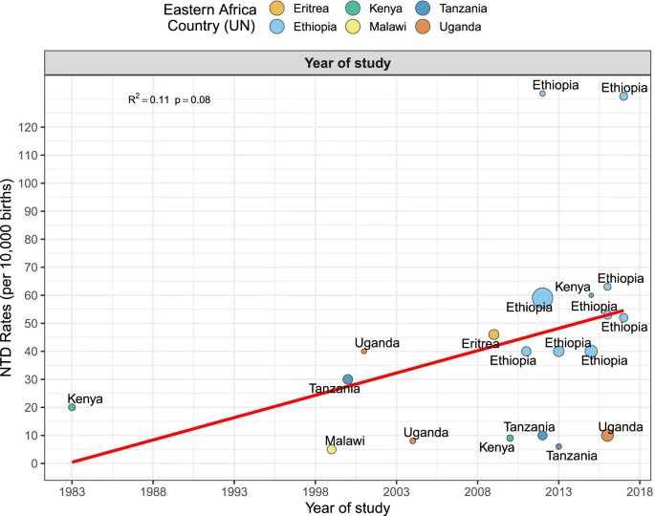
NTD prevalence – Eastern Africa
Birth prevalence of neural tube defects in eastern Africa: a systematic review and meta‑analysis. Paddy Ssentongo et al. BMC Neurology (2022) 22:202
Notes:
Temporal trend in the prevalence of NTDs in Eastern Africa. The birth prevalence of NTDs increased at a rate of 4% per year from 1983 to 2018.
Linear fit from linear regression model. Circles and color represent countries. The size of the circle is proportional to the sample size of each study

Slide 8
NTD prevalence – Eastern Africa
Most hospital-based. All Ethiopian studies were hospital-based
Birth prevalence of neural tube defects in eastern Africa: a systematic review and meta‑analysis. Paddy Ssentongo et al. BMC Neurology (2022) 22:202
Notes:
Let’s narrow a bit the scope of the prevalence and let’s focus now in the prevalence in Eastern Africa

Slide 9
NTD prevalence – Ethiopia
National pool prevalence
63 per 10 000 children
Per 10 000 births
No data
Notes:
This map shows the prevalence in Ethiopia as per shown in publications. Tigray and a hospital in Harar (Hiwot Fana Specialized Comprehensive hospital) have the higher prevalence, over 100 per 10 000 births, followed by Dire Dawa, Addis Ababa, Amhara region and Oromia. There is no publication, to my knowledge, from Afar, Somali, Gambella and the other regions shown in shadow.

Slide 10
NTD prevalence – Ethiopia
ALL hospital-based.
True prevalence UNKNOWN
Magnitude and Associated Factors of Neural Tube Defects in Ethiopia: A Systematic Review and Meta-Analysis. Zebenay Workneh Bitew et al. Global Pediatric Health Volume 7: 1–14, 2020.
Notes:
However, most of the studies were cross-sectional, only one was a cohort study (from Tigray), and all HOSPITAL BASED. The main problem with these figures is that they are likely overestimating the burden because only focused on children or birth outcomes in hospitals, and hospitals are more likely to attract complicated conditions such as NTD. However, they could even underestimate the burden, because they don’t include stillbirths or abortions, and as we have seen in the worldwide systematic review, around 50% of the NTD cases are estimated to be abortions or stillbirths that are not captured by these studies. So, the true prevalence is UNKNOWN

Slide 11
Prevalence of neural tube defects in Ethiopia by type

Slide 12
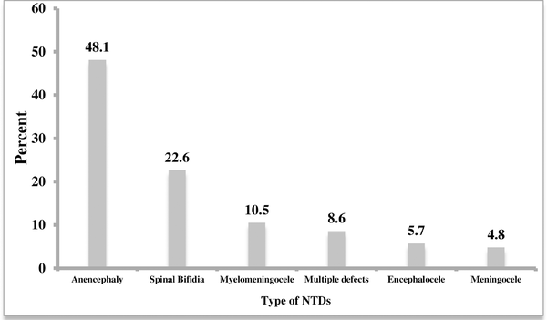
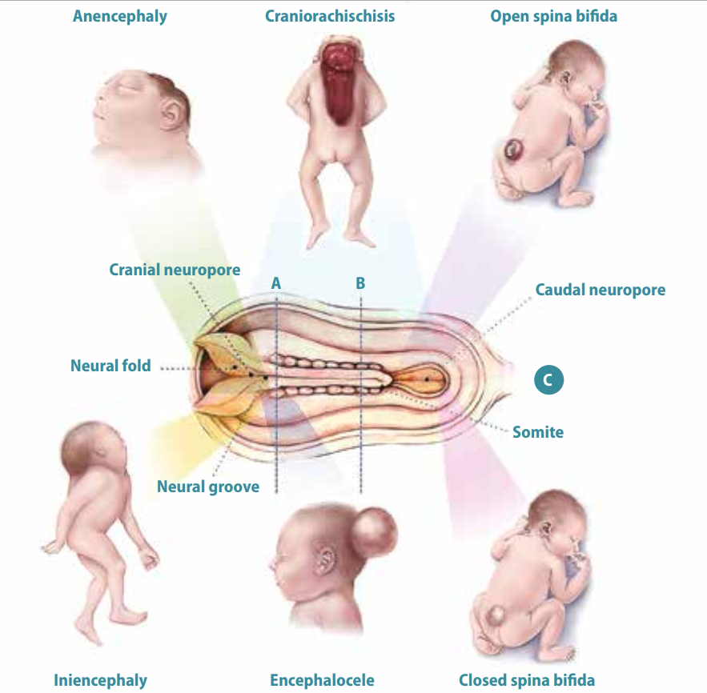
Prevalence of Type of NTDs in Ethiopia
Berhane A, Belachew T (2022) Trend and burden of neural tube defects among cohort of pregnant women in Ethiopia: Where are we in the prevention and what is the way forward?. PLOS ONE 17(2): e0264005. https://doi.org/10.1371/journal.pone.0264005
Notes:
There are different type of NTDs, that some experts relate with the severity of folic acid deficiency in the mother for folate sensitive cases. In a study done in hospitals in Eastern Ethiopia, the most common was anencephaly, which is incompatible with life, followed by spina bifida .

Slide 13
Mortality attributed to neural tube defects in CHAMPS
https://champshealth.org/

Slide 14
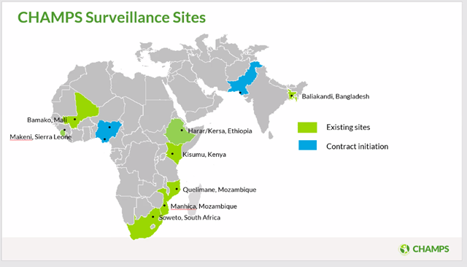
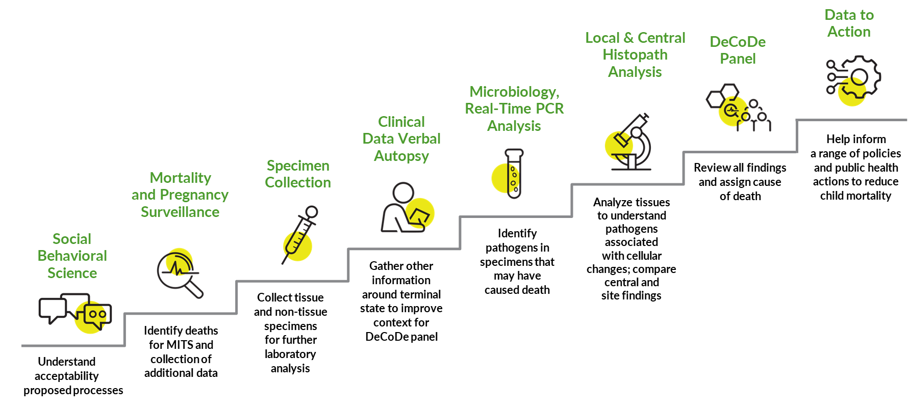
CHAMPS Network – Overarching Objectives
Track definitive causes of child mortality in sites throughout Sub-Saharan Africa and South Asia
Produce and disseminate high-quality data to inform policy and public health action
Enable sites to be able to leverage CHAMPS investment to prevent mortality
Notes:
Explain briefly what CHAMPS is doing in 1-2 minutes.

Slide 15
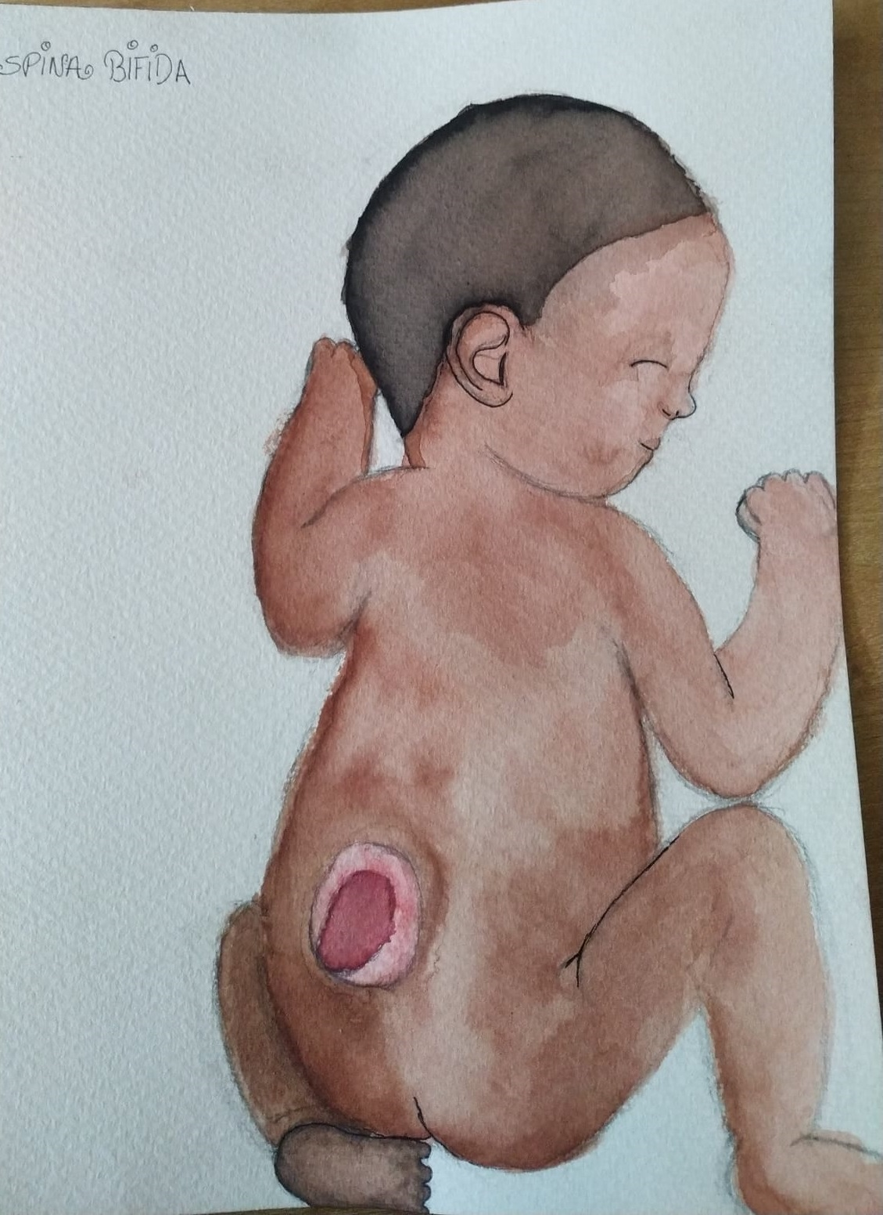
Birth defects and NTDs in CHAMPS sites
Jan 2017-December 2021
Other cause of death
All birth defects
Other birth defects
Neural Tube defects
Notes:
This is the cause-specific mortality fraction by CHAMPS site which is the proportion of all deaths with a cause of death determined where an NTD was identified within the causal chain. We can see that it is much higher in Ethiopia than any other site. When looking at the type of NTDs, anencephaly, craniorachischisis and iniencephaly, all incompatible with life, were the most prevalent.

Slide 16
Conclusions, challenges with current estimates and the way forward

Slide 17
Conclusions and challenges with current estimates
The prevalence in Ethiopia is much higher than in other countries worldwide and in sub-Saharan Africa
All data are from hospital-based studies
likely overestimating the burden of NTD among children born alive
Scarcity of data for abortions and stillbirths
True prevalence unknown due to the problems stated above

Slide 18
\
They way forward to estimate true prevalence
CHAMPS is implementing a NTD surveillance at the population level in Eastern Ethiopia (3 hospitals, 20 health centres and a community of >300 000 people)
It will generate data before and after a mandatory food fortification program is well implemented in Ethiopia
The experience of CHAMPS with this surveillance may serve as an example to implement surveillance across the country
We are working with the main hospital in the area to create a multidisciplinary team to improve the care of NTD cases
The project will also explore the feasibility and acceptability of a food fortification program with fortified salt (to be validated as a food vehicle) and community perceptions on NTDs and stigma

