Slide 1
Joint ECDC-EFSA rapid risk assessments on cross-border foodborne outbreaks
Johanna Takkinen, Principal Expert Food- and Waterborne Diseases
PANDORA workshop, 6 October 2022

Slide 2
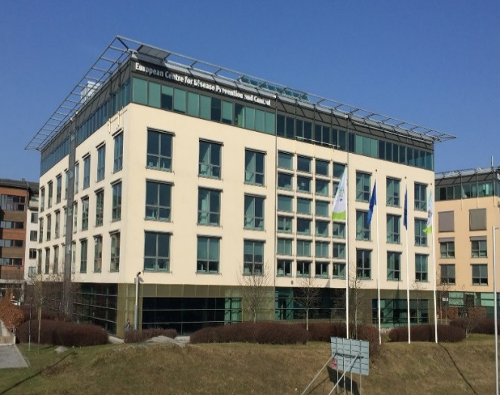
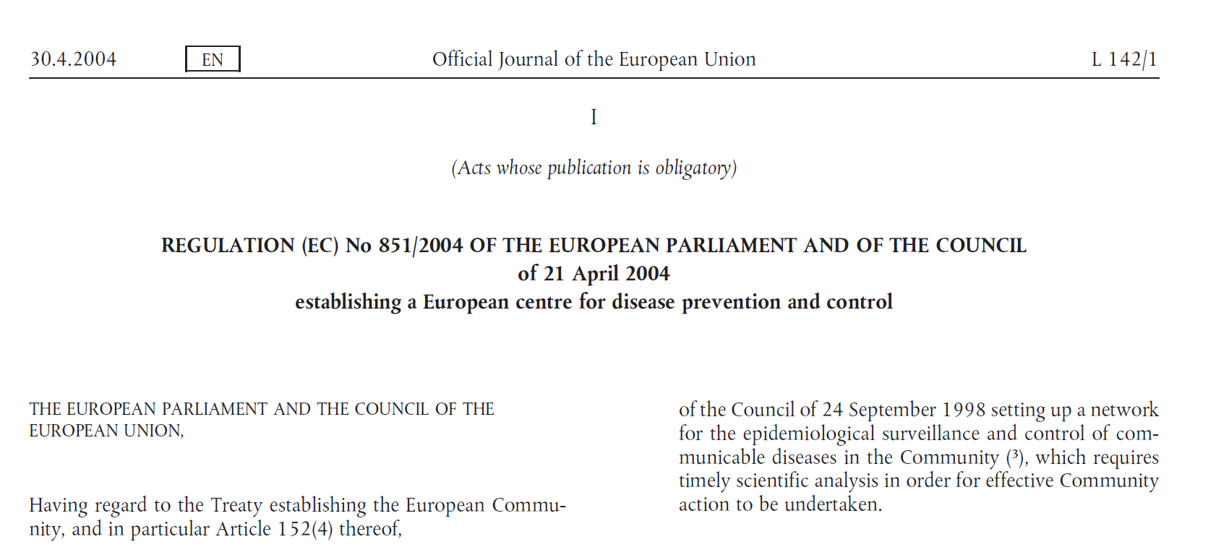
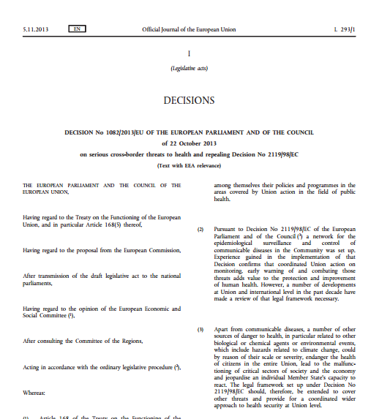
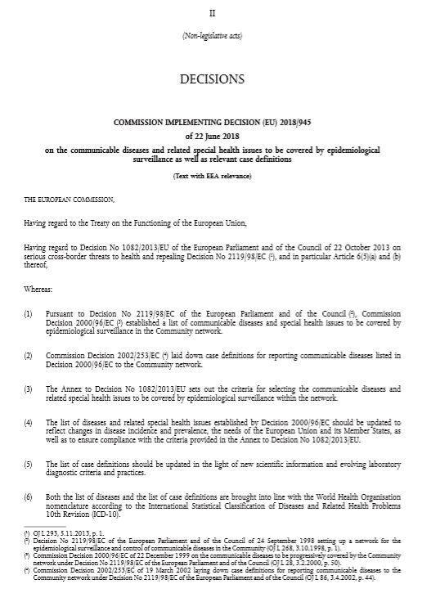
ECDC – European Centre for Disease Prevention and Control
Under revision
Regulation on ECDC 851/2004
Under revision
Decision 1082/2013 on serious cross-border threats to health
Decision 2018/945 on diseases under surveillance and relevant case definitions
Decentralised agency of the European Union, operational in 2005
Epidemiological surveillance of 56 diseases and special health issues (e.g. AMR)
Early Warning and Response System (EWRS)
Public health risk assessment
Preparedness and response planning

Slide 3
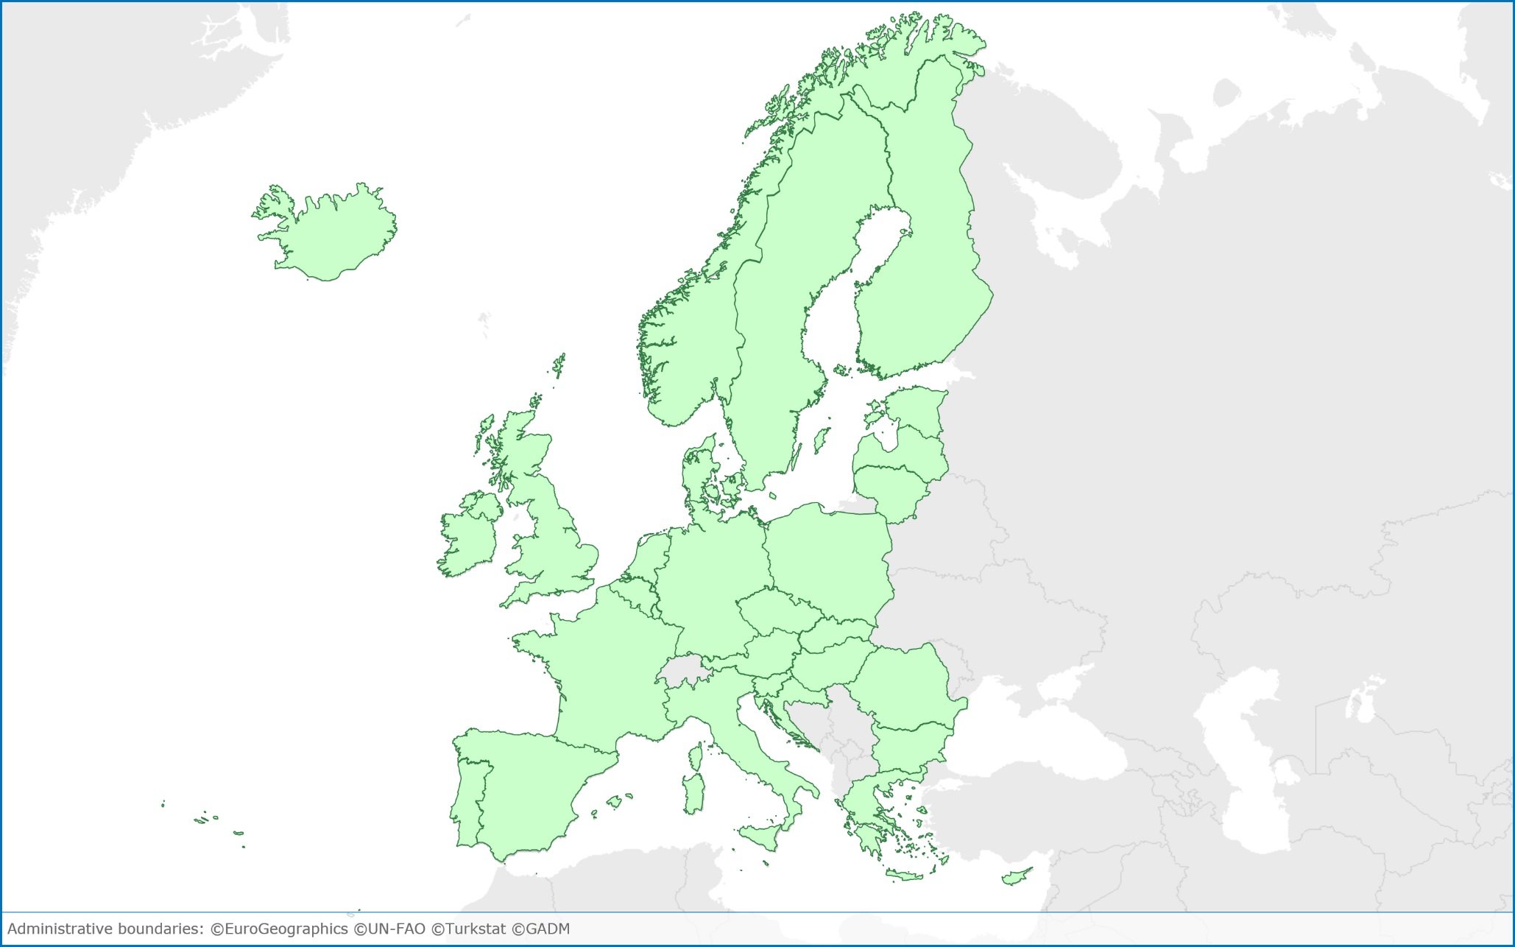



Public health and food safety networks in EU/EEA
EURL for Campylobacter, Sweden
EURL for foodborne viruses, Sweden
FWD-Net
EU/EEA
EURL for Salmonella, The Netherlands
Food safety, RASFF
Health security
EWRS
EURL for Listeria monocytogenes, France
EURL for VTEC, Italy
*RASFF = Rapid Alert System for Food and Feed
**EURL for VTEC=European Union Reference Laboratory for verotoxigenic E. coli

Slide 4


Public health risk assessment and risk management in the EU/EEA
 | EpiPulse | EWRS
Objective of the platform | Risk assessment | Risk management
Notification | Voluntary | Mandatory (Decision 1082/2013)
Type of notification | Informal | Formal
Participants | Disease/public health function networks’ epidemiologists/microbiologists (Public Heath Institutes and national laboratories) | Public health competent authorities Policy makers (Ministries of Health, European Commission)

Slide 5
Joint ECDC – EFSA rapid risk assessments outputs
Rapid evolvement
Number of countries and number of cases
Severity
Suspicion of food (type, trade)
Media interest
Need to inform general public or risk managers only
Joint Rapid Outbreak Assessment
Joint Notification Summary
Aim: assess cross-border foodborne public health threat
Active data collection, joint analyses
Agreed procedure
Published on agencies’ web sites
Aim: immediate notification of a cross-border foodborne risk to risk managers
Summary of available information
Restricted distribution to risk managers (RASFF, EWRS)

Slide 6




ECDC-EFSA Rapid Outbreak Assessment
INFOSAN
European Commission – food hygiene
European Commission – health security
Weekly teleconferences
PulseNet International
non-EU/EEA EpiPulse users
FDA, US
National reference laboratories (vet)
EURL
Member States
Member States
National public health institutes
FWD-Net
EU/EEA
National food safety authorities
RASFF
Member States
Member States
National public health laboratories
Data collection:
Centralised WGS analysis
Epi summary
Trace back and forward
ECDC-EFSA Rapid Outbreak Assessment
EURL = European Union Reference Laboratory
RASFF=Rapid Alert System for Food and Feed
FDA = Food and Drug Administration

Slide 7
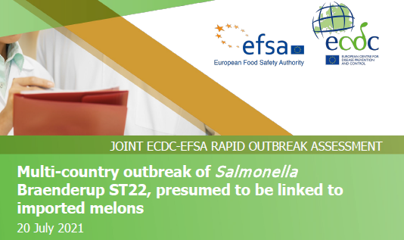

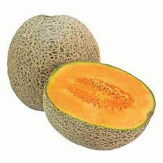

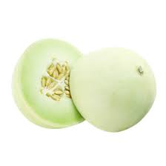
Multi-country outbreak of Salmonella Braenderup linked to imported melons, 2021 – opened by Denmark on 3 May 2021
Salmonella Braenderup ST22
358 cases in 12 EU/EEA countries and the United Kingdom
68 hospitalised
No deaths reported
Two samples of Galia melons imported from Honduras tested positive in the UK
Outbreak duration about three months
Source: https://www.ecdc.europa.eu/en/publications-data/rapid-outbreak-assessment-multi-country-outbreak-salmonella-braenderup-st22

Slide 8
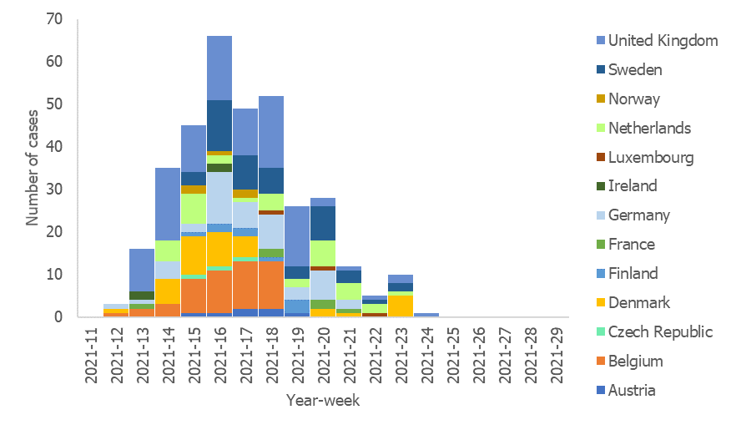
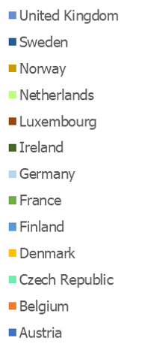
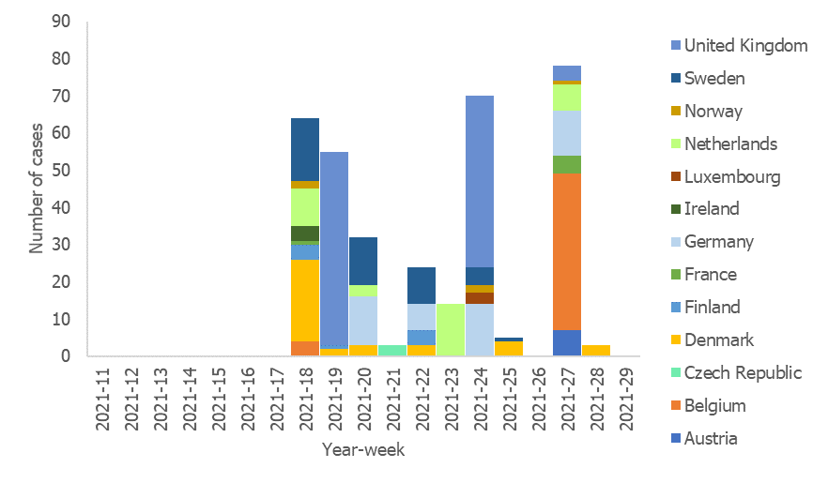
Response to S. Braenderup ST22 outbreak
3 May: UI by DK in EPIS
20 July: ROA
3 May: UI by DK in EPIS
20 July: ROA

Slide 9
Acknowledgements
EU/EEA countries and the United Kingdom
Public health epidemiologists and microbiologists (FWD-Net)
Food safety experts and authorities
EFSA
Valentina Rizzi, Mirko Rossi, Eleonora Sarno, Denise Pezzutto, Lorena Corredor
ECDC
Áine Collins, Margot Einöder-Moreno, Saara Kotila, Cecilia Jernberg, Taina Niskanen, Daniel Palm, Ettore Severi, Therese Westrell
European Union reference laboratories for Salmonella (RIVM, NL), Listeria monocytogenes (ANSES, FR), STEC (ISS, IT), Campylobacter (SVA, SE) and foodborne viruses (SLV, SE)

Slide 10

THANK YOU!

