Slide 1
One-Health Risk Communication
Prepared by
Dr. Mohammed Nour, MBBS, MD
Ministry of Public Health, Qatar

Slide 2
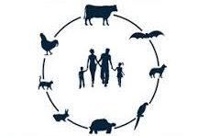
Risks shape our world today
Notes:
organisms have become more able to survive the climatic change with transformational coping mechanisms, but rather it can be conveyed from one end of the planet to the other within less than a day
Global Warming
Human-animal interface
Food and agriculture technology
Population Displacement
AMR
Terrorism
Other natural, manmade, or technological disasters can indirectly start an epidemics: Yemen and Haiti
Disasters can’t be prevented, but with the good preparedness its impact could be mitigated.

Slide 3
Core IHR2005 Capacities
Notes:
Surveillance to timely detect, report & investigate
Labs to diagnose
Hospitals to treat
Warning system
Human resources, legislation, $,
Threats: Zoonosis, Food safety, Radio-nuclear, Chemical and Physical

Slide 4
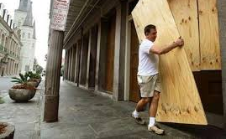
Risk Communication
“The real-time exchange of information, advice and opinions between experts, community leaders, officials, and the people who are at risk
an integral part of any emergency response.”
Notes:
Risk: Possible negative consequences.

Slide 5
Crisis Emergency Risk Communication (CERC)
Effort (by experts) to provide information to:
help people make the best possible decisions about their well-being
Accept the imperfect nature of choices during the crisis.”
within time constraints
Notes:
Effort (by experts) to provide information to help people make the best possible decisions about their well-being within nearly impossible time constraints and help people ultimately to accept the imperfect nature of choices during the crisis.” Decision during crisis is made within a narrow time constraint
with imperfect or incomplete info, may be irreversible, and its outcome may be uncertain.
Before the crisis hits: RCCE is ‘Warning or communicating the possibility that some bad thing might happen.
After it hits, it is perception, acceptance, and restore of resilience to respond and recove.

Slide 6
How the story began:
Notes:
The media was the first source for the information about the Qatari case to both the public and the some of the staff. It announced the case almost on Sep 23rd 2012 just hours after the HPA of the UK proclaimed the cornoavirus confirmation.

Slide 7
The national response:
Notes:
The novel disease make the news headlines.
SCH officials held a prompt press conference acknowledging the case as confirmed by the UK HPA and the WHO. The press conference was arranged in less than 24 hours after the media disclosure of the news. However, it needed to retrospectively collect information locally and internationally.
The press conference helped show the transparency and credibility of the health authorities. Spokespersons explained that despite good efforts were exerted by the medical team but it failed to manage the case as it was presented to them in an extraordinary features, where the patient family decided to take him abroad. They also tend to reassure the public that “no need to panic as only few cases reported so far”. Spokespersons were known credible persons to the Qatari community.
The officials were under tremendous pressure to bring answers (explain the situation, how bad, extend of the problem, what will happen next, who is at risk, how to prevent?)

Slide 8
No cases, but media interest, filling the vacuum
Notes:
Media depicts the novel virus as another SARS, linking it to travel
Over 7 weeks: 1 case, 1 press conference, 2 press releases, 1 TV interview and 16 news stories: how to strike a balance?

Slide 9
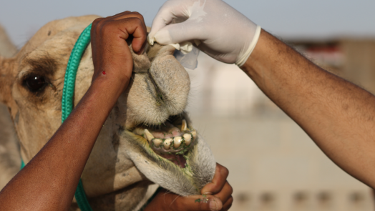
The turning point: The 1st days count
The communicators: RRT, Officials
Target: Camel owners
Message: risk assessment.
Outcome: Isolation of the virus
Camels were neither sick nor symptomatic.
Who takes the credit?
Notes:
The turning point: isolation of MERS from camels.
Denial and rejection. $ impact

Slide 10
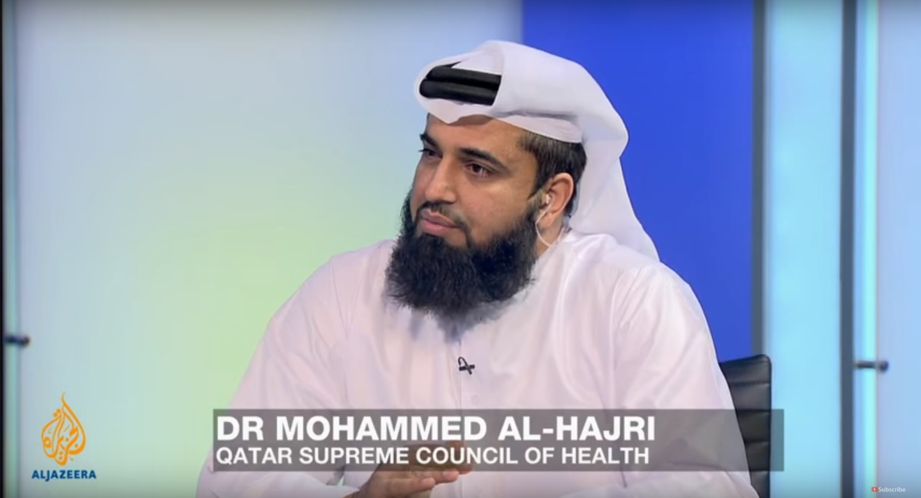
Prerequisites: Credibility and Public Trust
Showing Competence,
Simplification of science,
Timely release of facts,
Officials’ accountability for their judgements and risk perception decisions,
Watch for possible conflict of interest to be averted.

Slide 11
Streamlining conflicting agenda: Public Health and Animal Health
Sporadic cases
Poor risk perception
Denial
Stigma?
Notes:
Denial: Not to take a blame, conflict of interest. Not to look week: lack of, or insufficient, resources to investigate and control. Business

Slide 12
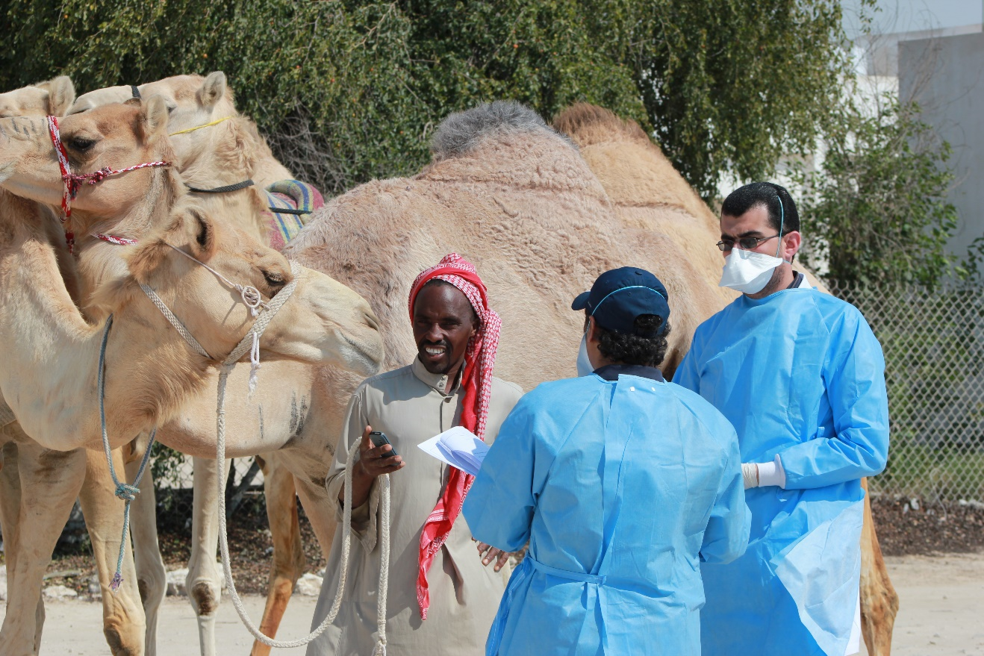
Further risk assessment
Notes:
All other domestic animals were free from the virus

Slide 13
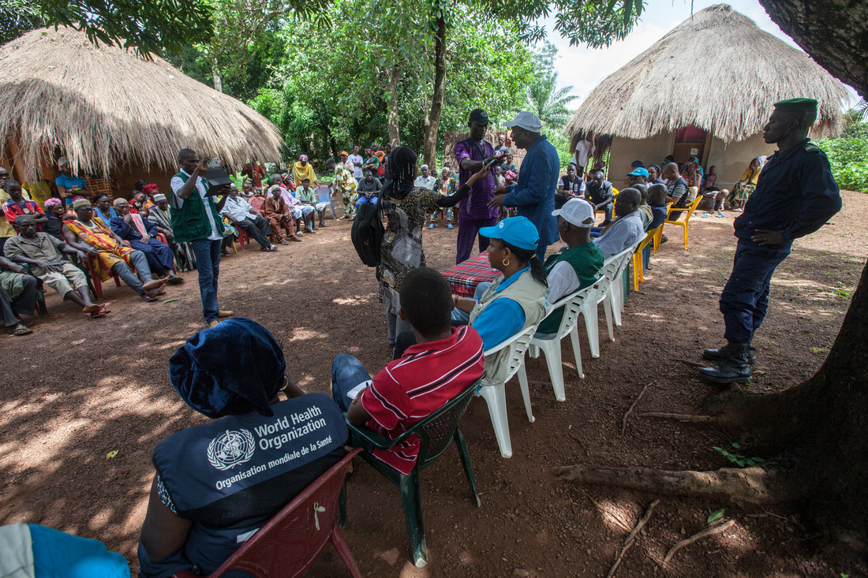
Community Engagement
The process to enable stakeholders work together to:
address health-related issues,
Promote well-being
Gain positive outcomes
Notes:
The WHO Definition:
The process of developing relationships that enable stakeholders to work together to address health-related issues and promote well-being to achieve positive health impact and outcomes

Slide 14
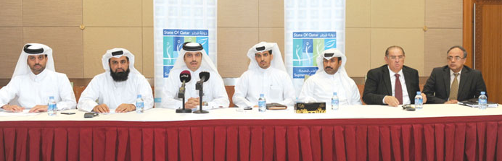
One health, one team..

Slide 15
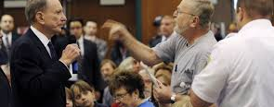
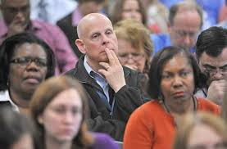
Community Engagement
Collaborative work
People affiliated by common interests
Partnerships,
mobilizing resources & influencing policies
Notes:
I believe this is the cardinal goal for the RCCE action. Agency for Toxic Substances and Disease Registry (ATSDR) introduced a working definition for Community Engagement that reads: “the process of working collaboratively with and through groups of people affiliated by geographic proximity, special interest, or similar situations to address issues affecting the wellbeing of those people.
It is a powerful vehicle for bringing about environmental and behavioral changes that will improve the health of the community and its members. It often involves partnerships and coalitions that help mobilize resources and influence systems, change relationships among partners, and serve as catalysts for changing policies, programs, and practices

Slide 16
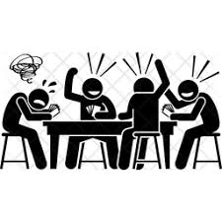
Persistent challenges
90% of the RC problems are not RC problems
Many practice RC unmindfully, ill-prepared
Insufficient resources (human and others)
RC is poorly integral to the EPR
Historical barriers to sharing data

Slide 17
The future:
Building competences
More teamwork in peace times
Agreements to share risks and benefits
Engage the public, and give them the right to decide

