Slide 1
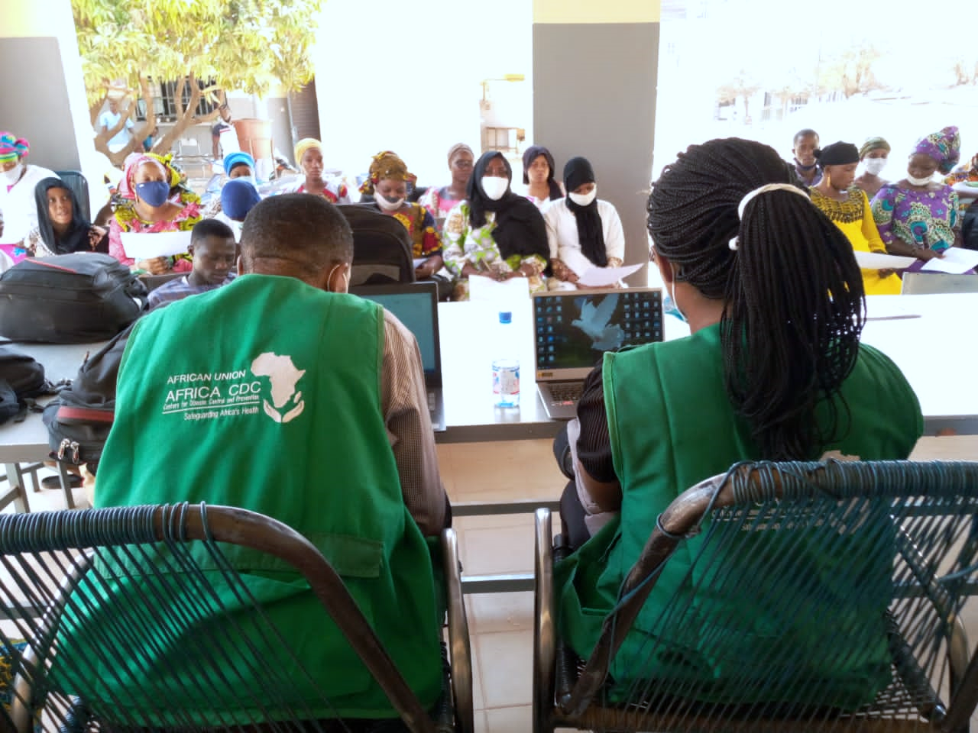
Adopting a One Health Approach to Zoonotic Disease Risk Assessment and Risk Communication
Risk Communication and Community Engagement for a Better Response to Zoonotic Diseases in Africa
Dr Benjamin Djoudalbaye
Head - Policy, Health Diplomacy and Communication, Africa CDC
7 October 2022

Slide 2
Africa CDC New Public Health Order for Africa
To respond to current and emerging public health emergencies including zoonotic diseases, Africa CDC is guided by the New Public Health Order for Africa (NPHO).

Slide 3
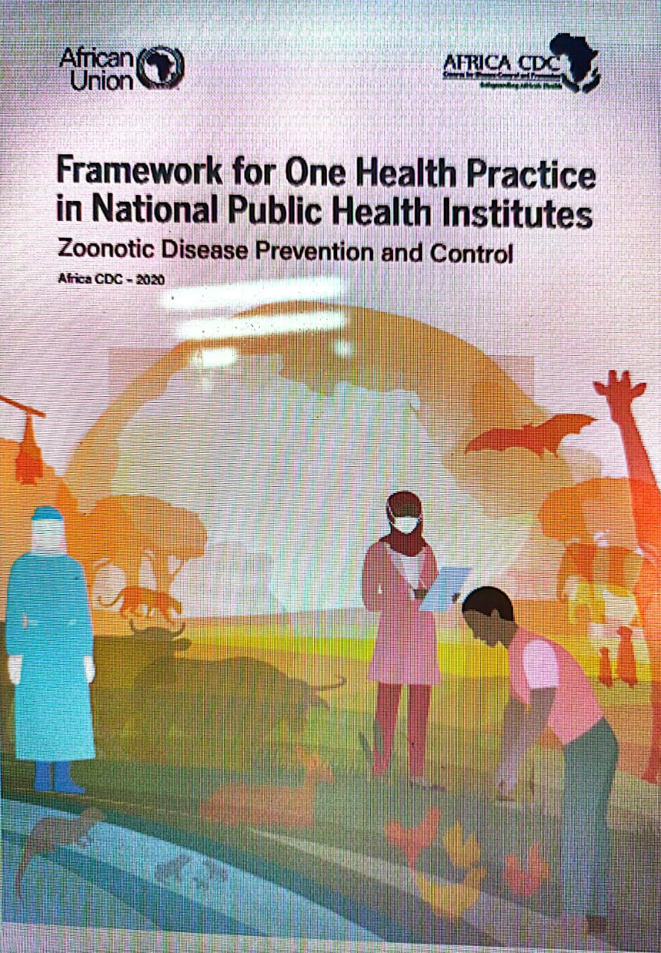
One Health Approach at Africa CDC
Africa CDC endorsed the One Health Approach to address shared health threats at the human-animal-environment interface for a safer and healthier Africa;
Framework for One Health Practice in National Public Health Institutes (NPHIs) for Zoonotic Disease Prevention and Control adopted in 2020;
The Framework defines One Health as a transdisciplinary approach to making Africa safer and healthier for humans, animals, plants, and their shared environment.

Slide 4
Zoonotic Diseases: A Look at the Numbers
In Africa, there has been a 63% increase of diseases spread from animals to people seen in last decade;
As population grows in the continent, demand for food derived from animals will increase – increasing the risk of zoonotic diseases;
Due to the complexity of zoonotic diseases, one-health approach which requires multiple sectors, disciplines, and communities to work in collaboration is recommended.

Slide 5
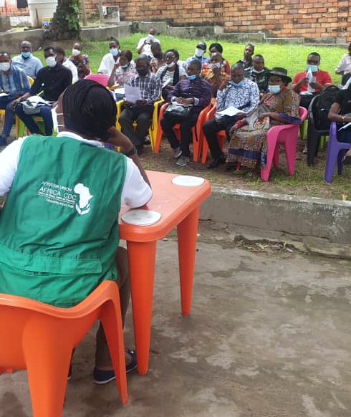
Risk Communication and Community Engagement (RCCE)
Africa CDC risk communication and community engagement is a cross-functional and core pillar in the work of Africa CDC emergency, preparedness and response (EPR).
RCCE supports Member States to ensure that public health threats are conveyed to all relevant parties in a transparent and timely manner and that communities are consulted, engaged, and informed on how to reduce their risk and better protect themselves.
Risk communication and community engagement need to move beyond messaging.
We need to invest in collecting, analyzing and responding to community feedback.

Slide 6
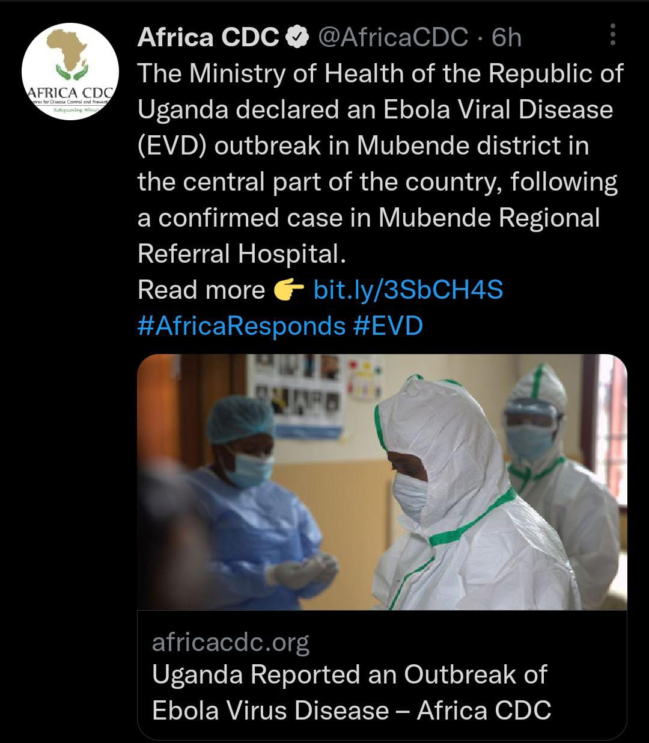
Africa CDC RCCE Strategies to Support Member Respond to Zoonotic Diseases
Community Engagement Through Social Media
Community management on social media is now more important than ever. With almost 2 million followers on our social media, we’re able to monitor and filter online discussions and effectively respond to questions about public health, including zoonotic diseases in the continent
Rumor Tracking and Media Monitoring System
To support evidence-based response to member states to fight zoonotic diseases, we established a rumor tracking and media monitoring system.
Monitoring and listening to online conversations and analyzing trends has also been key to identifying and addressing rumors or misinformation

Slide 7
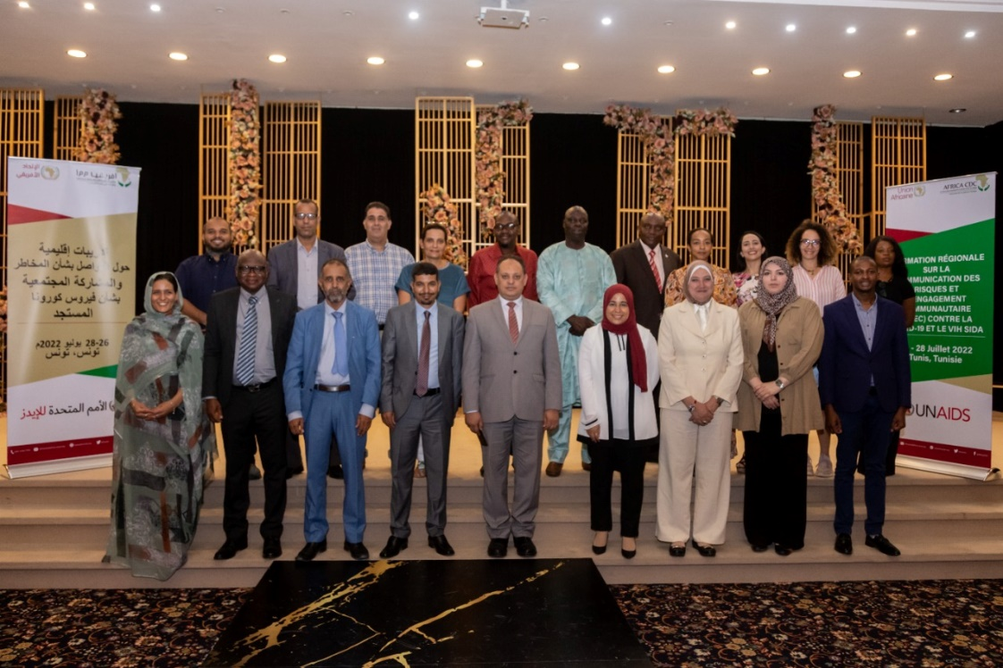
Africa CDC RCCE Strategies to Support Member Respond to Zoonotic Diseases
Training and Capacity Building to Member States
We have continuously built expertise of our Member States in RCCE.
We partnered with UNAIDS, WHO and other organizations to deliver national, regional and continental trainings on RCCE.
Community of Practice
To strengthen RCCE capacities on the continent, and in collaboration with WHO, we established Public Health - Risk Communication & Community Engagement Community of Practice for Africa (PH-RCCE CoPA) for countries to learn and exchange best practices on RCCE.

Slide 8
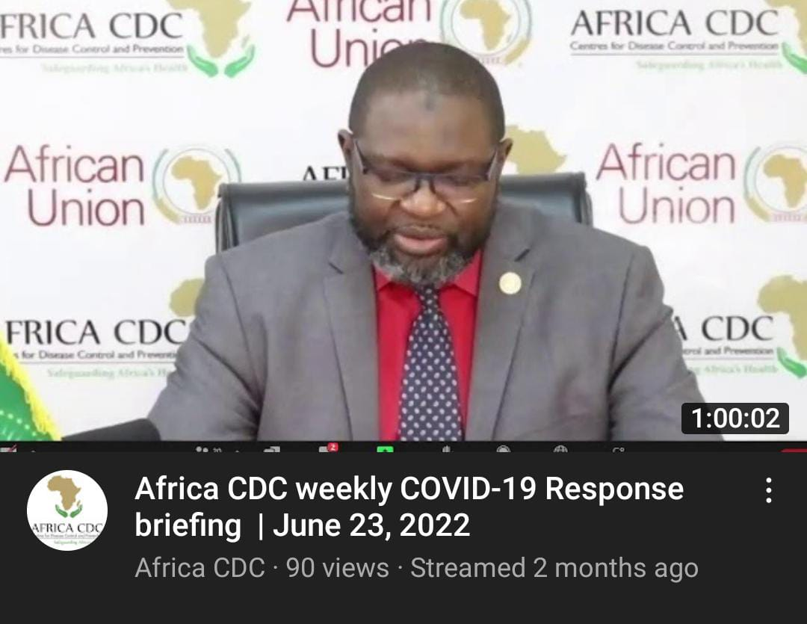
Africa CDC RCCE Strategies to Support Member Respond to Zoonotic Diseases
Continuous Media Engagement
Weekly press briefing by the Director on the current diseases in the continent.
A platform where health reporters can engage with Africa CDC and get their questions and clarifications addressed.

Slide 9
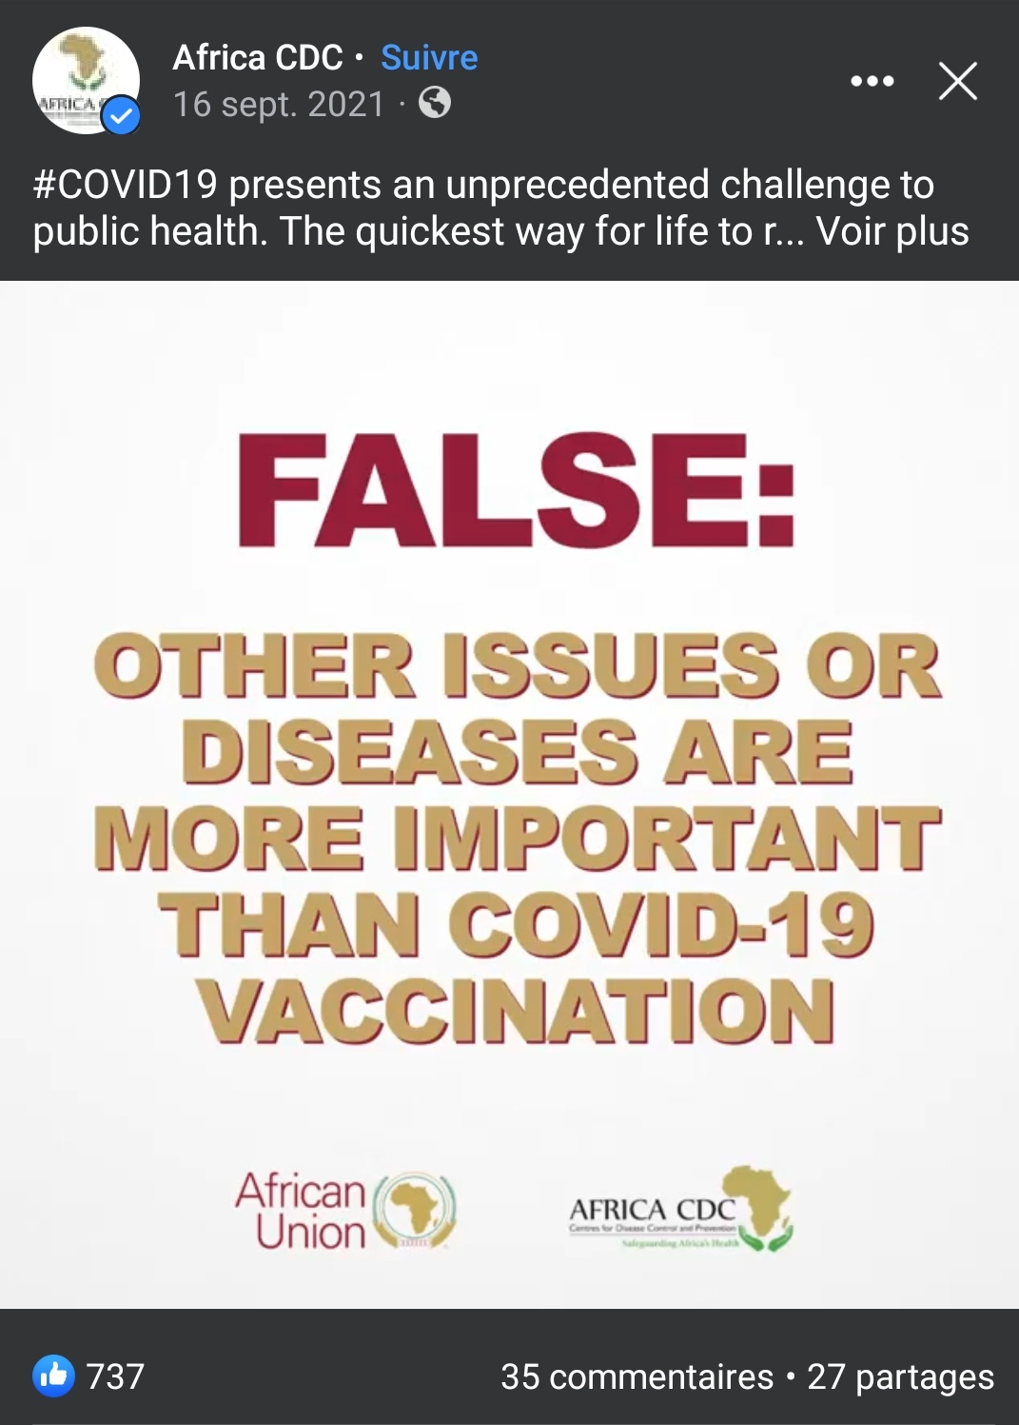
Africa CDC RCCE Strategies to Support Member Respond to Zoonotic Diseases
Partnerships to build e-learning resources for Social and behavior change
Africa CDC has partnered with Yale University and Meta (Facebook) to launch a social behavior change-learning platform, where communication specialists in MoH can hone their skills and knowledge to better strengthen behavior change.
A data sharing mechanism was initiative with partner like WHO and UNICEF to provide real time data which will serve as a solid basis for content creation.
Campaigns
Africa CDC has partnered with various public and private entities including Meta(Facebook), Access Challenge to create impactful campaigns to raise the awareness on zoonotic diseases such as Monkey pox, covid-19 and to address myths and rumors around various diseases.

Slide 10
Africa CDC RCCE Strategies to Support Member Respond to Zoonotic Diseases
Media Cafes
To better understand the work of Africa CDC, we hold media cafes with health journalists across the continent in order for them to appreciate the work we do and to create meaningful and impactful reporting on public health in the continent.

Slide 11
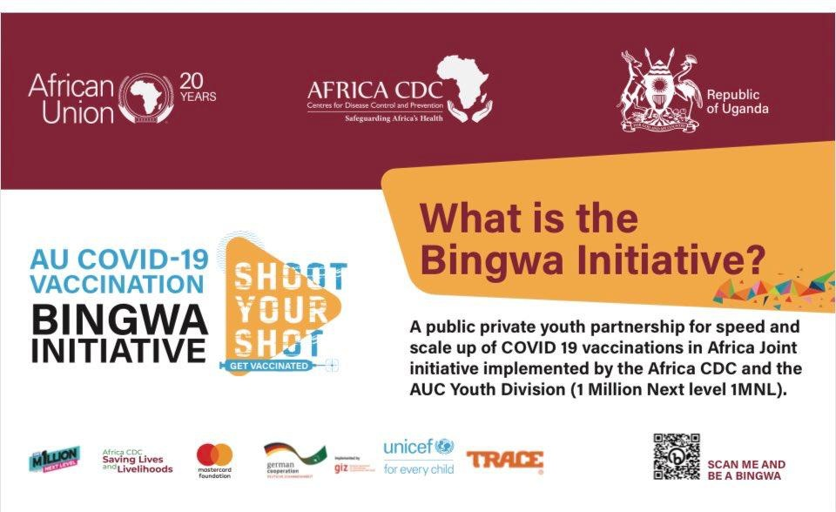
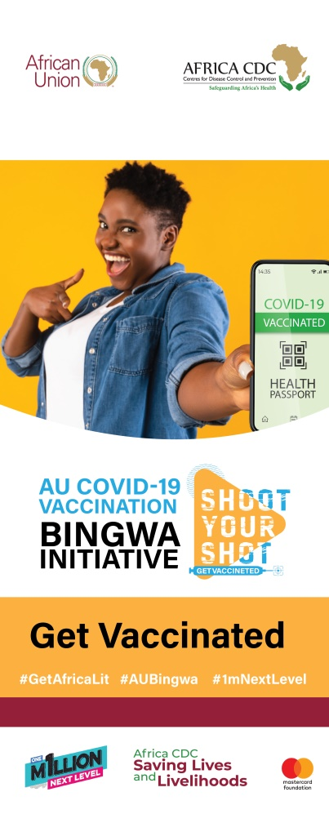
Africa CDC RCCE Strategies to Support Member Respond to Zoonotic Diseases

Slide 12
What Have We Learnt: Best Practices
Building and sustaining trust is key
If communities do not trust us, it is unlikely they will;
Listen to or follow health advice
Comply with measures like staying at home
Allow us safe access
Report cases or come for treatment
Feel safe to use the clinical services we provide
Epidemics start and end in communities
It is the actions of community members that will end or sustain an outbreak
It’s Important to treat communities we work with as partners
This include governments, civil societies, religious leaders etc.
To build trust, we need to listen, and we need to act

Slide 13
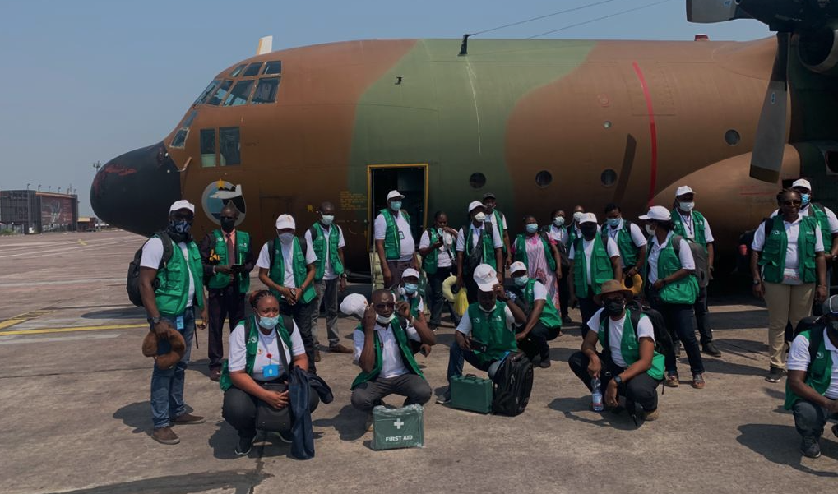
THANK YOU
LEARN MORE AT
africacdc.org/covid-19
Safeguarding Africa’s Health

