Slide 1
THE HANDBOOK OF COMMUNITY ENGAGEMENT
Subtitle

Slide 2
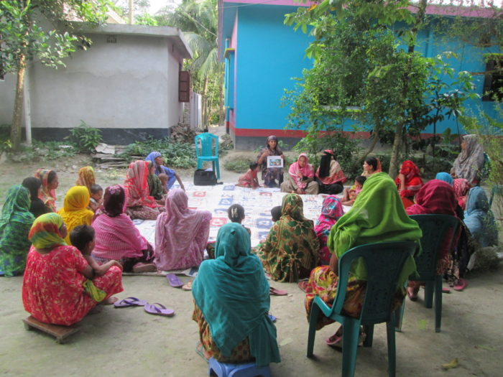
COMMUNITY ENGAGEMENT
Available at:
https://ce4amr.leeds.ac.uk/wp-content/uploads/sites/84/2021/11/CE4AMR-Handbook.pdf

Slide 3
PARTNERS
A knowledge exchange network

Slide 4
ENGAGING STAKEHOLDERS TO ADDRESS AMR
Beginning
Middle
End

