Slide 1
Oxford Nanopore Sequencing for hard-to-treat TB: set up in resource-constrained settings
TB ONT workshop – NIMR August 2022
Dr Linzy Elton
Postdoctoral research associate
@LinzyElton @PandoraIDNet @AmrCovid

Slide 2
TB ONT workshop – NIMR August 2022
We will record these sessions and put them online so you can refer back to them later on
We will also put the slides up online so you can access the notes (links and image credits)

Slide 3
TB ONT workshop – NIMR August 2022
Laboratory set up
Introduction to the TB sequencing pipeline
TB sequencing complications

Slide 4
TB ONT workshop – NIMR August 2022
Laboratory set up

Slide 5
TB ONT workshop – NIMR August 2022
Lead and delivery times
Some kits and equipment have a lead time
Generally, the Nanopore website suggests allowing a working week for orders to arrive for ‘rest of world’
Consider customs issues for your country

Slide 6
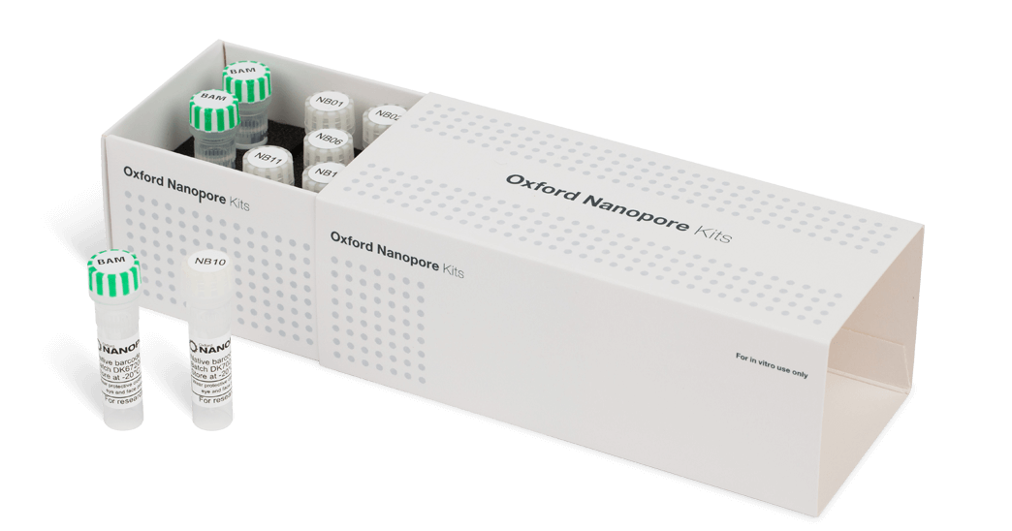
TB ONT workshop – NIMR August 2022
Reagents – Storage
Most of the kit reagents need a cold chain and so must be kept in a fridge/ freezer
Nanopore have created a field sequencing kit
Notes:
Image credit: ONT

Slide 7
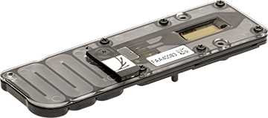
TB ONT workshop – NIMR August 2022
Flow cells
MinION flow cells can be stored (unopened) at room temperature for 4 weeks (from delivery date)
They can be stored for 12 weeks (unopened) at 2-8°C
Flow cells should be checked before library preparation (within 3 months of purchase) as part of the warranty
Notes:
Image credit: ONT

Slide 8
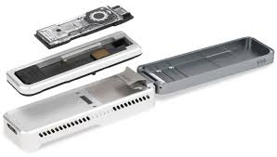
TB ONT workshop – NIMR August 2022
Sample Throughput
If few samples are being processed at a time, or you are looking at amplicons, smaller genomes or targeted regions, the Flongle might be more useful
Note that they are only guaranteed for 4 weeks after the shipment date (rather than 12 for a MinION)
Notes:
Image credit: ONT

Slide 9
TB ONT workshop – NIMR August 2022
Power issues
Need power for the duration of your sequencing run (if it cuts out, it will save data up until the power cut)
A laptop with a reliable battery may be more useful than a computer if power cuts are an issue
UPS is something to consider
Mk1C also needs an external power source

Slide 10
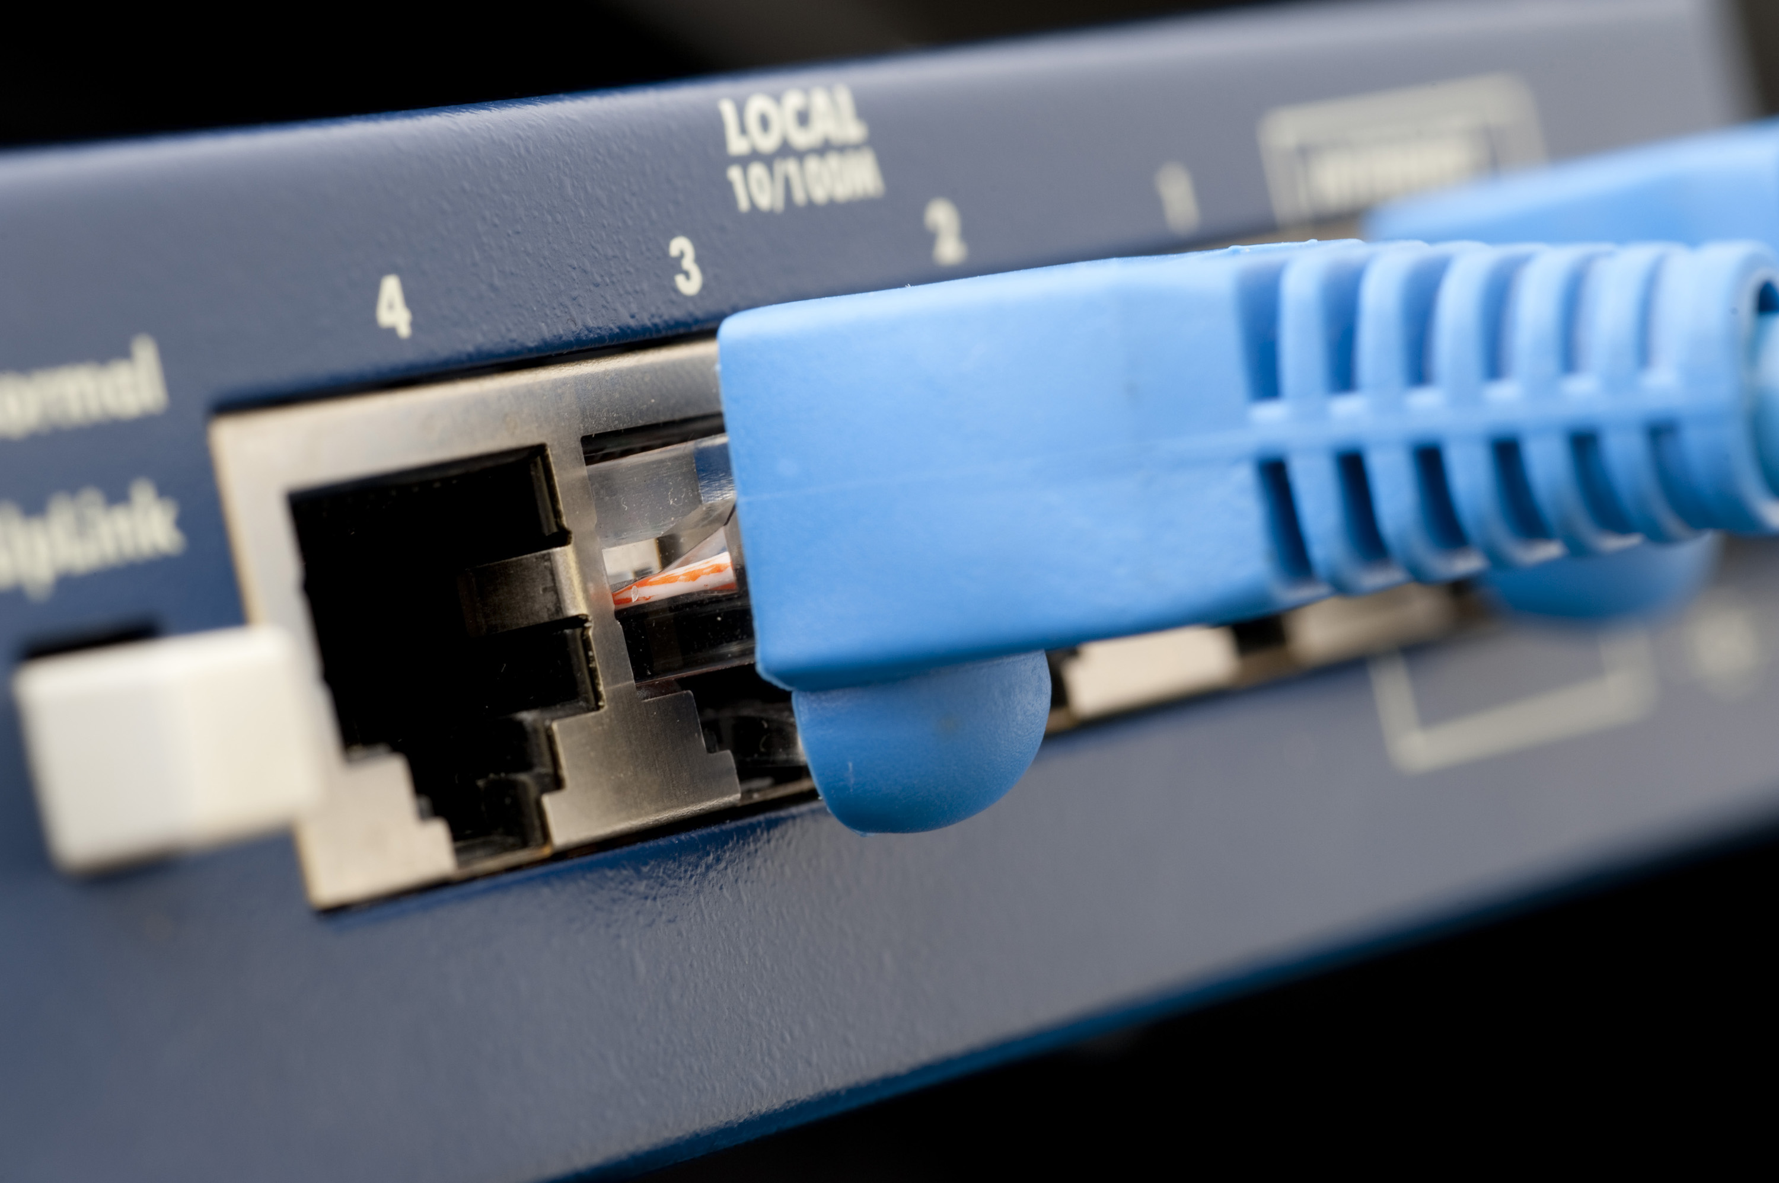
TB ONT workshop – NIMR August 2022
Internet Access
MinION Mk1B needs a constant internet connection
The Mk1C can sequence and basecall entirely without internet connectivity
Many analysis programmes (e.g. TB-Profiler) need internet access
Offline configurations are available

Slide 11
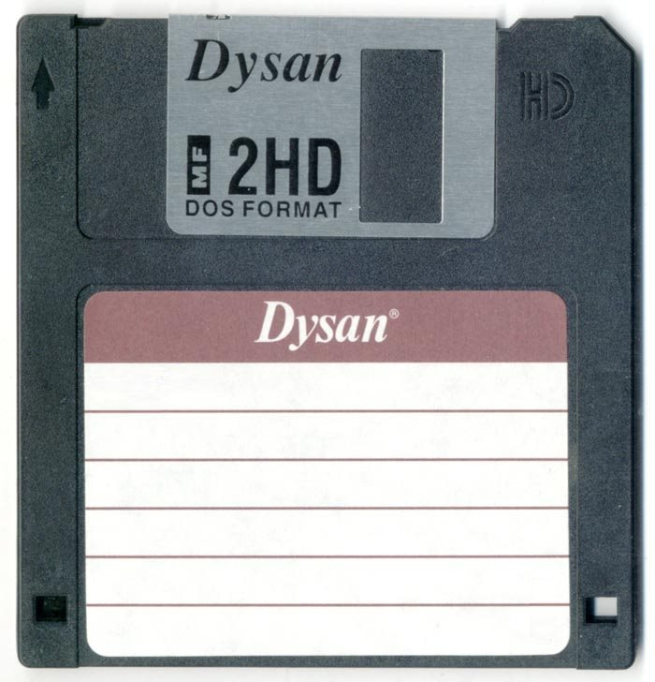
TB ONT workshop – NIMR August 2022
Data storage
A MinION flow cell can generate as much as 50 Gb of data, so storage may be an issue
Running out of disk space will halt your sequencing experiment
Unless you have GPUs, basecalling won’t happen in real time
The Mk1C has 1 TB SSD storage, 8 GB RAM + GPU
Consider human sequence data (GDPR)

Slide 12
TB ONT workshop – NIMR August 2022
The TB sequencing pipeline

Slide 13
TB ONT workshop – NIMR August 2022
Aim of the TB sequencing pipeline
Problem: can WGS be used to compliment routine diagnosis, especially in hard to treat cases e.g. relapse vs reinfection and drug resistant cases?
Aim to build a pragmatic pipeline: balance between cost, accuracy and feasibility for research and routine TB laboratory scientists
Speed vs concentration, MW and quality
Accuracy vs speed (computing power)
Accuracy and detail vs ease of use
Input DNA vs output data
Extraction
Library prep
Basecalling
Analysis

Slide 14
TB ONT workshop – NIMR August 2022
Why ONT for sequencing TB?
Cheap initial set up
Smaller laboratory footprint
Long reads can be useful for spanning traditionally hard to read sequences (TB is GC rich and has lots of repeats)
Relatively straightforward library preparation
~$160 per sample (basic pipeline)

Slide 15
TB ONT workshop – NIMR August 2022
Problems
ONT generally has lower accuracy than Illumina – so we need to validate it (new chemistry coming soon!)
ONT kits generally need more input DNA (for native DNA sequencing)
TB is difficult to work with:
Very slow growing!
Low yield from extraction (complex cell wall structure)
High GC content
Many repeat regions

Slide 16
TB ONT workshop – NIMR August 2022
CTAB extractions generally yield low concentrations (~5-100 ng/µl)
Rapid PCR barcoding kit (SQK-RPB004)
<2 ng/µl input DNA
Amplification was not even
Rapid barcoding kit (native) (SQK-RBK004)
400 ng of >30kb DNA
Normalise to fmol
Better coverage (still not as good as e.g. gram negatives)

Slide 17
TB ONT workshop – NIMR August 2022

Slide 18
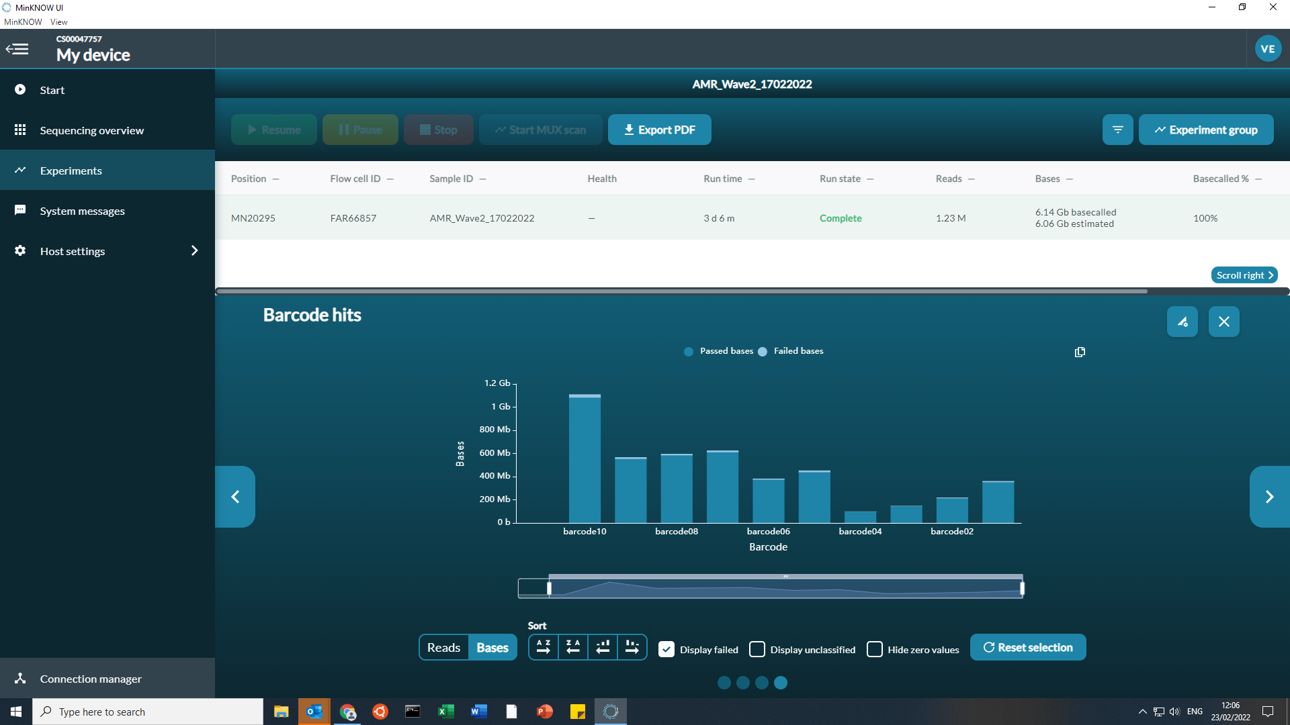
TB sequencing workshop – Tanzania 2022
Extraction method may be interfering with library preparation. Experimented with ethanol precipitation and bead washing, doesn’t seem to have had a noticeable effect

Slide 19
TB ONT workshop – NIMR August 2022
Is the DNA actually too long?
Mycobacteria have a high CG content and lots of repeat regions
The lower pore efficiency is possibly due to repeat regions binding to itself and blocking the pores
Does reducing the length of the DNA help?

Slide 20
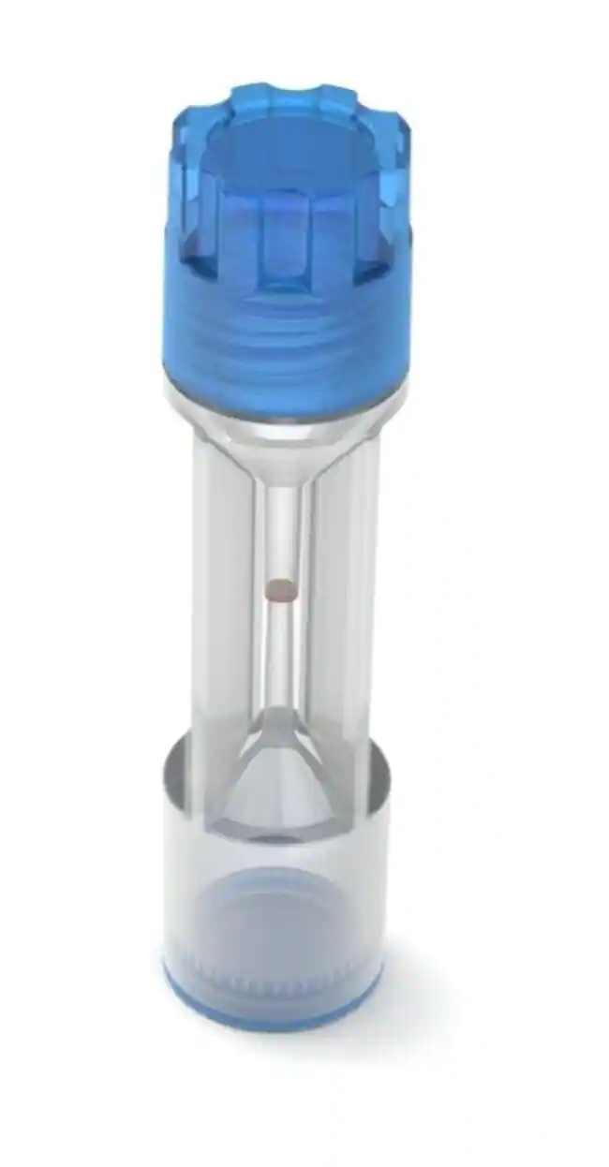
TB ONT workshop – NIMR August 2022
Is the DNA actually too long?
Use Covaris tubes to shear the DNA to 10k and 20k
Run each sample for 2 hours, wash the flow cell, compare to 50kb
Covaris tubes are expensive
Notes:
Link to Covaris tubes: https://www.covaris.com/products-services/consumables/g-tube
Image credit: ThermoFisher

Slide 21
TB ONT workshop – NIMR August 2022
Is the DNA actually too long?
Sequencing TB seems to be a trade off between long reads (more data) and pore efficiency (sequencing for longer)

Slide 22
TB ONT workshop – NIMR August 2022
Speed vs concentration, MW and quality
Accuracy vs speed (computing power)
Accuracy and detail vs ease of use
Input DNA vs output data
Extraction
Library prep
Basecalling
Analysis
Culture, CTAB +
DNA Shearing?
Ethanol precipitation?
Bead washing?
Rapid (native) Barcoding
Fast (newest Guppy)
TB-Profiler
Extra steps = extra costs

Slide 23
TB ONT workshop – NIMR August 2022
Questions?

