Slide 1

Introduction to ONT sequencing
TB ONT workshop – NIMR August 2022
Dr Linzy Elton
Postdoctoral research associate
Centre for Clinical Microbiology
linzy.elton@ucl.ac.uk
@LinzyElton @PandoraIDNet @AmrCovid

Slide 2
TB ONT workshop – NIMR August 2022
We will record these sessions and put them online so you can refer back to them later on
We will also put the slides up online so you can access the notes (links and image credits)

Slide 3
TB ONT workshop – NIMR August 2022
What is sequencing?
Uses and Sanger sequencing
Next generation sequencing
Oxford Nanopore Technologies

Slide 4
TB ONT workshop – NIMR August 2022
What is sequencing?
Sequencing determines the order of the four bases (A, T, G and C) that make up DNA
The first DNA sequences were obtained in the early 1970s
Requires both laboratory and bioinformatics skills!
Notes:
https://en.wikipedia.org/wiki/DNA_sequencing

Slide 5
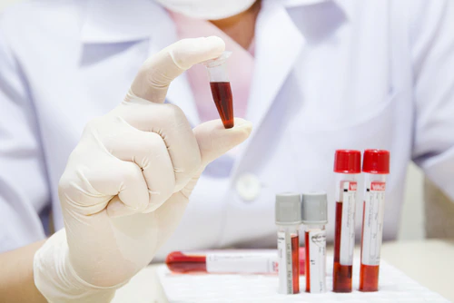
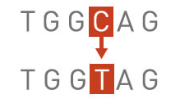
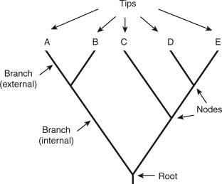
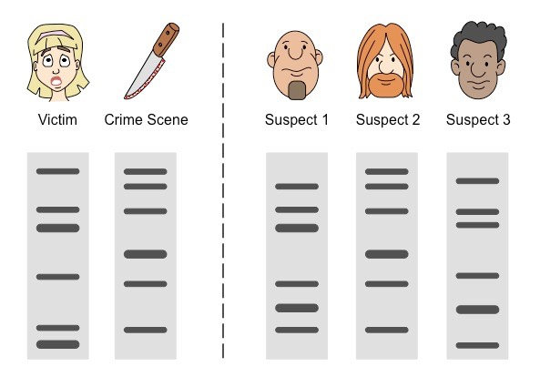

TB ONT workshop – NIMR August 2022
There are many uses for sequencing
Identifying species in a sample (e.g. sputum or waste water)
Identifying differences in genes (e.g. genetic diseases)
Seeing how closely related a group of organisms are (phylogenetic trees, evolution)
Forensics (e.g. DNA profiling, paternity testing etc.)
Look at whether bacteria is resistant to antibiotics
Notes:
Image credits:
https://www.thermofisher.com/blog/biobanking/within-subject-biological-sample-pooling-improves-accuracy-of-temporally-affected-biomarkers/
https://www.sciencedirect.com/topics/biochemistry-genetics-and-molecular-biology/phylogenetic-tree
https://www.singerinstruments.com/resource/what-are-genetic-mutation/
https://ib.bioninja.com.au/standard-level/topic-3-genetics/35-genetic-modification-and/dna-profiling.html
https://www.who.int/indonesia/health-topics/antimicrobial-resistance

Slide 6
TB ONT workshop – NIMR August 2022
The Human Genome Project
Began October 1990 and completed April 2003
Researchers aimed to decipher the human genome in three major ways:
    Determining the sequence of all the bases in the human genome
    Mapping the locations of genes for major sections of our chromosomes
    Producing linkage maps, so inherited traits (e.g. for genetic disease) can be tracked over generations
The sequence is derived from the DNA of several volunteers
Cost $2.7 billion!
Mainly used Sanger sequencing technology
Notes:
Links to the HGP - https://www.genome.gov/human-genome-project/What

Slide 7
Centre for Clinical Microbiology
Introduction to Sanger sequencing
The DNA sample is divided into four separate reactions, containing all four of the standard deoxynucleotides (dATP, dGTP, dCTP and dTTP) and a DNA polymerase (which attached the dNTPs)
To each reaction is added only one dideoxynucleotides (ddATP, ddGTP, ddCTP, or ddTTP)
Four separate reactions are needed in this process to test all four ddNTPs
The ddNTP stops the DNA polymerase when it comes to a base of that type (e.g. A, T, G, C)
The fragments are then run on a gel. The smallest move through the gel furthest and the ‘ladder’ shows the sequence of the DNA
Notes:
How does Sanger sequencing work? https://www.thermofisher.com/blog/behindthebench/how-does-sanger-sequencing-work/

Slide 8
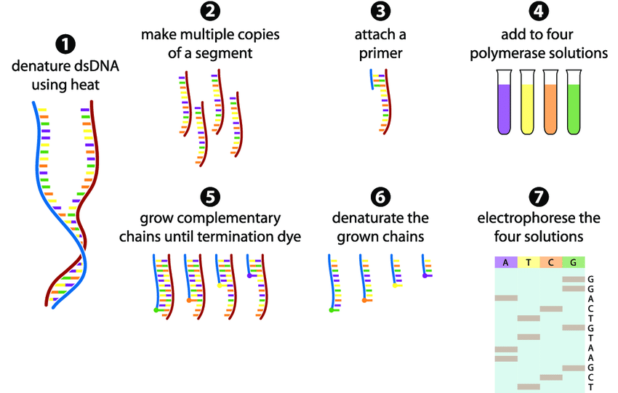
Centre for Clinical Microbiology
Notes:
Image credit: https://www.researchgate.net/figure/The-Sanger-sequencing-method-in-7-steps-1-The-dsDNA-fragment-is-denatured-into-two_fig2_234248746

Slide 9
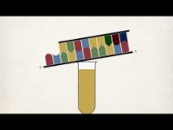
Centre for Clinical Microbiology
Notes:
Link to video: https://www.youtube.com/watch?v=FvHRio1yyhQ&t=171s

Slide 10
TB ONT workshop – NIMR August 2022
Next Generation Sequencing technology
The Sanger method only sequences a single DNA fragment at a time
NGS is massively parallel, sequencing millions of fragments simultaneously per run
NGS platforms include (but are not limited to):
    Illumina (short read) sequencing
    Oxford Nanopore Technologies (long read) sequencing
Notes:
Sanger vs Illumina: https://www.illumina.com/science/technology/next-generation-sequencing/ngs-vs-sanger-sequencing.html

Slide 11
Centre for Clinical Microbiology
Introduction to Illumina sequencing
Sequencing by synthesis
‘Short read’ technology – DNA is cut up into 200-600 bp chunks
The DNA is amplified, so there are lots of copies of the chunks
They are denatured, then fluorescent complimentary bases are attached
These fluoresce different colours, which is recorded, and the sequence is identified
Notes:
How Illumina sequencing works: https://www.yourgenome.org/facts/what-is-the-illumina-method-of-dna-sequencing

Slide 12
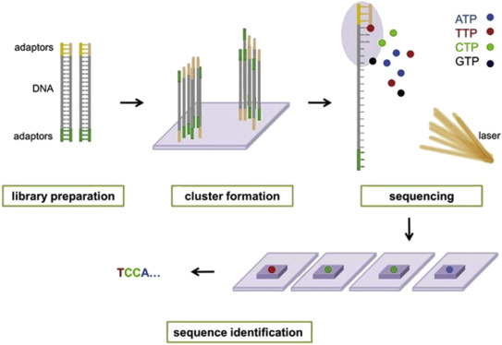
Centre for Clinical Microbiology
Notes:
Image credit: https://www.sciencedirect.com/topics/biochemistry-genetics-and-molecular-biology/illumina-dye-sequencing

Slide 13
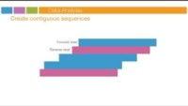
Centre for Clinical Microbiology
Notes:
Link to video: https://www.youtube.com/watch?v=womKfikWlxM

Slide 14


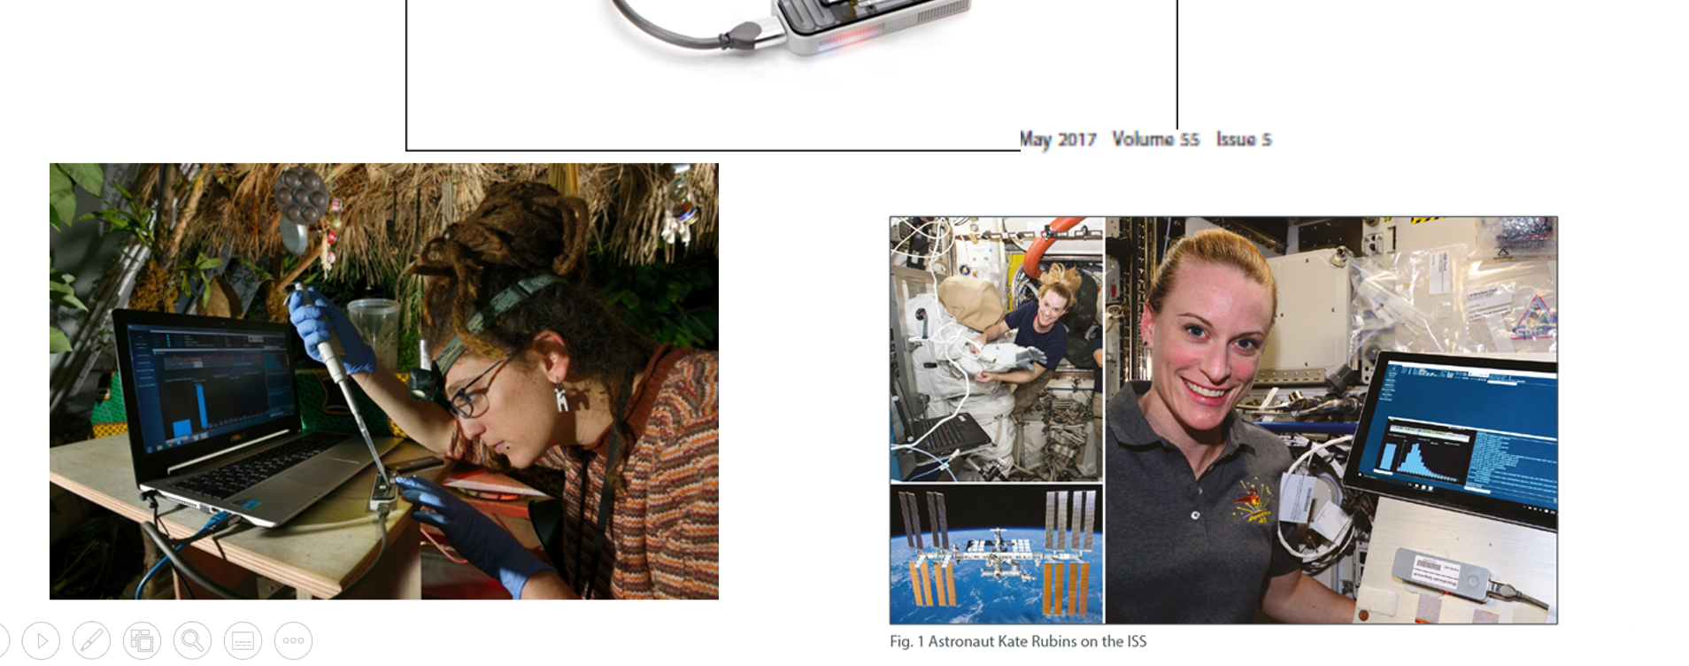
TB ONT workshop – NIMR August 2022
Oxford Nanopore Technologies
To enable the analysis of any living thing, by any person, in any environment
Shown to work in -5°C in Antarctica
Kabobo, Democratic Republic of Congo – biodiversity (high humidity, equatorial conditions)
Study of geothermal microbes in Iceland sequenced in a tent using only solar power (entirely ‘off-grid’)
© Farbregas Hareluya/Shutterstock
Mb photography/Getty images
Notes:
Image credit: https://www.nature.com/articles/521015a, https://nanoporetech.com/resource-centre/dna-sequencing-microgravity-international-space-station-iss-using-minion

Slide 15
TB ONT workshop – NIMR August 2022
Introduction to Oxford Nanopore Technologies
‘Long read’ technology
A DNA library is prepared (proteins are added)
Nucleic acids are passed through a protein nanopore
As the different bases move through the nanopore, it creates a different electrical signal
These resulting changes in the electrical signal is decoded to provide the specific DNA or RNA sequence
Notes:
Introduction to ONT - https://nanoporetech.com/applications/dna-nanopore-sequencing

Slide 16
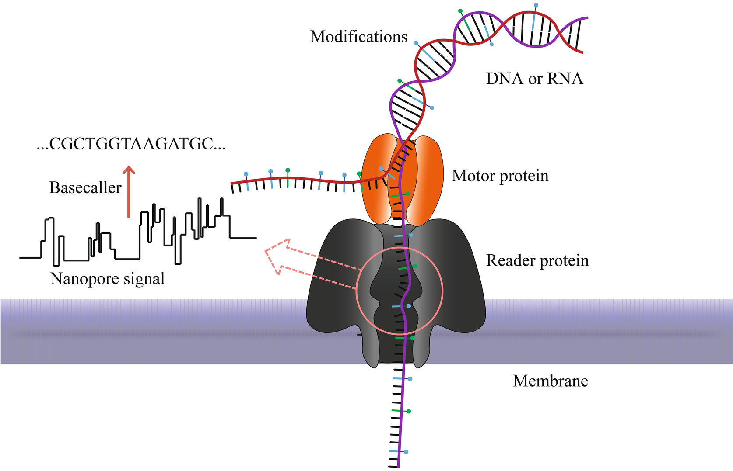
TB ONT workshop – NIMR August 2022
Notes:
Introduction to ONT (image credit) - https://link.springer.com/protocol/10.1007/978-1-0716-0868-5_9

Slide 17
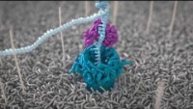
TB ONT workshop – NIMR August 2022
Notes:
Video link: https://www.youtube.com/watch?v=RcP85JHLmnI&t=18s

Slide 18
TB ONT workshop – NIMR August 2022
Oxford Nanopore Technologies
Different ‘library preparation’ kits and sequencing platforms can be used to sequence different things
Notes:
Introduction to ONT - https://nanoporetech.com/applications/dna-nanopore-sequencing

Slide 19
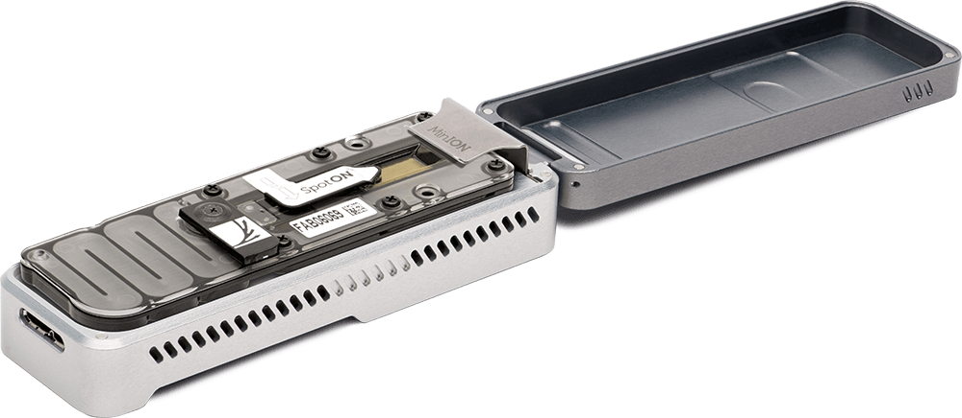
TB ONT workshop – NIMR August 2022
Oxford Nanopore Technologies
MinION
Notes:
Introduction to ONT - https://nanoporetech.com/applications/dna-nanopore-sequencing
Image credit: ONT

Slide 20
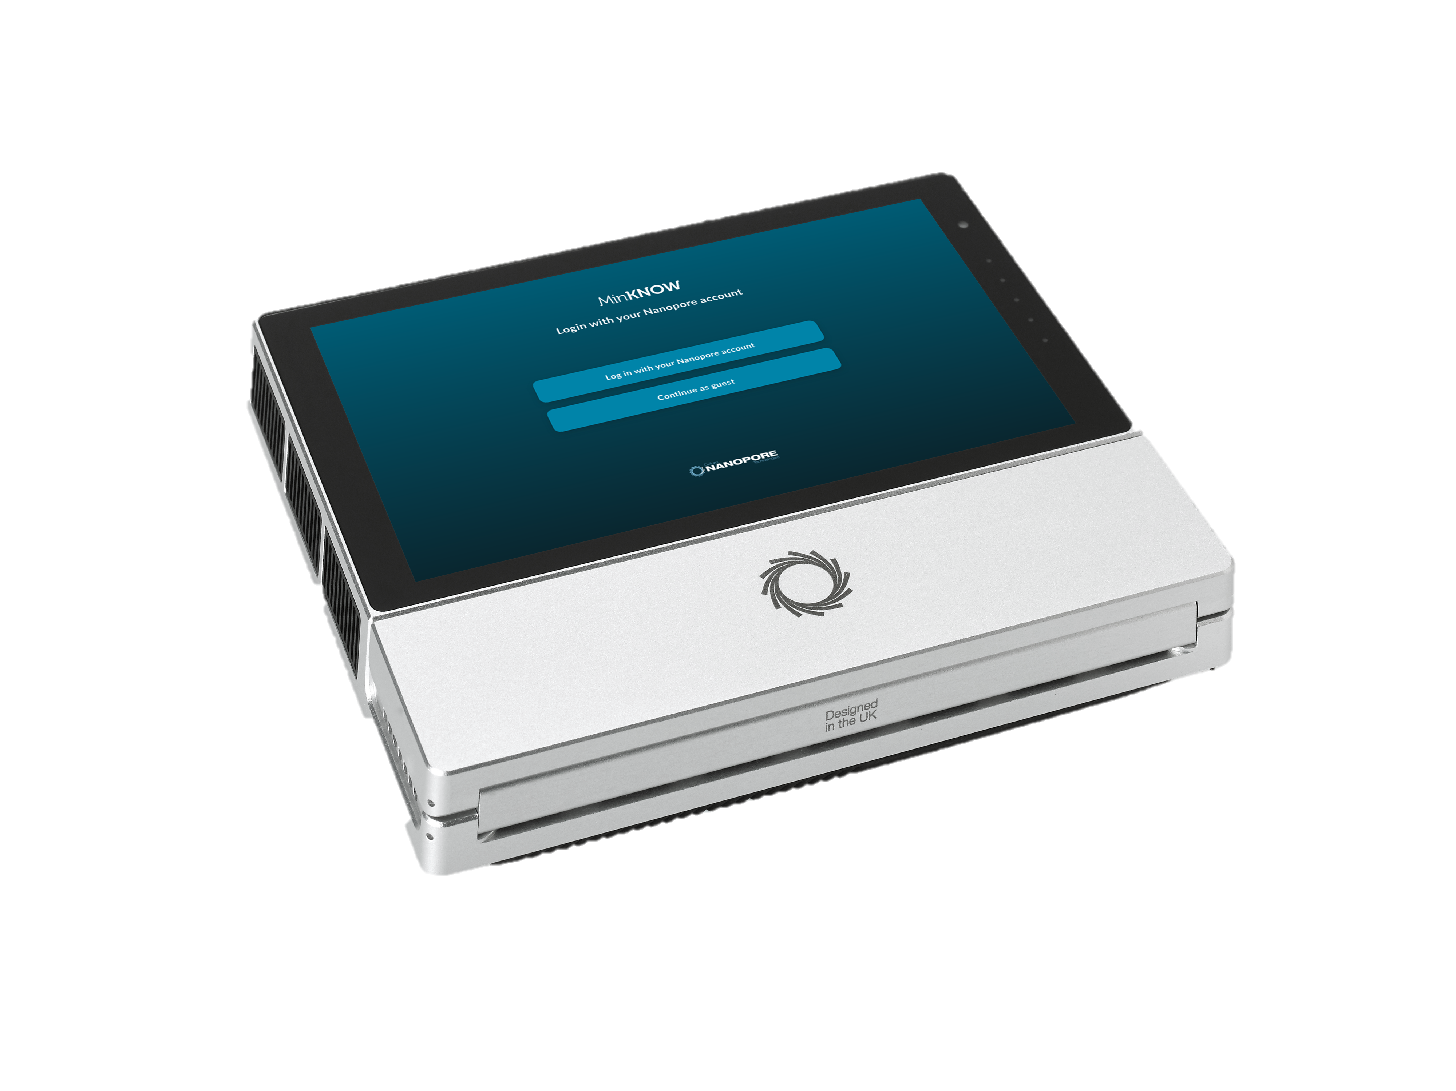
TB ONT workshop – NIMR August 2022
Oxford Nanopore Technologies
Mk1C
Notes:
Introduction to ONT - https://nanoporetech.com/applications/dna-nanopore-sequencing
Image credit: ONT

Slide 21
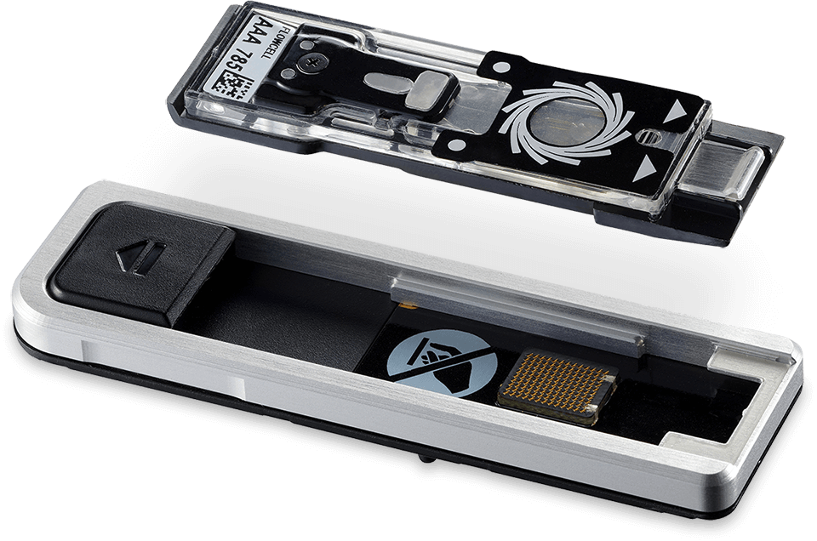
TB ONT workshop – NIMR August 2022
Oxford Nanopore Technologies
Flongle (technically a specialised flow cell for a MinION)
Notes:
Introduction to ONT - https://nanoporetech.com/applications/dna-nanopore-sequencing
Image credit: ONT

Slide 22
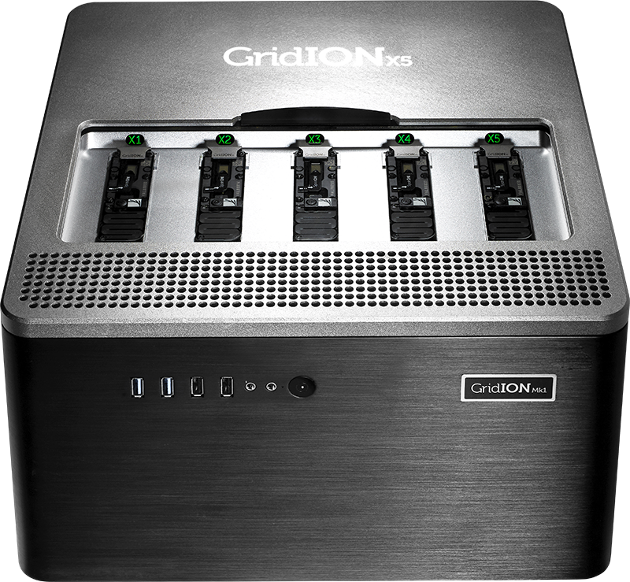
TB ONT workshop – NIMR August 2022
Oxford Nanopore Technologies
GridION
Notes:
Introduction to ONT - https://nanoporetech.com/applications/dna-nanopore-sequencing
Image credit: ONT

Slide 23
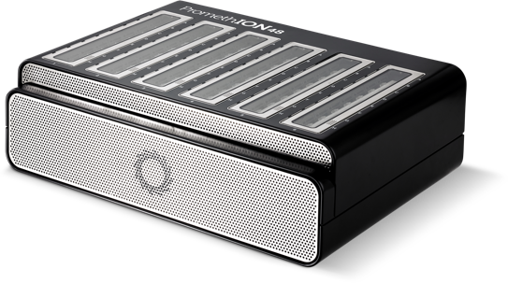
TB ONT workshop – NIMR August 2022
Oxford Nanopore Technologies
PromethION
Notes:
Introduction to ONT - https://nanoporetech.com/applications/dna-nanopore-sequencing
Image credit: ONT

Slide 24
TB ONT workshop – NIMR August 2022
Oxford Nanopore Technologies
Device | No. flow cells per run | Throughput | Theoretical maximum output | Cost
Flongle | 1 | 126 channels | 2.8 Gb | From $90 (per flow cell)
MinION | 1 | 512 channels | 50 Gb | From $1,000 (starter pack)
Mk1C | 1 | 512 channels | 50 Gb | From $4,000 (starter pack)
GridION | 5 | 5 x 512 channels | 250 Gb | From $49,000 (starter pack)
PromethION | 24 or 48 | 10,700+ channels | 2,596+ Gb | From $100,455 (starter pack)
Notes:
Comparison of platforms: https://nanoporetech.com/products/specifications

Slide 25
TB ONT workshop – NIMR August 2022
Why is getting so much information so important?

Slide 26
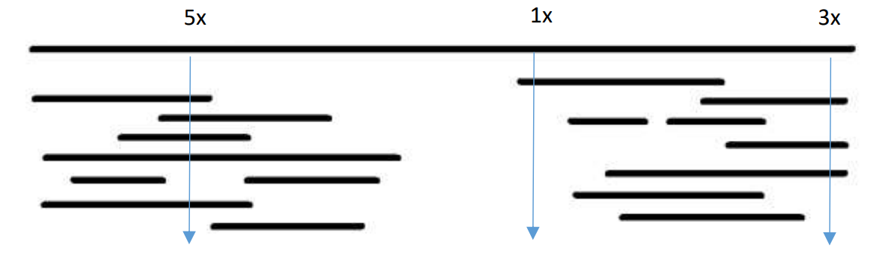
TB ONT workshop – NIMR August 2022
Depth vs coverage
Depth and coverage are both very important when it comes to sequencing, but they mean different things.
Depth
This is the amount of times a base within a genome has been sequenced
The greater the depth, the greater the confidence in the identity of the sequenced base
In the image below, the complete reference genome is at the top. Below it are the sequenced contigs (a series of overlapping DNA fragments). Three bases are represented, which have varying depth of reads.

Slide 27
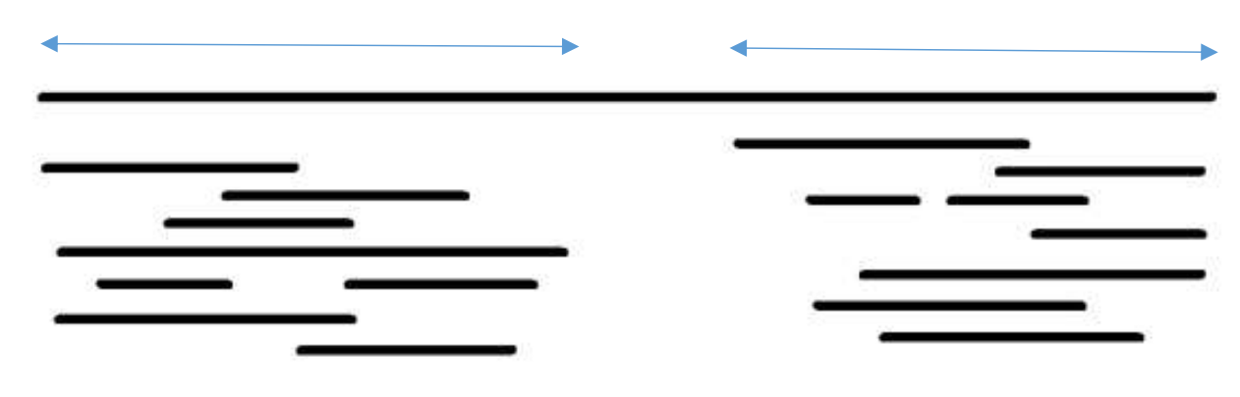
TB ONT workshop – NIMR August 2022
Depth vs coverage
Coverage
The percentage of the whole genome that has been sequenced.
For instance, in the example below, the sequenced contigs cover approximately 80% of the reference genome (at the top of the image), which means you would have sequenced 80% of the bases that make up the genome.
You will not be able to identify genes, SNPs etc. in parts of the genome that you do not have coverage for.
Notes:
YouTube video explaining depth v coverage: https://www.youtube.com/watch?v=3oNCSRyHWO8

Slide 28
TB ONT workshop – NIMR August 2022
Anatomy of a Flow Cell
Notes:
Image credit: https://currentprotocols.onlinelibrary.wiley.com/doi/abs/10.1002/cphg.39

Slide 29
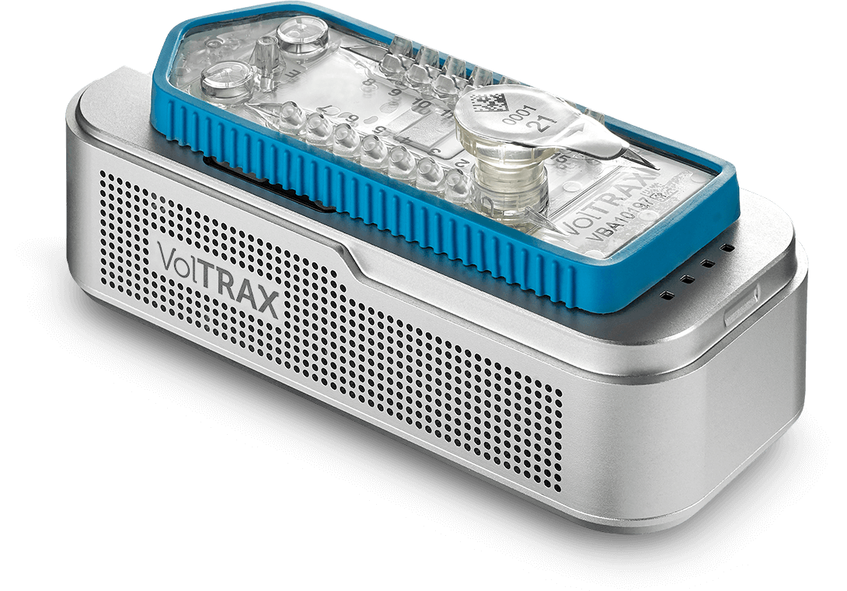
TB ONT workshop – NIMR August 2022
Different kits for ONT
Rapid barcoding kit
Ligation kit
PCR based kits
Automated kit prep
Notes:
Voltrax (image credit): https://nanoporetech.com/products/voltrax

Slide 30
TB ONT workshop – NIMR August 2022
ONT basic workflow
Extract DNA/RNA from the sample
Clean up the fragments
Prepare the sample(s) for sequencing
‘Assemble’ the fragments to make a whole genome
Run the sequencing!
Downstream processing e.g. making a phylogenetic tree, identifying genes etc.
Convert the ‘squiggles’ to bases – ‘basecalling’
Notes:
Introduction to ONT - https://nanoporetech.com/applications/dna-nanopore-sequencing

Slide 31
TB ONT workshop – NIMR August 2022
Minimum computer requirements
Purchase the highest specification you can afford, because sequencing is constantly improving and outputting more and more data!
Component | Required specification
Operating system | Windows – 10, Linux – Ubuntu 20.04 and 18.04, OSX – Mojave, Catalina
Memory/RAM | 16 GB RAM or higher
CPU | Intel i7, i9, Xeon, or better, with at least 4 cores/8 threads Ryzen 5, 7, or better, with at least 4 cores/8 threads
GPU | NVIDIA GPU RTX 2060 SUPER or better, with at least 8 GB of GPU memory
Storage | 1 TB internal SSD or higher
Ports | USB3.0
Notes:
ONT Laboratory and IT requirements webpage: https://nanoporetech.com/community/lab-it-requirements

Slide 32
TB ONT workshop – NIMR August 2022
Any questions?

