Slide 1
Importance of Social Sciences in Covid-19 disease control strategies for developing countries
Dr. Keneth Iceland Kasozi; Kabale University, Uganda
Fellow, Royal Society of Tropical Medicine and Hygiene
URL: https://rstmh.org/dr-keneth-iceland-kasozi
Email: kicelandy@kab.ac.ug and keneth.kasozi@ed.ac.uk

Slide 2
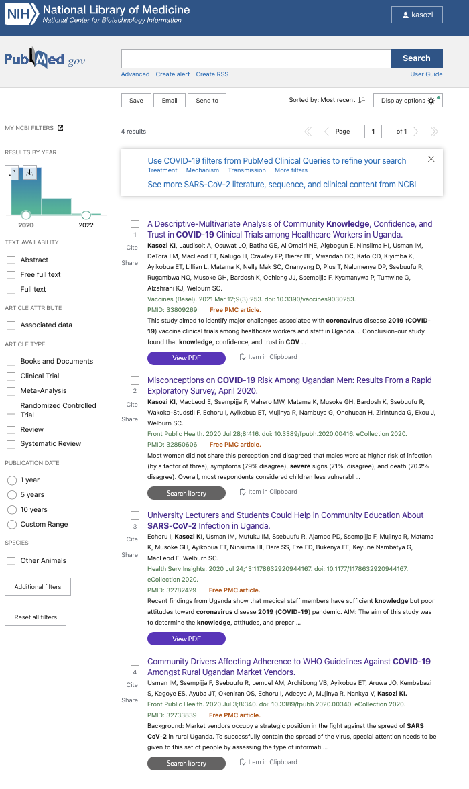
What we have done?

Slide 3
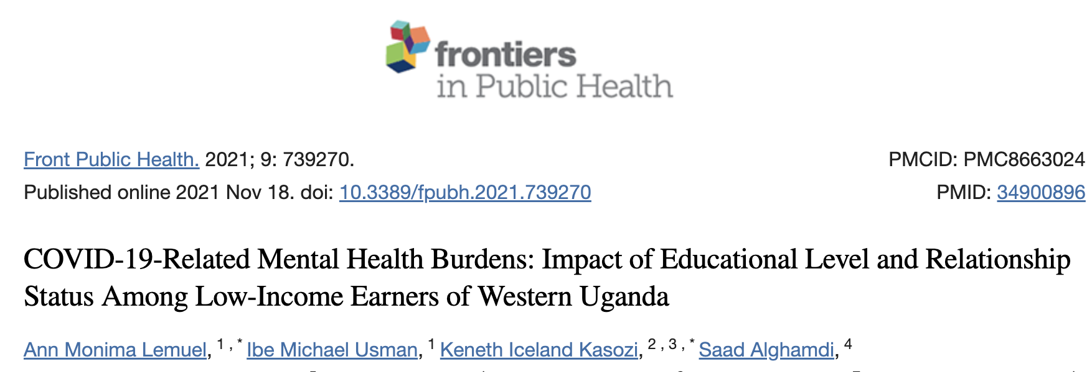
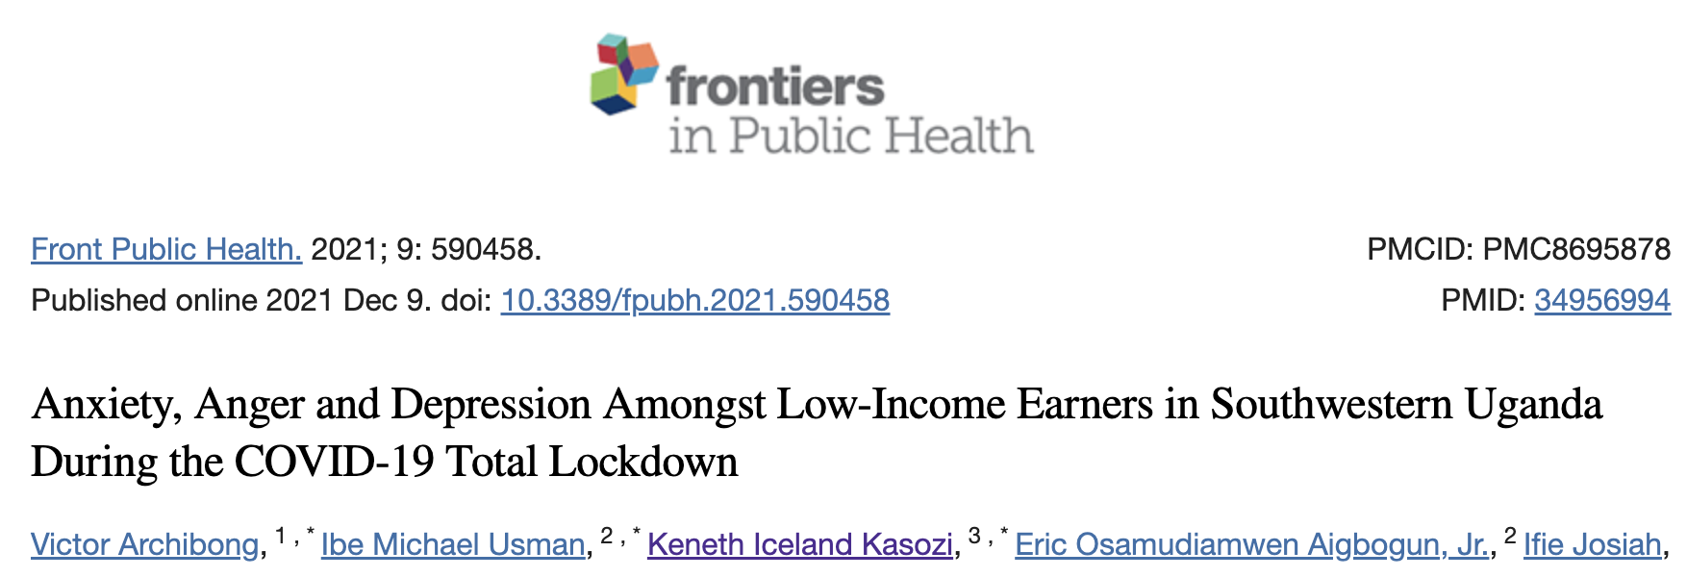
The Pandemic: Community effects

Slide 4
Methods: How we did it?
Data transformation
Quantitative (scores)
And
Qualitative (frequencies)
Knowledge
Attitude
Practices
Confidence
Trust
We adopted social science techniques to generate data
Collaborations Help!! No man is an island…

Slide 5
Vaccine Hesitancy in Uganda
Correlates with
education level,
social economic status and
job rank.

Slide 6
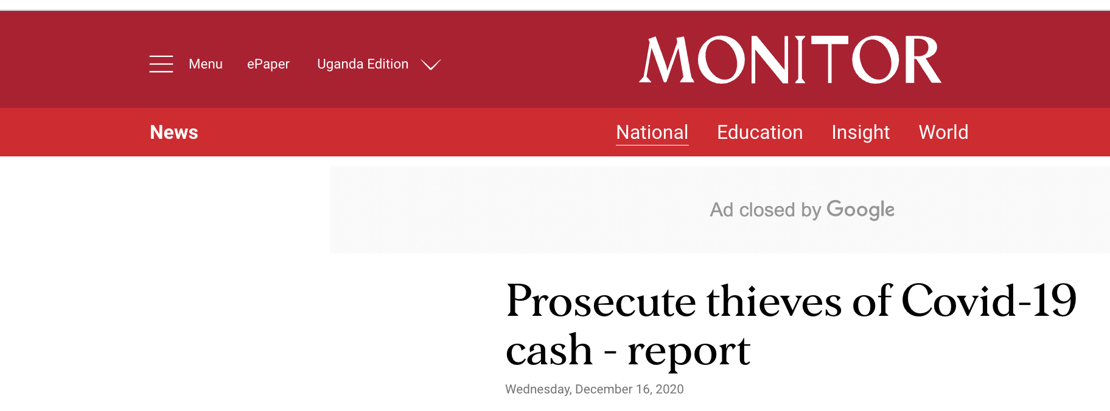
Why the Pandemic is under reported in developing countries?
Poor communication
Image credit: https://redbooth.com/blog/5-collaboration-lessons-from-partnerships-gone-terribly-wrong

Slide 7
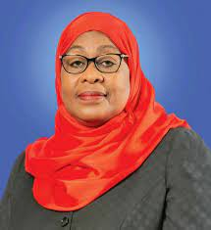
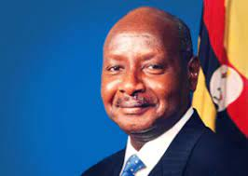
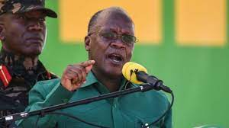
What I am doing Now?
Generating solutions for the future epidemics and pandemics in LMICs

Slide 8
Thank you
All collaborators on the papers cited in this presentation
Funders and
International partners

