Slide 1
How can theories be used to conduct and interpret primary research to inform epidemic control
Robert West
University College London

Slide 2
To identify research topics
To inform the content of surveys and measures
To analyse and interpret the results

Slide 3
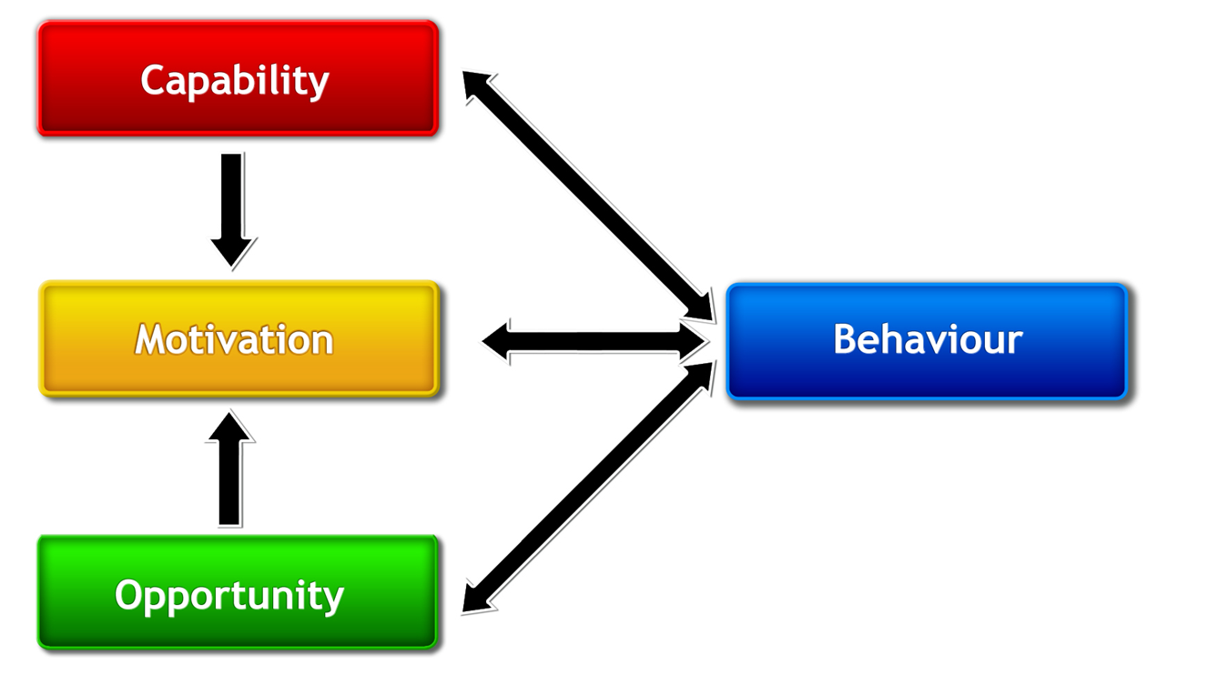
The COM-B model of behaviour
http://www.behaviourchangewheel.com/

Slide 4
Do they know what they need to do?
Do they know how to do it?
Do they understand why it is important?
Do they have the physical or mental skills to do it?

Slide 5
Do they think it’s a good idea?
Does doing it make them feel good?
Does it meet a personal need?
Does it fit with their self-identity?
Is it part of their routine?

Slide 6
Can they afford it?
Do they have time to do it?
Do they have the material resources to do it?
Do they have prompts and cues to do it?
Is it normal in their social network?
Is their social network supportive?

Slide 7
To promote behaviour make it:
Normal
Easy
Attractive
Routine
To deter behaviour make it:
Abnormal
Fraught
Aversive
Reflective
https://www.gov.uk/government/publications/behaviour-change-guide-for-local-government-and-partners

