Slide 1
Use of spatiotemporal models for predicting the burden of mosquito-borne infestation in Brazil
UCL IRDR
Centre for Digital Public Health & Emergencies
Dr. Anwar Musah
Global Health Network (14/07/2022)
Session 2: Integrating social sciences in One Health research during epidemics
[1]
Notes:
Aims and objectives: We want to understand and quantify risk trajectories of mosquito infestation on a neighbourhood-level January 2015 to October 2019; which in turn, will help informs us of the neighbourhood'(i.e., it having sustained risks or not).

Slide 2
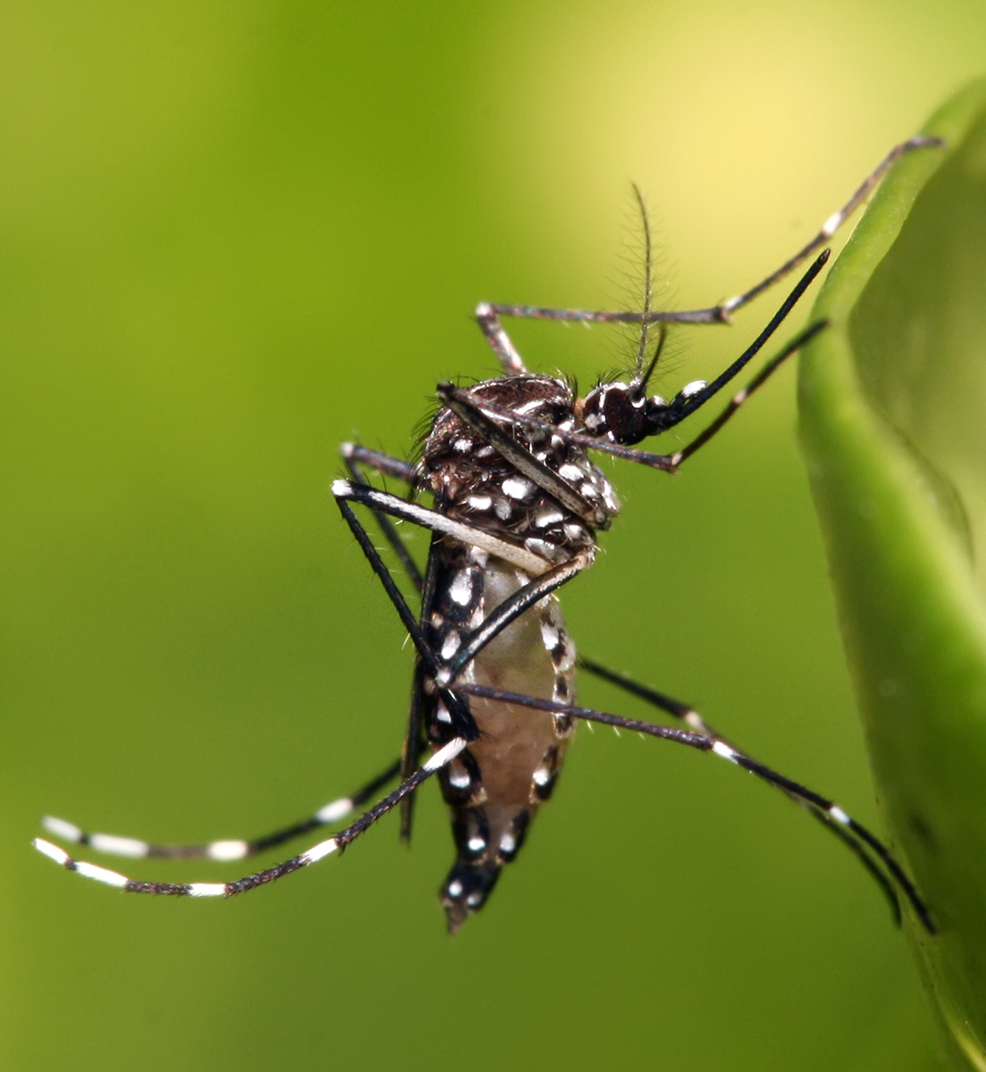
Aedes Mosquito Species
Aedes species are a unique class
The most common species are:
Aegypti
Albopictus
They transmit arboviruses:
Dengue
Chikungunya
Zika
Rift Valley Fever
Yellow Fever
Notes:
There are many different species of mosquitoes; the most infamous is the Anopheles family – they transmit a parasitic protozoa called Plasmodium which causes Malaria in humans.
And then, you have this bugger – the Aedes species, which is a carrier for some of the most deadliest arboviruses which cause NTDs such as Dengue, Chikungunya, Yellow Fever and Zika
To illustrate this transmission cycle (next slide):

Slide 3
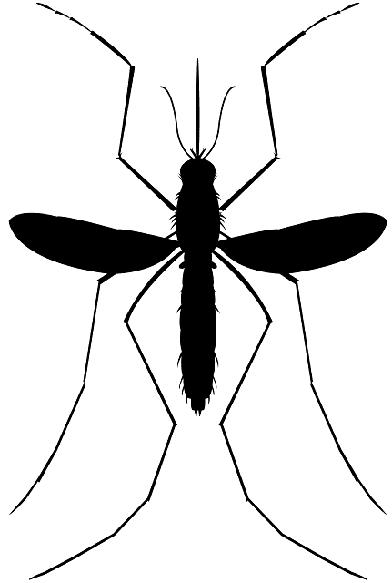
Transmission cycle of the Arboviruses
Female Aedes mosquitoes
Susceptible
Infected

Slide 4
Transmission cycle of the Arboviruses
Female Aedes mosquitoes
Susceptible
Infected
+

Slide 5
Transmission cycle of the Arboviruses
Female Aedes mosquitoes
Susceptible
Infected Female Aedes mosquito
Infected

Slide 6
Transmission cycle of the Arboviruses
Female Aedes mosquitoes
Susceptible
1-week later
+
Infected Female Aedes mosquito
Infected

Slide 7
Transmission cycle of the Arboviruses
Female Aedes mosquitoes
Susceptible
Infected Female Aedes mosquito
Infected
Female
Male

Slide 8
Transmission cycle of the Arboviruses
Female Aedes mosquitoes
Susceptible
Infected Female Aedes mosquito
Infected

Slide 9
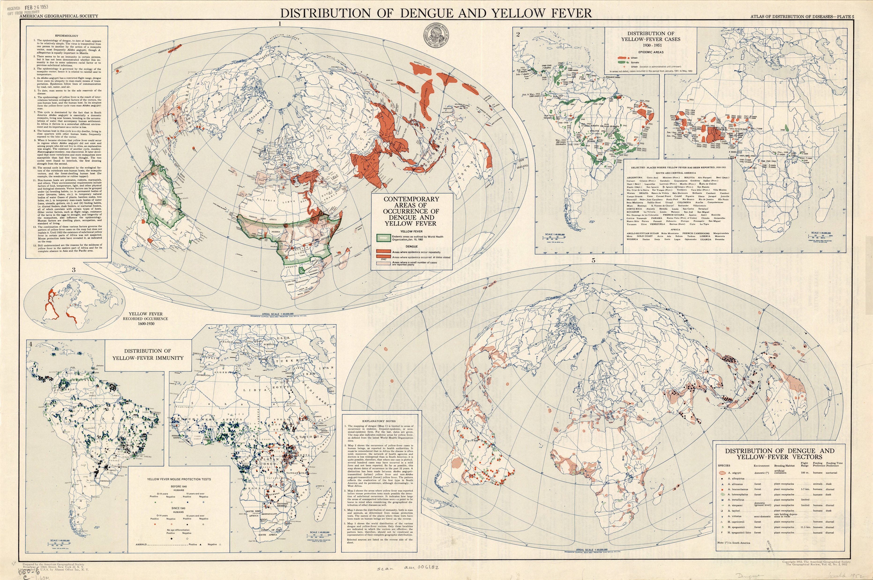
Global Distribution of Aedes Mosquito Species [1]
Atlas of diseases (1954)
Source: American Geographical Society Library Digital Map Collection (https://collections.lib.uwm.edu/digital/collection/agdm/id/5698)

Slide 10
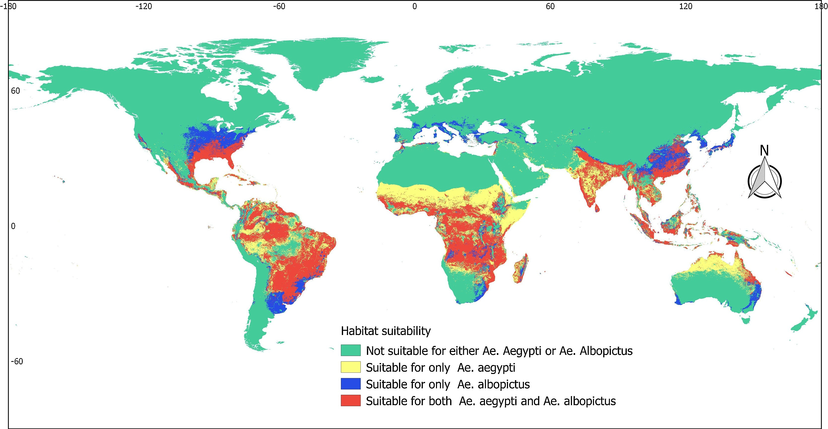
Global Distribution of Aedes Mosquito Species [2]
Global risk mapping of Aedes species (Leta et al. 2018) [https://doi.org/10.1016/j.ijid.2017.11.026]

Slide 11
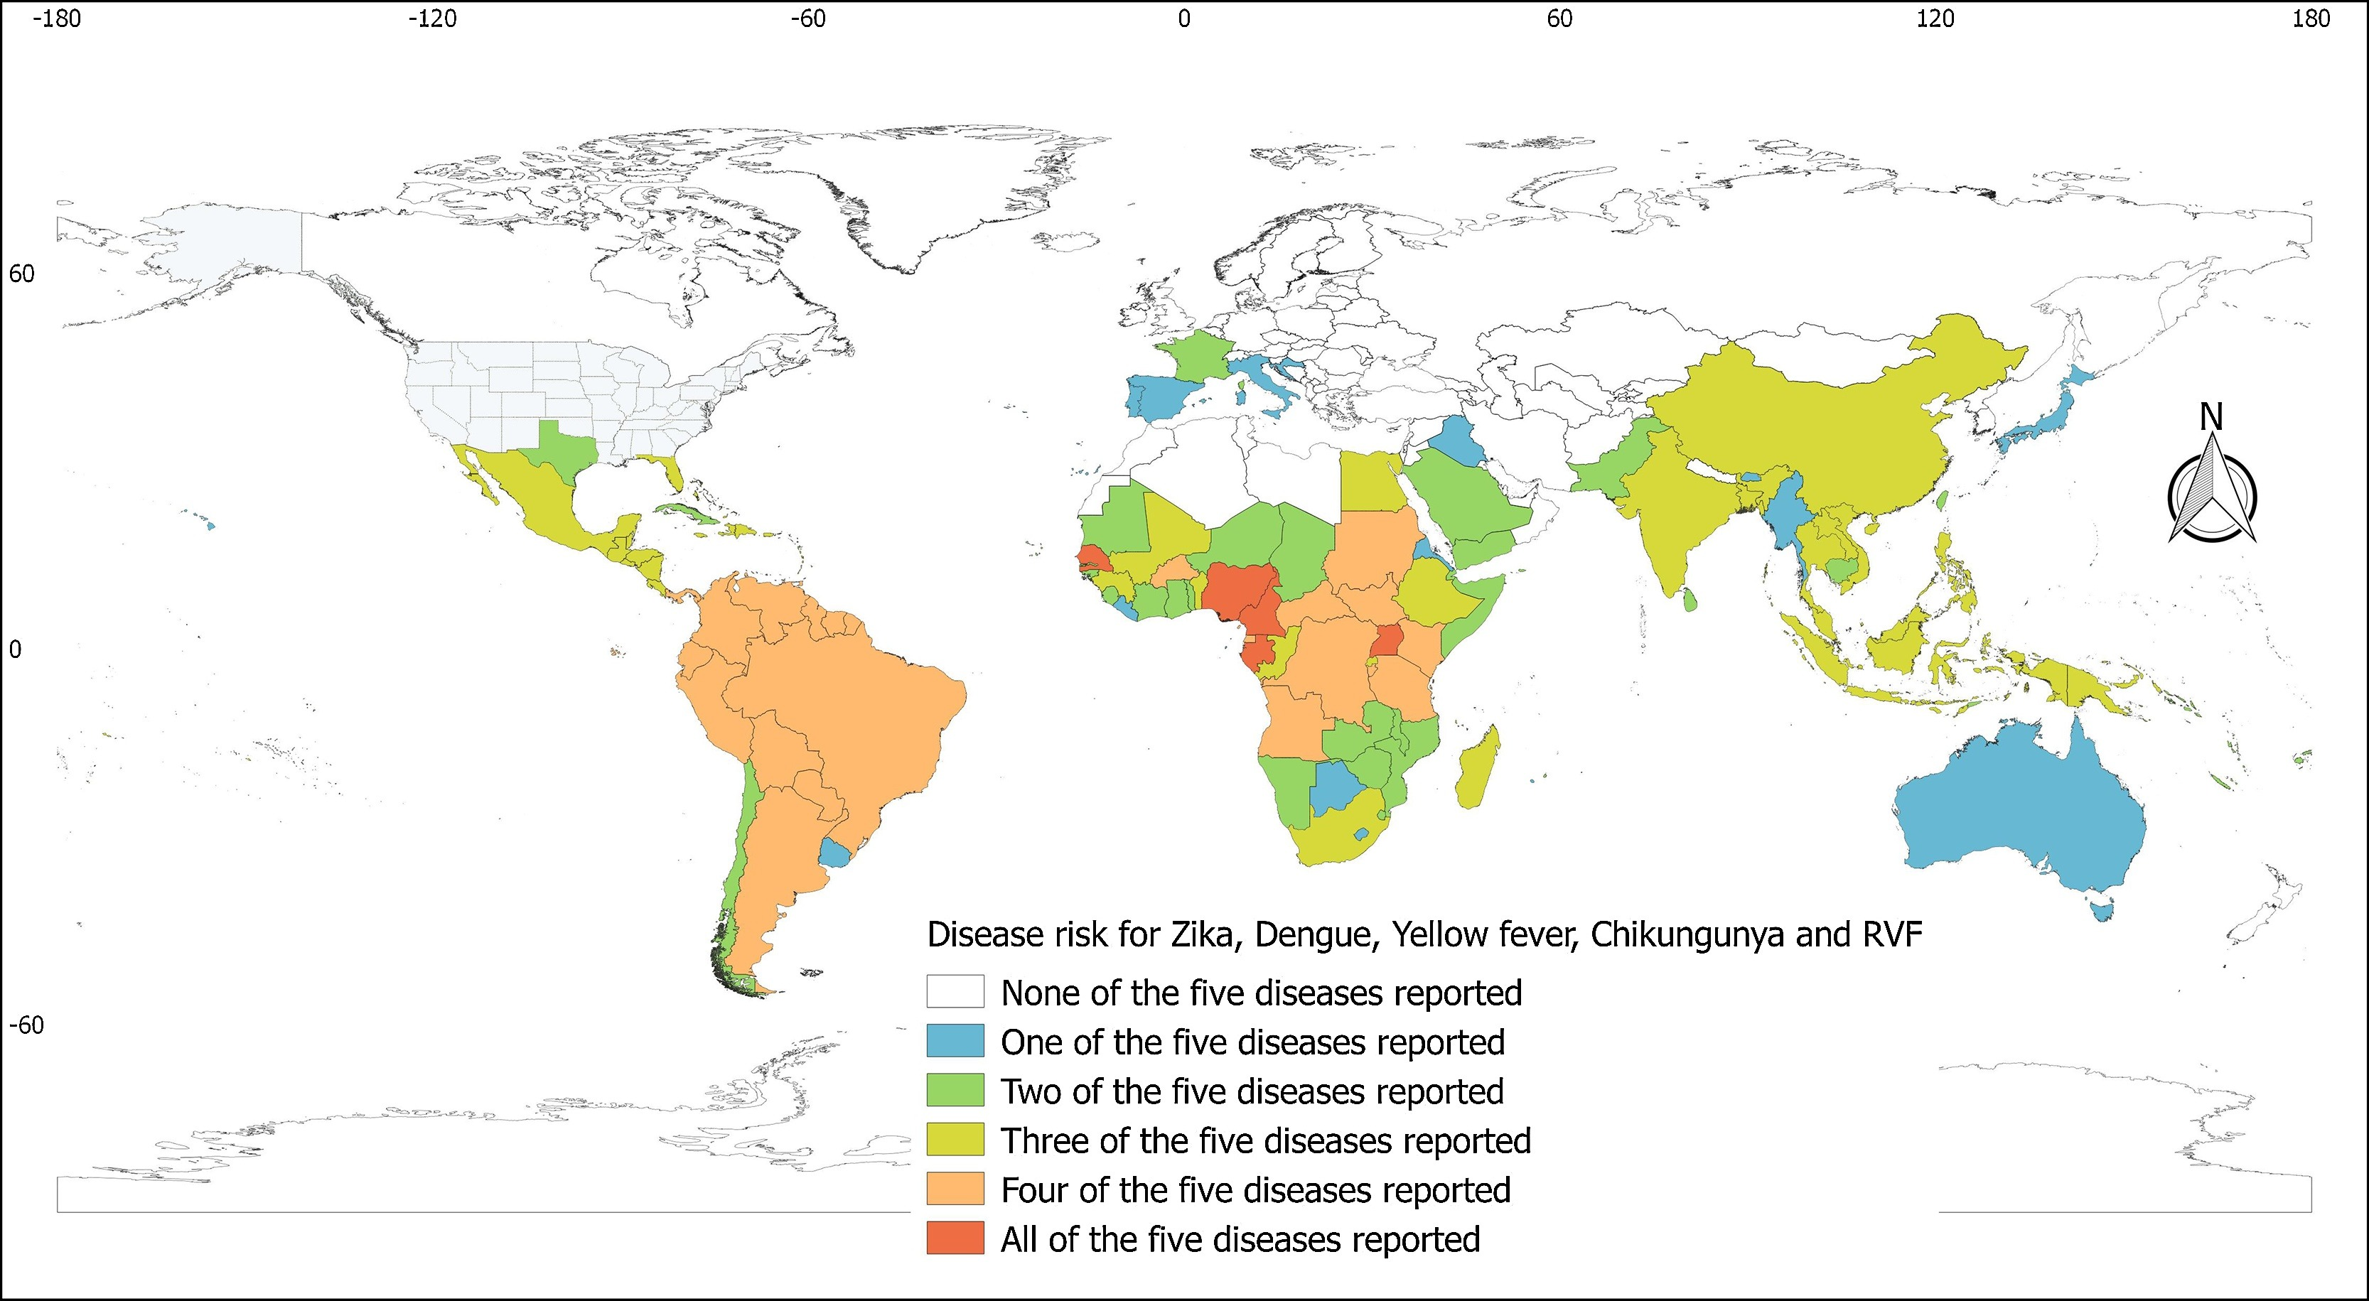
Global Distribution of Aedes Mosquito Species [3]
Global risk mapping of Aedes species (Leta et al. 2018) [https://doi.org/10.1016/j.ijid.2017.11.026]

Slide 12
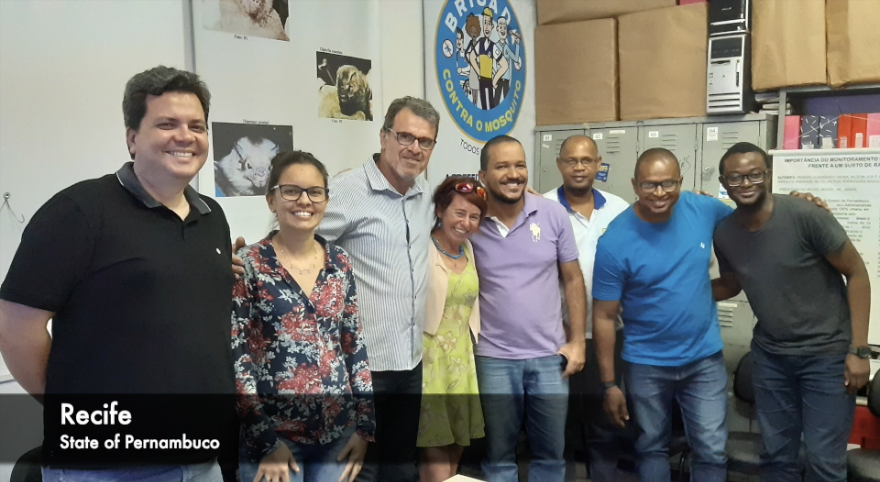
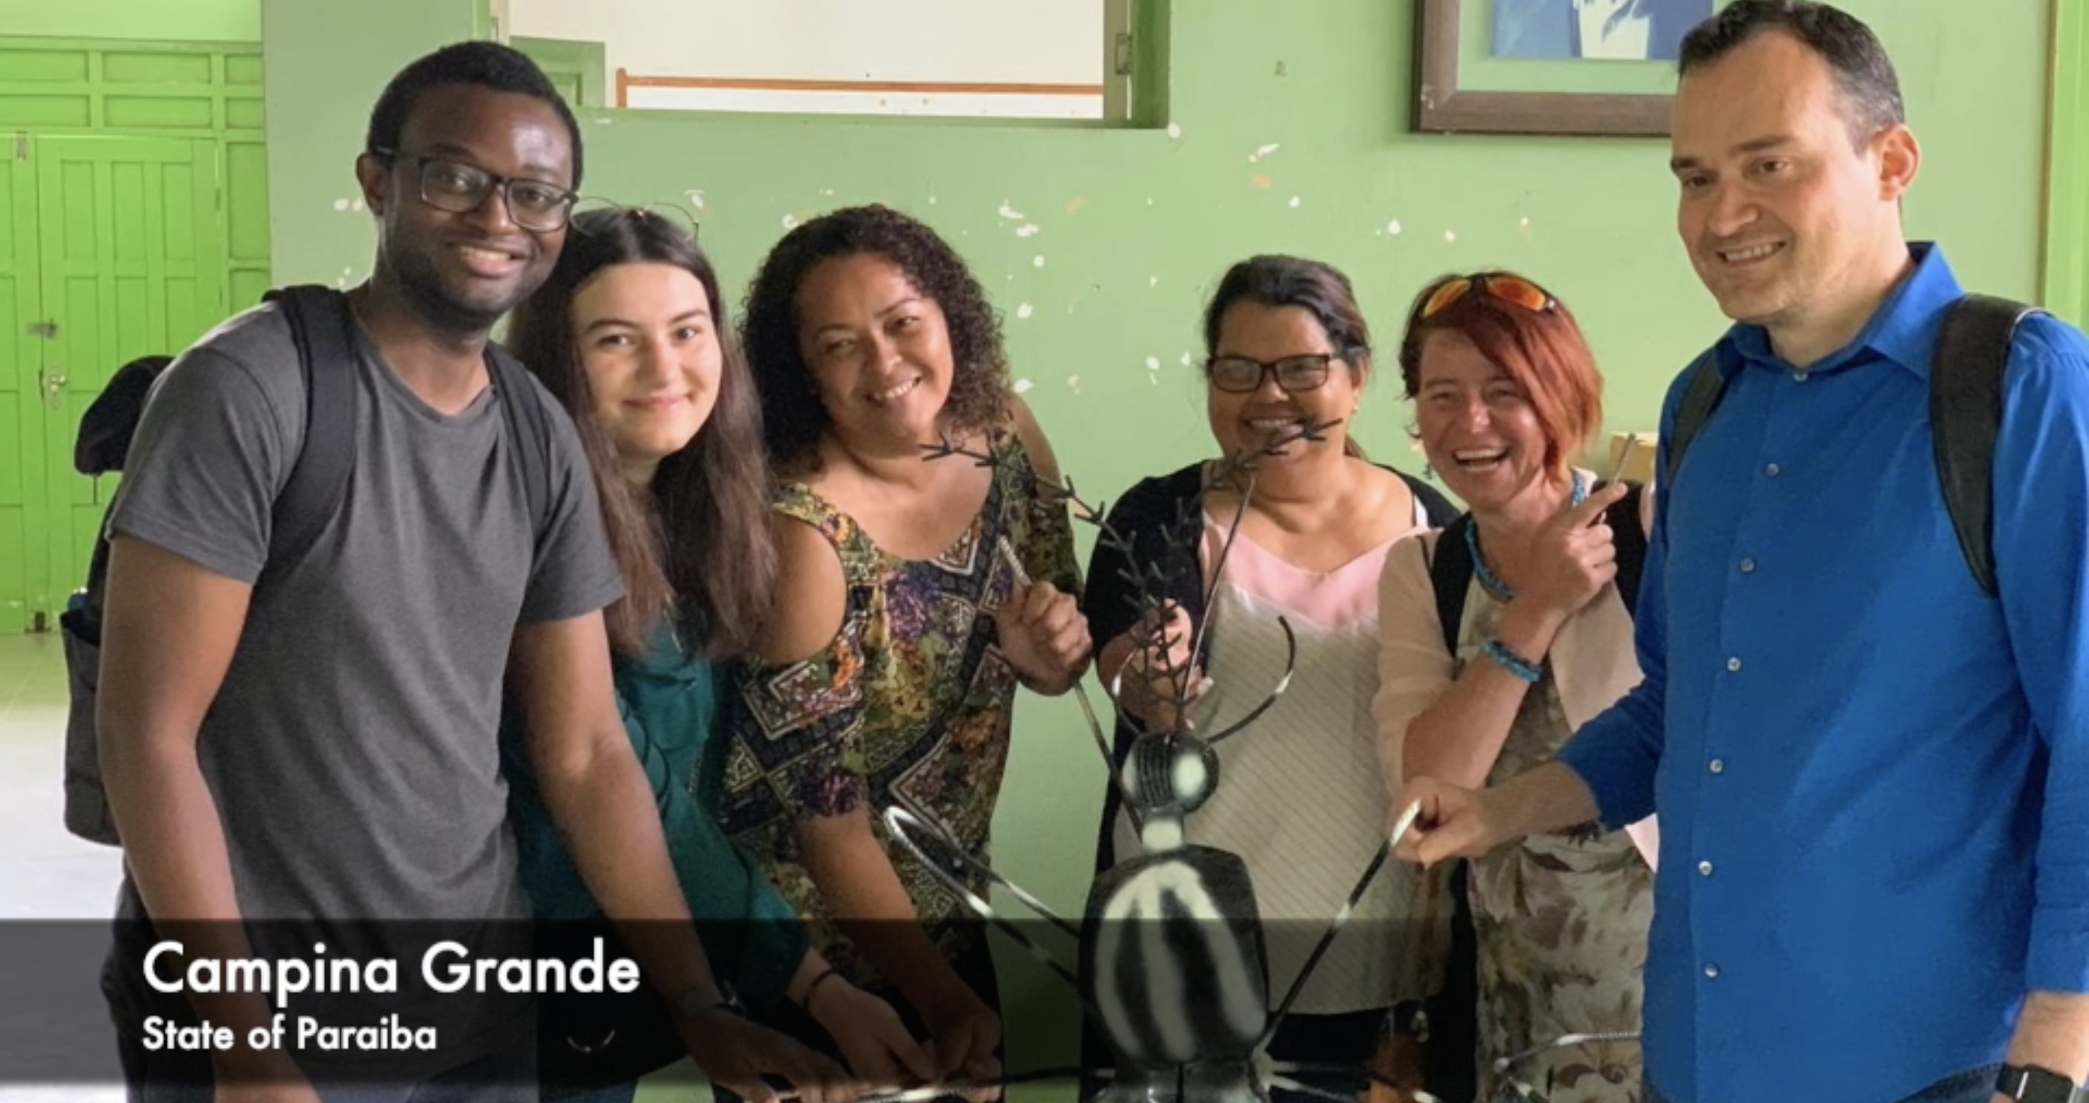
Current Research: Monitoring Mosquito Arboviruses in Brazilian cities
Currently work on a collaborative project with academics from UCL, Turkey & Centre of Environmental Surveillance in Recife and Campina Grande
We piloted a mobile phone (since August 2019) to support agents in collecting new information on household-levels of mosquito infestation
Early warning detection of dangerous mosquito-borne arboviruses (e.g., Zika, Dengue etc.)
Mapping and prediction of hotspots and breeding sites
Combating the social, environmental and climatic-related determinants of increased mosquito abundance
Notes:
I work closely with the Centre for Environmental Surveillance in Brazil. I am response for modelling mosquito populations across two major cities and addressing the paucity of spatial data (this involves con an interdisciplinary collaborative project the combines computer science, entomology, epidemiology and geography to XYZ

Slide 13
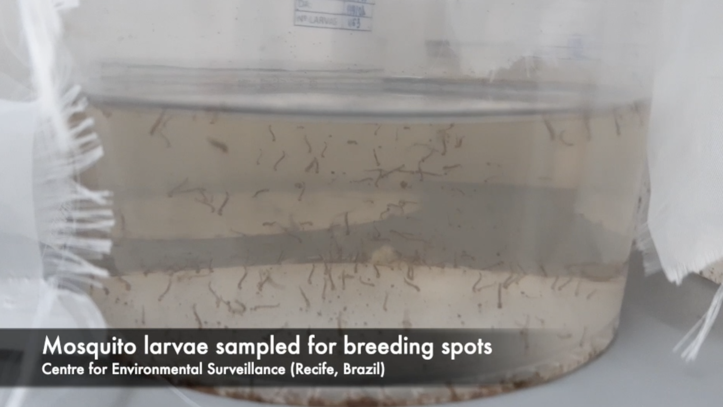

Slide 16
Mosquito-borne Surveillance in Recife, Brazil [2]
Environmental agents carry out on a bimester interval, i.e.,
visits to houses and residential premises to rid of potential breeding
habitats and infestation

Slide 17
Classification | Breeding site (or type of deposit) found in a household
A1 | Deposits from a water tank
A2 | Deposits from domestic consumption e.g. barrel, tub, clay deposit, tank, well and cistern
B | Deposits from household objects that can contain water e.g. water vases, dishes, drippings, ice containers, drinking fountains in general, small ornamental fountains, deposited building material, religious/ritual objects
C | Deposits from objects seated outdoors e.g. work tanks, drills and backyards, gutters, slabs and awnings in unevenness, disused sanitary drains, construction debris, untreated pools, ornamental fountains, vases / flower pots, shards of glass in walls, inspection and passage boxes
D1 | Deposits from discarded objects found outdoors in property e.g. tires and other rolling stock (stains/chambers)
D2 | Deposits from garbage (plastic containers, bottles, cans), scraps on old iron yards and recyclers, debris
E | Deposits from vegetations typically found outdoors of property e.g. armpits of leaves (bromeliads, etc.), holes in trees and rocks, bark of animals (hooves and shells)

Slide 18
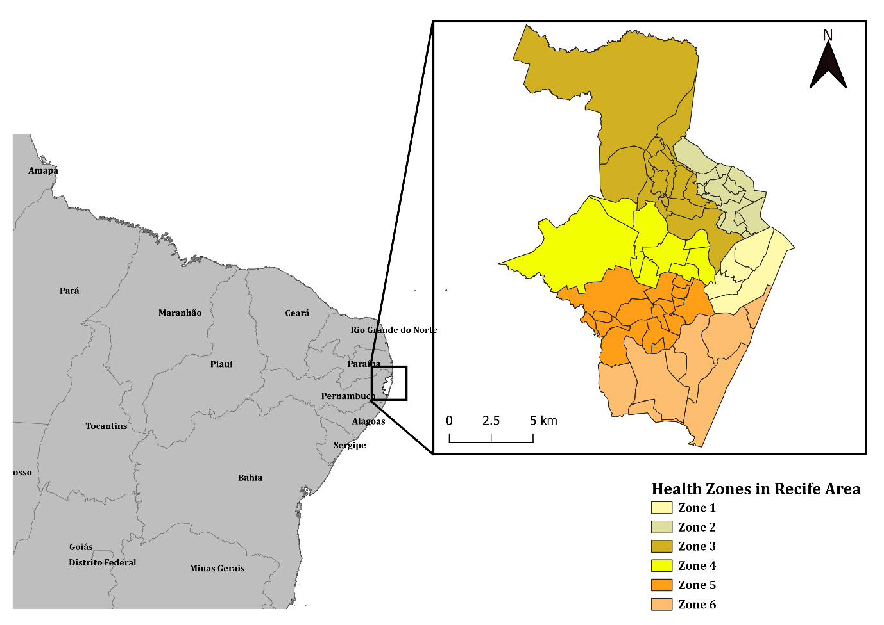
Recife, city profile
Recife is delineated in 6 health zones, and subdivided into 72 neighbourhoods (as of 2019)
Recent vector control data: January 2015 to October 2019
Baseline information – the overall number of properties by neighbourhood (as denominators); total number of properties infested with larvae or adult mosquito
Aims: We want to understand and quantify risk trajectories of mosquito infestation on a neighbourhood-level; which informs profile of the neighbourhood (i.e., it having sustained risks or not).
Notes:
The goal is to harness this rich resource in order to…

Slide 19
Model formulation and risk inference
Estimating the neighbourhood-level the risks of mosquito infestation using a Bayesian multivariable regression model:
$$Y_{i,j}=Bin(n_{i,j},θ_{i,j})$$
$$\log\left(θ_{i,j}\right)= α+ u_{i}+v_{i}+Xp(β+δ_{i})t_{j}$$
$$i=1, 2, 3, 4, …, 72 \& j=1, 2, 3, …,57$$
Quantity of interests are the odds ratios to measure levels risk (OR, $θ_{i,j}$)
If $θ_{i,j}$ < 1.00 (null value) its an indication of a reduction in the risk of infestation in an area
If $θ_{i,j}$ = 1.00, its an indication that there are no risks of infestation in an area
If $θ_{i,j}$ > 1.00, its an indication that there is an increased risk of infestation in an area
Note that 95% Credible Intervals excluding the null value determines whether or not the risk of infestation is significant

Slide 20
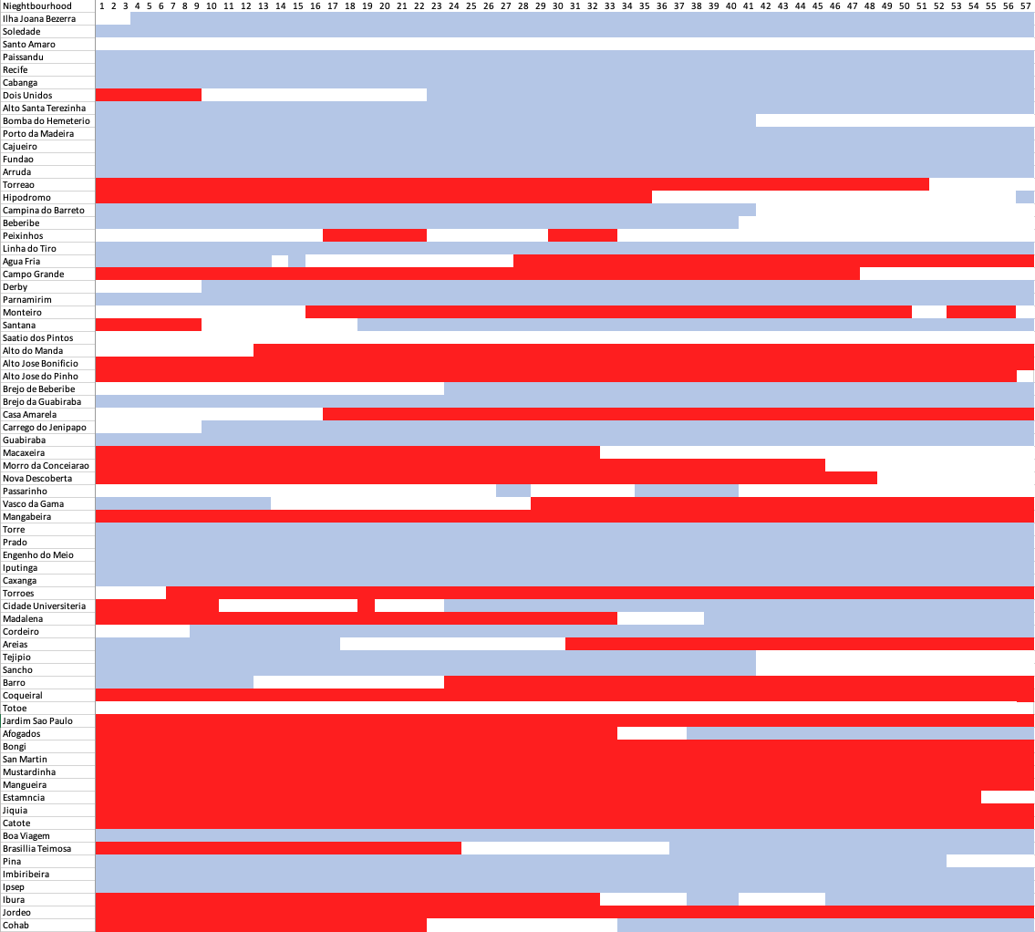
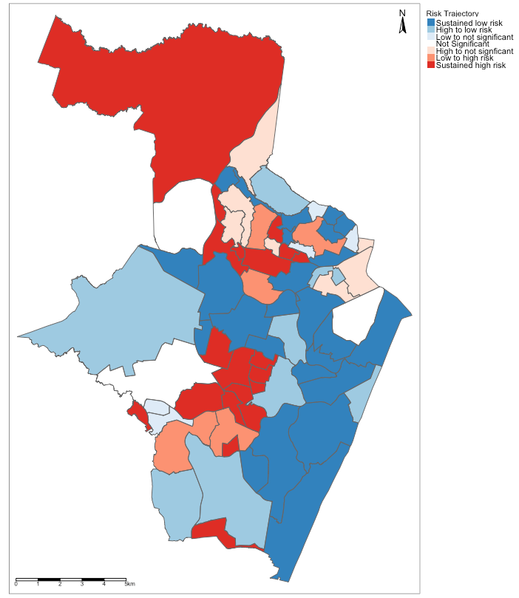
Results
Results & Conclusions
a.) Temporal risks for infestation
b.) Sustained Risk of Arboviral infestation

Slide 21
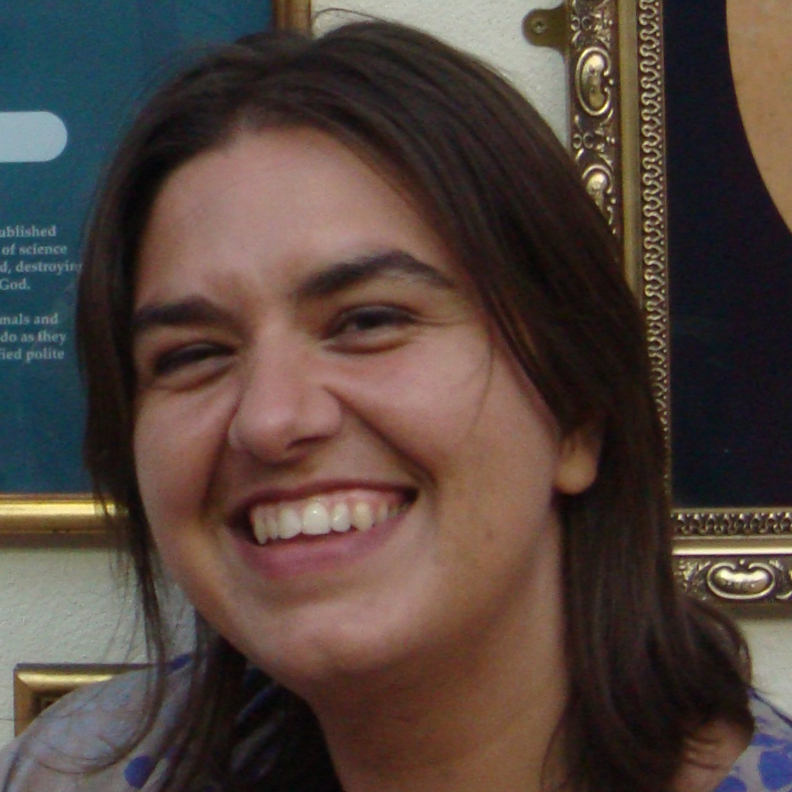
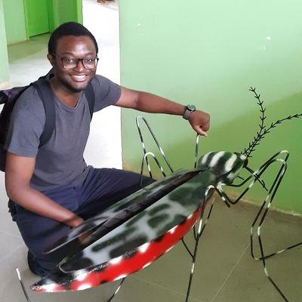
Thank You
Consortium Leaders
Researchers
[21]

Slide 22
Questions?
[22]

