Slide 1
ClinOps Training Program Set-up and Lessons Learned
Dawit A. Ejigu
6th April 2022
www.cdt-Africa.org

Slide 2
Outline
Background on CDT-Africa, AAU
Approaches in Clinical Research Training
ClinOps training program
Course setup
Lessons learned
Preliminary survey results
www.cdt-Africa.org

Slide 3
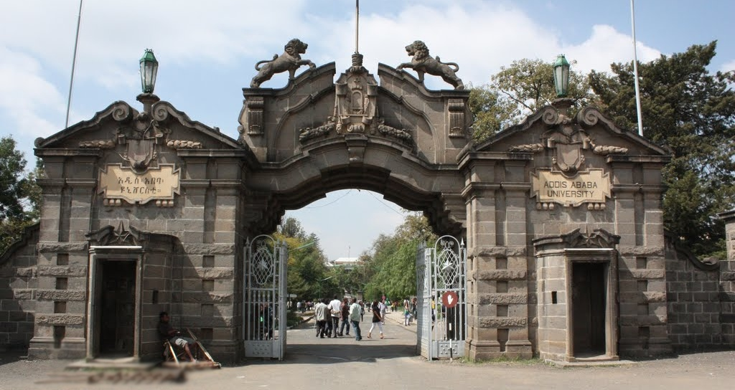
Host institution; AAU
1
2
3
4
Largest and
oldest in
Ethiopia
53,000 students
73 undergraduate programs
293 postgraduate programs
6tth in Africa
400-500 in the World
3 World Bank supported ACEs
Largest hospital
1
2
3
4
www.cdt-Africa.org

Slide 4
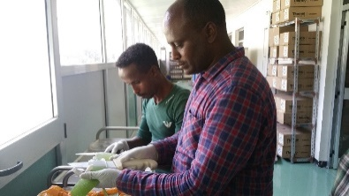
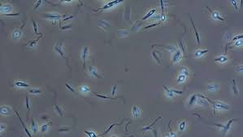
Research & Capacity Building in Medical Discovery and Development
Medical discovery
& Development
Care Delivery
Innovation
CT & Regulatory
Sciences
Platforms
www.cdt-Africa.org

Slide 5
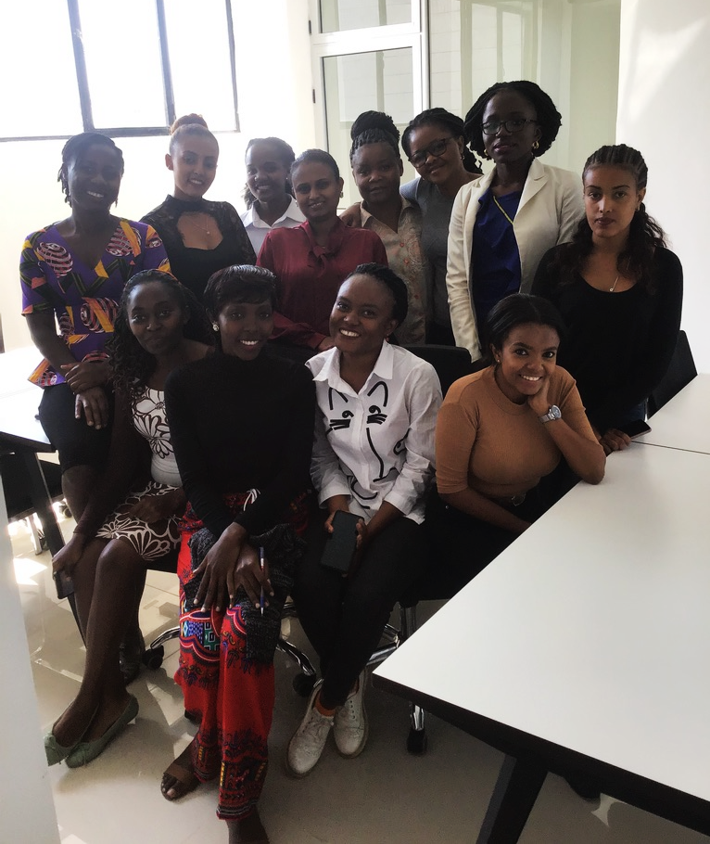
Education & Research
Programmes
Short courses
MSc
PhD
Postdoc
Regionality
Focus on supporting female students
www.cdt-Africa.org

Slide 6
Summary of Results (Past 4.5 Years)
700+ students
Product dev’t work
300+ publications
New Ed. programs
Resource + infrastructure
100+ new staff
www.cdt-Africa.org

Slide 7
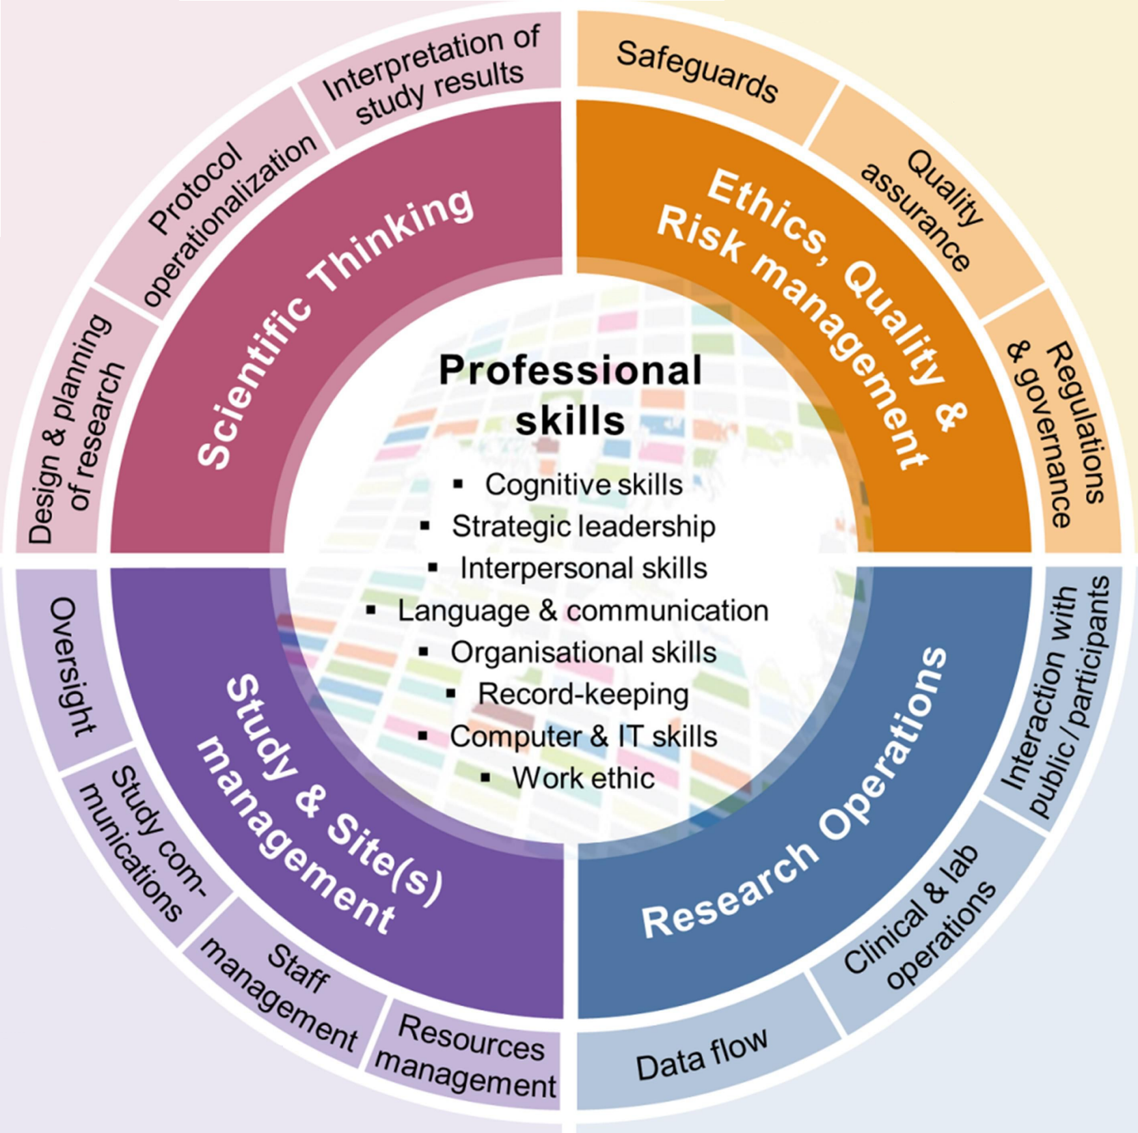
Approaches in Clinical Research Training
Calvin-Naylor et al: Education and training of clinical and translational study investigators and research coordinators: A competency-based approach. J Clin Transl Sci 2017, 1:16-25
www.cdt-Africa.org

Slide 8
Unique Features of ClinOps Program
Syllabus anchored in the TDR/TGHN competency framework
Input from PDPs, CROs, fellows, FCD
Focus on practical recurring problems in African sites
Covers all relevant domains to enable trial conduct
Intensive on the job training for study coordinators
Innovative Training approach
M&E effort to ensure course objectives are met
www.cdt-Africa.org

Slide 9
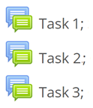
Course set-up; Innovative Approaches
www.cdt-Africa.org

Slide 10
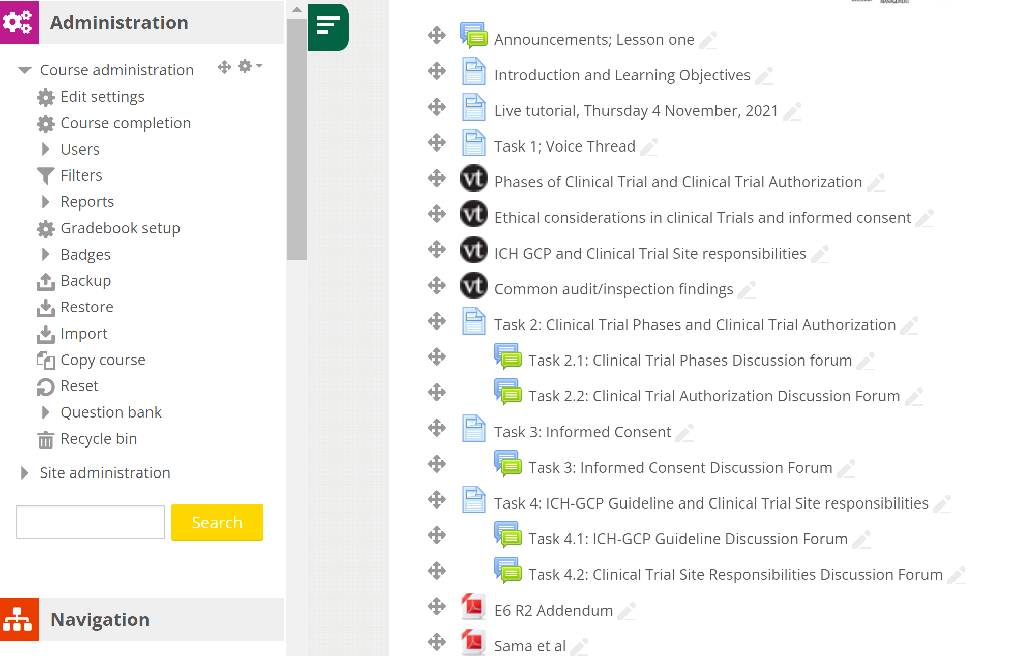
Course set-up; Moodle LMS
www.cdt-Africa.org
Notes:
Automatic grading for MCQ type questions
Trace performance
Schedule events and send reminders

Slide 11
Course set-up; VoiceThread
www.cdt-Africa.org

Slide 12
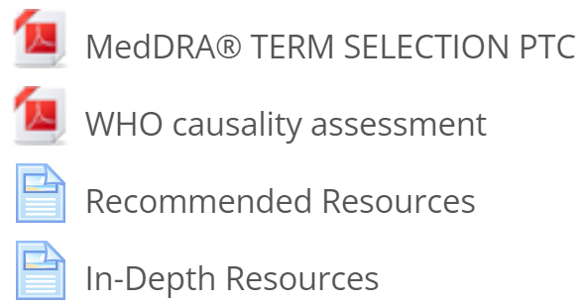
Course set-up; Innovative Approaches
www.cdt-Africa.org

Slide 13
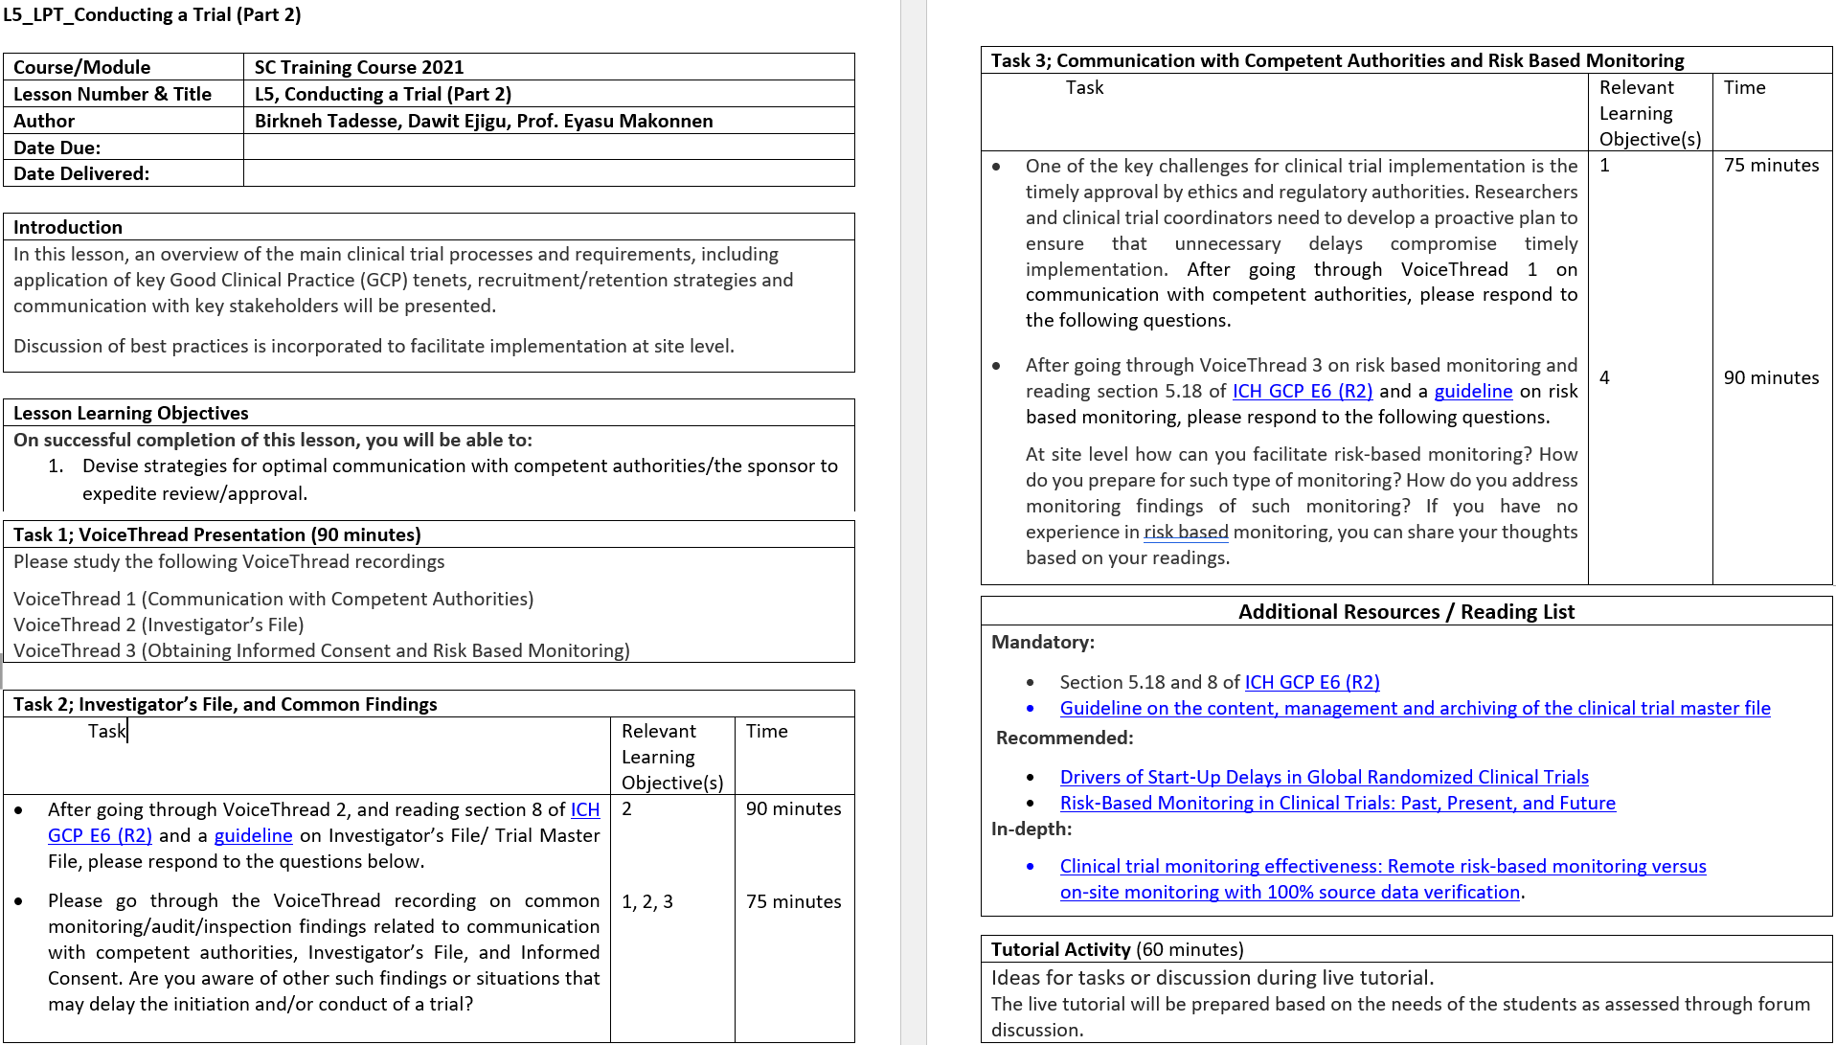
Course set-up; Upfront Extensive Planning
www.cdt-Africa.org

Slide 14
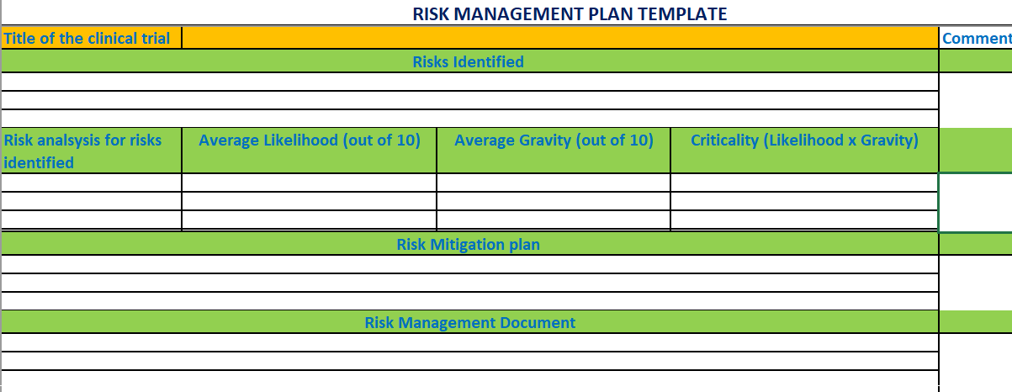
Course set-up; RMP
Group work on developing Risk Management Plan for a clinical trial trainees are working on
www.cdt-Africa.org

Slide 15
ClinOps Covers Various Domains in Depth
Lesson 1; Introduction to Clinical Research Operations
Lesson 2; Data Management and Biostatistics
Lesson 3; Study Design and Protocol Development
Lesson 4; Project and Financial Management
Lesson 5; Conducting a Trial (Part 1)
Lesson 6; Conducting a Trial (Part 2)
Lesson 7; Closing out and Reporting a Trial
Lesson 8; Working with External Partners
Lesson 9; Quality Systems, Audits & Inspections
Lesson 10; Pharmacovigilance
www.cdt-Africa.org
Notes:
Each lesson starts on Mondays, and we will have a live tutorial on Thursdays.

Slide 16
ClinOps Covers Various Domains in Depth …
Each lesson stays for a week and starts on Mondays
Takes between 8-10 hours
www.cdt-Africa.org
Notes:
Each lesson starts on Mondays, and we will have a live tutorial on Thursdays.

Slide 17
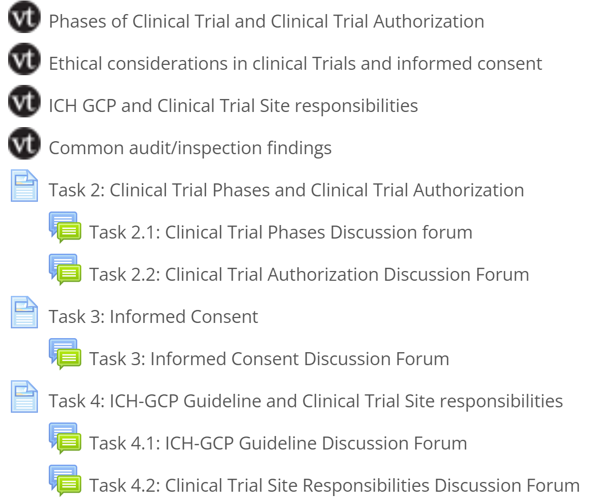
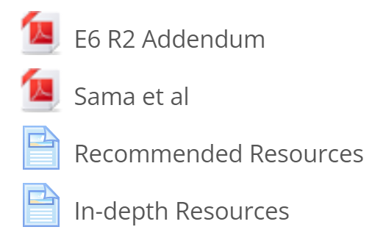
Lesson 1; Introduction to Clin. Res. Operations
www.cdt-Africa.org

Slide 18
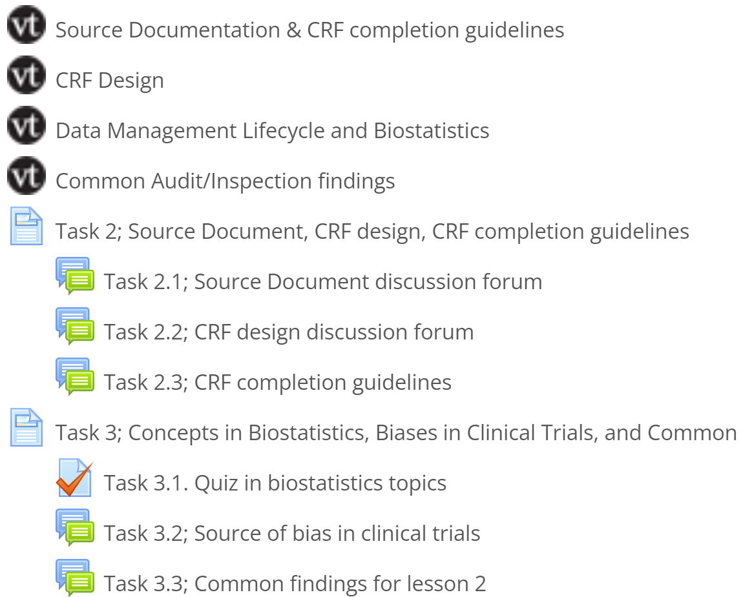
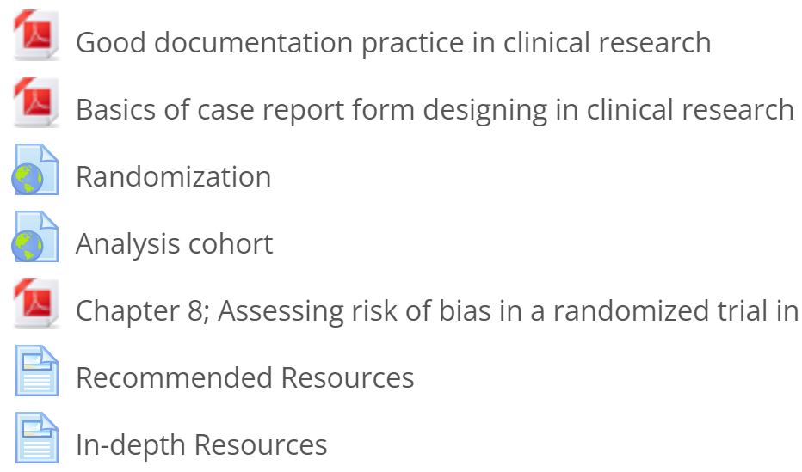
Lesson 2; Data Management and Biostatistics
www.cdt-Africa.org

Slide 19
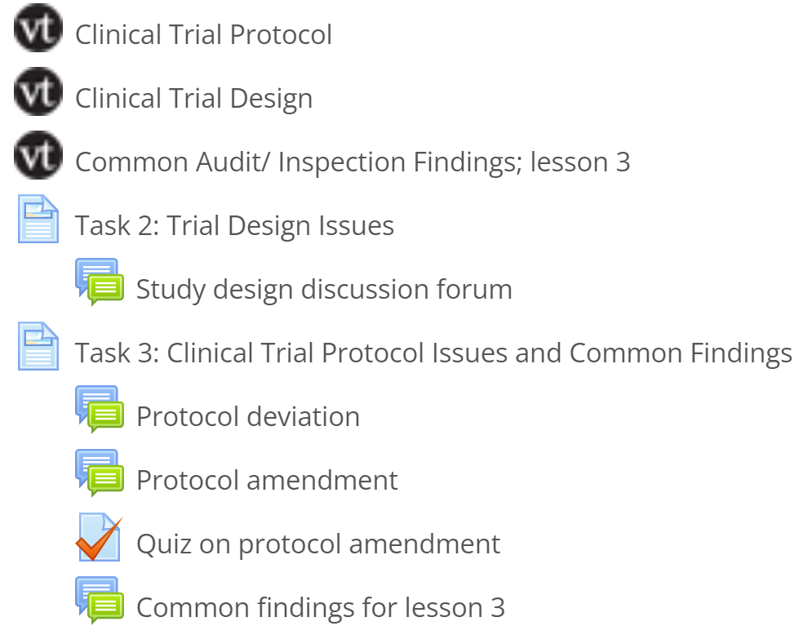
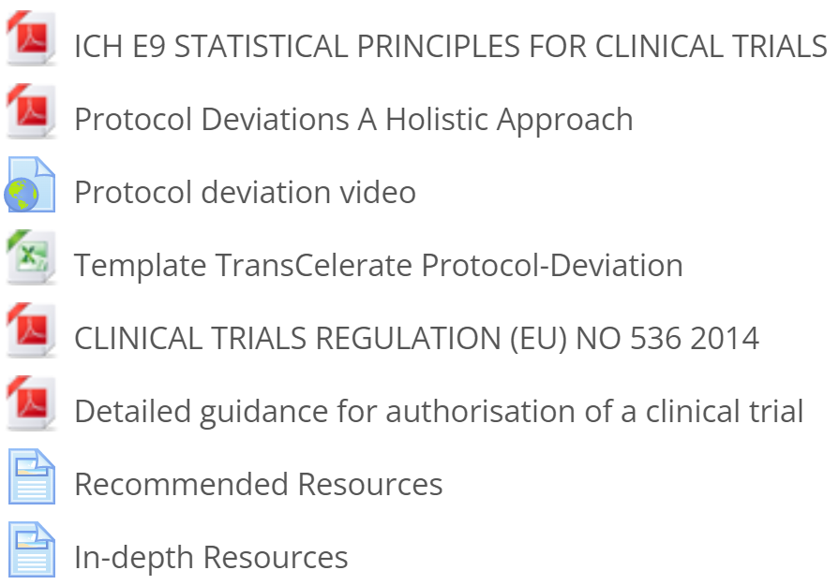
Lesson 3; Study Design and Protocol Development
www.cdt-Africa.org

Slide 20
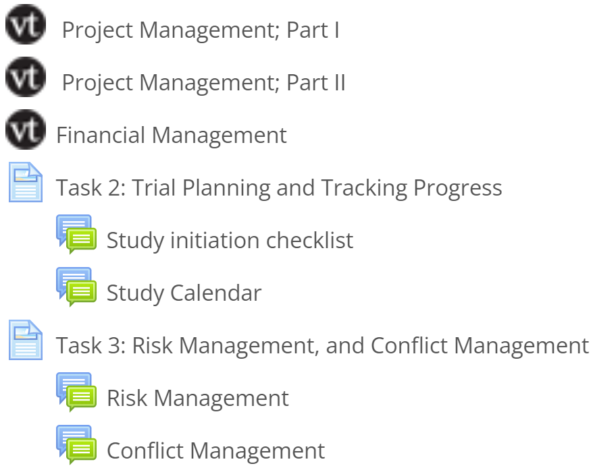
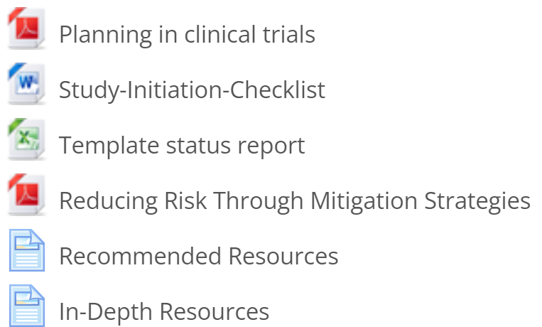
Lesson 4; Project and Financial Management
www.cdt-Africa.org

Slide 21
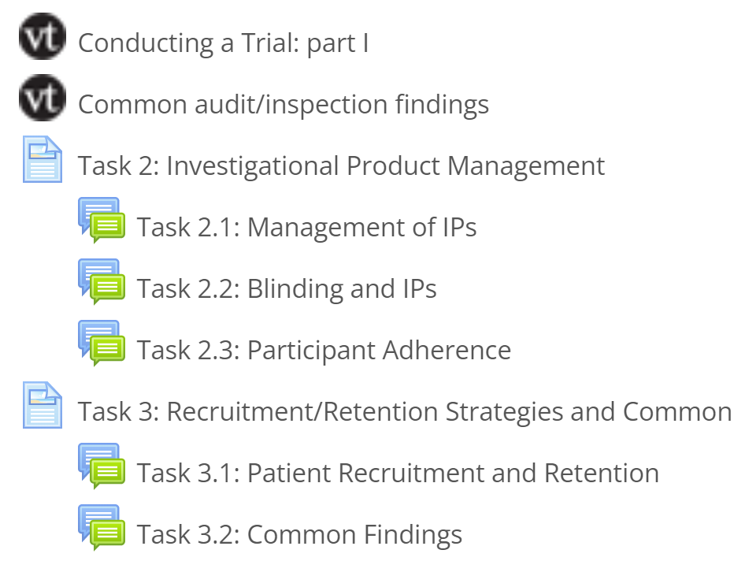
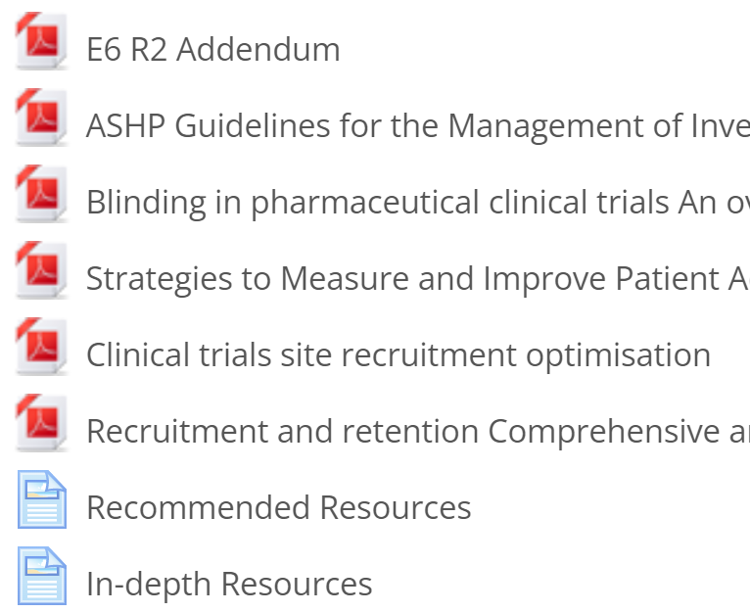
Lesson 5; Conducting a Trial (Part I)
www.cdt-Africa.org

Slide 22
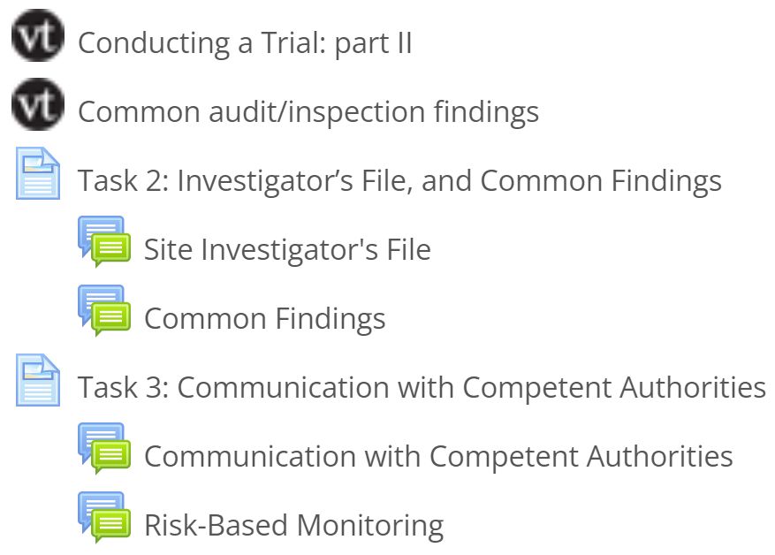
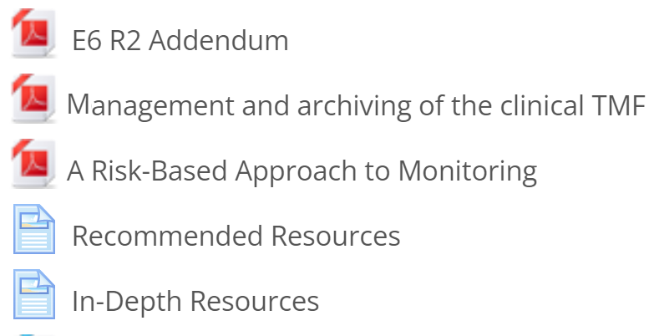
Lesson 6; Conducting a Trial (Part II)
www.cdt-Africa.org

Slide 23
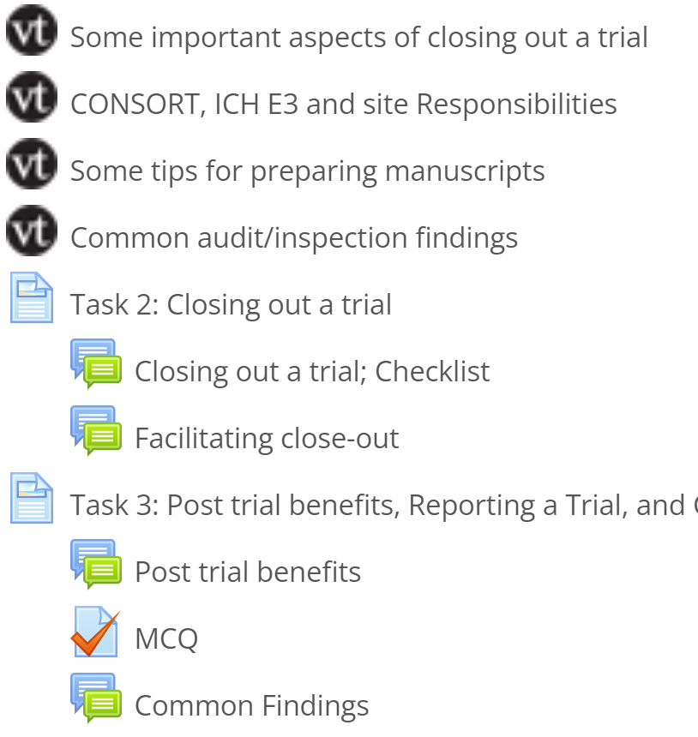
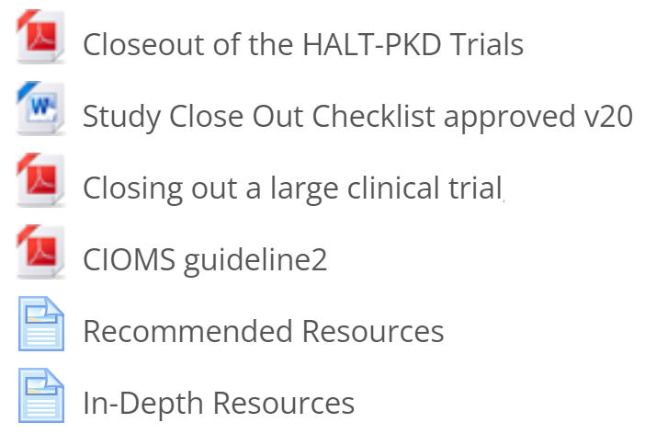
Lesson 7; Closing out and Reporting a Trial
www.cdt-Africa.org

Slide 24
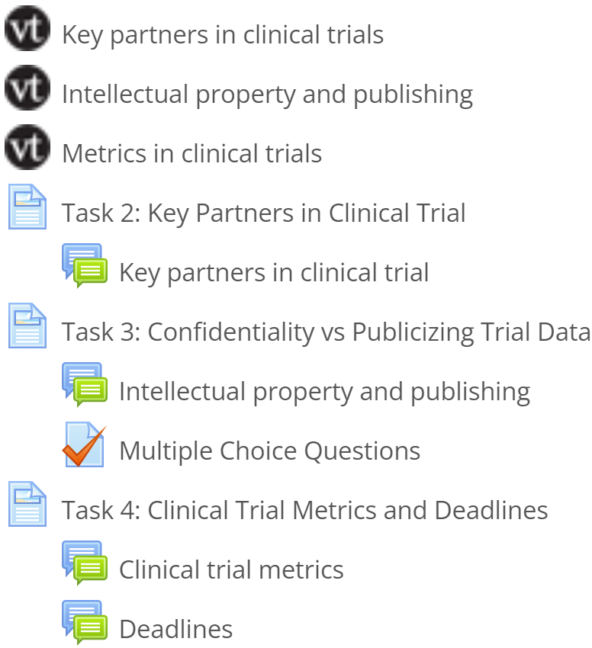
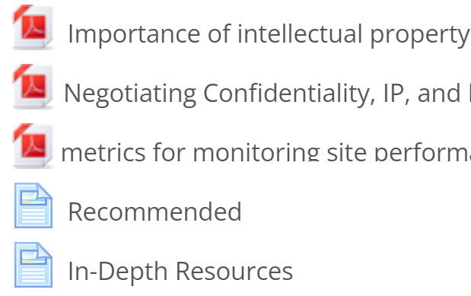
Lesson 8; Working with External Partners
www.cdt-Africa.org

Slide 25
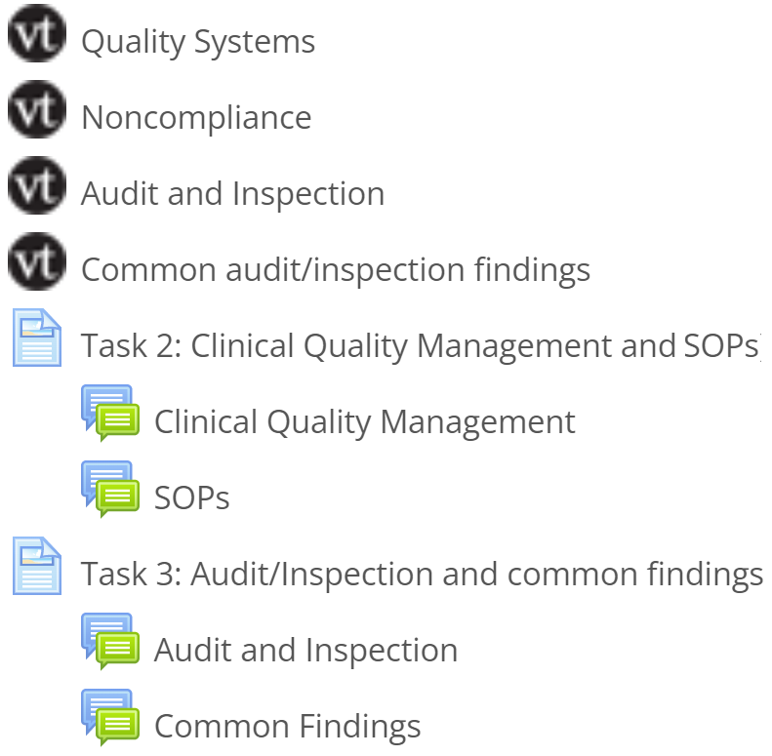
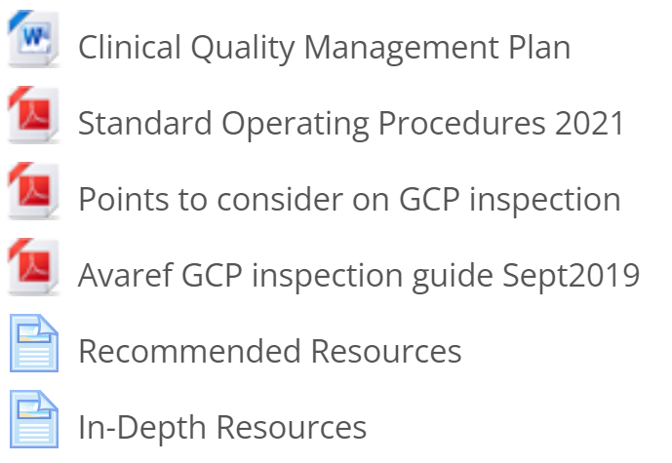
Lesson 9; Quality Systems, Audits & Inspections
www.cdt-Africa.org

Slide 26
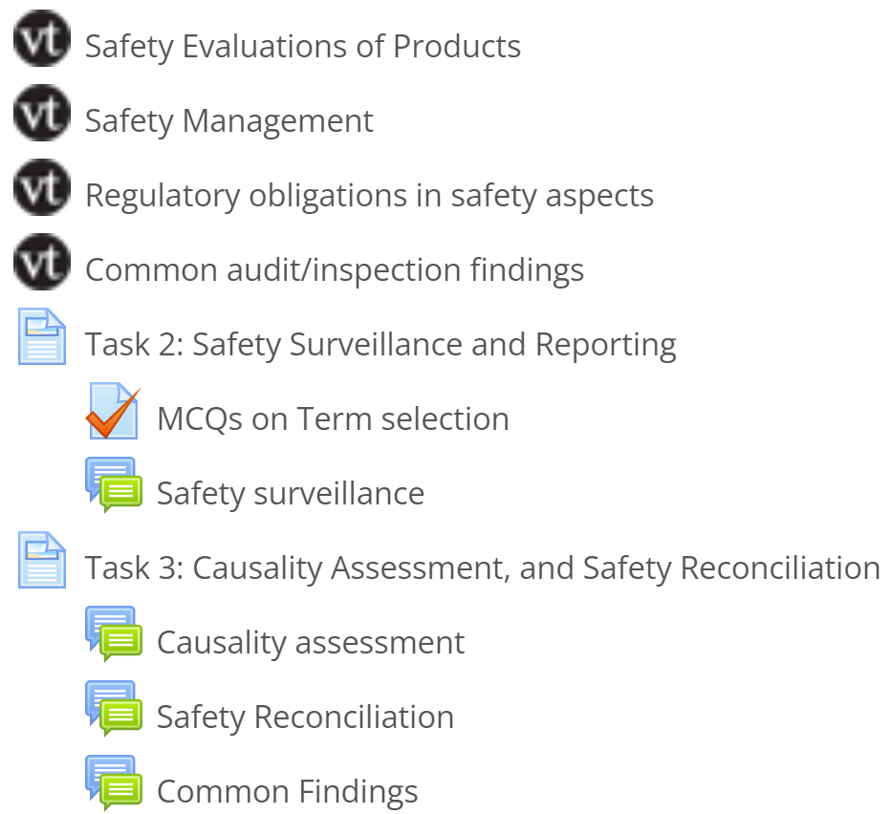
Lesson 10; Pharmacovigilance
www.cdt-Africa.org

Slide 27
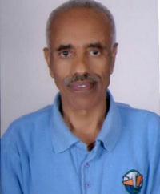
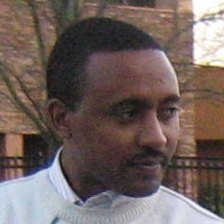
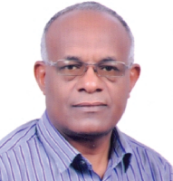
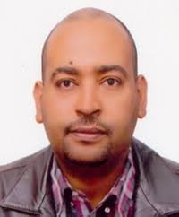
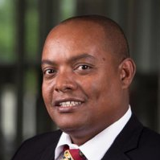
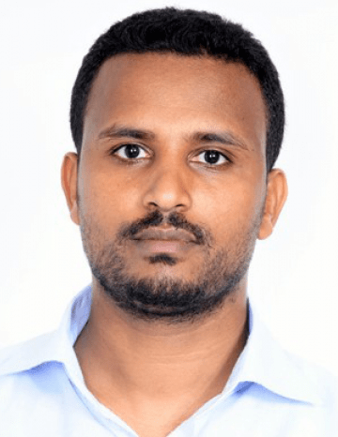
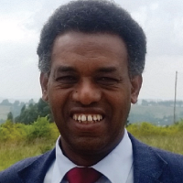
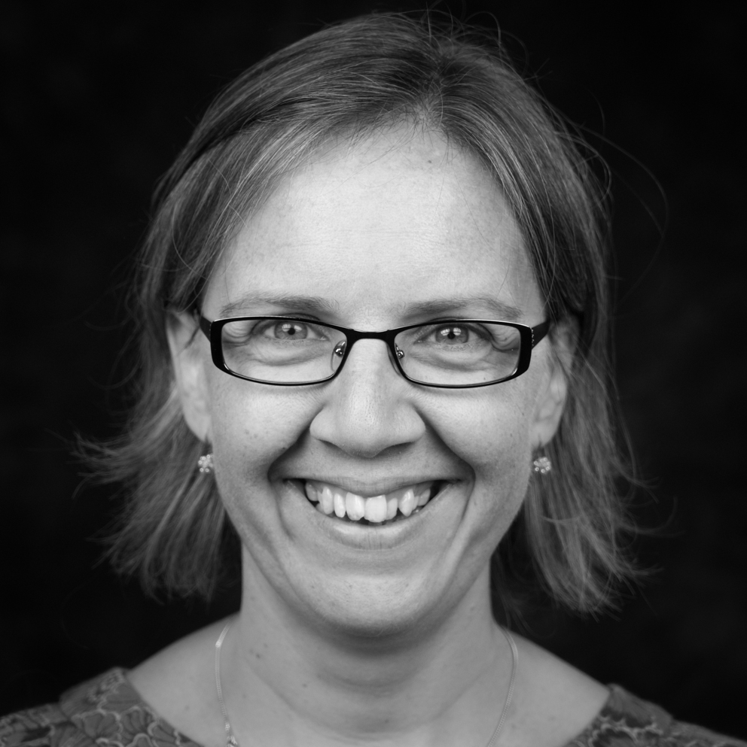
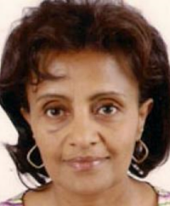
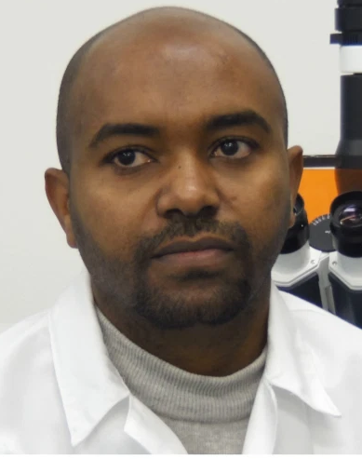
ClinOps tutors, highly experienced in clinical trials
Prof. Eyasu Makonnen
Dr. Dawit A. Ejigu
Prof. Asrat Hailu
Dr. Anteneh Belete
Dr. Getnet Yimer
Dr. Birkneh T. Tadesse
Prof. Abebaw Fekadu
Dr. Charlotte Hanlon
Dr. Yimtubezinash W/Amanuel
Dr. Solomon Mequanente
www.cdt-Africa.org

Slide 28
Lessons learned; social bond for success
www.cdt-Africa.org

Slide 29
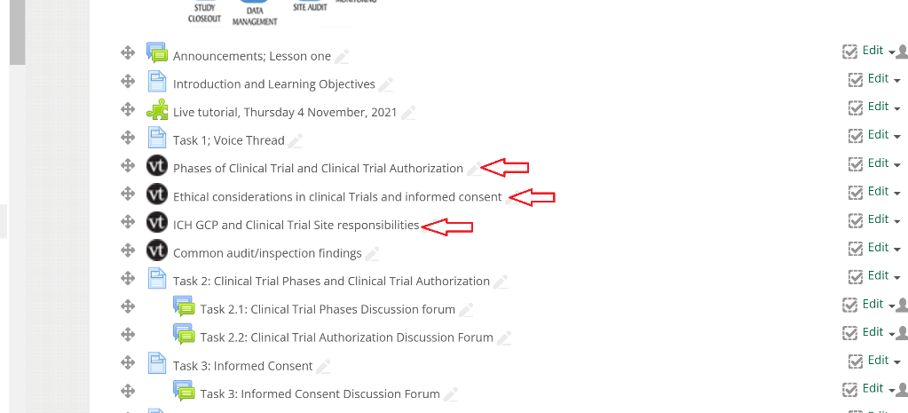
Lessons learned; attend to the needs of the trainees
www.cdt-Africa.org

Slide 30
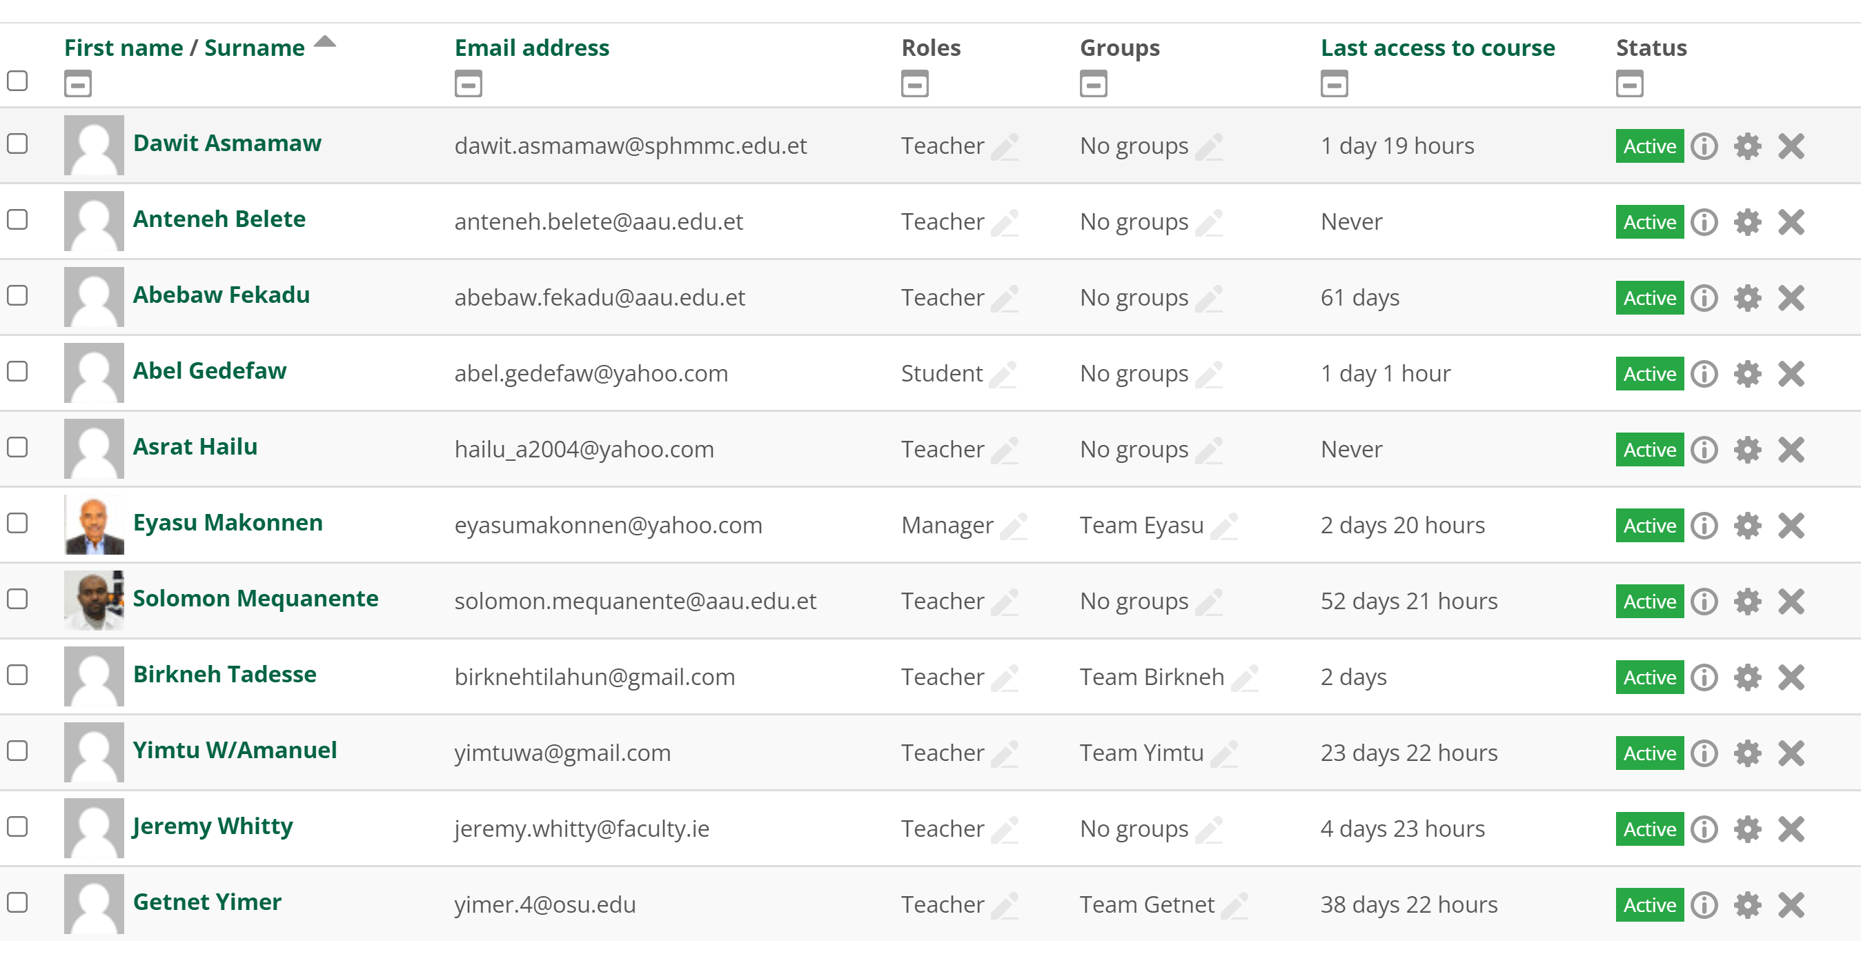
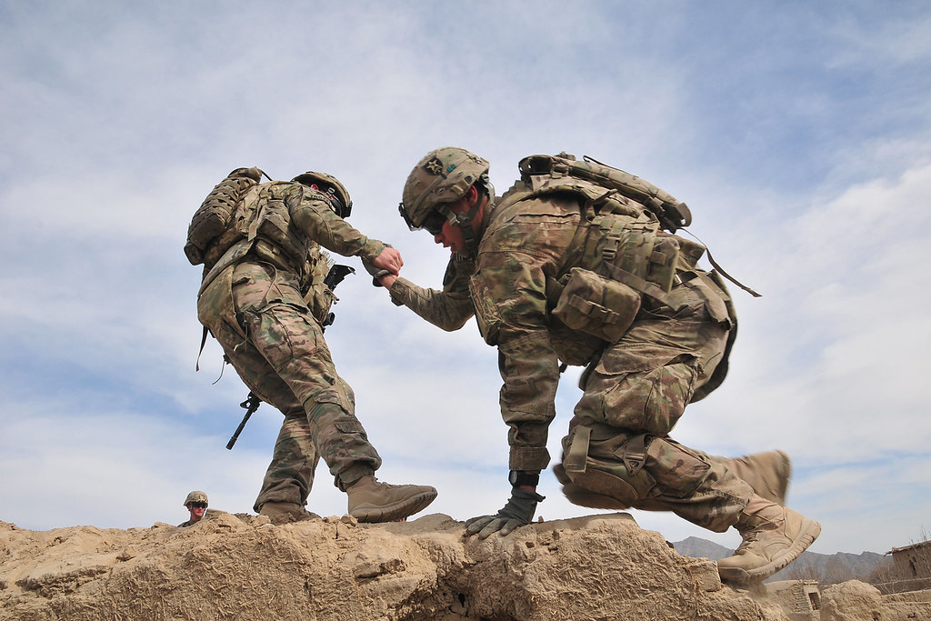
Lessons learned; trainees falling behind
www.cdt-Africa.org

Slide 31
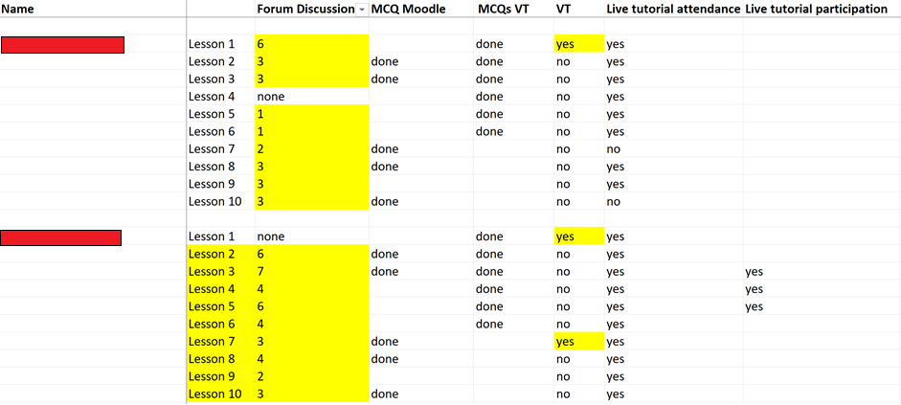
Lessons learned; trainees falling behind…
www.cdt-Africa.org

Slide 32
Lessons learned; extra time at the end
www.cdt-Africa.org

Slide 33
Confidence in effectively coordinating a trial
www.cdt-Africa.org

Slide 34
Confidence in understanding of clinical data management process
www.cdt-Africa.org

Slide 35
Confidence in conducting trials abiding by ethical principles
www.cdt-Africa.org

Slide 36
Confidence in understanding the informed consent process
www.cdt-Africa.org

Slide 37
Confidence in patient recruitment approaches
www.cdt-Africa.org

Slide 38
Confidence in managing IPs
www.cdt-Africa.org

Slide 39
Confidence in patient safety reporting process
www.cdt-Africa.org

Slide 40
Confidence about managing Investigational Site Files
www.cdt-Africa.org

Slide 41
Confidence in effectively closing-out a trial
www.cdt-Africa.org

Slide 42
Content was well organized and easy to follow
www.cdt-Africa.org

Slide 43
Instructors were readily available
www.cdt-Africa.org

Slide 44
Amount of time to complete the course
www.cdt-Africa.org

Slide 45
The learning approach worked well for me
www.cdt-Africa.org

Slide 46
The accessibility of the online course
www.cdt-Africa.org

Slide 47
Overall technical quality of the online course
www.cdt-Africa.org

Slide 48
Would you take another online course?
Couldn’t really keep track of the lessons as the timing didn’t work for me
www.cdt-Africa.org

Slide 49
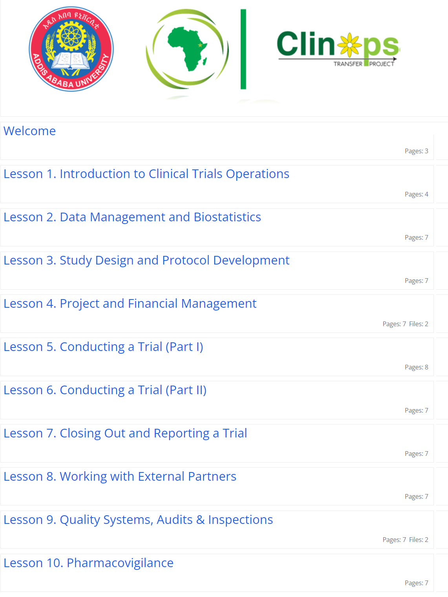
Free to access version of the course
https://learn.faculty.ie/course/view.php?id=40
www.cdt-Africa.org

Slide 50
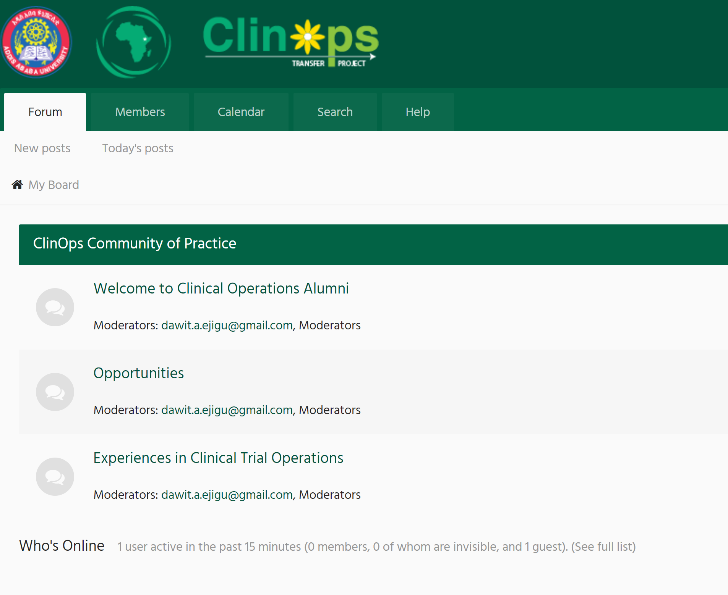
Community of Practice
https://alumni.cdt-africa.org/index.php
www.cdt-Africa.org

Slide 51
For further communication
For potential trainees to register for upcoming courses
https://www.cdt-africa.org/index.php/education/short-courses/clinops/applications
For organizations/initiatives to work with us in future delivery of the course
https://www.cdt-africa.org/index.php/education/short-courses/clinops/applications-ii
Email us @ applications.clinops@aau.edu.et
www.cdt-Africa.org

Slide 52
THANK YOU ! ! !
www.cdt-Africa.org

