Slide 1
Birth Defects Surveillance in Nigeria: Ibadan Experience
By:
Dr Adejumoke Idowu AYEDE
Department of Paediatrics
College of Medicine, University of Ibadan
And University College Hospital, Ibadan,
Nigeria.

Slide 2
The outline
The twin Institutions
The sub groups
Strategies for group establishment
Baseline data collection
Baseline data publications
Meeting with FMOH
Birth defect surveillance as part of agenda for Children with Special Needs sub-committee of CHTWG of FMOH
Immediate next plans

Slide 3
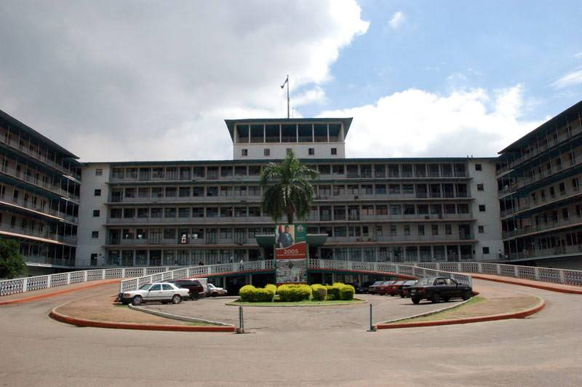
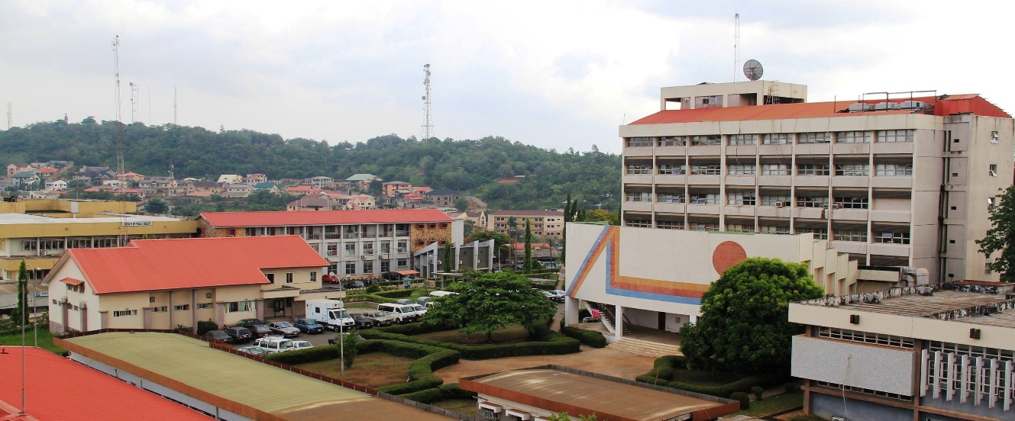
Our Institutions

Slide 4
Team Members (2015)
Core Members
Other members
Paediatric Cardiology Team: Prof S.I Omokhodion Sub-team Leader
Dr O.O Ogunkunle
Dr A. Adebayo
Endocrine and Genetics Team: Dr Ashubu Sub-team Leader
Paediatric Surgical Team: Dr Lawal Sub-team Leader
Dr Olulana
DrOgundoyin
Dr. A. I. Ayede: Team Chair
Dr. A. O. Adeleye: Team Co-Chair
Dr. A. A. Olusanya: Team Secretary

Slide 5
Other members cont’d
Paediatric Nephrology Team: Dr. Ada Asinobi Sub-team Leader
Dr Ademola
Cranio-Facial Surgery Dr. Olusanya Sub-team Leader
Prenatal Screening Team Dr. G. Ogbole Sub-team Leader
Dr. Akinmoladun Prof. A. Agunloye
Obstetrics Team Prof. O. Olayemi O Sub-team Leader
Dr Mohanson- Bello
Dr A. Adekanibi
Ophthalmology Prof. Baiyeroju Sub-team Leader
Dr. Olusanya
OLA Oluyoro, Ibadan Dr. V. Joel- Medewase Sub-team Leader
Urology Dr. S. Adebayo Sub-team Leader
Dr. Takure
Policy Makers Dr Afolabi K. Reproductive Health Unit FMOH
Dr James Child Health Unit FMOH
Child Health FMOH

Slide 6
Strategies for group establishment
Shared vision
Goals and objectives
Monthly token contributions from members
Initial monthly meetings and later less frequently
Proposal and publication targets
Institutional involvement and seeking for support
Chair and Co-Chair Joined ICBDSR
Co-Chair attended Tanzania meeting 2016

Slide 7
Baseline burden data collection and publications
Afr. J. Med. med. Sci. (2016) 45, 421-431
Implementing fetal anomaly ultrasound screening programs in developing countries: strategies, challenges, lessons and recommendations from Ibadan, Nigeria
AO Adeleye¹ , AI Ayede² , JA Akinmoladun³ , GI Ogbole³ , AM Agunloye ³ , AA Olusanya⁴ , OO Ogunkunle² , AO Asinobi² , TA Lawal⁵ , BA Olusanya ⁶ , OF Ashubu² , AOA Adekanbi⁷ , SI Omokhodion² , AO Adeyinka³ and TO Alonge ⁸.
Afr. J. Med. med. Sci. (2016) 45, 433-438
Congenital anomalies in Ibadan, Nigeria
AI Ayede¹ , AO Adeleye² , AA Olusanya³ , TA Lawal⁴ , BA Olusanya⁵ , OO Ogunkunle¹ , AO Asinobi¹ , BE Adebayo¹ , OO Jarrett¹ , DI Olulana⁴ , OO Ogundoyin⁴ , OF Ashubu¹ , IO Morhason-Bello⁶ , AOA Adekanbi⁶ , AM Baiyeroju5 , VI Joel-Medewase⁷ , AD Ademola¹ , O Olayemi⁶ , GI Ogbole⁸ , JA Akinmoladun8 , AM Agunloye⁸ , OO Akinrinoye¹ , AO Takure⁹ , OB Oyewole¹ , OM Oluwatosin¹⁰ and SI Omokhodion¹

Slide 8
Baseline burden data collection and publications 2
Afr. J. Med. Med. Sci. (2017) 46, 49-55
Congenital paediatric surgical cases in Ibadan: patterns and associated malformations
TA Lawal^{1,2}, AO Adeleye^{1,3}, AI Ayede^{4,5}, OO Ogundoyin^{1,2}, DI Olulana^{1,2} , AA Olusanya^{6,7}, BA Olusanya^{8,9}, OO Jarrett^{4,5}, AO Asinobi^{4,5} , OF Ashubu⁵ and OO Busari⁵
Afr. J. Med. Med. Sci. (2017) 46, 259-265
Congenital craniofacial anomalies: The experience of a sub-Saharan African tertiary hospital.
AA Olusanya¹ , AO Adeleye² , AI Ayede³ , TA Lawal⁴ , BA Olusanya⁵ , OO Ogunkunle³ , AO Asinobi³ , VI Joel-Medewase⁶ , AM Agunloye⁷ , OF Ashubu³ , AI Michael⁸ , OM Oluwatosin⁸ and O Olayemi⁹

Slide 9
Joined ICBDSR and Colaborated with CDC USA
ICBDSR
Lorenzo Botto
Boris Groisman
Pierpaolo Mastroiacovo- Director of the Coordinating Centre of International Clearinghouse for Birth Defects Surveillance and Research, Rome, Italy

Slide 10
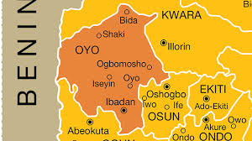
Proposed sites
Ibadan- capital of Oyo State with a population of ~3 million, and 4.5% births per year.
Main Maternity Hospitals | Total Births per year | Served Area classification
University College Hospital | 2000- 3,000 | Low and high socioeconomic status
Adeoyo Maternity Hospital | 4000- 6,000 | Low and high socioeconomic status
Oluyoro Catholic Hospital | 1000 -2,000 | Low and high socioeconomic status
Home births | Up to 50% in some rural communities, 20-30% in peri-urban /urban | Low and middle socioeconomic status

Slide 11
Project Objectives:
Determine the prevalence of neural tube defects, oro-facial clefts, talipes equinovarus, limb deficiencies, anorectal malformations, hypospadias, gastroschisis and omphalocoele in the three main birthing hospitals in Ibadan, Nigeria.
Determine any apparent clinical and or socio-demographic associations with the prevalence of each of these defects.
Quantify the human and financial resources required to provide medical care for the affected children.

Slide 12
Inclusion / Exclusion Criteria
Inclusion Criteria
Live births up to hospital discharge or 7 days of age / still births occurring in the selected hospitals regardless of mother’s place of residence
Babies weighing ≥1000g at birth
Exclusion criteria
Referrals from other hospitals or from the community for babies not born in the participating hospitals
Babies born before arrival (BBA) (only babies actually delivered within the hospital premises will be included)

Slide 13
Defects to be included
Neural Tube Defects: Anencephaly
Craniorachischisis
Encephalocele
Spina bifida
Orofacial Clefts: Cleft palate alone
Cleft palate
Bilateral Cleft Lip
Cleft lip, bilateral
Cleft Lip, specified as unilateral
Cleft Hard Palate with Bilateral Cleft lip
MSS: Talipes Equinovarus
Limb reduction deficiencies
Anorectal malformations Imperforate anus
Anal atresia with vestibular fistula
Anal atresia
Gastroschisis
Omphalocele
Hypospadias

Slide 14
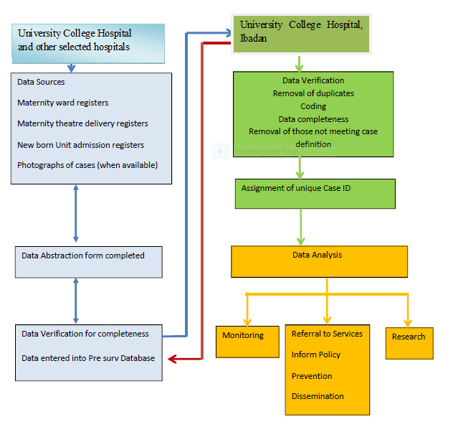
Process in Nigerian Birth Defects Surveillance System

Slide 15
Meeting with FMOH

Slide 16
OBJECTIVES
To provide an orientation on Birth Defect Surveillance
To determine specific activities (advocacy, promotional, curative, surveillance) being implemented by different stakeholders in the country
To obtain general consensus and a way forward on the feasibility of establishing Birth Defect Surveillance in Nigeria.

Slide 17
HIGHLIGHT
The highlight of the meeting were presentations by the participants, group work and plenary which brought the:
Burden
Challenges
Ethical considerations
Existing opportunities
Recommendation
Articulated next steps

Slide 18
KEY RECOMMENDATIONS
Develop a strategic document on Birth Defect Surveillance
Constitute a core group to develop draft of action protocol, tools for training and surveillance
Institutionalize Birth Defect Surveillance in two facilities in each of the six geopolitical zones
Develop health information management system for Birth Defect Surveillance

Slide 19
ACTIONS
Action plan
Protocols
Tools

Slide 20
Current success stories:
Buy in by FMOH
FMOH CHTWG rejuvenated
Sub-Committee on children with special needs in which birth defects surveillance is a najour components

Slide 21
What are our current needs?
Grant
More institutional support
Dedicated staff

Slide 22
THANK YOU

