Slide 1
COVID-19 in prisons and other prescribed places of detention (PPDs)
Laura Pomeroy, Simone Thorn Heathcock, Djamel Hamadache David Leeman, Charlotte Flynn, Nicki Banyard
Health Protection Teams, PHE London
February 2021

Slide 2
Relevance
Public and privately-managed prisons
Immigration removal centres (IRC)
Children and young people’s secure estate (CYPSE)
young offender institutions (YOI)
Secure training centres (STC)
Secure children’s homes (SCH)
Content accurate at time of presentation but always refer to online guidance for latest information

Slide 3
Learning outcomes
Describe coronavirus: the virus, infection and routes of transmission.
Identify, understand and apply the key principles of reducing COVID-19 spread.
Understand and apply the guidance for admissions, self-isolation, testing and outbreak management.
Understand how you can look after yourself and where support is available.

Slide 4
COVID-19

Slide 5
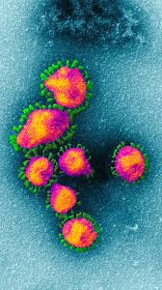
What is a coronavirus?
The name for a family of viruses.
Halo or crown around them – hence coronavirus.
Known about since 1930’s.
Mainly cause lung (respiratory) diseases.
The name of the current coronavirus is SARS-COV-2.
Notes:
Dr June Almedia identified the first human coronavirus in 1964 in St Thomas’s

Slide 6
Coronavirus diseases
Bronchitis
SARS
Mild
Severe
Common cold
MERS
COVID-19
Notes:
Coronavirus can cause mild to severe symptoms and disease depending on the type of coronavirus

Slide 7
COVID-19: symptoms
COVID-19 is the name of the DISEASE
It is caused by SARS-COV-2 which is the VIRUS
It causes an infection in the throat (upper respiratory tract) and lungs (lower respiratory tract)
Main symptoms
Fatigue
Muscle pain
Cough
Sore throat
Loss of smell and/or taste
Gastrointestinal
Headache
Fever
Shortness of breath or chest tightness

Slide 8
COVID-19: severity
Mild (Home)
~80%
Moderate (Admission)
~15%
Severe (ITU)
~5%
Severity & mortality increase with age
Source: WHO Coronavirus disease 2019 (COVID-19) situation report – 41
Notes:
80% of general population will experience mild disease
15% would require clinical attention and hospitalisation
5% require hospital admission to Critical Care Unit
Subsequent situation report updates do not include percentages, just say majority of people experience mild symptoms etc. (i.e. situation report 27 April 2020 # 98)

Slide 9
How do you get it?
Direct
Touching
of face
Airborne droplets or infected body fluids
Indirect via surfaces

Slide 10
Infected body fluids
Airborne droplets and aerosols
Blood
Urine & faeces
Tears
All bodily fluids (except sweat) should be regarded as potentially infectious

Slide 11
Infectivity and recovery
Incubation period – time when you are infected but not showing any symptoms: Usually 5-6 days (can be between 1 to 14 days).
Infectious period – time when you can infect others: Usually infectious up to 10 days after onset of symptoms. Further evidence awaited.
Recovery time – time taken to become well again: Mild/moderate cases up to 14 days. Severe cases 3-4 weeks or longer

Slide 12
Challenges for Prisons and Secure Settings

Slide 13
Influencing factors .
People in prison/closed settings are a marginalised and underserved group with significant health needs
Potentially a large ‘vulnerable’ population
Reliant on essential workers being present
An estate at nearly full capacity with cell sharing as routine

Slide 14
Public Health England (PHE) reported on 24 April 2020 that data it had collected “suggests that the ‘explosive outbreaks’ of COVID19 which were feared at the beginning of the pandemic wave are not being seen. Instead, there is evidence of containment of outbreak”
A press release from the Ministry of Justice on the 28 April 2020 said that “jails are successfully limiting deaths and the transmission of the virus within the estate”
Notes:
-

Slide 15
Guidance

Slide 16
Key messages for everyone
Hand-washing:
Soap kills and removes the virus and other infectious agents.
Most effective method for preventing spread.
Alcohol gel (>60%) can also be used – must let it dry.
Social distancing – 2 metres:
Prevents coughs/sneezes from reaching others.
Shielding:
Protect those who are extremely vulnerable.
Keeping them in a safe (home) environment.

Slide 17
Your staff
Staff MUST remain off work if: They have symptoms; OR Someone in their home has symptoms.
Staff should stay alert for symptoms
Staff with symptoms must remain off work for 10 days. Must have improved before returning to work. Must have been fever free for the last 48 hours – if not, continue self isolation until fever free for 48 hours.
Staff with someone unwell in their household must remain off work for 10 days: If a staff member develops symptoms during their 10 day isolation they only need to self-isolate for 10 days from onset of symptoms. This may mean they finish before or after the 10 day period.

Slide 18
Symptoms in staff member
COVID negative and no longer symptomatic
Return to work
Yes
If clinically improved and no fever for last 48 hours
Able to Access Testing via Pillar 2 portal?
https://www.gov.uk/apply-coronavirus-test
Testing
done
COVID negative and still symptomatic
Self-isolate
COVID positive
No
Continue self-isolation for at least 10 days
Notes:
PHE guidance states that if symptomatic must self isolate for 7 days despite negative test

Slide 19
Symptoms in household of member of staff
HH member is COVID negative and staff member is well
Improvement & 10 days after symptoms
onset*
Return to work
Yes
Staff member has no symptoms after 10 days
Household member able to Access Testing via Pillar 2 portal?
https://www.gov.uk/apply-coronavirus-test
Testing
done
Self-isolate
Staff member develops symptoms whilst isolating
HH member is COVID positive
No
Continue self-isolation for at least 10 days
Notes:
* = must be fever free for at least 48 hours – so from Day 5.

Slide 20
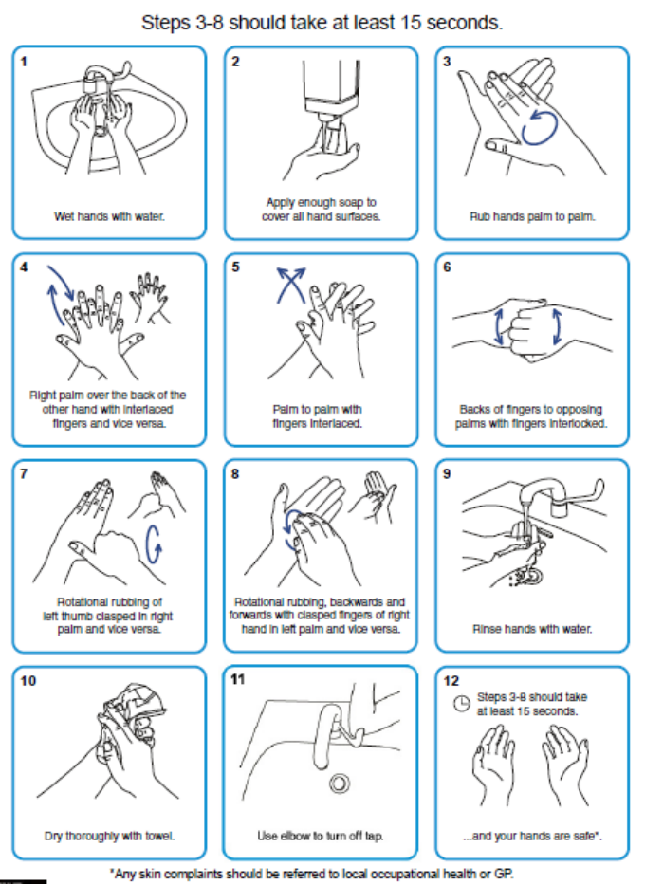
Hand washing
As often as possible for at least 20 seconds:
Ideally soap and warm water.
Alcohol gel otherwise (allow to dry).
Definitely:
Before and after resident contact.
After coughing/sneezing.
Before food preparation.
After toileting.
Correct technique essential
Include wrist and forearm.
Link to online video

Slide 21
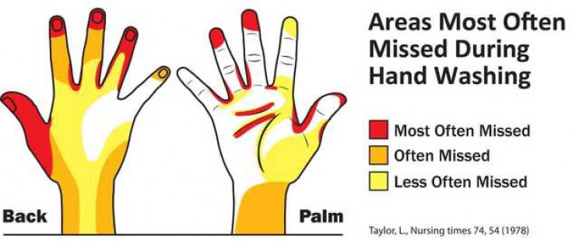
Hand washing: commonly missed areas

Slide 22
Work clothing
Wear your normal work clothes or uniform at work.
Do not wear your uniform when going home every day Refer to HMPPS guidance - transport uniform in a plastic bag and store/wash it safely.
Cleaning work clothes/uniform at home: Should be laundered after every shift separately from other clothes. If not, store separately from other clothes until washed. Use the maximum temperature possible and in a wash cycle of at least 10 minutes. Do not overload machine. A suitable detergent should always be used. Clothes should be ironed or tumble dried after wash.
Notes:
Check HMPPS guidance on uniforms

Slide 23
https://assets.publishing.service.gov.uk/government/uploads/system/uploads/attachment_data/file/900040/PPE_Table_Recommended_personal_protective_equipment__PPE__for_staff__clinical_and_non-clinical__in_custodial_settings_and_in_community_offender_V3.11.pdf

Slide 24
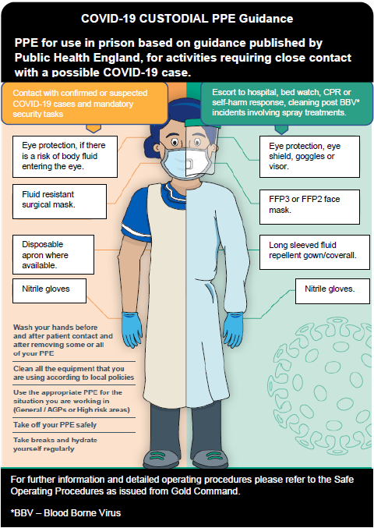
Correct wearing and removal technique is really important.
You must still wash your hands even if using PPE.
Most recent guidance always available on gov.uk website
Putting on (Donning) and removing (Doffing) PPE
Notes:
This will be answered by other work on PPE for previous slide

Slide 25
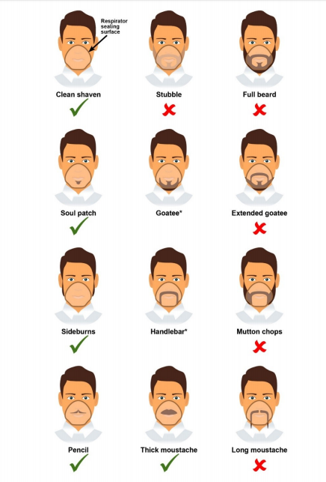
Facial Hair and FFP3 Respirators
For any style, hair should not cross or interfere with the respirator sealing surface. If the respirator has an exhalation valve, hair within the sealed mask area should not impinge upon or contact the valve.
Careful not to cross the seal
Careful not to cross the seal
*Ensure that hair does not cross the respirator sealing surface

Slide 26
Aerosol Generating Procedures (AGP’s)
FFP3 respirator
Fluid repellent gown
Aerosol Generating Procedure
Gloves
Full face protection
Full list of AGP’s available online
Single use only
Notes:
Ongoing discussion, CPR would be

Slide 27
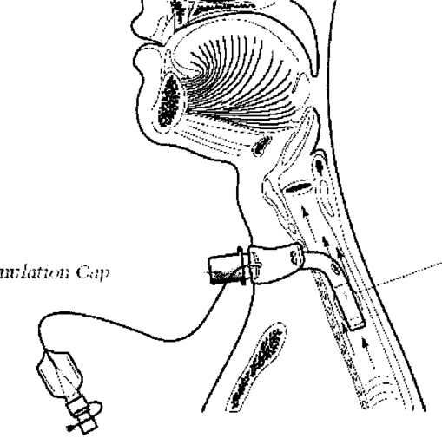
What is NOT an AGP
Nebulisers
Chest compressions & defibrillator
Tracheostomy care
(except suctioning)
Oxygen delivery (except high flow)

Slide 28
PPE changing frequency
Plastic apron
Fluid resistant mask
Eye protection
(only if risk of splashing)
Gloves
Sessional use permitted
Change between EACH resident/prisoner
Up to date guidance available online

Slide 29
What is “sessional” use?
Session: a period of time delivering care in a single setting: Prison wing Healthcare session Etc.
A mask (and eye protection) can be used continuously for the duration of a session.
A session ends when you LEAVE the setting (for any amount of time) or complete the task delivered to a group of people
Risk assessment required: Risk of infection spread from reusing PPE. Damage to masks and/or eye protection – change immediately.
Notes:
Be clear about taking mask off

Slide 30
Common misconceptions with PPE
DON’T remove PPE and then put it back on: E.g coffee break, drinking water, smoking a cigarette, toilet breaks. Remember that those who smoke have poorer outcomes with COVID-19
DON’T hang your mask on your neck or on your head – if the mask is removed from your mouth it must be disposed of and replaced.
DON’T touch your face especially if wearing gloves.
DO wash your hands often.
DO organise your breaks to minimise removal and replacement of PPE: Ensure ALL PPE is removed when you take your break. Make sure you eat and drink enough – wearing PPE can get hot. Ensure you use the toilet during your breaks.
DO remember to take all the equipment you need into each room.

Slide 31
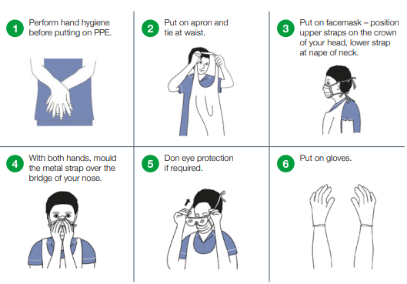
Putting on PPE

Slide 32
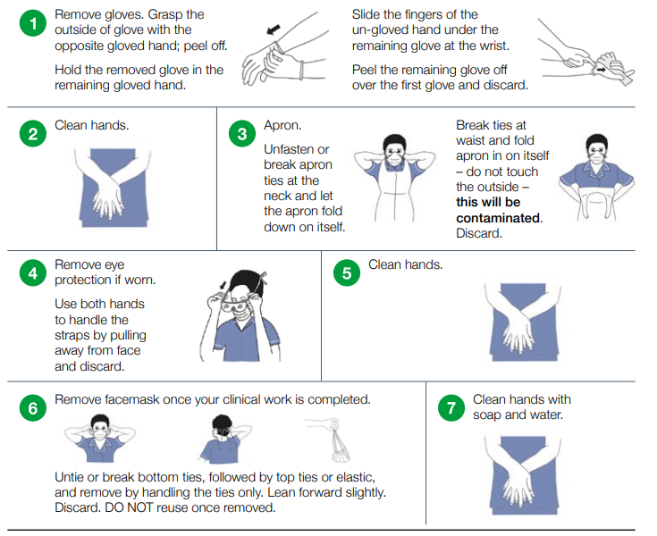
Taking off PPE
Discard used PPE into clinical waste and dispose as per local policy

Slide 33
Admissions

Slide 34
Admission or transfer in: scenario 1
Admission status | On admission to prison/PPDs | If develops symptoms
Any admission or transfer in
Reverse Cohorting Unit for 14 days
Isolate and test
No symptoms
Staff wear appropriate PPE

Slide 35
Admission or transfer in: scenario 2
Admission status | On admission to Prison/PPDs | If develops symptoms
Isolate until
10 days complete
Tested positive
Clinical assessment indicated
Appropriate PPE
Symptoms
If there are any concerns regarding prison ability to deal with isolating positive patients to discuss with HMPPS and PHE

Slide 36
Release

Slide 37
Release to community: scenario 1
Admission status | Release or transfer out | If develops symptoms
Tested positive
10-day isolation completed
No isolation
Clinical assessment indicated
No symptoms

Slide 38
Release to community: scenario 2
Admission status | Release or transfer out | If develops symptoms
Isolate in community until
10 days complete (Prisoners cannot be detained beyond their tariff)
Tested positive
Clinical assessment indicated
Recovering
Appropriate PPE
10-day isolation not complete
Any concerns with isolating positive patients in the community: to discuss with Local Authority and community services

Slide 39
Admissions to Prison and PPDs and release
Refer to current guidance on isolation, shielding and cohorting in Prison/PPDs and in the community
Prisons & PPDs, communities and hospitals should work together to enable smooth transfer of patients between settings in accordance with current guidance.
Testing is not required prior to admission or release
Results DO NOT need to be available prior to admission.
Management depends on test result, symptoms and days in isolation.

Slide 40
Test & Trace

Slide 41
Test and Trace
Test and Trace is in place nationally to help control COVID-19 Prisons are contacted by Tier 1 of the Test and Trace service; this is the local HPT Staff must tell the Test and Trace service that they work in a prison if contacted, to enable contact tracing to take place in the prison Any confirmed cases in staff or residents will be notified to Tier 1/HPT and all contacts will be traced If either direct or proximity exposure has taken place contacts will be advised to isolate for 14 days Symptomatic contacts will be tested

Slide 42
Outbreak management

Slide 43
Identification
Outbreak: 2 symptomatic cases within 14 days of each other.
Main symptoms
Cough
New confusion
Reduced alertness
Influenza like illness
Loss of smell and/or taste
Fatigue / lethargy
Reduced mobility
Diarrhoea
Fever
Atypical symptoms possible in the elderly
and young adults

Slide 44
Initial actions
Inform your local health protection team (HPT) or if in London, the London Coronavirus Response Centre (LCRC).
When calling, have the following information at hand: Number of prisoners affected and location (i.e. wing) Dates of first and most recent affected resident. Number of prisoners admitted to hospitals. Date and number of any COVID related deaths.
Info on affected staff incl. onset of symptoms, location, last day at work
Outbreak control team meeting
Notes:
STAR - EOL visitors can still come

Slide 45
Outbreak preparedness
Ensure soap, water and paper towels available at each sink.
Alcohol based hand rub available in specific location.
At least >72 hours of PPE available.
Adequate staffing numbers and reserve staff in case of illness.
Staff health and wellbeing is addressed and supported.
Notes:
Oxford Centre for Evidence based medicine recently reviewed all the evidence regarding IPC in care homes.
They found: Effectiveness of infection control measures is dependent upon a number of factors and a combination of strategies with the most significant being:
– Hand hygiene – Access to hand hygiene facilities at the workspace, in addition to use of four or more of the WHO multi-modal strategy generally improve adherence to hand hygiene measures
– Environmental decontamination – Daily cleaning of most touched surfaces and weekly deep clean
– Staff rotation – Allocating staff to one facility consistently may reduce spread across several locations
– Visitors – Restricting visitation to only emergency/critical cases
– Testing – Creates rapid response in placing added measures to contain and prevent further spread

Slide 46
Cleaning
Declutter rooms and communal areas: Reduces number surfaces exposed to any potential infection. Allows all surfaces to be cleaned effectively. Safer in terms of trip hazards.
For any cleaning agent ensure it is appropriately prepared and applied (contact time) following manufacturers instructions. Cloths and mop heads should be disposed of after a single use. Ensure cleaning items are disposed of safely.
Increase frequency of general cleaning paying particular attention to: High touch surfaces (door handles, light switches etc…). Equipment used between prisoners.
Full guidance and instructions available online including exact procedures (Annex G)

Slide 47
Testing (London) [Check with your local HPT]
Testing is available for ALL symptomatic prisoners and staff.
PHE will organise: Testing for ALL symptomatic prisoners on the day of notification of the suspected outbreak Testing kits (nasal swabs) will be couriered to the setting. Not applied retrospectively – only new outbreaks going forward. Testing for new symptomatic admissions may be indicated
Prison Staff can access testing via Pillar 2 testing strategy https://www.gov.uk/apply-coronavirus-test

Slide 48
Isolation & cohorting if symptoms
Symptomatic prisoners must be isolated for at least 14 days from onset of symptoms and 48hr fever-free.
Ideally this should be in a single accommodation
Cohorting of symptomatic prisoners if single cell not possible: prisoners should not be cohorted together if their COVID status is different (e.g. confirmed, suspected, asymptomatic).
Staff should ideally be cohorted to wings with either confirmed, symptomatic or asymptomatic prisoners (e.g. shielding) .
Appropriate PPE must be worn for ALL resident encounters/care.

Slide 49
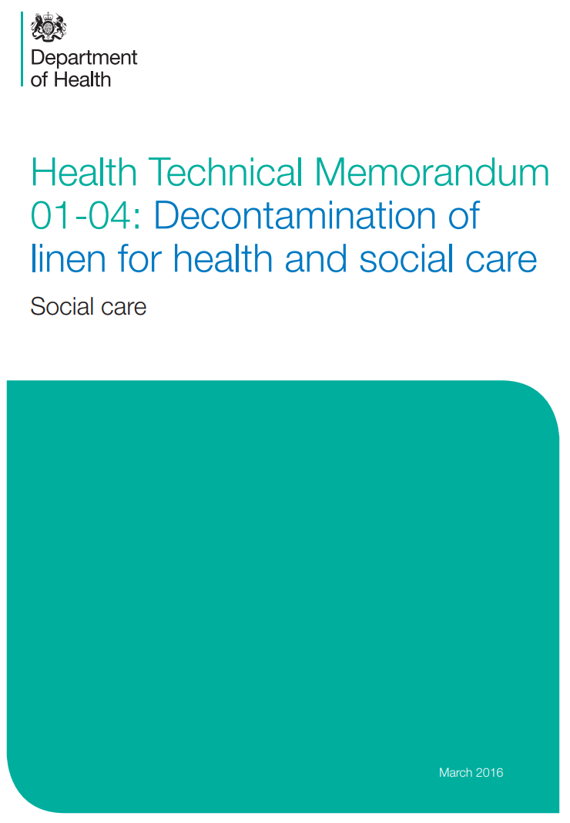
Linens, laundry & waste
Linen should be handled in accordance with the Health Technical Memorandum 01-04 (2016).
In summary: Potentially infected linen should be handled with appropriate PPE. Linen should be packaged in the prisoners room in an appropriate bag. If required, linen should be sorted before bagging/transport. Linen must be transported in a safe manner. Linen must be washed and prepared in an appropriate manner.
3 categories of waste:
Black = domestic
Yellow/black stripe =offensive
Orange = infectious

Slide 50
Vaccination
The COVID19 vaccination programme will be rolled out in phases to pre-defined cohorts of patients recommended by the Joint Committee on Vaccination and Immunisation(JCVI). Residents will be immunised in line with the community roll out. Several vaccines are available currently. The Astra Zeneca vaccine will be used in London prisons.
2 doses are required, with a minimum interval of 28 days
The vaccine should not be given within 4 weeks of recovering from COVID infection

Slide 51
Communicate with prisoners and families
Continue doing what you do in the best way you can. Many people depend and rely on you in their lives.
There is lots of fear and anxiety in the prison community – be prepared:
Be knowledgeable
Understand the basics of the virus and controlling infection.
Support your prisoners and their families:
Reassure where necessary using your experience and knowledge.
Escalate and seek medical advice where necessary:
There is a pandemic but normal care is also continuing.
Help your prisoners stay in contact with family and friends.
Notes:
Change to communication and simone to review wording

Slide 52
Look after yourself: health & wellbeing
You're doing the best for your prisoners, but don’t forget to do the best for yourself too.
Providing care is emotionally rewarding but can be tough – the current situation has amplified that.
Support is available for you: SHOUT free text message service – text FRONTLINE to 85258 PHE Mental health and wellbeing during COVID-19 NHS Every Mind Matters website Samaritans and NHS – confidential support line for NHS workers in England
The range of support packages is being constantly expanded – keep an eye out online.
Notes:
Ask Sam to check specific services available

Slide 53
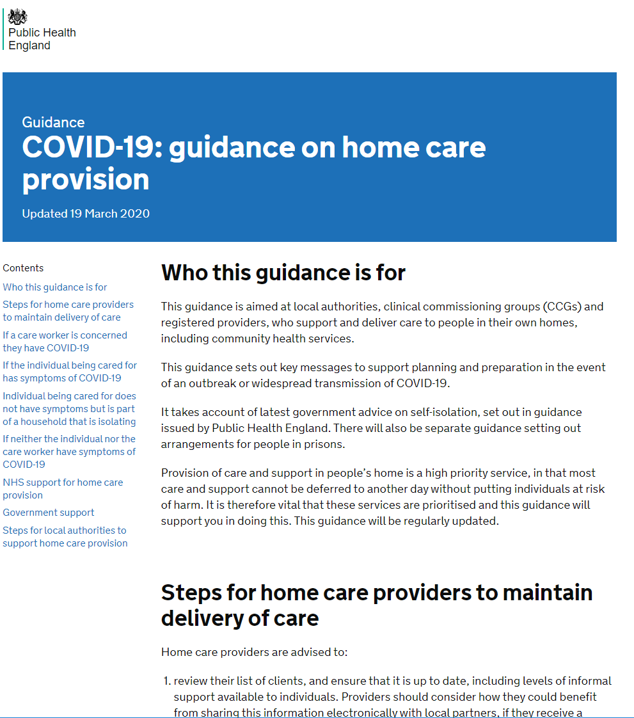
Where to find extra help
Ensure you have read relevant guidance on the gov.uk/coronavirus website
Speak to your line manager or senior for more advice
HMPPS Employee Assistance Programme:
call the support line free on 0800 019 8988 (It is open 24 hours a day, 7 days a week.
visit the website www.pamassist.co.uk – Username: HMPPS, Password: HMPPS1
download the PAM Life app to your smartphone or mobile device to help you make positive lifestyle changes
Notes:
Ask HMPPS colleagues
HM

Slide 54
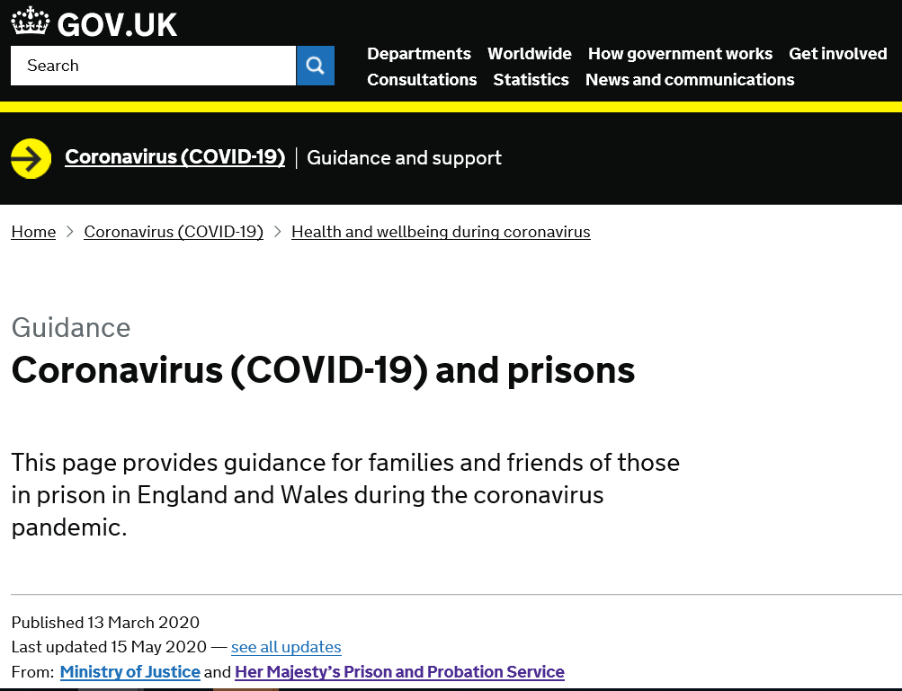
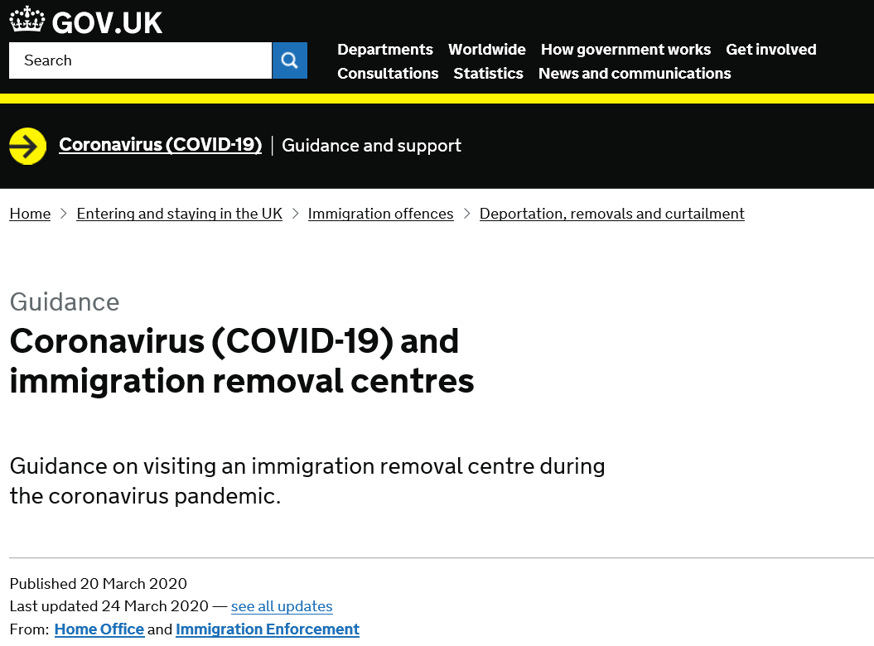
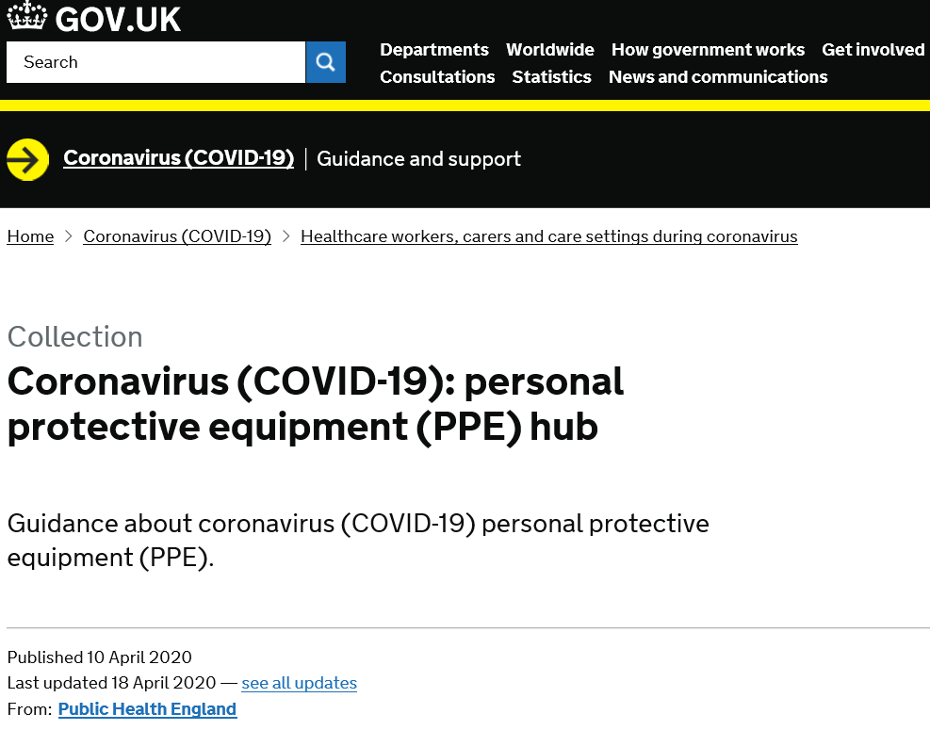
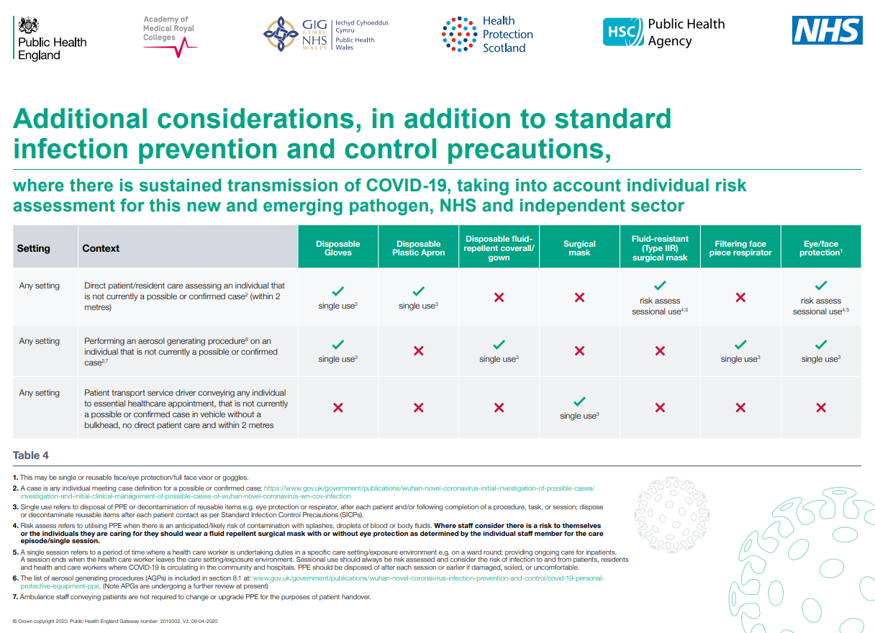
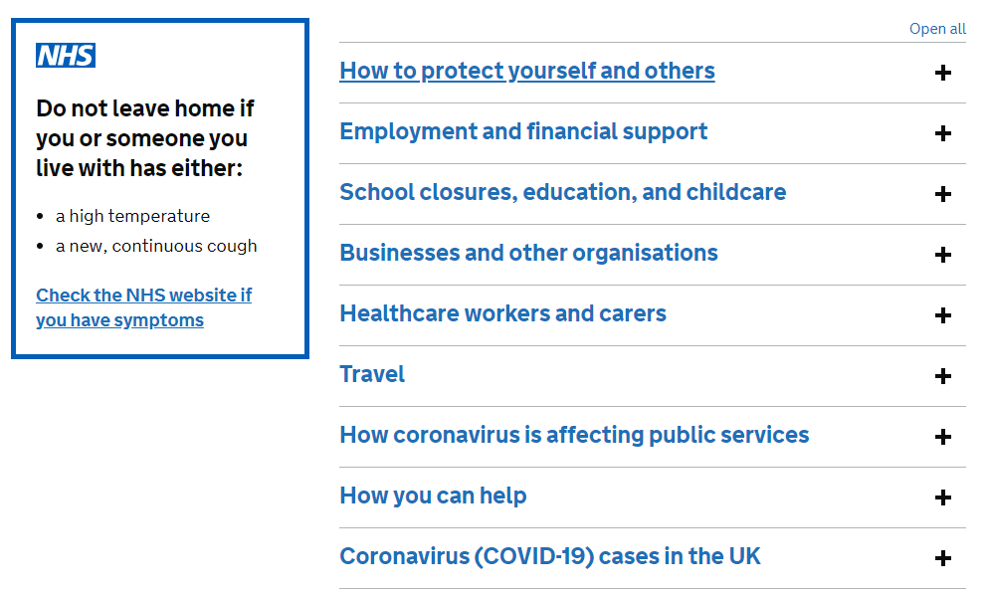
Link to resources
Covid19 & Prisons
COVID-19: prisons and other prescribed places of detention guidance
COVID19 & Immigration Removal Centres
COVID-19: personal protective equipment (PPE) hub
PPE for sustained transmission
Gov.uk coronavirus portal
Notes:
Check additional PPD guidance and signpost to HMPPS guidance
Check with HMPPS for guidance

Slide 55
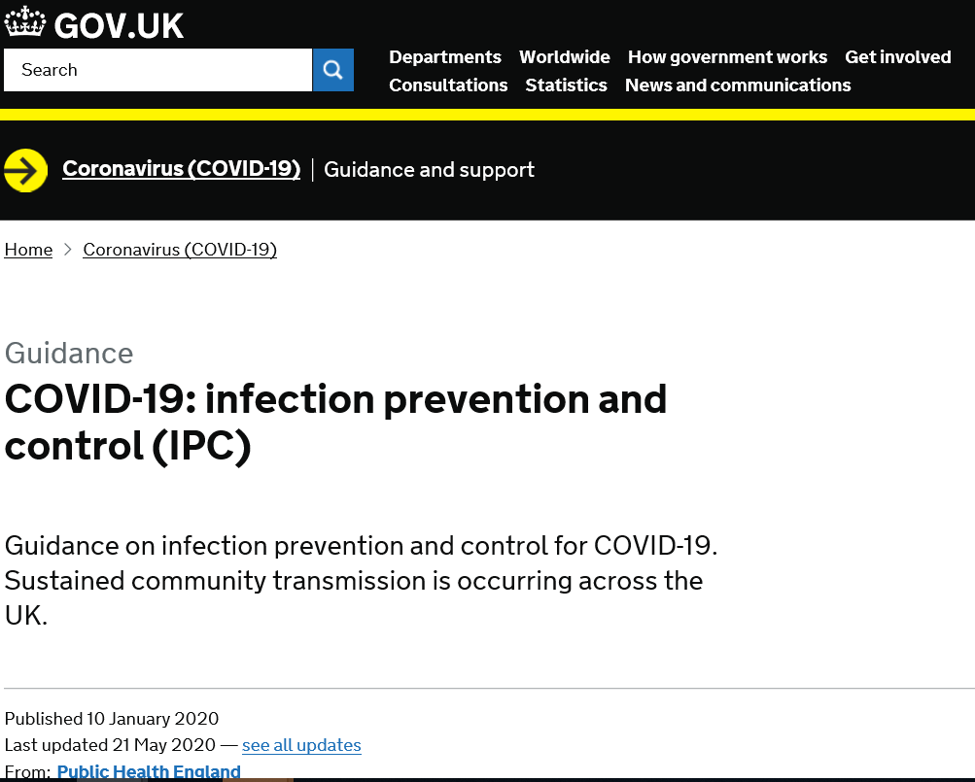
Link to resources
COVID-19: infection prevention and control (IPC)
COVID resource pages on the HMPPS intranet: https://intranet.noms.gsi.gov.uk/covid-19-coronavirus
Notes:
Check additional PPD guidance and signpost to HMPPS guidance
Check with HMPPS for guidance

Slide 56
Acknowledgements
Thank you to all staff supporting people in prisons. We hope this has been helpful.
With grateful thanks for sharing and contributing to content:
Youssof Oskrochi Bharat Patel
Karen Hawker Sarah Lang
Rebecca Cordery Christine Murphy
Karen Bernard Ann Lusmore
Viv Cleary Fiona Coogan
Gopal Rao Rachel Flowers
Sterling Rippy Laura Maclehose
Ellen Schwartz Deborah Turbitt
Laura D’Cruz Rachel Thorn Heathcock
Anjana Roy Lipi Begum
Dianne James Rachel Campbell
All staff working in the London Health Protection Teams and our colleagues in Health and Justice and HMPPS
Icons from the thenounproject used under license by PHE London.

