Slide 1
Antibiotic resistance in M. tuberculosis
Why looking at AbR in Mtb is different from the Gram-negative pathogens / metagenomics
How that affects sequencing analysis
How we know that a SNP causes AbR
Neil Stoker
UCL Centre for Clinical Microbiology

Slide 2
Antibiotic resistance in M. tuberculosis
Why looking at Ab^{R} in Mtb is different from the Gram negative pathogens / metagenomics
How that affects sequencing analysis
How we know that a SNP causes Ab^{R}

Slide 3
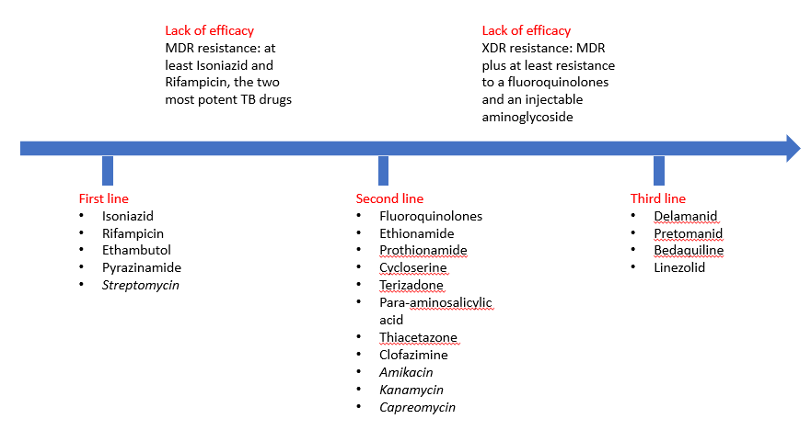
Treating TB
adapted from Mignani et al New Ways to Treat Tuberculosis Using Dendrimers as Nanocarriers. Pharmaceutics 2018, 10, 105.

Slide 4
M. tuberculosis is a highly conserved species
No horizontal transmission
No plasmids

Slide 5
Ab^{R} is caused by mutations
Mostly in structural genes
MDR occurs through sequential acquisition

Slide 6
Rifampicin resistance – the RRDR region
1172 amino acids
Examples of mutations found within the
‘rifampicin-resistance-determining region’
(RRDR) of M. tuberculosis
(Data taken from Mani et al. DOI: 10.1128/JCM.39.8.2987-2990.2001)

Slide 7
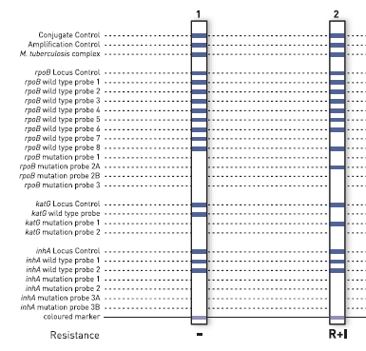
GeneXpert / Hain tests detect common mutations only
https://www.cepheid.com
https://www.hain-lifescience.de

Slide 8
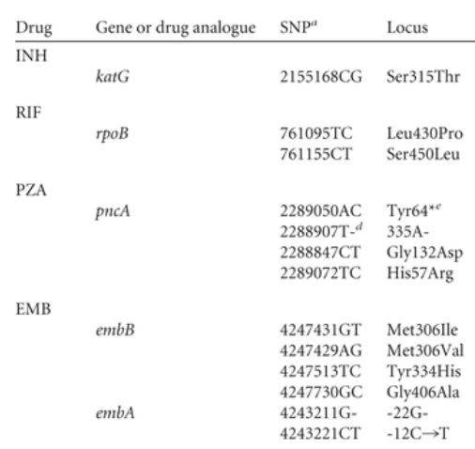
SNP nomenclature
Base:
A12345C
12345AC
Amino acid:
Leu123Pro
L123P

Slide 9
Prodrugs – many mutations in activator cause resistance
INH – katG
PZA - pncA

Slide 10
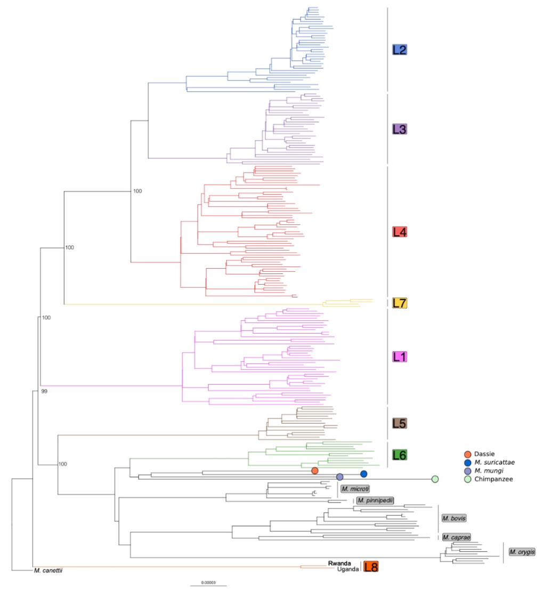
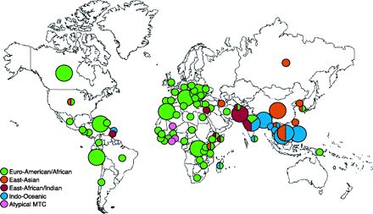
Mtb have SNPs unrelated to AbR - Lineages
Reed et al 2009 DOI: 10.1128/JCM.02142-08
Ngabonziza et al 2020 A sister lineage of the Mycobacterium tuberculosis complex discovered in the African Great Lakes region. bioRxiv 2020.01.20.912998; doi: https://doi.org/10.1101/2020.01.20.912998

