Slide 1
File Management
Dropbox and File Naming

Slide 2
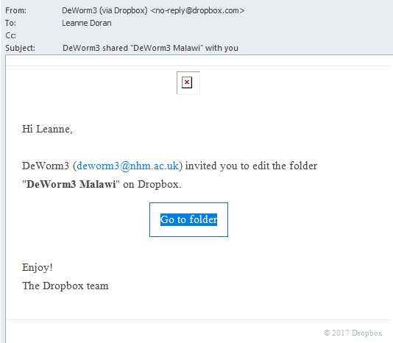
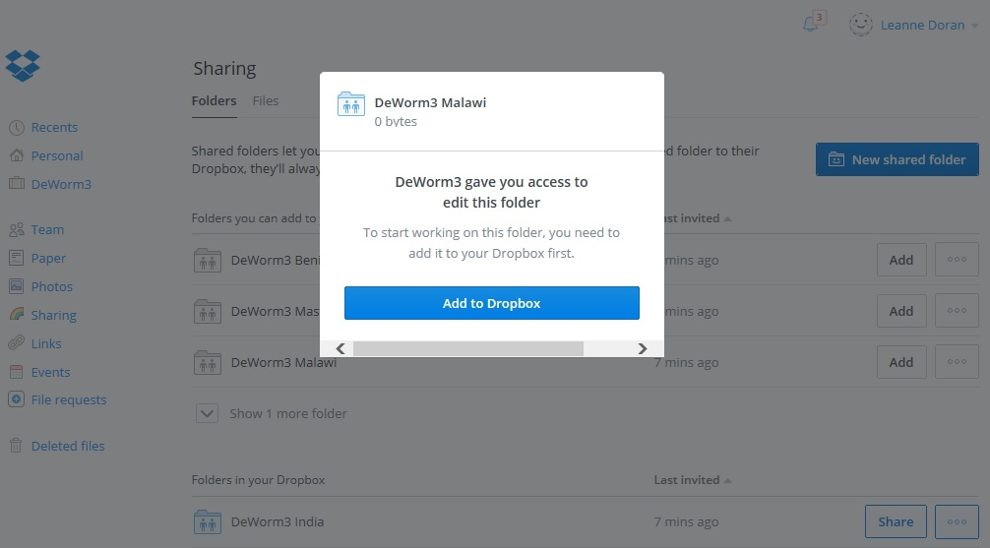
DeWorm3 will send and receive files using Dropbox
Receive Dropbox invitation email from DeWorm3 and select ‘Go to folder’
Each site will receive a DeWorm3 ‘Master’ folder and a site specific folder.
Select ‘Add to Dropbox’ for each

Slide 3
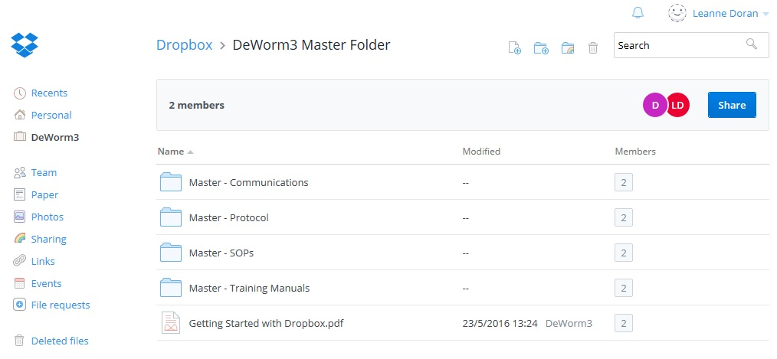
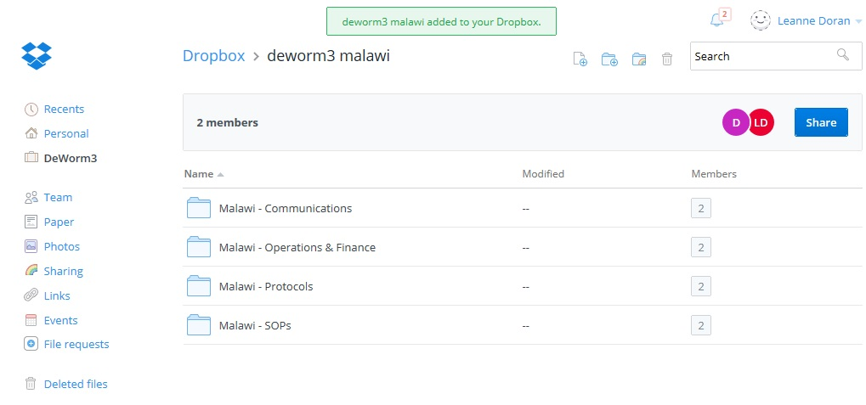
The Master Folder is accessible to all and contains information applicable to all 3 sites
Individual country folders contain site specific information

Slide 4
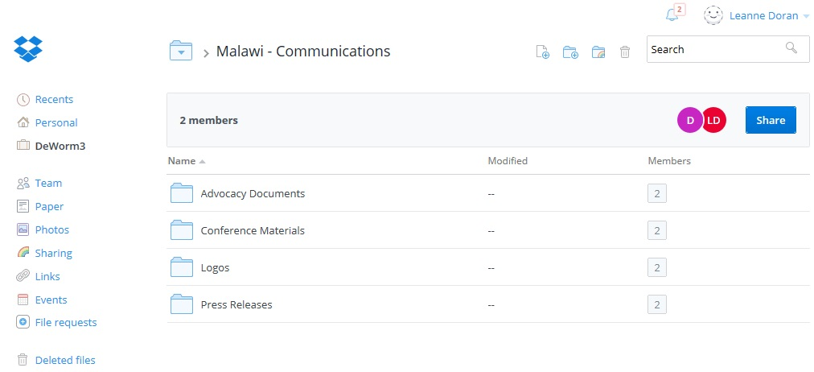
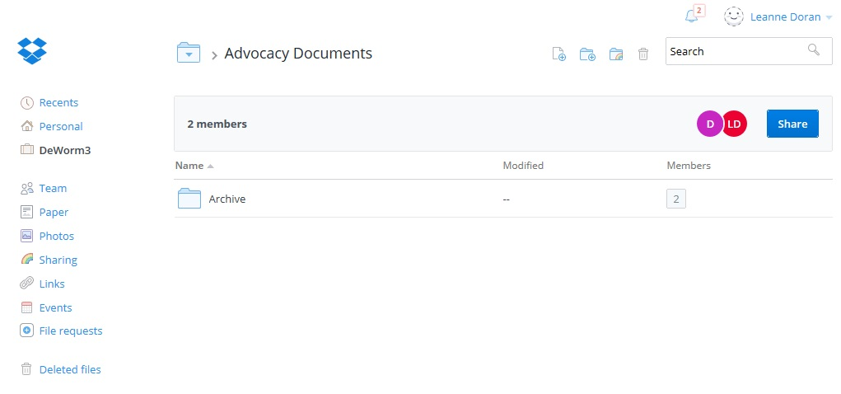
Each folder contains different levels of sub-folders
Each sub-folder will contain an ‘Archive’ to store past versions of the documents

Slide 5
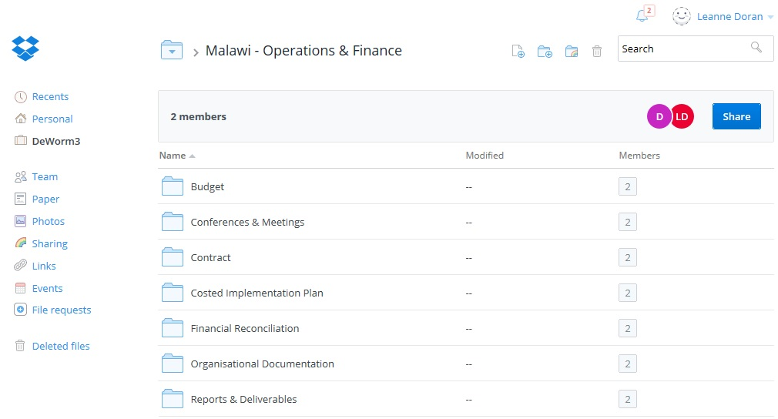
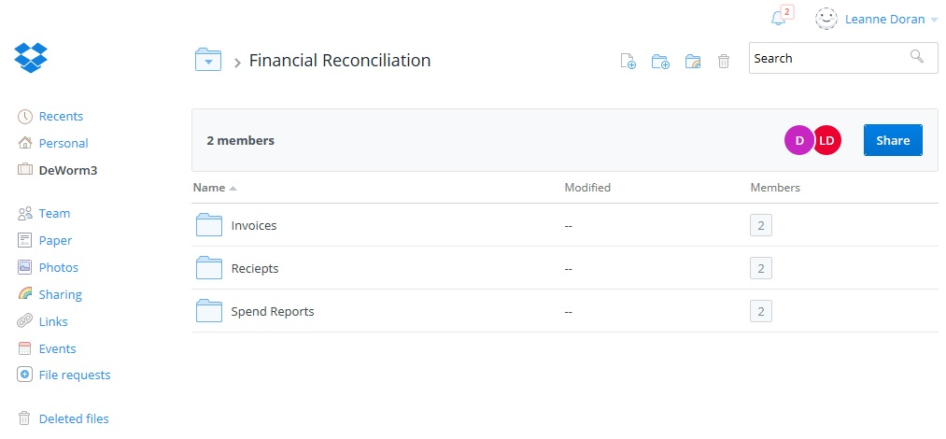
Operations and Finance folder will be used to share contracts, budgets and financial reconciliation documents
Financial reconciliation sub-folders for Invoices, Receipts and Spend Reports.

Slide 6
File Naming Convention
All files to be saved in Dropbox using the following format with each element separated by underscores (_):
File_Name_Year_Month_Date
Ex: Benin_Contract_2017_02_20
Malawi_Spend_Report_2017_03_13
Working documents: will contain the word ‘Draft’ in the title. Ex: Draft_Proposal_Benin_2017_02_23
Naming while editing: When multiple team members edit a document, the author will save document with their initials; date will not be updated until final changes are approved. Ex: Draft_Proposal_Benin_2017_02_23_LD
Final documents: will be saved as PDF and contain the word ‘Final’ in the title: Ex: Final_Proposal_Benin_2017_02_30
Previous versions to be moved to archive sub-folder.

