Slide 1
An R&D Blueprint for action to prevent epidemics
July 2017

Slide 2
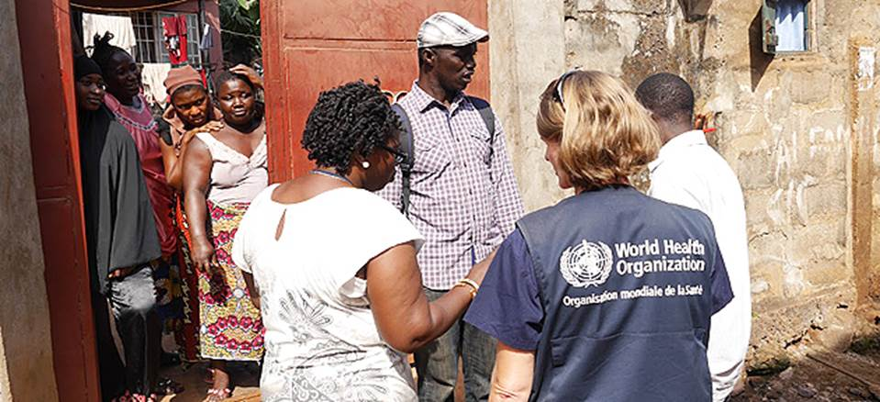
Preparing for the inevitable: the WHO R&D Blueprint
With more frequent travel, globalized trade and greater interconnectedness between countries, infectious disease outbreaks of international concern are becoming as inevitable as they remain unpredictable

Slide 3
Why an R&D Blueprint?
Experience during the Ebola epidemics has demonstrated that it is possible to accelerate R&D during emergencies
BUT
R&D preparedness and effective collaboration frameworks should be accelerated in advance of any new epidemic

Slide 4
Operational objective of the Blueprint
Availability of
effective diagnostics, therapeutics & vaccines
Declaration of PHEIC emergency
Day 0…I…I…I…I…I…I…I…I…I…I…I…I… Day available
The R&D Blueprint seeks to create an enabling environment through which all actors, through increased funding, data sharing and partnerships, can drive change in the public health landscape to provide an elevated level of global impact.

Slide 5
How the Blueprint works
Prioritization
Process
Priority list of Pathogens
R&D Roadmaps
Target Product Profiles
Development of Products
Data & Sample sharing
Clinical Trial Design
Regulatory pathways; EUAL
SAG
Scientific Advisory Group
GCM
Global Coordination
Mechanism
M&E
Monitoring & Evaluation

Slide 6
List of priority diseases 2017
(The order of pathogens on this list does not denote any ranking of priority)
Lassa Fever and other severe Arenaviral haemorrhagic fevers
Crimean Congo Haemorrhagic Fever
Filoviral pathogens (including Ebola and Marburg)
MERS-CoV
Other highly-pathogenic coronaviral pathogens (e.g. SARS)
Nipah and related henipaviral pathogens
Rift Valley Fever
Severe fever with thrombocytopenia syndrome
Zika
And any pathogen identified by the decision instrument
Chikungunya Virus continues to warrant further research and development.
Notes:
Annual review in January agreed a list of 9 priority pathogens
Most were on the top priority list from 2015
SFTS was upgraded from a second list that detailed pathogens for which R&D should be support as soon as resources available
Experts decided to only use a single list for clarity of messaging
Structure of list discussed at length
No ranking inside list
Groupings of pathogens revised
E.g. SARS & MERS split up as more known about MERS in own right
Expansion of other pathogens to capture close relations (e.g.(1) Lassa e.g. (2) Nipah)

Slide 7
3 Approaches
A
Improving coordination
Building an effective governance & coordination framework
Outlining transparent and aligned funding process
Encouraging effective communication
B
Assessing epidemic threat & defining priority pathogens
Developing R&D roadmaps to accelerate evaluation of Dx, therapeutics & vaccines
Outlining regulatory & ethical pathways
Accelerating R&D
C
Supporting expansion of capacity to implement adequate study designs
Developing guidance & tools
Anticipating evidence needs for regulatory review and policy development
Developing new norms
& standards

Slide 8
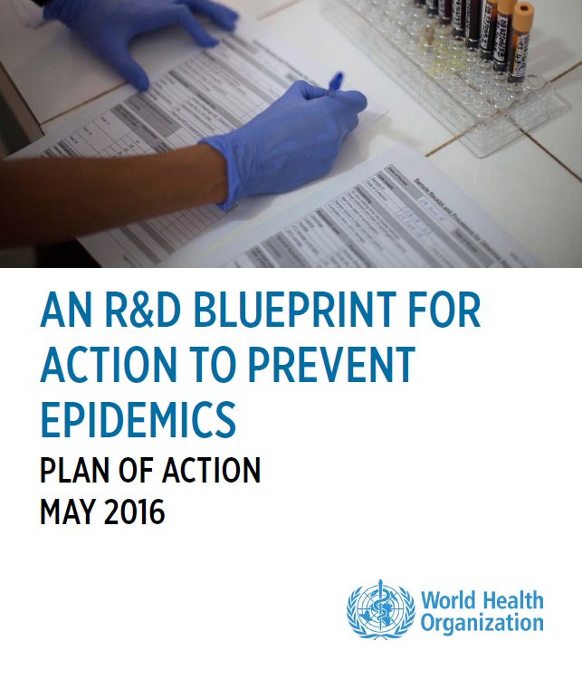
Towards a Global Coordination Mechanism
A
Global
Coordinating Mechanism
Improving coordination & fostering an enabling environment
B
Accelerating R&D processes
C
Developing new norms & standards tailored to the epidemic context

Slide 9
Towards a Global Coordination Mechanism
Review of TORs & governance structure
Wellcome Trust
March 28, 2017
Annual Meeting GCM
Location TBD
1st Quarter 2018
Scoping Meeting
Chatham House
Nov 10, 2016
Each member will be individually contacted by the WHO Secretariat to finalize the TORs.
Working groups on the priorities identified will be formed.
The primary role of a GCM would be to address the global R&D agenda in a collaborative manner in order to ensure that identified R&D gaps are filled effectively.
WHO requested to facilitate the establishment and functioning of the GCM
The “right” dose of coordination.
Initial focus on Blueprint priority pathogens.
An inclusive implementation framework.
Voluntary with sharing of responsibilities.
Using Zika vaccines R&D as a case study for the proposed collaborative model.
Review of data sharing, regulatory issues.
Proposed topics:
data sharing policies,
strengthening of regulatory pathways,
mainstreaming of ethical reviews,
identification of options to address liability/indemnification in case of deployment of yet unregistered MCMs.
consensus building on pathways for Zika vaccine clinical development.

Slide 10
Towards a Global Coordination Mechanism
Institutions that have participated to date…
MSF UK
Ministry of Health, Brazil
Ministry of Health, Thailand
NIH US
NIH Colombia
Oxfam
PHE UK
Research Council, Norway
Save the Children, UK
RHI Network, S Africa
Wellcome Trust
…..
AHRI, Ethiopia
BARDA, USA
BMGF
CDC, USA
CEPI
Chatham House, UK
CIDRAP
COHRED
COLCIENCIAS – Colombia
DCVMN
DFID, UK
EDCTP
GLOPID-R
HHS, USA
IFPMA
IPN, France
IMRC, India
KEMRI, Kenya
KFPE, Switzerland
LSHTM, UK
MRC, UK
MSF International

Slide 11
Accelerating Research & Development Processes
A
Improving coordination & fostering an enabling environment
B
Accelerating R&D processes
R&D Roadmaps
C
Developing new norms & standards tailored to the epidemic context

Slide 12
Context
WHO is
Leading, coordinating and ensuring continuous oversight
Establishing and refining the generic methodology
For each roadmap
Commissioning the baseline situation analysis (background paper)
Identifying the need and subsequently develop WHO target product profiles
Contacting partners to seek their interest
Commissioning partners to assemble in pathogen-specific taskforces to conduct the roadmapping exercise, including convening and financing meetings & consultations
Participating in all activities to ensure adherence to the principles
Developing and maintaining a dashboard
Ensuring publication of roadmaps as joint products

Slide 13
A generic methodology Developing and implementing R&D Roadmaps for priority pathogens with epidemic potential
R&D Blueprint roadmaps are forming a strategic framework that underpins strategic goals and research priorities of the global R&D community
developed on the basis of
a generic methodology
purpose: to provide a standardized procedure that structures and harmonizes the development and implementation of R&D roadmaps
Cycle of review
Internal review – completed
Intermediate review – completed
External review – ongoing
Pilot testing for development of the following roadmaps (taskforce) – ongoing
Ebola/Marburg, Lassa and Nipah (CIDRAP)
CCHF (WHO)
Pathogen X (BMGF)

Slide 14
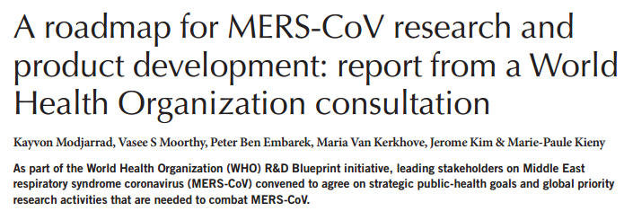
Nature Medicine 22, 701–705 (2016)

Slide 15
Accelerating Research & Development Processes
A
Improving coordination & fostering an enabling environment
B
Accelerating R&D processes
Target Product Profiles
C
Developing new norms & standards tailored to the epidemic context

Slide 16
What is a WHO Target Product Profile?
Developed to allow funders, manufacturers, and other stakeholders to take into account WHO preferences in development decision-making.
Intended to articulate the vaccine preferences from an end to end perspective bridging development to use from LMIC perspective.
Intended to inform product specific TPPs that are developed by manufacturers, and to reduce the timeline between vaccine licensure and introduction into countries that have the greatest need.

Slide 17
Development timeline for vaccine TPPs
 | Circulation of draft TPP to Expert Working group for comments | Public consultation of draft TPPs | Final TPP published at WHO website
Monovalent Ebola – reactive and preventive use |  |  | 2015
Multivalent filovirus vaccine TPP – preventive use |  | Oct 2016 | Nov 2016
Revised Zika virus vaccine TPP (first version, published July 2016) |  | Dec 2016 | Feb 2017
MERS Co-V vaccine TPPs (3) |  | Feb 2017 | May 2017
Nipah Virus vaccine TPP | Q1 | Q1 | June 2017 (Finalization)
Lassa Fever virus vaccine TPP | Q1 | Q2 | June 2017 (Finalization)

Slide 18
MERS CoV vaccine TPPs
Roadmap MERS CoV Research and Product development¹
3 vaccine strategies called for in the Roadmap
Dromedary camel vaccine – for prevention of transmission of MERS-CoV among camels and from camels to humans (close collaboration with OIE)
Human vaccine – for long term protection of persons at high ongoing risk of MERS-CoV such as healthcare workers and those working with potentially infected animals
Human vaccine – for reactive use in outbreak settings with rapid onset of immunity
1 Modjarrad K, Moorthy VS, Embarek P Ben, Kerkhove M Van, Kim J, Kieny M. A roadmap for MERS-CoV research and product development : report from a World Health Organization consultation. Nat. Publ. Gr. 2016; 22:701–705. Available at: http://dx.doi.org/10.1038/nm.4131.

Slide 19
Development timeline for diagnostic TPPs
 | Circulation of draft TPP to Expert Working group for comments | Public consultation of draft TPPs | Final TPP published at WHO website
Ebola virus |  |  | October 2014
Zika virus diagnostics² | March 2016 | 22 March to 11 April 2016 | April 2016
Planned for 2017: Diagnostics Mapping: MERS- CoV, CCHF, Lassa Fever and Nipah Virus

Slide 20
Accelerating Research & Development Processes
A
Improving coordination & fostering an enabling environment
B
Regulatory & Ethical
Preparedness
Accelerating R&D processes
C
Developing new norms & standards tailored to the epidemic context

Slide 21
Some of the Gaps in regulatory preparedness:
Lack of coordinated emergency regulatory processes
Link regulatory processes with overall national preparedness planning for public health emergencies
Weakness of drug regulatory systems and lack of capacity
Strengthen regulatory collaboration and capacity
Limited capacity and experience in stakeholder communication
Need for guidance in communicating with the media and public
Poor engagement of product developers with affected regulators
Weakness in regulation of supply chains
Need to minimize entry of substandard and falsified products in supply chains

Slide 22
Assessment pathways for medicines, vaccines & diagnostics:
Pathways in LMICs
(likely to be first hit by epidemic)?
Most authorities have “full” or “abbreviated” (based on reliance) but not conditional, emergency, exceptional use, compassionate use options..

Slide 23
Ethical preparedness: review during outbreaks
Time is crucial
But standards cannot be compromised
"Emergency review" mechanisms (rapid turn-over) needed
Differing situation in countries
Ethics Review Committees often ill-equipped to deal with emergencies – capacity building crucial for future epidemics
Potential of "joint reviews"

Slide 24
WHO Guidance for managing ethical issues in infectious disease outbreaks - 2016
http://apps.who.int/iris/bitstream/10665/250580/1/9789241549837-eng.pdf.

Slide 25
Methodological tools to improve the way we evaluate vaccines and therapeutics during outbreaks
A
Improving coordination & fostering an enabling environment
B
Accelerating R&D processes
C
Implementing
adequate
study designs
Developing new norms & standards tailored to the epidemic context

Slide 26
Methodological tools to improve the way we evaluate vaccines
4th Consultation to review final drafts
Boston
October, 2017
3rd Consultation to review progress
Annecy
May 1-2, 2017
Scoping Meeting
Chamonix
March 28, 2016
2nd Consultation to review progress
PAHO
October, 2016
ZIKA vaccines: end points, designs, site selection
Geneva
June 1-2, 2016
30 experts in clinical trials discussed the rationale of designing a vaccine efficacy trials during public health emergencies.
The group agreed to conduct a collaborative effort around the Blueprint priority pathogens via 4 working groups.
G1 –Comprehensive methodological discussion paper on vaccine trial designs
G2 –An interactive decision tree to facilitate and structure discussion around key methodological options;
G3 – a Trial Simulator to assess and compare the performance of various vaccine trial designs;
G4 –Annotated pathogen-specific generic protocols
DRAFTs available:
Methodological paper,
Decision tree
Trial Simulator
Draft generic protocol.
Review identified additional areas of work
Finalization of documents and tools
Submission for open consultation
Final tools available (early 2018)

Slide 27
Developing new norms & standards tailored to the epidemic context
A
Improving coordination & fostering an enabling environment
B
Accelerating R&D processes
C
Developing guidance & tools for collaborations & exchanges (data & sample sharing)
Developing new norms & standards tailored to the epidemic context

Slide 28
Rationale for WHO 2015 position calling for prompt public disclosure of results from clinical trials
40-50% of all clinical trials remain unreported according to systematic reviews of over 100 studies on publication bias*
Applies to large and small trials across all product classes examined
Evidence that published literature overestimates efficacy and under-estimates harms (although bias can go in either direction for individual products)* & **
Multiple concrete examples of harm related to non-disclosure of results and data, including deaths, billions of dollars of wasted research funding per year***, poorly allocated financing of available interventions, slower timelines for product development
It is unethical to conduct human research without publication and dissemination of the results of that research.
Social and scientific benefits cannot accrue if the results are not made available.
Withholding results may subject future volunteers to unnecessary risk.
*Schmucker C., et al. (2014) PLoS ONE 9(12): e114023
**Golder S, Loke YK, Wright K, Norman G (2016). PLoS Med 13(9): e1002127
***Chalmers I, Glasziou P. Lancet 2014; 374: 86-9.
Notes:
Concrete examples of harm include class I anti-arrhythmic drugs in 1980s (estimated to be 100,000s deaths), and rofecoxib and cardiac deaths

Slide 29
WHO position on registration & reporting of clinical trials
WHO position on universal registration since 2005
WHO position on timely public disclosure of results since 2015
Initial
registration dataset
Access to full protocol
Summary results using registries
Journal publication
Access to full data set
WHO policy
Trial registry
Notes:
WHO convening network of registries in May 2017 to expand access to methods and results in support of WHO 2015 position on public disclosure of results.

Slide 30
Material Transfer Agreements
Draft content for a R&D Blueprint online MTA tool was open for public consultation until 16 June.
This tool will be pilot tested later this year.
The intention is to empower outbreak-affected countries through capacity development for MTAs, and benefit sharing and guidance on Nagoya are both explicitly addressed.

Slide 31
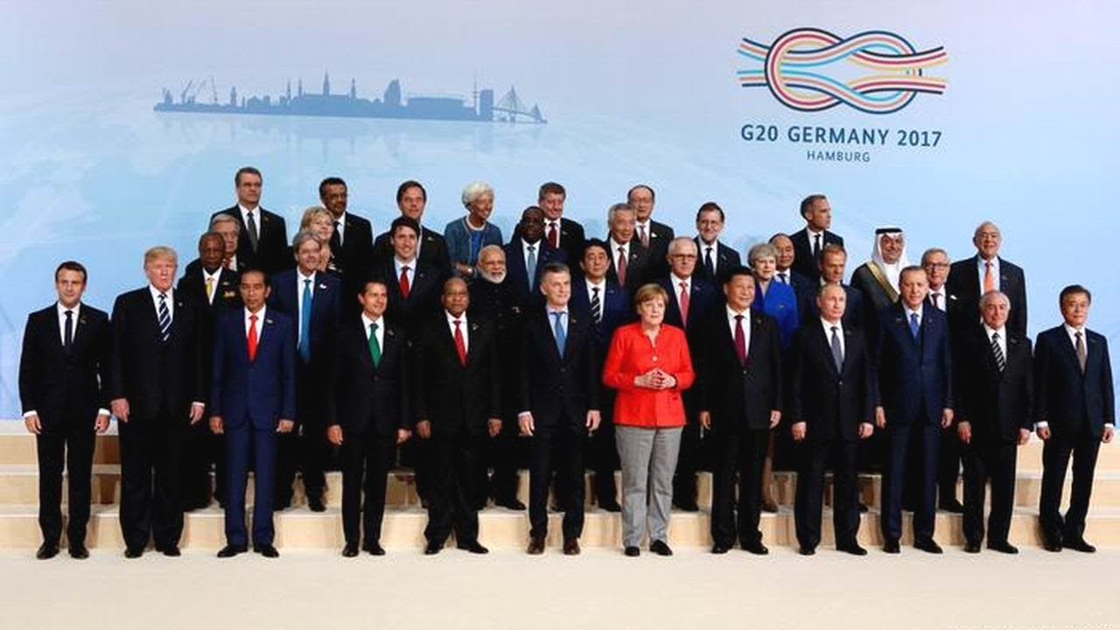
"We support the WHO´s central coordinating role, especially for capacity building and response to health emergencies…
Furthermore, we see a need to foster R&D preparedness through globally coordinated models as guided by the WHO R&D Blueprint, such as the Coalition for Epidemic Preparedness Innovations (CEPI). "
G20 Declaration,
8 July 2017

Slide 32
Thank you!
Keep up to date with our activities:
Follow the official R&D Blueprint Twitter account
@mpkieny
Or sign up to our newsletter
Acknowledgements:
Dr Ana Maria Henao Restrepo & colleagues, WHO

