Slide 1
ISARIC – INTERNATIONAL SEVERE ACUTE RESPIRATORY INFECTION CONSORTIUM
Labs
Clinical
Public Health
ISARIC
ISARIC’s vision is to change the approach to global collaborative patient-oriented research between and during epidemics of SARI and other rapidly emerging public health threats - in order to generate new knowledge, maximise the availability of clinical information, and thereby save lives.
Notes:
ISARIC’s objectives
-To develop a more comprehensive understanding of human and pathogen factors contributing to SARI and disease severity across all ages
- To define and validate optimal clinical management approaches adapted to global range of resource settings
- To develop operational readiness to conduct essential clinical research to characterise and respond to new epidemic or pandemic threats and to inform and guide evidence-based optimal clinical management
- To develop capacity to undertake research including in middle – low resourced settings
- To coordinate international studies on severe acute respiratory infection (SARI) and emerging threats and liaise with national and supra-national public health authorities
- Do so in a timely, efficient, targeted and coordinated manner in order to maximise the information from studies
ISARIC is initially focusing on SARI, but will eventually spread the focus towards other diseases and syndromes. Most of our members do not focus exclusively on SARI.
Integrating with public health is important to ISARIC and the information flow can be a two way process. Integrating lab, public health and clinical research should help to improve patient care and inform decisions that affect the wider population.

Slide 2
ISARIC – INTERNATIONAL SEVERE ACUTE RESPIRATORY INFECTION CONSORTIUM
ISARIC
WG1: Inter-pandemic clinical trials
WG2: Global data collection and collation
WG3: Genomics, pathogenesis and pharmacology
WG4: Changing clinical research paradigms for rapidly emerging threats
Capacities & Barriers Survey
iTools
Adaptive Randomised Clinical Trials
IISIG, and other proposals
Notes:
WG1: develop candidate cross-Consortium studies based on both novel and traditional clinical trial designs that can be implemented in the inter-pandemic period.
WG2: undertake standardisation and harmonisation of definitions, including data variables and mechanisms to collect data e.g. ISARIC itools. Prototype in planning phase.
WG3: develop pathogenesis studies aimed at understanding the dynamics of host responses, host genetic factors in susceptibility, virus/host interactions, and pharmacokinetic-pharmacodynamic relationships in treated patients.
WG4: drive the critical evaluation of the barriers and the ethical framework required to facilitate the development of clinical research in response to a rapidly emerging health threat.
Appearing annimations
iTools (WG2) – an on-the-shelf rapid-response protocol for outbreaks and emerging threats. ISARIC Tools will contain standard definitions, tired data sets and data sharing mechanisms.
Capacities and Barrriers Survey (WG4) – investigating the capacity of ISARIC members to respond to outbreaks and mapping the barriers faced.
IISIG and other proposals – WG3 has submitted a grant for a Strategic Award (Wellcome Trust) which was presented during Annecy with following discussions and comments. Similarily, ISARIC has given rise to other proposals that will be sent in – we have sent one to a MRC/DFiD/WT Global Health Trials Call – and another is being sent in for a Strategic Award. We are also preparing a bid for FP7.
Global Adaptive Randomised Clinical Trials Programme as developed in collaboration with InFACT. (WG1) + the running of trials in the inter-pandemic period.

Slide 3
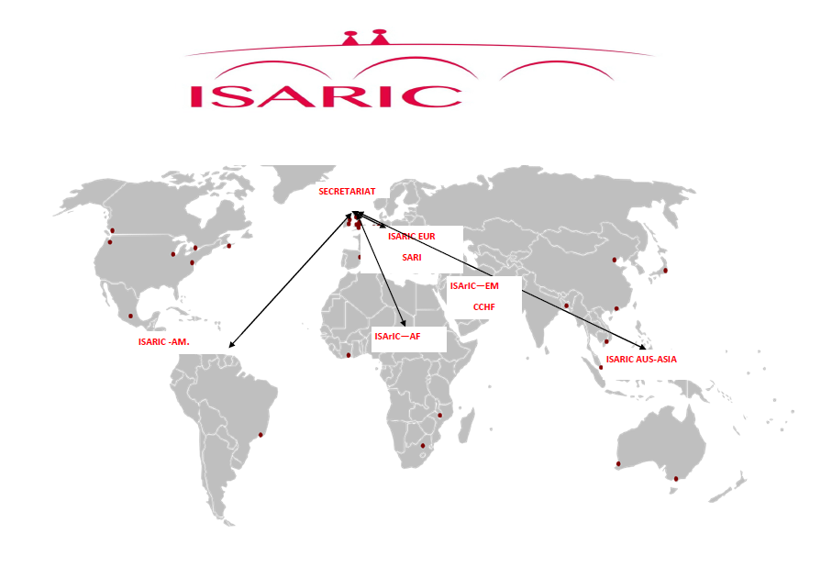
ISARIC – INTERNATIONAL SEVERE ACUTE RESPIRATORY INFECTION CONSORTIUM
Global access through Regional Hubs
ISARIC Africa
ISARIC Americas
ISARIC Australasia
ISARIC Europe
ISARIC is open for national and regional memberships
Notes:
ISARIC is a global initiative – with each arch of the bridge enclosing a third of the world and ISARIC linking all of it together by encouraging networking and collaboration.
In the pursuit of global access – ISARIC aims to create 4 regional hubs – Africa, Americas, Australasia, and Europe
We currently have Regional representatives for all regions – 1 in Australasia and Americas, and 2 each for Europe and Africa. The next step will be to establish offices in each region.
We appreciate that some regions will focus in on studying respiratory disease whereas others may wish to study another disease, which is a burden to them e.g. CCHF.

Slide 4
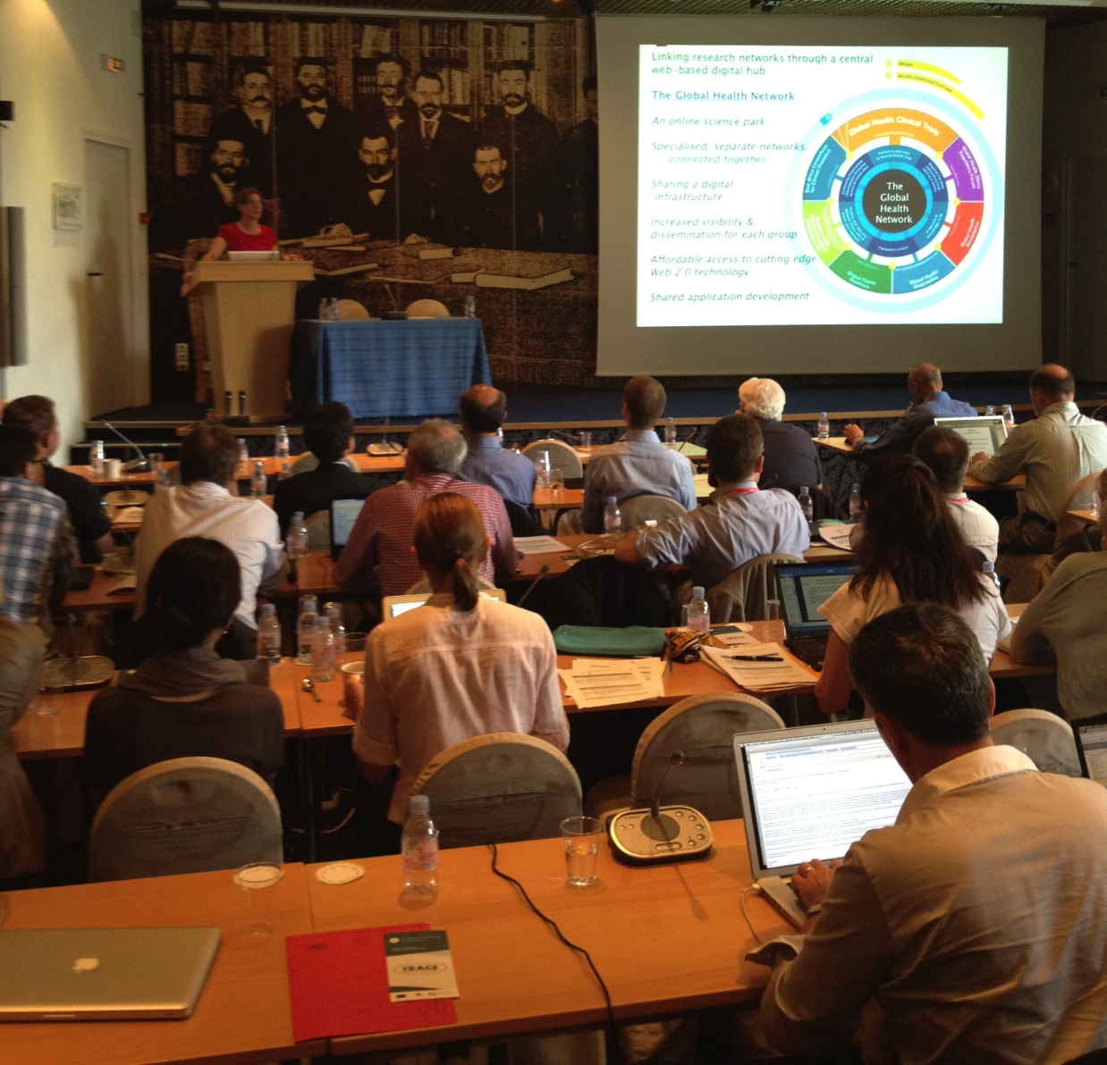
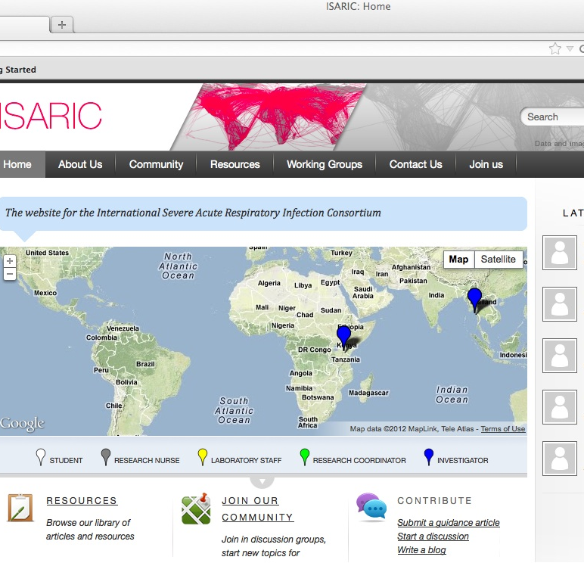
ISARIC – INTERNATIONAL SEVERE ACUTE RESPIRATORY INFECTION CONSORTIUM
Membership
ISARIC Offers two types of membership:
Full Membership
Individual Membership (if not eligible for Full Membership)
Networks seeking Full Memberships should be:
Independent and led by academia (not industry)
Scientifically active
Multi-centre (divisions/institutes/organisations)
Have access to patients for future studies
Supportive of ISARIC’s vision and mission
Organised in a manner consistent with ISARIC’s vision
Benefits: sharing and receiving information globally and across Clinical/Lab/Epi divides, access to protocols, participating in working-group activities, global links, communications, networking and collaboration (national, regional, international)…
Notes:
ISARIC is happy to consider national, regional or international networks – and we are using a very loose definition for networks. We are happy to consider networks who do not fully comply with the criteria listed.

