Slide 1
These slides have been developed to help explain how covid-19 vaccine trials work. They have been used in presentations as slides, and also as animations, for slide and for short informational films. See for example https://kemri-wellcome.org/ and https://vimeo.com/459448658
PPT is versatile because: the slides can be modified to suit many 2-arm vaccine trials; narration tracks can be added if needed; slide animation and transition speeds can be adjusted; the slides can be split to help explain different aspects of vaccine trials; and the slides can be easily exported to MP3
If you use these slides, please acknowledge the KEMRI-Wellcome Trust Research Programme and Alun Davies for the animation development

Slide 2
COVID-19 Vaccine research at KEMRI-Wellcome Research Programme

Slide 3
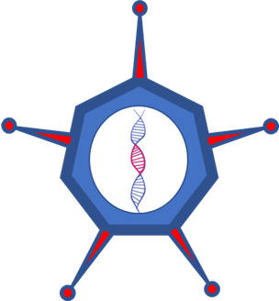
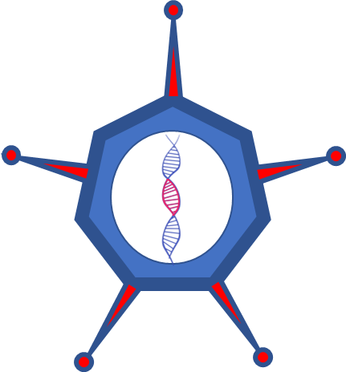
[Vaccine name]
Notes:
Kenyan researchers from KEMRI are currently collaborating with researchers from the UK to test a new vaccine called xxxx
It’s important to bear in mind that work by Kenyan researchers work, contributed to the development of this trial vaccine, and that Kenyan trials will be led by Kenyan researchers.
So how will researchers test this vaccine to see if it gives protection?

Slide 4
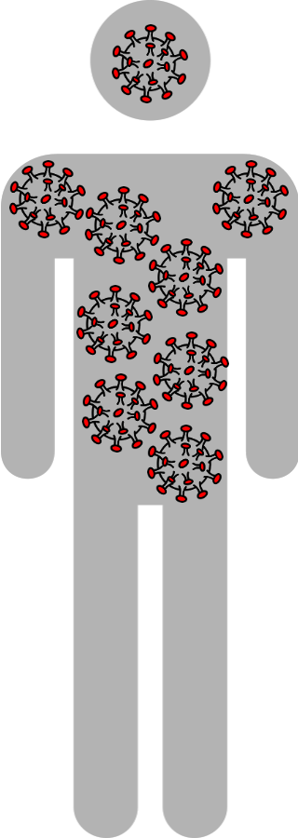
Protected
Notes:
People who have never had COVID-19 can easily become infected themselves if they come into close contact with a person who has the disease.
This is because they have no natural immunity, or defence to protect them against infection.
Being infected may enable the body to build natural immunity which may prevent a second infection.

Slide 5
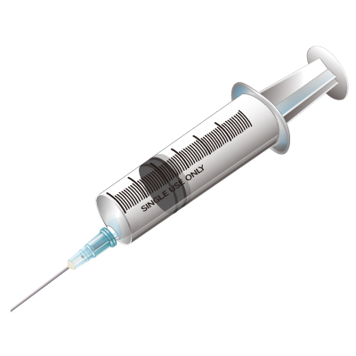
Protected
Notes:
Vaccines mimic this.
When a person is vaccinated, the vaccine stimulates the body to produce an immune response, or a defence against infection.

Slide 6
Basic Science
Vaccine design
Testing in animals
Phase 1 trial
20-80 people
Phase II trial
Several hundreds of people
Phase IV
Monitoring in the population
Phase III trial
Several thousands of people
Notes:
A tremendous amount of lab work is needed to develop a vaccine and this can take many years.
From the initial lab work, trial vaccines are first tested on animals, and if safe, they proceed through different phases of increasing sized clinical trials, to confirm safety and to see whether they give protection against disease.
When there is strong, carefully reviewed evidence of protection, regulatory bodies give permission for the vaccines to be rolled out to large populations, but the vaccines are still monitored

Slide 7
Local science/ethics review
InternationalResearch Ethics Committee
National regulatory body
National Scientific and Ethical Review body
National Pharmacy and Poisons Board
Notes:
Before any health research can be done with people, the research must be carefully reviewed and approved by local, national and international scientific and ethical committees. These committees check that the scientific plan is strong, that the risks to participants are minimized and that their rights are guarded

Slide 8
How are adenovirus vaccines put together?

Slide 9
Modified
Adenovirus
COVID-19
Notes:
This is a picture of an Adenovirus that causes a mild flu amongst chimps
It can be used to deliver the vaccine into the human body,
but first, the adenovirus is modified so that it cannot cause any disease in humans
Then, researchers carefully extract a component of genetic material from a COVID-19 virus,

Slide 10
Modified
Adenovirus
Notes:
and insert it into the genetic material of the adenovirus.
This specific component stimulates the human body’s immunity.

Slide 11
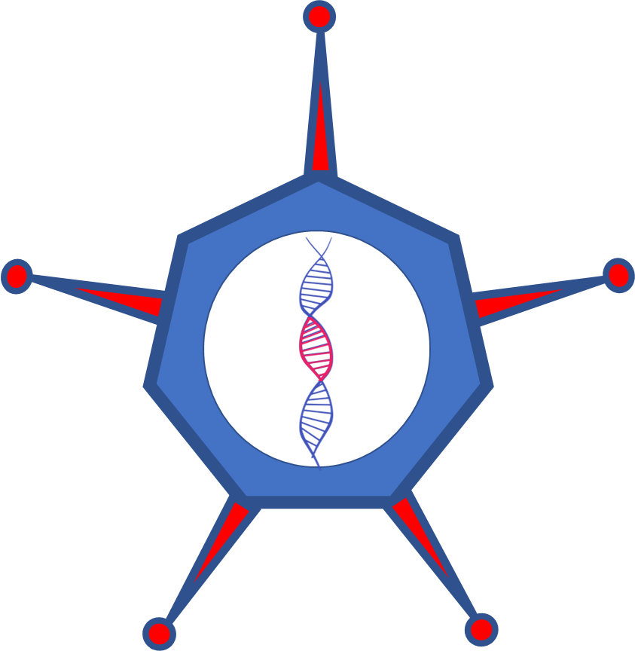
Notes:
More of this modified adenovirus is made so that a vaccine can be prepared.
This approach using adenovirus has been used before to make an Ebola vaccine which is now licensed and was used to control the epidemic in West Africa, and recently in DRC
We want to find out whether this new vaccine can protect people from COVID-19 infection.

Slide 12
Notes:
More of this modified adenovirus is made so that a vaccine can be prepared.
This approach using adenovirus has been used before to make an Ebola vaccine which is now licensed and was used to control the epidemic in West Africa, and recently in DRC
We want to find out whether this new vaccine can protect people from COVID-19 infection.

Slide 13
Notes:
More of this modified adenovirus is made so that a vaccine can be prepared.
This approach using adenovirus has been used before to make an Ebola vaccine which is now licensed and was used to control the epidemic in West Africa, and recently in DRC
We want to find out whether this new vaccine can protect people from COVID-19 infection.

Slide 14
Trial vaccine
Rabies
Control
Notes:
In this trial, rabies vaccine is used as a placebo. We know that rabies vaccine doesn’t protect against COVID-19, but it will give participants protection against Rabies… as a benefit for taking part in the trial

Slide 15
Notes:
For the first month, the vaccine will be given to forty volunteers to confirm its safety.
The study will be explained to them, and if they are healthy and willing to participate, they will sign a consent form.

Slide 16
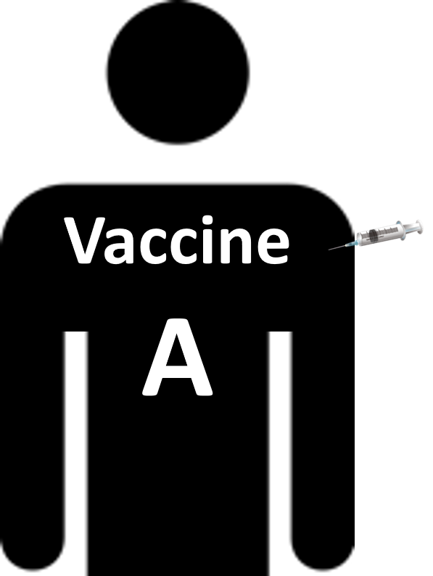
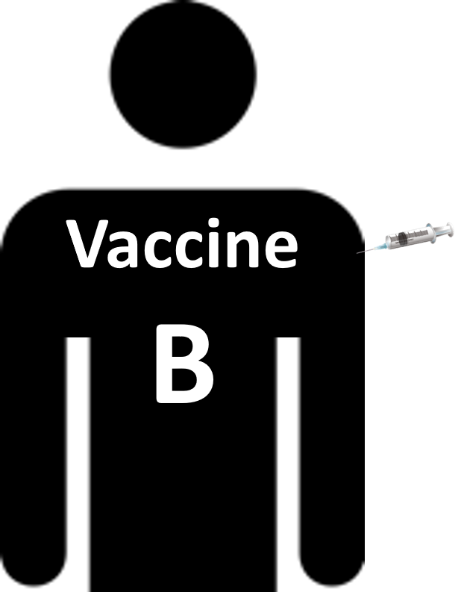
Vaccine A
Vaccine B
Notes:
Each of the 40 participants is given either the test vaccine, or the placebo (rabies), and this is decided randomly, or by chance – a bit like flipping a coin
But, participants will not know whether they have been given the test vaccine, or whether they were given the placebo
This is to make sure that their behaviour is not influence by the type of vaccine given to them.

Slide 17
Health
Immune response
Safety
Notes:
For the first month, Participants are followed-up to closely monitor:
Their health,
The safety of the vaccine and whether participants experience vaccine reactions like mild fever, swelling or itchiness around the site of the injection.
And
How the participants bodies develop immunity in response to the vaccine
Because of the way it’s made, the vaccine can’t cause COVID-19 infection, but If a participant becomes infected, then they will be treated according to the Ministry of health guidelines.
They will also be reminded to try to avoid infection through following government guidelines on hand-washing and social distancing

Slide 18
Vaccine A
Vaccine B
Notes:
When researchers are confident that the research can proceed, 360 new participants will be recruited.
Again, chance will be used to decide which vaccine participants are given. Half the participants will be given xxxxx and the other half will receive the placebo.

Slide 19
Vaccine A
Vaccine B
Month 1
2
8
4
12
6
3
10
Notes:
Over the next 11 months, the participants will be monitored and regularly tested.

Slide 20
Animation and Editing Alun Davies

Slide 21
Maps Christopher Nyundo Johns Hopkins COVID-19 dashboard https://coronavirus.jhu.edu/map.html WHO CORONAVIRUS dashboard https://coronavirus.jhu.edu/map.html Music https://bensound.com Images Pixabay.com free images Creative Commons

