Slide 1
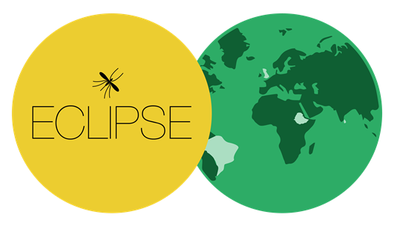
Community engagement in cutaneous leishmaniasis research:
a decolonial approach for global health
Dr Kay Polidano

Slide 2
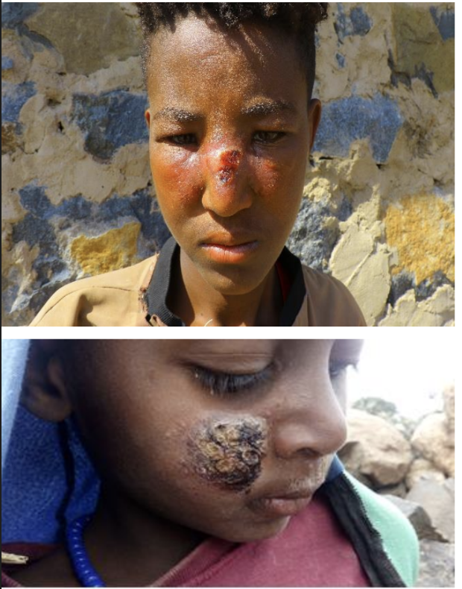
Introducing ECLIPSE
Empowering people with Cutaneous Leishmaniasis (CL): Intervention Programme to improve patient journey and reduce Stigma via community Education
Aim
To explore and improve:
Psychosocial impact
Stigma and its effects
Patient journey
Notes:
Neglected tropical diseases --- NTD day celebrated last week
Caused by infection with Leishmania parasites
Spread by sand fly bites and results in skin lesions
Treatment involves multiple injections with toxic drugs
Association with extreme poverty and areas of conflict

Slide 3
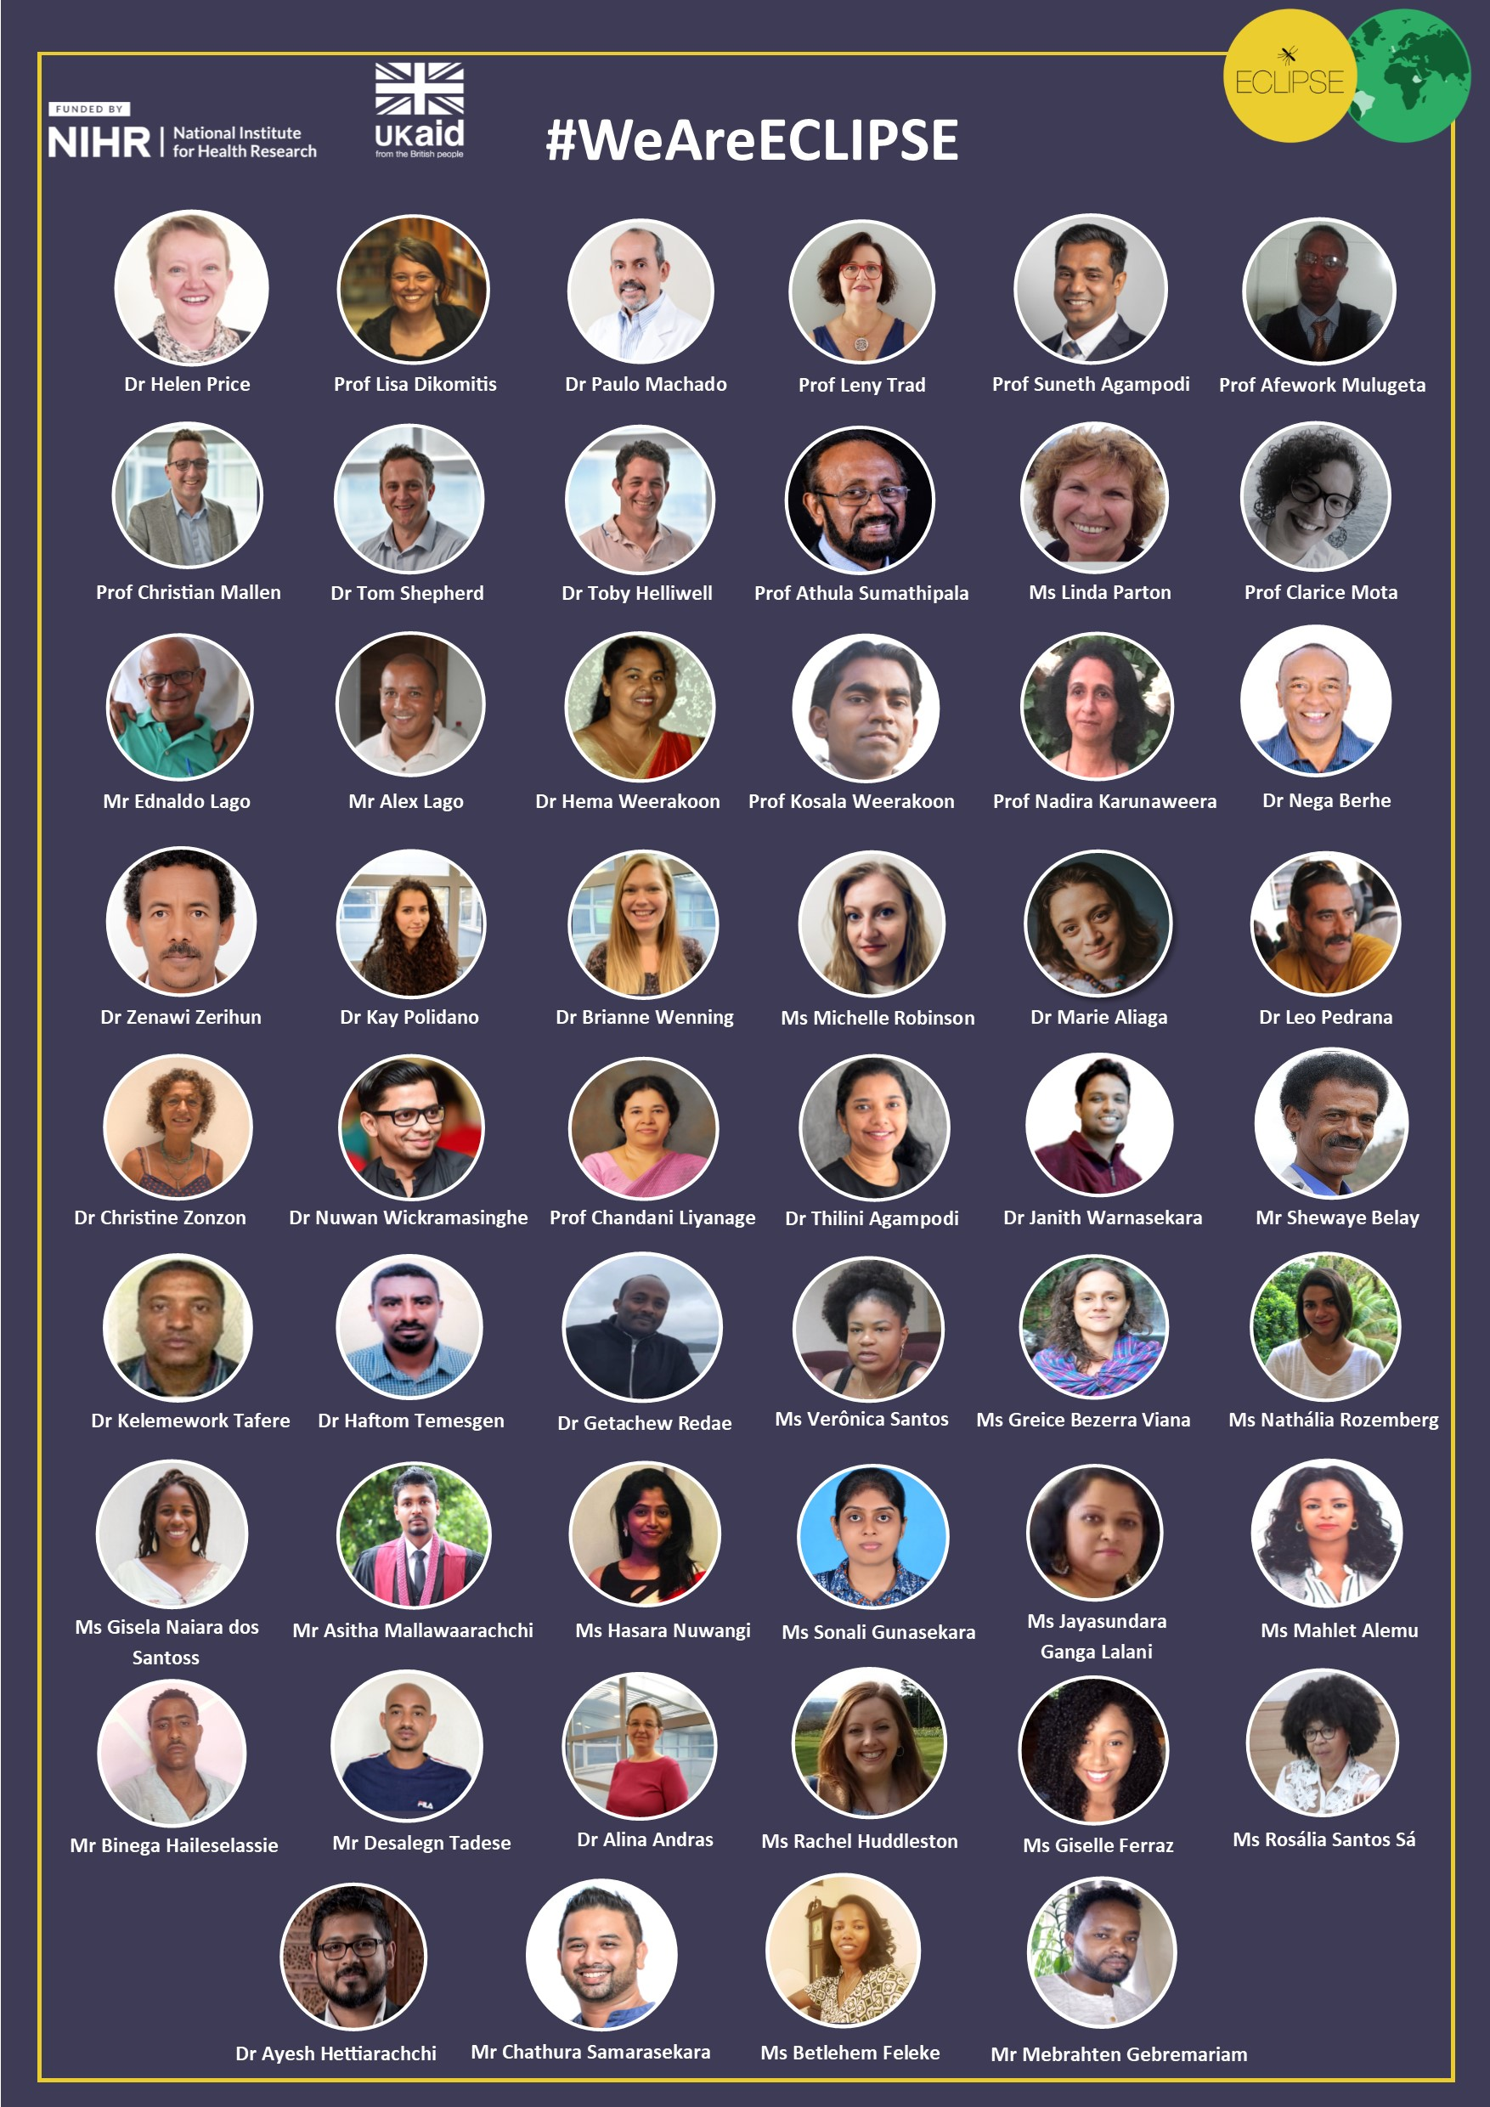
Introducing ECLIPSE
Sri Lanka
Brazil
Ethiopia

Slide 4
Introducing ECLIPSE
Exploring CL in communities
Interventions
Evaluation
Community engagement and involvement (CEI)
Notes:
Neglected tropical diseases --- NTD day celebrated last week
Caused by infection with Leishmania parasites
Spread by sand fly bites and results in skin lesions
Treatment involves multiple injections with toxic drugs
Association with extreme poverty and areas of conflict

Slide 5
Our CEI mission
Parachute researcher
Privileging experiential knowledge
Sustained partnership
Culturally appropriate and context-bespoke
Notes:
Tendenxy main characteristics in current CL literature
No engagement with community members – conducted by parachute researchers who collect data at a time and manner of their choosing
Sustained partnership: Already from grant development meetings, CEI was crucial

Slide 6
CEI strategy:
People working/living in CL-affected community (village-level)
Various stakeholders (regional-level)
Notes:
The skeleton of our CEI

Slide 7
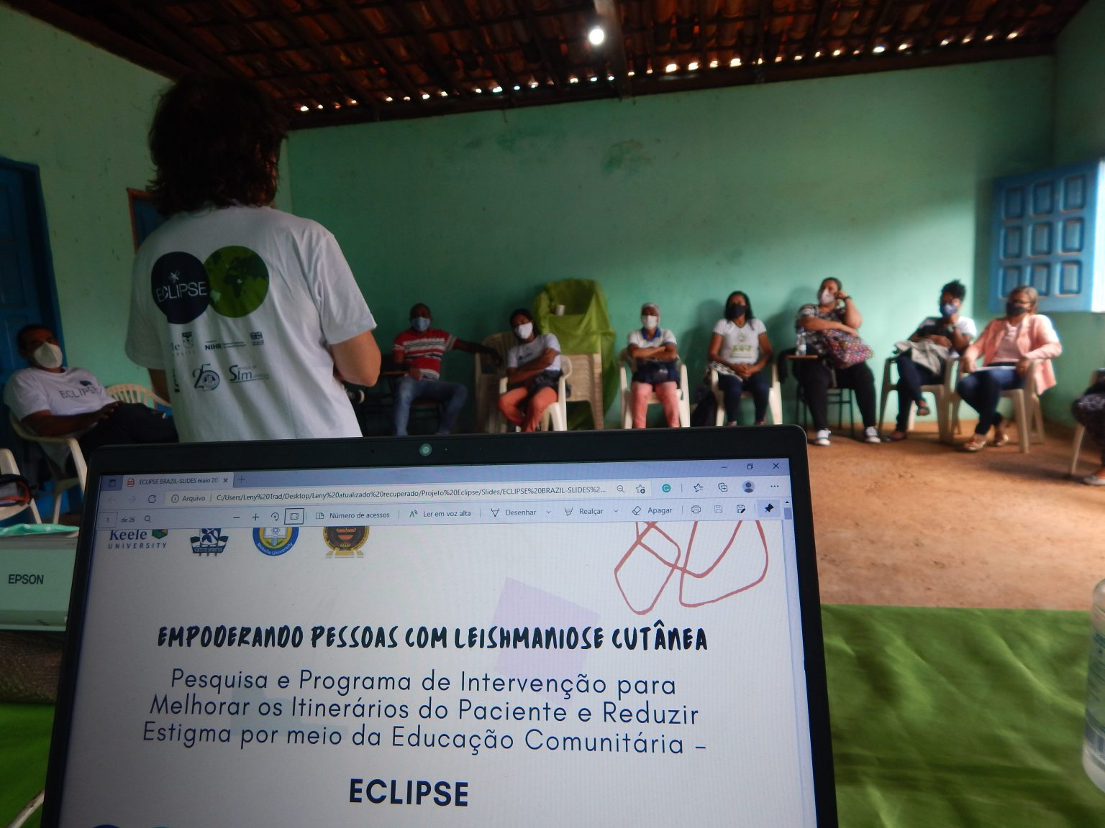
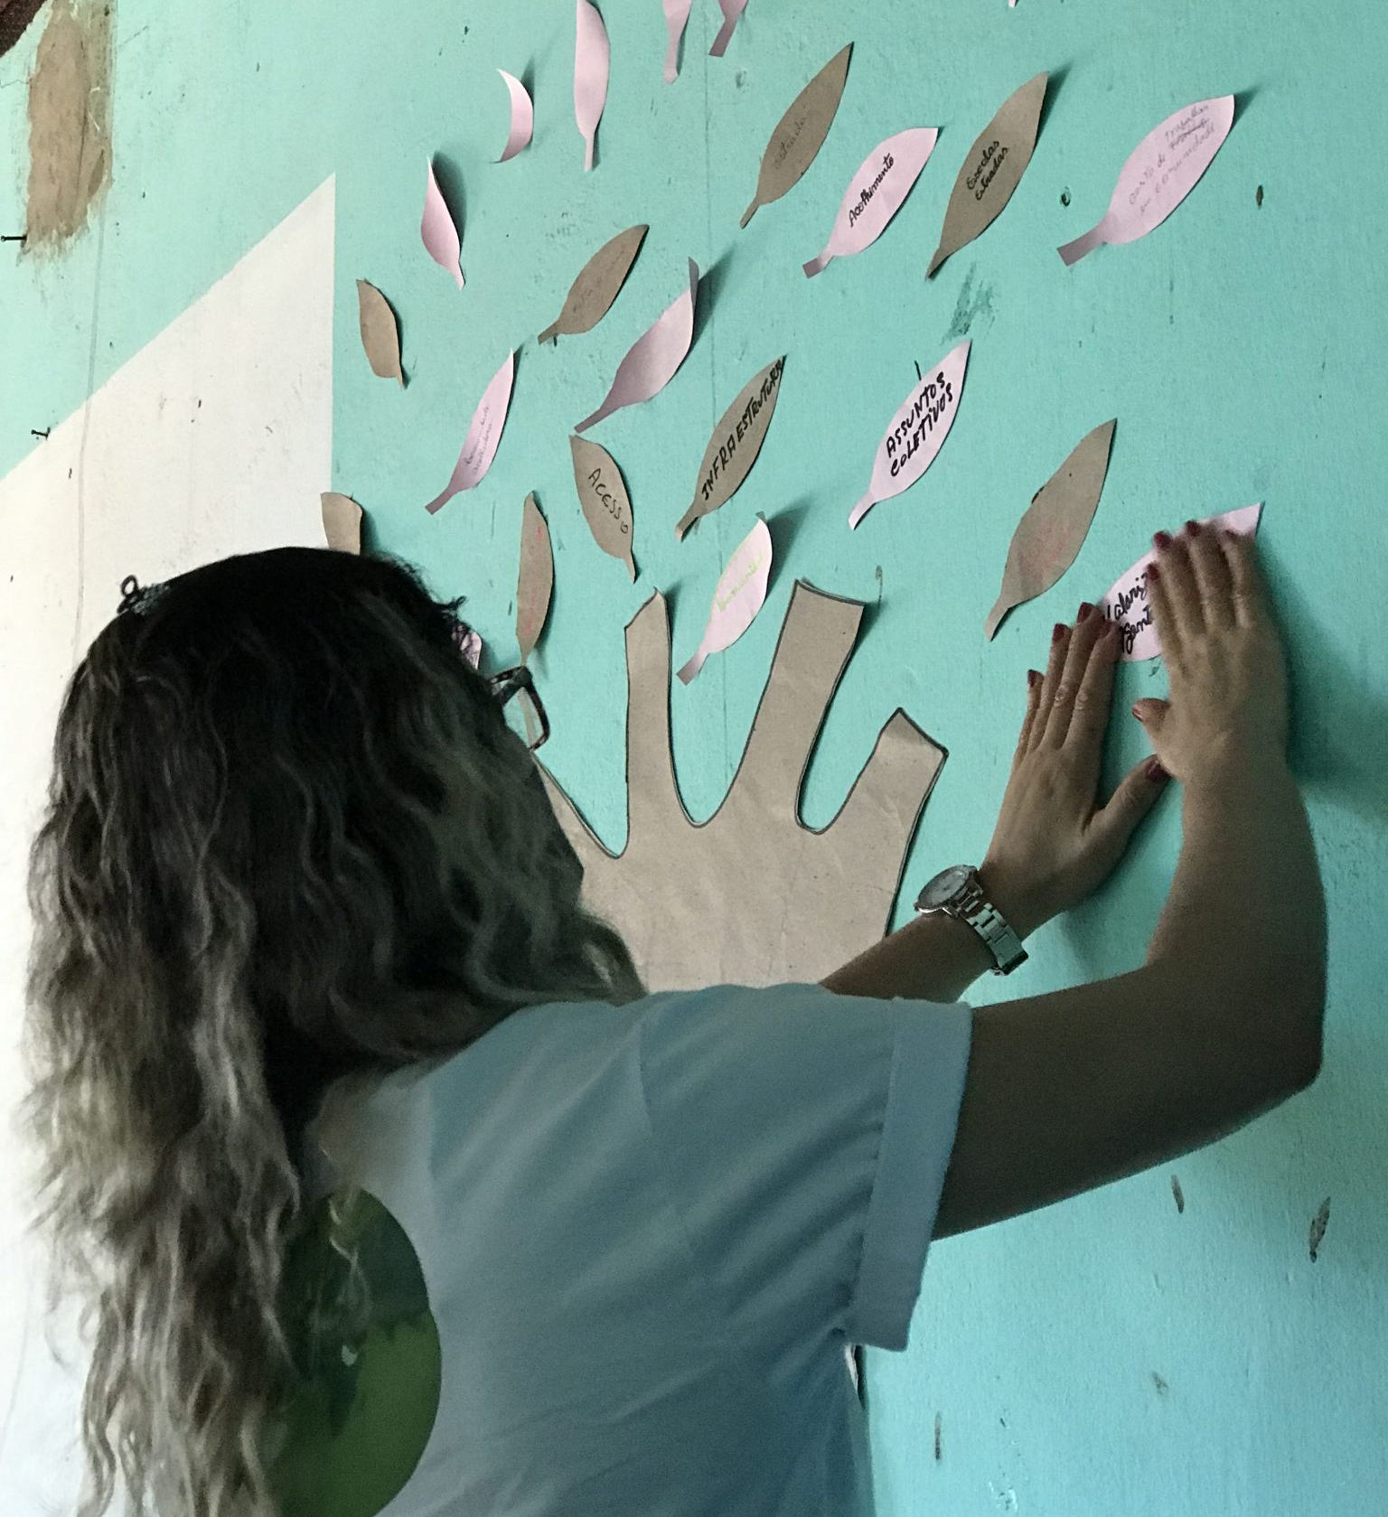
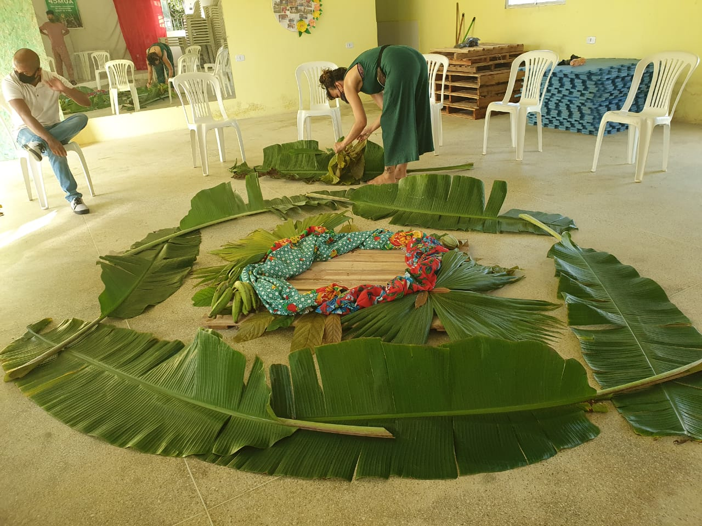
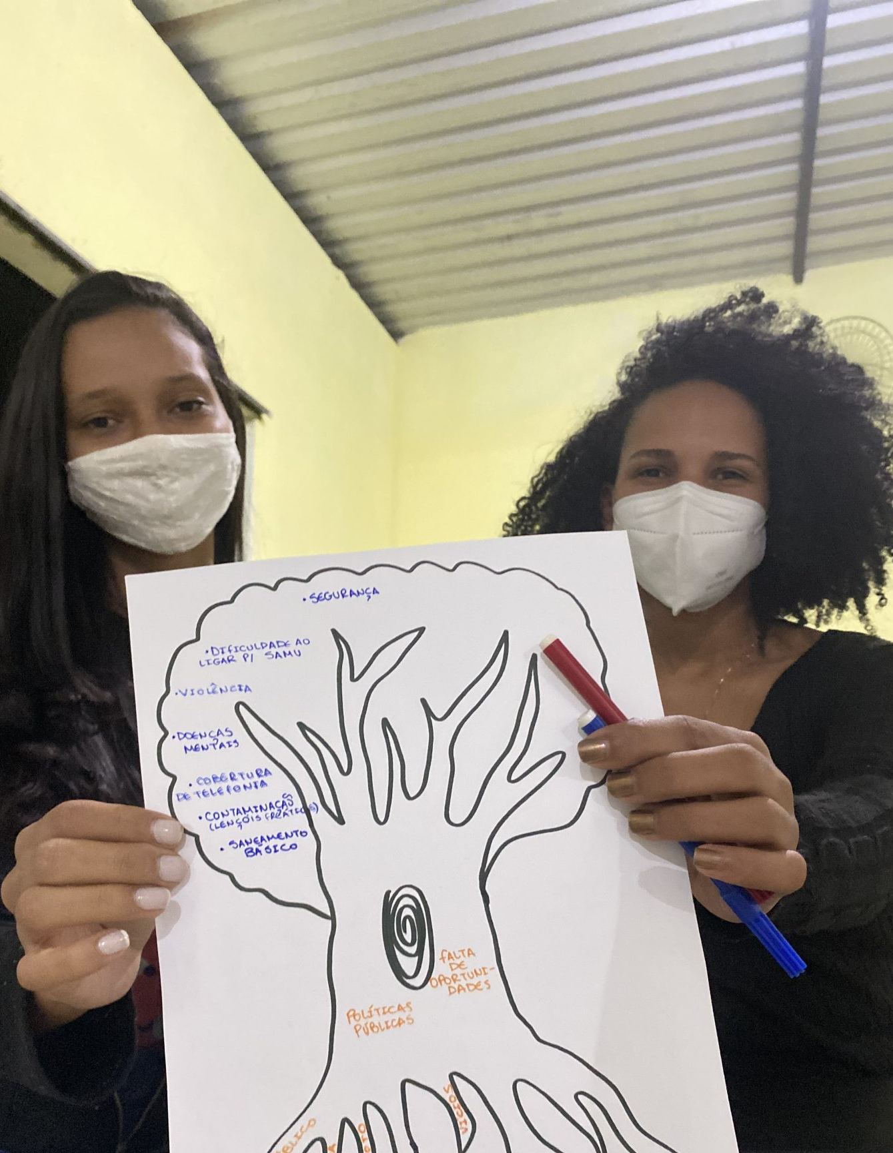
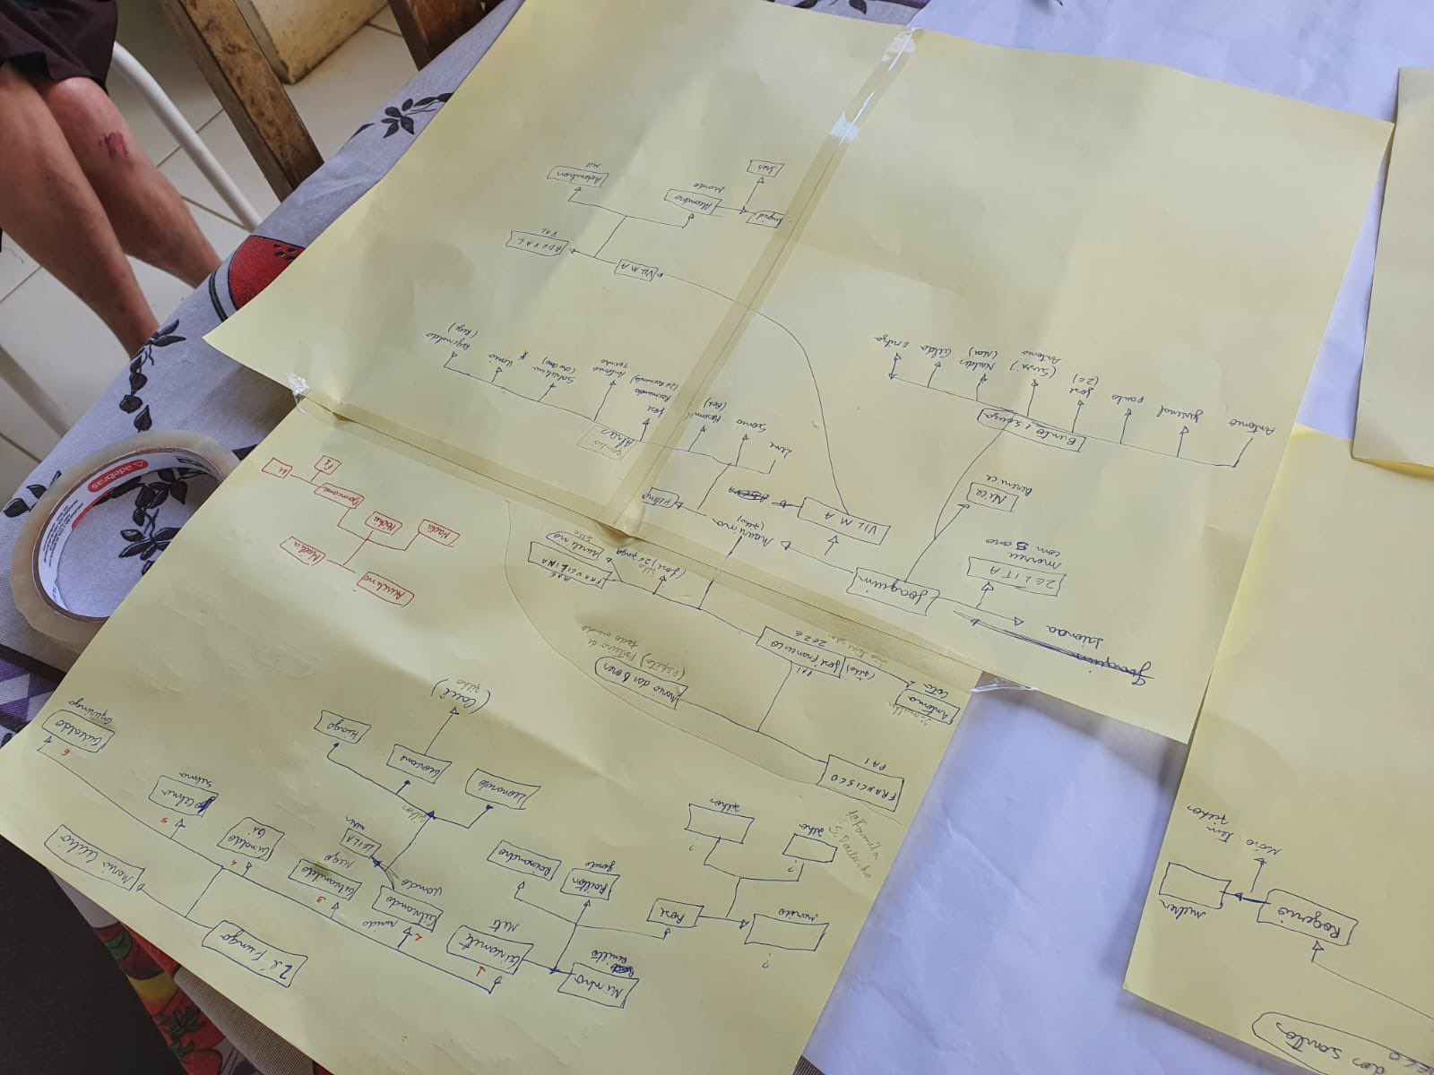
Notes:
Same model but implemented in very different ways

Slide 8
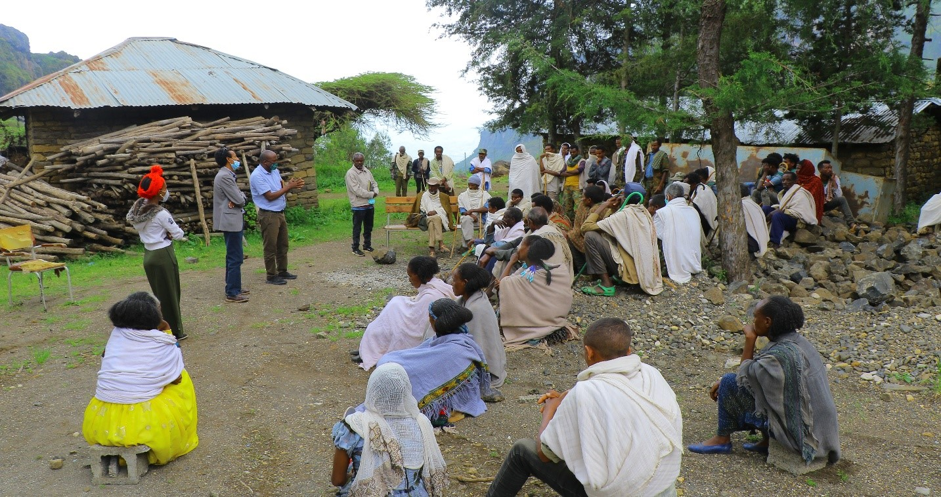
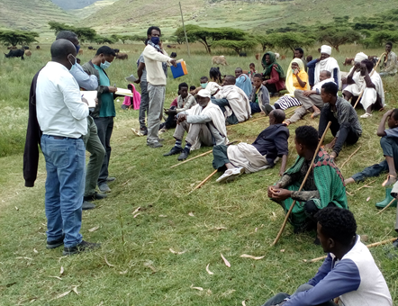
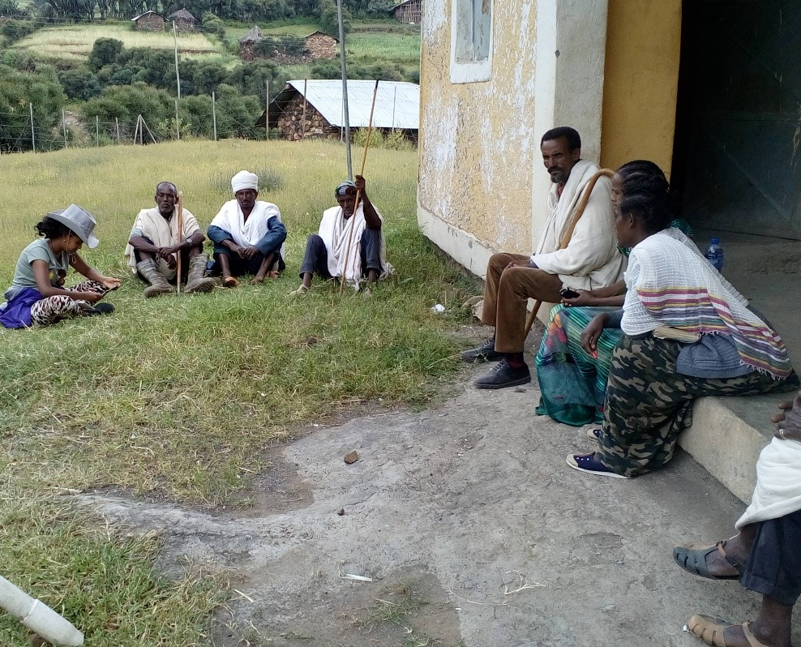
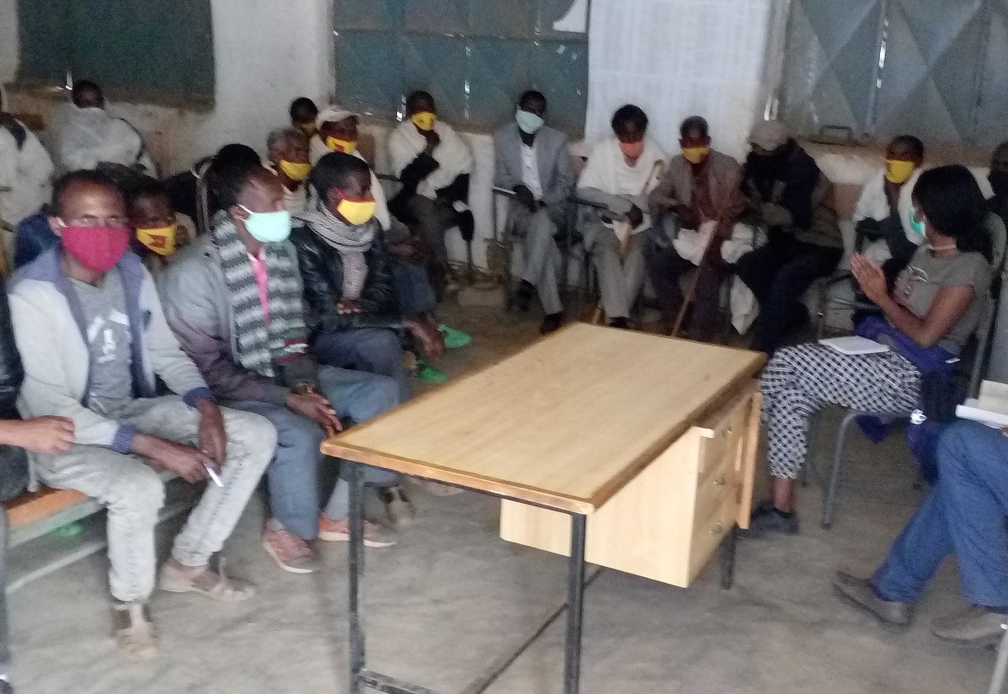

Slide 9
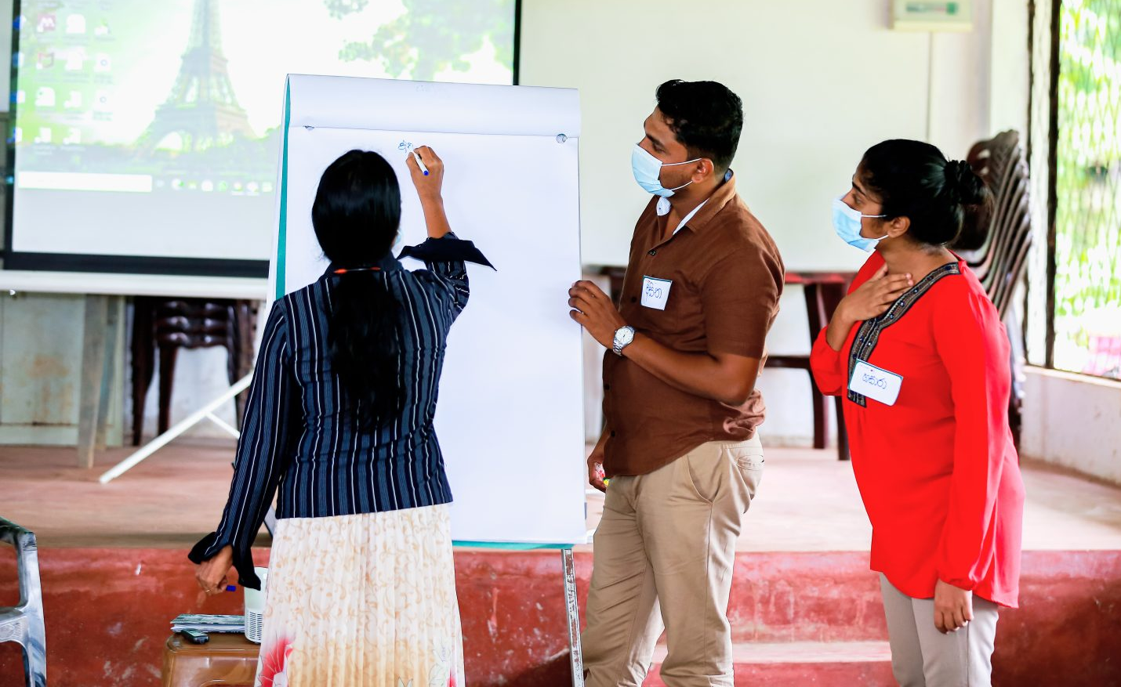
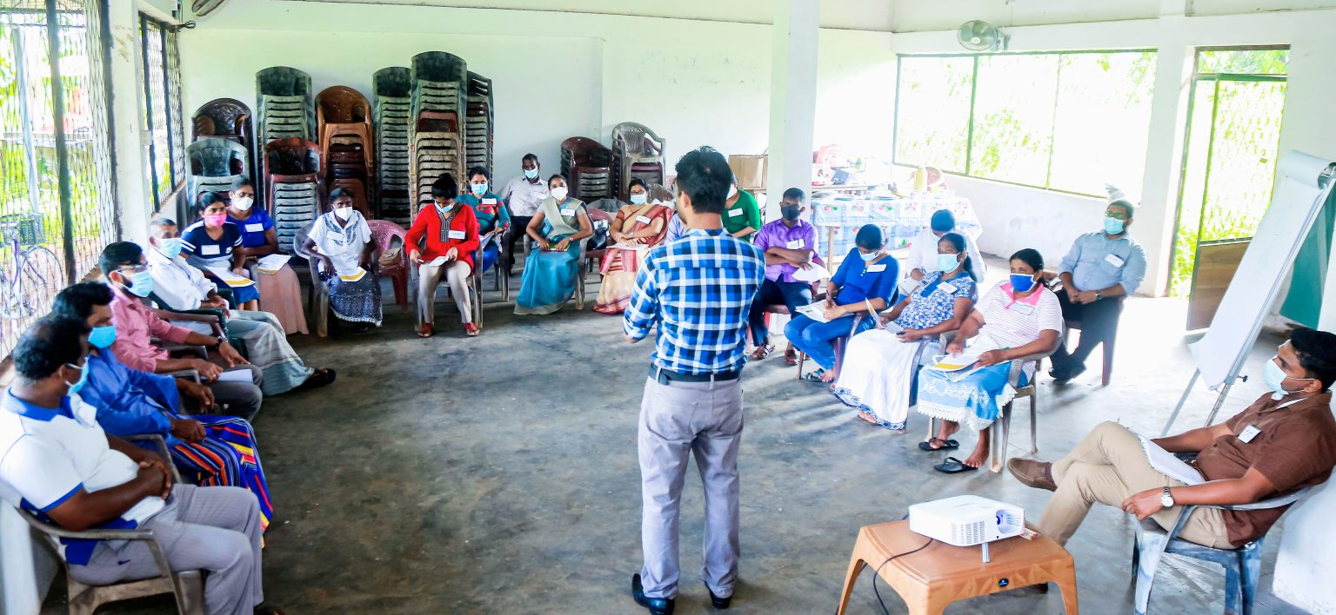
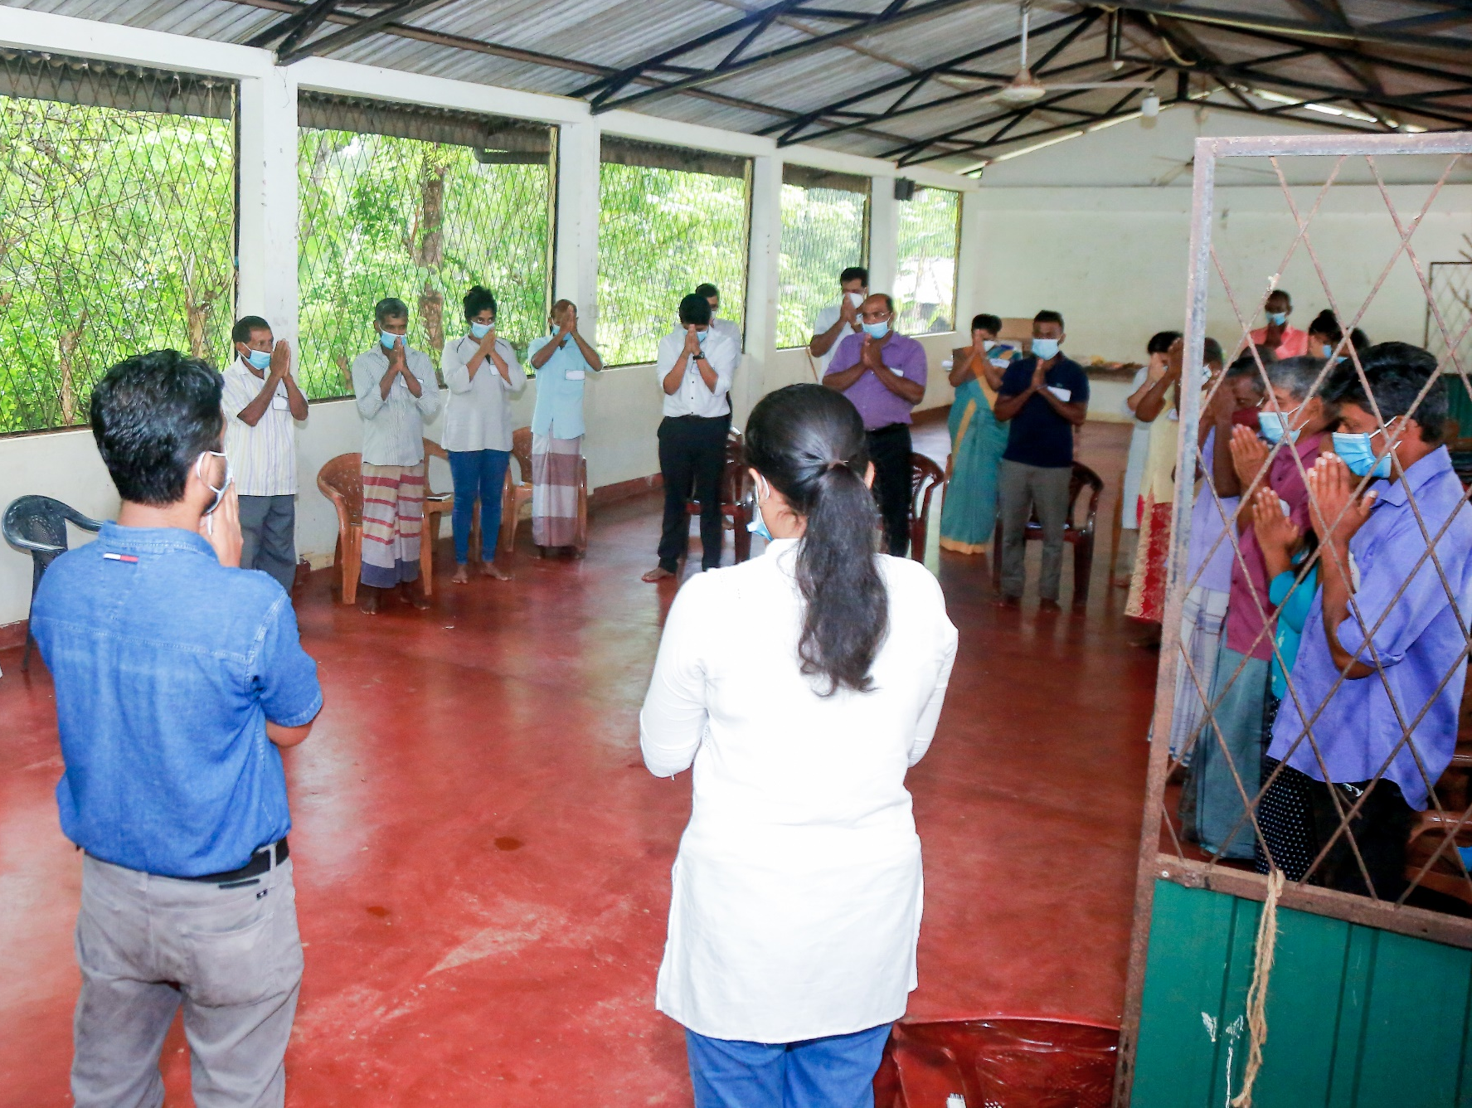
Notes:
Example of rope

Slide 11
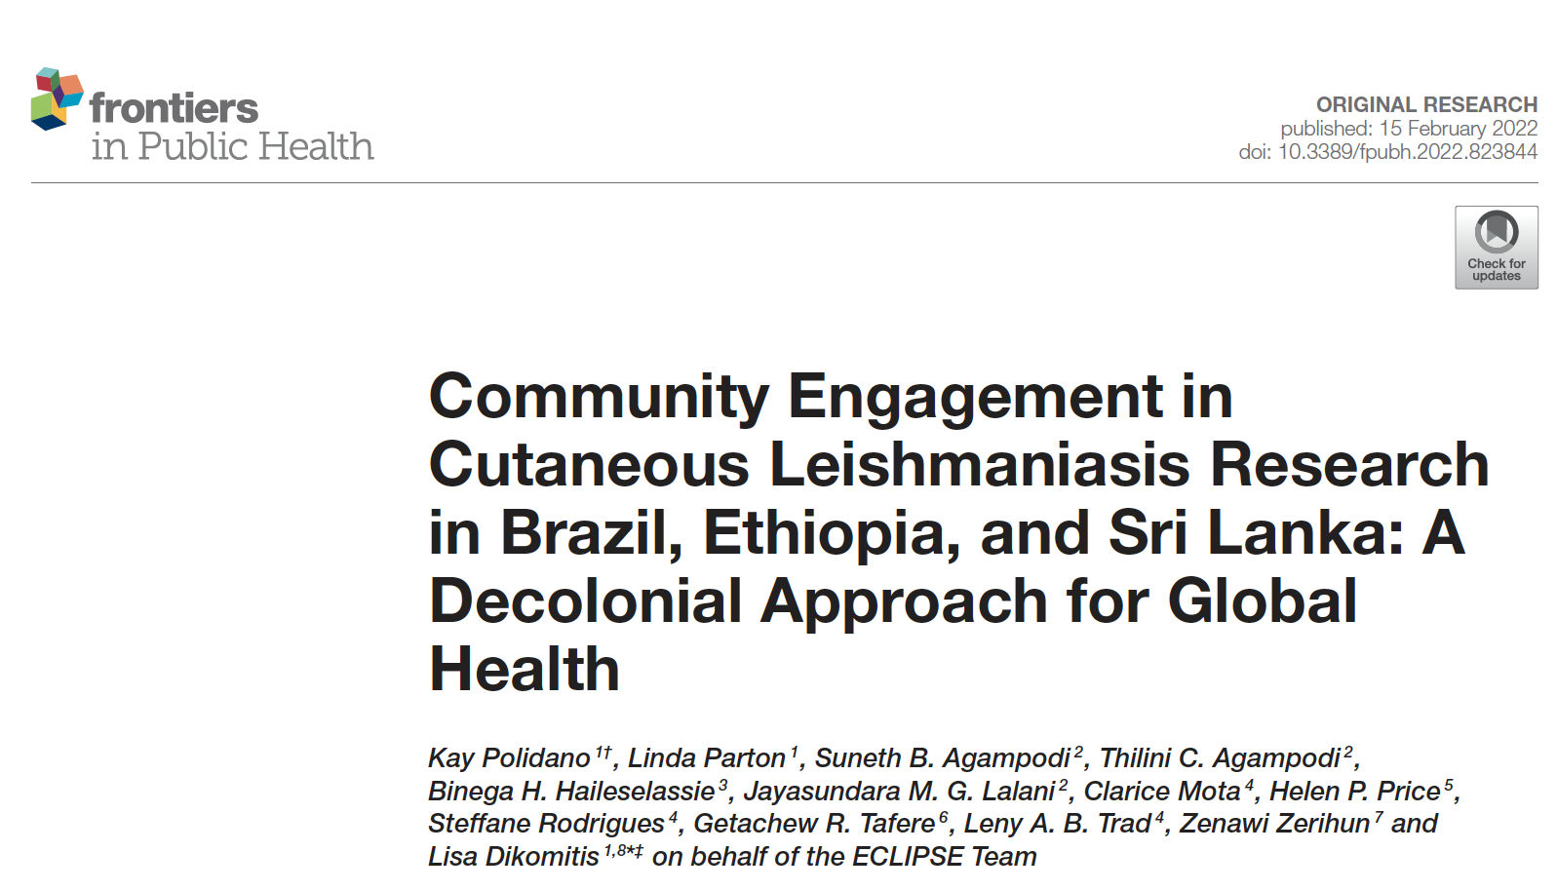
Participant observation
Interviews
Group discussions with CAG members
A
B
C
Establishing CAGs
CAG membership and community representation
Culturally appropriate and context-bespoke engagement
Relationships between researchers and community members
Challenges, dilemmas and lessons learned
Notes:
First evaluation timepoint (18 months) – publication
Multi-method approach to our engagement: Participant observation, interviews, group discussions with CAG members, visual methods (photographs and videos) --- March 2020 and September 2021

Slide 12
Uninvited guests
Trusted partners
Constraints:
Funding – budgets, deliverables, milestones
Sociocultural context of communities
External events
Notes:
Humility of knowing that we arrived as ‘uninvited guests’. They did not invite us.
Trust and credibility do not appear spontaneously, but are the result of consistent, long-term and often (invisible) work. Trust not only individual researchers but the whole project
It was the first time ECLIPSE researchers were working in these specific sites, so we really needed to start from scratch
Time – engaging with community members as early as possible – we visited communities and discussed plans with residents during the grant development stage (possible from a small grant by the funder) - several months of preliminary work
Legacy of broken promises and unmet expectations

Slide 13
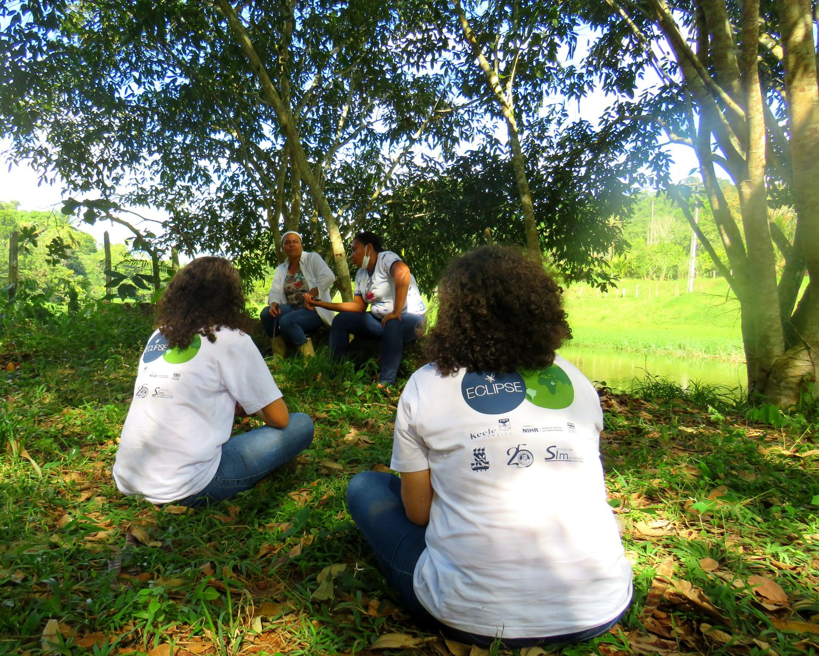
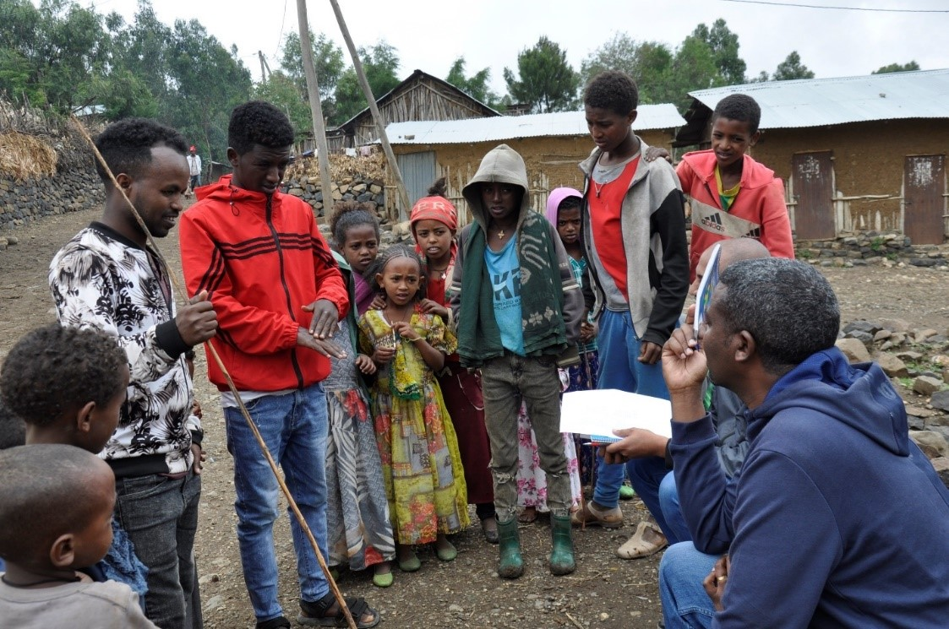
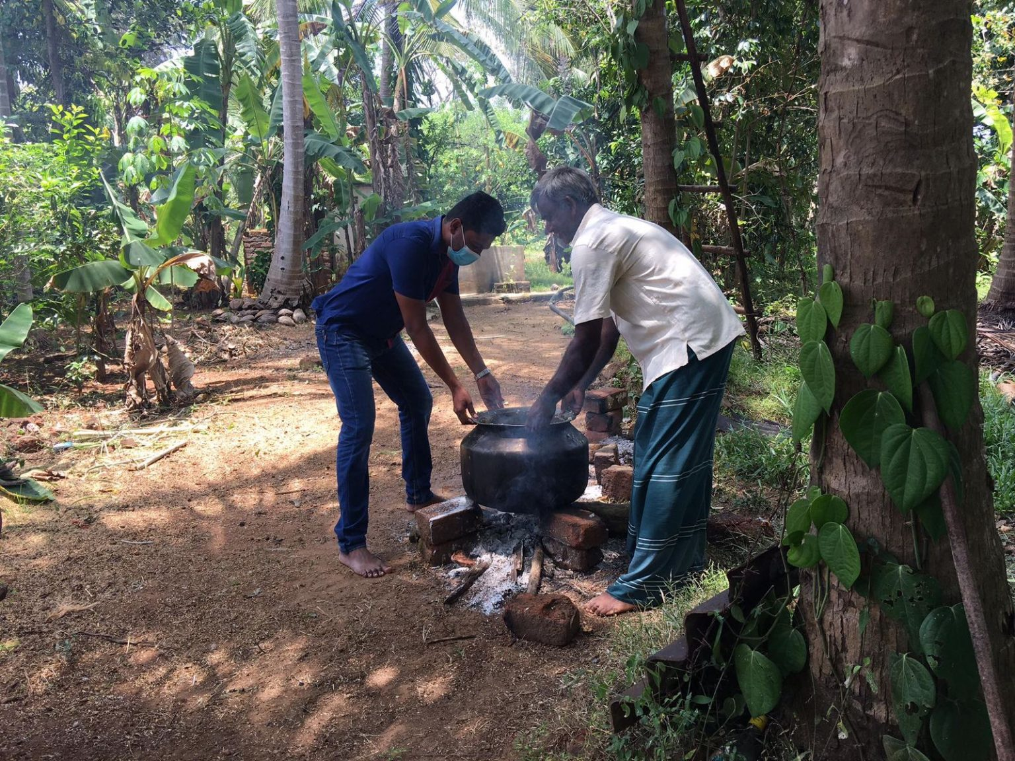
Challenges and lessons learned
1
Laying the groundwork… it takes time

Slide 14
Challenges and lessons learned
2
Managing expectations (early on)
We had a number of similar engagements in the past but once the job is done, nothing changes. What makes this project different from the previous ones?
- CAG member, Brazil
Balance between allaying skepticism and over-promising
Notes:
Balance – be realistic – not to break promises – the idea of the ’university’ solving their problems
Concerns tied to
It’s also important to be sensitive to historical context

Slide 15
Challenges and lessons learned
CAG member: The lady [ECLIPSE researcher] says [the project has not been created], but there’s a plan. Yes we may bring important points [but] the thing is set up. So please, do not say that project is not yet
created, no.
Facilitator 1: I will give an anatomical example. The project is, at most, a skeleton. Organs, muscles, they are missing.
CAG member: But it has a skeleton!
Facilitator 2: It is not a rigid skeleton (...) There is the theme, cutaneous leishmaniasis, there are some elements that are part of it: thinking about care, thinking about participation [. . . ]. To be a participatory project, the thing that is most defined in it is that it needs to be carried out by the community
3
Resistance… can be productive
- CAG meeting, Brazil
Notes:
We welcomed resistance and disagreements in CAG meetings becayse when these are discussed respectfully and productively, they represent another facet of dissolving hierarchies

Slide 16
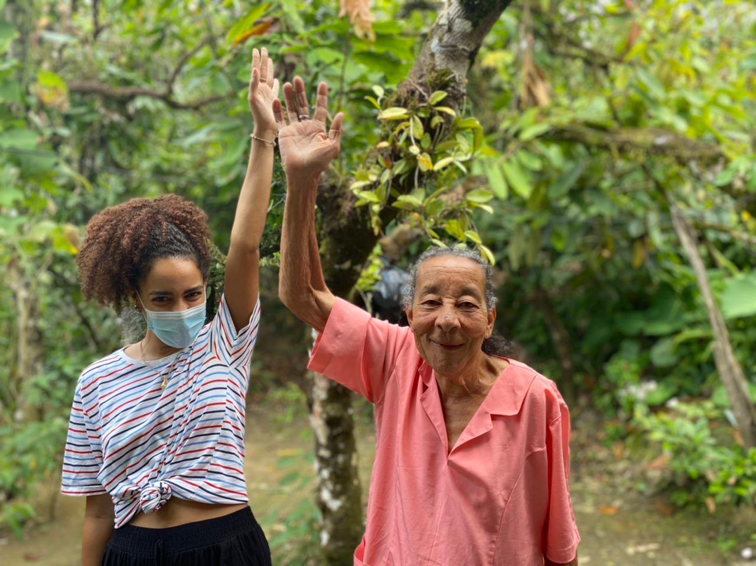
Challenges and lessons learned
4
Friendly, non-hierarchical atmosphere
I was expecting suited-up people [from the research time]. When you hear ‘university’, you think of someone formal, with a straight posture, with a certain way of being. But what I see are people who came here and humanized us. People who reached out to us about a problem that we have, and therefore, we want to be part of finding a solution
- CAG member, Brazil
Notes:
Steering away from top-down approaches

Slide 17
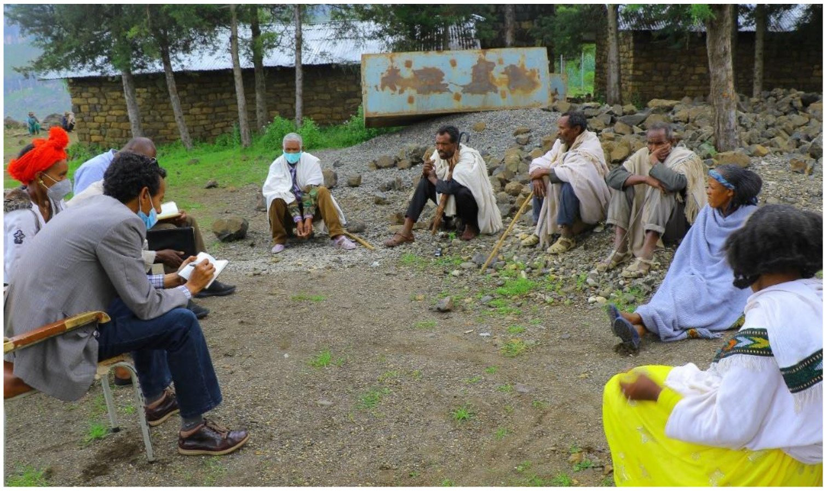
Challenges and lessons learned
5
Power dynamics embedded in local customs
Notes:
Pictures of Ethiopia
Importance of activities

Slide 18
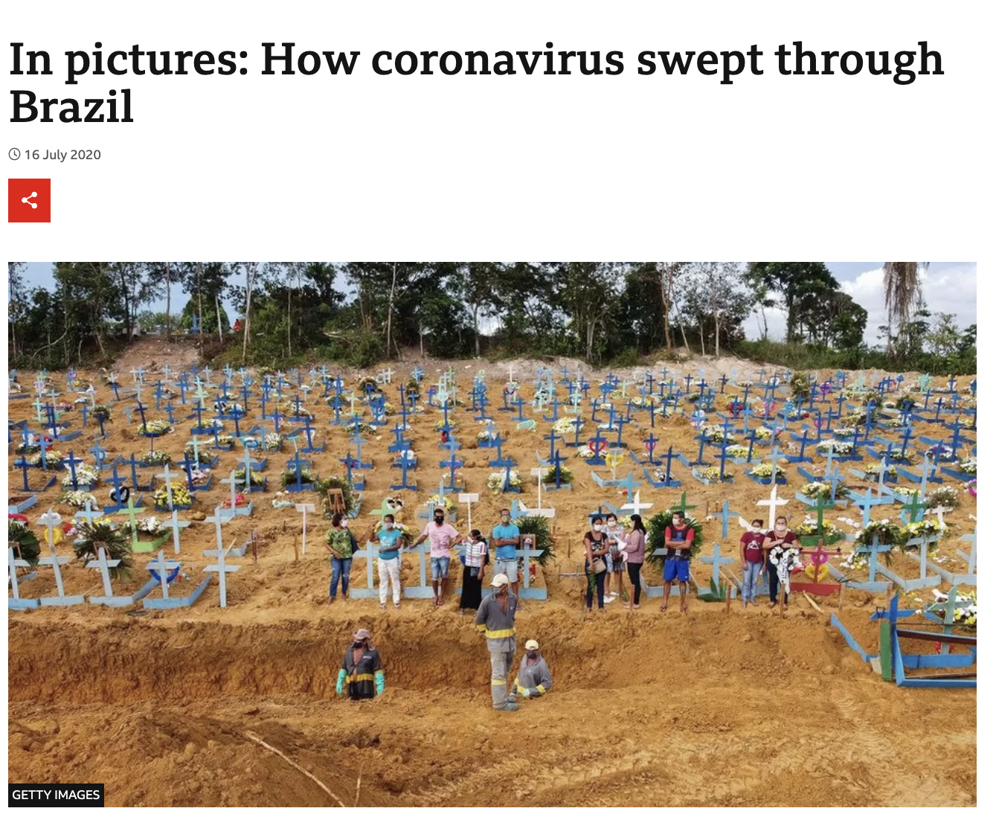
Challenges and lessons learned
6
Adaptability: social, cultural and health priorities are not fixed
Notes:
Shifting priorities
Shifting

Slide 19
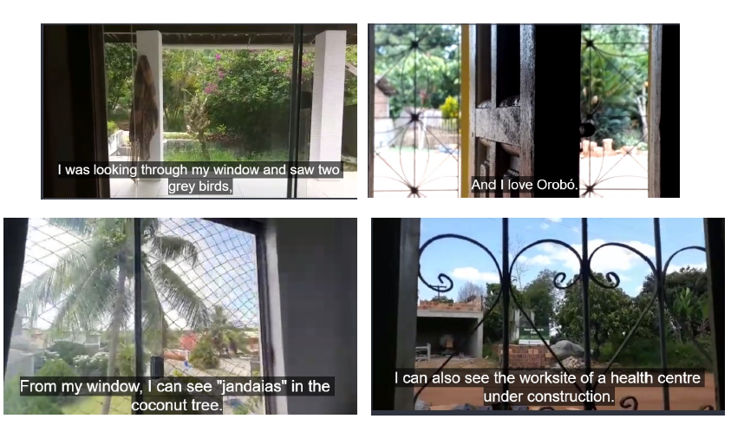
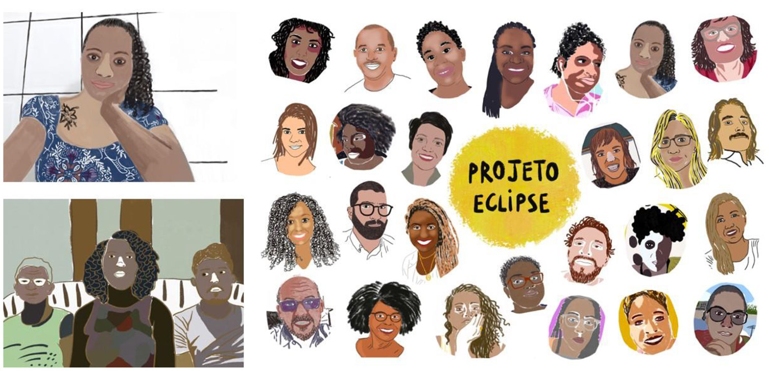
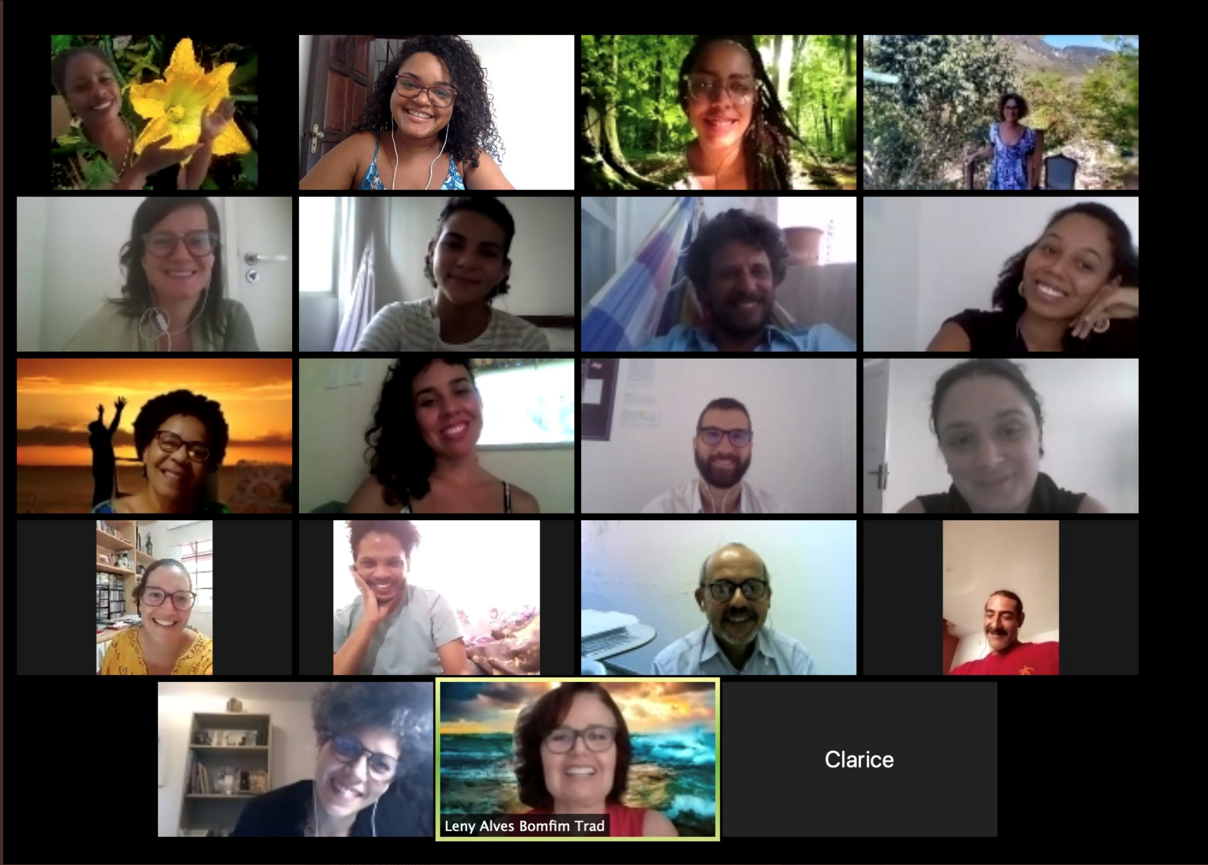
Online engagement during COVID-19

Slide 20
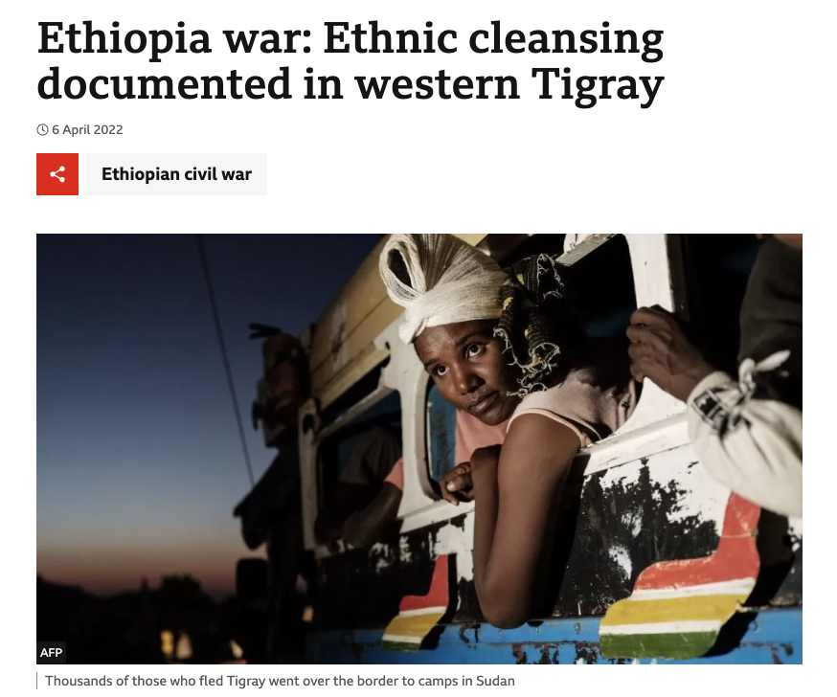
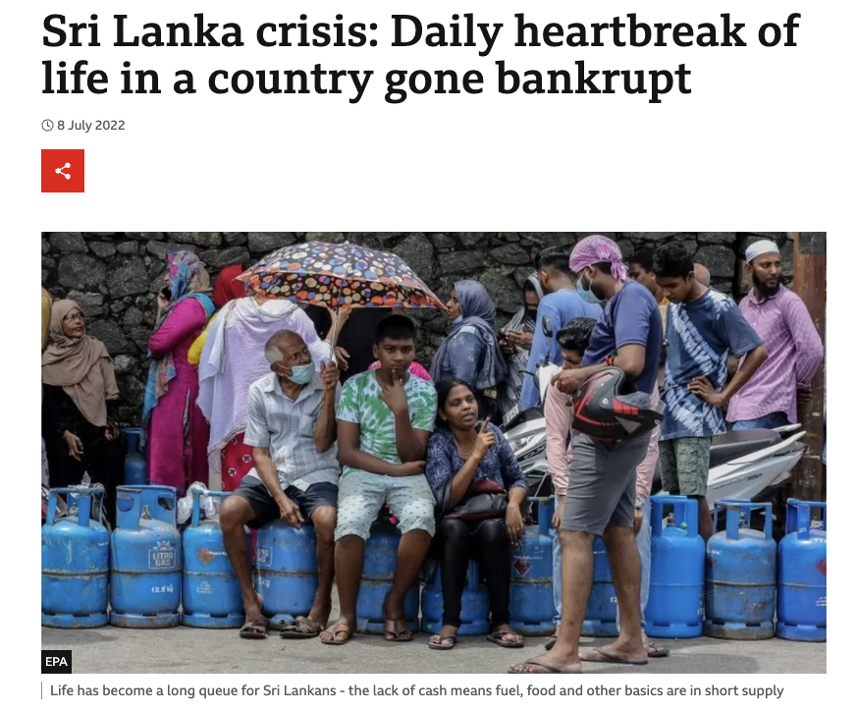
Challenges and lessons learned
6
Adaptability: social, cultural and health priorities are not fixed

Slide 21
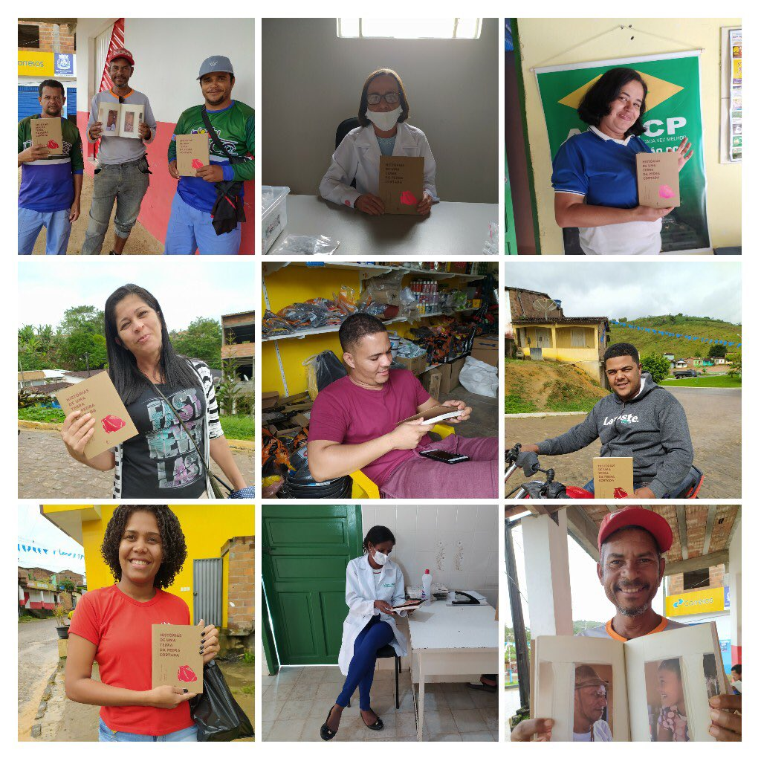
Since then…

Slide 22
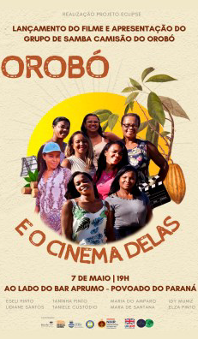
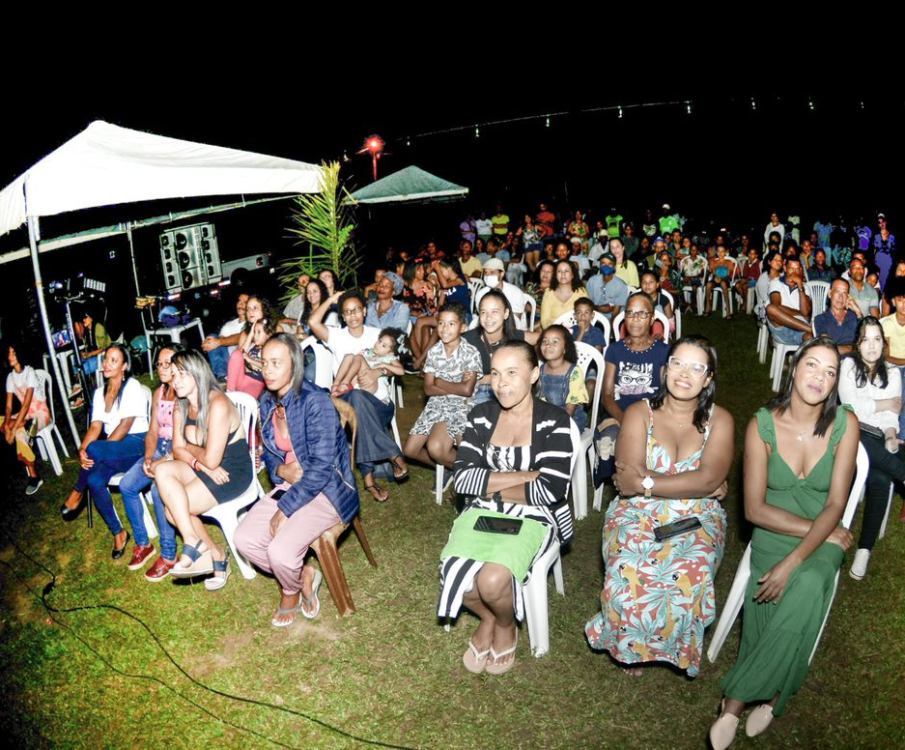
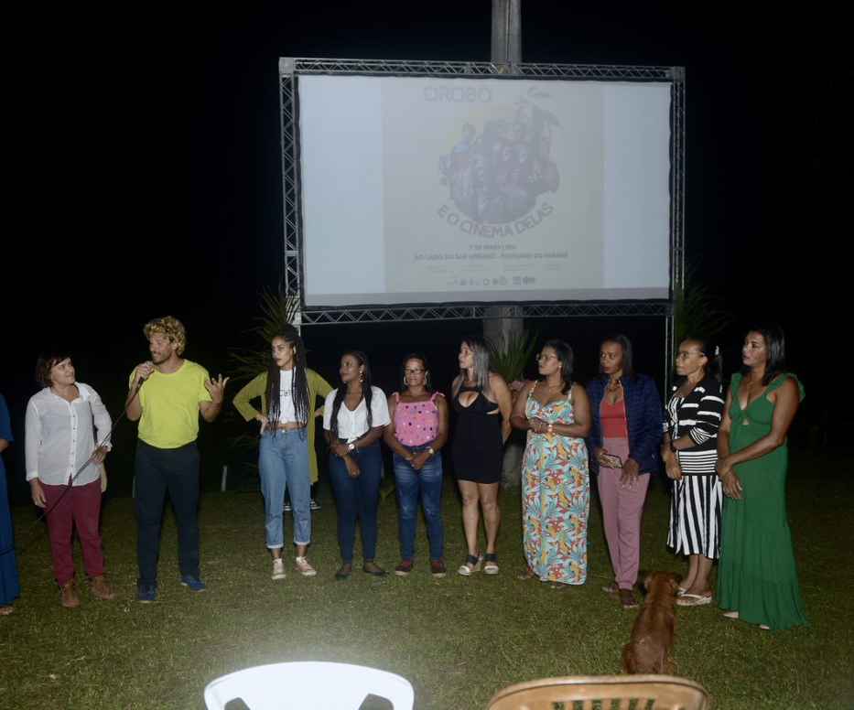

Slide 24
www.eclipse-community.com
@ECLIPSE_Keele
eclipse.community@keele.ac.uk
This research was funded by the National Institute for Health Research (NIHR) (NIHR200135) using UK aid from the UK Government to support global health research. The views expressed in this presentation are those of the author(s) and not necessarily those of the NIHR or the UK Department of Health and Social Care.

